Slide 1
Assignment 5 Docker+ MicroServices
Team: Anvai Patil (AP89263N) , Neeraj Kulkarni(NK85105N)

Slide 2
We have used technology like docker and microservices to complete this assignment
This assignment shows how the microservices and dockers are used by dividing a certain program into parts and only use the section of the code to complete the desired service with help of micro services like for example we used a database only used certain part of service as required.

Slide 3
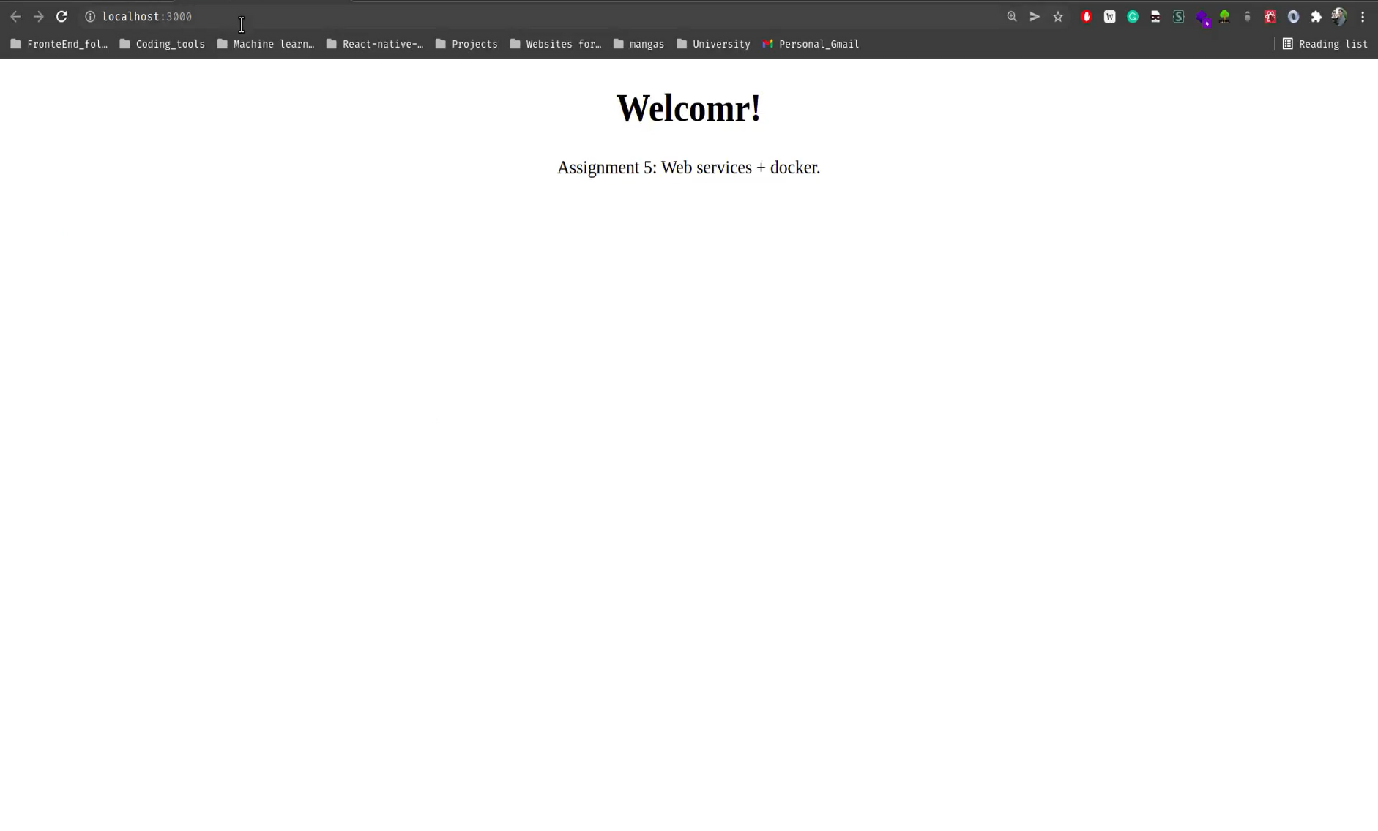
The following is the image of our program on how it looks on frontend and backend.

Slide 4
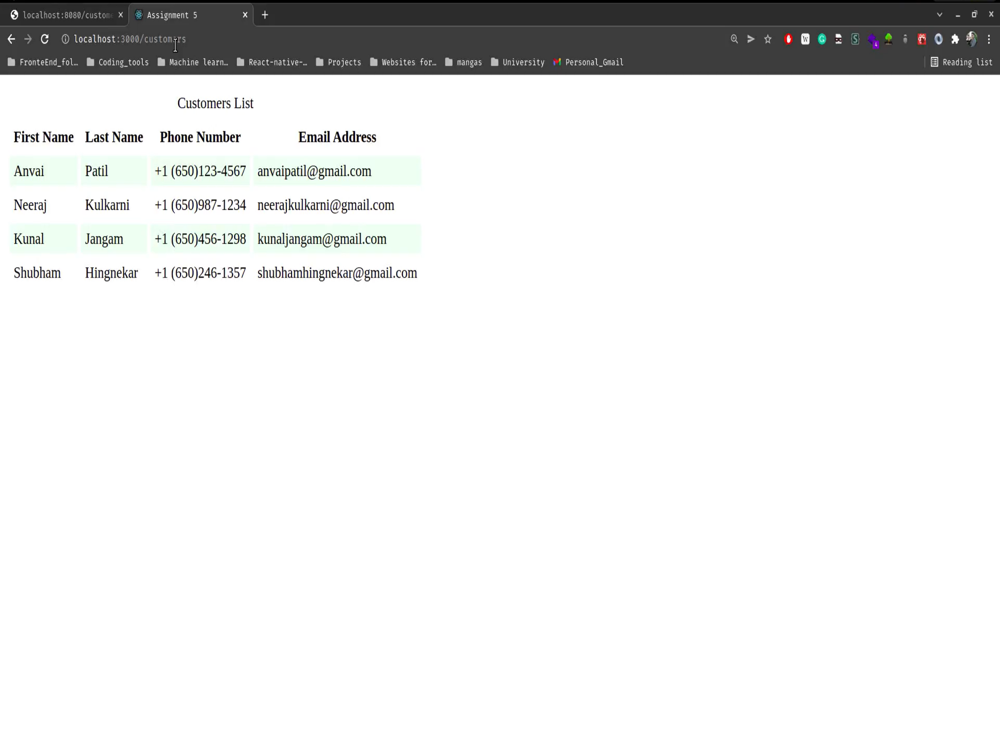

Slide 5
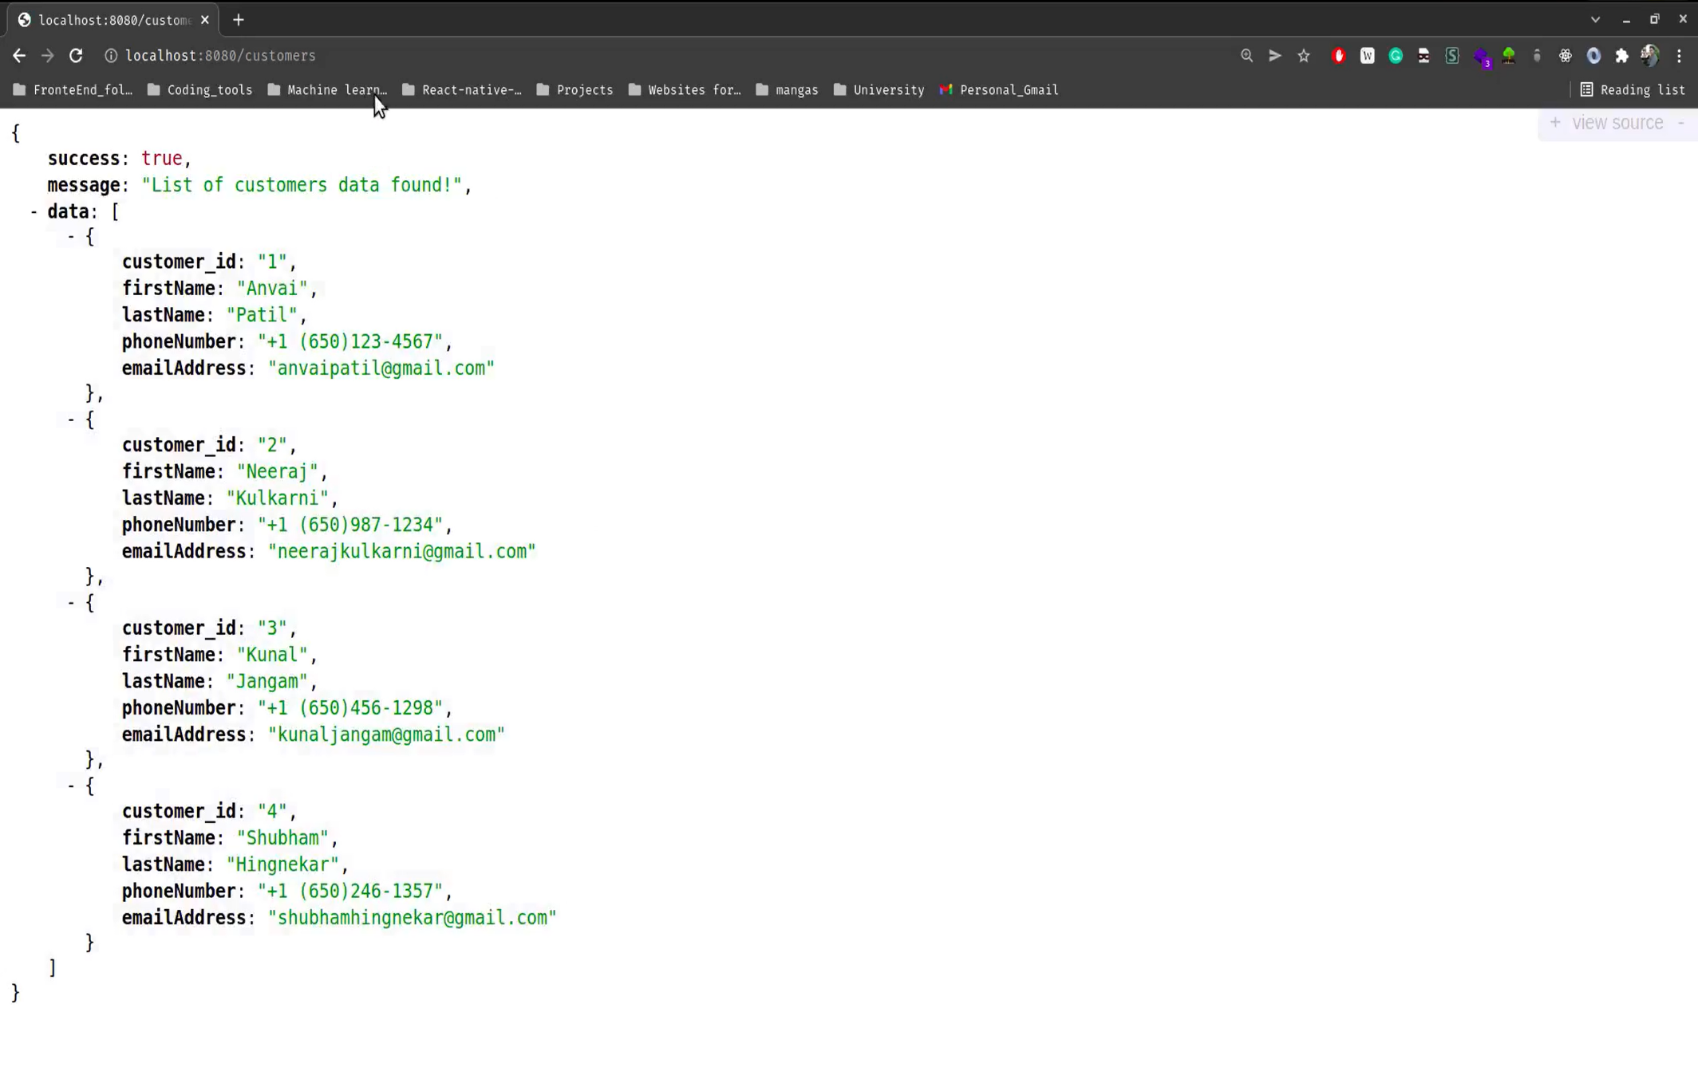

Slide 6
