Slide 1
CRICKET RECORD KEEPING SYSTEM
This software will help to maintain all the data of a player regarding their performance.
At any time we can edit Players information.
We can search any players profile at any time.

Slide 2
Objective
Every players profile will remain secure .
At any instant we can view any players profile

Slide 3
FEATURES
Create a new profile.
Edit Profile.
Search
View Proflie.

Slide 4
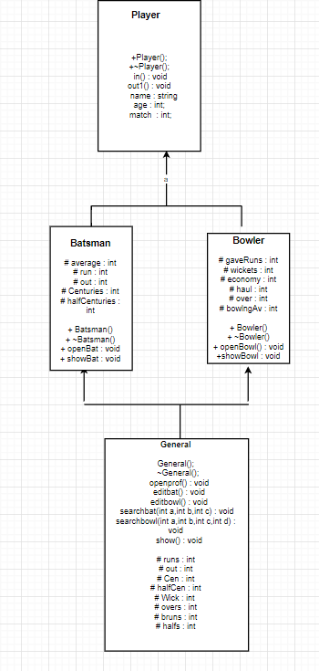
Class Diagram

Slide 5
TOOLS AND TECHNOLOGIES
Classes & Objects(C++)
Inheritance (Single & Multiple)
Virtual Base class
Switch Cases
Filing

