Slide 1
Final Project Review
KAIROS
Knowledge Acquisition, Indexing, Ranking & Optimized Scheduling
Plan around deadlines with the hours you have and the files you already own
GROUP · Group No. 16
COURSE · GUIDE
Surya Charan — CB.AI.U4AID25009
Moorthy Neeraj — CB.AI.U4AID25031
Sai Srikar — CB.AI.U4AID25006
Sai Sathwik — CB.AI.U4AID25041
23AID204 — Advanced Data Structures & Algorithm Analysis
Guide: Dr Ardra P S
School of AI
Notes:
Introduce the team and the one-line idea: KAIROS helps a student see which work is at risk given the hours they have, find their own files for each task, and keep the plan current as they work.

Slide 2
The material exists; the plan does not keep up
MOTIVATION & PROBLEM STATEMENT
1
2
3
Competing deadlines
Scattered material
Plans that go stale
Several submissions overlap. A list sorted by due date hides that a large task due Friday must start before a small one due Wednesday.
Notes, slides, PDFs and lab files sit in many folders. Finding the right one depends on remembering what it was called.
A timetable written on Monday stops matching reality as soon as work runs ahead or falls behind.
PROBLEM STATEMENT
Given a student's tasks, deadlines, estimated effort, progress, daily hours and their own folders: show which work is at risk, find the files that help, choose what to do next, and keep the plan current as progress is recorded.
Notes:
Three everyday problems. The target user is one student managing coursework on their own computer. Group work and instructor tools are out of scope.

Slide 3
Each tool covers part of the workflow
EXISTING SOLUTIONS
PRODUCT | WHAT ITS OWN PAGE DESCRIBES | OVERLAP WITH KAIROS
Todoist | Tasks with four priority levels, P1 to P4 | Task priority
MyStudyLife | Timetable, assignment tracker, exam countdowns, reminders, focus timer, AI week planning, calendar sync | Tasks, reminders, focus timer, planning
Motion | Auto-schedules tasks by deadline, priority and duration, within working hours and around calendar events | Planning into available time — more capable than KAIROS here
Obsidian | Notes stored on the device as plain-text Markdown, available offline | Private, local files
None of these, on the pages checked, searches the folders a student already uses for each task or explains workload risk against the hours left. KAIROS combines those with tasks, a plan and focus sessions.
Only features stated on each product's own page are listed (checked 25 Oct 2026). Absence here does not prove a product lacks a feature. Sources: slide 19.
Notes:
Be measured: Motion's scheduling is stronger because it reads real calendars; MyStudyLife covers more of student life. Do not claim nobody else does planning or reminders.

Slide 4
What KAIROS brings together
RESEARCH GAP / NOVELTY
1
Starts from your own folders
Indexes the folders a student already uses, reads inside common file types, and leaves every file where it is.
2
Explains workload risk
Compares remaining effort with the hours left before each deadline, and says why in one sentence.
3
One next action, with reasons
Recommends a single task and a session length that fits the hours available today.
4
A plan that moves with progress
Focus sessions update remaining effort; risk, recommendation and plan recalculate at once.
5
Local and private
No account. Files never leave the computer; web suggestions are opt-in and send only search words.
No single feature is new. The contribution is the combination, in one student workflow.
Notes:
These five points replace the mid-review's internal-mechanics angle with what the student gets. If asked about novelty, repeat the last line.

Slide 5
What the system sets out to do
PROJECT OBJECTIVES
1
Manage tasks with deadline, priority, effort and progress
2
Estimate deadline risk and explain it in plain words
3
Recommend one next task and a realistic session length
4
Index only folders the student chooses, and keep them current
5
Rank files with visible reasons; web suggestions optional
6
Fit remaining work into daily and weekly hours
7
Record focus sessions that update progress and the plan
8
Save every change locally; verify with tests and a browser run
Notes:
Each objective maps to a screen in the demo. Objective 8 is backed by the testing slide.

Slide 6
Everything runs on the student's computer
SYSTEM ARCHITECTURE
React interface in the browser
Dashboard · Tasks · Knowledge · Plan · Focus · Progress · Settings
JSON over local HTTP (/api)
FastAPI backend on this computer (127.0.0.1)
Task analysis
Scheduling module
In-memory store
urgency, deadline risk,
recommended next action
day-by-day plan within
daily and weekly hours
tasks, files, folders,
sessions and settings
Resource service
Focus and progress
Persistence
indexes folders you choose,
ranks results with reasons
sessions record time and
update task progress
atomic JSON snapshot,
restored on start
read only
search words only, if turned on
after every change
Your folders
Wikipedia
Snapshot file
notes, slides, PDFs, code
suggestions, off by default
kairos_snapshot.json
Notes:
Walk top to bottom: the interface only talks to the local backend. The backend reads chosen folders but never writes to them, saves a snapshot after every change, and contacts Wikipedia only if web suggestions are switched on. Code: task_analyzer.py and insights.py, resource_service.py, scheduler.py, focus.py, persistence.py, store.py.

Slide 7
One journey from task to updated plan
METHODOLOGY / WORKFLOW
1
2
3
4
5
6
7
Set daily hours
Add tasks
Add your folders
See risk and the next action
Find the files for it
Focus and record progress
Plan recalculates
Settings
deadline, priority, effort
files stay in place
Dashboard
search or task details
one session at a time
deadline first, within hours
repeats after every focus session
Saved after every change, restored on restart.
Dark steps repeat each working session: the next recommendation and plan always start from the student's real progress, not from Monday's timetable.
Notes:
This is the demo order. Steps 4 to 7 loop: record a session, everything recalculates, the next recommendation starts from there.

Slide 8
Every number on screen can be explained
HOW DECISIONS ARE MADE
1
Deadline risk
2
Next action
3
Search ranking
ratio = remaining effort ÷ hours before the deadline
Critical: overdue, or ratio ≥ 2
High: ratio > 1
Moderate: ratio ≥ 0.75, or due within a day
Low: otherwise
Highest risk level first, then urgency
urgency = 10 × priority weight + 100 ÷ (1 + days left) + 2 × remaining hours (+40 if overdue)
Session = shortest of 90 min, today's hours, remaining work
Points add up, and the reasons are shown
+30 exact keyword · +12 prefix · +18 tag
+8 word inside the file · +25 phrase in title
+15 your own file · up to +6 by type · +6 / +3 recently changed
A workload estimate, not a probability.
Weights are hand-chosen, not tuned with users.
Your own files always rank above web suggestions.
Notes:
This slide answers 'why did it say that?'. Risk is recalculated on every request; urgency is recalculated when a task changes, which is a known limitation (slide 16).

Slide 9
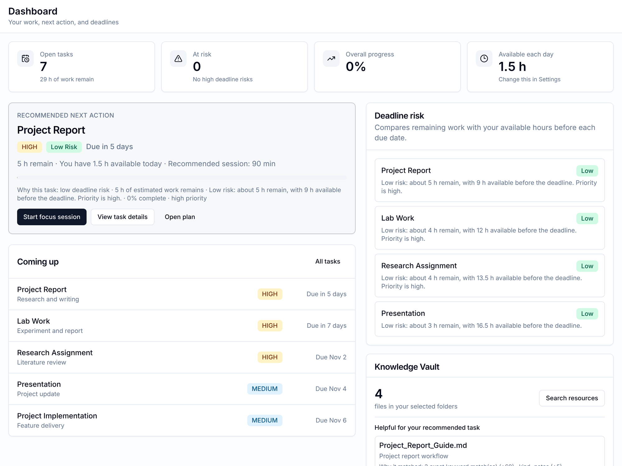
The dashboard names one next action and says why
OUTPUTS — WORKING APPLICATION
1
Recommended next action
Project Report, 90-minute session: about 5 h remain, with 9 h available before the deadline.
1
2
2
Deadline risk
Every open task, each with a one-sentence explanation of its rating.
3
3
Coming up
The next deadlines with their priority, nearest first.
Example data, 1.5 h per day, recorded 25 Oct 2026 from the current code.
Notes:
Real screenshot from the recorded run. Point at the reasons line under the recommendation: every recommendation explains itself.

Slide 10
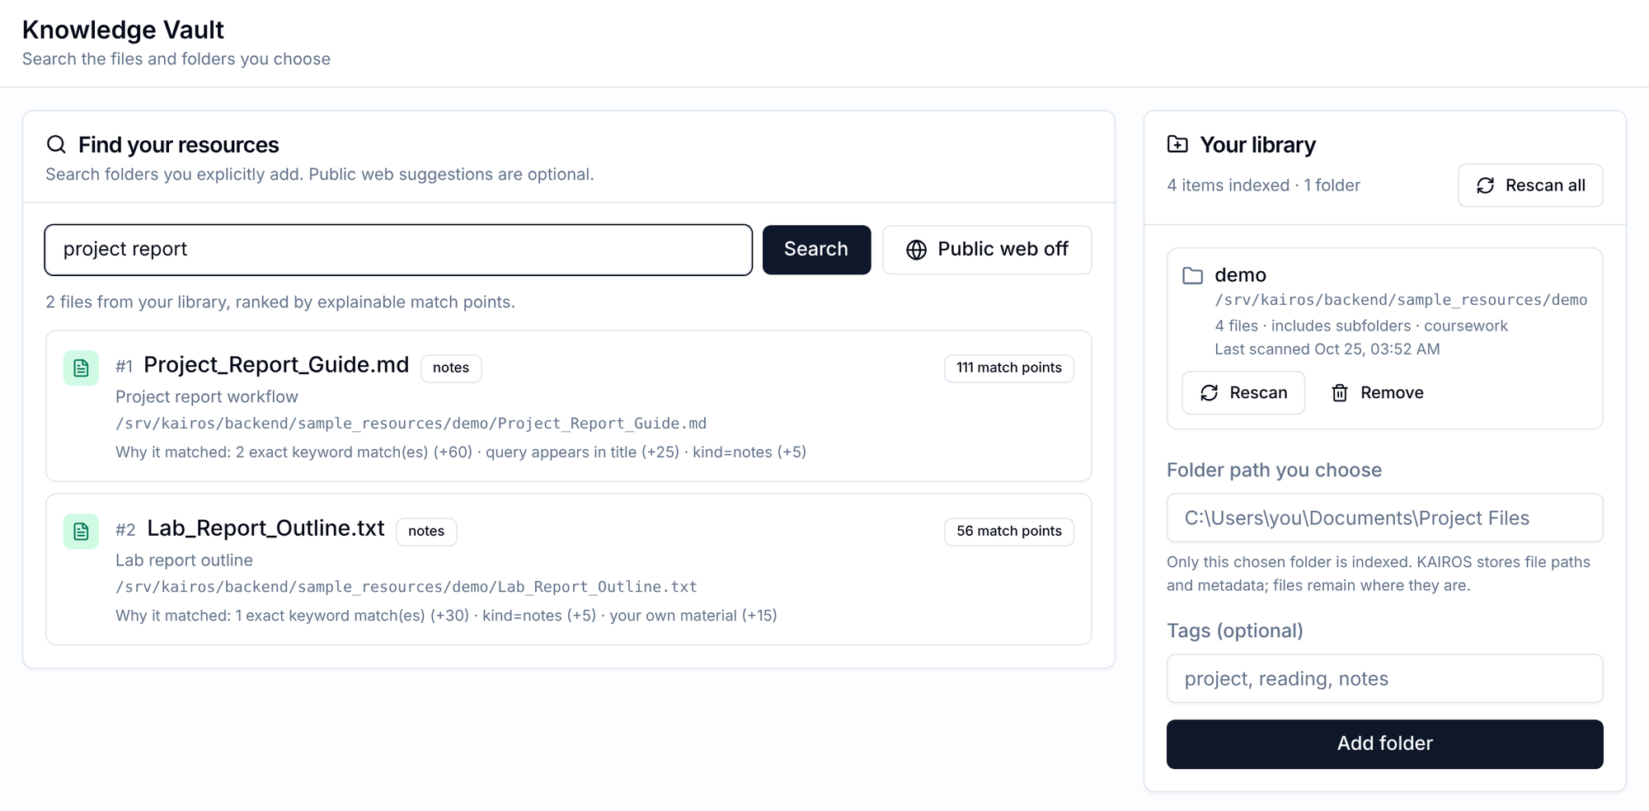
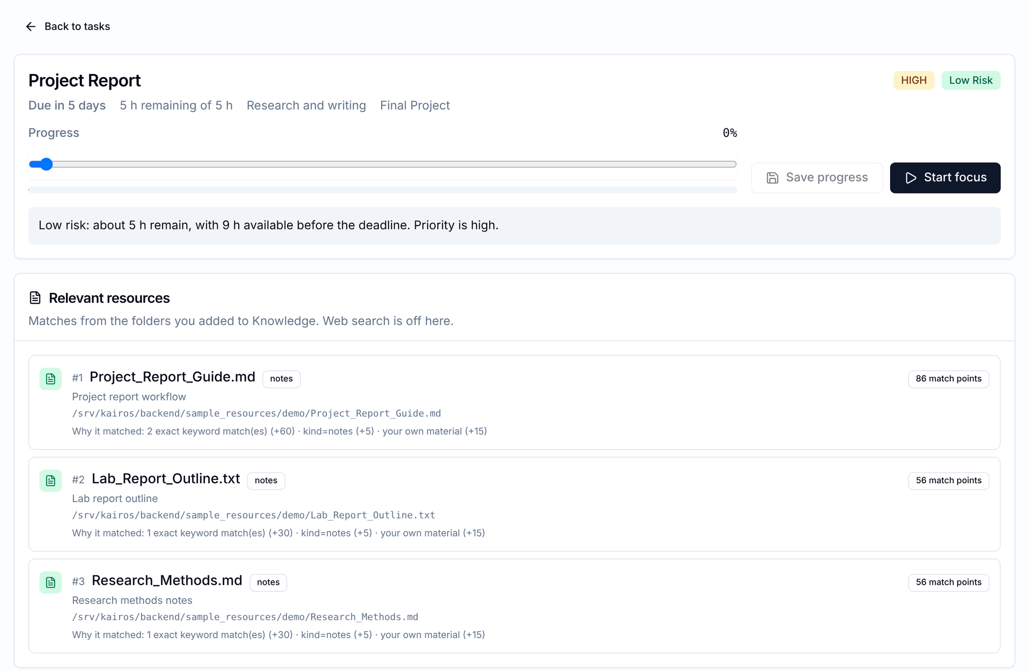
Search reads inside files and says why each matched
OUTPUTS — KNOWLEDGE VAULT
Knowledge Vault. “project report” returns Project_Report_Guide.md first: 111 points from two keyword matches and the phrase in its title. The library panel lists each folder with Rescan and Remove.
Task details. The same guide sits beside the task, with its progress and risk sentence. No search needed.
Notes:
Files are referenced in place, never copied. Deleting a file on disk and pressing Rescan removes it from the library; the demo shows this live.

Slide 11
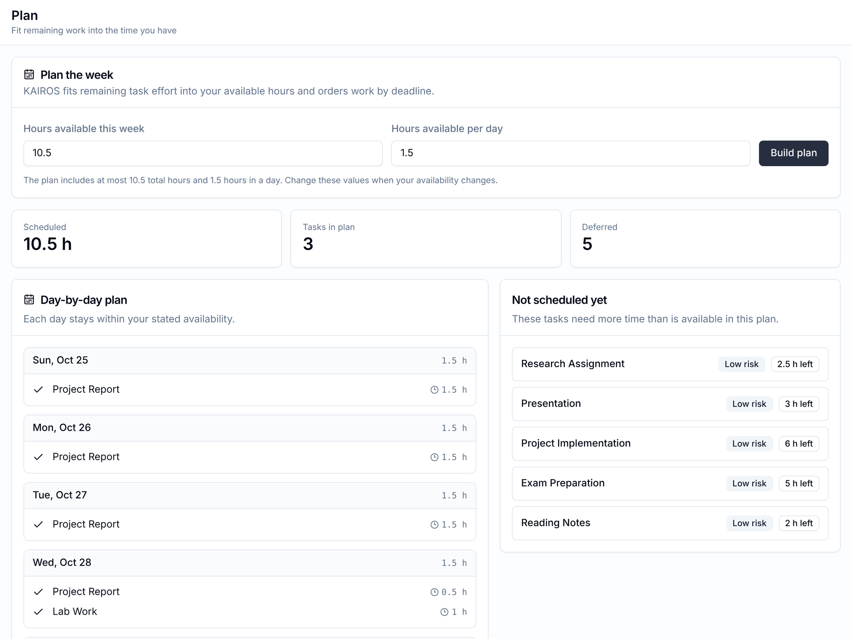
The week plan never overbooks, and shows what doesn't fit
OUTPUTS — WEEK PLAN
1
Never overbooked
Each day stays within the daily hours, and the week within its total.
2
Nearest deadline first
Project Report fills the first three days, then Lab Work begins.
3
Honest about the rest
Five tasks are listed as not scheduled this week, while each still shows Low risk on its own (slide 16).
Notes:
Say the limitation before the panel does: risk is rated per task, so the plan can defer tasks that each look Low risk.

Slide 12
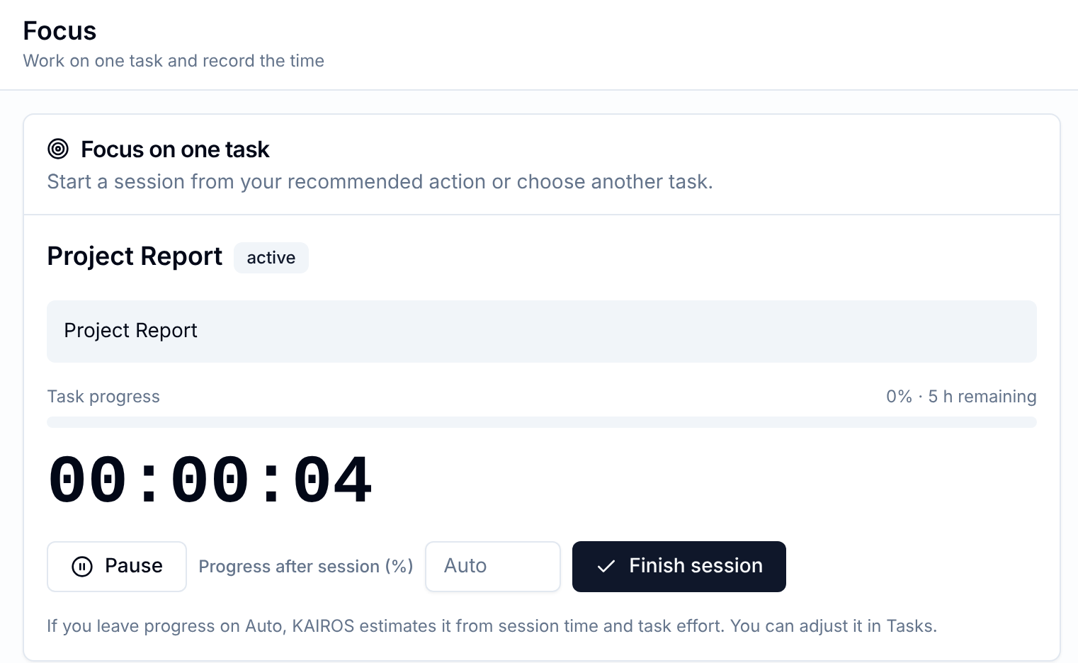
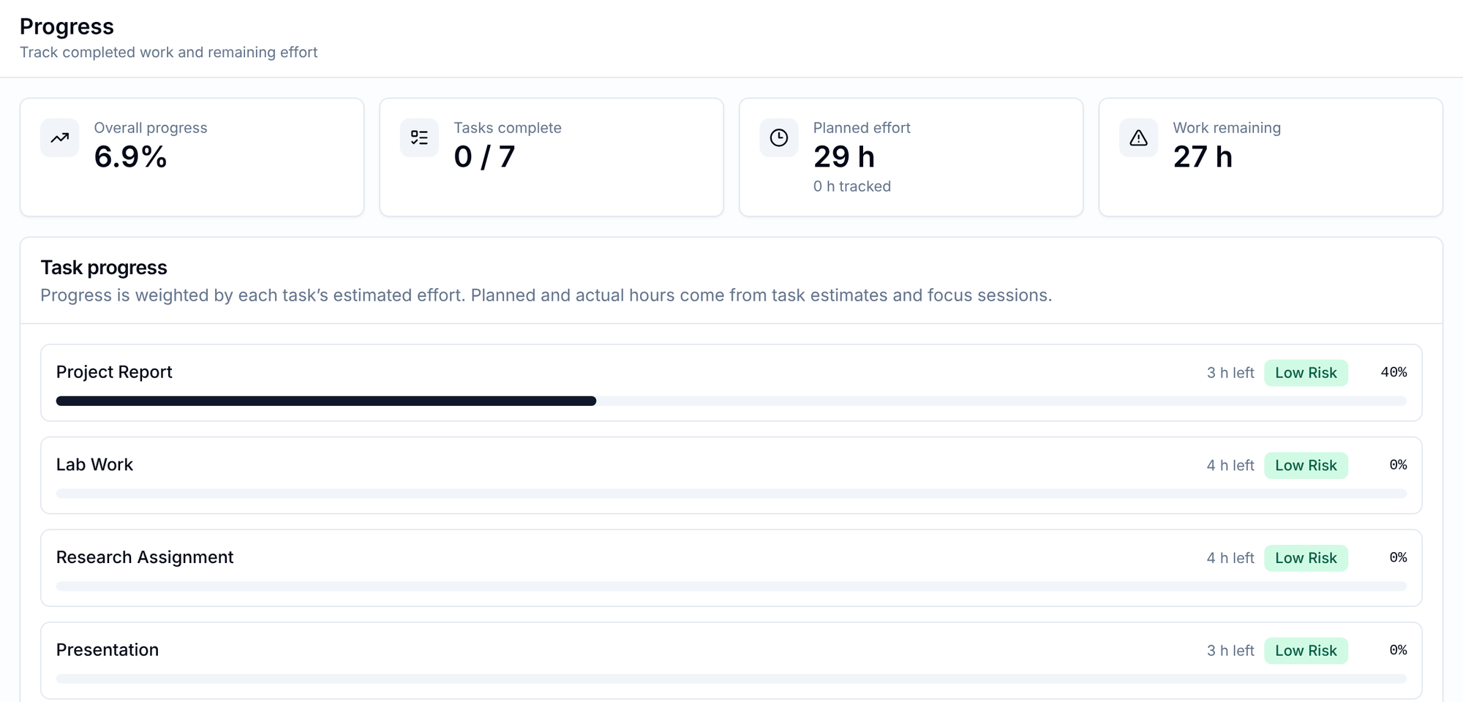
A focus session updates progress; the rest recalculates
OUTPUTS — FOCUS AND PROGRESS
Progress. After one session at 40%, Project Report shows 3 h left and overall progress is 6.9%, weighted by effort. Risk and the plan update from the same numbers.
Focus. One session at a time: pause, resume, then finish with a progress value or let KAIROS estimate it from the time spent.
Notes:
Progress is self-reported or time-estimated. There is no assessment of understanding yet; that is future work.

Slide 13
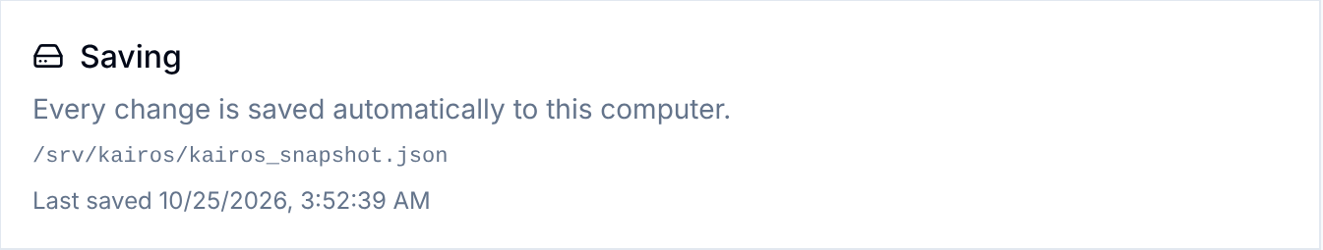
Nothing is lost on restart
PERSISTENCE & RELIABILITY
What is saved
Tasks and progress, focus sessions, daily hours, library folders and the file index.
When
After every successful change, while the app runs, plus a final save on shutdown.
Settings → Saving shows the file, the last save time, and any save error.
How
The whole state goes to a temporary file that atomically replaces the last snapshot. An abrupt stop loses at most the change in flight.
WHAT IT IS NOT
Not a database: one JSON file, one process, one user.
Each change rewrites the file: about 30 ms with 3,000 files on the test machine.
Tested: a restart from the file as it stood mid-session restores the data.
Restore
On start, the file is checked in full before it replaces anything in memory.
Notes:
Demo: stop the backend with Ctrl+C, start it again, reload. Same tasks, progress and folders. Describe storage accurately: a snapshot file is not a database.

Slide 14
Every result here is reproducible from the current code
TESTING & VALIDATION
197
14 / 14
Passed
backend tests passed, 0 failed
browser walk-through steps passed
interface type-check, on the laptop
CAVEATS
Tests ran on Linux, CPython 3.13, with the project's library versions. Re-run on the laptop, with npm run build, before the review.
Profile on the test machine: 1,500 files indexed in 1.2–1.4 s; main screens' data in 3–10 ms.
No study with students yet.
Notes:
Report only what was run. Commands: python -m pytest -q in backend; npx tsc in frontend; node e2e/demo-flow.mjs against an empty workspace; python scripts/profile_kairos.py.

Slide 15
Ten capabilities verified, four partial
IMPLEMENTATION STATUS
VERIFIED
PARTIAL
NOT IMPLEMENTED
Task management
Deadline risk with explanation
Recommended next action
Folder library: add, rescan, remove
Reading inside files
Ranked search with reasons
Task details with relevant files
Week plan within available hours
Focus sessions and progress
Saving and restore
Web suggestions: opt-in; live call not exercised in this review
Reminders: on the dashboard only, no notifications
Weak-area planning: backend only, self-rated
Workload risk: per task, not combined
Notifications
Calendar connection
Accounts and multiple users
Database storage
Notes:
Verified means covered by automated tests and, for most rows, the scripted browser walk-through. Partial items are stated plainly; do not demo them as finished.

Slide 16
Two small fixes matter most before real use
LIMITATIONS & FUTURE WORK
Example data at 1.5 h a day: 22 h is due by 6 Nov against 19.5 h available — yet every task shows Low risk, because each is rated against its own deadline alone.
BEFORE THE REVIEW
FUTURE WORK
Rate risk on combined workload
Short quizzes to measure understanding, replacing self-rating
SQLite storage with transactions for larger libraries
Per-day availability or calendar import
OCR for scanned PDFs, more formats, a folder picker
Weak-area plan and a reminder list in the interface
Sign-in and multiple users, only if hosted beyond one computer
1
All work due by each deadline vs hours to it. Small effort.
Recalculate urgency every day
2
Today it updates only when a task changes. Small effort.
Show the full points breakdown
3
Results list three reasons, so points may not add up. Small effort.
Notes:
Name the two weaknesses before the panel finds them. Other limits: one daily-hours figure, no notifications, keyword search rather than meaning, first five PDF pages only, no sign-in so the backend must stay local.

Slide 17
Three submissions, four days apart, 1.5 hours a day
REAL-WORLD EXAMPLE
SUBMISSION | DUE | EFFORT
Project Report | Fri 30 Oct | 5 h
Lab Work | Sun 1 Nov | 4 h
Research Assignment | Mon 2 Nov | 4 h
WHAT KAIROS SHOWED
1
Next action
Project Report, 90 min: “about 5 h remain, with 9 h available before the deadline.”
2
Material
“project report” finds Project_Report_Guide.md first, 111 points; it also tops the task's details page.
All High priority. Notes in one project folder. Run on 25 Oct 2026 with the example data.
3
Plan
First three days go to the Project Report at 1.5 h each; Lab Work starts on day four.
INTENDED BENEFITS — NOT MEASURED
See early which work will not fit, spend less time hunting for files, and replan from real progress instead of a stale timetable.
4
After one session
40% done: 3 h left, the explanation updates, overall progress 6.9%. Still there after a restart.
Notes:
Every number here came from the recorded run. Do not claim time saved or grades improved; none of that has been measured.

Slide 18
A complete single-student workflow, honestly evidenced
CONCLUSION & EVALUATION
Problem relevance
Workflow completeness
Implementation evidence
Reliability
Strong
Strong
Strong
Adequate
Everyday student problems
Task to plan to focus, in one run
197 tests, browser run, profile
Autosave; per-task risk gap
Usability and clarity
Practical usefulness
Differentiation
Readiness for real users
Adequate
Adequate
Moderate
Early
Plain reasons; typed folder paths
One computer; no calendar
Combination, not single features
No sign-in; untested with students
NEXT
Fix combined workload risk and daily urgency, verify the build on the laptop, then run a two-week trial with students measuring deadlines met and time spent searching.
Notes:
Close on strengths and the honest gaps. Invite questions.

Slide 19
References
REFERENCES
[1]
Todoist Help Center. Introduction to priorities. https://todoist.com/help/articles/205873321
[2]
MyStudyLife. The ultimate student productivity tool (home page). https://mystudylife.com/
[3]
Motion Help Center. What Auto-Scheduling considers. https://www.usemotion.com/help/time-management/auto-scheduling/reference-auto-scheduling/what-auto-scheduling-considers
[4]
Obsidian. Home page. https://obsidian.md/
[5]
KAIROS project documentation: README.md and AUDIT.md (follow-up of 25 Oct 2026).
[6]
KAIROS test suite, browser walk-through (frontend/e2e/demo-flow.mjs) and profile script (backend/scripts/profile_kairos.py).
Product pages accessed 25 October 2026.
Notes:
Only sources actually opened are listed.

