Slide 1
MID-PROJECT REVIEW · ADVANCED DATA STRUCTURES & ALGORITHMS
O(log n)
KAIROS
O(1)
O(n log n)
Knowledge Acquisition, Indexing, Ranking & Optimized Scheduling
O(m + k)
An algorithm-driven academic productivity platform that turns a deadline into a ranked workspace and an optimised study plan — built on data structures implemented from scratch.
O(2ⁿ)
O(n·W)
GROUP [ __ ]
Guide
[ Faculty Name ]
Department / Semester
[ Branch ] · Semester III
Team members
[ Student Name ] — [ Registration No. ]
[ Student Name ] — [ Registration No. ]
[ Student Name ] — [ Registration No. ]
160 unit + integration tests passing · 9 algorithms implemented from scratch
Notes:
Fill in the group number, member names and registration numbers before presenting. Opening line: KAIROS is Greek for 'the opportune moment' — which is what a deadline app is really about. Today's review covers the complete data layer plus the scheduling, adaptive-learning and benchmarking engines.

Slide 2
SECTION 01
Motivation & Problem Statement
A student already owns the material they need. It is sitting in course folders on their own laptop. The problem is not scarcity — it is retrieval, prioritisation and time.
Material is invisible
Everything feels urgent
Plans ignore weakness
Notes, PDFs and lab manuals pile up across folders. Filename search fails the moment you forget what you called the file.
Five deadlines, no defensible order. Students sort by anxiety, not by a workload model.
A generic timetable gives the topic you have already mastered the same hours as the one you keep failing.
PROBLEM STATEMENT
Given a student's tasks, their local study material and a limited number of study hours, retrieve the most relevant resources per task and allocate the available time so that urgency is maximised and weak concepts receive proportionally more attention.
Retrieval
Prioritisation
Allocation
Adaptation
Trie + hash index over the student's own files
Documented urgency score feeding a max-heap
0/1 knapsack over available study hours
Time re-weighted by measured concept mastery
KAIROS · Mid-Project Review
2
Notes:
Frame the gap: existing planners answer 'what should I study'. None answer 'what do I already have on this machine that helps me finish this specific task'.

Slide 3
SECTION 02
Literature Survey
Work / System | Focus | Approach | Limitation for our problem
Gligorea et al. (2023) Educ. Sci. 13(12):1216 | Adaptive learning review | Systematic review of AI/ML personalisation in e-learning | Confirms personalisation works; does not address retrieval from the learner's own files
Mustapa, Salahuddin & Hashim (2022), IJACSA 13(8) | Study plan generation | Rule-based logic + knapsack optimisation for course plans | Plans at course-enrolment granularity; no per-task resources or progress feedback
Zobel & Moffat (2006) ACM Comput. Surv. 38(2) | Text indexing | Inverted files for text search engines | Optimised for web-scale corpora; heavier than a desktop-scale keyword index
Adelson-Velsky & Landis (1962) | Balanced search trees | Height-balanced BST with rotations (AVL) | Core structure; must be integrated with a workload model to order deadlines
Cormen et al. (2022) CLRS, 4th ed. | Algorithm foundations | Heaps, heapsort, hashing, greedy, DP, branch & bound | Reference implementations; no application to academic workload planning
Commercial planners (Ahead, Caktus AI, Eduplanner) | Student productivity | LLM-generated schedules from syllabus and deadlines | Opaque generation, cloud-only, no algorithmic guarantees or complexity evidence
Two literatures exist side by side: adaptive-learning research that models the learner but assumes a curated content library, and classical DSA that solves indexing and allocation but is rarely applied to a student's real workload. KAIROS joins them.
KAIROS · Mid-Project Review
3
Notes:
Do not claim nobody has built a study planner — they have. The claim is about the combination: local-file retrieval plus algorithmic allocation plus measured evidence.

Slide 4
SECTION 03
Research Gap & Novelty
THE GAP
Existing tools plan around the deadline. None connect the deadline to the knowledge repository the student already owns, and none expose measurable evidence for the algorithms they use.
1
Algorithm-first architecture
2
Local resource intelligence
3
Algorithmic retrieval pipeline
The data structures are the product, not an implementation detail. Every ordering, lookup and allocation the UI shows is produced by a structure written for this project.
Asks “what on my machine helps me finish this task?” — indexing the student's own folders into a Trie and hash table. Nothing is uploaded; only filenames and tags are read.
Topic → Trie prefix match → hash hydration → relevance scoring → heap Top-K → heapsort. A deterministic, inspectable ranking rather than an opaque generated answer.
4
Adaptive time reallocation
5
Built-in Algorithm Laboratory
6
Correctness made visible
Mastery per concept re-weights the plan: weight = (100 − mastery) + 12. A concept at 30% pulls roughly twice the time of one at 90%.
Instead of asserting “hashing is faster”, the system measures it live across dataset sizes and shows the growth curves.
160 tests assert the AVL invariant after every one of 500 random inserts and 300 deletes; exact schedulers are cross-validated against each other.
KAIROS · Mid-Project Review
4
Notes:
If asked 'is this novel?' — the honest answer is that the combination is novel, and item 5 is the strongest academic differentiator.

Slide 5
SECTION 04
Project Objectives
1
Model academic workload
2
Organise by deadline
Score every task from deadline proximity, priority and estimated effort using a documented, auditable formula.
Maintain tasks in a self-balancing AVL tree keyed by (deadline, id) with guaranteed O(log n) operations.
3
Prioritise by urgency
4
Index local material
Serve the most urgent task in O(1) and the full ordering in O(n log n) from a binary max-heap.
Walk selected folders and index filenames, extensions and tags into a Trie and a hash table with explicit collision handling.
5
Retrieve and rank
6
Optimise study time
Combine local and web candidates, score relevance, and return Top-K through heap selection and heapsort.
Solve the hours-allocation problem four ways — Greedy, DP, Backtracking, Branch & Bound — and compare them.
7
Adapt to the learner
8
Prove it experimentally
Track concept mastery, detect weak areas and reallocate study hours towards them automatically.
Benchmark every structure and algorithm across input sizes, reporting measured time and structural facts.
Constraint carried throughout: every structure is implemented from scratch — no dict, no heapq, no sorted() on any path that matters.
KAIROS · Mid-Project Review
5

Slide 6
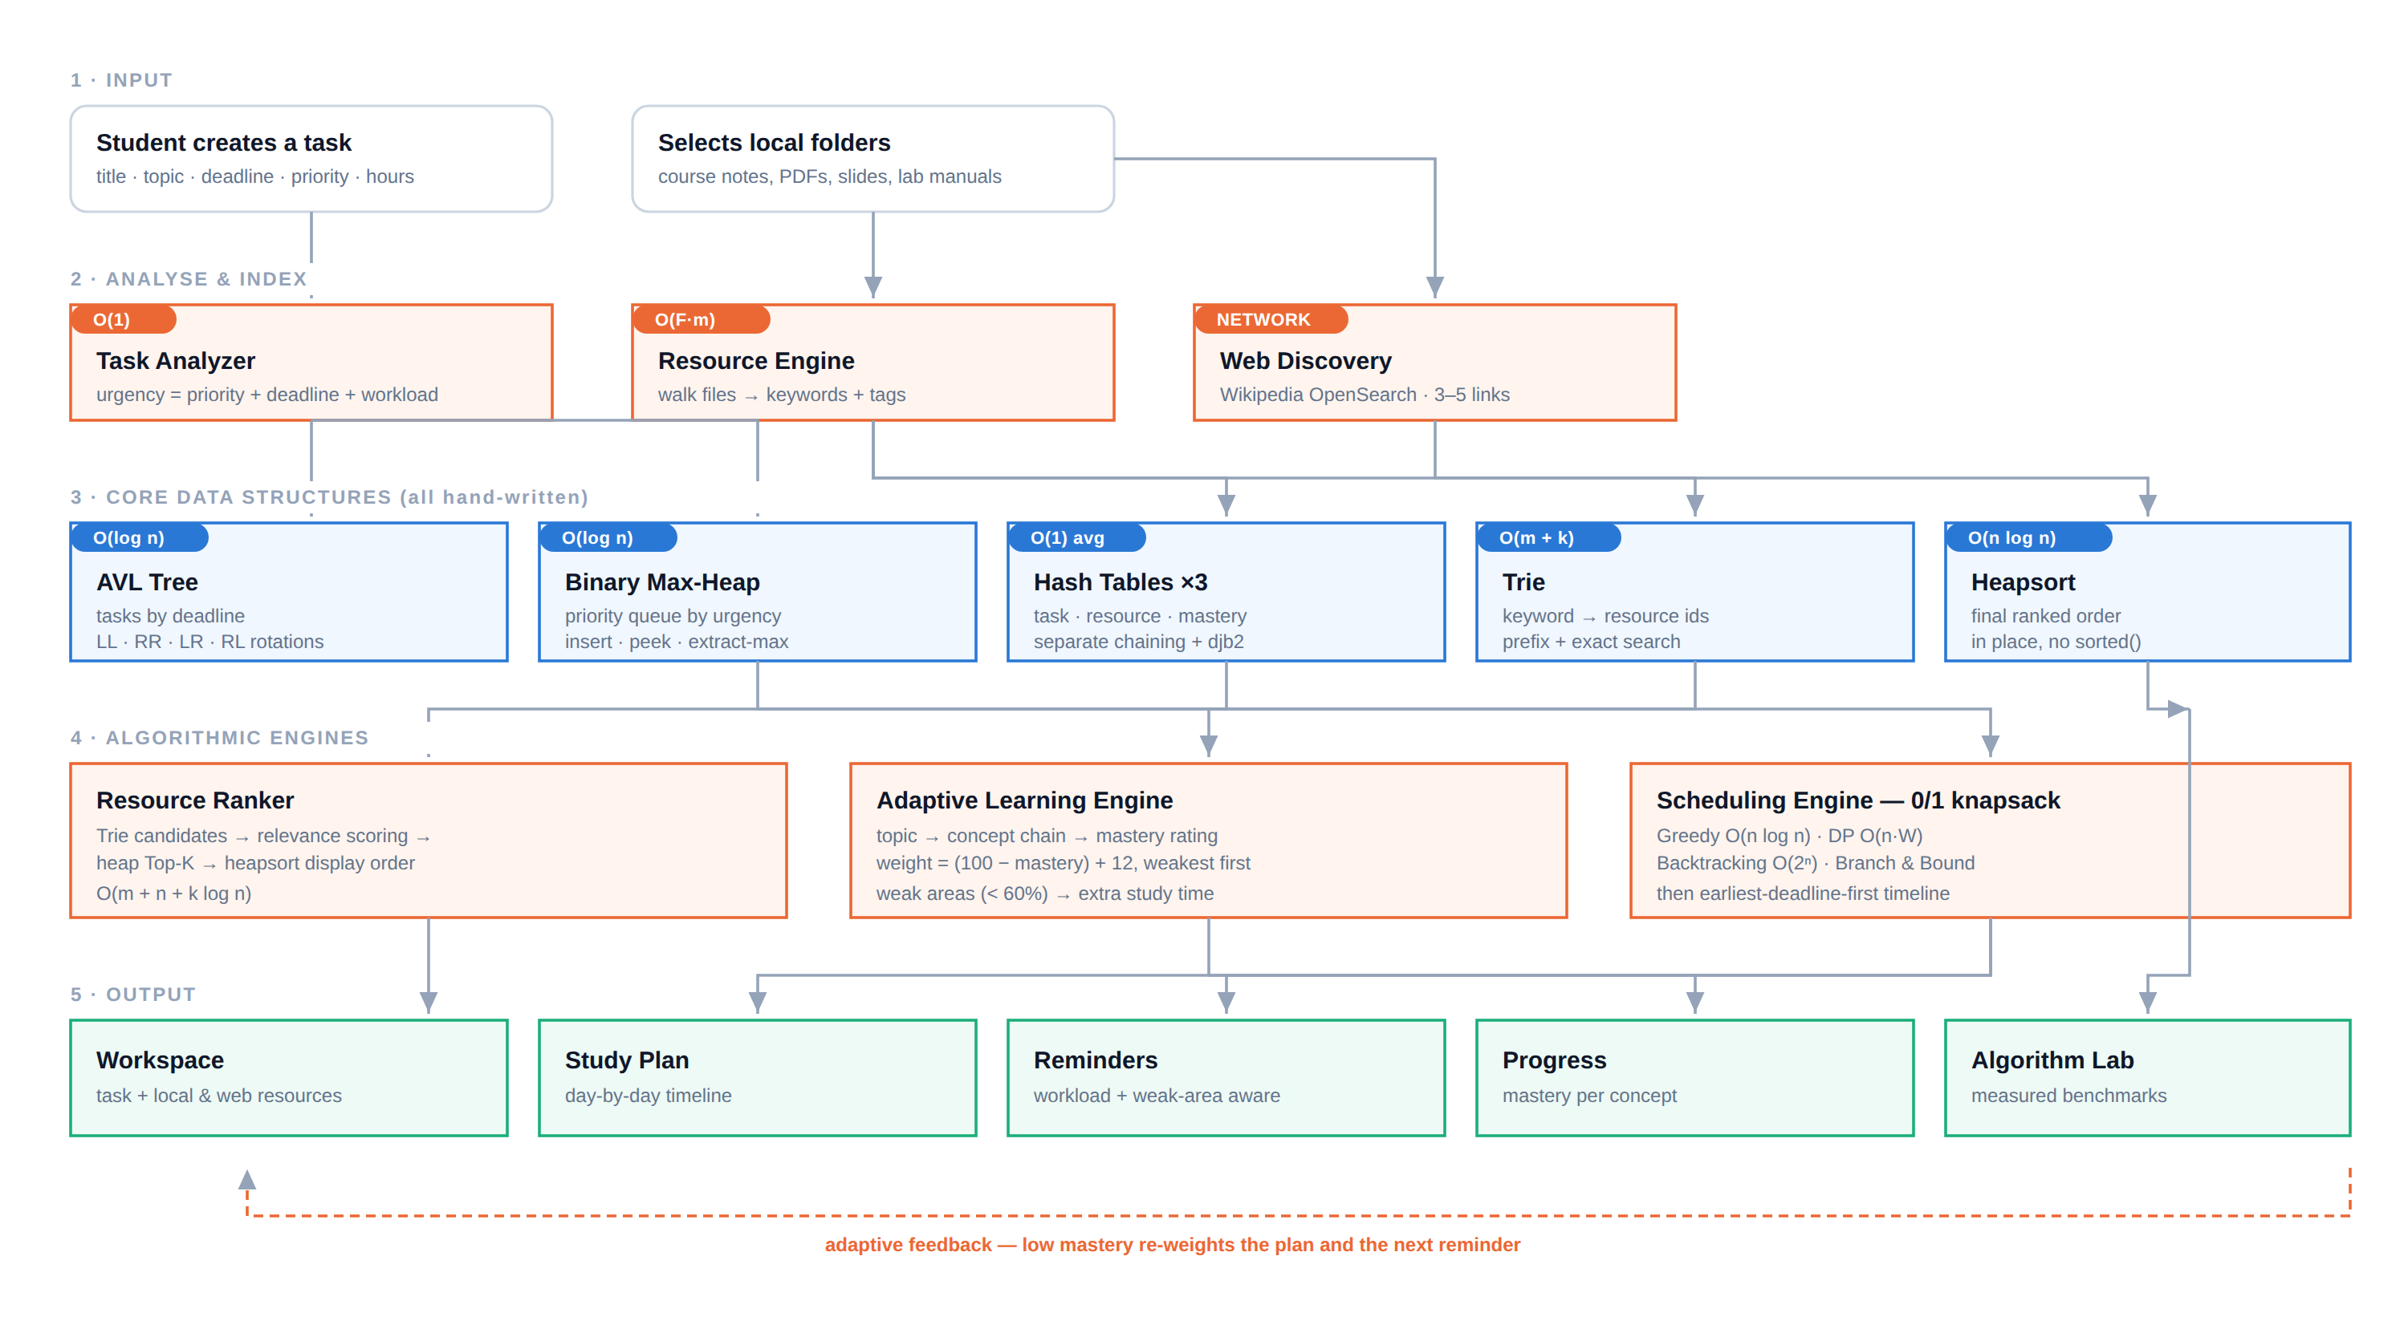
SECTION 05
System Workflow
KAIROS · Mid-Project Review
6
Notes:
Walk it left to right, top to bottom: input, analyse and index, the five core structures, the three engines, and the five outputs. The dashed orange line is the adaptive loop — a low mastery rating re-weights the plan and changes the next reminder.

Slide 7
SECTION 06 · A
Implementation — Core Data Structures
Python 3 · FastAPI backend · React + Tailwind + shadcn/ui frontend · REST over JSON
AVL Tree
O(log n)
Binary Max-Heap
O(log n)
Hash Table × 3
O(1) avg
avl_tree.py
binary_heap.py
hash_table.py
Keyed by (deadline, task id). Recursive insert/delete with explicit LL, RR, LR and RL case detection. In-order traversal gives the deadline view; per-node height and balance factor are exposed for inspection.
Array-backed: parent (i−1)/2, children 2i+1 and 2i+2. Hand-written sift-up/sift-down, Floyd O(n) build, non-destructive Top-K. Ties break by insertion order so the ordering is total.
Separate chaining — each bucket is a singly linked list. Hand-written djb2 rolling hash; doubles and rehashes above load factor 0.75. Used for tasks, resources and concept mastery.
Trie
O(m + k)
Heapsort
O(n log n)
Task Analyzer
O(1)
trie.py
heapsort.py
task_analyzer.py
Children stored as a sorted association list with binary search, not a dict — so traversal emits lexicographic order for free. Exact search, prefix autocomplete, delete with dead-node pruning.
Build-max-heap then n−1 swap-and-sift passes, in place. Descending order comes from negating the key rather than reversing, so equal-scoring items keep their original order.
urgency = 10 × priority_weight
+ 100 / (1 + days_left)
+ 2 × estimated_hours
+ 40 if overdue
Due today scores 100 on the deadline term; in a week, 12.5.
KAIROS · Mid-Project Review
7

Slide 8
SECTION 06 · B
Implementation — Algorithmic Engines
Scheduling Engine — one problem, four strategies
Adaptive Learning Engine
Modelled as a 0/1 knapsack: value = urgency, weight = estimated hours, capacity = the hours you actually have. All four solve the identical instance, so the comparison is fair.
Concept chain per topic
avl tree → BST · Balance Factor · Rotations · Insertion · Deletion
Greedy
O(n log n)
approximate
Sorts by urgency-per-hour with our heapsort and takes what fits.
Time reallocation
weight = (100 − mastery) + 12
Dynamic Programming
O(n·W)
optimal
Normalised over available hours and ordered weakest-first by heapsort. Concepts below 60% are flagged as weak areas.
0/1 knapsack tabulation at 0.5 h granularity, then back-walks the table.
Backtracking
O(2ⁿ)
optimal
Design decision
Exhaustive include/exclude DFS, pruning branches that overflow capacity.
An unassessed concept is not a weak one. Unrated concepts count as 50% for allocation but never displace a concept you actually tested badly on — a bug our own tests caught.
Branch & Bound
O(2ⁿ) worst
optimal
Best-first over a max-heap of fractional-knapsack bounds; prunes what cannot win.
Reminder Engine
Once the set is chosen, the timeline lays it out earliest-deadline-first — the classic greedy ordering for minimising lateness — splitting long tasks across days.
“ADSA Lab is due tomorrow. About 1.5 h of work remain. Start with your weak area: Rotations.”
KAIROS · Mid-Project Review
8

Slide 9
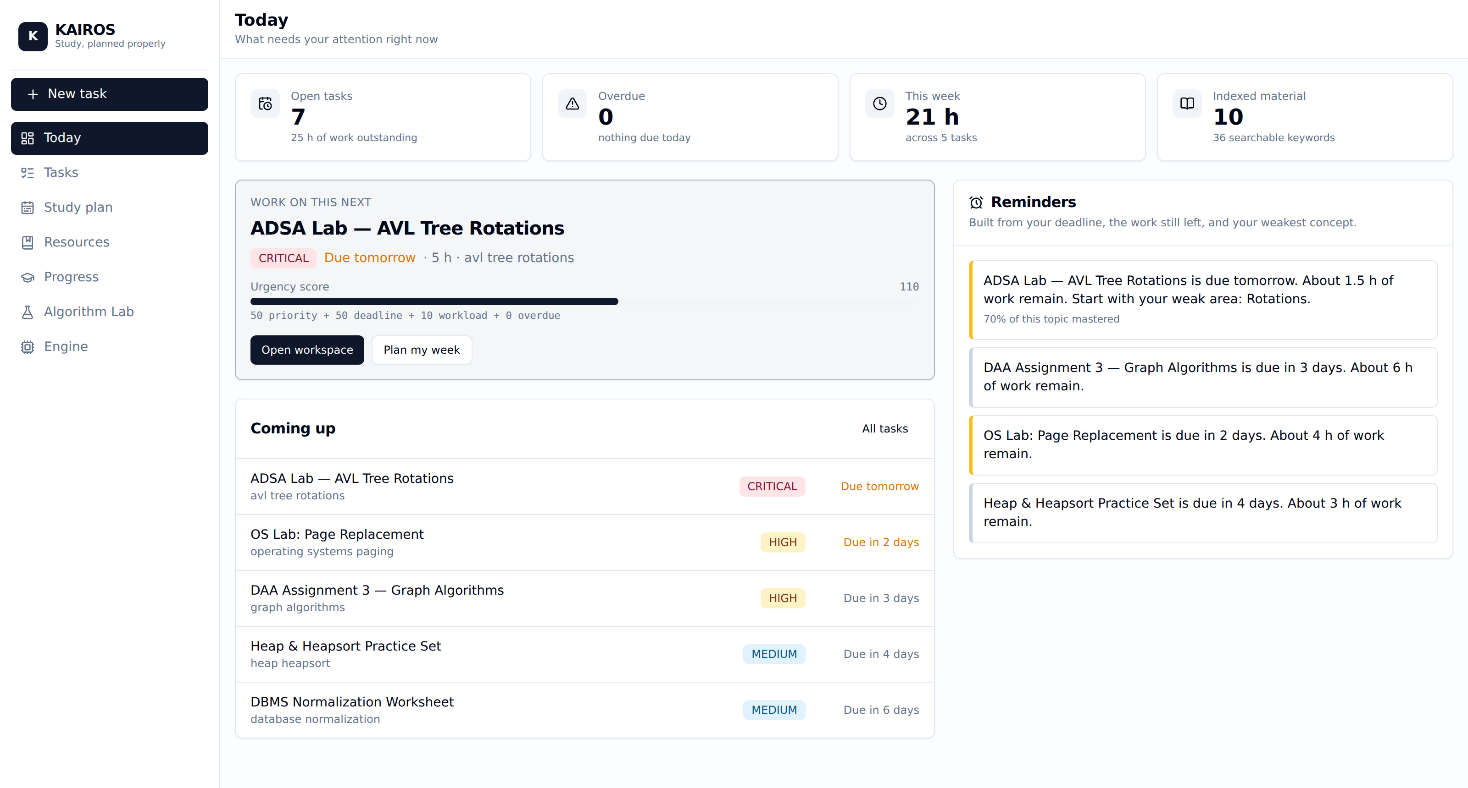
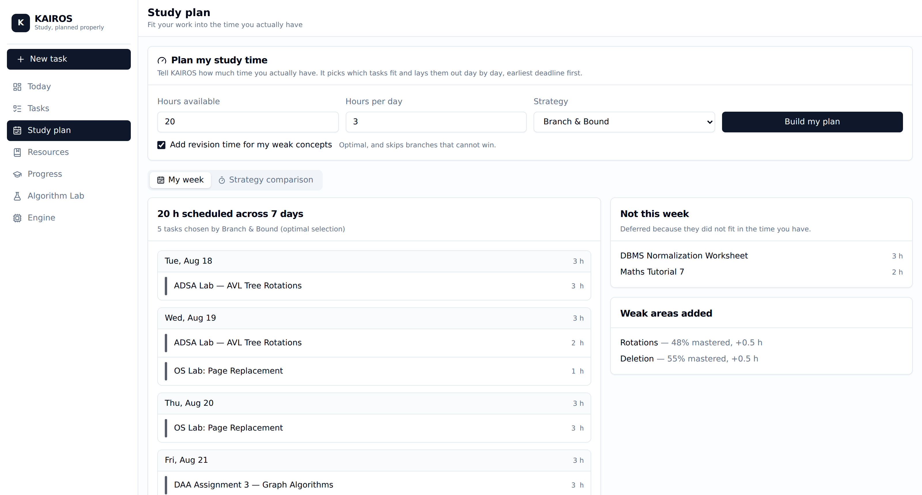
SECTION 07 · A
Outputs — Working Application
Dashboard — heap peek names the single task to work on next, with the urgency breakdown and reminders built from deadline, remaining workload and weak area.
Study plan — Branch & Bound selects which tasks fit into 20 hours; the timeline lays them out earliest-deadline-first and injects revision blocks for weak concepts.
7
18
5
9
screens shipped
REST endpoints
structures from scratch
algorithms implemented
KAIROS · Mid-Project Review
9

Slide 10
SECTION 07 · B
Outputs — Algorithm Lab (measured, not asserted)
Search benchmark · 10,000 keys inserted in SORTED order · 200 lookups · measured on the development machine
100×
AVL tree over an unbalanced BST on sorted input.
Sorted keys collapse the plain BST to height 10,000 — a linked list. The AVL tree holds at height 14 through rotations. This is the entire justification for AVL, measured rather than asserted.
Sorting, n = 20,000
Quicksort 19.8 ms · Merge 35.1 ms · Heapsort 89.4 ms · Insertion 4,496 ms
Scheduling, n = 18
Branch & Bound explores 153 states; Backtracking explores 157,905 for the same optimum
Hash behaviour
4,349 collisions across 16,384 buckets, longest chain 6, load factor 0.61
The Lab exposes dataset size, insertion order and algorithm selection, then runs the real implementations on the spot — so every number on this slide can be reproduced live during the viva.
KAIROS · Mid-Project Review
10
Notes:
Offer to re-run this live. Switch 'Insertion order' to Sorted and the BST bar jumps by two orders of magnitude while the AVL bar does not move.

Slide 11
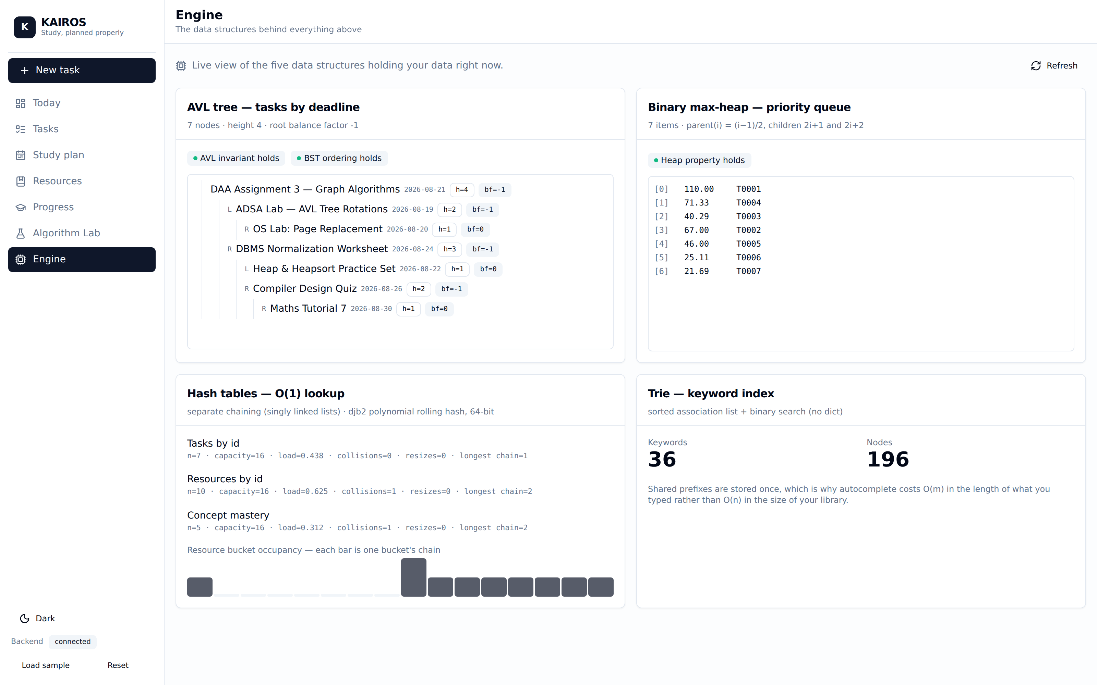
SECTION 07 · C
Outputs — Correctness & Structure Inspection
“How do you know it's correct?”
160
tests passing across 9 modules
pytest -q → 160 passed in 2.9 s
AVL invariant under stress
Balance factors re-checked after every one of 500 random inserts and every one of 300 random deletes; height bound h ≤ 1.44·log₂(n+2) asserted.
Heap property per operation
Verified after every insert and every extract-max, not just at the end.
Schedulers cross-validated
DP, Backtracking and Branch & Bound must agree on the optimum across randomised trials; a constructed case proves Greedy can lose.
Engine view — the live AVL tree with every node's height and balance factor, the raw heap array in level order, and per-bucket hash occupancy.
Oracles, not shortcuts
dict and sorted() appear only as test oracles — never in the implementations they check.
KAIROS · Mid-Project Review
11

Slide 12
SECTION 08
Work Progress Timeline
MID REVIEW
W1
W2
W3
W4
W5
W6
W7
W8
Requirements & architecture
AVL tree + Binary heap
Trie + Hash table
Task Analyzer & REST API
Local indexing + web fetch
Ranking pipeline & workspace
Scheduling engine (4 algorithms)
Adaptive learning & reminders
Algorithm Lab & benchmarks
Frontend (7 screens) & tests
Persistence layer (SQLite)
Quiz-based mastery assessment
Memory profiling & report
Documentation & final demo
Completed
Remaining
≈ 70% complete
All mid-review deliverables are done and running. Remaining work is persistence, a real quiz engine to replace self-reported mastery, memory profiling and the final report.
KAIROS · Mid-Project Review
12
Notes:
Be honest about scope: the mid-review target was the data layer. We also completed the scheduling, adaptive and benchmarking engines, which were planned for final review.

Slide 13
SECTION 09
References
01
Adelson-Velsky, G. M., & Landis, E. M. (1962). An algorithm for the organization of information. Proceedings of the USSR Academy of Sciences, 146, 263–266.
02
Cormen, T. H., Leiserson, C. E., Rivest, R. L., & Stein, C. (2022). Introduction to Algorithms (4th ed.). MIT Press.
03
Knuth, D. E. (1998). The Art of Computer Programming, Volume 3: Sorting and Searching (2nd ed.). Addison-Wesley.
04
Zobel, J., & Moffat, A. (2006). Inverted files for text search engines. ACM Computing Surveys, 38(2), 6–es.
05
Gligorea, I., Cioca, M., Oancea, R., Gorski, A.-T., Gorski, H., & Tudorache, P. (2023). Adaptive learning using artificial intelligence in e-learning: A literature review. Education Sciences, 13(12), 1216.
06
Mustapa, M. A., Salahuddin, L., & Hashim, U. R. (2022). Automated study plan generator using rule-based and knapsack problem. International Journal of Advanced Computer Science and Applications, 13(8).
07
Martello, S., & Toth, P. (1990). Knapsack Problems: Algorithms and Computer Implementations. John Wiley & Sons.
08
Fredkin, E. (1960). Trie memory. Communications of the ACM, 3(9), 490–499.
09
Williams, J. W. J. (1964). Algorithm 232: Heapsort. Communications of the ACM, 7(6), 347–348.
10
MediaWiki contributors. (2026). API:Opensearch — MediaWiki Action API documentation. https://www.mediawiki.org/wiki/API:Opensearch
Every benchmark figure in this deck was produced by the Algorithm Lab on the development machine and can be reproduced live.
KAIROS · Mid-Project Review
13

