Slide 1
Mid Project Review
KAIROS
Knowledge Acquisition, Indexing, Ranking & Optimized Scheduling
An algorithm-driven academic productivity platform
GROUP [ Group No. 16 ]
COURSE / GUIDE
[ Surya Charan ] — [ Roll No. CB.AI.U4AID25009 ]
[23AID204 -- Advanced Data Structures & Algorithm Analysis ]
[ Moorthy Neeraj ] — [ Roll No. CB.AI.U4AID25031 ]
[ Sai Srikar ] — [ Roll No. CB.AI.U4AID25006 ]
Guide: [ Dr Ardra P S ]
[ Sai Sathwik ] — [ Roll No. CB.AI.U4AID25041 ]
Department of [ School of AI ]

Slide 2
MOTIVATION & PROBLEM STATEMENT
Studying is hard to plan — even when the material already exists
The problem
What's missing
Our angle
Students juggle multiple deadlines, scattered notes across folders, and no clear sense of what to study first or how much time it actually needs.
Existing planners generate a schedule but treat it as a black box — no visibility into why a plan looks the way it does, and no adaptation when a student is clearly struggling with a specific concept.
Build the planner on top of real, inspectable data structures and algorithms, so every decision — ranking, prioritizing, scheduling — can be shown and measured, not just claimed.
02

Slide 3
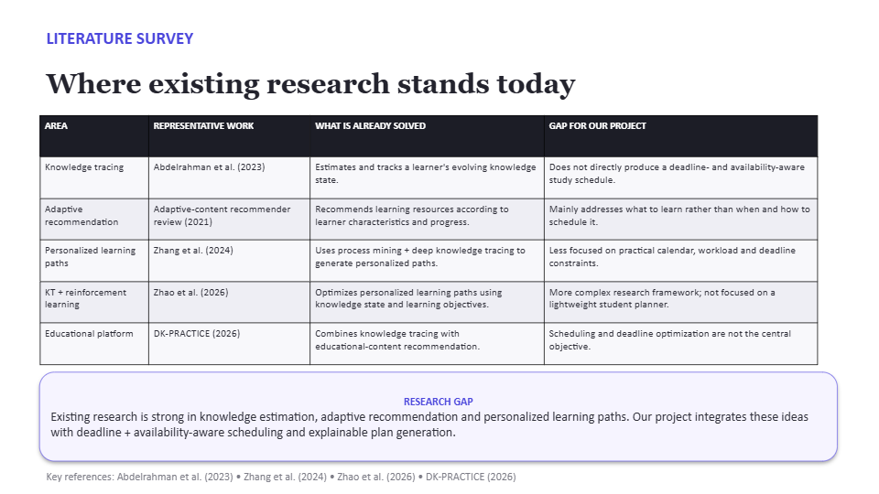

Slide 4
RESEARCH GAP / NOVELTY
What existing tools don't do
Algorithm-first, not AI-black-box
Most planners hide their logic behind an LLM call. Kairos makes the data structures themselves the computational core — inspectable and measurable.
1
Local resource intelligence
Instead of only asking "what should I study?", it asks what already exists on your own machine that helps this specific task.
2
Algorithmic resource retrieval
A defined pipeline — Trie → Hash Index → Relevance Scoring → Heap → Top-K — replaces generic keyword search.
3
Adaptive scheduling + learning together
A weak concept doesn't just get flagged — it reshapes the schedule and the reminders in the same pass.
4
Built-in Algorithm Lab
Performance claims ("Hash Table is faster") are benchmarked live on the actual dataset, not asserted.
5
04

Slide 5
PROJECT OBJECTIVES
What the system sets out to do
Manage assignments, projects, deadlines & academic tasks
Analyze topic, deadline, priority & estimated workload per task
1
2
Index and search local study resources (Trie + Hash Table)
Retrieve supplementary web-based educational resources
3
4
Organize tasks by deadline via a self-balancing AVL Tree
Prioritize tasks & rank resources via Binary Heap + Heapsort
5
6
Compare Greedy, DP, Backtracking & Branch-and-Bound scheduling
Adapt the learning plan to tracked progress & weak concepts
7
8
Generate workload- and deadline-aware reminders
Provide measurable, benchmarked evidence via an Algorithm Lab
9
10
05

Slide 6
WORKFLOW DIAGRAM
One pipeline, seven structures
Task
Analyzer
AVL Tree +
Hash Table
Binary Heap
Trie
Heapsort
Scheduler
Adaptive
Engine
→
→
→
→
→
→
urgency formula
store & order
priority queue
resource search
ranking
Greedy·DP·BT·B&B
weak-area shift
Task created → analyzed for urgency → inserted into AVL (by deadline), hash table (by id), heap (by urgency) → resources ranked → schedule optimized → plan adapts to weak areas.
USER FLOW
Create task → System indexes local + web resources → Ranked workspace assembled → Study plan generated → Progress logged → Plan & reminders adapt
06

Slide 7
IMPLEMENTATION DETAILS — DATA STRUCTURES
Hand-built, not borrowed
STRUCTURE
COMPLEXITY
AVL Tree
O(log n)
Hash Table
O(1) avg
Trie
O(m + k)
Binary Max-Heap
O(log n)
Heapsort
O(n log n)
Backend: Python + FastAPI, each structure in its own testable module. Frontend: React + Vite + Tailwind + shadcn/ui.
07

Slide 8
IMPLEMENTATION DETAILS — ALGORITHMS
Urgency formula & scheduling strategies
SCHEDULING — 0/1 KNAPSACK, FOUR STRATEGIES
urgency = 10 × priority_weight
+ 100 / (1 + days_to_deadline)
+ 2 × estimated_hours
+ 40 if overdue else 0
Greedy
O(n log n)
No
Dynamic Programming
O(n·W)
Yes
Backtracking
O(2ⁿ)
Yes
This score drives the priority heap and is what the scheduler maximizes.
Branch & Bound
O(2ⁿ) worst
Yes
ADAPTIVE LEARNING
weight = (100 − mastery) + 12, normalized over available hours, ordered weakest-first by heapsort. An unassessed concept is not treated as weak — it counts as 50% for time allocation only.
08

Slide 9
OUTPUTS
Seven working screens
Today
Next task, specific reminders
heap peek O(1)
Tasks
By deadline or by urgency
AVL in-order / heap extract-max
Study Plan
Fits tasks to available hours; races all 4 strategies
Greedy / DP / BT / B&B
Resources
Index a folder, search with autocomplete
Trie → hash → heap → heapsort
Progress
Mastery per topic, weakest concepts surfaced
Adaptive Learning Engine
Algorithm Lab
Pick size + algorithms, run, get real numbers
everything, benchmarked live
Engine
Live AVL tree, heap array, hash buckets, Trie
direct structure view
09

Slide 10
WORK PROGRESS TIMELINE
Core system complete — polish & hardening ahead
COMPLETED
REMAINING / FUTURE WORK
✓
Task Analyzer (urgency scoring)
○
Persistence — no database yet, state is in-memory only
✓
AVL Tree, Hash Table, Trie, Binary Heap, Heapsort — all hand-built
○
Multi-user support & authentication (currently one global store)
✓
Resource Engine — local indexing + web fetch + ranking
○
Urgency re-aging — recompute automatically as deadlines approach
✓
Scheduling Engine — Greedy / DP / Backtracking / Branch & Bound
○
Indexed heap with decrease-key (avoid full O(n log n) rebuild per priority view request)
✓
Adaptive Learning Engine — mastery tracking & weak-area shift
○
Real quiz engine to replace self-reported mastery
✓
Reminders & dashboard assembly
✓
Algorithm Lab — live benchmarking, searching/sorting/scheduling/growth curve
○
Production deployment
✓
All 7 frontend screens wired to the backend (27 endpoints)
○
Final UI polish & full workspace automation
✓
160 unit + integration tests passing
10

Slide 11
REFERENCES
References
[1]
Cormen, T. H., Leiserson, C. E., Rivest, R. L., & Stein, C. (2009). Introduction to Algorithms (3rd ed.). MIT Press.
[2]
Adelson-Velsky, G. M., & Landis, E. M. (1962). An algorithm for the organization of information. Soviet Mathematics Doklady.
[3]
Williams, J. W. J. (1964). Algorithm 232 — Heapsort. Communications of the ACM.
[4]
Fredkin, E. (1960). Trie memory. Communications of the ACM.
[5]
Ahead — AI-powered study planner.
[6]
RealStudy — Study block planner.
[7]
DK-PRACTICE — Adaptive learning research platform.
[8]
FastAPI documentation. [ https://fastapi.tiangolo.com ]
[9]
shadcn/ui component library. [ https://ui.shadcn.com ]
Replace bracketed entries with exact citations / URLs used in your report.
11

