Slide 1
USE CASE DIAGRAMS
A presentation by:
Neeraj Ranade
u3245987

Slide 2
Scenario
Patient management system
For a small clinic (GP)
Not applicable to big organizations
(hospitals, maternity homes)
Based on my personal experience
Worked as a medical receptionist (part-time)

Slide 3
Assumptions
Assumption 1 : case paper contains the information about patients like their age, diseases, illness, medical condition and information about patient's vitals, medication history of patient

Slide 4
Assumptions
Assumption 2: the doctor will fill in the case paper for every visit of the patient. Once the doctor has filled in the case paper, the prescription will be automatically printed

Slide 5
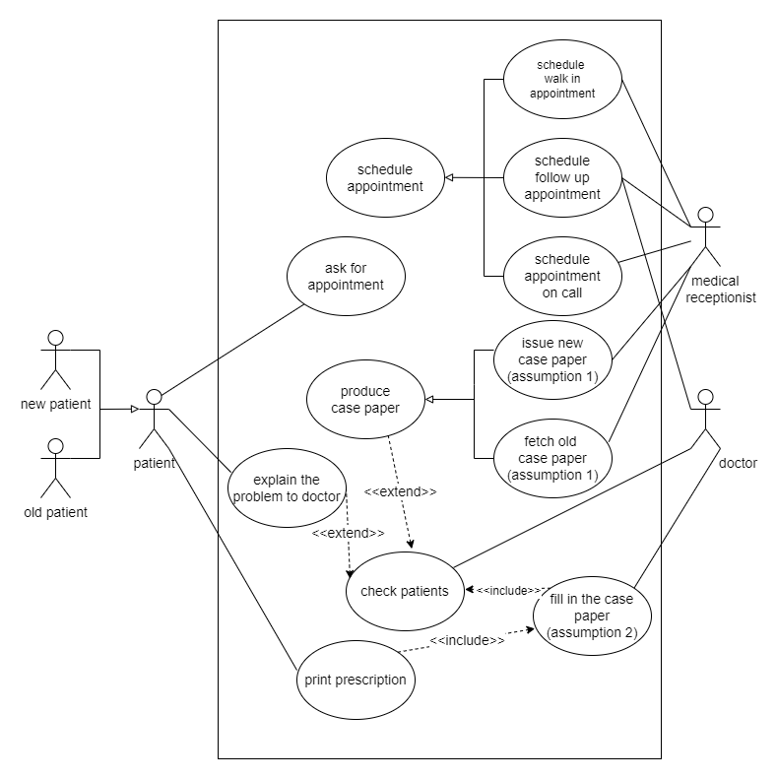

Slide 6
THANK YOU!!!

