Slide 1
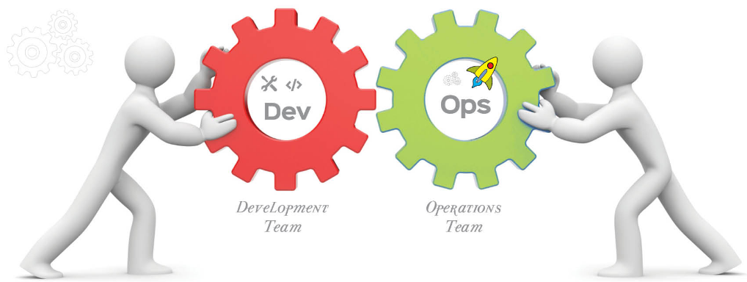
DevOps

Slide 2
Software Engineering
"The systematic, disciplined approach to the development, operation and maintenance of software“
-- IEEE
Goal:
Is to deliver an efficient and reliable software product to client OR to end user OR to market.

Slide 3

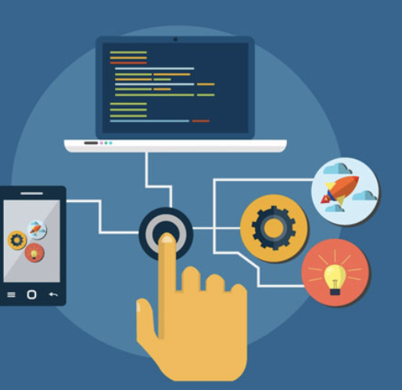
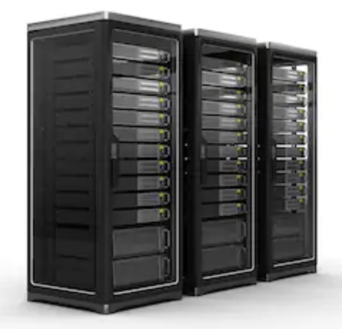
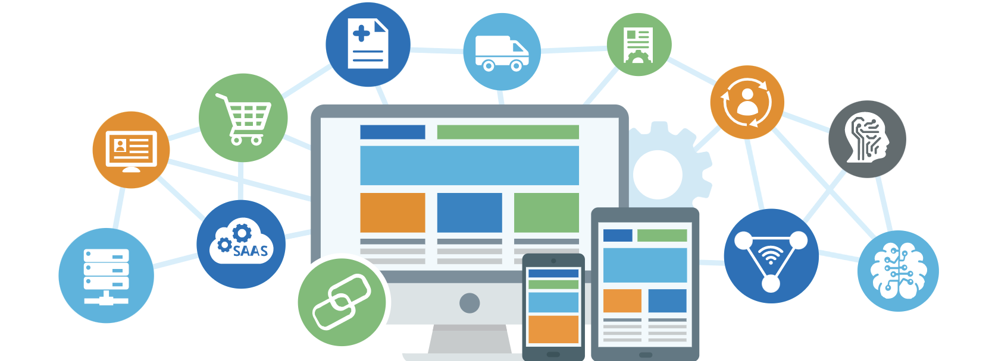
Basics...
Server Applications

Slide 4
Basics... Application Types
Standalone Applications:
applications we install on Desktops – only a single user can access the application at any point of time
ex: VLC player, calc app, MS Office etc..
Web Applications:
applications that can be accessed by N number of people from N number of Geographic Locations over an internet.
ex: simple websites like ThinkWright.in, simplesite.com etc..
These application we host on web servers such as apache, nginx, iis, tomcat etc…
Enterprise Applications:
applications that can be accessed by N number of people from N number of Geographic Locations over a internet, but have an extended features over web applications such as security, messaging, High Availability, Integrations etc..
ex: amazon.com, bookmyshow, flipkart, etc…
These type of application we host / install on application servers such as WebSphere, Jboss, Weblogic etc…

Slide 5
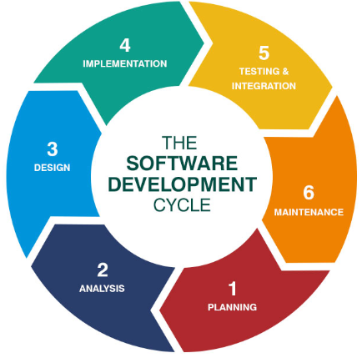
SDLC
SDLC defines the complete life cycle of software i.e. all the tasks involved in planning, creating, testing, and delivering a Software to client or market.
SDLC process aims to produce high-quality software that meets customer expectations

Slide 6
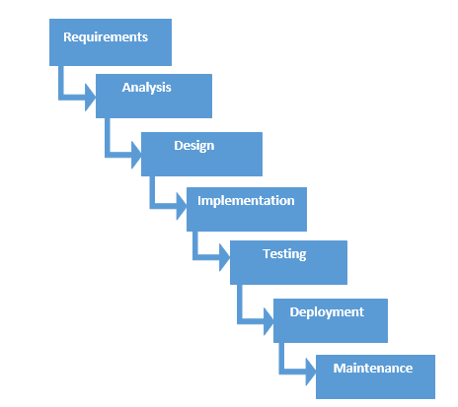
Evolution of IT
Waterfall
New phase in the development process begins only if the previous phase is complete
Challenges:
Time to market is very high
No client interaction
Requirements are rigid, means we cannot accommodate dynamic requirements.

Slide 7
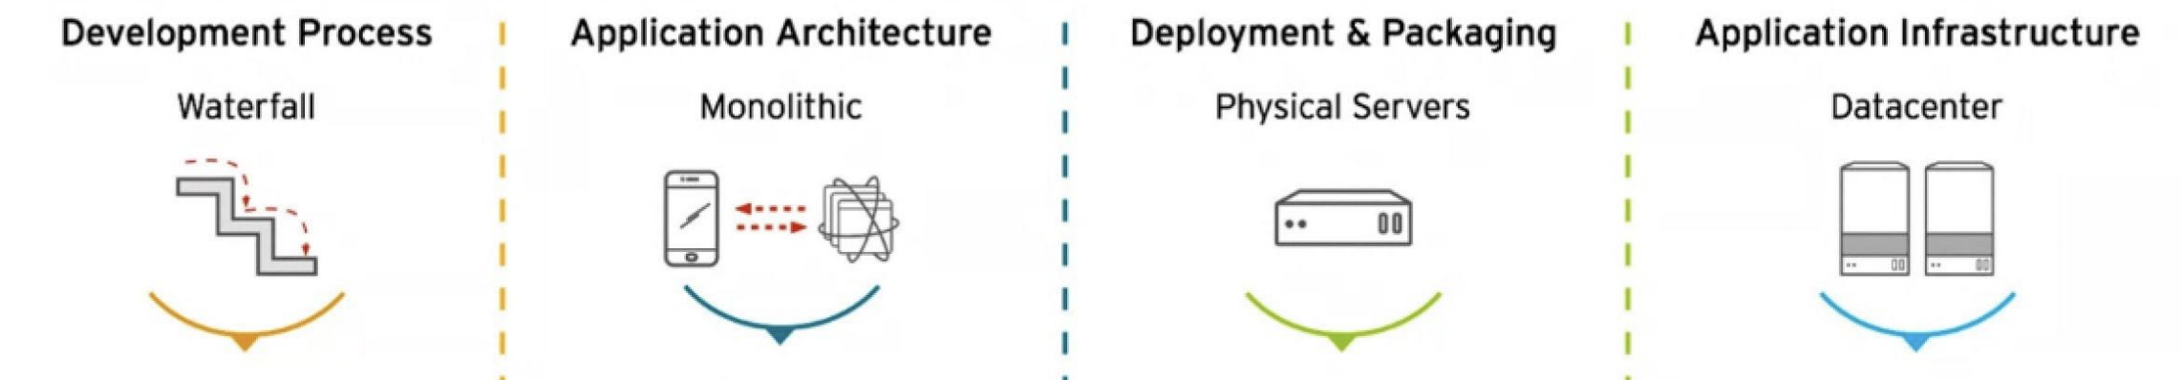
Evolution of IT

Slide 8
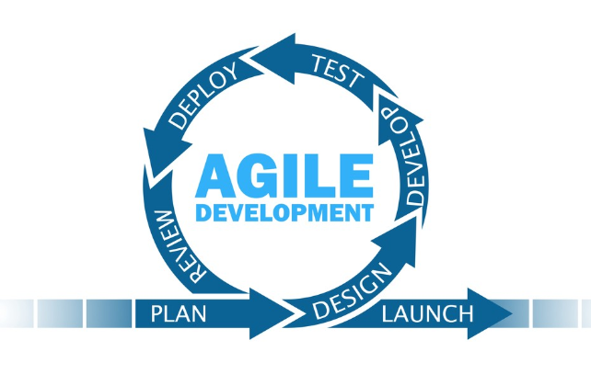
Evolution of IT

Slide 9
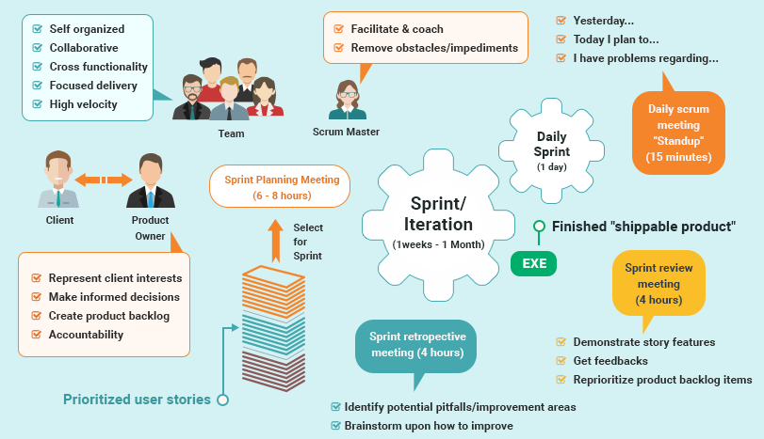

Slide 10
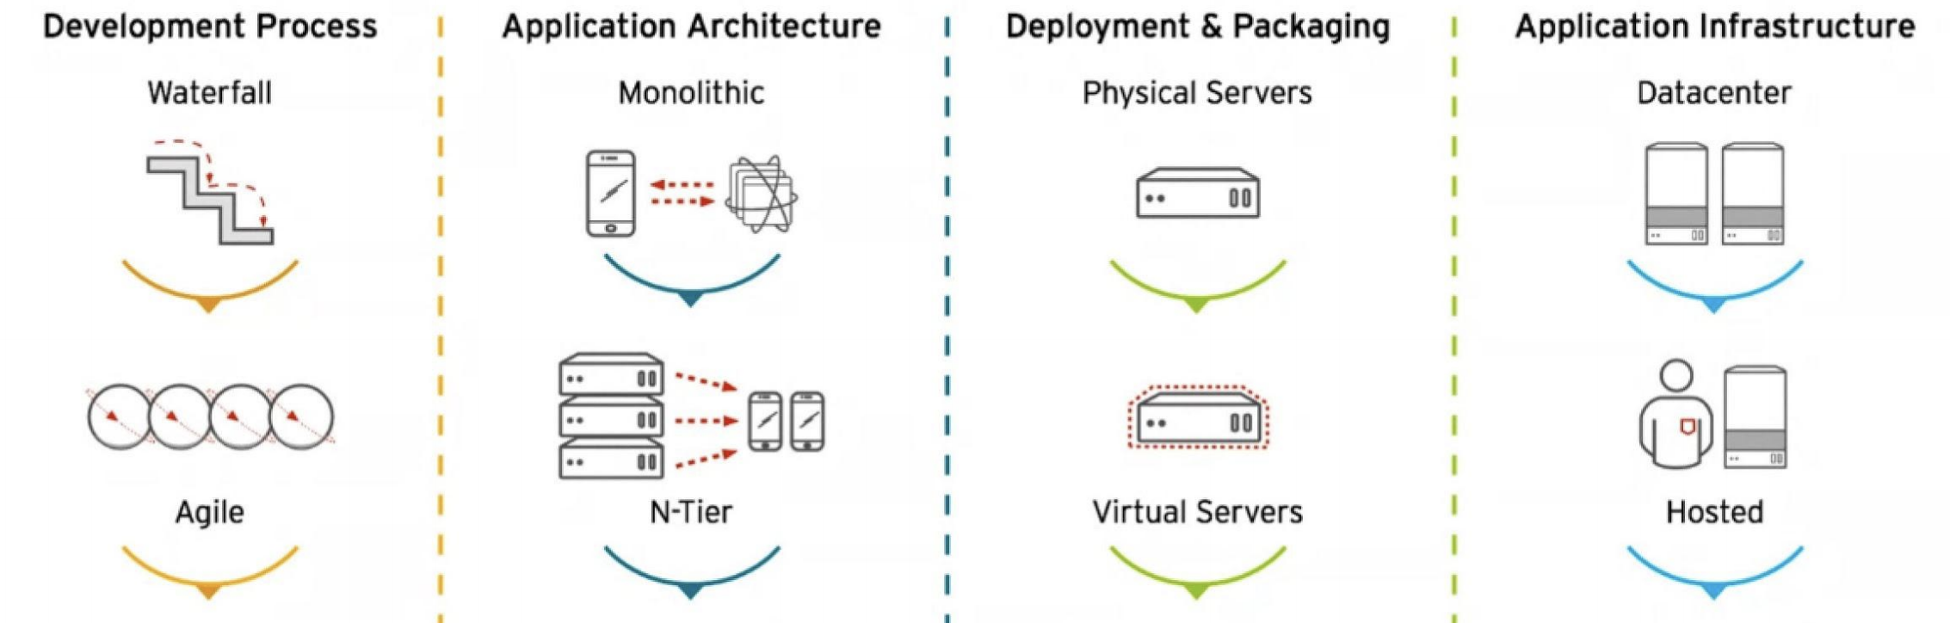
Evolution of IT

Slide 11
Challenges:
Infrastructure Readiness
Scalability
Quality of the Product
automation
Limited Release windows – Releases may slip/fail
we want no down time deployment -- CICD

Slide 12
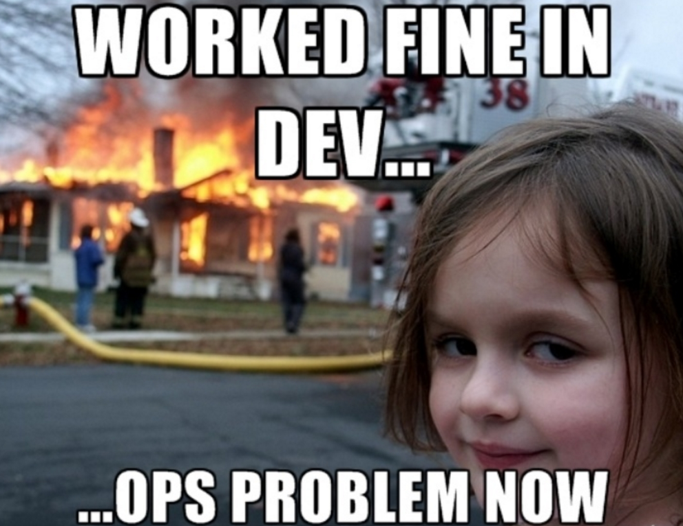

Slide 13
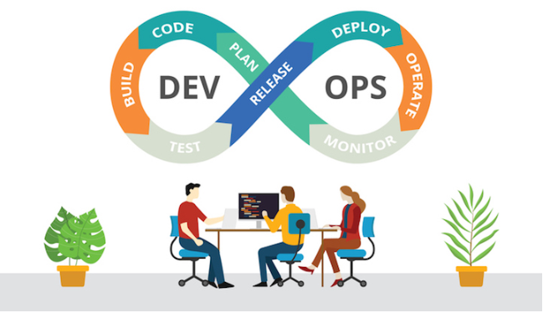
Evolution of IT

Slide 14
What is DevOps ????
Is it a culture?
Is it a job title?
Is it a team?
Is it a way of organizing?
Is it a tool stack?
Or just a way of thinking?

Slide 15
“DevOps is a re-org, not a new team to hire”
-- Adrian Cockcroft

Slide 16
Technically….
“DevOps is agile IT operations delivery, required to match the cadence of agile IT development”.
“DevOps is the philosophy of unifying Development and Operations at the culture, practice, and tool levels, to achieve accelerated and more frequent deployment of changes to Production (The IT Sceptic)”.
DevOps is a software Engineering Culture and Practice that is unifying Software Development and Software Operations. It Aims at Shorter Deployment cycles, More dependable releases in close alignment with business objectives.

Slide 17
Technically….
DevOps is first a Culture of Collaboration between developers and Operations.
The culture has given scope for set of practices.
DevOps is a revolutionary movement by Practitioners , for practitioners.

Slide 18
Goals….
The goal of the development team is to deliver features into the hands of the customer as quickly as possible, so their goal is speed. But the goal of the operations team is to maintain the stability of the system and minimize downtime.
stability and speed of delivery
Time-to-market
No Production Failures
Immediate recovery from failures.
There is no wall in a DevOps culture.

Slide 19
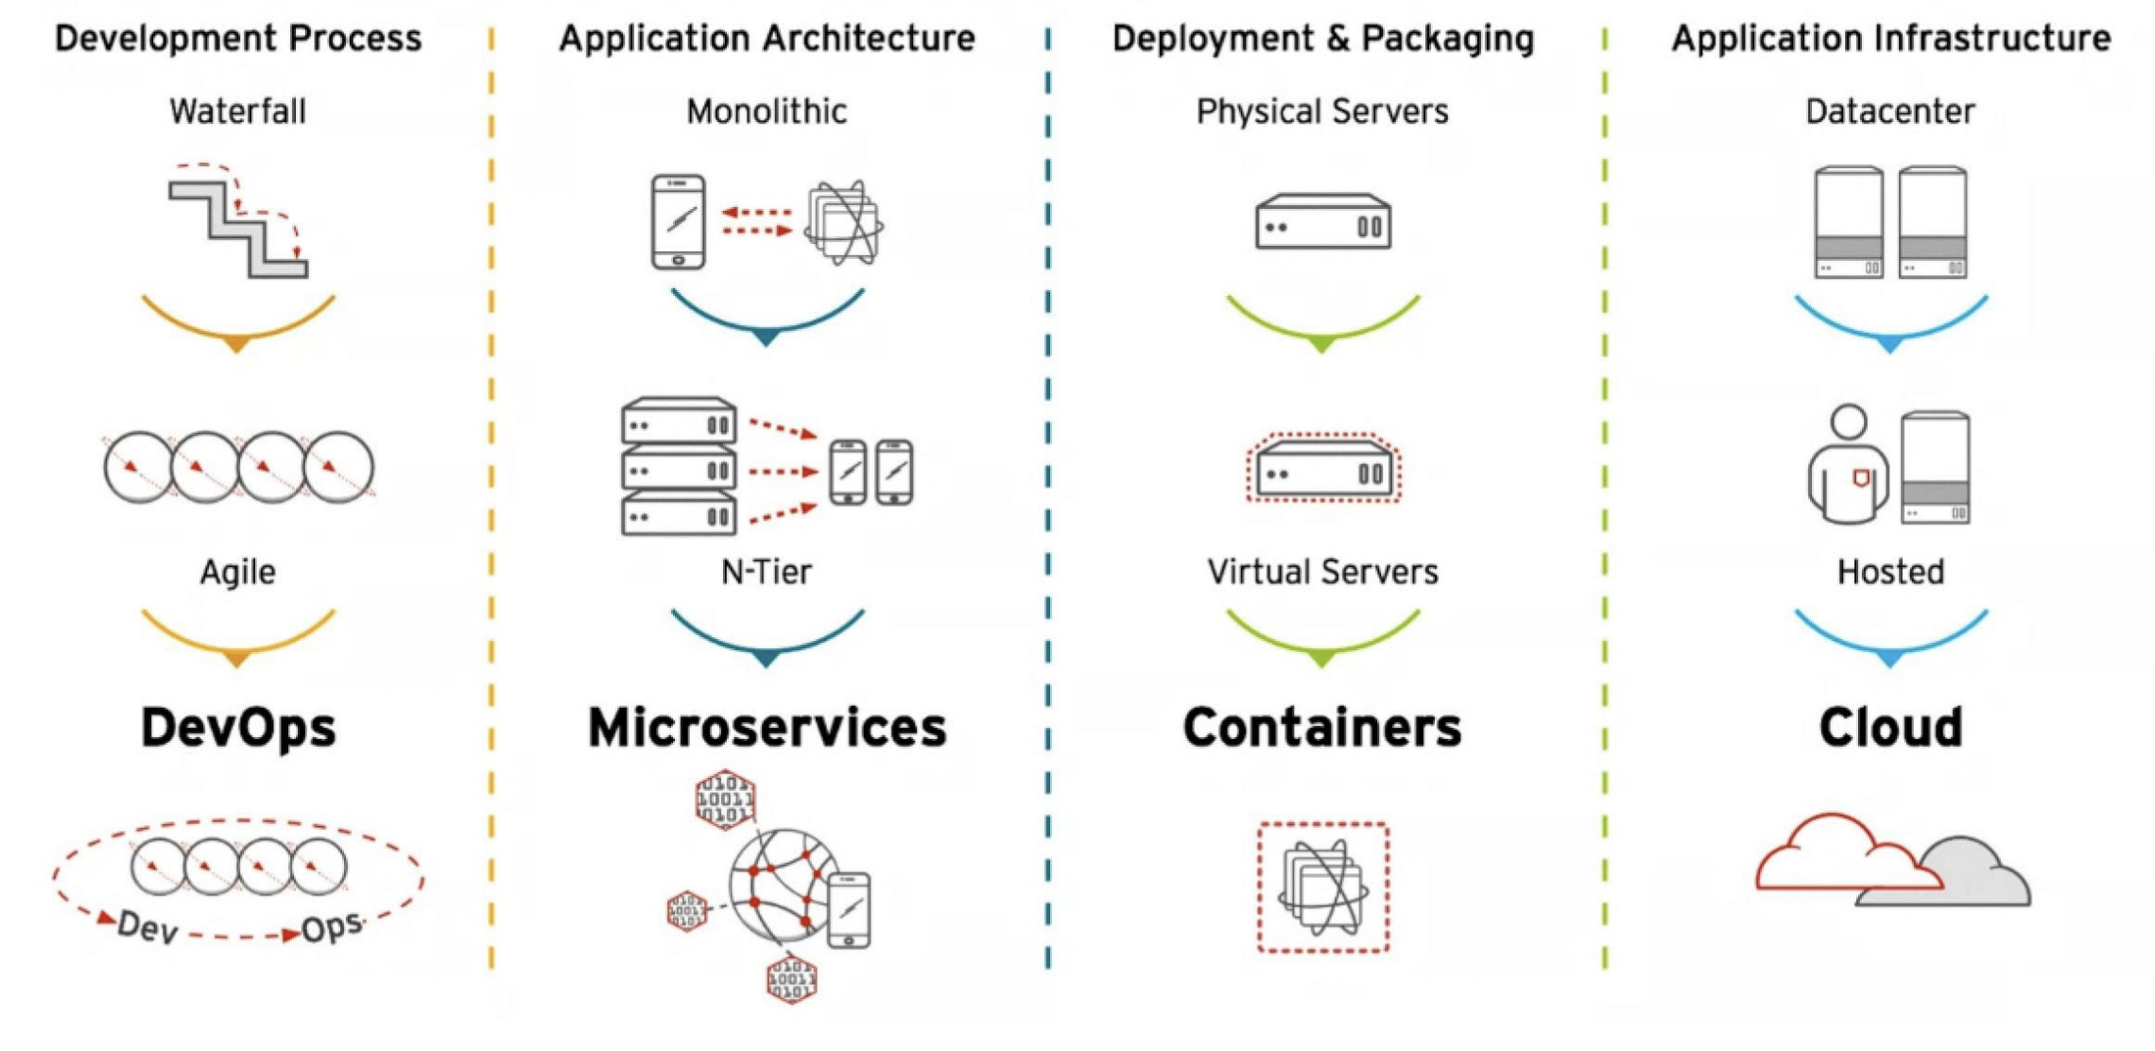
Evolution of IT

Slide 20
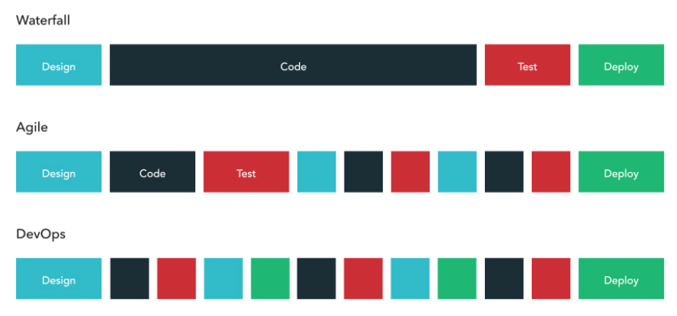

Slide 21
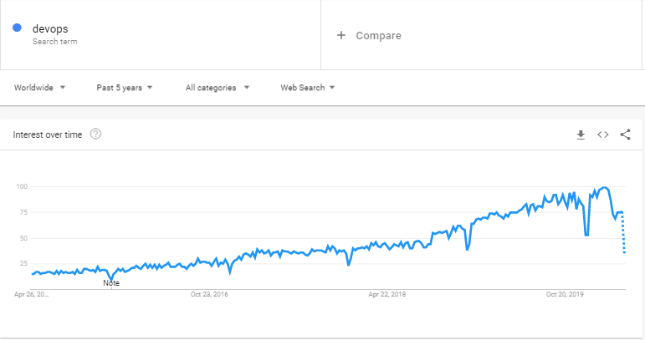
WHY DevOps ?
All Organizations today are working hard to respond better around changing market needs and are keen to adopt DevOps practices. As a result
All Organizations are now hiring DevOps Engineers, who can work & adopt dynamic market needs easily.
a growth of 75 % in last couple of years as every organization is adopting DevOps Practices.

Slide 22
DevOps Engineer Roles & Responsibilities ?
With DevOps, there is more scope for frequent changes in the code, due to which it is expected to do
Test, build, design, deployment, and ability to maintain continuous integration and continuous delivery process using tools like Jenkins, maven Git, etc.
Must know how to choose the best tools and technologies which best fits the business needs.
Ability to automate test and deploy the code and monitor.
Work in close coordination with the development and operations team such that the application is in line with performance according to the customer's expectation.
It’s not expected to DO Everything, but have an idea of end-to-end process, Master couple of tools as Primary Skills then know various tools which can help to achieve the DevOps process.

