Slide 1
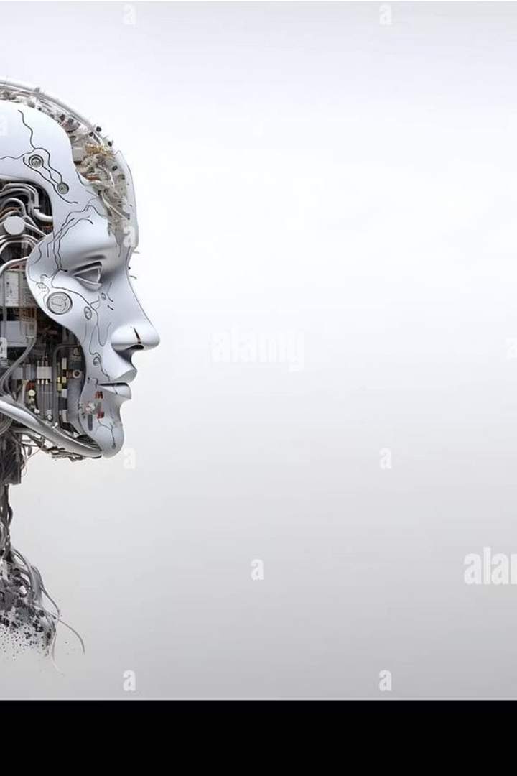

Generative AI, LLMs, Agents & Agentic AI:
This presentation explores the exciting world of artificial intelligence, differentiating between Generative AI, Large Language Models (LLMs), AI Agents, and the emerging field of Agentic AI. We'll uncover how these advanced technologies create, understand, and act.
by Neeraj Vohra

Slide 2





Generative AI: Creating New Content
Definition
Algorithms that generate new, original content.
Examples
Images (DALL-E 2), text (GPT-3), music (Jukebox).
Core Function
Learning patterns from existing data to produce novel outputs.
Impact
Revolutionizing creative industries, content creation, and design.

Slide 3
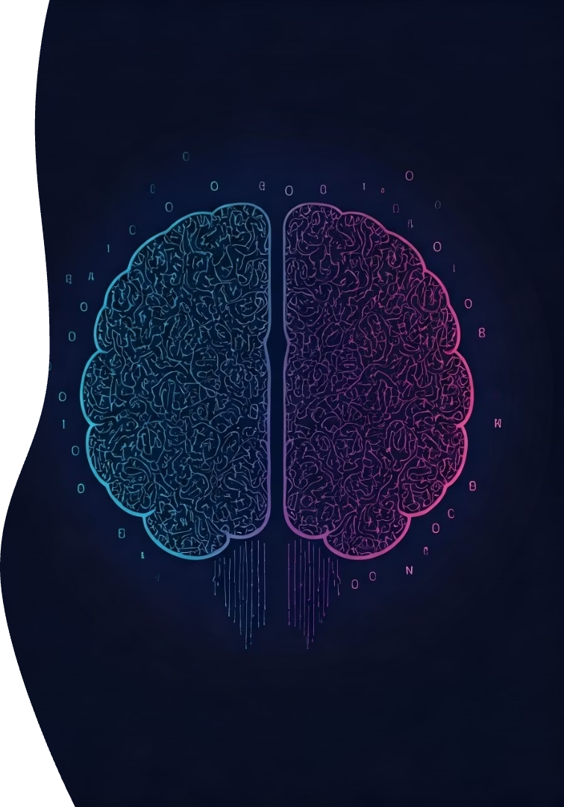




Large Language Models (LLMs): Powering Generative Text
Definition
Deep learning models trained on massive text datasets.
Examples
GPT-4 (OpenAI), LaMDA (Google), Llama 2 (Meta).
Key Capabilities
Natural language understanding, generation, and translation.
Significance
Backbone of many generative AI applications that involve text.

Slide 4

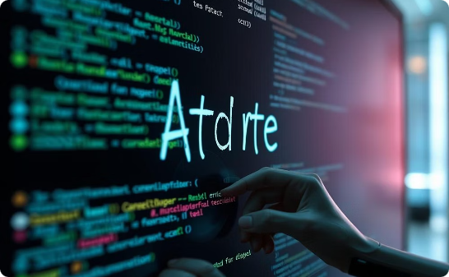

Generative AI: The Creators of Content
Image Generation
Code Generation
Text Generation
Tools like Stable Diffusion craft stunning visuals from text prompts.
AI can write programming code, accelerating software development.
LLMs produce human-like text for various applications.
Generative AI focuses on creating novel content. It learns patterns from vast datasets to produce new text, images, or code. These systems are highly adept at creation but do not typically make independent decisions or take actions.

Slide 5




Large Language Models (LLMs): Mastering Text
Vast Training Data
Human-like Text
LLMs are trained on massive amounts of text.
They generate coherent and contextually relevant responses.
Natural Language Understanding
LLMs excel at interpreting and responding to human queries.
LLMs are a specialized type of Generative AI. Their primary function is generating and comprehending human language. Models like GPT-3 or BERT demonstrate remarkable capabilities in conversation and content creation.

Slide 6





AI Agents: Task Executors
Execute Tasks
Agents perform specific actions or sequences of tasks.
Interact with Environment
They engage with digital or physical surroundings.
Decision Making
Agents make choices based on their programming or learned data.
AI Agents are components designed to perform tasks and interact with their environment. They can be found in chatbots, virtual assistants, or autonomous vehicles. While they make decisions, they often require human oversight or are limited to specific predefined functions.

Slide 7

Agentic AI: Combining Generation and Action
Definition
AI Agents leveraging generative AI (often LLMs) for enhanced capabilities.
Function
Agents create, plan, and execute tasks by generating content adaptively.
Examples
Code generation agents: Write and debug software automatically.
Personalized education agents: Generate customized learning materials.
Automated marketing agents: Create and deploy targeted ad campaigns.
Potential
Automating complex tasks with creative problem-solving.

Slide 8

Agentic AI: Autonomous Systems
Key Features
Multi-step planning
Environment interaction
Continuous feedback loops
Agentic AI represents a significant leap towards truly autonomous systems. It enables AI to operate independently, make complex decisions, and take actions to achieve sophisticated goals. This field integrates LLMs and AI Agents into a cohesive, proactive framework.

Slide 9




The Evolution of AI Capabilities
Generative AI
Creates new data based on learned patterns.
LLMs
Specialized in text generation and understanding.
AI Agents
Perform specific tasks and interact with environments.
Agentic AI
Autonomous, goal-oriented, and proactive systems.
AI capabilities are evolving rapidly. From merely generating content to executing complex, autonomous actions, the progression showcases increasing levels of intelligence and independence. Each layer builds upon the preceding one, expanding AI's potential.

Slide 10



Why Agentic AI Matters
Complex Task Handling
Agentic AI can manage intricate, multi-faceted operations.
Adaptive Learning
Systems adjust and improve from ongoing experiences.
Proactive Solutions
AI anticipates needs and initiates actions autonomously.
Agentic AI systems offer significant advantages. They can perform highly complex tasks, learn from ongoing interactions, and proactively address challenges. This leads to more efficient and resilient AI applications across industries.

