Slide 1
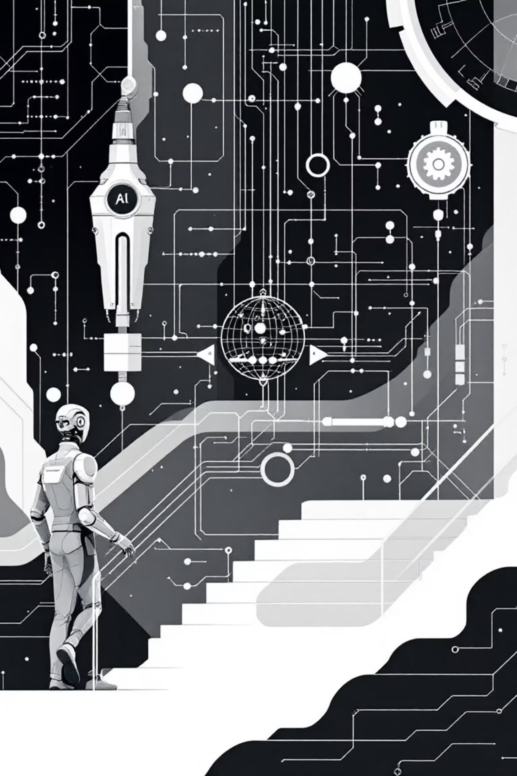
Workflow Orchestration for LLM Apps
LangGraph transforms AI development by providing structured, reliable, and intelligent workflow orchestration—moving beyond simple prompts to sophisticated agent systems.

Slide 2
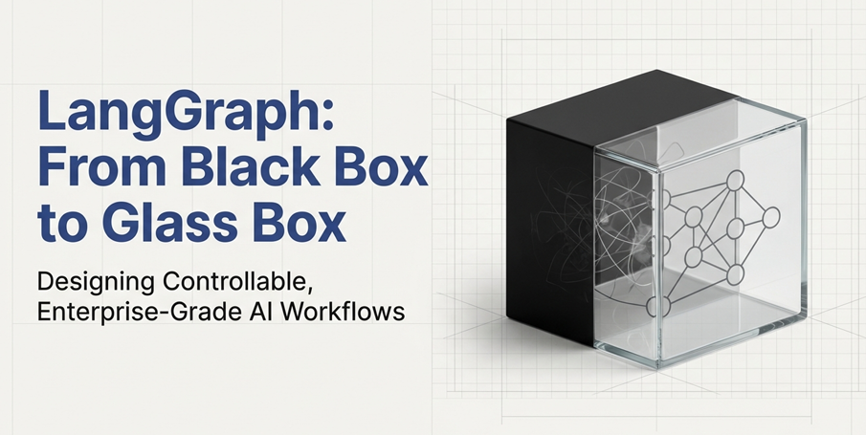

Slide 3
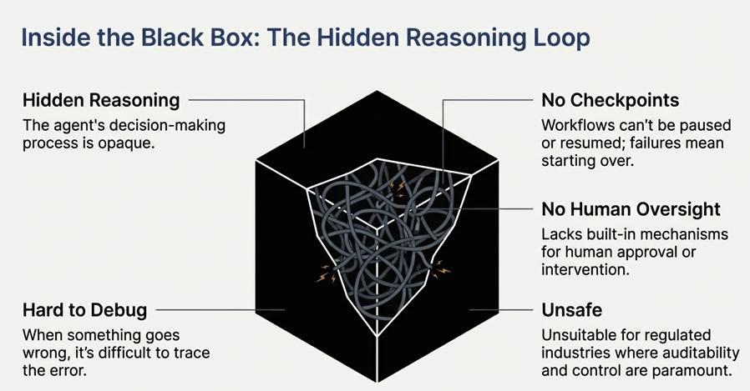

Slide 4
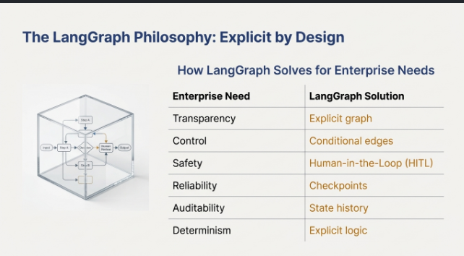

Slide 5
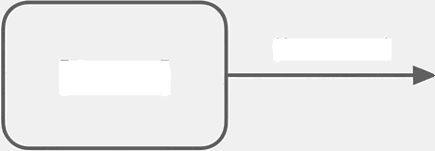
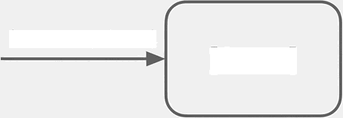
Lang Graph Built on One Simple Idea
[Node]
(flows into)
(returns updated)
[State]
[Statej
State flows through nodes, guided by edges.
Nothing more. Nothing less.

Slide 6
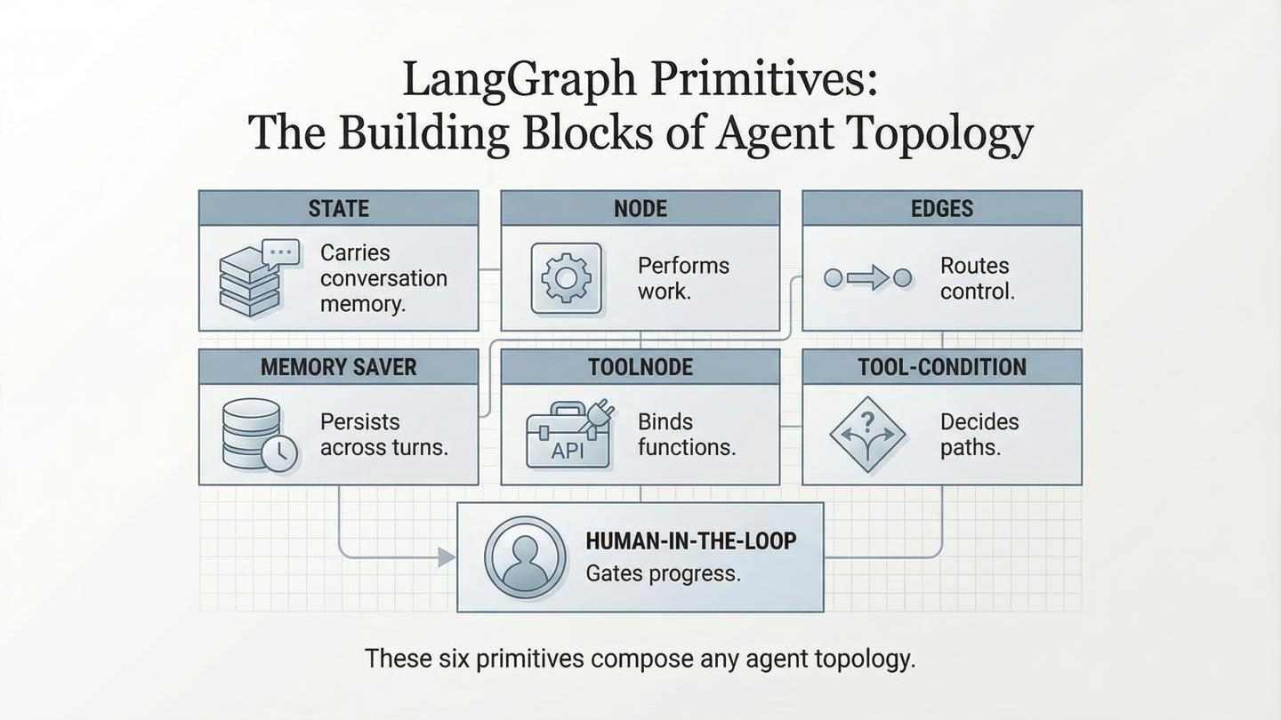

Slide 7
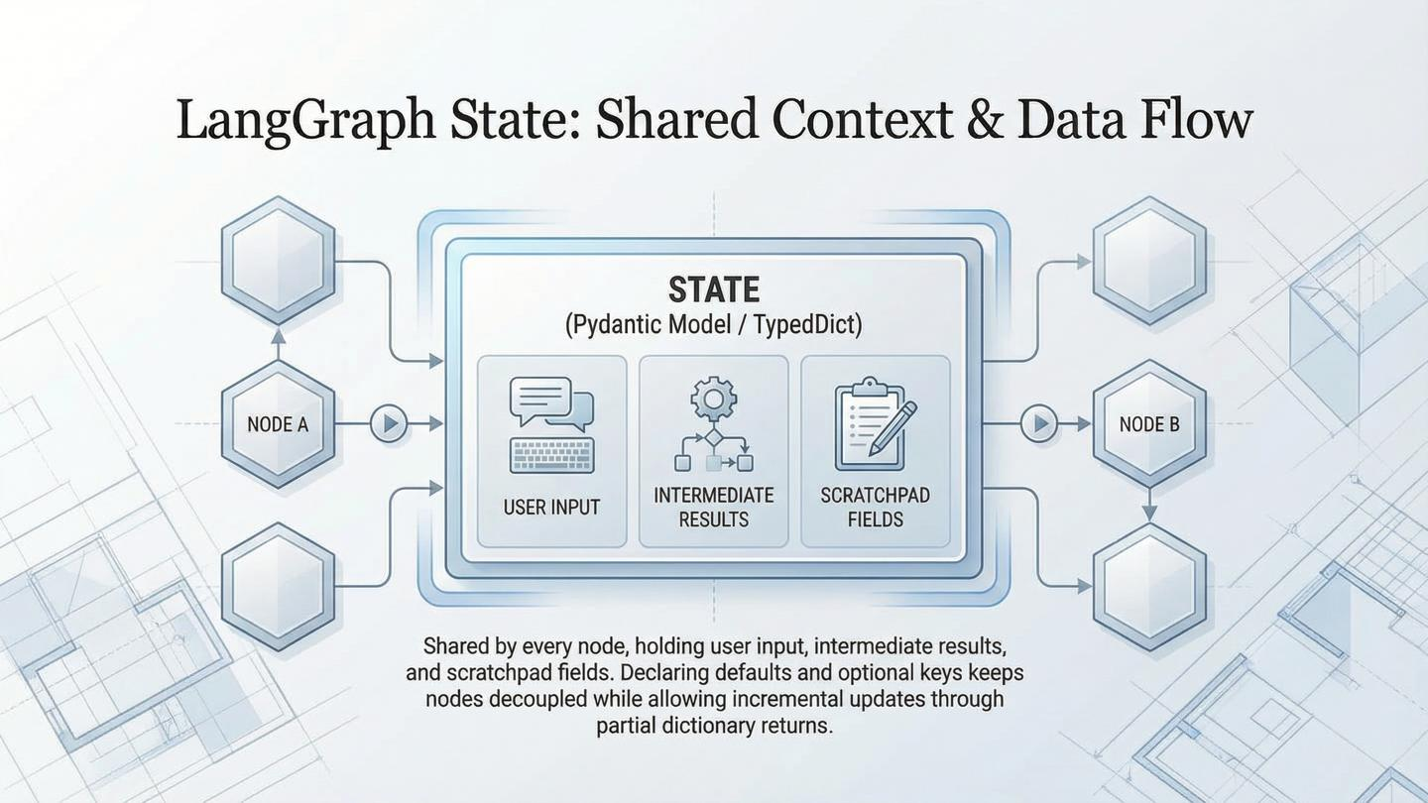

Slide 8
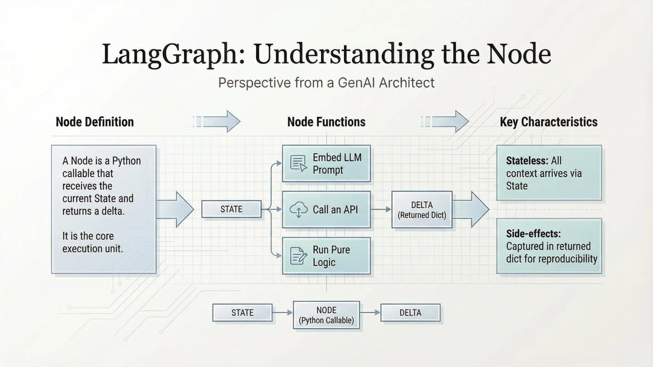

Slide 9
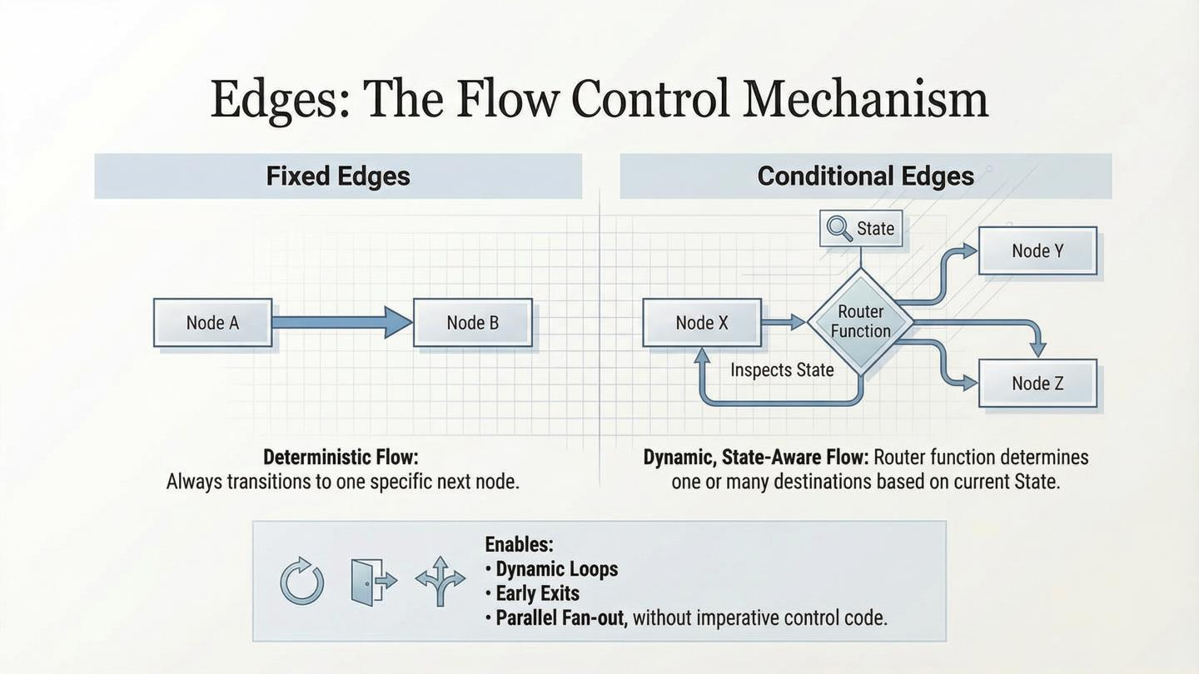

Slide 10

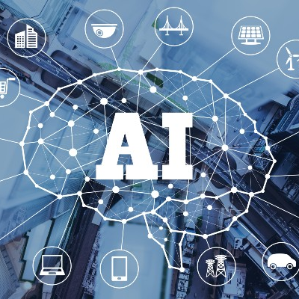
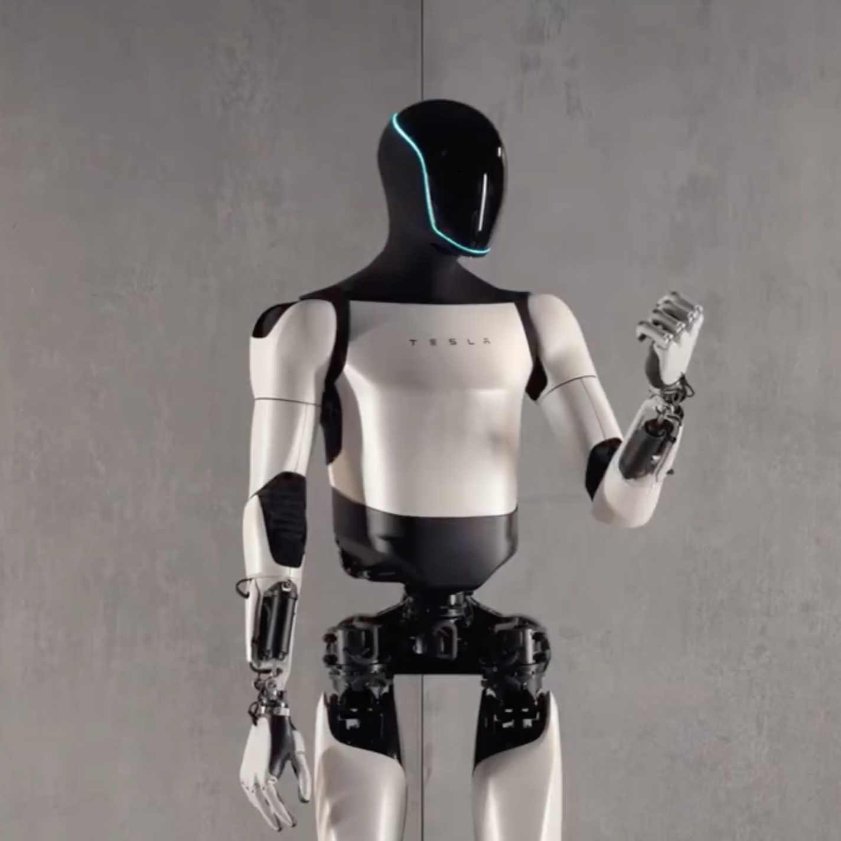

ToolNode: Safe External Integration
A pre-built node that safely executes tools like APIs or functions, handling parsing, errors, and formatting.
ToolNode is the bridge between the LLM's plan and the real world. It executes the functions the LLM decides to call.
→
→
LLM (The Brain)
ToolNode (The Worker)
Result
Decides to use a tool.
Executes the function call.
Returns data to the LLM.
It handles parallel execution, error trapping, and formatting, so the agent can self-correct on the next loop.

Slide 11
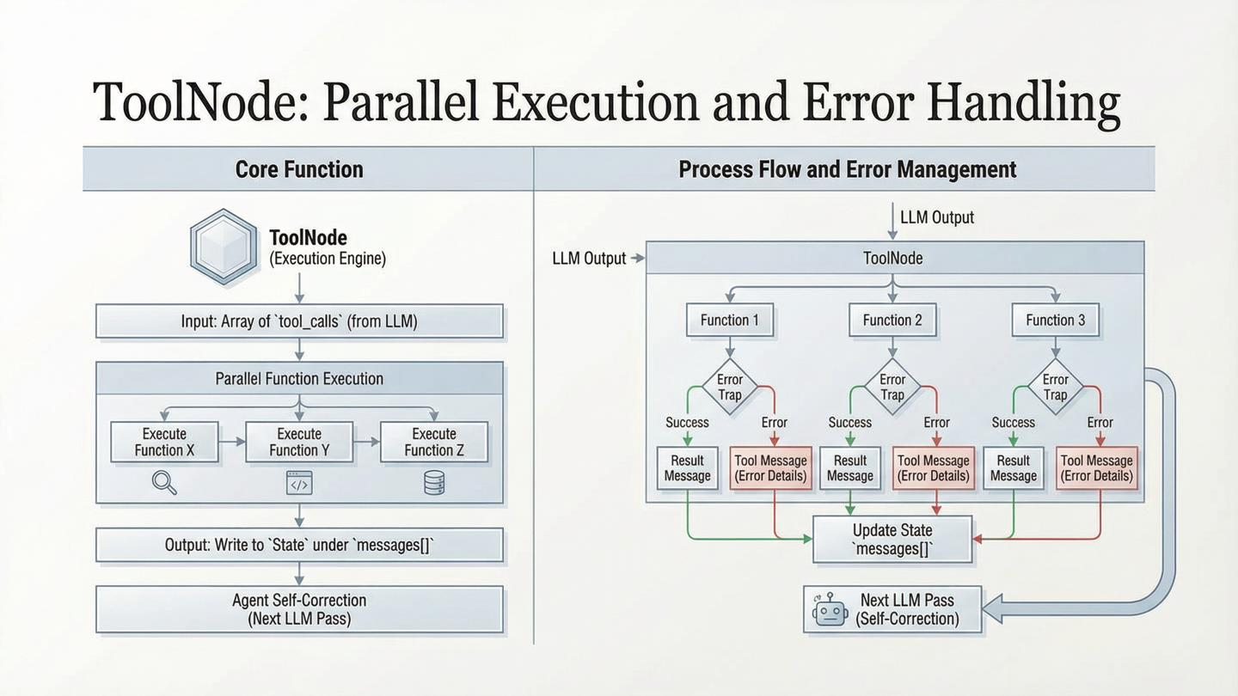

Slide 12

LangGraph Checkpointers
Your Agent's Automatic Save-Game System
Every time a node finishes, LangGraph takes a full snapshot. Think of it as creating restore points throughout your agent's execution journey.
Checkpoints enable you to pause execution, resume later, or even rewind to previous states for debugging and recovery.

Slide 13





What Gets Saved in Each Checkpoint
Entire State
Node History
Next Destination
All messages, variables, files, and data structures preserved exactly as they were.
Which node just ran and completed its execution.
Where the graph should go next in the execution flow.
Timestamp
Thread ID
When this checkpoint was created for debugging and replay.
Who this checkpoint belongs to for multi-user scenarios.

Slide 14
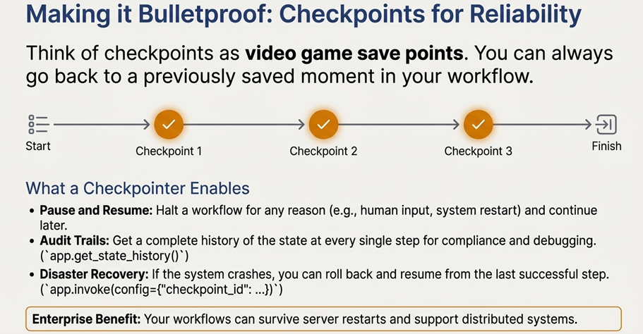

Slide 15

Human-in-the-Loop
1
Agent Processing
Graph executes automated steps
2
Pause for Review
Execution stops for human input
3
Human Decision
User reviews and approves action
4
Continue Execution
Graph resumes with approval
Human-in-the-Loop allows you to pause graph execution for human review and approval before critical actions, ensuring oversight and control.

Slide 16
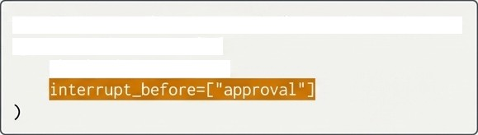

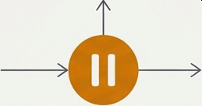
Keeping a Human in the Loop (HITL)
HITL isn't a hack or an afterthought in LangGraph; it's a core capability.
Critical Use Cases Code Example (to show simplicity)
Financial approvals
Legal review
Safety checks
Quality control
# Tell the graph to pause *before* this node runs
app = workflow,compile(
checkpointer=memory,
How it Works
[Node A]
[Node B]
[Node C]
[Approval Node]
You can easily build workflows that require explicit human sign-off before proceeding.

Slide 17
Human-in-the-Loop: The Approval Gate
1. Compile with Interrupt
2. Human Reviews
3. Resume Execution
Use `interrupt_after=["node"]` to pause after a specific node finishes.
Use `get_state()` to inspect the output. A human can then approve, edit, or reject.
Call `stream(None)` to continue from the checkpoint. The graph proceeds with the human's decision.
This pattern ensures compliance and safety by putting a human in control of critical junctures without losing the conversation's context.

Slide 18


The ReAct Agent Loop
ReAct = Reason + Act
ReAct is a powerful agent architecture that combines reasoning (thinking through problems step-by-step) with acting (using tools to gather information or perform actions).

Slide 19
The ReAct Agent: A Single, Powerful Pattern
This single graph pattern handles search, calculation, coding, and approval flows with minimal code.
tools_condition
Agent Node
Loop Back
Tool Node
Memory remembers the conversation.
Streaming shows live progress.
Interrupts guard sensitive steps.

Slide 20








Safe Loop Execution
Think
Act
Define the approach and strategy
Execute the planned steps
Retry
Check
Adjust and repeat if needed
Validate results and quality
Loops allow workflows to repeat steps safely, ensuring quality through iterative refinement.

Slide 21
The Heart of the ReAct Loop
`tools_condition` is the tiny function that powers 99% of agents. It's the traffic light at the core of the loop.
Last AI Message
tools_condition
Inspects the message for tool calls.
"tools"
"end"
If tool calls exist, route to the ToolNode to execute them.
If no tool calls, the agent is done. Route to END.
This single conditional edge replaces dozens of manual if-statements and creates the infinite ReAct loop.

Slide 22


Assembling the Pattern, Step 1 & 2: Reason and Act
Step 1: The Reason Node (Think) Step 2: The Tool Node (Act)
An 'Agent Node' where an LLM is bound with a set of tools. Its job is to think and decide if a tool is needed.
This node's only job is to execute the tool call requested by the Reason Node. It follows a deterministic rule: if a tool is called, run it.
llm_with_tools =
llm.bind_tools([tools])
too1_node = Too lNode(tools)
Key Insight: ToolNode does not reason or decide; it follows a checklist.

Slide 23
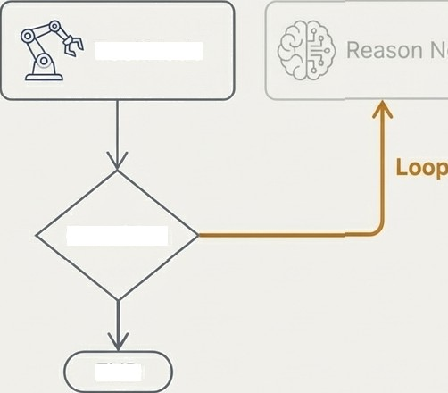
Assembling the Pattern, Step 3: The Critical Loop
Step 3: The Conditional Edge (Observe & Decide)
After the tool acts, a simple function which you write checks the state to decide what to do next. This is not AI. This is your logic.
Tool Node
Condition
def should_continue(state):
1ast_nsg = state ["messages"] [—1]
if last_msgtool_cal{s:
return "tool" # Loop back to Reason
END
return "end" # Finish
This is where you have full control. No hidden AI.

Slide 24
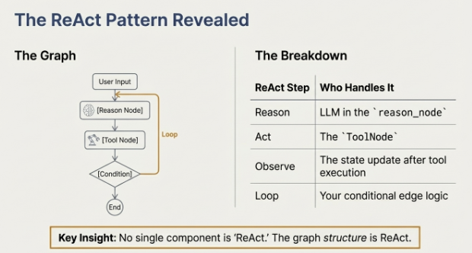

Slide 25
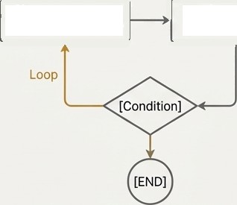
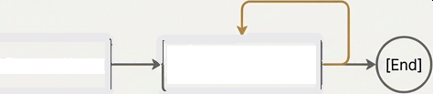

The Power of Control: Swapping the Engine
Because you define the graph, you can define the behavior. Want a planning agent instead of a reactive one? Just change the graph.
ReAct
Decides step-by-step, looping after each
action. It's reactive.
Planner
Decides the full plan upfront, then executes
the fixed plan. It‘s predictive.
[Reason Node]
[Tool Node]
[Planner Node]
[Executor Node]
Same framework, different behavior. You are the architect.

Slide 26
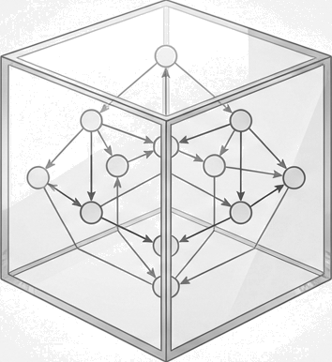
Build with Clarity and Confidence
Summary of Benefits
Total Control: You define the agent's reasoning process by designing the graph.
Full Transparency: Every step, state change, and decision is explicit and auditable.
True Modularity: Swap out reasoning patterns (like ReAct vs. Planner) without changing the framework.
LangGraph doesn't hide complexity; it gives you the tools to manage it.
Stop building black boxes. Start designing intelligent systems.

