Slide 1


Retrieval Augmented Generation (RAG) for AI Models
Unlock real-time and private data insights by enhancing large language models (LLMs) with external context.
by Neeraj Vohra

Slide 2
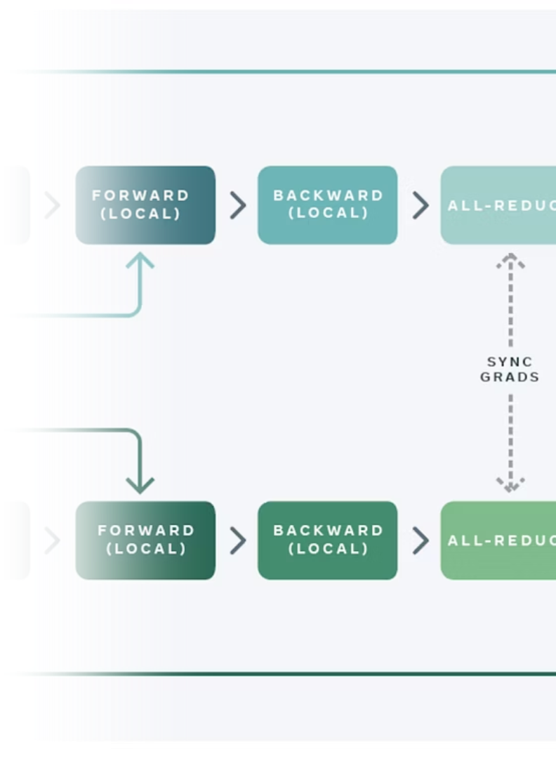
Why Use RAG with LLMs?
Limitations of LLMs
Real-Time Accuracy
LLMs cannot access up-to-date or private data on their own.
RAG enables LLMs to provide answers using the latest information.
Private Data Integration
Securely incorporate private databases into LLM responses.

Slide 3
Core Concept of RAG
Retrieval (Embedding)
Generation (LLM)
Data transforms into numeric vectors stored in a vector database.
LLM generates answers combining context and prompts.

Slide 4
Embedding: Data Preparation
1
Load Data
Split into Chunks
2
Break data into small, manageable pieces.
Embed Chunks
3
Convert text chunks into numeric vector representations.
Store Vectors
4
Save vectors into a vector database like Pinecone for retrieval.

Slide 5
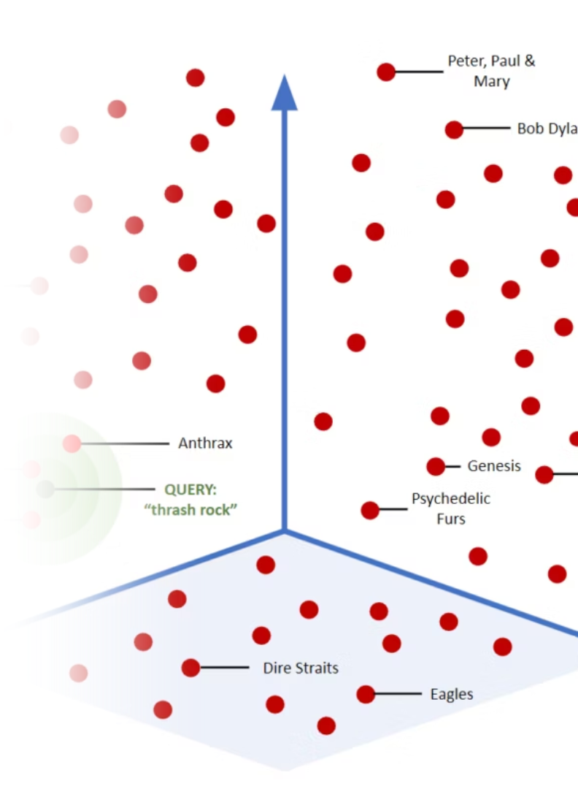
Vector Database and Similarity Search
Use of Pinecone
A scalable vector database optimized for similarity search.
Cosine Similarity Search
Find vectors closely matching queries for accurate context retrieval.

Slide 6
Combining Context with Prompt for Generation
Concatenate Context
LLM Response
Retrieved context enriches the original prompt.
Generates answers grounded in augmented context for precision.

Slide 7

Benefits of RAG in AI Applications
Improved Accuracy
Privacy and Security
Scalability
Enhanced responses using up-to-date and relevant data.
Integrate confidential data without exposing it to the LLM.
Easily expand knowledge base with new external data sources.

Slide 8





Next Steps to Implement RAG
Data Collection
Identify and curate relevant private or custom data.
Embedding Setup
Implement chunking and vector embedding workflows.
Vector Storage & Retrieval
Configure Pinecone or similar for efficient search.
LLM Integration
Combine retrieved context with prompts in your generation logic.
Testing & Refinement
Iterate to optimize retrieval quality and response accuracy.

