Slide 1
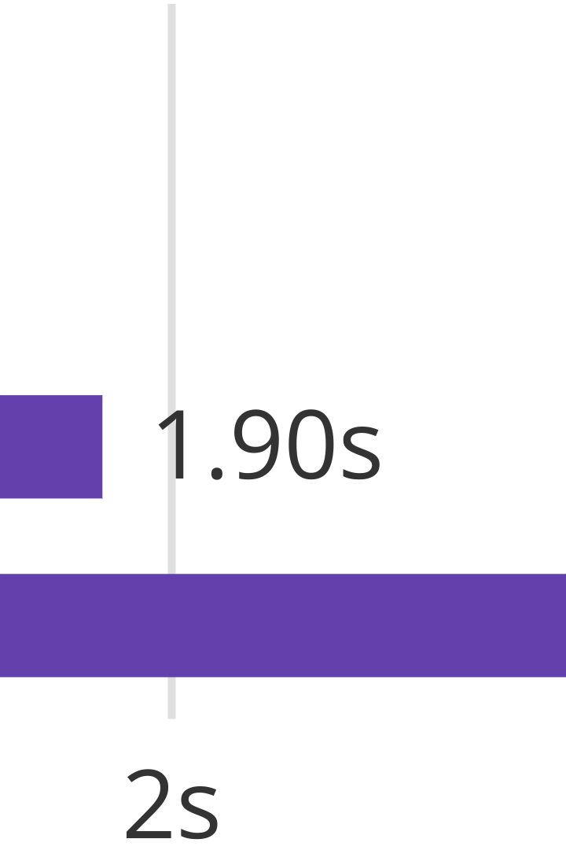

UV: The Future of Python Project Management
UV is an extremely fast Python package and project manager. It is written in Rust, delivering unparalleled speed. This presentation will cover its core features and benefits.
by Neeraj Vohra

Slide 2




Consolidate Your Python Toolchain
All-in-One Utility
Streamlined Workflow
Replaces pip, pip-tools, pipx, poetry, and more.
Simplifies dependency and environment management.
Unified Ecosystem
Integrates various functions into a single tool.
UV significantly reduces the number of tools Python developers need. It provides a comprehensive solution for package, project, and environment management.

Slide 3

Blazing Fast Performance
10-100x
<1s
Faster than Pip
Rapid Installs
Experience dramatically quicker dependency resolution.
Install complex dependency trees in under a second.
UV is engineered for speed, offering 10 to 100 times faster operations than pip. This performance boost is crucial for large-scale projects.

Slide 4




Comprehensive Project Management
Universal Lockfile
Ensures consistent, reproducible builds across environments.
Predictable Dependencies
Manages project dependencies with precision.
Scalable Workspaces
Supports multi-project structures with Cargo-style workspaces.
UV brings robust project management capabilities. It utilizes a universal lockfile and supports workspaces for complex projects.

Slide 5






Efficient Python Environment Handling
Isolates Environments
Creates virtual environments for project isolation.
Python Version Control
Installs and manages multiple Python versions.
Manages Tooling
Runs and installs tools published as Python packages.
UV simplifies Python environment management. It handles Python versions, virtual environments, and package-based tools efficiently.

Slide 6

Developer-Friendly Features
Script Execution
Pip-Compatible CLI
Runs scripts with inline dependency metadata support.
Offers a familiar command-line interface for easy adoption.
Global Cache
Ensures disk-space efficiency via dependency deduplication.
UV is designed with developers in mind. It includes script execution, a pip-compatible interface, and an efficient global cache.

Slide 7




Broad Compatibility and Accessibility
macOS Support
Fully functional on Apple's operating system.
Linux Compatible
Seamless integration with various Linux distributions.
Windows Ready
Robust performance on Windows environments.
UV ensures wide accessibility, supporting macOS, Linux, and Windows. It can be installed without Rust or Python, using curl or pip.

Slide 8

Conclusion: Transform Your Python Workflow
Boost Productivity
Leverage UV's speed to accelerate development cycles.
Simplify Management
Consolidate tools and streamline project workflows.
Embrace Efficiency
Benefit from disk-space savings and reliable environments.
UV offers a transformative solution for Python development. Its speed, unified features, and broad compatibility make it indispensable for modern projects.

