Slide 1

UV Package Manager
Revolutionizing Python package management with speed, reliability, and modern tooling

Slide 2

The Problem with Traditional Package Management
Slow Installation
Dependency Hell
Traditional tools like pip can be painfully slow, especially with large dependency trees
Conflicting package versions and resolution issues plague development workflows
Inconsistent Environments
Different machines often end up with different package versions, causing bugs

Slide 3

What is UV?
UV is an extremely fast Python package installer and resolver, written in Rust. It's designed as a drop-in replacement for pip and pip-tools, offering 10-100x faster performance.

Slide 4




Key Features
Blazing Fast
Reliable Resolution
10-100x faster than pip thanks to Rust implementation and parallel processing
Advanced dependency resolver prevents conflicts and ensures consistent installs
Drop-in Replacement
Memory Efficient
Compatible with existing pip workflows - just replace 'pip' with 'uv'
Lower memory usage and better caching for improved performance

Slide 5
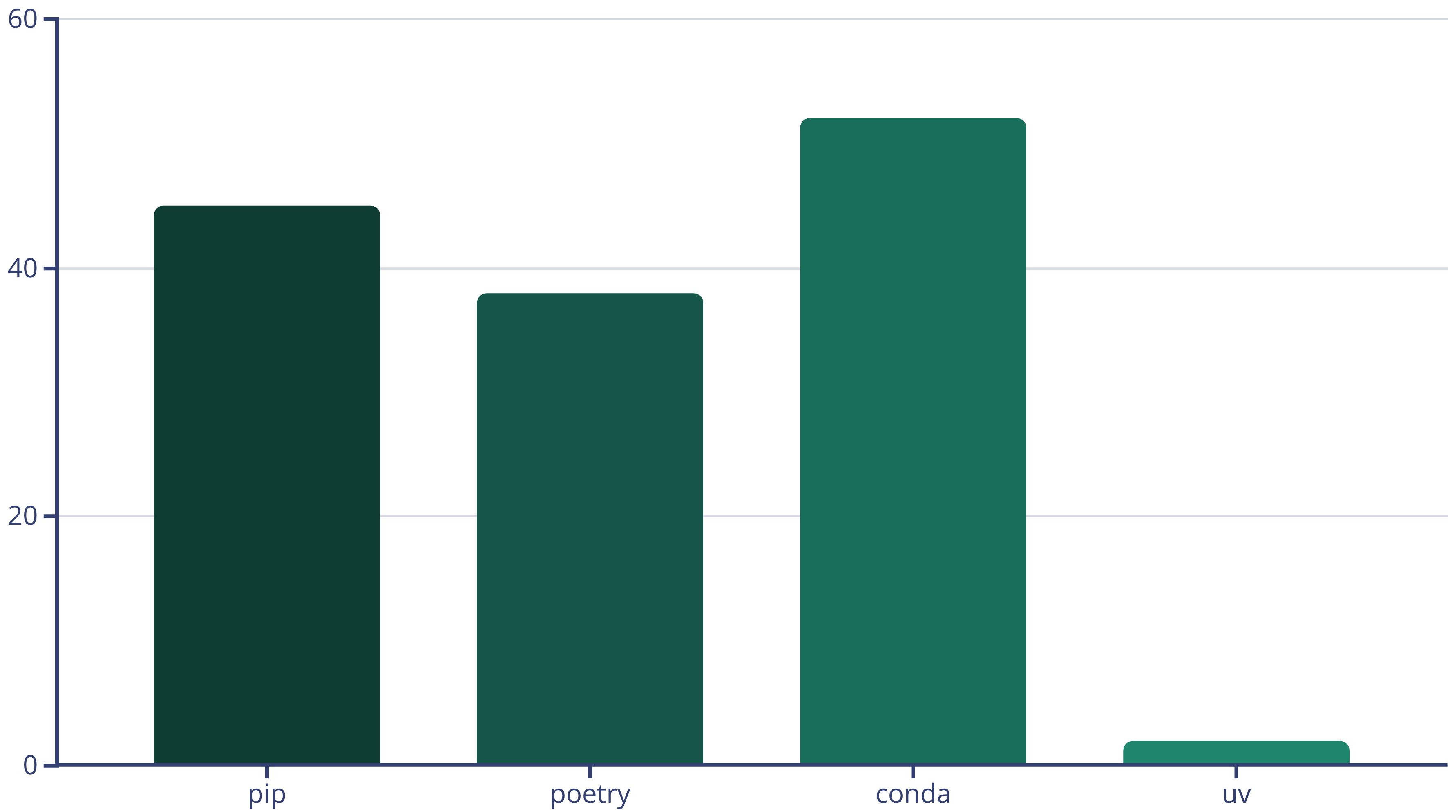
Performance Comparison
UV dramatically outperforms traditional package managers, completing installations in seconds rather than minutes.

Slide 6
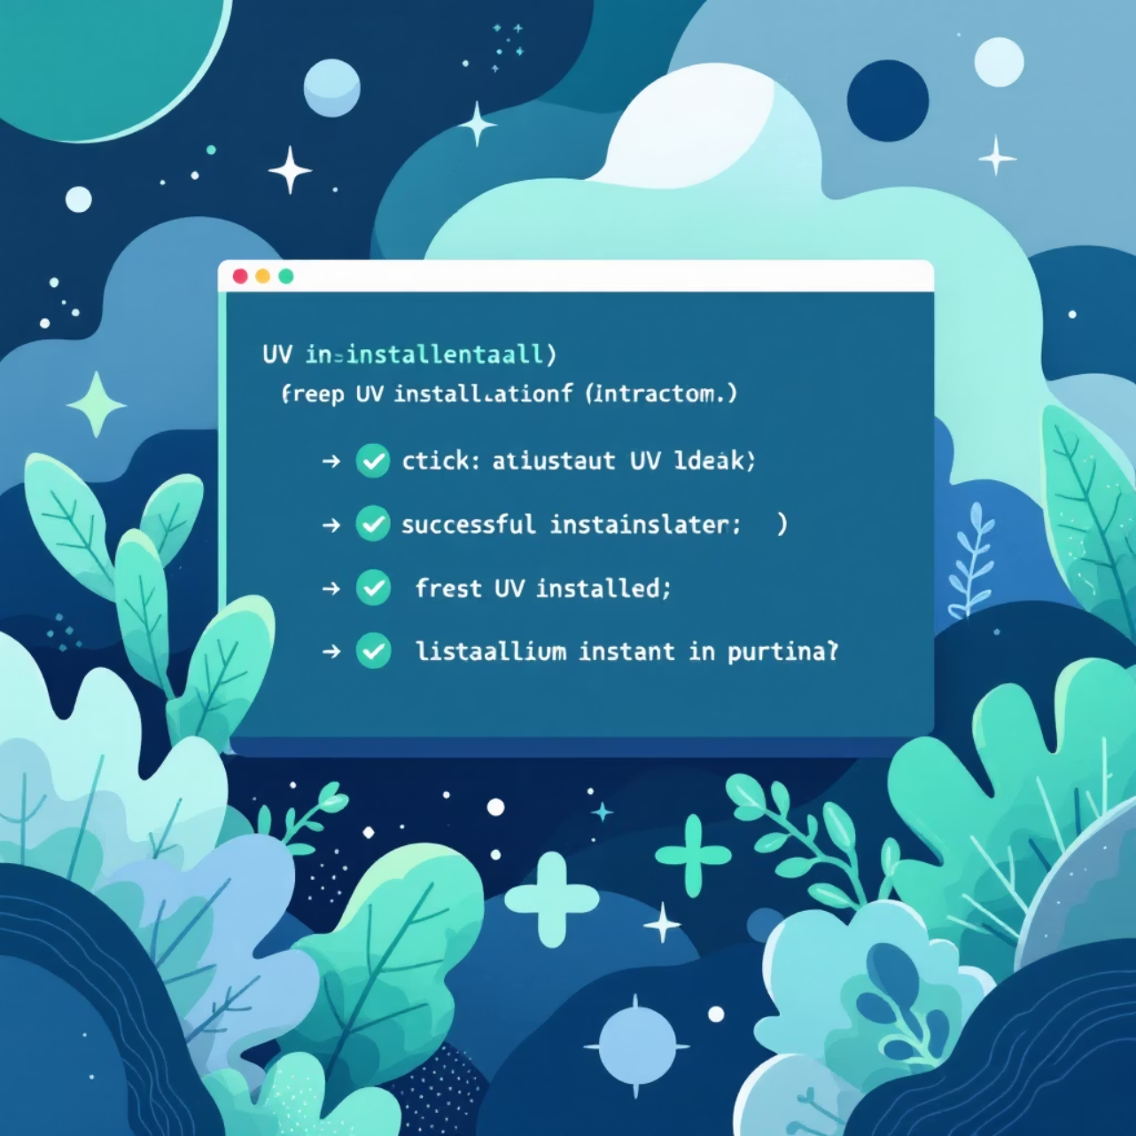
Installation & Setup
Quick Installation
curl -LsSf https://astral.sh/uv/install.sh | sh
Or install via pip:
pip install uv
Basic Usage
uv pip install requestsuv pip install -r requirements.txtuv pip freeze > requirements.txt

Slide 7

Advanced Features
01
Virtual Environment Management
Create and manage virtual environments with uv venv
02
Lock File Generation
Generate precise lock files for reproducible builds
03
Cross-platform Support
Works seamlessly across Windows, macOS, and Linux
04
Cache Optimization
Intelligent caching reduces redundant downloads

Slide 8
Real-World Impact
95%
50%
100%
Time Saved
Memory Usage
Compatibility
Reduction in package installation time for large projects
Lower memory consumption compared to traditional tools
Drop-in replacement for existing pip workflows
"UV has transformed our CI/CD pipeline. What used to take 10 minutes now takes 30 seconds."

Slide 9




Getting Started Today
Install UV
Quick installation via curl or pip
Replace pip Commands
Simply replace 'pip' with 'uv' in your existing workflows
Experience the Speed
Watch your package installations complete in seconds

Slide 10


Ready to Accelerate?
Join thousands of developers who have already made the switch to UV for faster, more reliable Python package management.
Next Steps
Install UV today
Try it on your current project
Share the speed with your team

