Slide 1
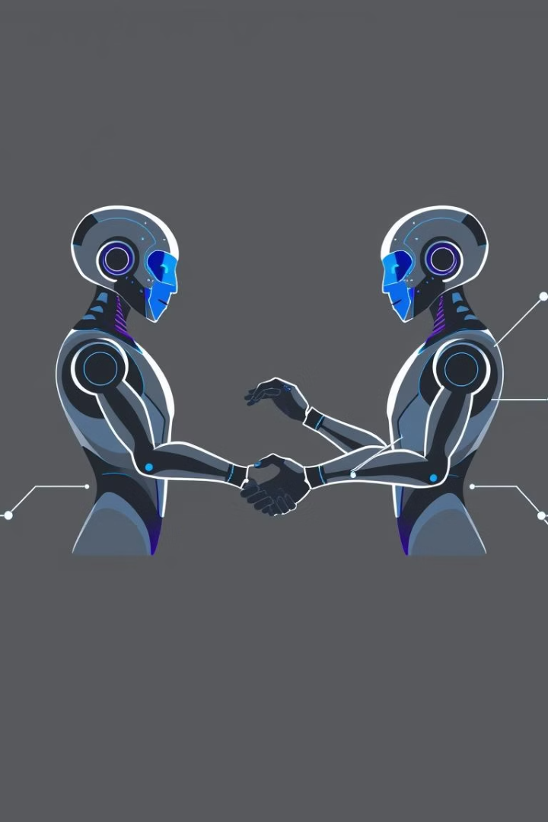

Unlocking AI Collaboration: The Agent-to-Agent (A2A) Protocol
Discover how A2A creates a universal language for AI agents. It enables seamless, secure communication between diverse AI systems. We will explore its core concepts and transformative potential.
by Neeraj Vohra

Slide 2

The Challenge: Fragmented AI Landscape
Current State
The Problem
Today's AI agents operate in silos. They use disparate frameworks and APIs. This limits their ability to work together effectively. Imagine a world where every app spoke a different human language.
This fragmentation creates significant barriers. It prevents true AI collaboration and scalability. Integrating different agents is complex and time-consuming. A unified approach is essential for progress.

Slide 3




Introducing the A2A Protocol
Universal Language
Seamless Interoperability
A2A provides a common communication standard. It allows agents to understand each other. This breaks down compatibility barriers.
Agents from any platform can now collaborate. They can exchange information and tasks effortlessly. This streamlines complex workflows.
Enhanced Security
The protocol includes built-in security features. Agents communicate securely. This protects data integrity and privacy during interactions.
The Agent-to-Agent protocol acts as a translator and facilitator. It enables a new era of collaborative AI. Think of it as a universal translator for autonomous systems.

Slide 4
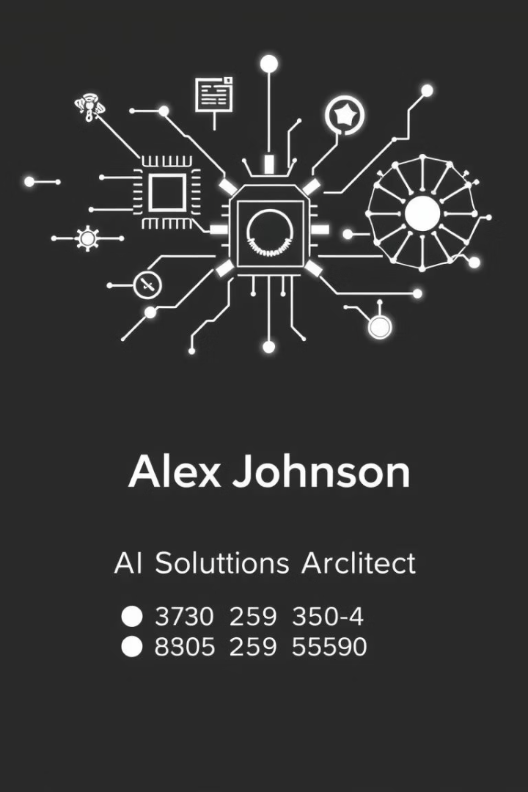
Core Concept 1: The Agent Card
Agent's Digital ID
Key Information
The Agent Card is an agent's digital business card. It's a JSON document. It defines the agent's identity and capabilities.
It details what the agent can do. It specifies how other agents can interact. This includes available functions and data types.
Discovery & Interaction
Other agents read this card. They learn how to initiate tasks. It simplifies agent discovery and communication setup.

Slide 5




Core Concept 2: The A2A Server
Live Bot
Task Execution
Result Delivery
The A2A Server is the agent itself. It runs in the background. It listens for incoming A2A tasks.
Upon receiving a task, the server performs the work. It executes the required actions. Then it processes the data.
Once complete, the server returns the results. It sends them back to the requesting client. This completes the task cycle.

Slide 6






Core Concept 3: The A2A Client
Agent Proxy
It can also be another AI agent. It acts as a bridge. It facilitates communication between agents.
User Interface
The A2A Client can be a user-facing application. It allows humans to interact with agents. It simplifies task submission.
Task Orchestration
The client reads Agent Cards. It packages tasks for the server. It receives and processes server results.
The A2A Client is the interface to the A2A network. It enables both human and AI agents to leverage the protocol effectively.

Slide 7
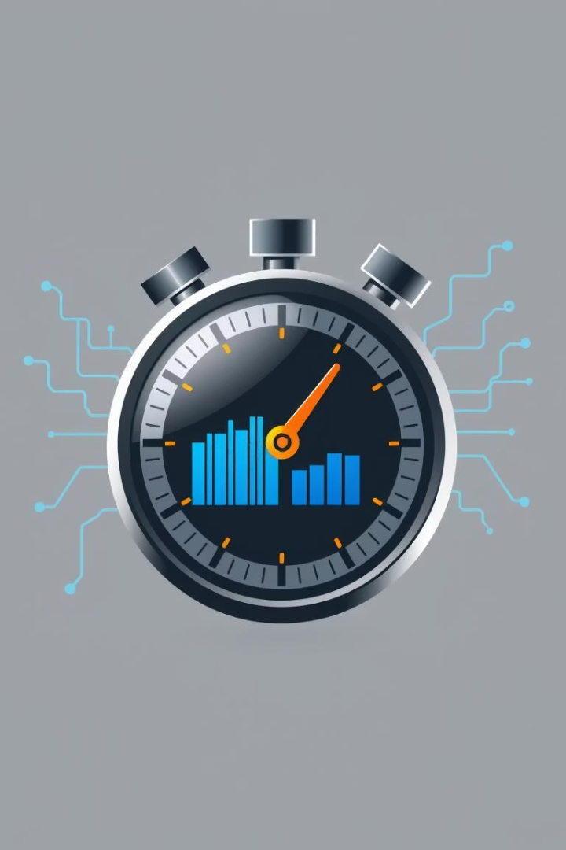



Core Concept 4: The A2A Task
Submitted
A task is created and sent to an agent. It contains all necessary instructions. The agent acknowledges receipt.
In Progress
The agent begins processing the task. It performs the requested operations. The task status is updated.
Completed
The agent finishes the work. It sends back the results. The task lifecycle concludes successfully.
The A2A Task provides a standardized unit of work. This ensures clear communication and tracking. It facilitates efficient agent collaboration across various stages.

Slide 8




The Future: Collaborative AI Ecosystem
Modular Development
Developers can build specialized agents. They easily integrate diverse functionalities. This fosters innovation and efficiency.
Global Interoperability
A2A enables agents to communicate globally. It breaks down vendor lock-in. A truly open AI ecosystem emerges.
Automated Workflows
Complex tasks are broken down into sub-tasks. Different agents handle specific parts. This creates powerful automated workflows.
The A2A protocol is pivotal for AI's next evolution. It unlocks unprecedented collaboration. Get ready for a new era of intelligent systems working together seamlessly.

