Slide 1
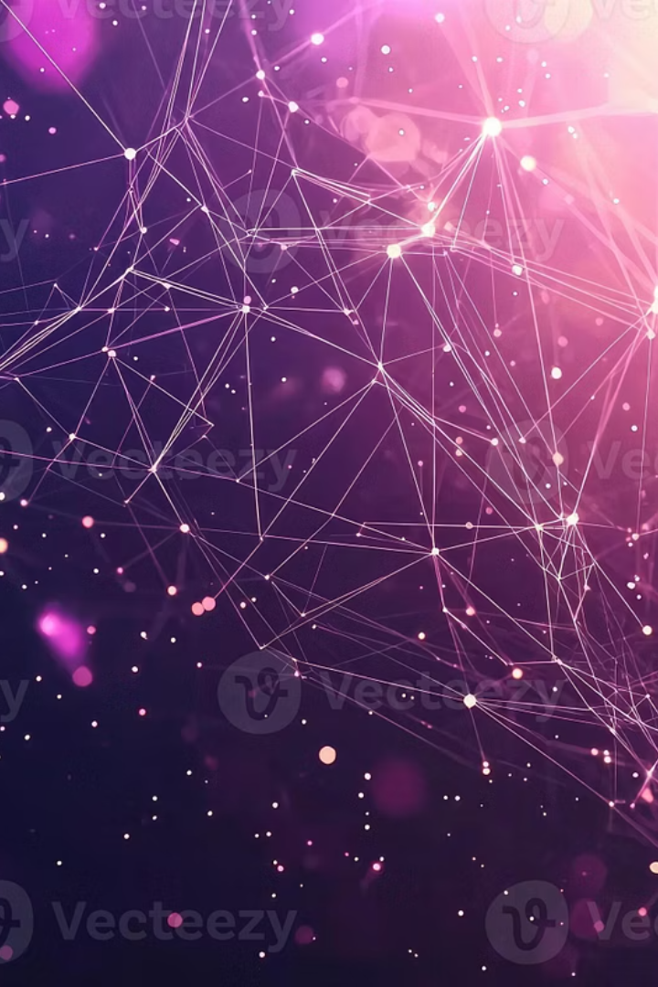

Unlocking Agentic Systems: A2A and MCP
Explore A2A and MCP, two critical protocols enabling advanced agentic applications. Learn how they work together to facilitate sophisticated AI collaboration.
by Neeraj Vohra

Slide 2

Understanding MCP: Agent Capabilities
Tool Access
Structured I/O
Connects agents to external tools and APIs.
Ensures consistent data exchange formats.
Resource Integration
Enables agents to leverage various resources.
MCP allows agents to access external functionalities and resources in a standardized way. This protocol is fundamental for agents to perform real-world tasks effectively.

Slide 3




Understanding A2A: Agent Collaboration
Multimodal
Peer-to-Peer
Delegation
A2A facilitates rich, dynamic communication between agents. It's designed for agents to work together seamlessly, supporting complex interactions and task distribution.

Slide 4
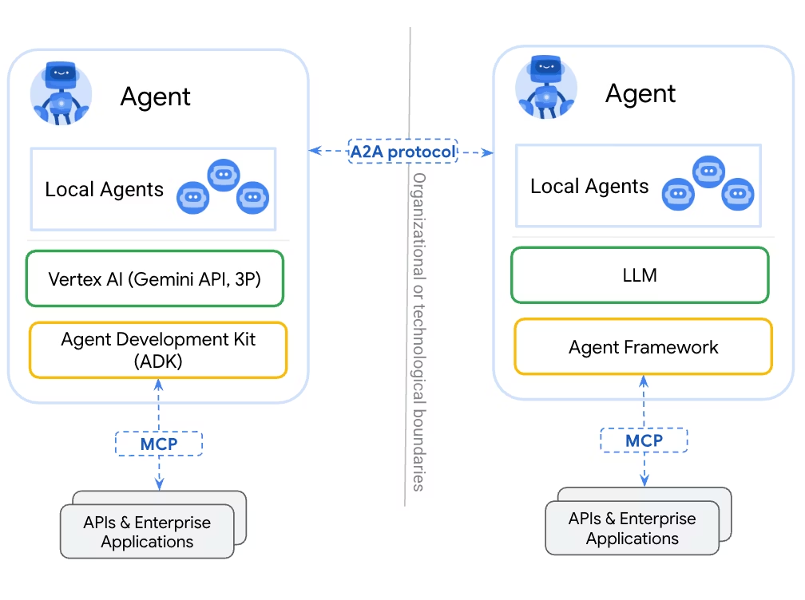
A2A and MCP: A Complementary Relationship
MCP Role
A2A Role
Provides agents with the means to act by connecting them to external capabilities.
Enables agents to coordinate and communicate actions and information among themselves.
While MCP grants agents access to tools and resources, A2A allows them to collaborate effectively, making decisions and sharing information as peers.

Slide 5




The Agentic Stack
Agentic Applications
1
Sophisticated, autonomous systems
A2A Protocol
2
Agent-to-agent communication
MCP Protocol
3
Tool and resource integration
Large Language Models (LLMs)
4
Core reasoning and generation
Agentic systems build upon foundational LLMs, integrating MCP for external interactions and A2A for inter-agent collaboration, forming a powerful stack for complex tasks.

Slide 6




Benefits of Combined Protocols
Enhanced Autonomy
Complex Task Handling
Agents act more independently.
Break down and delegate tasks.
Robust Architectures
Build resilient agentic systems.
The synergy of A2A and MCP enables agents to achieve higher levels of autonomy and tackle more intricate problems, leading to robust and scalable agentic applications.

Slide 7




Future of Agentic Systems
Autonomous AI
Agents making independent decisions.
Decentralized Systems
Distributed agent networks.
Scalable Solutions
Handling increased complexity.
These protocols pave the way for a future where AI agents form intricate, decentralized networks, collaboratively solving problems at unprecedented scale and complexity.

Slide 8

Key Takeaways & Next Steps
A2A: Agent Communication
Peer-to-peer interaction and delegation.
MCP: Tool Integration
Connecting agents to external capabilities.
Synergy is Key
Enabling robust agentic applications.
A2A and MCP are essential for building advanced agentic systems. Explore their specifications to build your own intelligent, collaborative AI applications.

