Slide 1

Advertisement Display Using Deep Age and Gender Recognition
Student Name: NEERAJA GOLI
UID: 111723039147
Guide: Mr. A. Rajeshwar, Assistant Professor, Loyola Academy

Slide 2
Introduction
Traditional advertisements lack adaptability and to engage diverse audiences effectively.
This project introduces a Smart Advertisement Display System that dynamically updates content based on real-time age and gender recognition.
The system detects and classifies individuals, ensuring advertisements are tailored to the audience for better engagement.
Demographic data such as age, gender, timestamp, and displayed advertisement is recorded for marketing analysis.
Ensures sustainable and data-driven advertising, optimizing content delivery in retail stores, malls, smart billboards, and digital kiosks.the topic, its significance, and the problem statement.

Slide 3
Problem Statement
Traditional advertisement systems display the same content to all viewers, regardless of their age or gender. This leads to:
Poor audience engagement.
Low advertisement effectiveness.
Wasted marketing resources.
➡️ There is a need for a smart system that can detect the viewer's age and gender in real-time and display personalized advertisements accordingly.

Slide 4
Objectives
Detect human faces in real-time using webcam input.
Predict the age and gender of each detected face using pre-trained AI models.
Identify and count only faces within a specific time window.
Display personalized advertisements based on the detected age and gender.
Store demographic data and ad display logs in an SQLite database.
Provide a dashboard with demographic charts using Chart.js.

Slide 5
Scope
Uses AI-based models to detect age and gender from live webcam feed.
Displays targeted advertisements based on real-time demographic data.
Provides an interactive dashboard to view demographic trends.
Maintains a database of detected faces, age-gender statistics.
Can be deployed in malls, supermarkets, public spaces for smart marketing.
Offers potential for future upgrades like emotion detection or multi-language ads.

Slide 6
Existing System
Traditional advertisement displays use static content, which remains unchanged regardless of the audience.
Digital billboards and posters lack adaptability, displaying the same advertisement for all viewers.
No real-time audience analysis is performed, making advertisements less engaging and less relevant.
There is no data collection on viewer demographics, making it difficult to analyze consumer behavior and optimize marketing strategies.

Slide 7
Proposed System
The Smart Advertisement Display System dynamically updates advertisements based on real-time age and gender recognition to enhance audience engagement.
If the number of males detected exceeds females, a male-oriented advertisement is shown, and vice versa (children also).
The advertisement display updates continuously to remain relevant based on the real-time audience composition using Advertisement Database (JSON) and using Deep Learning Hugging Face Models.

Slide 8
Literature Review Summary
1. Impact of Gender Cues in Advertisements on Perceived Gender Identity Meanings of the Advertised Product-Namrata Sandhu
The study explores how gender cues in advertisements shape the perceived gender identity of products. Three groups viewed differently gendered ads for the same product. Results show that gender cues significantly influence product perception, with notable differences between male and female interpretations. The study offers insights for marketers on gendered advertising.
2. Gender Classification from Facial Images-Cunjian Chen
The study evaluates gender classification methods using visible (VIS) and near-infrared (NIR) face images, highlighting challenges like illumination normalization for cross-spectral prediction. While NIR images show some gender-related features, they are less discriminative than VIS images. Attribute classification (expression, age, ethnicity) is also discussed.

Slide 9
Literature Review Summary
3. Khalifa NEM, Taha MHN, Hassanien AE, Mohamed HNET. Deep Iris: Deep Learning for Gender Classification Through Iris Patterns. Acta Inform Med. 2019 Jun;27(2):96-102. doi: 10.5455/aim.2019.27.96-102. PMID: 31452566; PMCID: PMC6689381.
Gender classification from iris images aids in database search optimization, demographic analysis, real-time marketing, social screening, and high-security scenarios, while also advancing scientific understanding of iris-based information extraction.The dataset of 3,000 images was augmented to 15,000 images, improving model robustness and achieving 98.88% testing accuracy
4.Discrimination through optimization: How Facebook's ad delivery can lead to skewed outcomes-Muhammad Ali
The study reveals that Facebook's ad delivery process skews ad exposure along gender and racial lines, influenced by market optimization and ad relevance predictions, even with inclusive targeting. This highlights the need for policy scrutiny of ad delivery mechanisms to prevent discrimination.

Slide 10
Related Work Comparison
Paper 1: Sustainable Smart Advertisement Display Using Deep Age and Gender Recognition
Paper 2: Gender Relation in Advertisement : from Time to Time
Our Project: Advertisement Display Using Deep Age and Gender Recognition
A) Objective:
Paper 1: Display ads based on age and gender using CNNs.
Paper 2: Analyze gender portrayal in TV ads, addressing stereotypes.
Our Project: Display gender-targeted ads in a supermarket based on real-time male-to-female ratio using Flask.

Slide 11
Related Work Comparison
B)Approach:
Paper 1: Uses CNNs for face detection and classification with real-time updates.
Paper 2: Qualitative analysis of gender roles in TV ads from the 1980s to present.
Our Project: Uses face detection and gender classification to choose ads based on gender dominance.
C)Implementation:
Paper 1: Automated real-time system in public places with high accuracy.
Paper 2: Theoretical study without practical implementation.
Our Project: Real-time supermarket ad display system, storing gender counts for analysis.

Slide 12
Final Problem Identification
Traditional advertisement display systems lack dynamic gender-based customization, leading to reduced marketing effectiveness.
The challenge lies in real-time detection of gender from live video feeds and automated selection of appropriate advertisements based on the majority demographic.
Existing methods often face accuracy issues, privacy concerns, and challenges in managing demographic data efficiently.
This project proposes a Gender-Based Advertisement Display System using computer vision and deep learning to detect faces, classify gender, and display targeted ads.
An JSON database will store demographic data and advertisement metrics, facilitating efficient data management and analysis for marketing optimization.

Slide 13
Hardware and Software Requirements
Software Requirements:
Operating System: Windows
Programming Language: Python 3.x
Frameworks & Libraries: OpenCV ,TensorFlow,Hugging Face Model,
Flask,NumPy & Pandas ,JSON
Web Technologies: HTML, CSS, JavaScript (for user interface)
Hardware Requirements:
Processor: Intel Core i5 or higher
RAM: Minimum 8GB
Camera: HD Webcam
Storage: Minimum 50GB SSD (to store logs and models)

Slide 14
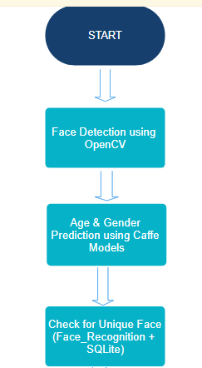
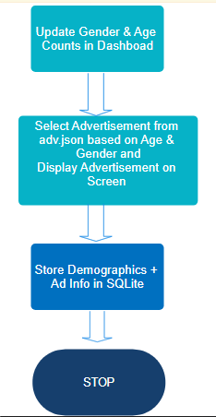
System Architecture
Continue
Age and Gender Prediction using Huggging Face Model
Continue

Slide 15
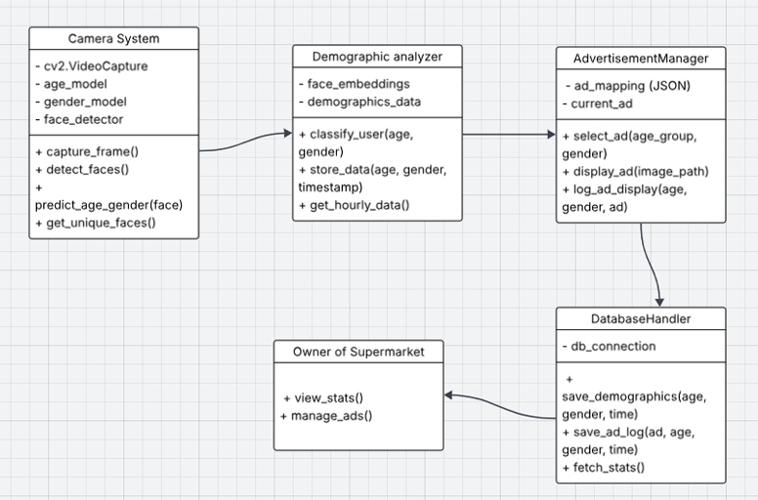
Class Diagram:
Continue

Slide 16
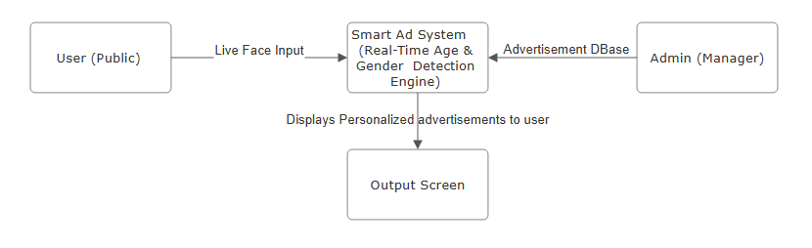
DFD Level 0 -
External Entity
User: A person who is passively detected by the system via the webcam. They do not interact directly with the system.
Main System Process
Captures webcam input using OpenCV.---->Detects and analyzes age & gender using pre-trained Hugging Face models.-->Identifies faces using face recognition.
Retrieves appropriate advertisement from adv.json.--->Displays targeted ads.-->
Stores demographic data and unique detections in SQLite database and JSON files.
Outputs
Display Screen : Visually presents the selected ad.
SQLite Database: Stores demographic counts and unique face encodings.

Slide 17
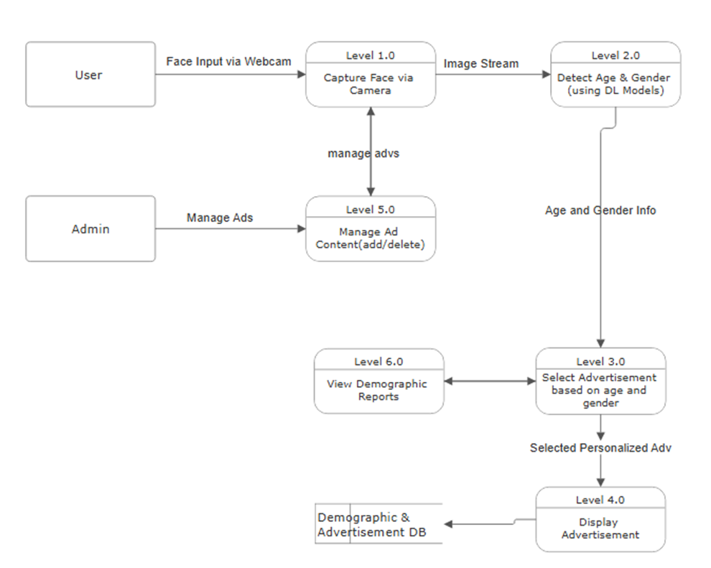
DFD Level 1:

Slide 18
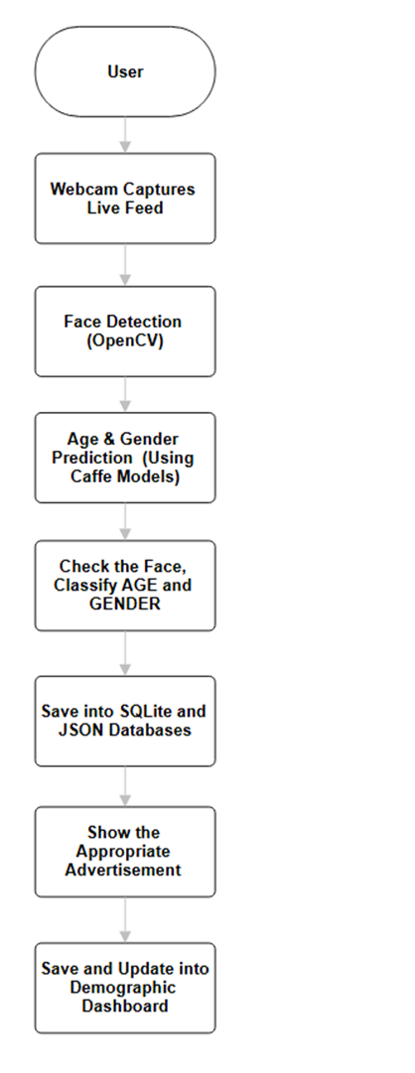
Workflow Diagram:
Gender based detection using HUGGUGING Face Model

Slide 19
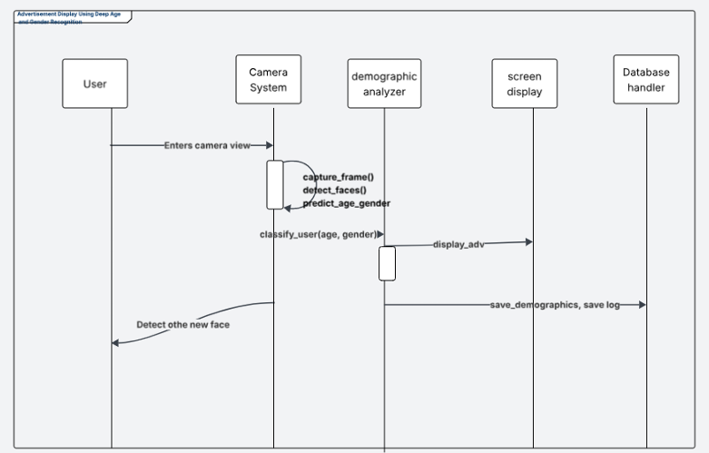
Sequence Diagram:
Gender based detection using HUGGUGING Face Model

Slide 20
Implementation Plan
Module | Tasks | Timeline | Status
Module 1 – UI Design | Layout design, wireframing, responsive UI Frontend development with React | Week 1 - 2 | Done
Module 2 – Backend Development | Build REST APIs, Connect database Age & Gender detection module (Python + Hugging Face Model) SQLite DB setup and data schema design | Week 3-4 | Done
Module 3 – Integration & Testing | UI + backend integration, testing Real-time video stream + Advertisement logic Bug fixing | Week 5-6 | Done

Slide 21
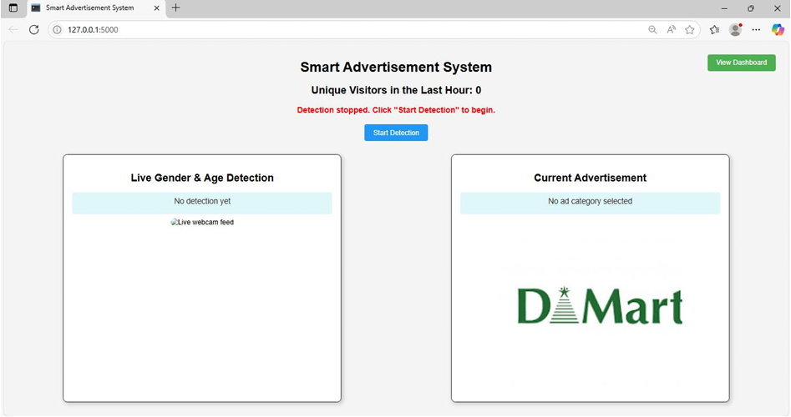
Test Cases:
Test case 1: Checking for Start of Webcam.

Slide 22
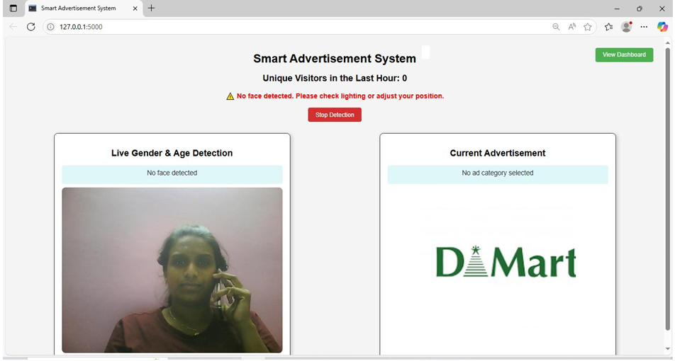
Test Cases:
Test case 2: Checking for Lighting and adjustment of user position.

Slide 23
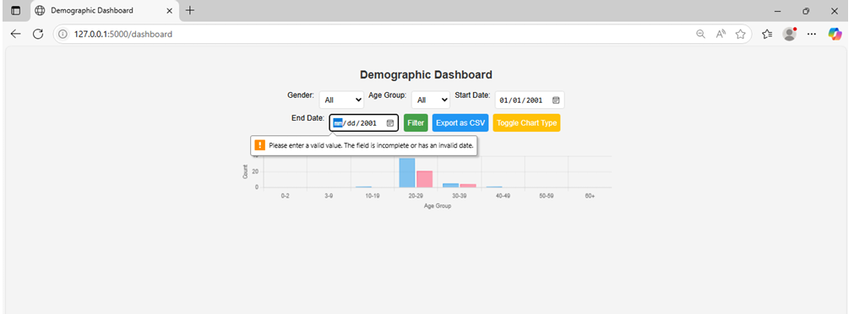
Test Cases:
Test Case 3: Demographic date validation.

Slide 24
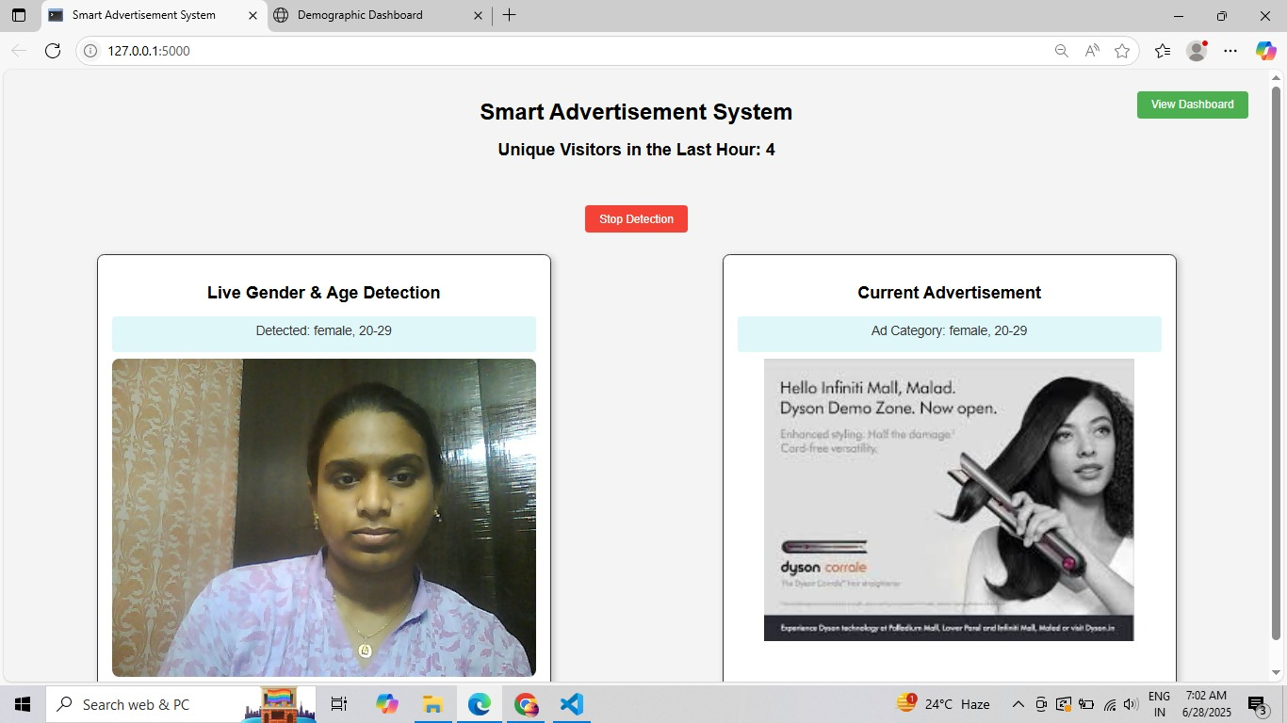
OUTPUT SCREENS:

Slide 25
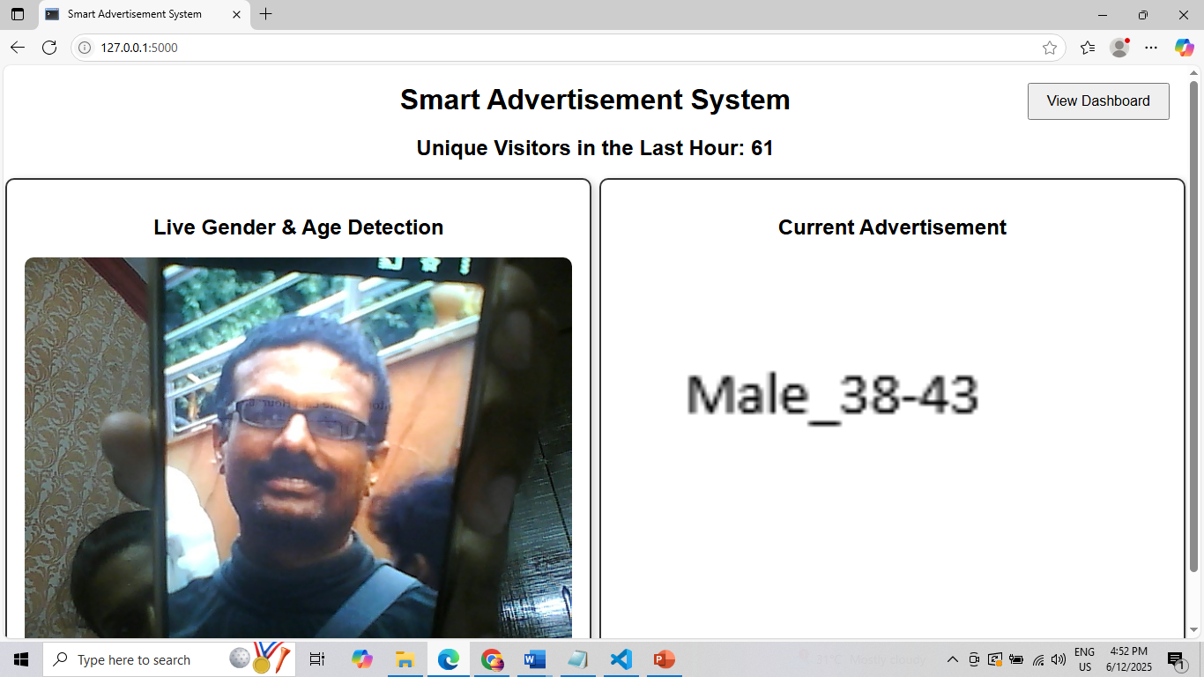
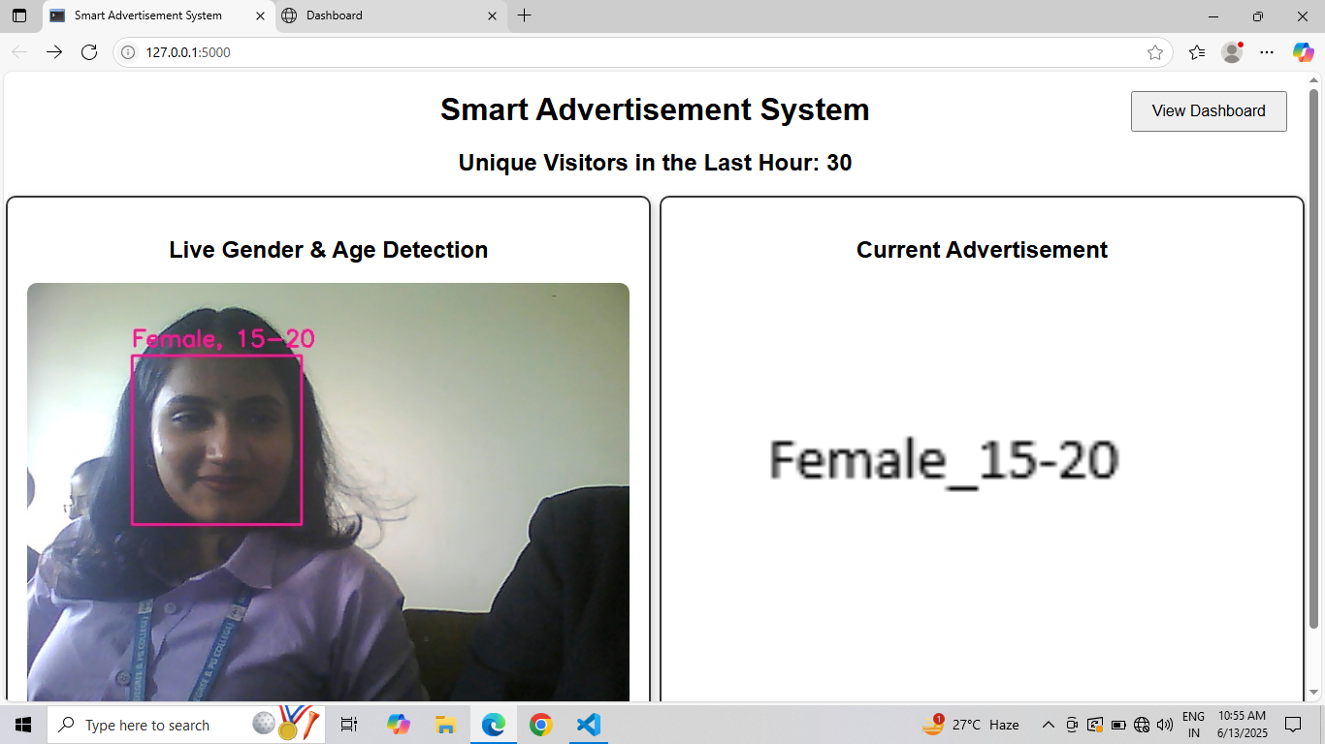
OUTPUT SCREENS:

Slide 26
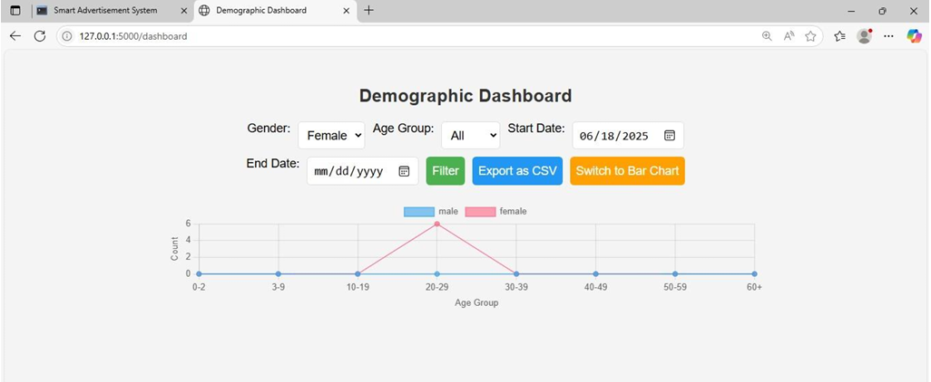
OUTPUT SCREENS:

Slide 27
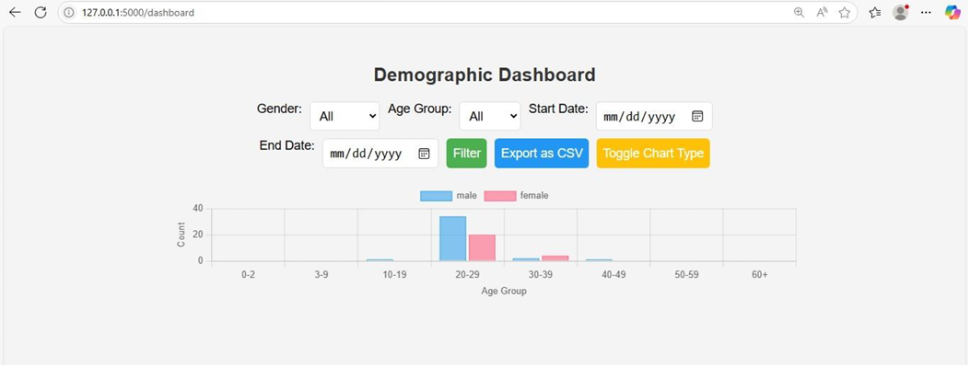
OUTPUT SCREENS:

Slide 28
Conclusion:
Demonstrates real-time age and gender detection for personalized advertisement display.
Combines computer vision, machine learning, and a Flask-based web interface seamlessly.
Uses webcam input to identify demographics and show relevant ads dynamically.
Enhances both user experience and marketing impact with targeted content.
Provides a scalable prototype that can be extended with emotion recognition or crowd analytics

Slide 29
Future Scope:
Integrate emotion detection, eye-gaze tracking, and facial expression analysis for better ad targeting.
Add voice recognition and behavioral analytics for deeper personalization.
Expand database for long-term visitor trends and predictive marketing.
Integrate with IoT-enabled display systems and send mobile notifications for broader outreach.
Deploy in Residential Marts, analyzing community behavior while ensuring data privacy and security.
Enable cloud-based analytics and remote monitoring for multi-location scalability and efficiency

Slide 30
Advertisement Display Using Deep Age and Gender Recognition
End of Phase 5- Project Review
THANK YOU
- BY NEERAJA GOLI

