Slide 1
Television_Market_Analysis_Flipkart
Vishnu Priya.G
Neeraja. D
Akanksha. A
Batch no.438

Slide 2
Agenda
Use case domain understanding
Business Problem
Objective of the Project
Web Scraping – Details
Process followed
Dataset Overview
Exploratory Data Analysis:
Data Cleaning Steps
Data Manipulation Steps
Univariate Analysis Steps
Bivariate Analysis Steps
Key Business Question
Summary
Conclusion
Challenges working on Web Scraping

Slide 3
Use case domain understanding
This dataset belongs to the online retail / e-commerce domain, specifically focusing on television products sold on Flipkart.
It captures product-level details such as pricing, brand, screen size, resolution, ratings, reviews, discounts, and specifications.

Slide 4
Business Problem
Flipkart offers a wide range of television models across different brands, prices, and features, making it challenging to identify what drives customer purchasing decisions.
Variations in pricing, discounts, and specifications impact sales performance and customer satisfaction differently.
The company needs to understand how factors such as brand, screen size, resolution, and price influence ratings and demand.
Lack of clear insights can lead to inefficient pricing, overstocking, or poor promotional strategies.
This analysis aims to use television market data to optimize product offerings, pricing strategies, and overall sales performance.

Slide 5
Objective of the Project
To analyze Flipkart’s television market data to understand customer preferences
and buying behavior.
To identify the impact of price, discounts, brand, and product features on customer ratings and demand.
To evaluate the performance of different television brands, screen sizes,
and resolutions.
To uncover patterns and trends that influence sales and customer satisfaction.
To provide data-driven insights and recommendations for optimizing pricing,
inventory, and marketing strategies.

Slide 6
Web Scraping – Details
Website Scraped:
Flipkart (Television category pages)
Data Source Type:
Publicly available product listing pages on Flipkart’s website
Tools & Technologies Used:
Python
Requests – to send HTTP requests and fetch webpage content
BeautifulSoup (bs4) – to parse HTML and extract required elements
Pandas – to store and structure the scraped data into a DataFrame

Slide 7
Process Followed:
Identified Flipkart television listing pages and relevant product URLs.
Sent HTTP requests to fetch HTML content of product pages.
Parsed HTML using BeautifulSoup to extract attributes such as brand, price, screen size,
resolution, ratings, reviews, and discounts.
Cleaned and structured the extracted data into tabular format using Pandas.
Exported the final dataset to an Excel/CSV file for further analysis.
Ethical Considerations:
Scraped only publicly visible information
Avoided excessive requests to prevent server overload
Used data strictly for educational and analytical purposes

Slide 8
Dataset Overview
Source: Flipkart ( web scraping)
Rows & Columns: TV products with multiple features (brand, price, rating, etc.)
Key Features:
Brand (company) – Samsung, LG, Sony
Price (MRP, DiscountPrice, Discount)
Customer Feedback (Rating, Reviews)
Specifications (Edition, ScreenSize, SoundOutput, Warranty)
Data Types: Mix of numerical and categorical
Purpose: Analyze pricing, brand performance, and customer satisfaction for
business insights

Slide 9
Simple description of each column in your dataset:
company: Brand of the TV (e.g., Samsung, LG, Sony)
MRP: Original price before discount
DiscountPrice: Price after discount
Discount: Percentage of discount offered
Rating: Customer rating out of 5
reviews: Number of customer reviews
Edition: TV edition type (Standard, Premium, etc.)
ScreenSize: Size of the TV screen in inches
SoundOutput: Audio output specification
Warranty: Warranty period in years

Slide 10
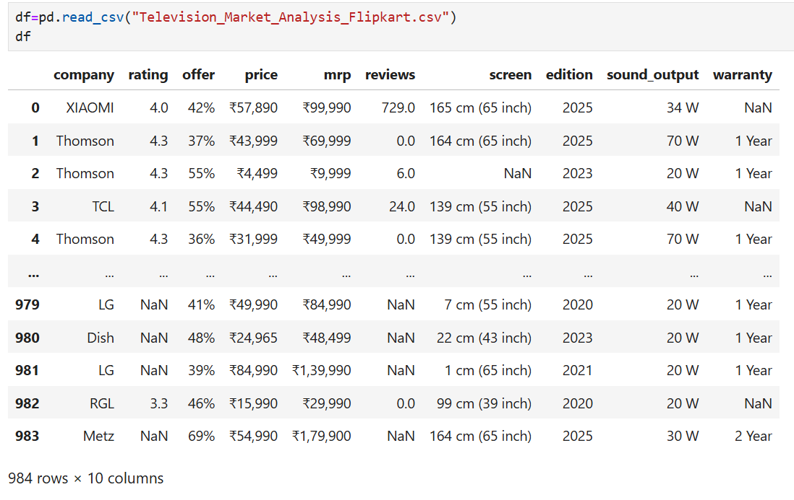
Reading Dataset

Slide 11
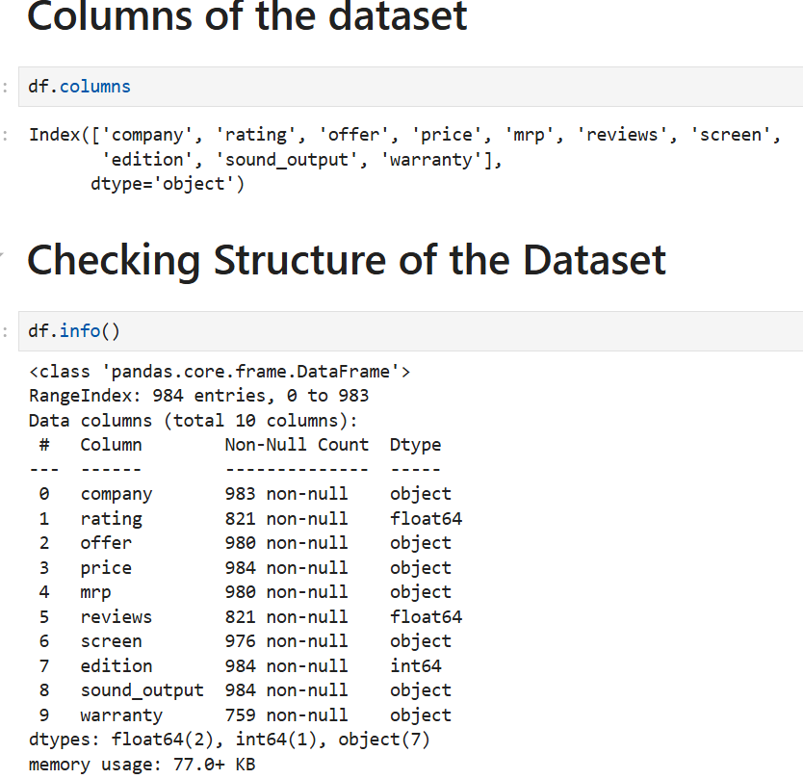
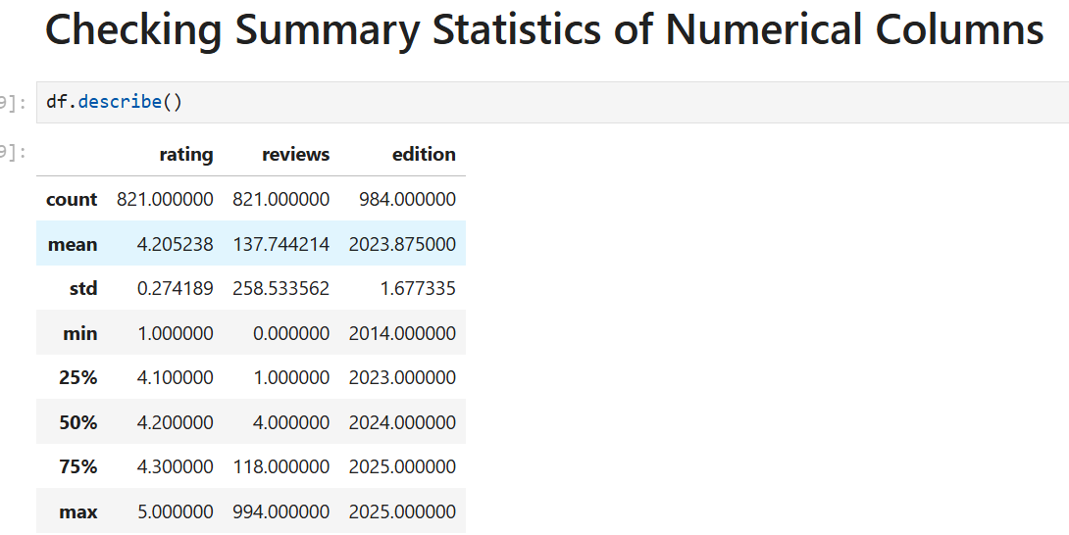
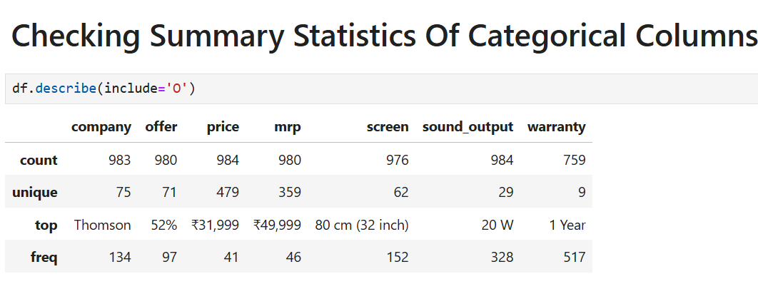
Basic Checks

Slide 12
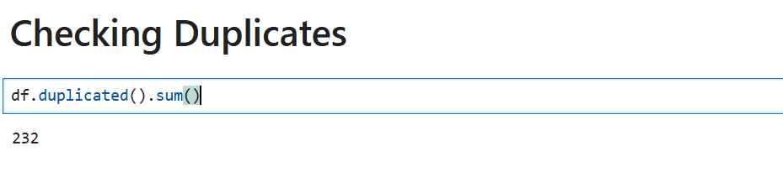
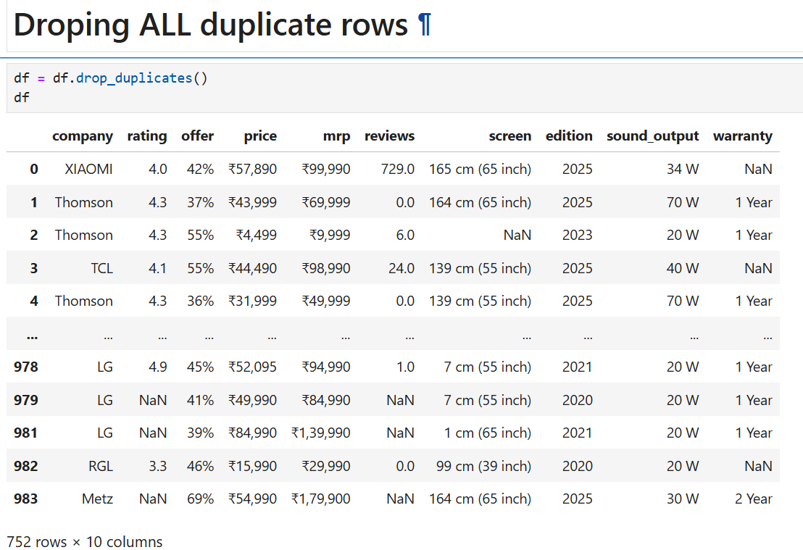
Preprocessing Techniques on Dataset:

Slide 13
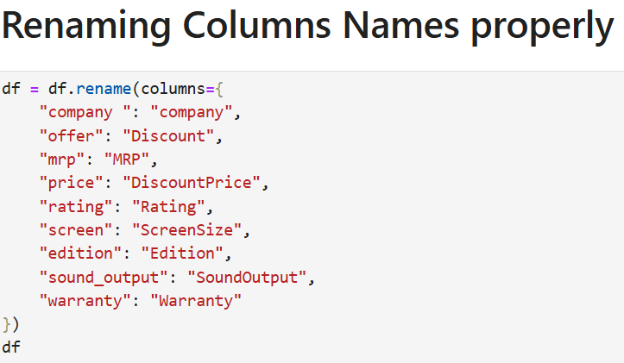
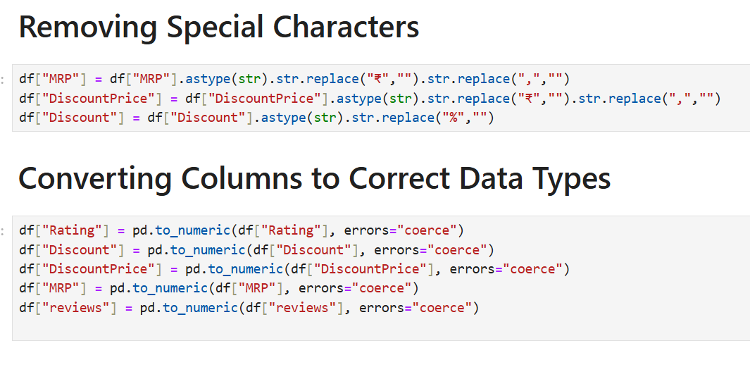
jkrjk

Slide 14
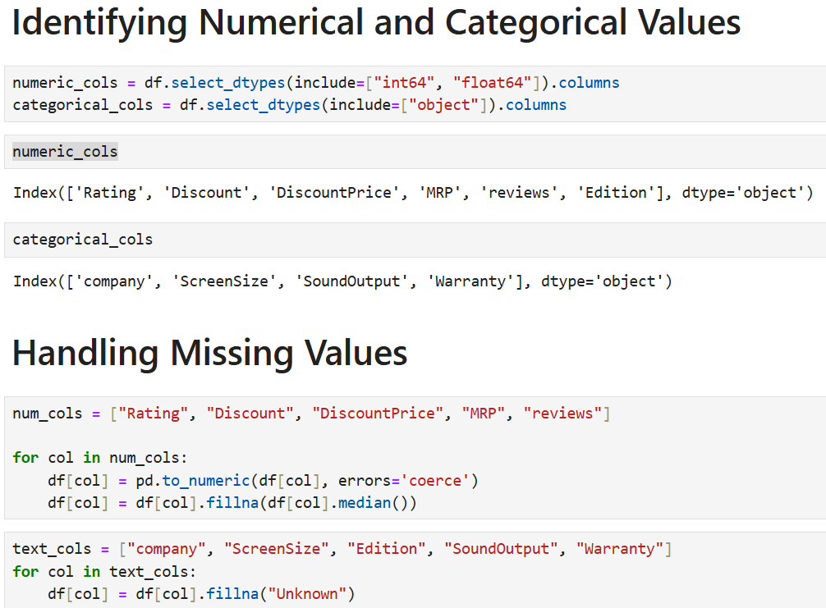
ss

Slide 15
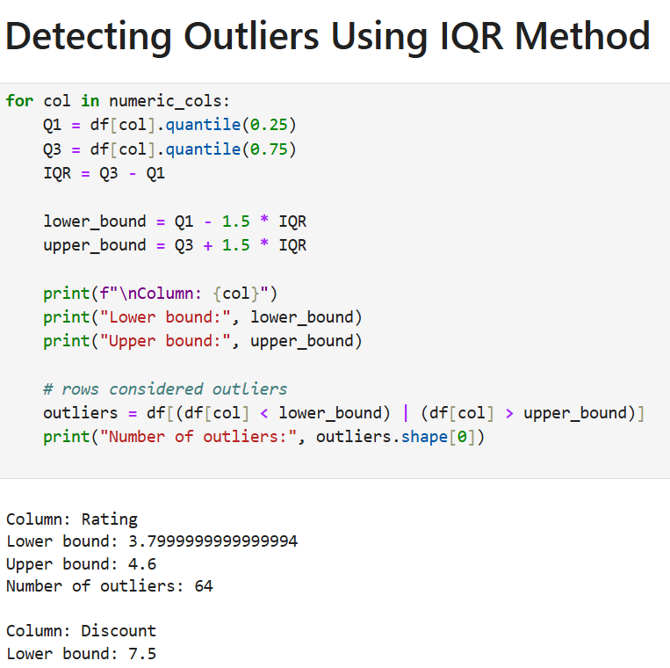

Slide 16
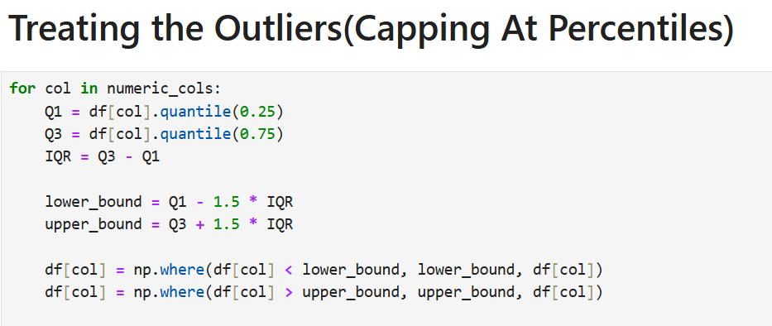

Slide 17
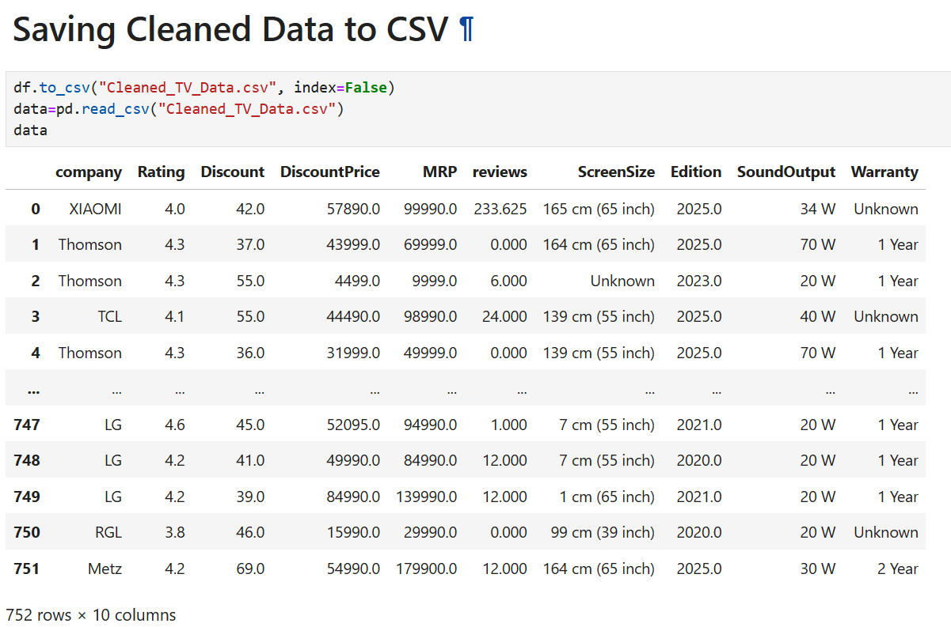

Slide 18
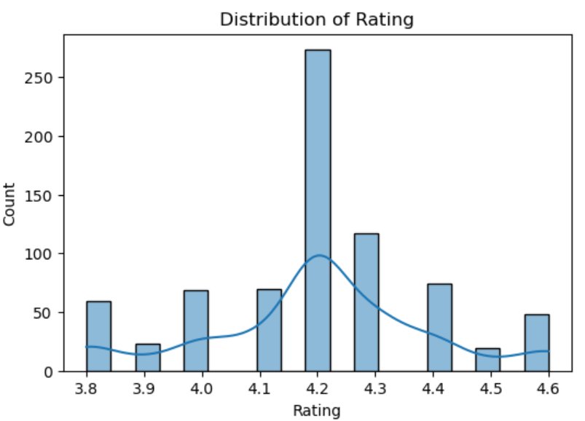
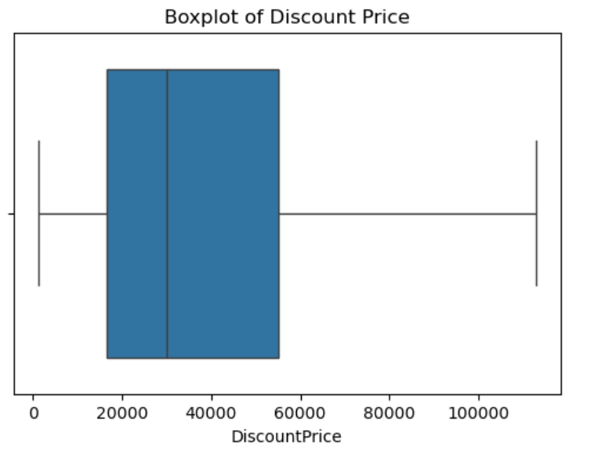
Data Analysis through Visualizations
Univariate Analysis
Most TVs have ratings between 3.5 and 4.5, showing overall good customer satisfaction.
Very few products have low ratings below 3.0.
The distribution is slightly right-skewed, meaning higher ratings are more common.
Discount prices show wide variation across products.
A few high outliers indicate very large discounts.
Most TVs fall within a stable, moderate discount range.

Slide 19
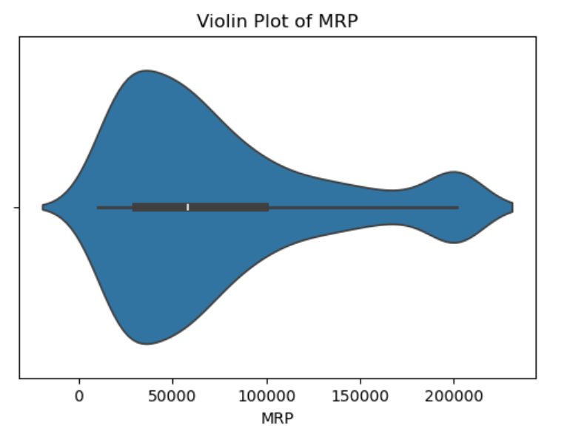
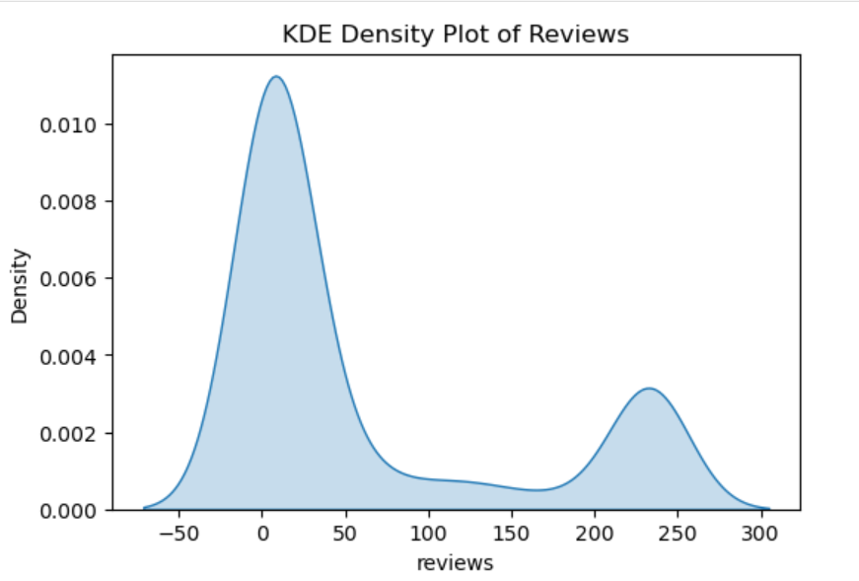
MRP values show a wide spread, indicating both budget and premium TVs.
Most products cluster in the mid-price range.
A long upper tail suggests the presence of high-priced premium models.
Most TVs have low to moderate review counts.
A few products show very high review volumes, forming long right tail.
Indicates only some models attract significantly higher customer engagement.

Slide 20
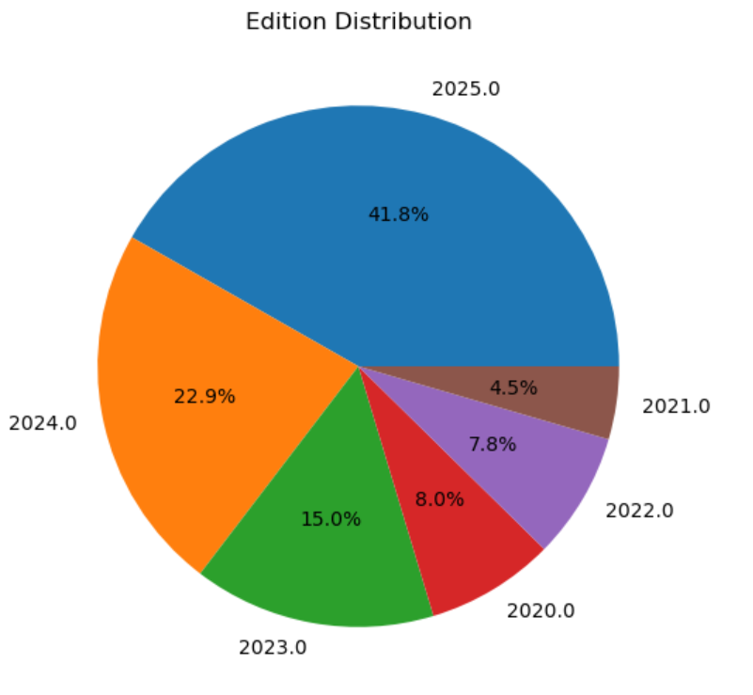
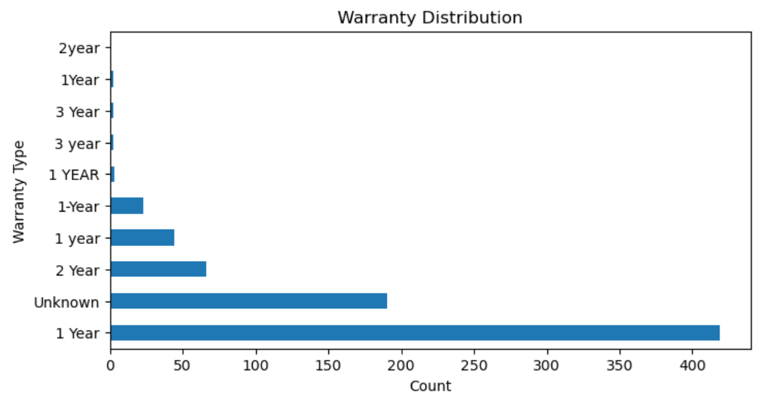
Standard editions are the most common among all products.
Premium and special editions appear less frequently.
Overall, the dataset is dominated by standard TV editions.
Most TVs offer 1-year or 2-year warranty.
Longer warranties are less common and mostly linked to premium brands.
Overall warranty distribution is concentrated in lower durations.

Slide 21
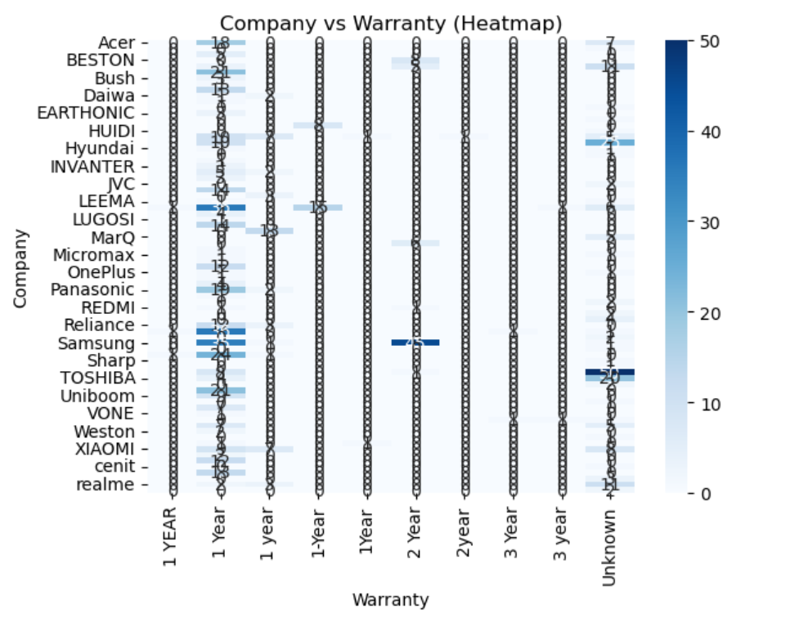
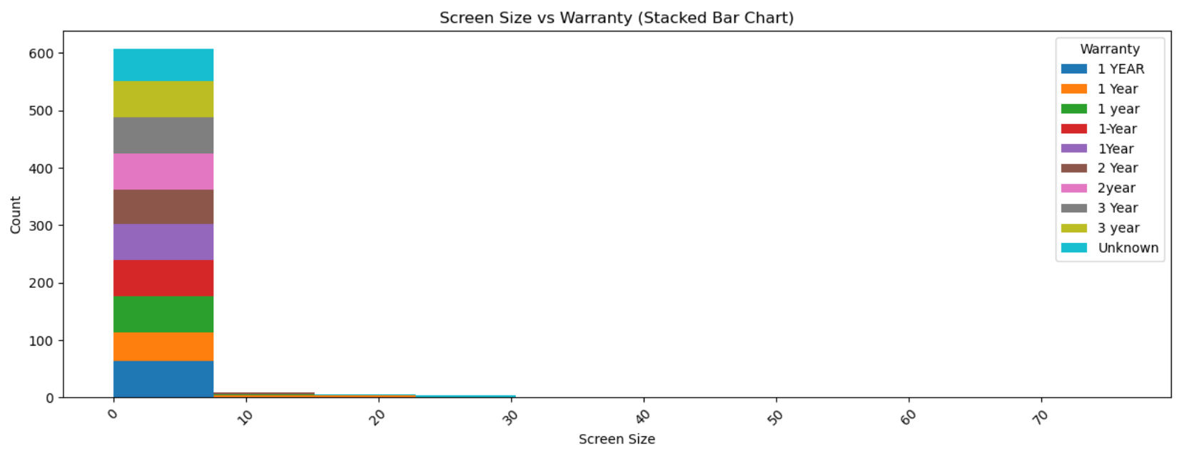
Bivariate Analysis-Categorical and Categorical
The heatmap shows most brands concentrate heavily around 1–2 year warranties.
Premium brands display darker intensity in higher warranty categories, indicating longer coverage.
Overall, warranty patterns vary by brand, with clear clusters visible in the heatmap.
Most screen sizes commonly offer 1–2 year warranties
Larger screen sizes show a higher share of extended warranties.
Warranty distribution increases slightly as screen size increases, reflecting premium product segments..

Slide 22
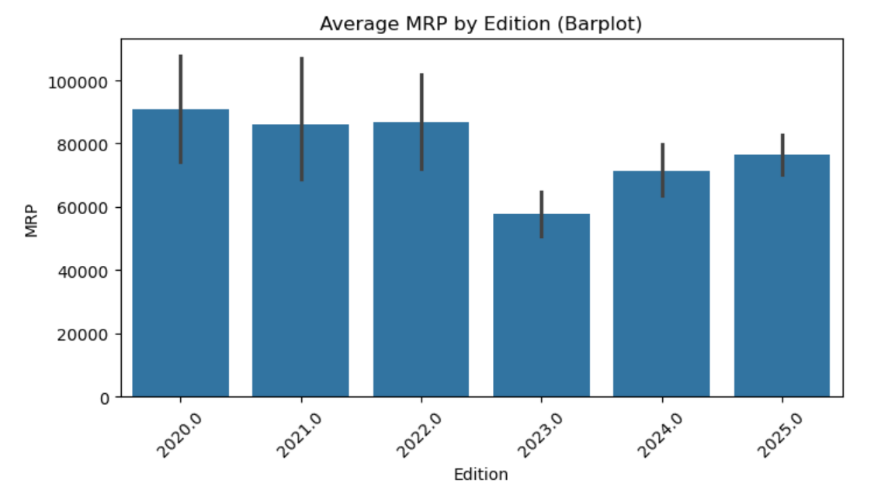
Bivariate Analysis-Categorical and Numerical
Premium editions have the highest average MRP.
Standard editions fall in the mid-range pricing category.
Budget editions show the lowest average prices, reflecting entry-level models.

Slide 23
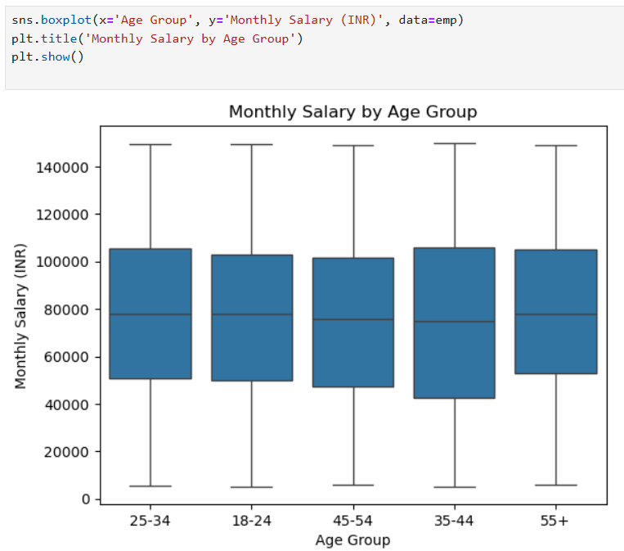
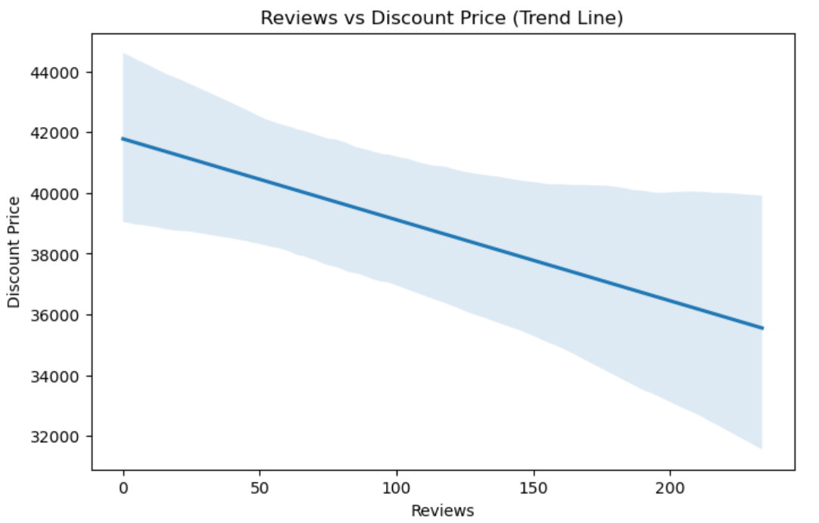
Bivariate Analysis-Numerical and Numerical
The boxplot compares how monthly salary varies across different age groups.
Younger groups show lower and more compressed salary ranges, indicating early-career earnings.
Younger groups show lower and more compressed salary ranges, indicating early-career earnings.
The trend line shows how customer review counts relate to the product’s discount price.
A positive slope suggests that products with higher discounts tend to receive more reviews.
This indicates that discounts may drive customer engagement and purchasing activity.

Slide 24
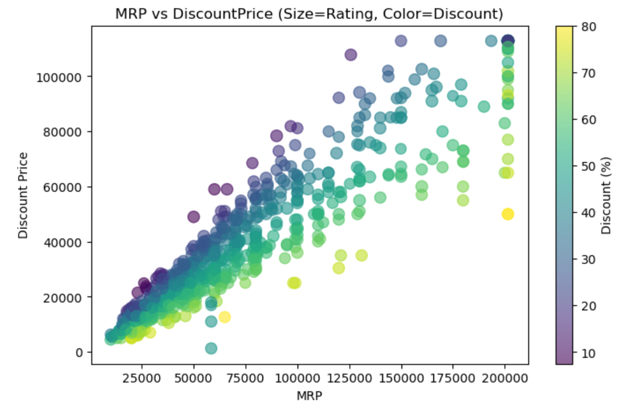
Multivariate Analysis
The plot shows how MRP and discount price are related, with higher-priced products generally having higher discount prices.
Bubble size indicates ratings, and larger bubbles cluster around moderately priced items, showing better customer satisfaction in that range.
Color intensity reflects discount percentage, revealing that products with bigger discounts are often positioned in the mid-to-high MRP range.

Slide 25
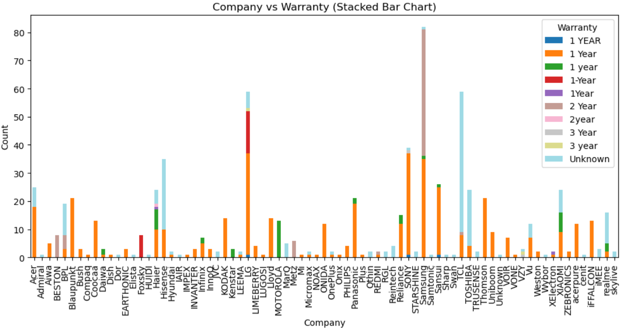
bd
The chart shows how warranty periods are distributed across different TV brands.
Most brands offer 1–2 year warranties, while premium brands provide longer coverage.
Stacked bars highlight brand differences, indicating warranty as a key factor in product positioning.

Slide 26
Key Business Question
1.Which television brands and models perform best on Flipkart?
Brands such as Samsung, LG, Sony, and Mi generally receive higher customer ratings and a larger number of reviews, indicating strong brand trust and consistent product performance.
2.How do price and discounts influence customer demand and satisfaction?
Televisions in the mid-price range with moderate discounts tend to attract more customers and receive better ratings, while very high prices or heavy discounts do not always guarantee higher satisfaction.
3.What screen sizes and resolutions are most preferred by customers?
32-inch and 43-inch TVs, especially with Full HD and 4K resolution, are the most popular due to their balance between price, viewing experience, and space requirements.

Slide 27
4.Which product features have the greatest impact on purchase decisions?
Smart TV functionality, 4K resolution, and Android-based operating systems significantly influence customer preference and are commonly associated with higher ratings.
5.How can TVs be segmented to improve business strategy?
Televisions can be grouped into budget, mid-range, and premium segments, allowing Flipkart to tailor pricing, inventory planning, and marketing campaigns for each customer segment more effectively.

Slide 28
Summary
Market Trend: Mid-range TVs (32–43 inches, standard editions) dominate sales; premium editions are fewer but high-priced.
Brand Insights: Samsung and LG lead in premium segments, offering longer warranties and higher MRPs.
Pricing & Discounts: MRP and discount price are positively correlated; bigger discounts often attract more reviews and engagement.
Customer Feedback: Most TVs rated 3.5–4.5; reviews concentrated in low-to-moderate range, indicating consistent satisfaction.
Warranty & Features: Longer warranties linked to premium brands and larger screen sizes.
Business Insight: Mid-range products drive volume; premium products emphasize quality, warranty, and higher pricing strategy.

Slide 29
Conclusion
Mid-range TVs (32–43 inches, standard editions) dominate the market.
Premium brands (Samsung, LG) offer high-priced TVs with extended warranties.
Ratings and reviews are slightly higher for premium TVs.
Edition, screen size, and warranty influence pricing and consumer preferences.
Insights can guide pricing, inventory, promotions, and product strategy.

Slide 30
Challenges working on Web Scraping
Missing values in price, ratings, or reviews
Inconsistent price formats (₹ symbols, commas, text)
Ratings shown as text instead of numeric values
Inconsistent brand and model naming
Duplicate product listings across pages
Incomplete or missing product specifications
Mixed data types within the same column

Slide 31
Thank You

