Slide 1


Organic Fruits Shopping
Showcase-7th October 2022

Slide 2
Agenda
INTRODUCTION
PROJECT MODULES
PROJECT DEMO
CHALLENGES FACED
AREAS OF GROWTH
SUMMARY

Slide 3

Introduction
At ORGANIC, we provide customers with fresh organic fruits which are highly accumulated with vitamins and minerals needed , at a very affordable price .
Using ORGANIC is easy and it also reduces the extra effort of grocery shopping.
To create this website the tools we used are react,spring and postgresql.

Slide 4
Project Modules

Slide 5
Main page
Registration
login
It is the first page of the website with a simple layout which includes login and registration links to redirect to the respective pages.
It is one of the most important module for any website ,in this project I have created a simple form which is easy to register with validation and authentication using spring and Postgresql.
For this website I have designed a login form with minimal fields to login easily anywhere and anytime.
It also includes validation, authentication and a forgot password option to reset the password.

Slide 6
Home
product
Shopping cart
This page includes some sub pages where the additional information of the website resides like, About the website and why organic fruits are necessary etc .
This page contains the list of products with their name and price and an additional add to cart button which helps in adding the products to the cart.
In this page we display the products chosen by the users and the total cost of the order and a payment button to redirect to payment page.

Slide 7
Payment
Logout
In this module we provide a simple payment option to pay for their order and on successful payment redirects to another page where a thankyou message is displayed.
The logout process is quite easy in this website with just a click of the logout button provided we can logout from the website.

Slide 8
PROJRCT DEMO

Slide 9
Timeline
29 september
Implementing main page and the registration form with validation
28 september
Project assigning and designing the pages in website
30 september
Login form implementation with validation and
1, 2 ,3 OCTOBER
Authentication of register, login forms and implementing the first page in project module
4,5,6 october
Implementing product , cart , payment and logout pages with CSS styling .

Slide 10
Challenges faced
Authentication and Encryption of password for Registration and Login forms.
Payment gateway.

Slide 11
Areas of growth
Adding multiple payment methods in payment module.
Adding “Wishlist” feature to the website.
Extra modules which includes coupons , order tracing , gift cards etc.
Adding Filter options to shop based on user requirements.

Slide 12
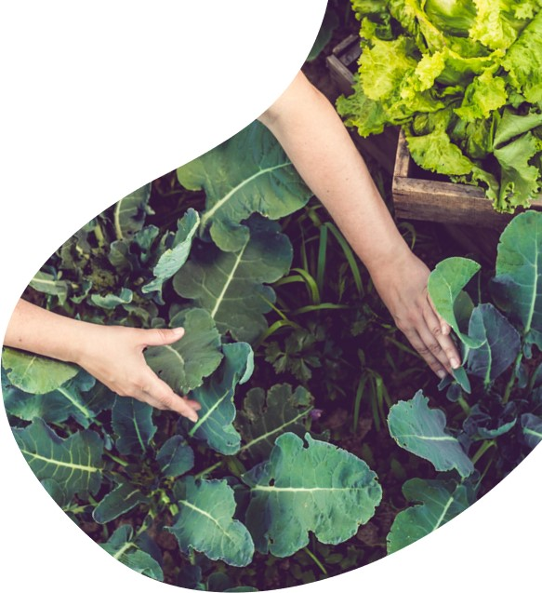
summary
At ORGANIC, we believe in giving 100% . By using our website , our customers not only get benefits of organic fruits but also at an economical price with efficient delivery services. We thrive because of our market knowledge , great team and their enthusiasm to provide customers with high quality fruits with least effort from their side .

Slide 13
thank you
Hari Neeraja Siripalli
Neeraja.Siripalli@ivycomptech.com

