Slide 1
INFOSYS SPRINGBOARD – VIRTUAL INTERNSHIP 6.0
Project Title:
SkillGapAI – Analyzing Resume and Job Post for Skill Gap
Submitted by:
Neeraja Talasu
talasuneeraja2003@gmail.com
Under the Guidance of:
Mr. Eldhose Mathew

Slide 2
ABSTRACT:
In today’s competitive job market, job seekers must ensure that their skills align with job requirements. Manual comparison between a resume and job description is time-consuming and often inaccurate. This project, SkillGapAI, automates the process of analyzing a resume and job post to identify skill gaps using NLP and Sentence-BERT similarity. The system extracts skills from both documents, detects exact, partial, and missing skills, calculates match percentage, and visualizes results in an interactive dashboard.

Slide 3
PROBLEM STATEMENT:
Many job seekers struggle to identify how well their skills match the job roles they apply for. Manually comparing job descriptions and resumes is time-consuming and often inaccurate. There is no easy automated tool that analyzes resumes against job requirements and clearly highlights skill gaps. This project addresses this challenge by designing a system that compares both documents and identifies exact, partial, and missing skills using NLP and semantic similarity.

Slide 4
OBJECTIVES:
• Extract skills from resume and job description using NLP.
• Compare skills using semantic similarity with Sentence-BERT.
• Identify matched, partially matched, and missing skills.
• Display results using interactive visual dashboards.
• Provide recommendations for upskilling based on missing skills.

Slide 5
SCOPE OF PROJECT:
• The project is designed to support job seekers in identifying skill gaps and improving job readiness.
• Enables comparative analysis between resume content and job requirements in a structured and automated manner.
• Helps candidates understand which skills are aligned with the job role and which skills need enhancement.
• Assists recruiters in quickly shortlisting suitable candidates without manually reading every resume.
• Can be applied across multiple industries and job roles as it is not restricted to a single domain.

Slide 6
SYSTEM ARCHITECTURE:
Upload Resume & JD
↓
PDF Text Extraction
↓
Skill Extraction using NLP
↓
Semantic Comparison using BERT
↓
Skill Gap Analysis
↓
Interactive Dashboard & Recommendations

Slide 7
TECHNOLOGIES USED:
Python
Flask
NLP
Sentence-BERT
Pdfplumber
Pandas
NumPy
Plotly Charts
HTML
CSS
JavaScript

Slide 8
MODULES:
• File Upload
• Text Extraction
• NLP Skill Extraction
• BERT Similarity Model
• Skill Comparison Engine
• Dashboard Visualization
• Recommendation Engine
• CSV Report Generator

Slide 9
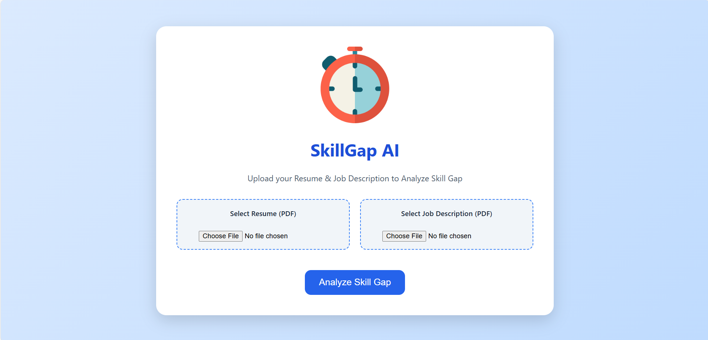
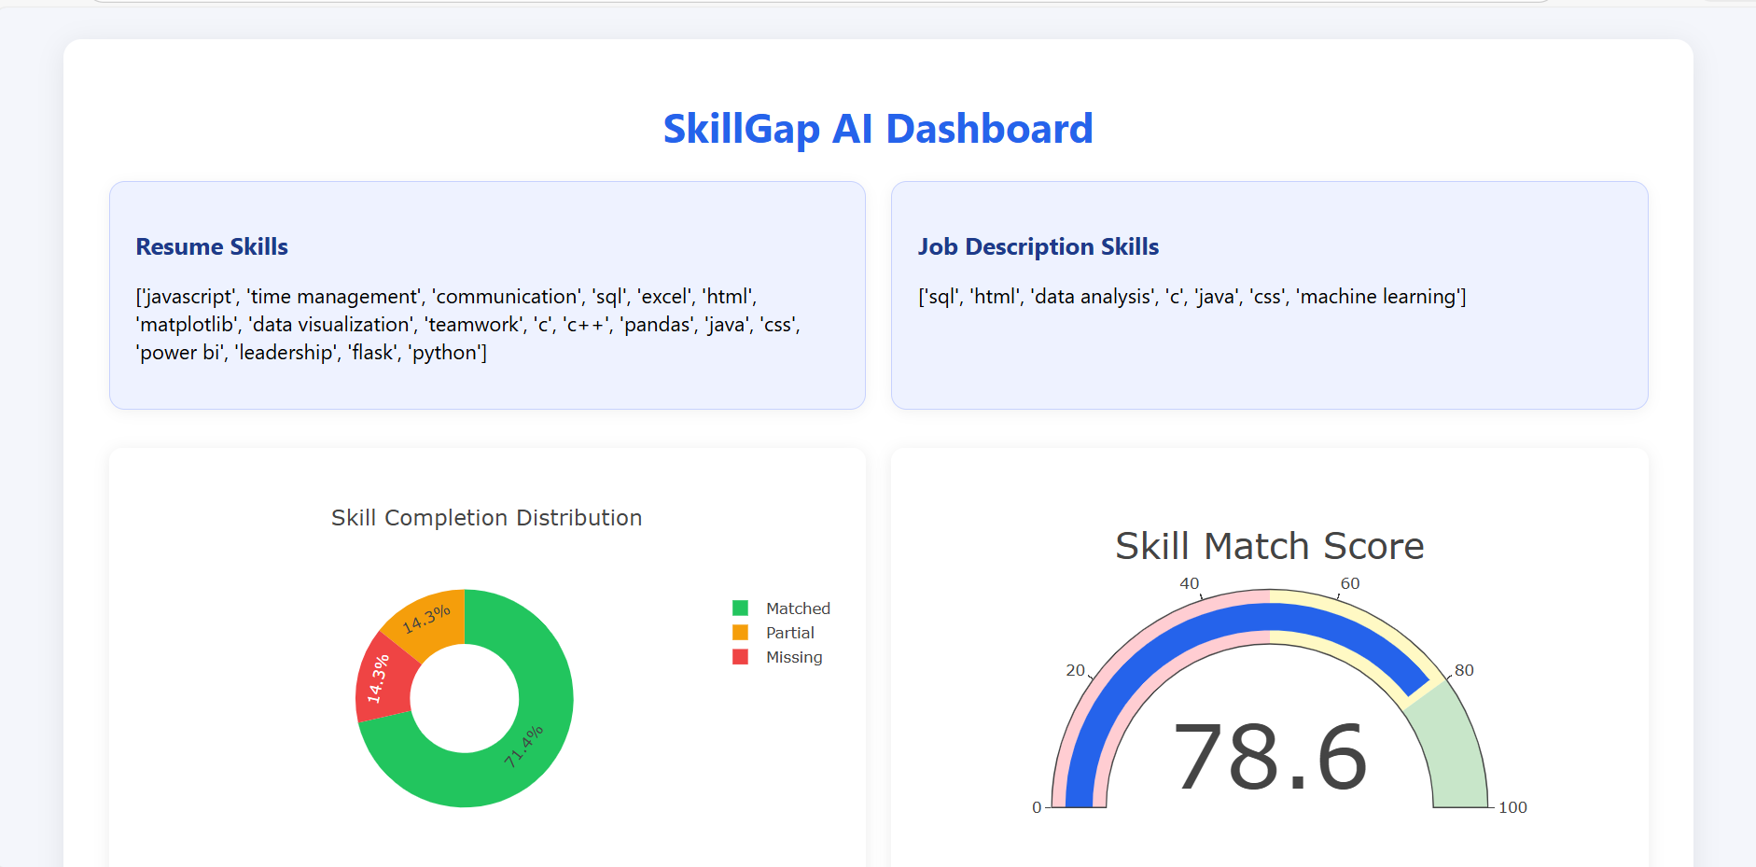
OUTPUT SCREENSHOTS:

Slide 10
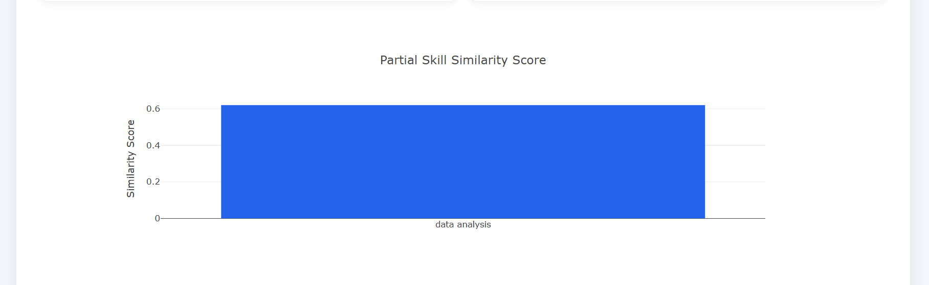
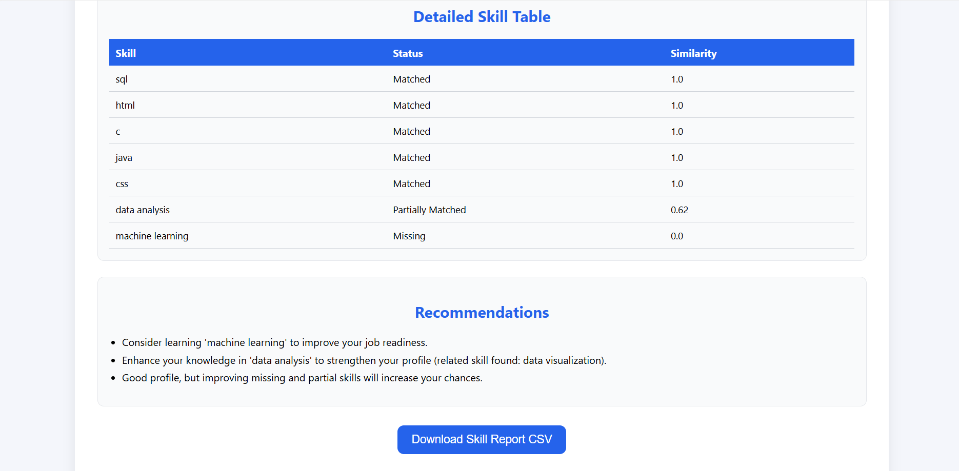

Slide 11
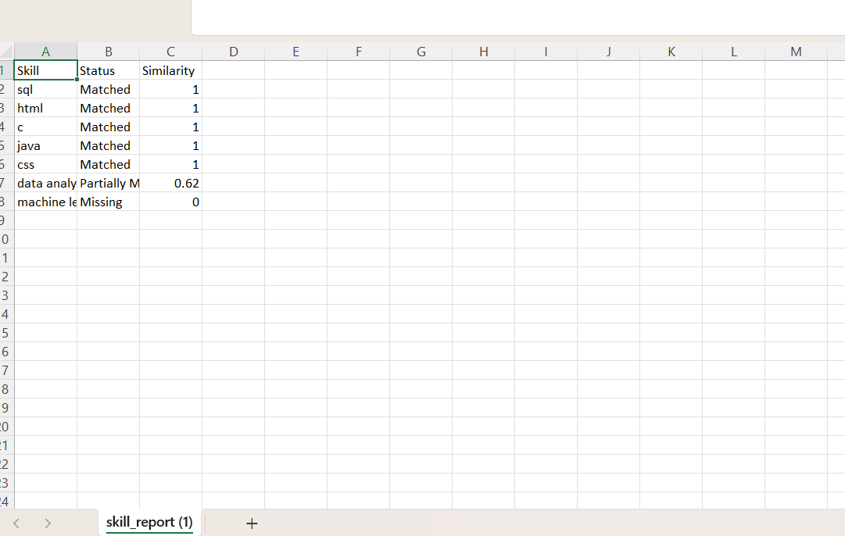
Generated Report

Slide 12
RESULT:
• Detects matched, partially matched, and missing skills
• Calculates skill readiness score
• Displays visual distribution of skills
• Generates recommendations for upskilling

Slide 13
CONCLUSION:
The project successfully automates skill gap analysis between resume and job description using NLP and AI-based similarity. It supports job seekers in improving employability and helps recruiters streamline screening.
Future Enhancements:
• AI-based resume improvement suggestions
• Career recommendations based on profile
• Multi-language support
• Cloud deployment & mobile app version

Slide 14
THANK YOU!!

