Slide 1
What is a boiler?
Boiler is an apparatus to produce steam. Thermal energy released by combustion of fuel is used to make steam at the desired temperature and pressure.
The steam produced is used for:
Producing mechanical work by expanding it in steam engine or steam turbine.
Heating the water in residential and industrial buildings.
Performing certain processes in the sugar mills, chemical and textile industries.

Slide 2
Classification of boilers
According to Relative Passage of water and hot gases:
Water Tube Boiler: A boiler in which the water flows through some small tubes which are surrounded by hot combustion gases, e.g., Babcock and Wilcox, Stirling, Benson boilers, etc.
Fire-tube Boiler: The hot combustion gases pass through the boiler tubes, which are surrounded by water, e.g., Lancashire, Cochran, locomotive boilers, etc.
According to Water Circulation Arrangement:
Natural Circulation: Water circulates in the boiler due to density difference of hot and water, e.g., Babcock and Wilcox boilers, Lancashire boilers, Cochran, locomotive boilers, etc.
Forced Circulation: A water pump forces the water along its path, therefore, the steam generation rate increases, Eg: Benson, La Mont, Velox boilers, etc.

Slide 3
Classification of boilers
According to the Use:
Stationary Boiler: These boilers are used for power plants or processes steam in plants.
Portable Boiler: These are small units of mobile and are used for temporary uses at the sites.
Locomotive: These are specially designed boilers. They produce steam to drive railway engines.
Marine Boiler: These are used on ships.
According to Position of the Boilers:
Horizontal, inclined or vertical boilers
According to the Position of Furnace
Internally fired: The furnace is located inside the shell, e.g., Cochran, Lancashire boilers, etc.
Externally fired: The furnace is located outside the boiler shell, e.g., Babcock and Wilcox, Stirling boilers, etc.

Slide 4
Classification of boilers
According to Pressure of steam generated
Low-pressure boiler: a boiler which produces steam at a pressure of 15-20 bar is called a low-pressure boiler. This steam is used for process heating.(1 bar = 10⁵ pascal or n/m²⁾
Medium-pressure boiler: It has a working pressure of steam from 20 bars to 80 bars and is used for power generation or combined use of power generation and process heating.
High-pressure boiler: It produces steam at a pressure of more than 80 bars.
According to charge in the furnace.
Pulverized fuel,
Supercharged fuel and
Fluidized bed combustion boilers.(bed of ash & sand/limestone)

Slide 5
Boiler Mountings
Boiler mountings are components used for ensuring the safety of boiler operation.
These are generally mounted on the surface of the boiler.
Control fluid parameters at the inside of the boiler shell.
The mountings are the essential part of a boiler, without which boiler operation is impossible.
Examples: Pressure gauges, Water level indicator, Safety valves, Stop valve, Fusible plug, Blow off cock, etc.

Slide 6
Boiler Accessories
Accessories are the auxiliary items required for proper operation of boiler and improve the efficiency of it.
These are integral parts of the boiler, but not mounted on it.
Control fluid parameters at outside of the boiler.
These are not essential parts of the boiler, without which boiler can operate though at lower efficiency.
Examples: Super heater, Feed pump, Economizer, Steam separator, Air preheater, etc.

Slide 7
Babcock and Wilcox Boiler
It is a Horizontal drum axis, natural draft, natural circulation, multi-tubular, stationary, high pressure, solid fuel fired, externally fired water tube boiler.
It was discovered by George Herman Babcock and Stephen Wilcox in the year 1967. And if was named after its discoverer as Babcock and Wilcox boiler.
This boiler is generally used to produce high pressure steam, and this high pressure steam is used to produce electricity in power generation industries. It is also used in the area where high pressure steam is required.

Slide 8
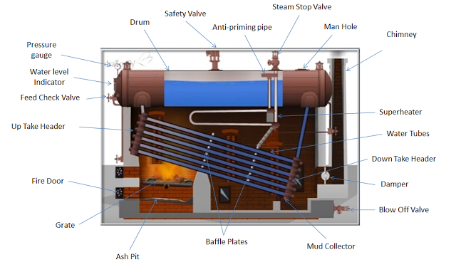
Babcock and Wilcox Boiler

Slide 9
Main Parts of Babcock and Wilcox Boiler
Drum: It is horizontal axis drum which contains water and steam.
Down Take Header: It is present at rear end of the boiler and connects the water tubes to the rear end of the drum. It receives water from the drum.
Up Take Header: it is present at front end of the boiler and connected to the front end of the drum. It transports the steam from the water tubes to the drum.
Water Tubes: They are the tubes in which water flows and gets converted into steam. It exchanges the heat from the hot flue gases to the water. It is inclined at angle of 10-15 degree with the horizontal direction. Due to its inclination the water tubes do not completely filled with water and the water and steam separated out easily.
Baffle Plates: Baffle plates are present in between water tubes and it allows the zigzag motion of hot flue gases from the furnace.

Slide 10
Main Parts of Babcock and Wilcox Boiler
Fire Door: It is used to ignite the solid fuel in the furnace.
Grate: It is a base on which the burning of the solid fuel takes place.
Mud Collector: It is present at the bottom of down take header and used to collect the mud present in the water.
Feed Check Valve: it is used to fill water into the drum.
Damper: It regulates the flow of air in the boiler.

Slide 11
Other Boiler mountings and accessories attached to Babcock and Wilcox Boiler
Superheater: It increases the temperature of saturated steam to the required temperature before discharging it from steam stop valve.
Pressure Gauge: It is used to check the pressure of steam within the boiler drum.
Water Level Indicator: It shows the level of water within the drum.
Safety Valve: It is a valve which acts when the pressure of steam within the boiler drum increase above the safety level. It opens and releases the extra steam in the environment to maintain the desired pressure within the boiler.

Slide 12
Working of Babcock and Wilcox Boiler
First the water starts to come in the water tubes from drum through down take header.
The water present in the inclined water tubes gets heated up by the hot flue gases. The coal burning on the grate produces hot flue gases and it is forced to move in zigzag way with the help of baffle plates.
As the hot flue gases come in contact with water tubes, it exchanges the heat with water and converts it into steam.
The steam generated is moved upward and through up take header it gets collected at upper side in the boiler drum.
An anti-priming pipe is provided in the drum. This anti-priming pipe filters the water content from the steam and allows only dry steam to enter into superheater.
The superheater receives the water free steam from the anti-priming pipe. It increases the temperature of steam to desired level and transfers it to the steam stop valve.
The superheated steam from the steam stop valve is either collected in a steam drum or made to strike on the steam turbine for electricity generation.

Slide 13
Advantages of Babcock and Wilcox Boiler
Steam generation capacity is high. It is about 2000 to 40000 kg/hr.
It occupies less space.
Replacement of defective tubes is easy.
It is the only boiler that is used to generate large quantity of heat in power stations.
The draught loss is minimum.
Inspection of this types of boiler can be done anytime during its working.

Slide 14
Disadvantages of Babcock and Wilcox Boiler
High maintenance cost.
It is not much suitable for impure and sedimentary water. In case of impure and sedimentary water, scale may deposit in the tubes and this leads to overheating and bursting of tubes. That’s why water treatment is must before feeding into the boiler.
Continuously supply of feed water is required for the working. In the case if feed water is not continuously supplied even for a short period of time, the boiler gets overheated. Water level must be carefully watched during the operation of the Babcock and Wilcox boiler.

Slide 15
