Slide 1

SISTec/BTech/CS/2023/6/MinorProject_II/17
Online HOSTEL RESERVATION system

Slide 2

PRESENTED BY
Neeraj Kumar 0187CS201106
Mohit Gautam 0187CS201095
MD Rehan 0187CS201087
Kapil Barsker 0187CS201073
Under the guidance of :-
Prof. Amit Kumar Rathore

Slide 3
Table of Content
Introduction
Purpose
Technology
Functional Requirements
Non-functional Requirements
Class Diagram
Use Case Diagram
ER Diagram

Slide 4
Introduction :
We are design and development of Online Hostel Reservation System is an online hostel reservation system is a web-based platform that allows students to book and pay for accommodations in hostels. This system is designed to simplify the process of hostel reservations for students, enabling them to browse through different hostels, check availability, and book their preferred accommodations online.

Slide 5
Purpose :
A hostel reservation system is a software platform designed to simplify the process of booking accommodation in a hostel. Its purpose is to provide students with an easy and efficient way to book hostel rooms, and to help hostel owners manage their bookings more effectively.

Slide 6
Technology :
In this Project we use the Technology of :-
1. Frontened
>HTML
>CSS
>JavaScript
2. Backened
>Python
>Django
3. Database Connectivity
>SQLite

Slide 7
Functional Requirements :
Functional requirements define a function that a system or system element must be qualified to perform and must be documented in different forms. The functional requirements describe the behavior of the system as it correlates to the system's functionality.
Log In : A login is a function or specific behavior. You either have a login capability or you don’t .
Register : Students can register for login Hostel Reservation.
Check Room : Here Student can check the room .
Booking : Booking confirmation should be sent to the specified contact details.

Slide 8
Non Functional Requirements :
Non-functional requirements are not related to the software's functional aspect. They can be the necessities that specify the criteria that can be used to decide the operation instead of specific behaviors of the system.
Security : The system should be secure, and data encryption should be implemented to protect customer data and prevent unauthorized access.
Performance: The system should be able to handle a large number of requests and transactions simultaneously without any delay or performance degradation.
Availability : To check the availability of room in Hostel and System services must be available 24/7.
Reliability: The system should be highly reliable and available 24/7, as customers may want to book a hostel room at any time.

Slide 9
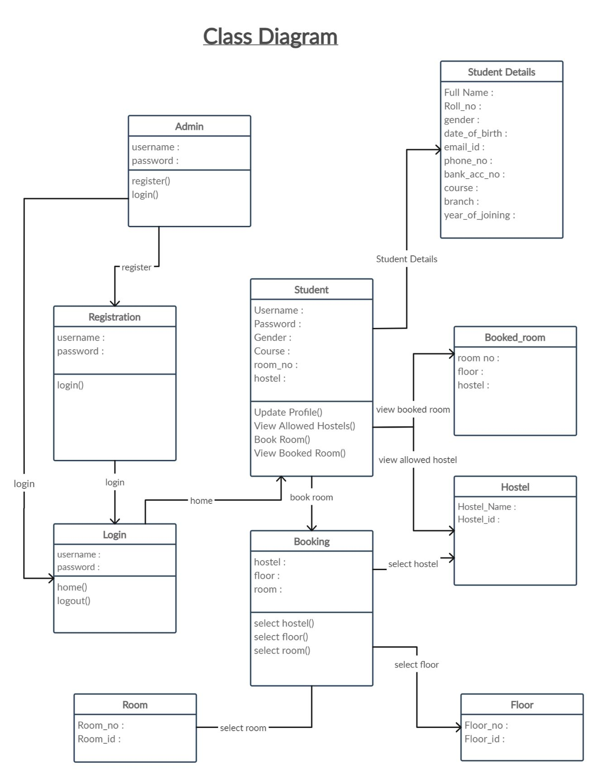

Slide 10
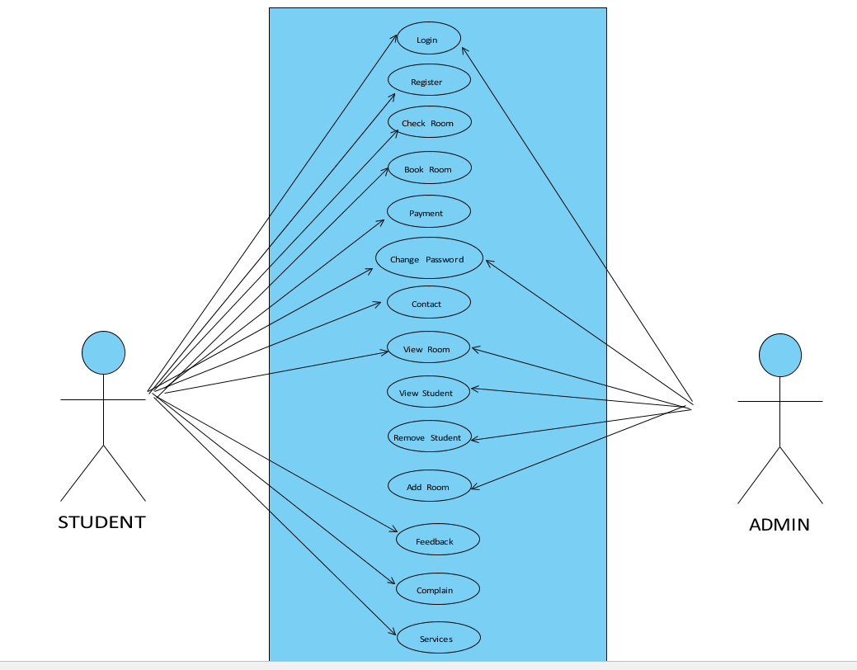
Use Case Diagram :

Slide 11
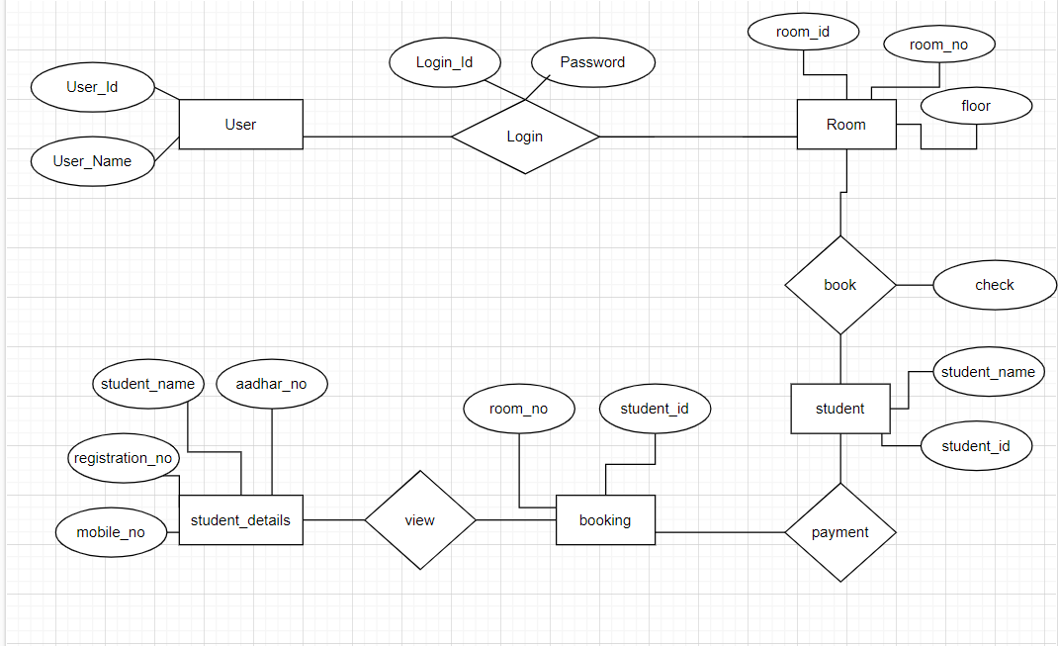
ER Diagram :

Slide 12
THANK YOU !

