Slide 1

Rajkiya Engineering College Bijnor
"Internship Presentation
on
Python Django
Thinknext Private Ltd. Mohali Chandigarh"
Presented By-Neeraj Kumar Kannoujiya
Roll No.- 2007350130031
Branch- Information Technology
Year- 3rd year
Guided By- ER. Suneel Kumar
(Software Engineer)
(Thinknext Pvt. Ltd.)

Slide 2
Abstract
This project is on the Internship program at Thinknext Private Limited Company At Mohali chandigarh during the period from 14th March 2022 to 28th April 2022.
This project deals with developing a Virtual website ‘E-commerce Website’.
Technology Used :-
Django
HTML
CSS
JavaScript
SQLite
Bootstrap

Slide 3
Contents -
Introduction toThinknext Private Ltd.
What is Web development
Introduction to Django Technology
Projects woked during Internship:
Developed an e-commerce website GreatKart
What I learnt?
Conclusion

Slide 4
Introduction to Thinknext Technology
ThinkNEXT Technologies Private Limited (An ISO 9001:2008 Certified Company), is emerging as most innovative company in Education Domain in India.
The Management of ThinkNEXT Technologies Private Limited has wide experience more than nine years in education domain.
And approved from Ministry of Corporate Affairs which deals in Web Designing andDevelopment, Mobile Apps Development, Digital Marketing, College/School ERP Software, University Conferences and Journals Management, Android/iPhone Mobile Apps development , Cloud Telephony Services.
ThinkNEXT offers various 6 Months/3 Months/ 6 Weeks/45 days/Summer Industrial Training programs for B.Tech Engineering students, MCA, BCA, Polytechnic Diploma, M.Sc (IT), B.Sc (IT), MBA, BBA, B.Com students and job-seekers.

Slide 5
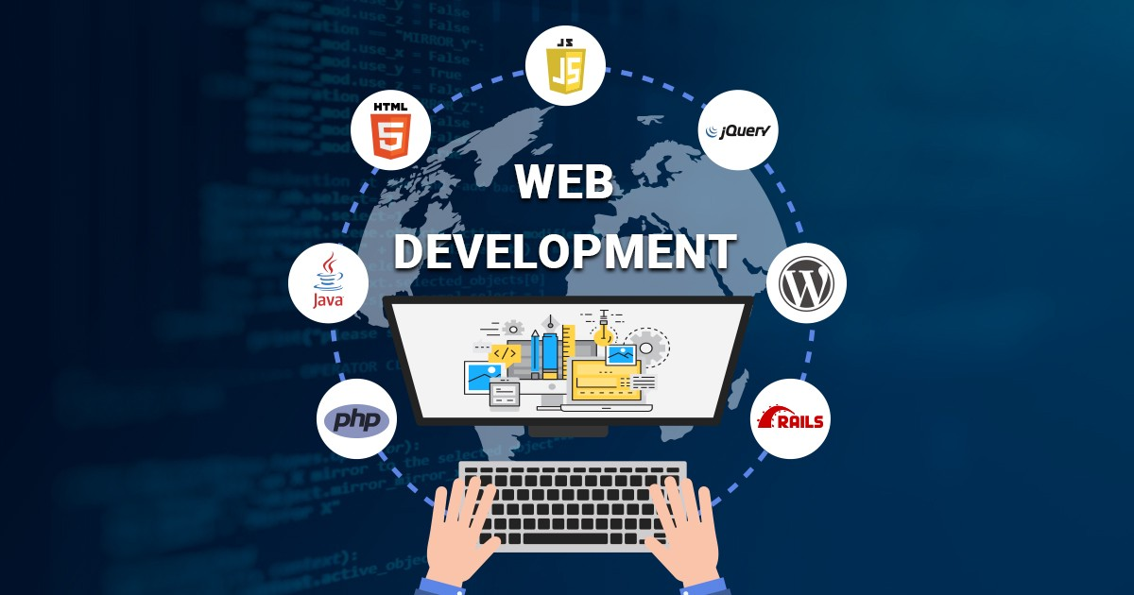
What is Web Development
Web Development refers to the building, creating, and maintaining of websites.
It includes aspects such as web design, web publishing, web programming, and database management.
It is the creation of an application that works over the internet i.e. websites.

Slide 6
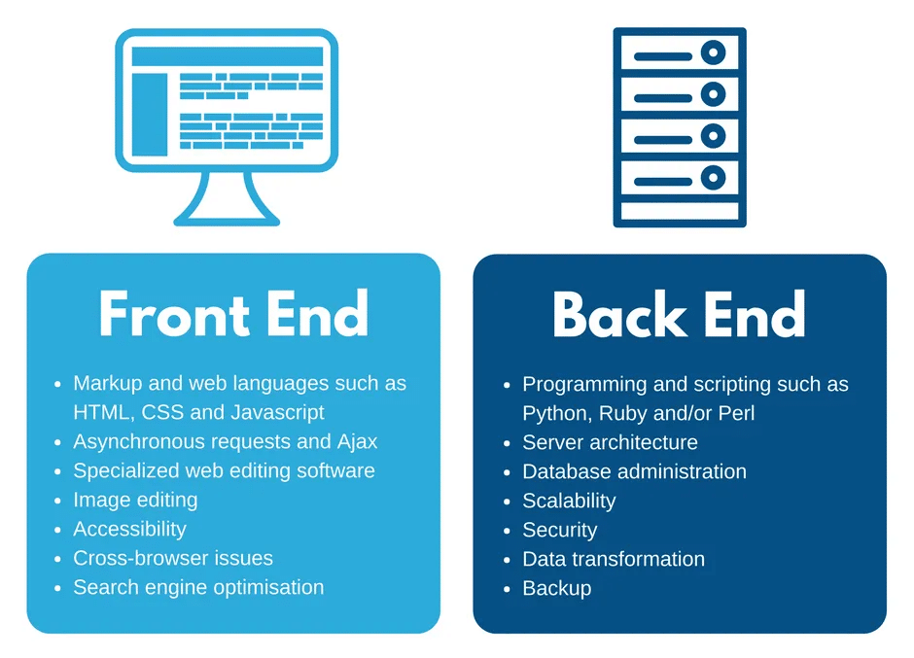

Slide 7
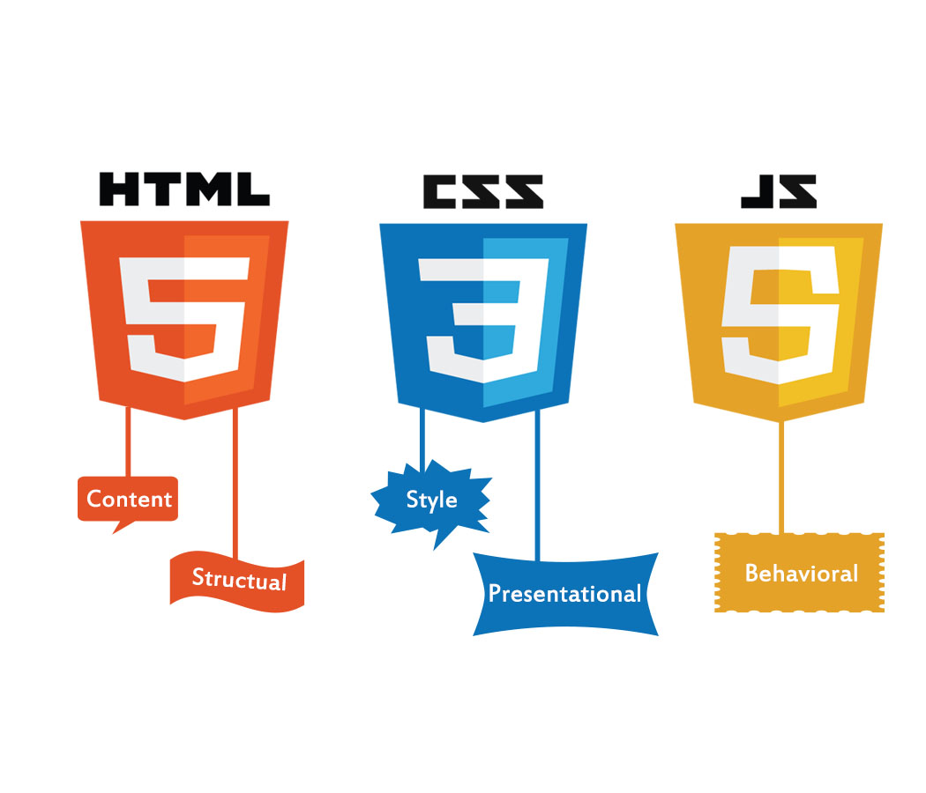
HTML , CSS , JS
HTML- HTML provides the basic structure of sites, which is enhanced and modified by other technologies like CSS and JavaScript.
CSS- CSS is used to control presentation, formatting, and layout.
JAVASCRIPT- JavaScript is used to control the behaviour of different elements.

Slide 8
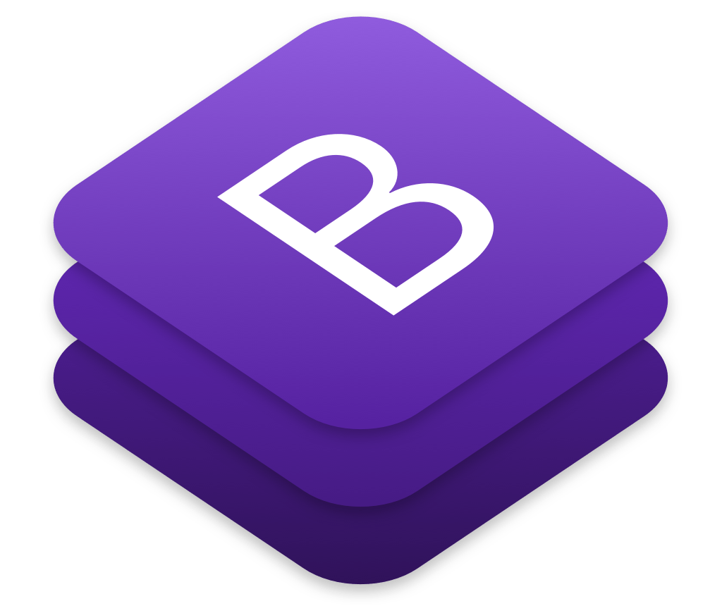
Bootstrap
Bootstrap is a free, open source front-end development framework for the creation of websites and web apps.
Design to enable responsive development of mobile first websites, Bootstrap provides a collection of syntax for template designs.
As a framework, Bootstrap includes the basics for responsive web development, so developers only need to insert the code into a pre-defined grid system.
Bootstrap

Slide 9

SQLITE
SQLite is an open-source database that helps to interact with relational databases.
SQLite is self-contained means it requires minimal support from the operating system or external library.
By default, Django uses the SQLite database.
SQLITE

Slide 10
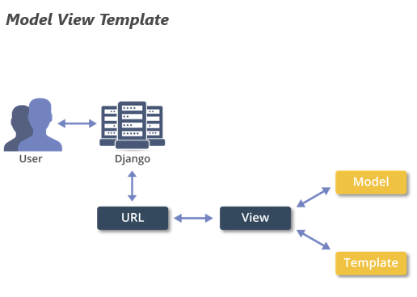
DJANGO
Django is a web application framework written in Python programming language. It is based on MVT (Model View Template) design pattern.
Django takes less time to build application after collecting client requirement.
Various Companies using Django are :-
Google
Instragram
Youtube
Netflix

Slide 11
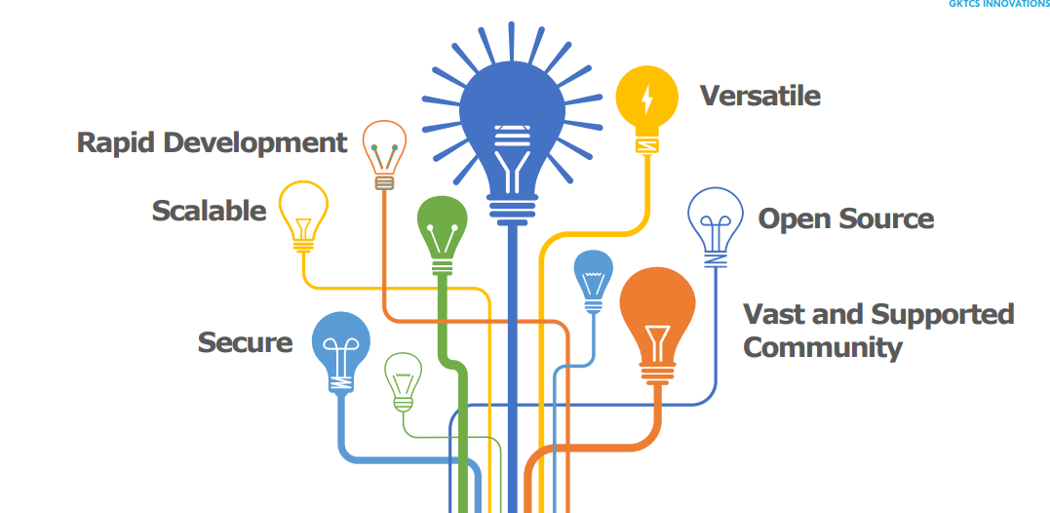
Features of Django

Slide 12
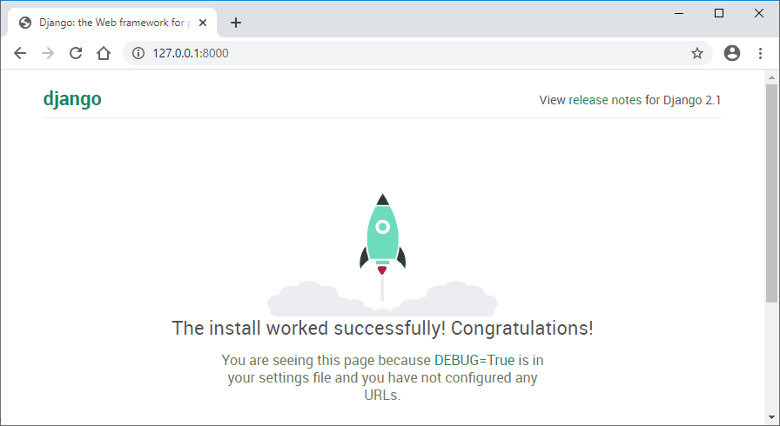
Django Installation
To install Django, first visit to django official site (https://www.djangoproject.com) and download django by clicking on the download section.
Here, we will see various options to download The Django.
Django requires pip to start installation.
Pip is a package manager system which is used to install and manage packages written in python.
For Python 3.4 and higher versions pip3 is used to manage packages. the installation command is given below

Slide 13
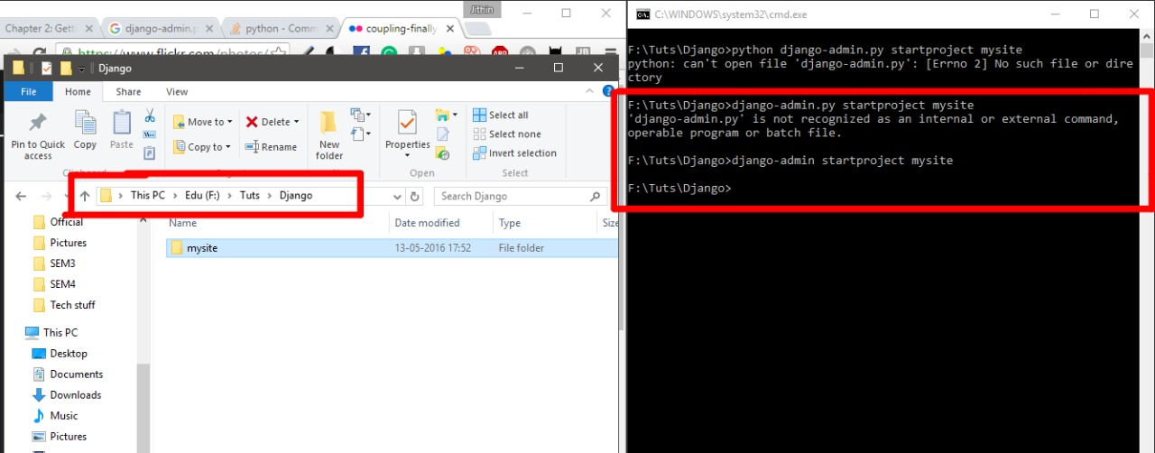
Django Project
In the previous topic, we have installed Django successfully.
Now, we will learn step by step process to create a Django application.
Run the command -
django-admin startproject projectname
django-admin startproject project

Slide 14
Web Framework Used – DJANGO ( PYTHON) DATABASE – SQLITE3 DESIGN – HTML, CSS, JAVASCRIPT , BOOTSTRAP WEB BROWSER – GOOGLE CHROME SOFTWARE – VS CODE , ATOM SERVER – LOCAL HOST
Project I have worked for
GreatKart

Slide 15
Objective:-
The main objective of GreatKart is that to provide the all type of Items available easily at your doorstep taking care of everyone’s need, Interest & budget.
It provides reliability & security as shopping made Convenient to customers 24X7 access.
It provides the user with a list of various products available for purchase in the store.
It provides 360 degrees view of products.

Slide 16
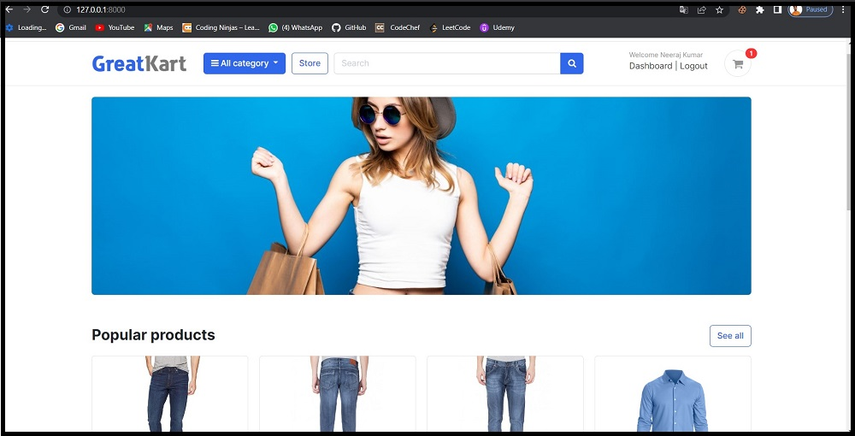
Homepage

Slide 17
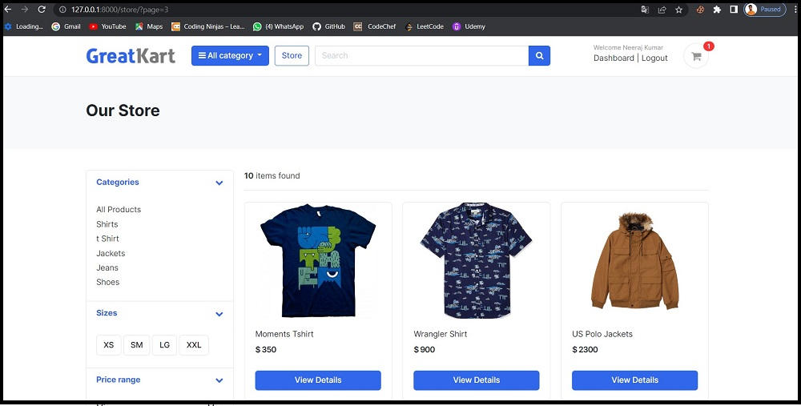
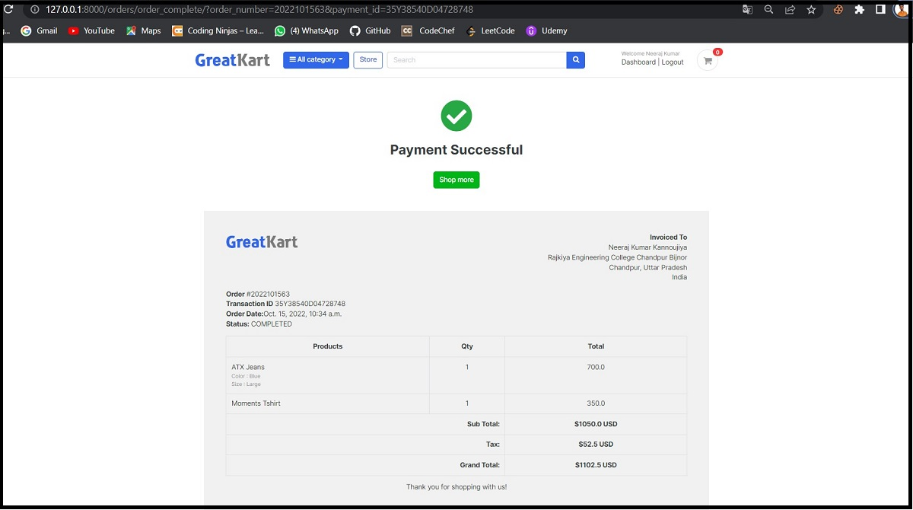
Store Page
Invoice

Slide 18

What I Learn ?
Learnt how to use Python to create a fully functioned real world website.
Learn to add 2-step verification in the web application with Django.
Proper use of html , css, JavaScripts in a website.
After this internship I made many websites.which is on my GitHub whose link is below :-
https://github.com/Neerajkumar73880

Slide 19
ThankYou

