Slide 1
Git-Flow

Slide 2
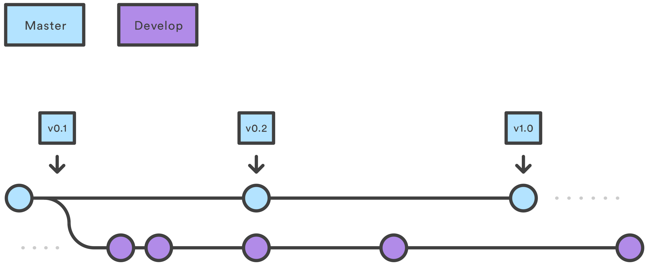
What?
Develop will always be ahead or equivalent to Master
Master will always be release ready at any time (And versioned for different releases, to keep release history)

Slide 3
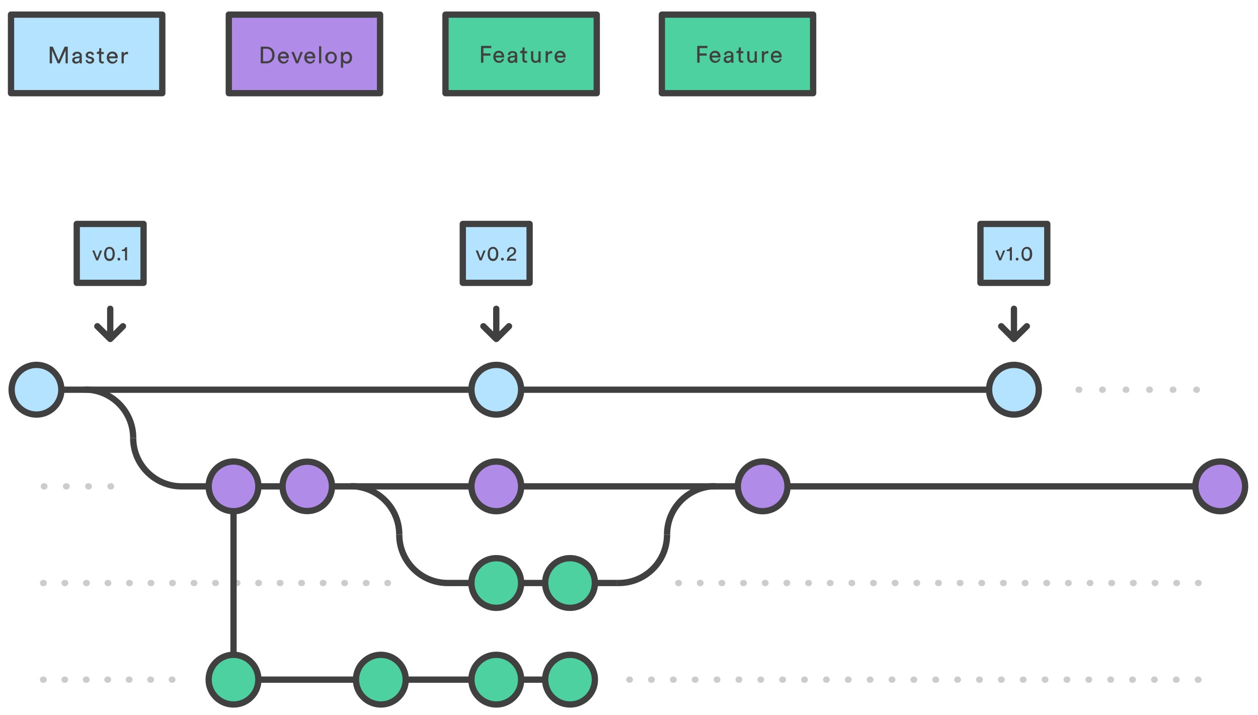
New Features
Feature branches will always be cut from Develop and it should be ideally merged back to develop

Slide 4
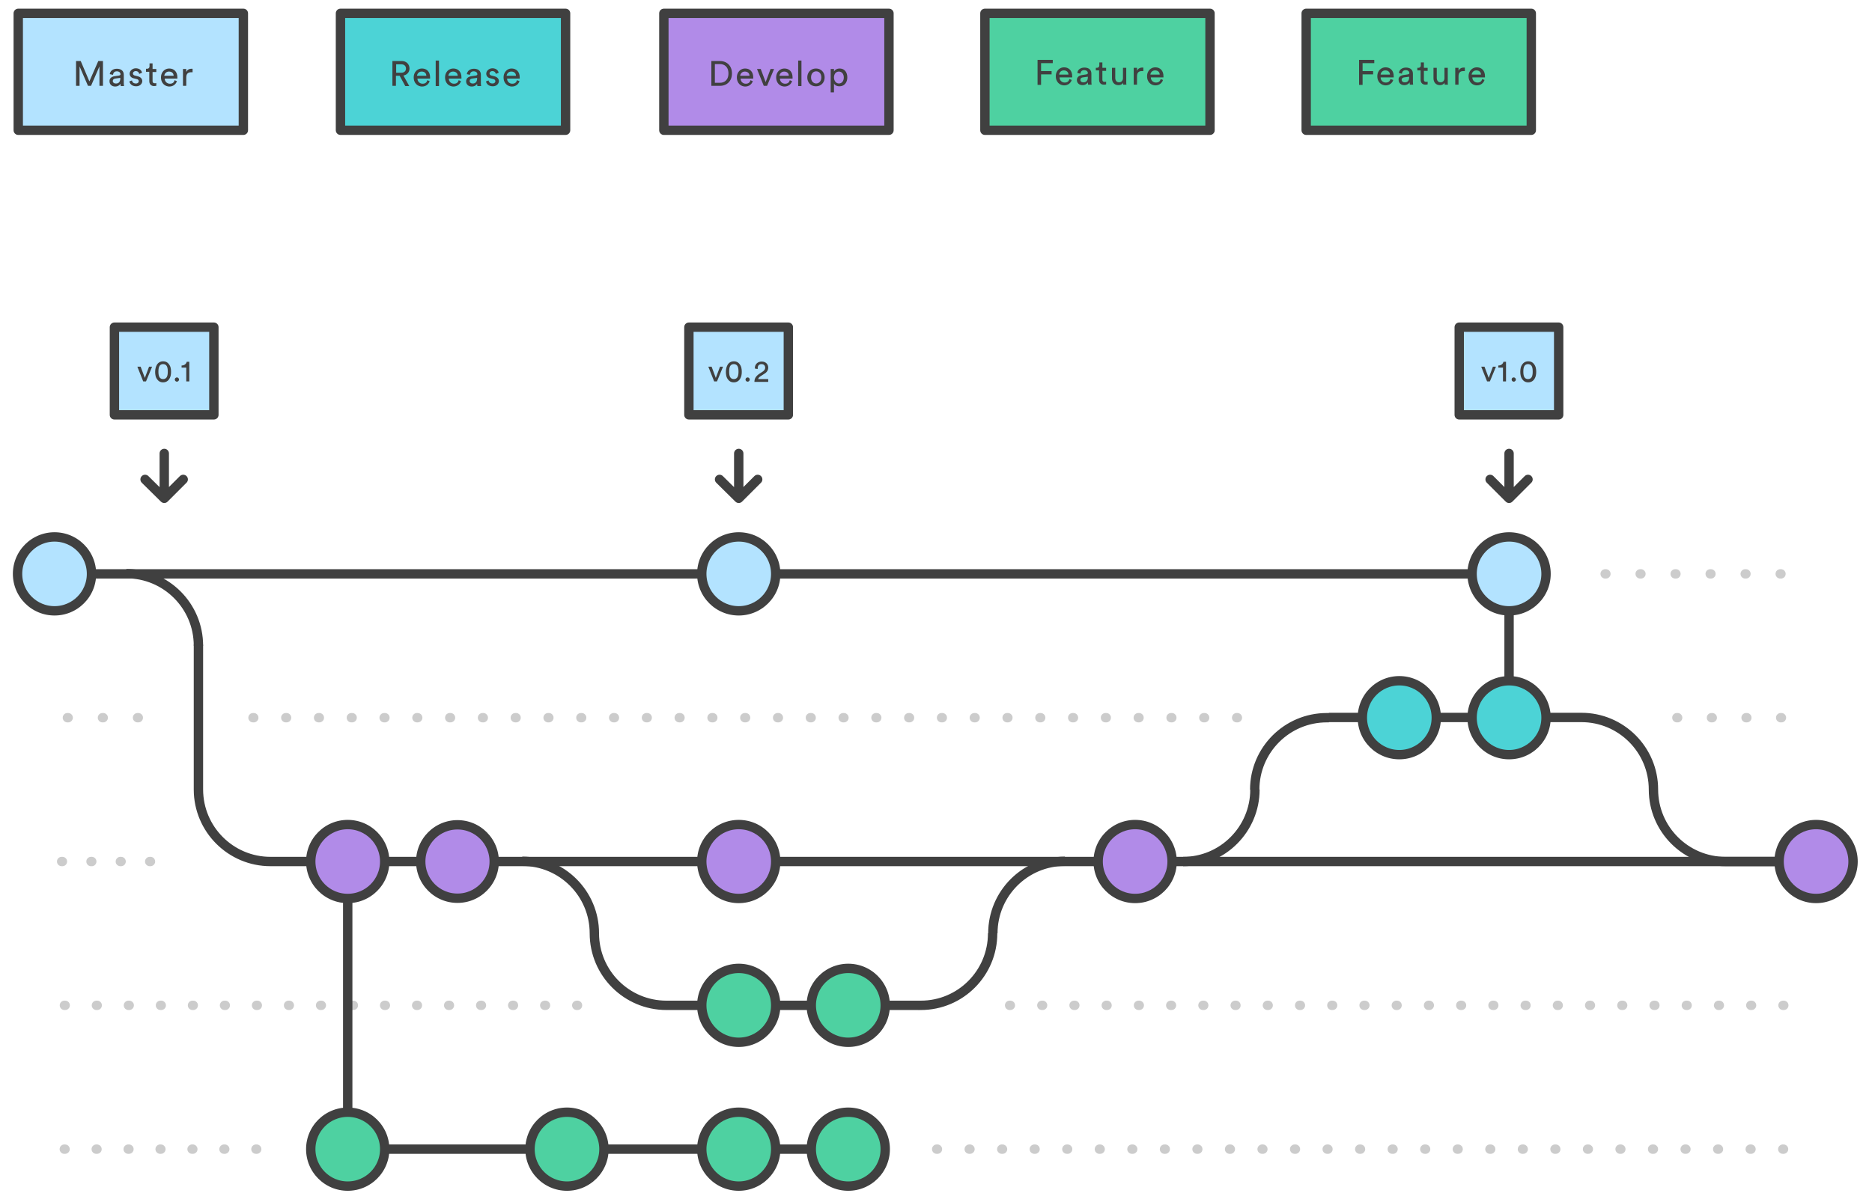
Release Branches
Release branch is will be cut from develop and now the new release branch can only have bug fixes and release related tasks like versioning etc.
Release branch again merged back to develop post release/release versioning

Slide 5
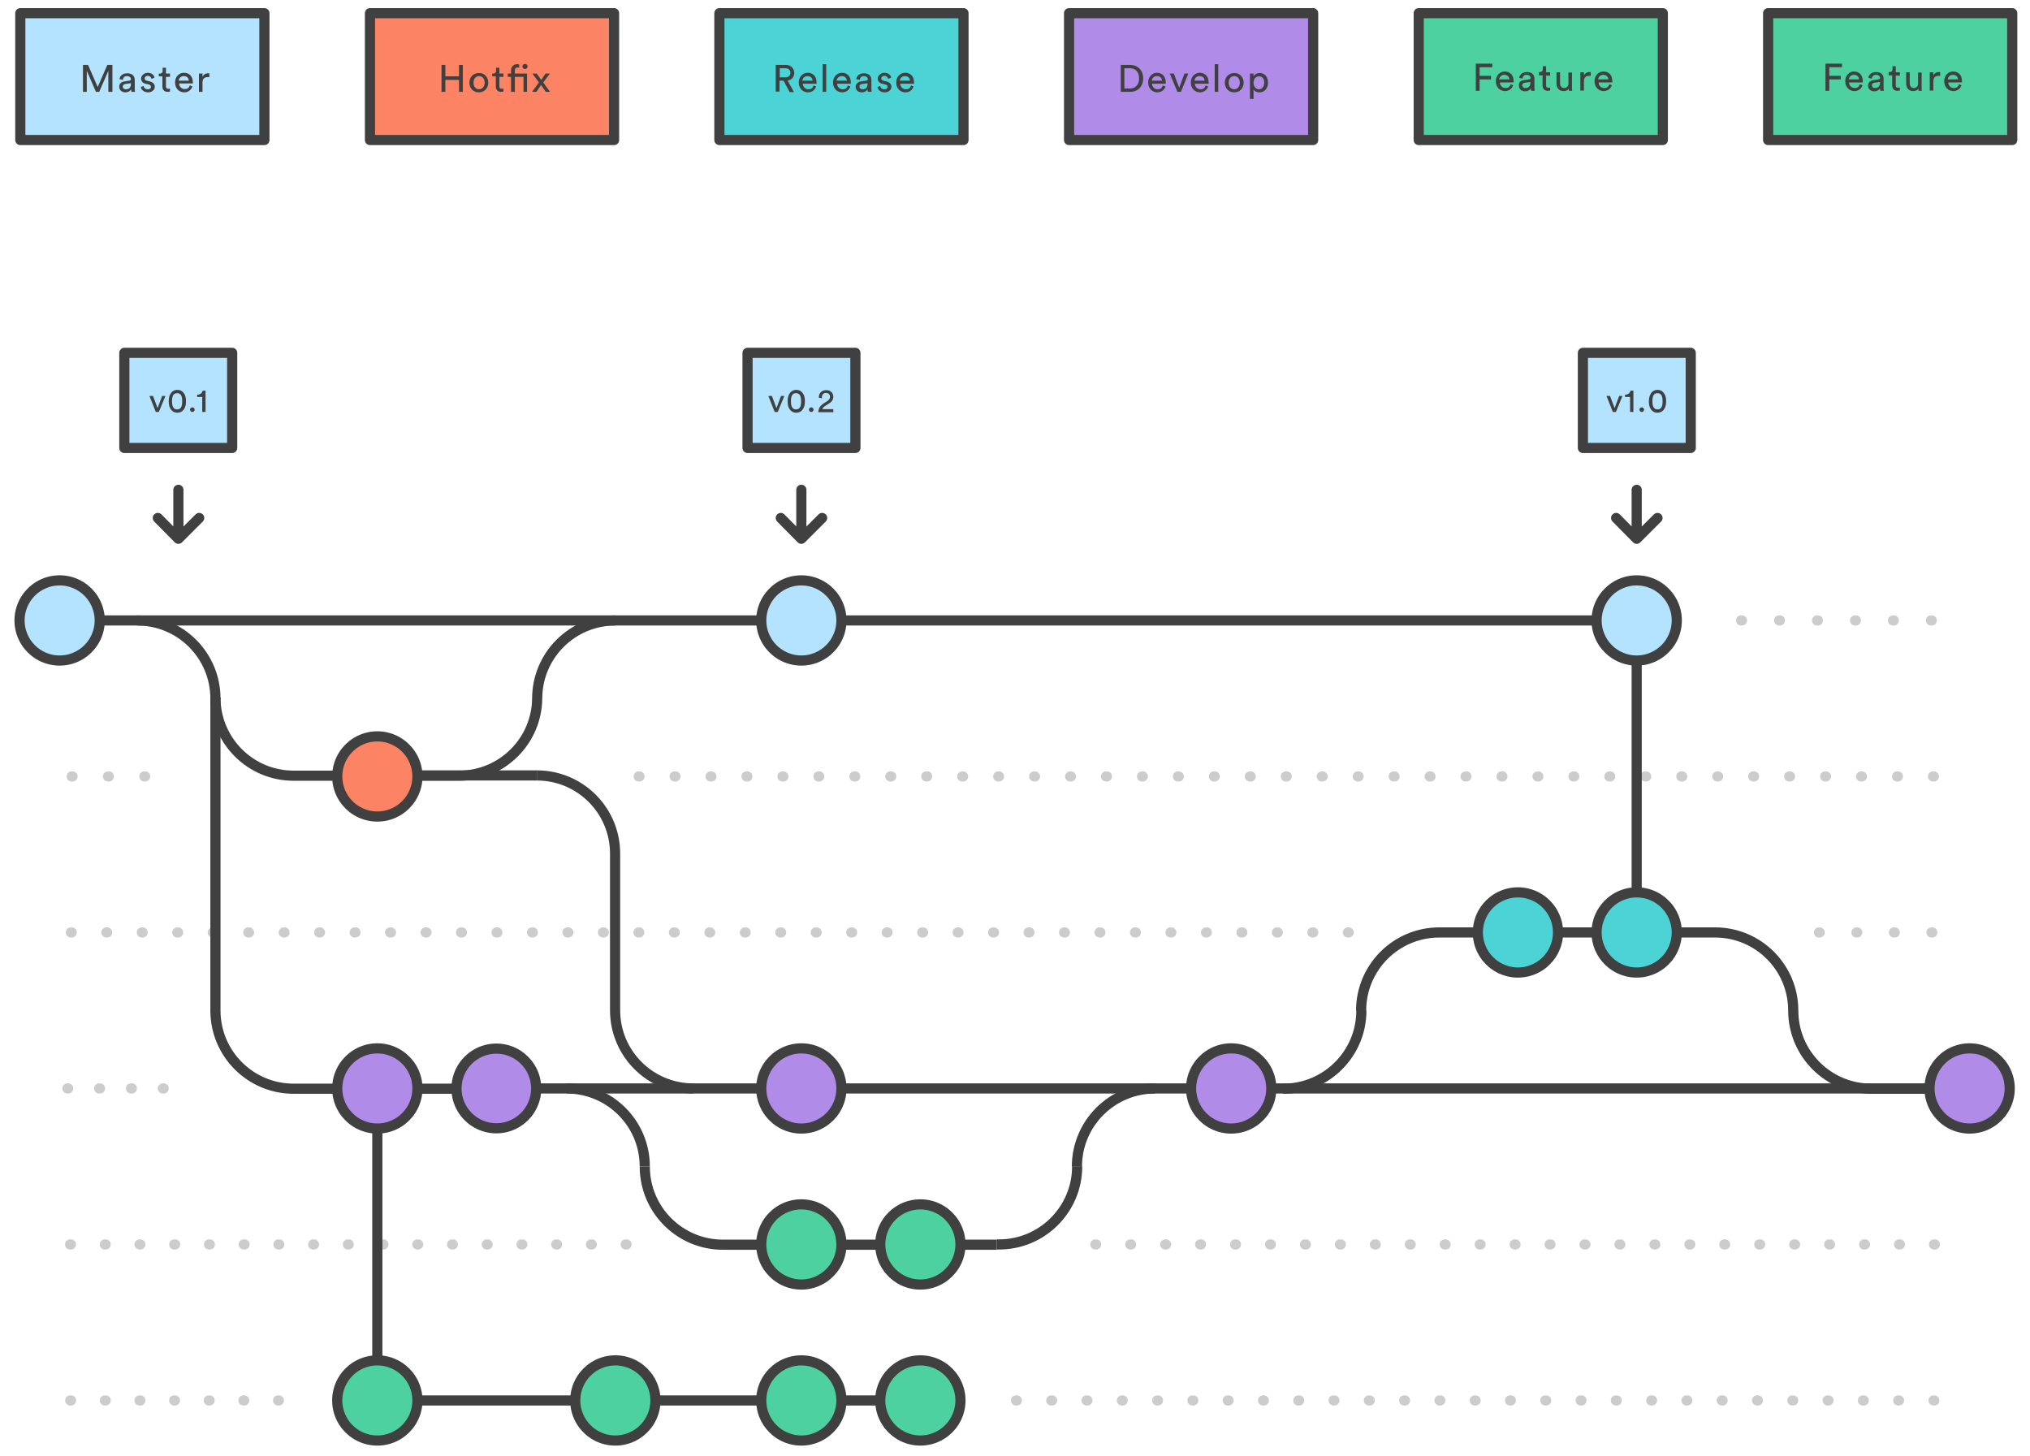
Hot Fixes
Hotfix branches will be cut from master.
Changes done on that and than merged back to master post fix and development post release

