Slide 1
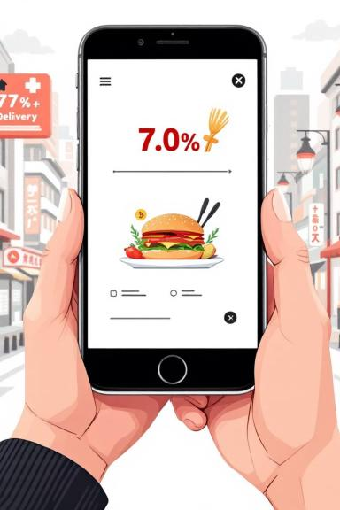
Swiggy Sales Analysis
Analyzing Swiggy food delivery sales data to derive meaningful business insights using SQL, dimensional modeling, and Power BI dashboards.

Slide 2
Project Overview
Data Handling
Data Modeling
Clean raw transactional data and ensure high data quality.
Design a scalable Star Schema for efficient BI reporting.
KPI Calculation
Visualization
Calculate key performance indicators for sales and customer behavior.
Visualize trends related to revenue, orders, cities, and dishes.
This project demonstrates end-to-end data analytics skills, from raw data handling to executive-level reporting.

Slide 3






Business Objectives & Data Source
Data Quality
Raw Data Table: swiggy
Ensure high data quality through cleaning and validation.
State, City, Location
Order Date
Performance Optimization
Restaurant Name
Build a performance-optimized analytical data model.
Category (Cuisine)
Dish Name
Sales Tracking
Price (INR)
Rating & Rating Count
Track sales across time, location, restaurant, and cuisine.
Top Performers
Identify top-performing cities, restaurants, and dishes.
Customer Insights
Understand customer spending patterns and ratings.

Slide 4




Data Cleaning & Validation (SQL)
Null Value Check
Blank / Empty Value Check
Verified missing values in critical columns (state, city, order_date, price, rating).
Identified records with empty strings impacting aggregation accuracy.
Duplicate Detection & Removal
Detected and removed duplicate rows using ROW_NUMBER() to retain valid records.
This rigorous process ensured a clean and reliable dataset for analysis.

Slide 5

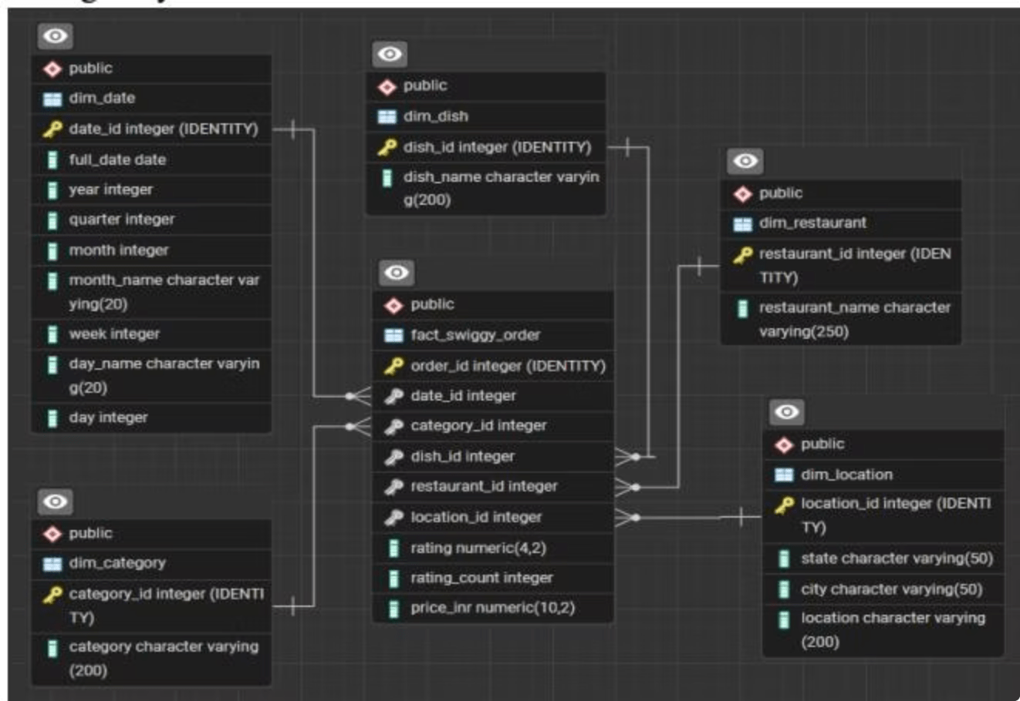
Data Modeling – Star Schema
A Star Schema was implemented to support efficient BI reporting.
Improved Query Performance
Enhanced Data Readability
Scalability for BI Tools

Slide 6

Star Schema Details
Dimension Tables
Fact Table: fact_swiggy_order
dim_date: Date, Year, Quarter, Month, Week, Day Name
Price_INR
Rating
dim_location: State, City, Location
Rating_Count
Foreign keys to all dimensions
dim_restaurant: Restaurant Name
dim_category: Cuisine / Category
dim_dish: Dish Name

Slide 7
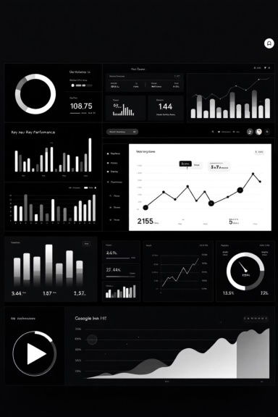
Key Performance Indicators (KPIs)
Core KPIs calculated using SQL and visualized in Power BI.
53.00M
197K
4.34
Total Revenue
Total Orders
Average Rating
INR
High
Average Order Value (AOV)

Slide 8

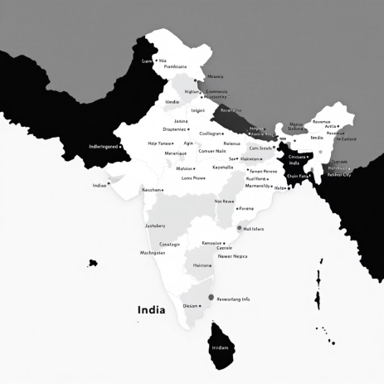
Analytical Insights: Time & Location
Time-Based Analysis
Location-Based Analysis
Monthly revenue and order trends show seasonal fluctuations.
Bengaluru leads in total revenue (5.46M INR).
Q2 recorded the highest revenue contribution.
Other high-performing cities: Lucknow, Hyderabad, Mumbai.
Clear weekday vs. weekend order behavior patterns.
Revenue contribution varies significantly across states.

Slide 9
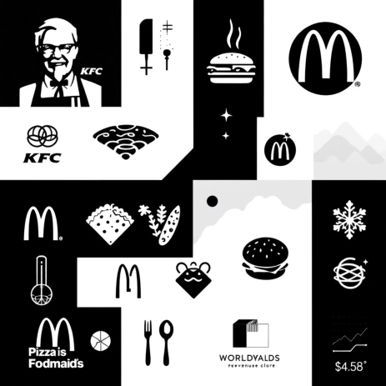
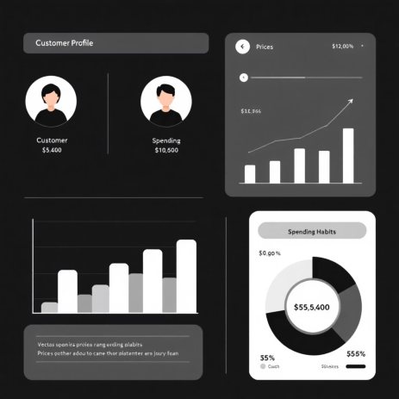
Analytical Insights: Restaurant & Customer
Restaurant Performance
Customer Spending Insights
KFC (4.25M INR) and McDonald's (3.34M INR) are top revenue generators.
Customers segmented into spending ranges.
Certain restaurants have lower order volume but higher AOV.
Most orders fall within the 200-299 INR range, indicating a mid-price preference.

Slide 10
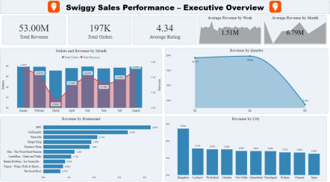
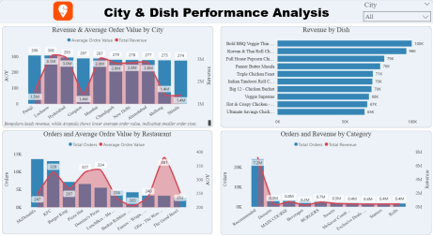
Power BI Dashboard Overview
Interactive dashboards for comprehensive sales analysis.
Tools Used: SQL (PostgreSQL), Power BI, Star Schema Modeling, CSV.

