Slide 1

BE Sem. VII: Project Proposal Presentation (AY:2024-25)
Advanced Surveillance and Multi-Utility Rover
Presented by
Pratik Chauhan - 09
Neeraj Chaurasia - 10
Mojes Dhotre - 11
Aryan Menon - 12
Under the guidance
of
Ms. Savita Kulkarni
Department of Electronics and Telecommunication Engineering
St. Francis Institute of Technology, Mumbai

Slide 2
Contents
Introduction and Motivation
Specific Problems Addressed with Objectives
Progress Update: Hardware Integration and Testing
Flow Diagram
Literature Review
Software/Hardware Requirements
Image Processing Implementation on Raspberry Pi 4 B
Challenges and Solutions
Conclusion and Future Work
References

Slide 3
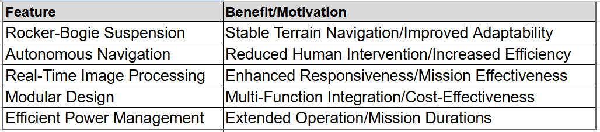
Introduction and Motivation
The Advanced Surveillance and Multi-Utility Rover is designed to meet the growing demand for autonomous surveillance solutions. Its unique combination of robust mobility, intelligent navigation, and a multi-functional design enables enhanced situational awareness through improved data collection and real-time analysis, while also reducing operational costs by minimizing manpower requirements and extending deployment durations. This makes it an ideal platform for a wide range of surveillance applications, from perimeter security and remote monitoring to environmental observation and search and rescue operations.

Slide 4
Specific Problems Addressed with Objectives
Problem Statement
Design a versatile, autonomous rover capable of navigating challenging terrains for applications like surveillance and environmental monitoring.
Objectives
Terrain Navigation: Develop robust navigation capabilities for uneven terrains.
Autonomy: Implement advanced autonomous navigation algorithms.
Real-Time Processing: Enhance object detection and gesture recognition using image processing.
Modular System: Create a flexible, multi-utility design.
Power Management: Optimize power usage for extended operation.

Slide 5
Progress Update
Hardware Progress
Cameras: Integrated RPi IR-CUT camera (OV5647 sensor) for real-time image capture.
Motors: Installed DC motors with encoders for precise movement and control.
3D Printing: Custom rocker-bogie and chassis parts printed using PLA material for durability and lightweight design.
Testing and Challenges
Camera Issues: Low frame rates, image latency, and connectivity problems.
Encoder Motor Issues: Inaccurate position tracking and calibration errors.
Solutions:
Updated camera drivers and adjusted settings.
Recalibrated encoder motors and improved wiring.

Slide 6
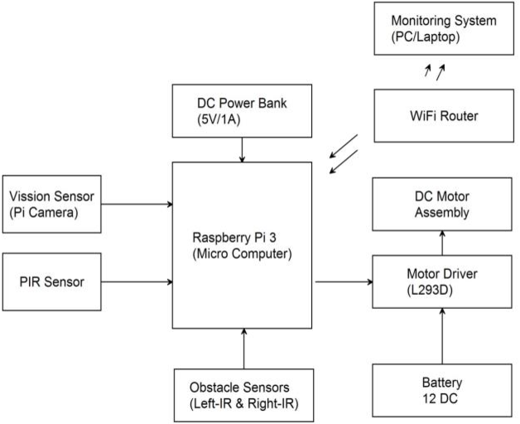
Block Diagram
Raspberry Pi 4 B

Slide 7

Literature Review
Project Title with authors
Description
Results
IoT Based Smart Multi Application Surveillance
Robot-2020
Aishwarya K Telkar, Prof.Baswaraj Gadgay
Robot obstacle recognition algorithm utilizing computer vision and artificial intelligence techniques for accurate navigation in complex environments.
Improved CNN model achieves significantly higher accuracy and efficiency in real-time obstacle recognition and classification, outperforming traditional methods with enhanced reliability and speed in dynamic terrain navigation.
Video Surveillance Robot Control using Smartphone and Raspberry Pi-2020
Ashish Bokade and V.R. Ratnaparkhe
The document presents a comprehensive overview of an IoT-based surveillance robot, detailing its design, components, and function. focus on enhancing security and monitoring capabilities through advanced technologies.
The IoT-based surveillance robot achieves effective surveillance, environmental monitoring, and remote operation, offering cost-effective, scalable, and real-time monitoring solutions for various applications, while addressing challenges.

Slide 8
Literature Review
Project Title with authors
Description
Results
Kinematics Analysis and Simulation of a Rocker- Bogie Mobile Robot-2019
It provides a kinematic analysis and simulation of a rocker-bogie mobile robot, focusing on its ability to traverse uneven terrain while maintaining stability. It includes geometric and mathematical modeling, simulation.
The kinematic analysis and simulation of the rocker-bogie mobile robot demonstrate that the system maintains stability on uneven terrains. The kinematic model accurately predicts the robot's motion, and the simulation results validate the theoretical models. Overall, the robot effectively handles diverse and complex terrains.
Mohammad Reza Iman Dashti
Design of Robot Obstacle Recognition Location Ranging Algorithm Based on Computer Vision and AI-2023
It provides the designing a robot obstacle recognition location ranging algorithm using computer vision and artificial intelligence, aiming to improve obstacle recognition and avoidance in robots.
The proposed algorithm, utilizing an improved CNN model, achieves superior performance in accuracy and efficiency for obstacle recognition, significantly outperforming traditional methods, with a lower recognition error rate, especially in complex terrains.
Libo Yang

Slide 9
Software/Hardware Requirements
Hardware
Raspberry Pi 4 B: 1.5 GHz Quad-Core ARM Cortex-A72, 2GB/4GB/8GB RAM.
Camera: RPi IR-CUT camera (OV5647 sensor, 5 MP, 1080p).
Motors: DC motors with encoders for precise control.
3D-Printed Parts: Custom rocker-bogie and chassis parts (PLA material).
Software
OpenCV: For real-time image processing.
TensorFlow Lite: For deploying lightweight machine learning models.
Picamera2 Library: For interfacing with the Raspberry Pi camera.
Python: Primary programming language for implementation

Slide 10
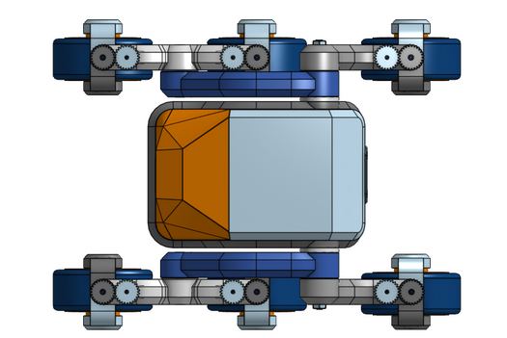
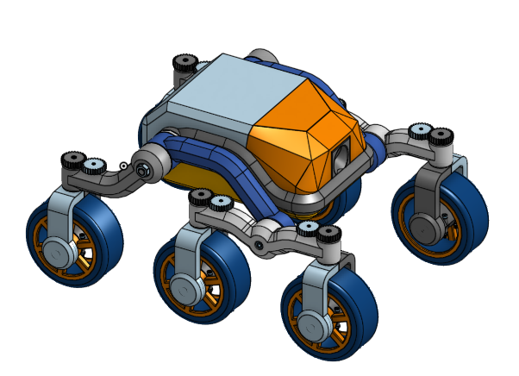
Hardware Requirements
3D Design
Custom 3D parts for the rocker-bogie system ensure stability on uneven terrain.

Slide 11
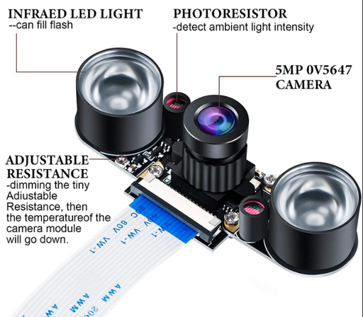
Hardware
RPi IR-CUT camera
Sensor: OV5647
Megapixel: 5
Sensor best resolution : 1080p
Infrared LED and/or fill flash LED
Operating Voltage :3.3V
obstacle avoidance sensor
Ultrasonic: Detects walls, large objects (2 cm - 4 m).
IR: Detects edges, small obstacles (few cm - 1-2 m).
Combined: Provides full coverage for obstacle avoidance.

Slide 12
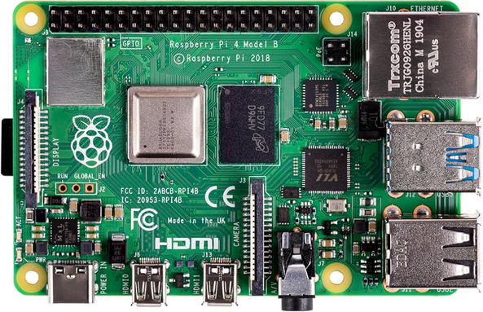
Hardware
Raspberry Pi 4 Specifications
Processor: 1.5 GHz Quad-Core ARM Cortex-A72
Memory: 2GB / 4GB / 8GB LPDDR4
Connectivity: Wi-Fi, Bluetooth 5.0, Gigabit Ethernet
Ports: 2 × USB 3.0, 2 × USB 2.0, 2 × Micro HDMI (4K support)
Power: 5V/3A via USB-C

Slide 13
Image Processing Implementation
Workflow
Image Capture: Use the Raspberry Pi camera to capture real-time images.
Preprocessing: Resize, normalize, and apply filters to enhance image quality.
Model Inference: Use pre-trained models (e.g., MobileNet, YOLO) for object detection and gesture recognition.
Post-Processing: Analyze model output (e.g., bounding boxes, class labels) for decision-making.
Applications
Object Detection: Identify and classify objects in the environment.
Gesture Recognition: Enable human-rover interaction through hand gestures.
Autonomous Navigation: Use visual data for path planning and obstacle avoidance.

Slide 14
Conclusion and Future Work
Conclusion
Successfully integrated cameras, motors, and 3D-printed parts.
Implemented image processing models on the Raspberry Pi 4 B for object detection and gesture recognition.
Addressed challenges like camera latency and encoder motor calibration.
Future Work
Model Optimization: Further optimize image processing models for better performance.
Real-World Testing: Test the rover in real-world environments.
Integration with Navigation: Use image processing data for autonomous navigation.
Gesture Recognition: Improve algorithms for more intuitive human-rover interaction.

Slide 15
References
Key References
Video Surveillance Robot Control Using Smartphone and Raspberry Pi: IEEE Link.
IoT-Based Smart Multi-Application Surveillance Robot: IEEE Link.
Kinematics Analysis and Simulation of a Rocker-Bogie Mobile Robot: Typeset Link.
Design of Robot Obstacle Recognition Location Ranging Algorithm: IEEE Link.

Slide 16
Thank You
Notes:
‹#›

