Slide 1
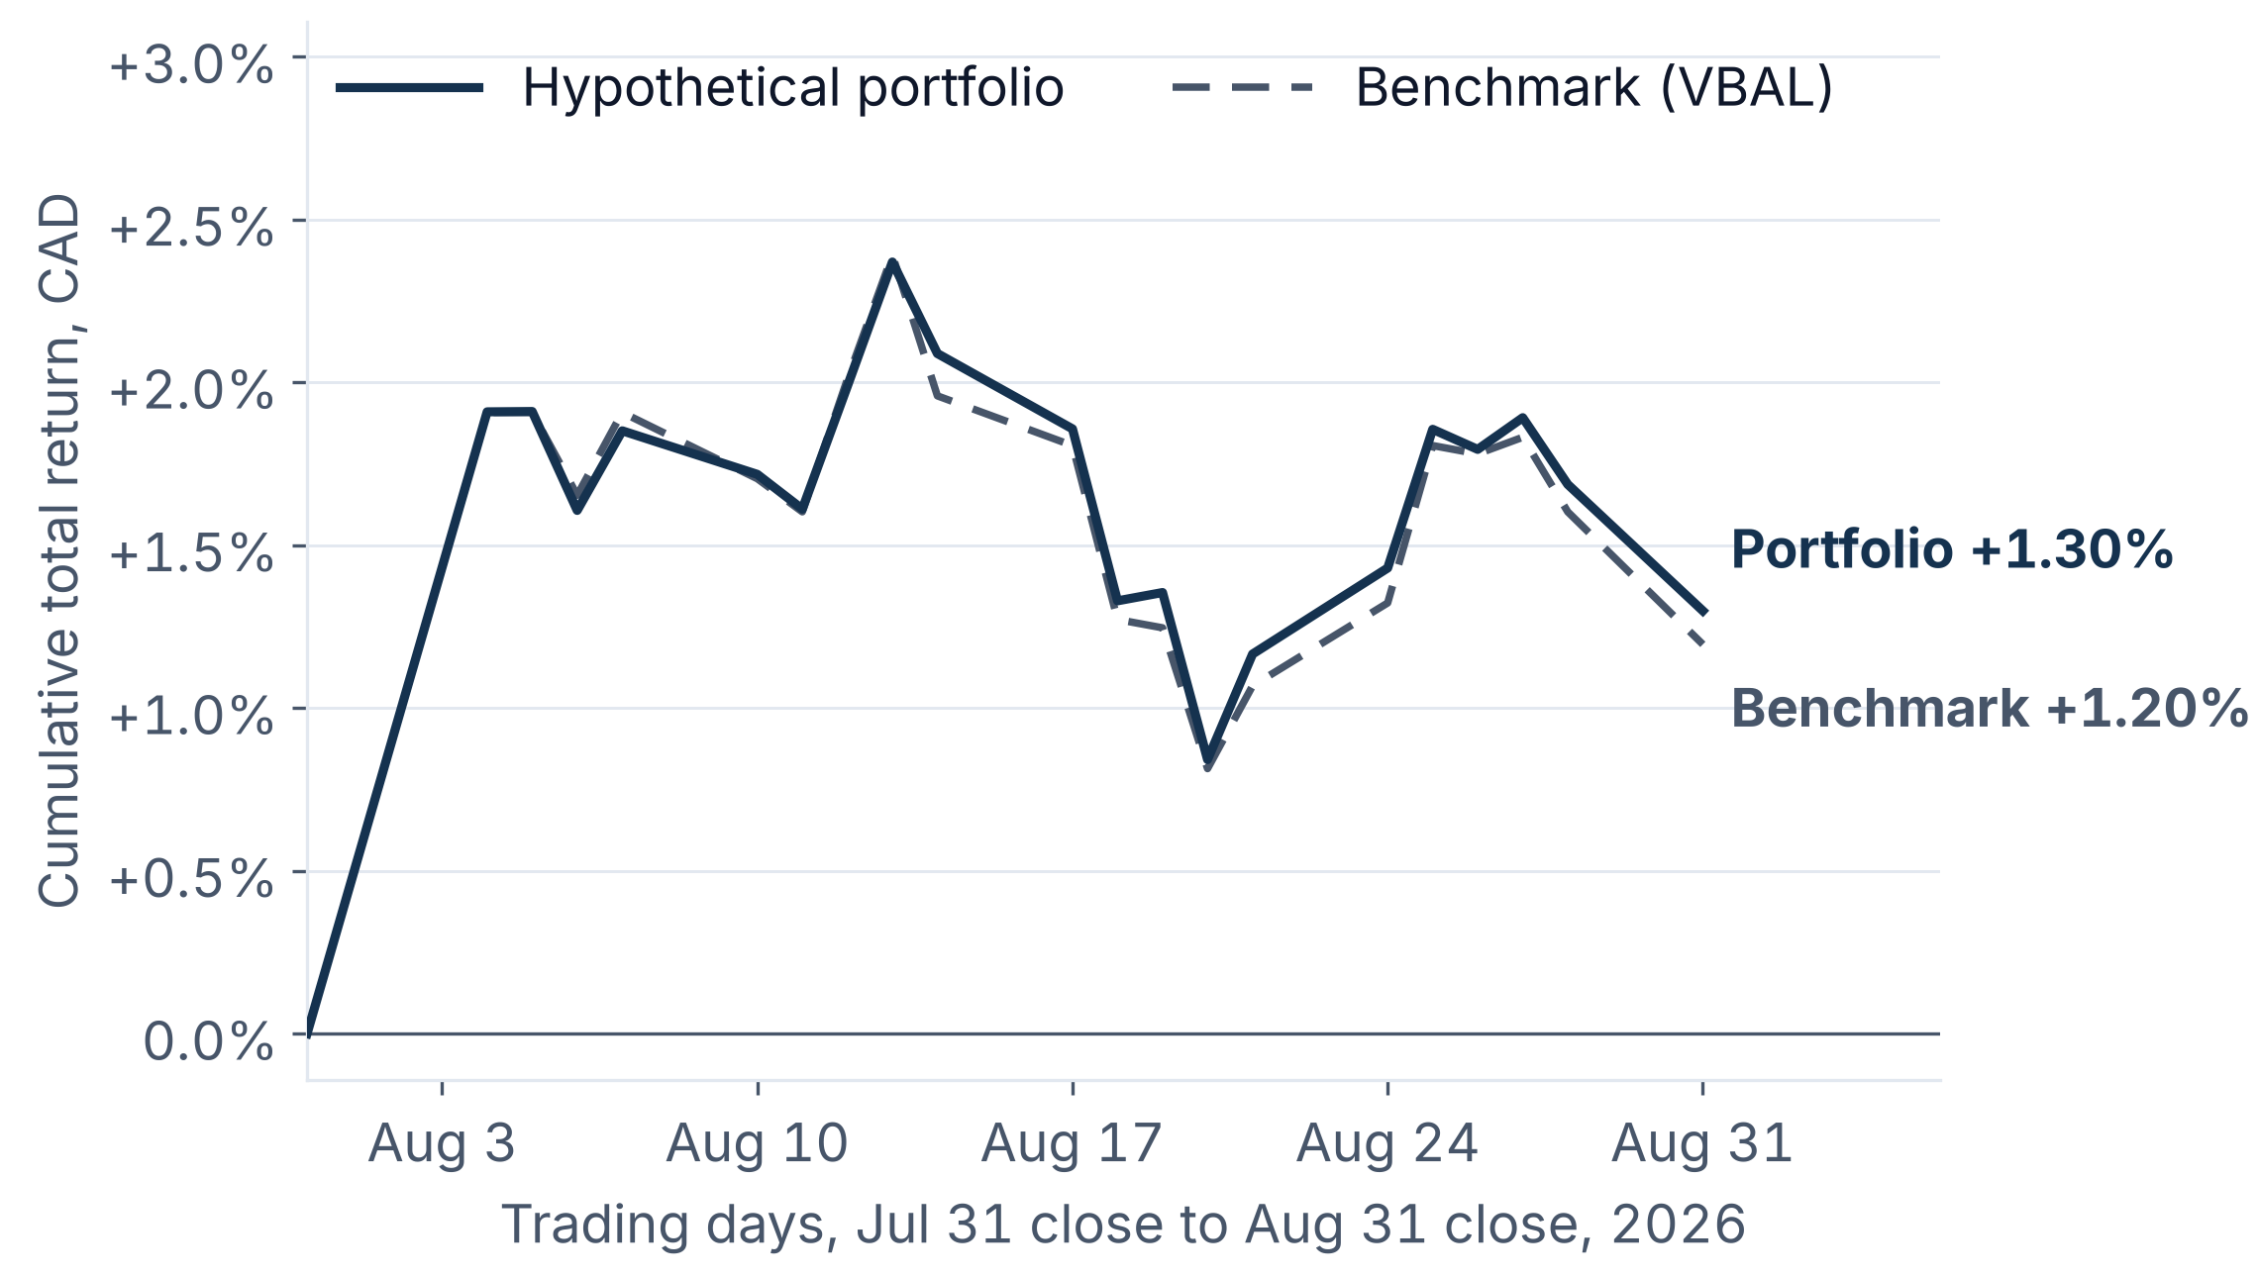
INDEPENDENT EDUCATIONAL RESEARCH SAMPLE | HYPOTHETICAL PORTFOLIO
Market & Portfolio Report | August 2026
Equities led and bonds stood still in August
+1.30%
+1.20%
+0.10
Portfolio
Benchmark (VBAL)
Difference (pp)
Portfolio +1.30% versus benchmark +1.20%, a difference of +0.10 pp
Equities added +1.30 pp; bonds added 0.00 pp
Theme: USD/CAD fell 1.16%, trimming gains on unhedged foreign equities
Cumulative total return since the Jul 31 close, CAD. Daily closes.
Sources: [1] Yahoo Finance; [2] Bank of Canada Valet. Full references in the report.
1 / 3
Notes:
Main message. In August 2026 the hypothetical 60/40 portfolio returned +1.30% in Canadian dollars and the benchmark returned +1.20%. Equities contributed +1.30 pp and bonds 0.00 pp. The chart shows cumulative total return from the July 31 close. The theme is currency: USD/CAD fell from 1.4029 to 1.3866, which trims what unhedged foreign equities earn for a Canadian investor. For a client: stocks rose, bonds were flat, and a stronger Canadian dollar took a little off foreign holdings. Sources are the exchange closes and Bank of Canada series listed in the report.

Slide 2
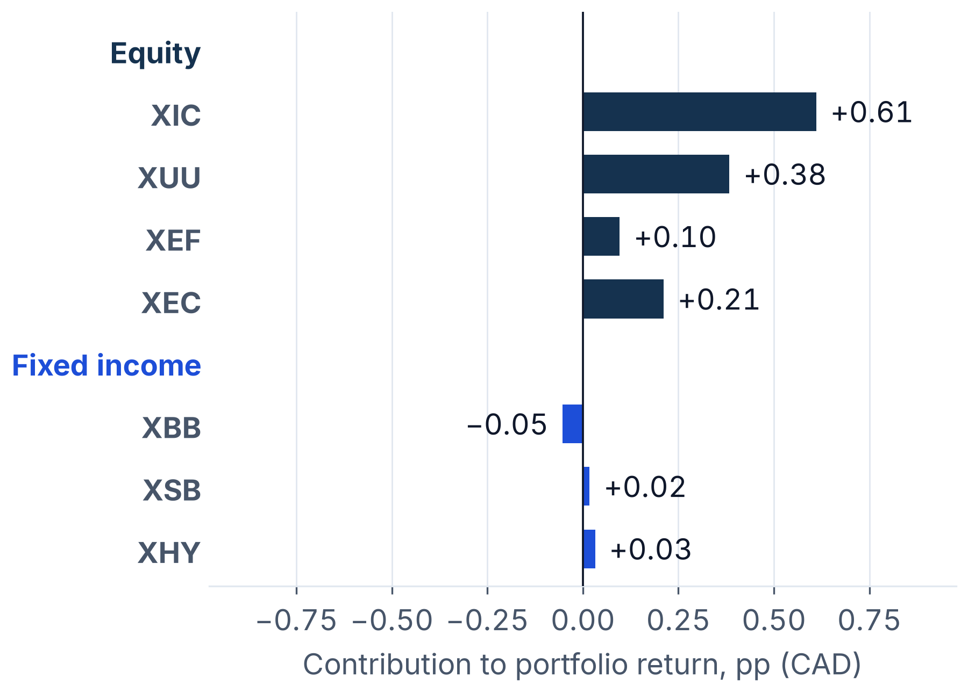
INDEPENDENT EDUCATIONAL RESEARCH SAMPLE | HYPOTHETICAL PORTFOLIO
Market & Portfolio Report | August 2026
Implications: maintain weights, drift is inside the bands
Maintain
Equity 60.0% to 60.5%; fixed income 40.0% to 39.5%
Equity: Canada +3.06% and emerging markets +4.22% led; sleeve ended at 60.5%
Fixed income: 2-year yield +10 bp, 10-year +8 bp; sleeve flat at −0.01%
Decision: Maintain. Largest drift 0.37 pp against a 1.5 pp band
Contribution = start weight x total return, in percentage points.
Sources: [1] Yahoo Finance; [2] Bank of Canada Valet. Full references in the report.
2 / 3
Notes:
Portfolio implications. Canadian equities and emerging markets led. The equity sleeve ended at 60.5% against a 60% target. Bond yields rose modestly, so price losses on the broad bond fund were mostly offset by distributions. The illustrative rule says maintain: the largest drift is 0.37 pp, inside the 1.5 pp band. Resetting to target would trade 0.55% of the portfolio. This is an illustration of a rule, not advice for any client.

Slide 3
INDEPENDENT EDUCATIONAL RESEARCH SAMPLE | HYPOTHETICAL PORTFOLIO
Market & Portfolio Report | August 2026
Risks and what to monitor
Downside risks
What to monitor
Higher yields hurt bonds and can weigh on equities
Currency moves are two-way on 40.0% of the portfolio
Policy and trade uncertainty flagged by the Bank of Canada
Bank of Canada, Sep 2
FOMC, Sep 15-16
Canada yields and USD/CAD
Weight drift versus bands
Counterargument. For acting: yields are rising, three FOMC members preferred a hike on July 29 [4], and bonds gave no cushion. For patience: drift is inside the bands and one month of yields is weak evidence of a trend.
Sources: [1] Yahoo Finance; [2] Bank of Canada Valet; [3] Bank of Canada; [4] Federal Reserve Board. Full references in the report.
3 / 3
Notes:
Risks and monitoring. Rates are the main risk: three FOMC members preferred a rise on July 29 and Canadian yields moved up in August. Currency risk is two-way. The Bank of Canada has flagged the Middle East war and US trade policy. Next events: the Bank of Canada decision on September 2 and the FOMC meeting on September 15 and 16. The counterargument is that a more defensive investor could act now; the case for patience is that drift is small and one month of yields is weak evidence.

