Slide 1
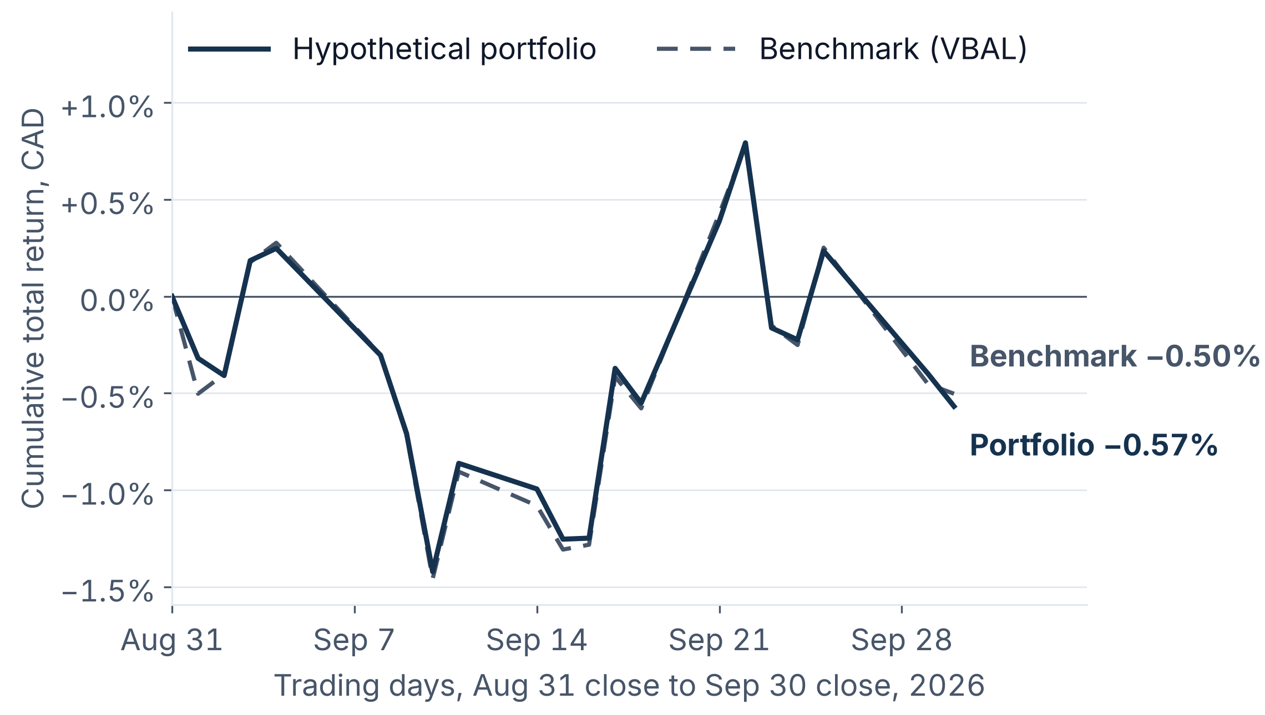
INDEPENDENT EDUCATIONAL RESEARCH SAMPLE | HYPOTHETICAL PORTFOLIO
Market & Portfolio Report | September 2026
Rising rates hit bonds and credit in September
−0.57%
−0.50%
−0.06
Portfolio
Benchmark (VBAL)
Difference (pp)
Portfolio −0.57% versus benchmark −0.50%, a difference of −0.06 pp
Bonds subtracted 0.54 pp; equities were flat at −0.03 pp
Theme: Fed raised to 3-3/4 to 4 percent; Canada 2-year yield +36 bp
Cumulative total return since the Aug 31 close, CAD. Daily closes.
Sources: [1] Yahoo Finance; [2] Bank of Canada Valet. Full references in the report.
1 / 3
Notes:
Main message. In September 2026 the hypothetical 60/40 portfolio returned −0.57% in Canadian dollars and the benchmark returned −0.50%. Bonds subtracted 0.54 pp, about 95% of the decline, while equities were roughly flat because US and emerging-market gains offset losses in Canada and developed international markets. The theme is rates: the Fed raised its range to 3-3/4 to 4 percent on September 16 and Canada's 2-year yield rose +36 bp. Bank of Canada series end on Sep 29 because September 30 was a federal holiday. For a client: higher yields pushed bond prices down, and Canadian stocks fell as well.

Slide 2
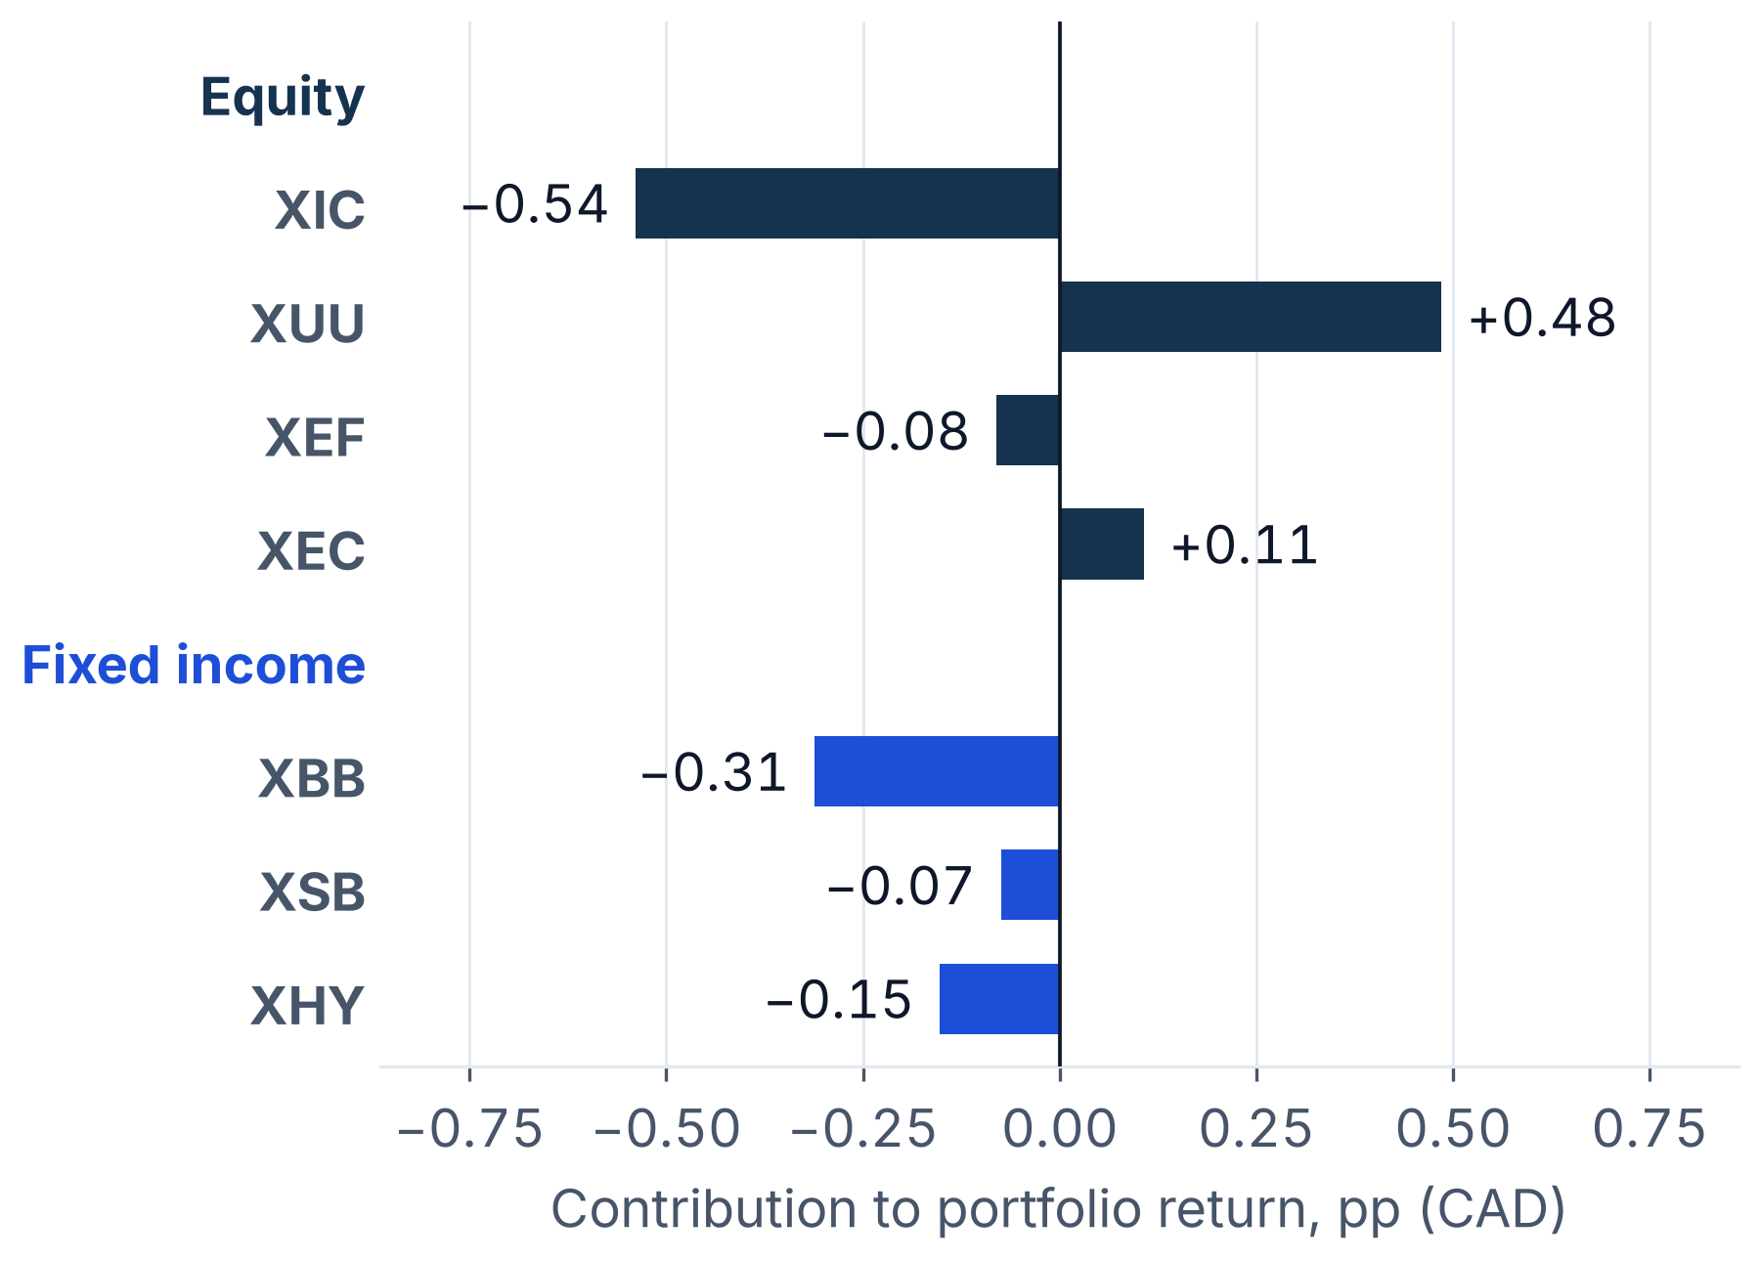
INDEPENDENT EDUCATIONAL RESEARCH SAMPLE | HYPOTHETICAL PORTFOLIO
Market & Portfolio Report | September 2026
Implications: maintain weights, drift is inside the bands
Maintain
Equity 60.5% to 60.8%; fixed income 39.5% to 39.2%
Equity: US +1.93% and emerging +2.07% rose; Canada −2.65% fell
Fixed income: sleeve −1.36%; short-term bonds fell less than the broad fund
Decision: Maintain. Largest drift 0.69 pp against a 1.5 pp band
Contribution = start weight x total return, in percentage points.
Sources: [1] Yahoo Finance; [2] Bank of Canada Valet. Full references in the report.
2 / 3
Notes:
Portfolio implications. The equity sleeve was flat but dispersion was wide. The bond sleeve fell −1.36%, and the short-term fund held up better than the broad index. The illustrative rule says maintain: the largest drift is 0.69 pp, inside the 1.5 pp band, and a reset would trade 0.97% of the portfolio. Weights this month began from August's drifted weights because August's decision was Maintain. This illustrates a rule, not advice for any client.

Slide 3
INDEPENDENT EDUCATIONAL RESEARCH SAMPLE | HYPOTHETICAL PORTFOLIO
Market & Portfolio Report | September 2026
Risks and what to monitor
Downside risks
What to monitor
More yield increases would extend bond losses
US tariffs and counter-measures cloud growth
Credit weakness: XHY −3.07%
Currency reversal on foreign equity
Bank of Canada and MPR, Oct 28
FOMC, Oct 27-28
Canada yields and USD/CAD
XHY and credit conditions
Counterargument. For acting: the Federal Reserve is tightening; moving part of XBB into XSB would lower rate sensitivity. For patience: drift is inside the bands, and selling bonds after a decline locks in the loss without evidence of where yields go next.
Sources: [1] Yahoo Finance; [2] Bank of Canada Valet; [3] Bank of Canada; [4] Federal Reserve Board. Full references in the report.
3 / 3
Notes:
Risks and monitoring. More yield increases would extend bond losses; the Bank of Canada says upside inflation risks increased and tariffs add uncertainty to growth. XHY fell −3.07%, a reminder that credit can weaken with equities. Next events: the Bank of Canada decision and Monetary Policy Report on October 28 and the FOMC meeting on October 27 and 28. The counterargument is to shorten bond duration now; the case for patience is that drift is small and selling after a decline locks in the loss.

