Slide 1








GROUP
PROJECT

Slide 2




TABLEAU
01

Slide 3



contribution
Aswathy
●Year wise loan amount Stats
●State wise and last_credit_pull_d wise loan status
Ankita
●Total Payment for Verified Status Vs Total Payment
for Non Verified Status
Arbind
●Grade and sub grade wise revol_bal
neerav
●Home ownership Vs last payment date stats

Slide 4
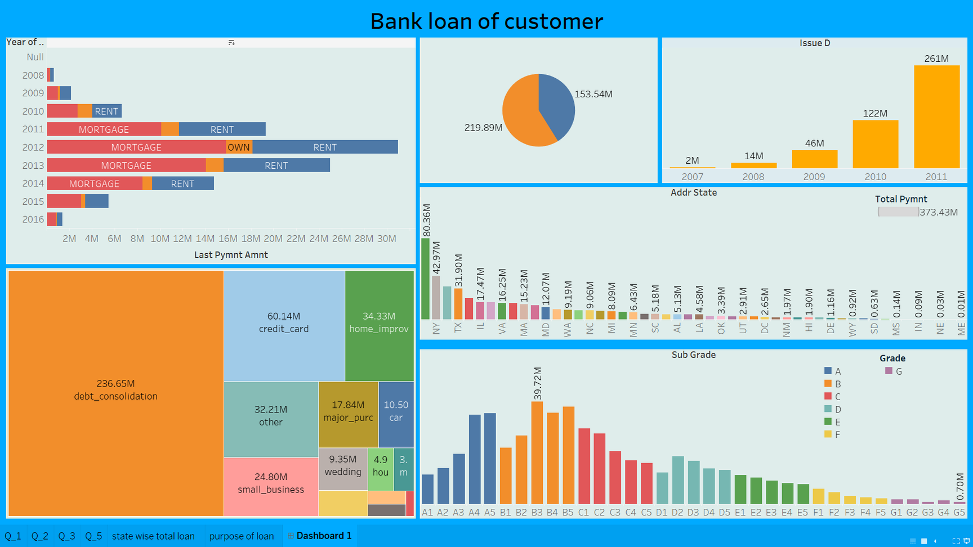

Slide 5
POWER BI
02

Slide 6
contribution
Aswathy
●Year wise loan amount Stats
●State wise and last_credit_pull_d wise loan status
Ankita
●Total Payment for Verified Status Vs Total Payment
for Non Verified Status
Arbind
●Grade and sub grade wise revol_bal
neerav
●Home ownership Vs last payment date stats

Slide 7
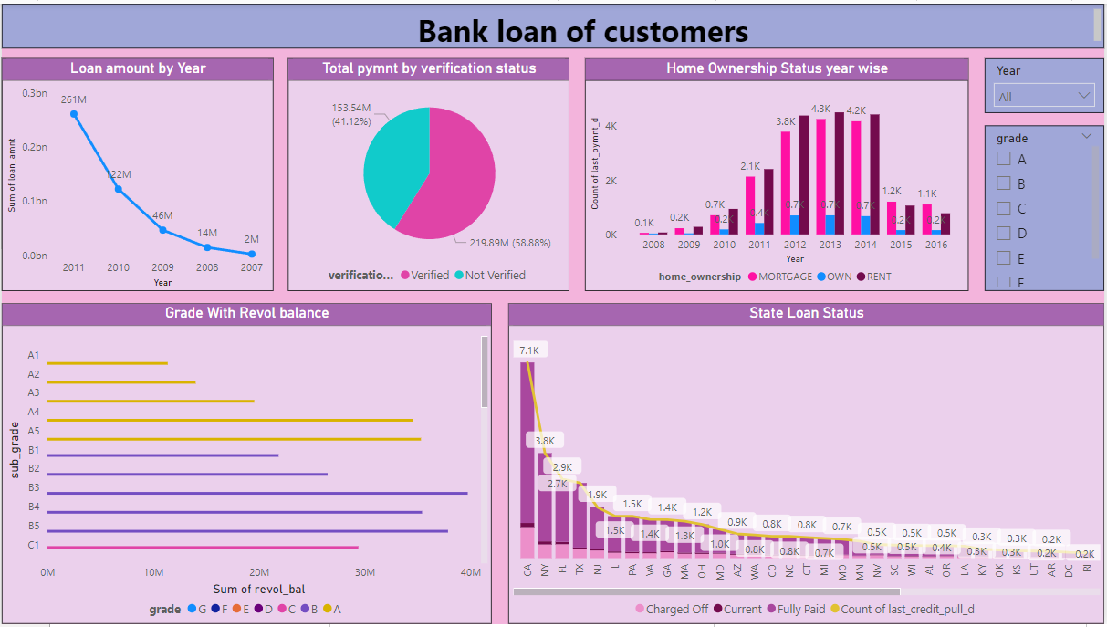

Slide 8
EXCEL
03

Slide 9
contribution
Aswathy
●Year wise loan amount Stats
●State wise and last_credit_pull_d wise loan status
Ankita
●Total Payment for Verified Status Vs Total Payment
for Non Verified Status
Arbind
●Grade and sub grade wise revol_bal
neerav
●Home ownership Vs last payment date stats

Slide 10
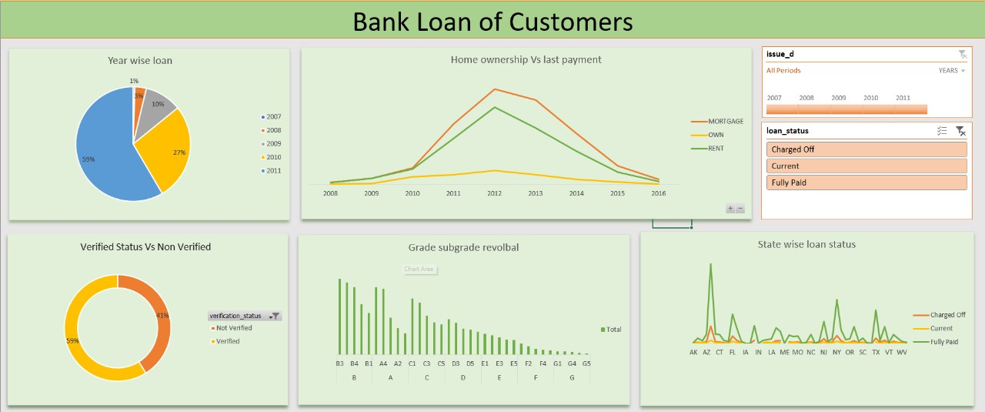

Slide 11
SQL
04

Slide 12
contribution
Aswathy
●Year wise loan amount Stats
●State wise and last_credit_pull_d wise loan status
Ankita
●Total Payment for Verified Status Vs Total Payment
for Non Verified Status
Arbind
●Grade and sub grade wise revol_bal
neerav
●Home ownership Vs last payment date stats

Slide 13


Slide 14




Slide 15






