Slide 1



Slide 2
Group 1-Team Members
Mr Arabinda Sahoo
Mr. Neerav Singhwal
Mr. Shivraj Yashwant Jane
Ms. Aswathy R B
Ms. Ankita Dattatray vetal

Slide 3
What is crowdfunding?
Raising money or funding a business by getting small amounts of capital from a large number of people.
Main Players:
Product Creators: The creators post a Kickstarter campaign to gauge how much a new product will succeed before investing in manufacturing.
Backers: Pledge to purchase a product before it's on the market thereby support the creation of new creative products
Funding:
Product Creators: The creators set a funding goal and the duration to achieve it.
Backers: Backers are charged only if the creator meets his/her funding goal and the duration.

Slide 4




Project Objective
The project aim to analyze the dataset of crowdfunding, through a report to get insights from it by using different software tools such as Excel, MySQL, Tableau and Power Bi.
From these gained insights accurate business decisions are made.

Slide 5
Key Performance Indicators
Total Number of Projects based on outcome
Total Number of Projects based on Locations
Total Number of Projects based on Category
Total Number of Projects created by Year , Quarter , Month
Successful Projects
Amount Raised
Number of Backers
Avg Number of Days for successful projects
Top Successful Projects
Based on Number of Backers
Based on Amount Raised
Percentage of Successful Projects overall
Percentage of Successful Projects by Category
Percentage of Successful Projects by Year , Month etc..
Percentage of Successful projects by Goal Range
Blue – Neerav Orange – Arabind Yellow - Aswathy Red – Ankita Green - Shivraj

Slide 6
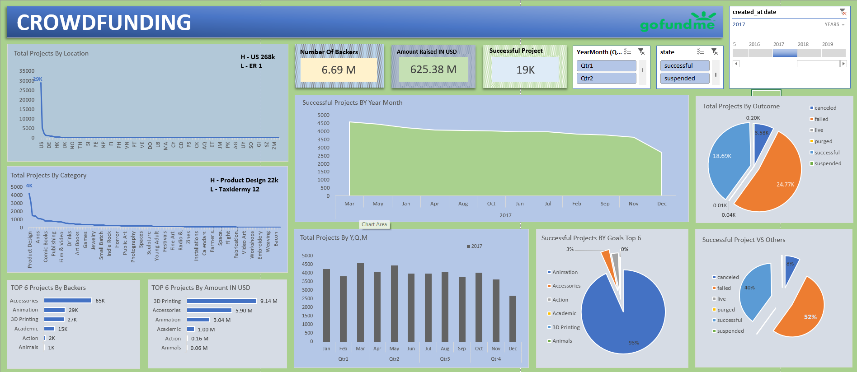

Slide 7
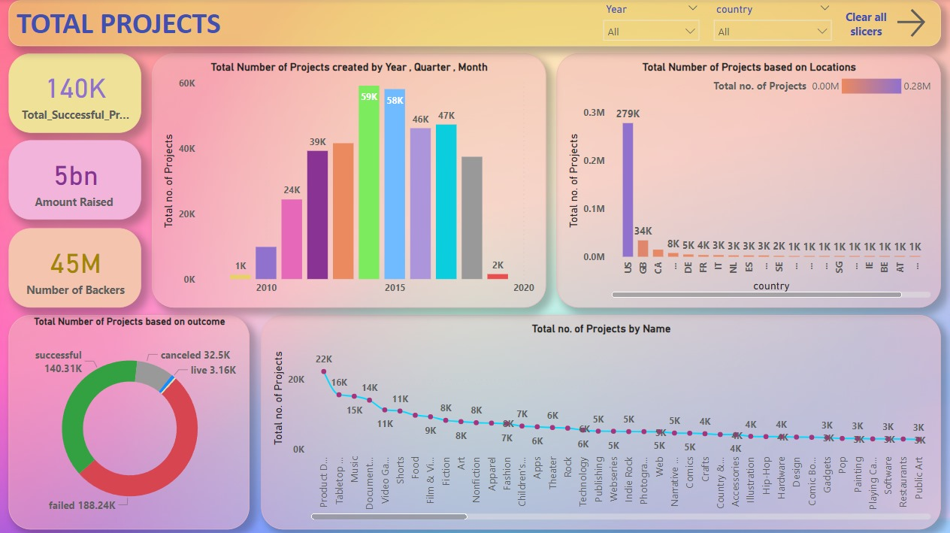

Slide 8
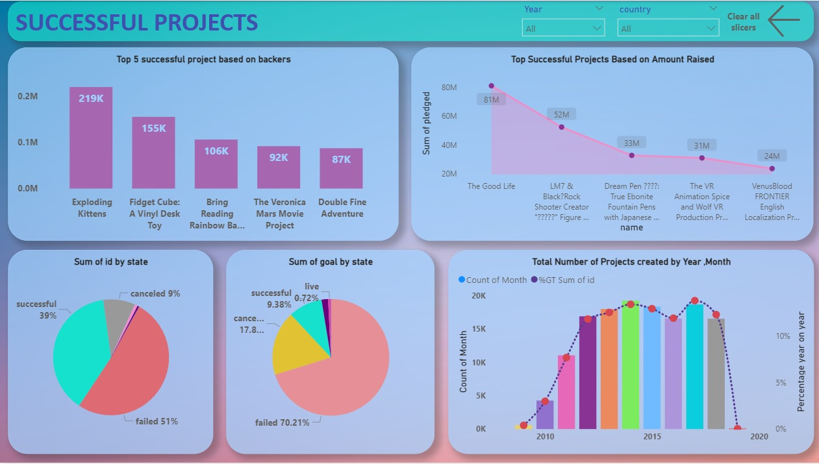

Slide 9
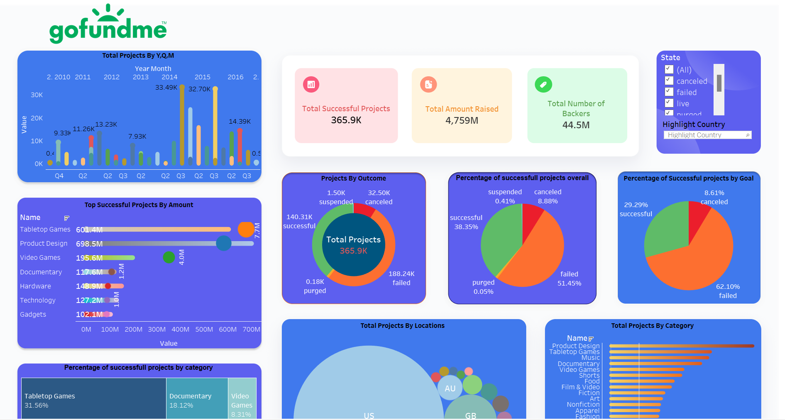

Slide 10
Conclusion
Multiple outcomes for a project can be observed, viz., Successful, Failed, Live, Purged, Suspended and Cancelled.
It can be observed that the success of a project is low in comparison to failure, suspension and cancellation put together but where the amount need to be raised more than 50000$ in that case most failures happening the success rate was 13%. The average success rate for projects is 38.3%. It defines that individual people wants to invest in small projects where the success rate is much higher.
Among the Most fails happens because there are many reasons like for suspension, lack of trust and non-transparency in disclosing relevant information about the project or the creator, as well as presenting others' work as one's own, are significant factors.

Slide 11

This Photo by Unknown Author is licensed under CC BY-SA

