Slide 1

PROJECT NAME: ZOMATO ANALYSIS
By: - Neerav Singhwal

Slide 2




| AGENDA |
The project aim to analyze the dataset of zomato, through a report to get insights from it by using different software tools such as Excel, MySQL, Tableau and Power Bi.
From these gained insights accurate business decisions are made.

Slide 3

CLIENT'S PROBLEM
Zomato, a leading restaurant discovery and food delivery platform, seeks to enhance its market understanding and operational strategies through comprehensive data analysis. The client aims to leverage data insights to improve restaurant selection algorithms, enhance user experience, and optimize delivery services.

Slide 4
Build a Country Map Table
Construct a Calendar Table with Datekey and additional attributes (Year, Monthno,
Monthfullname, Quarter, YearMonth, Weekdayno, Weekdayname, FinancialMonth, Financial Quarter).
Analyze Number of Restaurants by City and
Country.
Track Restaurant Openings by Year, Quarter, and
Month.
Calculate Average Ratings and segment restaurants
based on ratings.
Create price buckets and analyze restaurant
distribution.
Determine percentages of restaurants with Table Booking and Online Delivery options.
Develop visualizations and insights on Cuisines,
Cities, and Ratings.

Slide 5
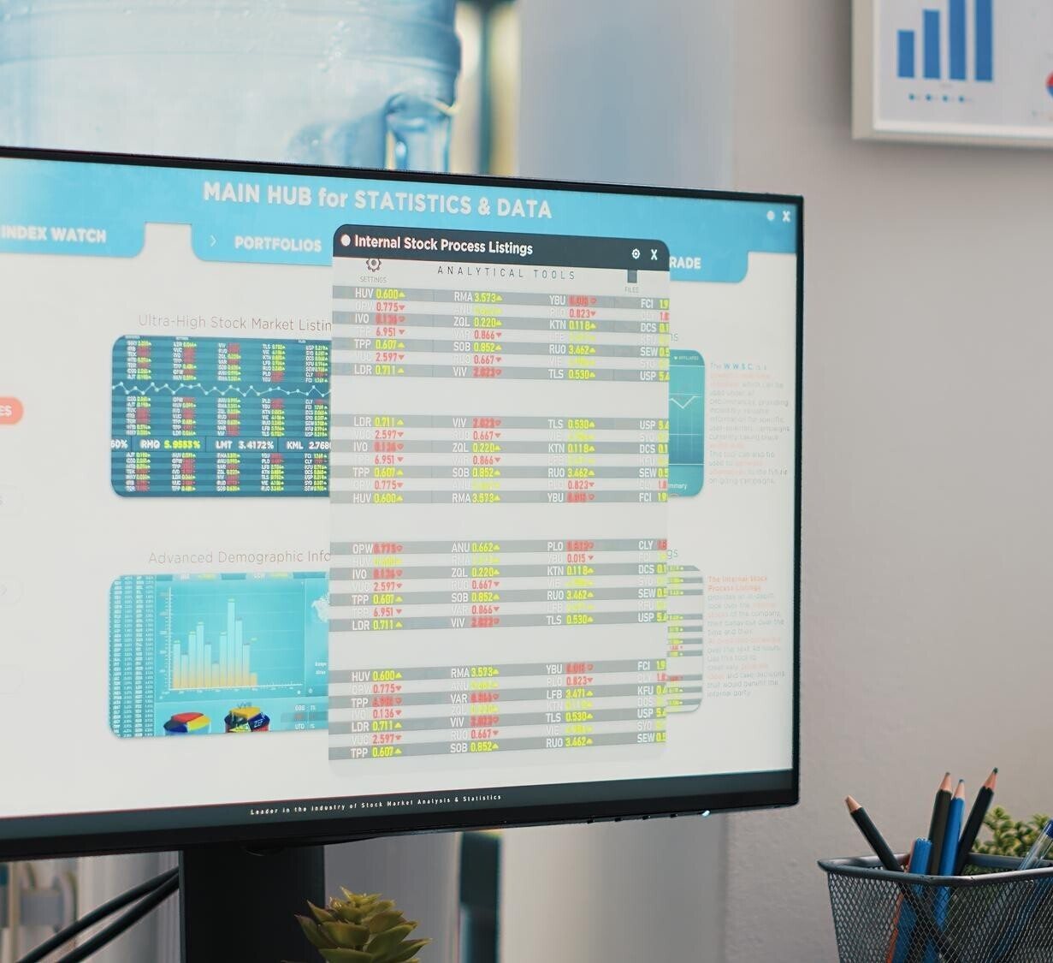
ETL EXPERIENCE
Our ETL (Extract, Transform, Load) process involved:
Extraction: We sourced data from Zomato's API and databases, ensuring comprehensive coverage of restaurant information across multiple regions.
Transformation: Data was cleaned to remove duplicates, correct inconsistencies, and standardize formats.
Loading: Processed data was loaded into structured tables, enabling efficient querying and analysis across different platforms.
Challenges: Challenges included handling large
and
volumes of data, ensuring data quality, integrating diverse data sources seamlessly.

Slide 6

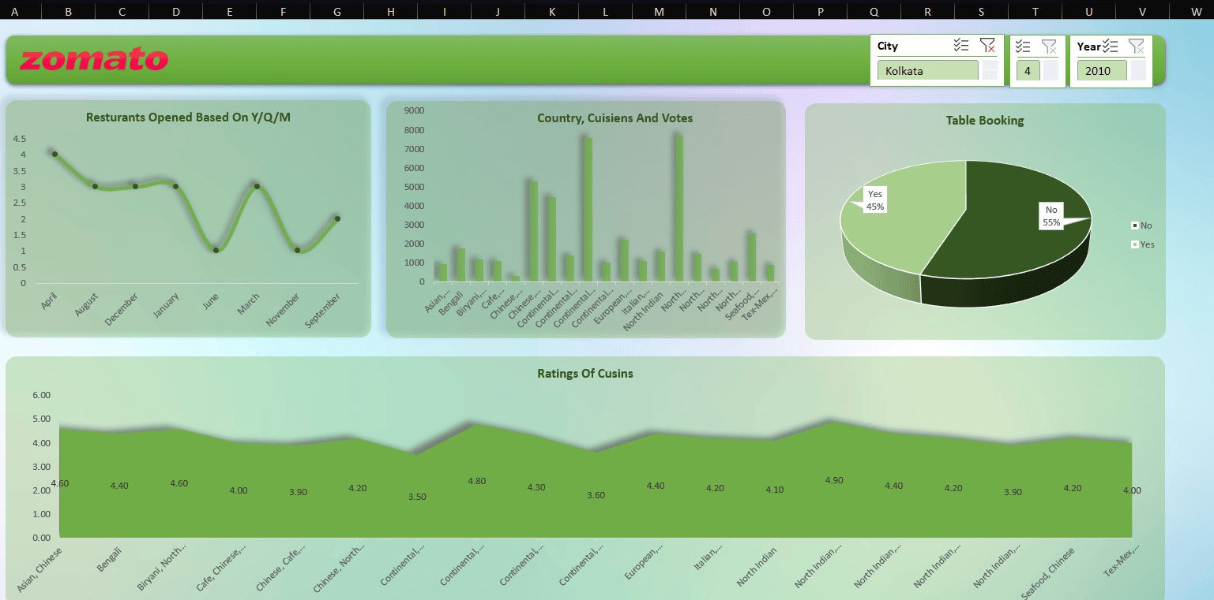
Results - Excel

Slide 7

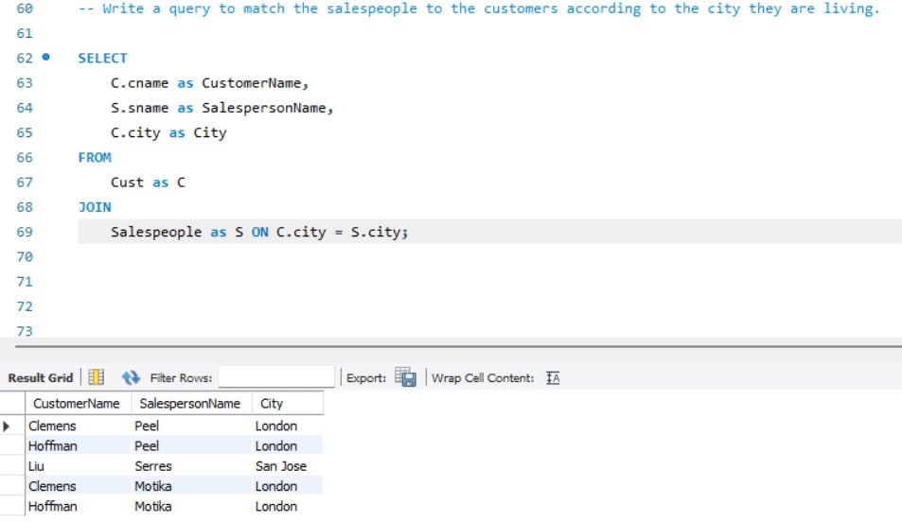
Results - SQL

Slide 8

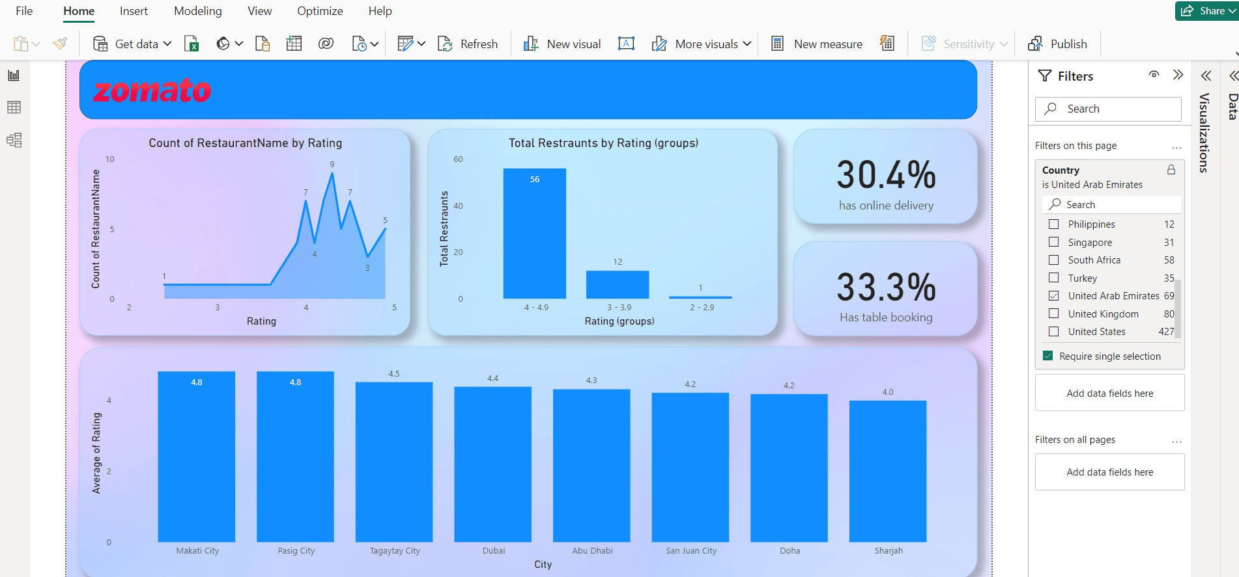
Results - PowerBi

Slide 9

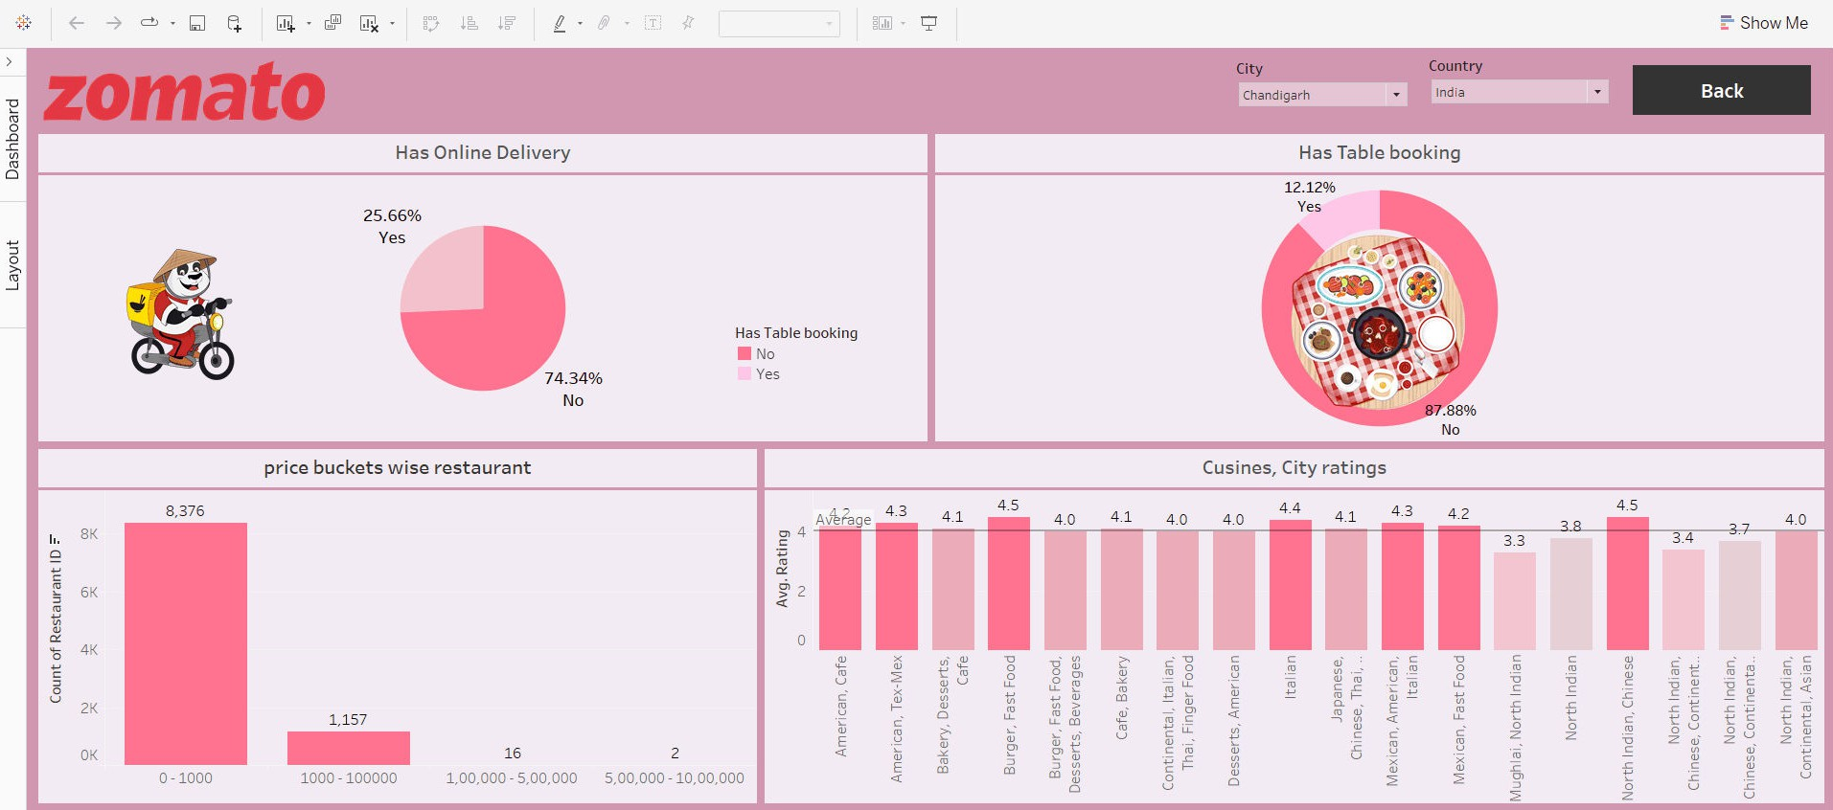
Results - Tableau

Slide 10

C O N C L U S I O N
In conclusion, our Zomato project successfully built essential data structures like the Country Map and Calendar Tables, enabling detailed temporal and spatial analysis.
We quantified restaurant distribution by city and country, tracked openings over time, and analyzed customer satisfaction through average ratings.
Additionally, we segmented restaurants by price and evaluated operational features like table booking and online delivery.
Our visualizations on cuisine preferences, city-specific trends, and rating analyses provide actionable insights for strategic decisions.
This project underscores our commitment to data-driven excellence and supports Zomato in optimizing service delivery and customer experience effectively.

Slide 11


