Slide 1
Applied Process Engineering-2 Group 3
CH22B025 Neerav Sreekumar
CH22B030 Raghav Khandelwal
CH22B031 Rajan Raj
CH22B035 Satyam Kumar Singh

Slide 2

Table of Contents
Process Definitions
Process Description-1
Process Description-2
Process Reaction Conditions
Process Description-3
Recovering Benzene
Process Flowsheet
Material Balance for questions
Appendix- Q1,2,3

Slide 3

Process Definitions
Quenching
The rapid cooling of the heated mixture to prevent coking.
Coking
The deposition and accumulation of carbon materials inside the equipment which could reduce efficiency.
Hydrocracking
The process of breaking down larger hydrocarbons to lighter and smaller ones using hydrogen and catalysts.

Slide 4
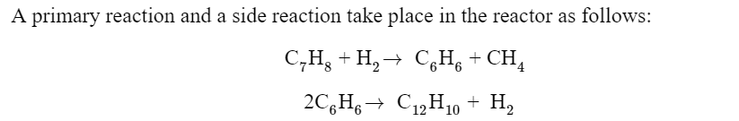
Hydrodealkylation of Toluene
The hydrodealkylation of toluene (HDA) is a process used to produce Benzene, where Methane and Diphenyl are also produced as a byproduct.
The reactant mixture is first preheated in a feed-effluent heat exchanger (FEHE) using the reactor effluent stream and then to the reaction temperature in a furnace.
Hydrodealkylation is a chemical process in which an aromatic hydrocarbon, like Toluene, undergoes a reaction with Hydrogen gas, resulting in the formation of a less complex aromatic hydrocarbon without any functional groups.

Slide 5
Process Description-1
HDA
Fresh Toluene
Mixture of 95% hydrogen and 5% methane
Recycled Toluene and Hydrogen
To produce Benzene, where Methane and Diphenyl are also produced as a byproduct.

Slide 6
Process Description-2
The reactor effluent is quenched by a portion of the recycle separator liquid flow to prevent coking, and further cooled in the FEHE and cooler before being fed to the vapor-liquid separator.
Part of the vapor containing unconverted hydrogen and methane is purged to avoid accumulation of methane within the process while the remainder is compressed and recycled to the process.
The liquid from the separator is processed in the separation section consisting of three distillation columns. The stabilizer column removes small amounts of hydrogen and methane in the overhead product, and the benzene column takes of the benzene product in the overhead.
Reactant > FEHE > Furnace > Quenching > Vapour Liquid Separator

Slide 7
Process Reaction Conditions
Temperature
1150 °F to 1300 °F
(Less than 1150 °F has a low reaction rate; greater than 1300 °F causes hydrocracking.)
Pressure
500 Psia = 35 bar,
Gas phase reaction with no catalyst involved.
To avoid coking, there must be an excess of hydrogen—a 5:1 ratio.

Slide 8
Process Description 3-
Before being fed into the reactor, the streams of raw toluene and hydrogen are heated and mixed with recycled toluene and hydrogen.
01- Feed
Together with the undesired diphenyl, the reactor's product stream also includes hydrogen, methane, benzene, and toluene. By flashing away the light gases, we try to extract the majority of the hydrogen and methane from the aromatics.
02- Separation
Methane, which is created during the reaction and enters the hydrogen stream as an impurity, will build up in the gas-recycle loop, we would still prefer to recycle the hydrogen left in the flash vapour. Therefore, to eliminate methane from the process and product stream, a purge stream is needed.
03- Recycle and Purge

Slide 9
Recovering Benzene
Extracting Hydrogen and Methane
Extract the majority of the leftover hydrogen and methane in a distillation column, known as the stabiliser, to keep them from contaminating our benzene product because not all of it can be separated from the aromatics in the flash drum.
Recovery of Benzene
The benzene recovery happens in a second distillation column, the undesired diphenyl is eventually removed from the recycled toluene.

Slide 10
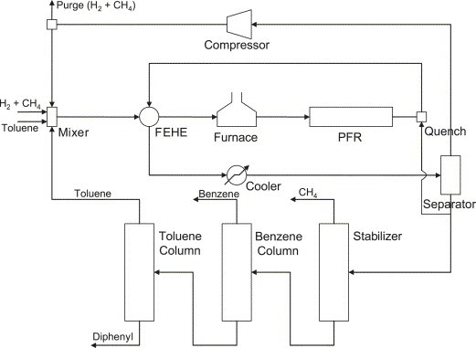
Process Flowsheet
De Araújo, A. C. B., Govatsmark, M. S., & Skogestad, S. (2007). Application of plantwide control to the HDA process. I—steady-state optimization and self-optimizing control. Control Engineering Practice, 15(10), 1222–1237. https://doi.org/10.1016/j.conengprac.2006.10.014

Slide 11
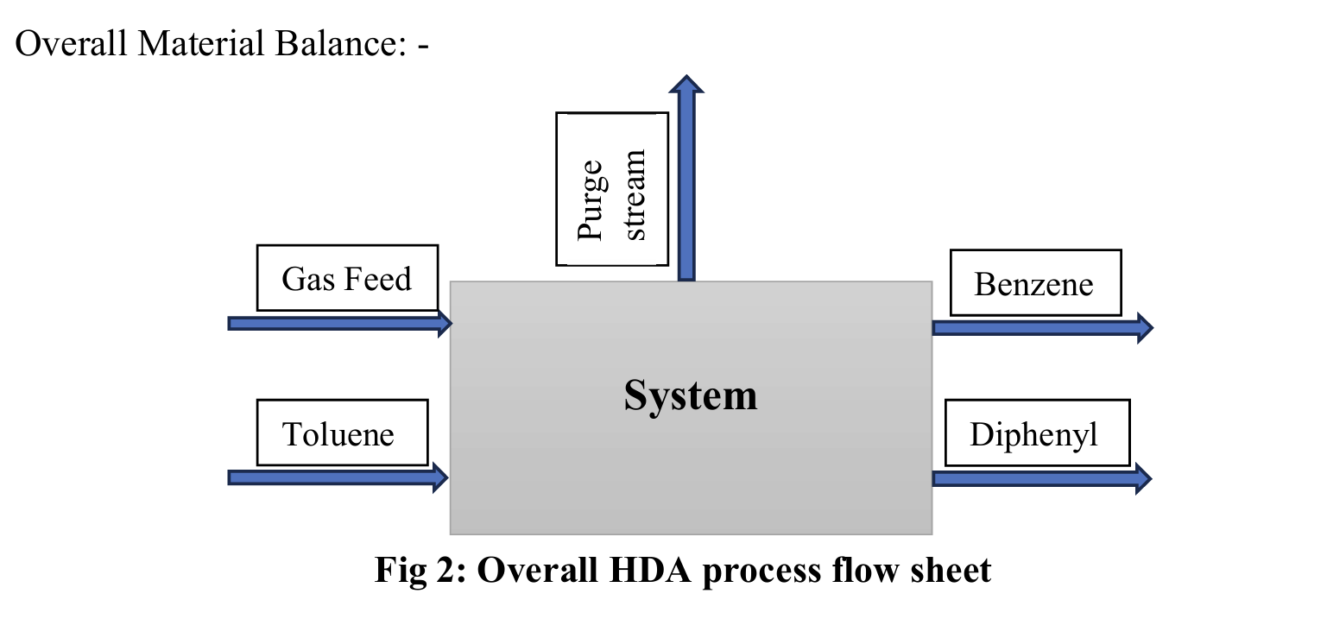

Slide 12
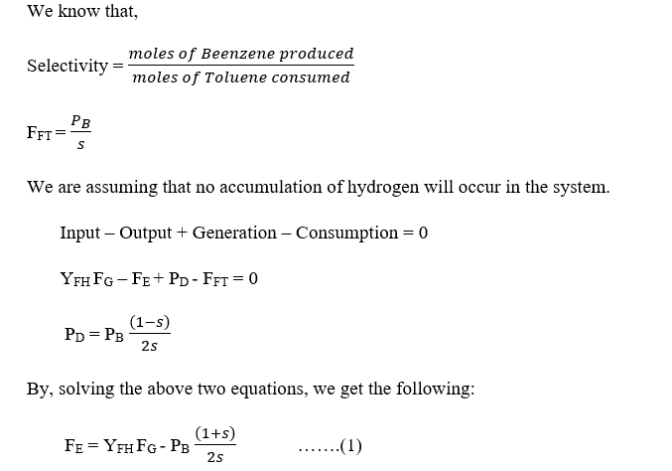
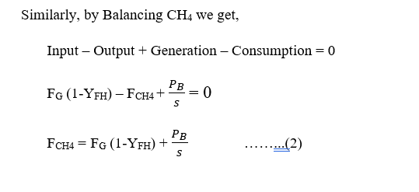
Basis for Calculations

Slide 13
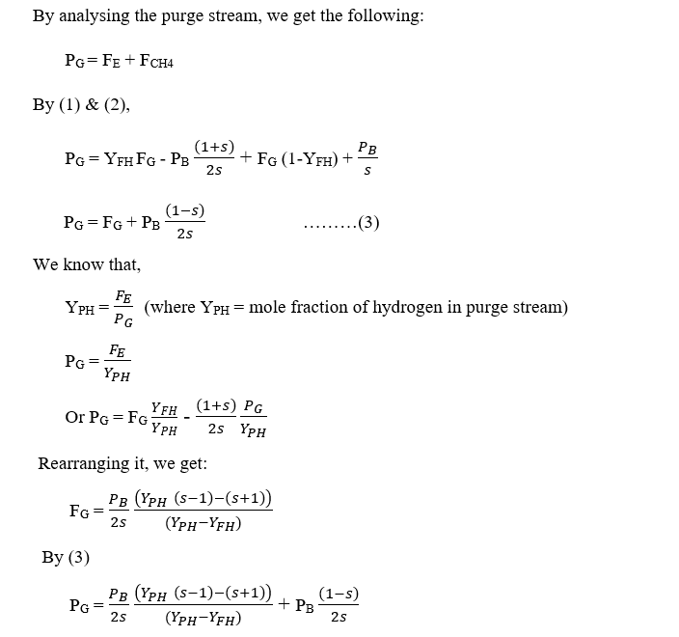
Material Balance for Questions

Slide 14
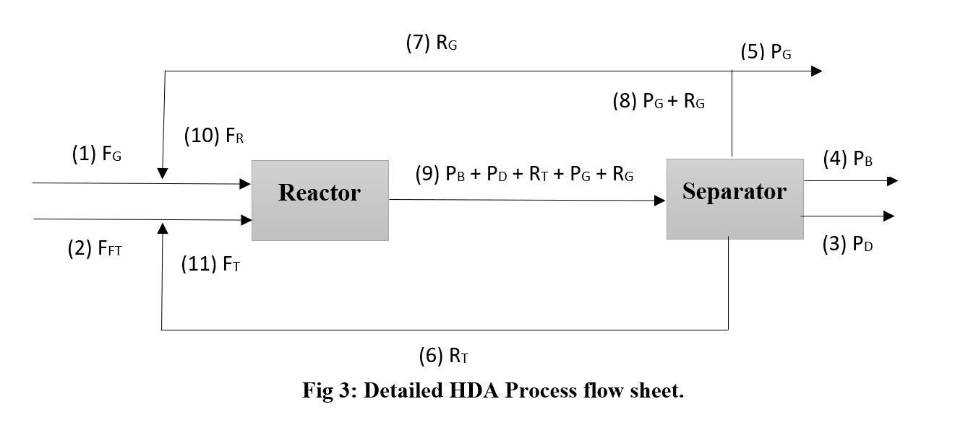
Flowsheet used for Assignment

Slide 15
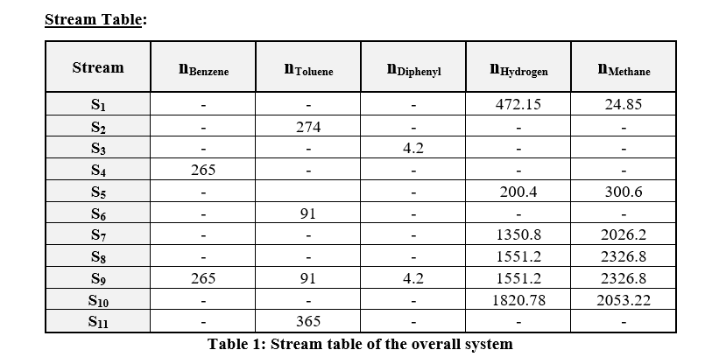

Slide 16
APE 3: Heat Exchanger Design (Assignment 4)
Counter Current Heat Exchanger (FEHE)

Slide 17
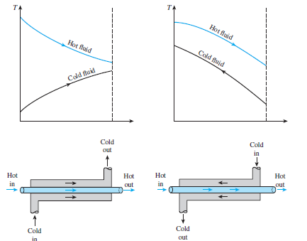
Graphs (Heat Transfer, Cengel et al.)

Slide 18
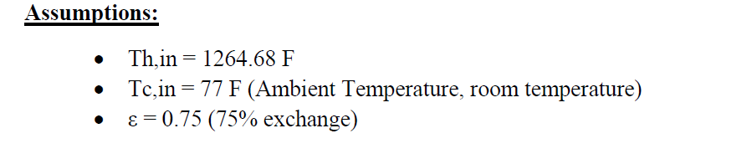
Procedure
Given data and assumptions:

Slide 19
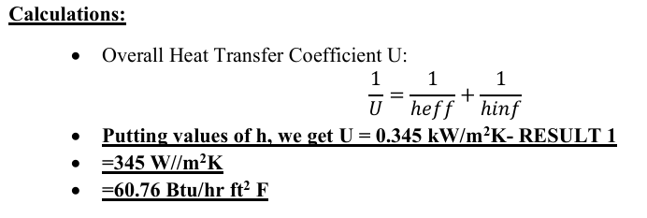
Overall Heat Transfer Coefficient Calculations

Slide 20
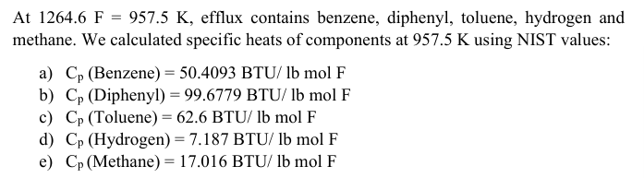
Weighted average of Specific Heat for effluent and feed for calculations

Slide 21
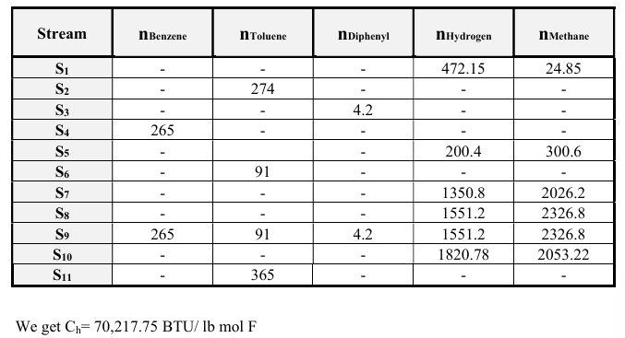
Stream Table and C of effluent calculation

Slide 22
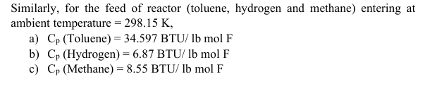
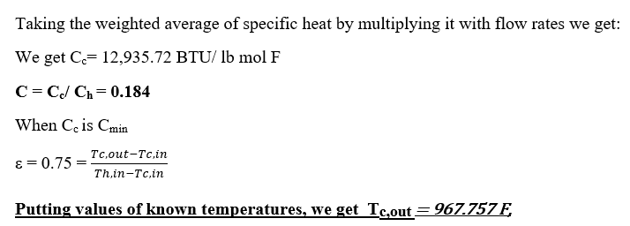
Specific heat of feed using weighted mean

Slide 23
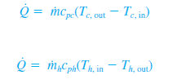




Formulae used for heat transfer calculations

Slide 24
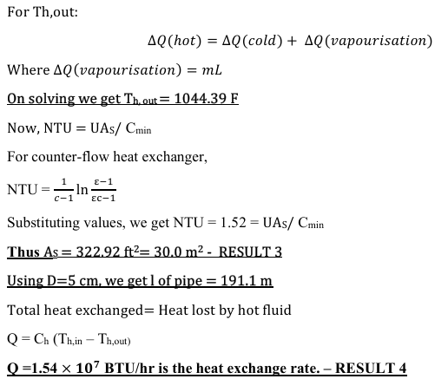
Final Calculations: Q using NTU and T

Slide 25
Multicomponent Distillation
Identify
Light Key (Top)
Bottom Key (Bottom)
Classify
Lighter than the light key will go in the overhead.
Heavier than the heavy key will go in the bottoms.
FUG Shortcut
The FUG method applies to binary and multicomponent feeds.
The method is quite accurate for ideal mixtures of a narrow-boiling range.

Slide 26

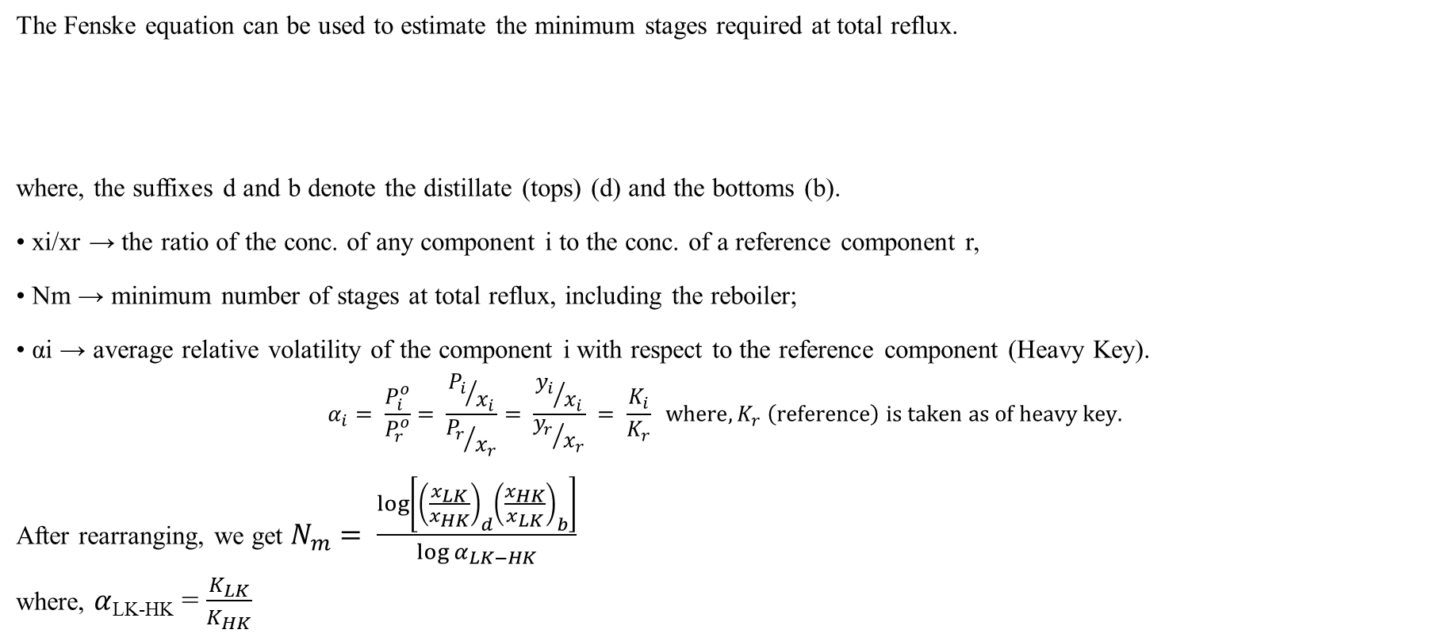
Fenske-Underwood-Gilliland (FUG) method
The Fenske equation can be used to estimate the minimum stages required at total reflux.
where, the suffixes d and b denote the distillate (tops) (d) and the bottoms (b).
• xi/xr → the ratio of the conc. of any component i to the conc. of a reference component r,
• Nm → minimum number of stages at total reflux, including the reboiler;
• αi → average relative volatility of the component i with respect to the reference component (Heavy Key).
$$α_{i}= \frac{P_{i}^{o}}{P_{r}^{o}}= \frac{{P_{i}}/{x_{i}}}{{P_{r}}/{x_{r}}}= \frac{{y_{i}}/{x_{i}}}{{y_{r}}/{x_{r}}} = \frac{K_{i}}{K_{r}} where,K_{r} \left(reference\right) is taken as of heavy key.$$
After rearranging, we get $N_{m}= \frac{\log\left[{\left(\frac{x_{LK}}{x_{HK}}\right)}_{d}{\left(\frac{x_{HK}}{x_{LK}}\right)}_{b}\right]}{\log{α_{LK−HK}}}$
where, $α$_{LK-HK} = $\frac{K_{LK}}{K_{HK}}$

Slide 27

Fenske-Underwood-Gilliland (FUG) method
Using Underwood Equation to estimate minimum reflux ratio,
$$\sum{\frac{α_{i} × x_{i,f}}{α_{i} − θ}=1−q}$$
where, $θ$is the root of the equation.
$$\sum{\frac{α_{i} × x_{i,d}}{α_{i} − θ}= R_{m}+1}$$
Here, $R_{m}$ denotes minimum reflux ratio.
$$R/{R_{min}}=1.5$$
Using Gilliland Correlation for finding actual number of stages,
Gilliland Correlation graph equation is given as below:
$$Y=0.2788−1.3154X+0.4114X^{0.2910}+0.8268\ln{X}+0.9020\ln\left(X+ \frac{1}{X}\right)$$
where, Y = $\frac{N− N_{min}}{N+1}$ and X = $\frac{R− R_{min}}{R+1}$

Slide 28
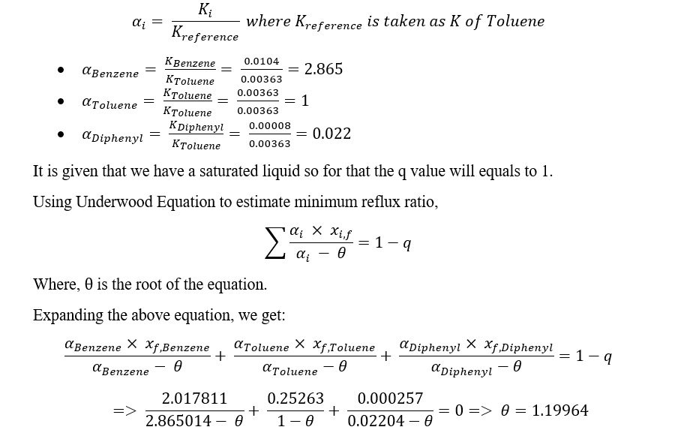
Underwood Calculations

Slide 29
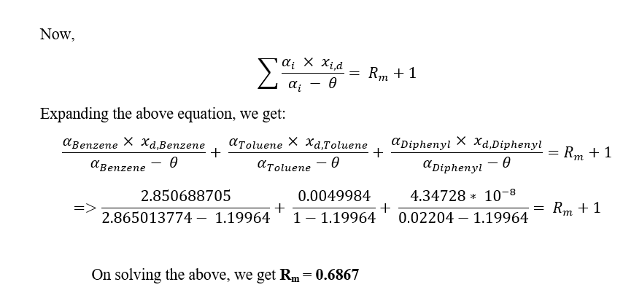
Underwood Calculations-2

Slide 30
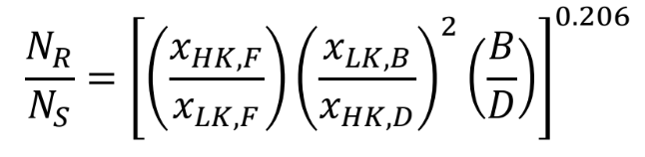
Kirkbride Equation
Where,
Total Number of Stages = N_{R} + N_{S}
N_{R} = number of stages above the feed, including any partial condenser.
N_{S} = number of stages below the feed, including the reboiler.

Slide 31
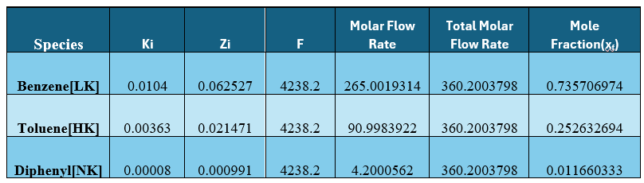
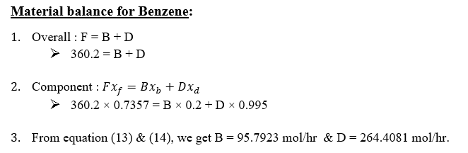
Stream Table and Material Balance
Now, for calculation of Bottom & Distillate moles, we will do material balance of Benzene in multicomponent distillation column.

Slide 32
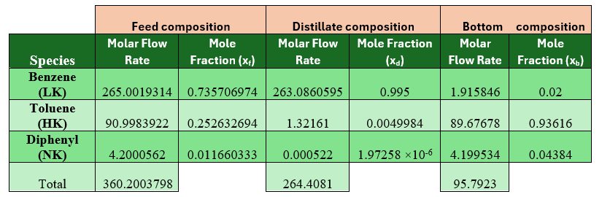

Calculations:
Minimum Number of Stages, $N_{min}= 8.7264$ (calculated by the Fenske Equation given in previous slide).
We did the material balance for Diphenyl and obtained its composition in top and bottom phase as:
(Above chart shows the composition of top and bottom stream)
A more accurate estimate of N_{min} obtained by putting these values in Fenske Equation and its value is 8.6832.
Minimum Reflux Ratio, R_{m} = 0.6867 (calculated using Underwood Equation).

Slide 33
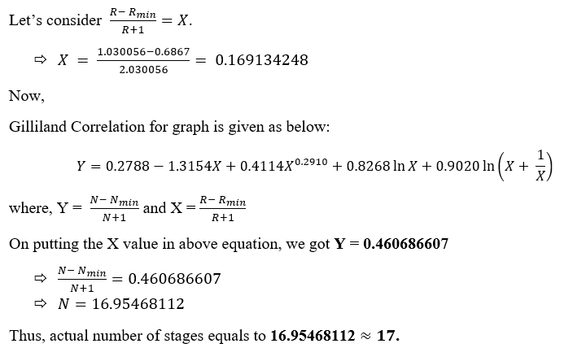
Calculations:
For actual number of plates,

Slide 34
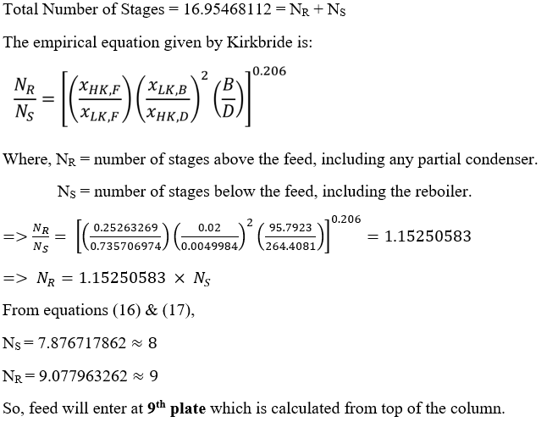
Calculations:
For Feed Location,

Slide 35
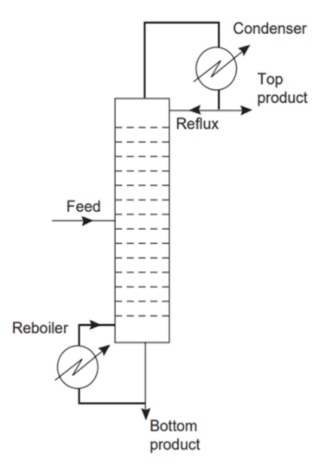
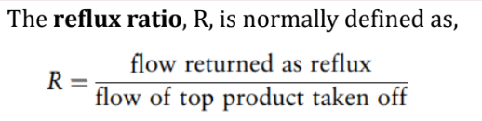
McCabe Thiele Method for Toluene and Diphenyl Separation
Given:
Q=1 (Saturated Liquid)
To find:
N
Nmin
R
Rmin
Feed location
Compositions

Slide 36
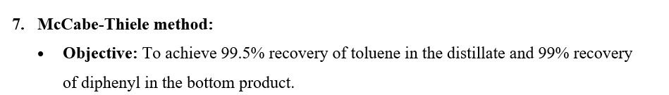
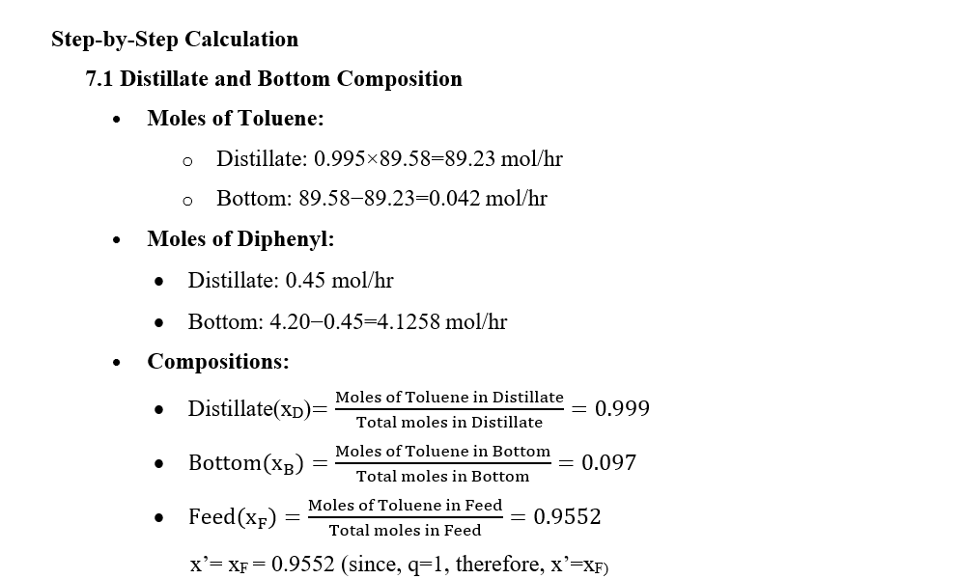
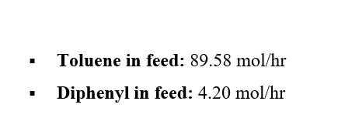
Composition Calculations

Slide 37
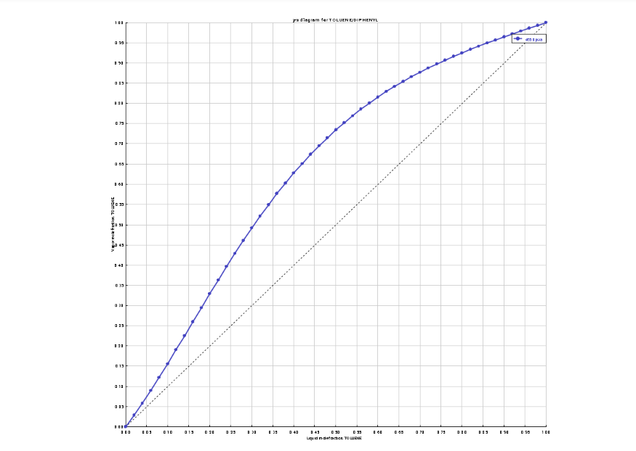

Slide 38
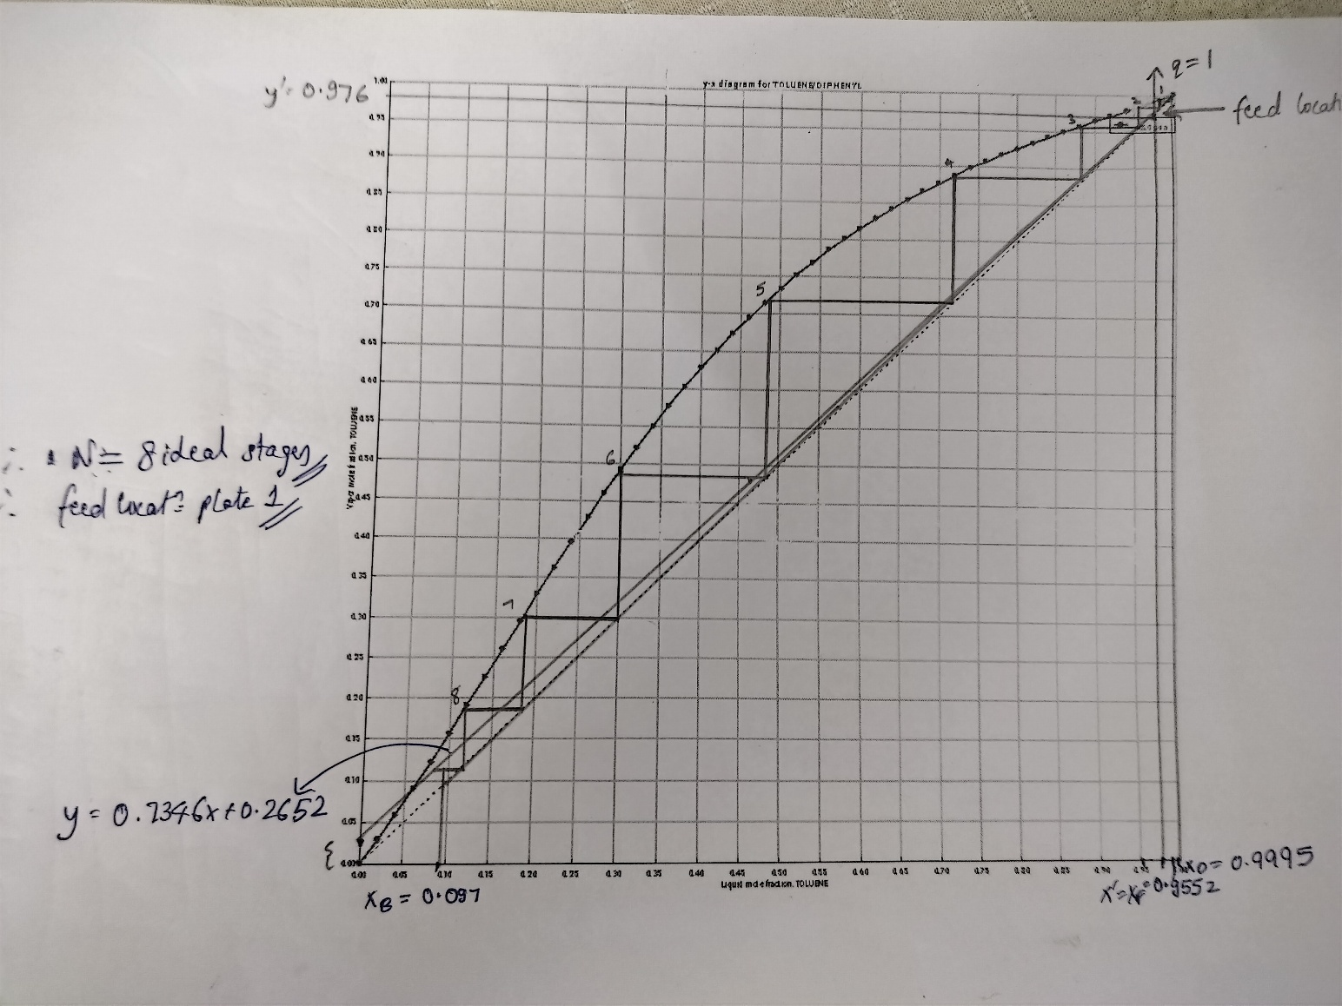
McCabe Thiele Graphical Method

Slide 39

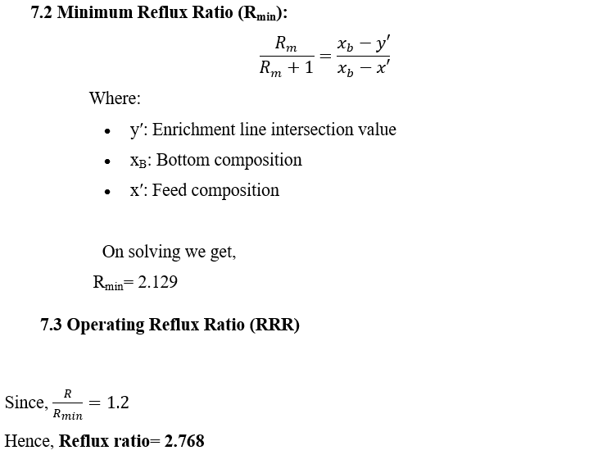
Reflux Calculations from Equilibrium Curve

Slide 40
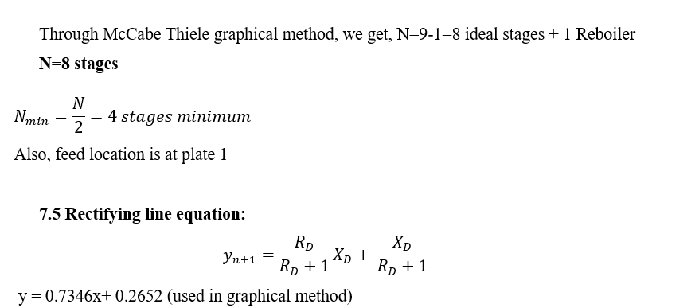
Plate Calculations

Slide 41
ASPEN Simulations
HDA Calculations- MB & EB
Flash, FEHE, Distillation columns designs
Verify using ASPEN Simulations

Slide 42
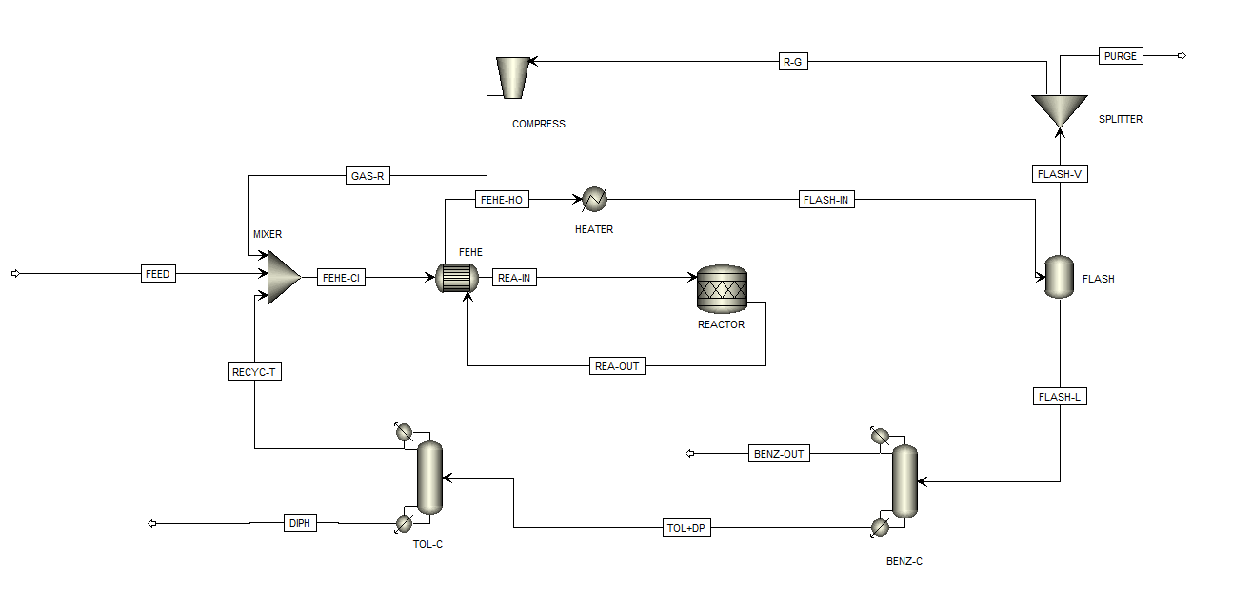
FLOWSHEET

Slide 43
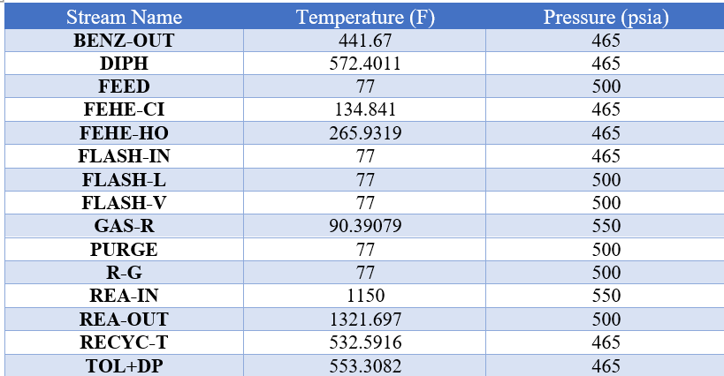
T,P of components

Slide 44
Units-1
Mixer
It combines the fresh feed and the recycled toluene and gas stream and ensures proper mixing of streams before preheating.
FEHE-CI
It preheats the mixed feed using heat from the reactor effluent, and reduces energy consumption by utilizing waste heat.
FEHE
The heat exchanger facilitates heat transfer between the cold feed and the hot reactor effluent, bringing the feed to the desired temperature of 1150°F.
To achieve this, a counter-current shortcut flow direction model was used, where the hot fluid flowed through the tube.

Slide 45
Units-2
Heater
Temperature of 1260°F and a pressure of 500 psia
Reactor (R STOICH)
Flash
The vapour phase is directed to the splitter, while the liquid phase undergoes further separation. This process is conducted at 500 psia and 77°F to achieve optimal liquid and gas recovery.
An R-Stoich reactor was used, where the stoichiometric coefficients of the two reactions involved in the HDA process were specified. Since the reactor operates adiabatically, the heat duty was set to 0 Btu/hr.

Slide 46
Units-3
Flash V&L
The vapor stream from the flash drum is sent to a splitter, where valuable gases are separated, and the excess is purged.
COMPRESSOR
Distillation columns (RADFRAC)
Used to separate benzene, toluene, diphenyl. We used Total Condenser & Kettle Reboiler, with appropriate R and N to get our desired products.
The liquid phase from the flash unit is sent for further separation to recover valuable products.
The compressor increases the pressure of the gas stream from the flash separator, raising it from 500 psia to 550 psia. This step ensures the required pressure is maintained for further processing. An isentropic model was used for the compressor to achieve efficient performance.

Slide 47
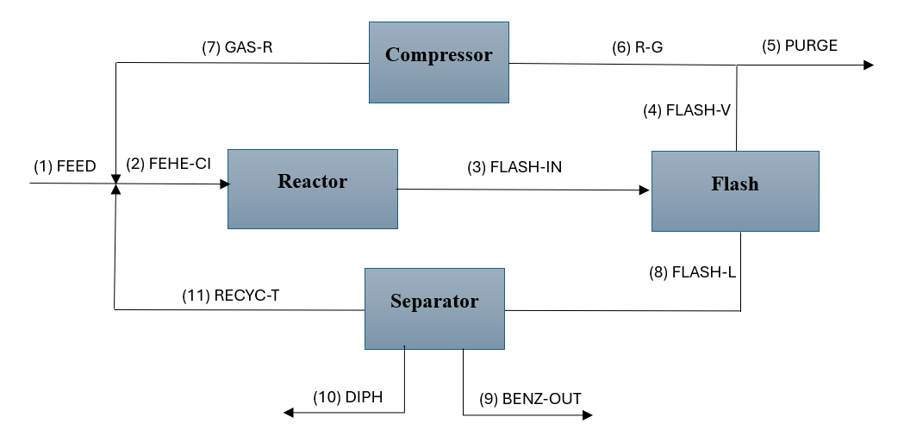
Flow Diagram- Aspen

Slide 48
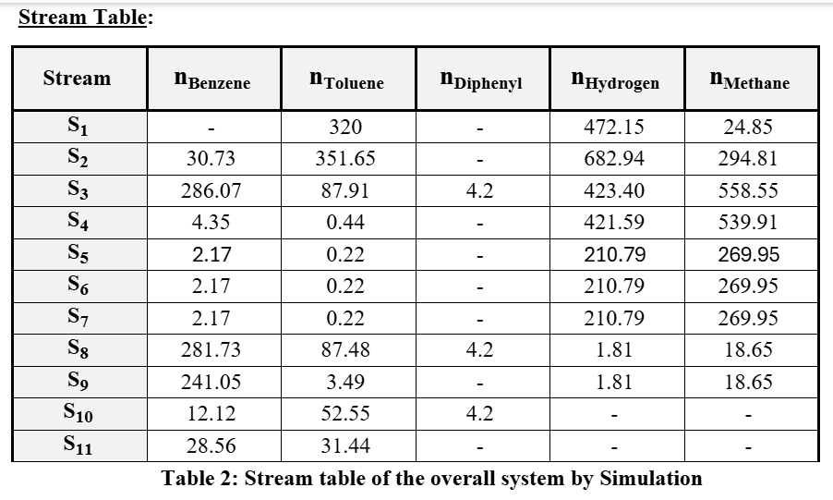
Simulation stream table used for Material Balances on each component

Slide 49
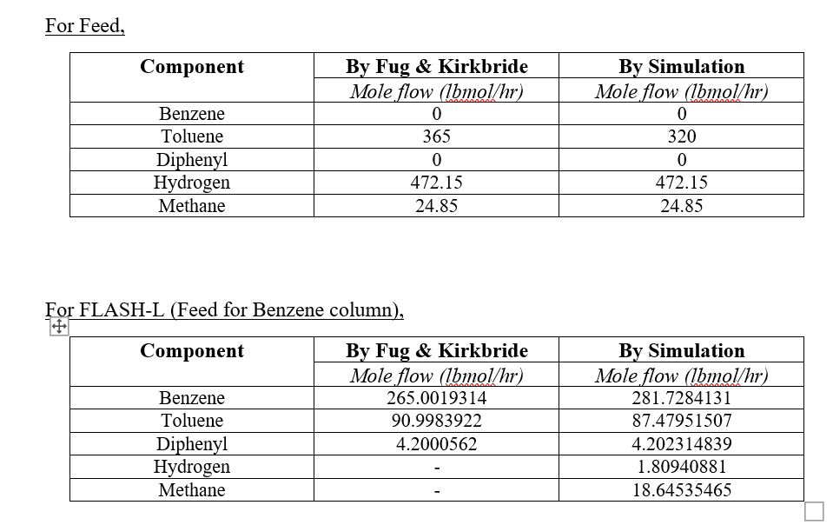
Theoretical vs ASPEN comparison

Slide 50
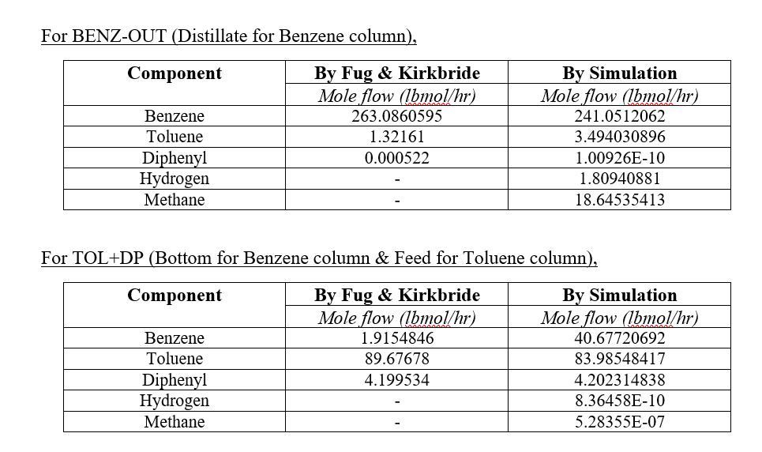
Column flow rate comparison

Slide 51
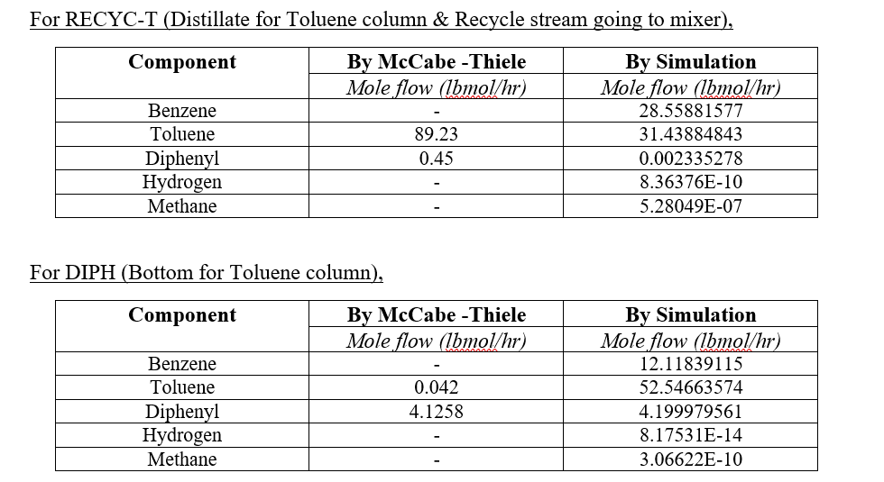
Recycle & Bottom analysis

Slide 52
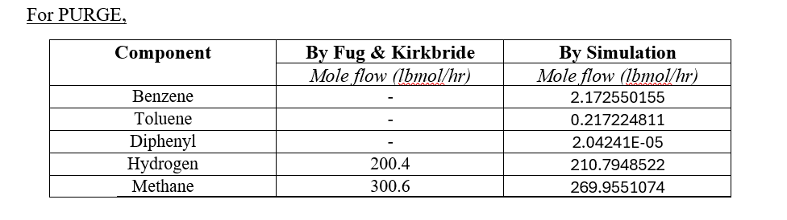
Purge analysis

Slide 53
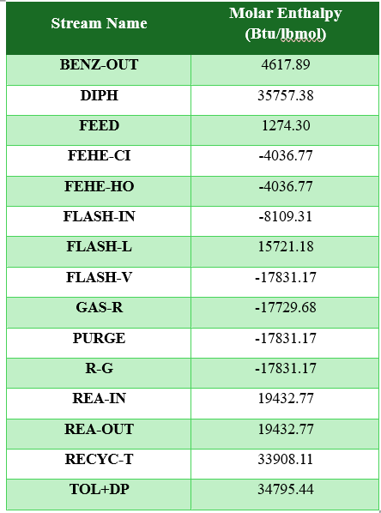

Enthalpy & Energy Balances

Slide 54
Discussions
The difference in values of top & bottom product values is due to different reflux ratios taken both manually and in simulation. Another reason could be non – ideality of distillation column reflected in simulation, which we assumed ideal in McCabe – Thiele method.
All the compositions of the other streams can be compared using the Aspen Data Excel file attached and our previous theoretical calculations. The converging values of Aspen and our calculations prove that we were able to successfully simulate the HDA process without excessive disturbances and variations.
The small deviation in values has occurred because of the assumptions in our theoretical calculations that all the gas and liquid are perfectly separated in the flash, which isn't the ideal case in Aspen. The distillation columns also don't operate at 100% efficiency, and the errors accumulate to cause small variations from our originally calculated values. However, the final values being close to the estimated ones support our calculations for the Aspen simulations.

Slide 55
Conclusions
1
Thus, we have conducted an elaborative study on the HDA process for benzene production by toluene.
2
We have carried out the necessary material balances for every stream in the process and made the required stream table.
3
We also learnt to apply concepts from heat transfer and other topics to solve problems associated with the process, and also performed flash column calculations using Excel Solver in the report (Assignment 3).
4
We also conducted the heat exchanger design by finding out U, Area, and temperatures of the counter flow FEHE.
5
We also calculated N, Nmin, R, Rmin and compositions for benzene, toluene and diphenyl using FUG and McCabe Thiele method with the aid of Excel Solver.
6
We have also performed the Aspen Simulations and analysed our results for the same elaboratively.

