Slide 1


Slide 2
INTRODUCTION
What is Breast Cancer ?
Breast cancer is a disease characterized by the uncontrolled growth of cells in the breast tissue, leading to the formation of tumors.
Types of Breast Cancer :
There are various types of breast cancer, including ductal carcinoma in situ (DCIS), invasive ductal carcinoma, and invasive lobular carcinoma.
Risk Factors and Causes:
Factors such as age, family history, genetic mutations and exposure to radiation contribute to the risk of developing breast cancer.
The development of breast cancer is linked to genetic mutations, hormonal influences, and environmental factors.

Slide 3
OBJECTIVES
Diagnostic Prediction: Diagnostic prediction involves using data-driven models, such as machine learning algorithms, to predict the presence or absence of a particular condition or disease based on patient data and medical records.
Risk Assessment: Analyzing patient data to estimate the risk or probability of certain health outcomes.
Effectiveness: Determining the effectiveness of a specific treatment or intervention based on patient data and outcomes.
Notes:
Predicting the likelihood of disease recurrence after treatment completion using patient data and survival analysis techniques.

Slide 4
Recurrence: Predicting the likelihood of disease recurrence after treatment completion using patient data and survival analysis techniques.
Survival Analysis: Analyzing patient data to estimate the probability of patient survival after diagnosis or treatment initiation.

Slide 5
MODELS USED
Logistic Regression : Diagnostic Prediction and Risk Assessment.
Decision Tree : Effectiveness and Survival Analysis.
Support Vector Machine : Recurrence.
Cox Proportional Hazard : Survival Analysis.

Slide 6
PROPOSED METHODS
Diagnostic Prediction:
Logistic Regression: Employed to predict the likelihood of breast cancer occurrence or diagnosis based on patient data and features. This method uses a binary classification approach to categorize individuals into having or not having the disease.
Risk Assessment:
Logistic Regression: Used to assess the risk or probability of certain health outcomes related to breast cancer. This method analyzes patient data to estimate the likelihood of specific health conditions or events.
Effectiveness Evaluation:
Decision Tree: Implemented to determine the effectiveness of specific breast cancer treatments or interventions. Decision trees are utilized to understand which factors contribute significantly to treatment effectiveness and categorize patients based on these factors.

Slide 7
Recurrence:
Support Vector Machine (SVM): SVMs is applied to predict the likelihood of breast cancer recurrence post-treatment by analyzing patient data and features. The algorithm aims to find the optimal hyperplane that best separates recurrence and non-recurrence instances in the data.
Survival Analysis:
Cox Proportional Hazard: attempts to perform survival analysis using the Cox Proportional Hazards model from the lifelines library with the breast cancer dataset.

Slide 8
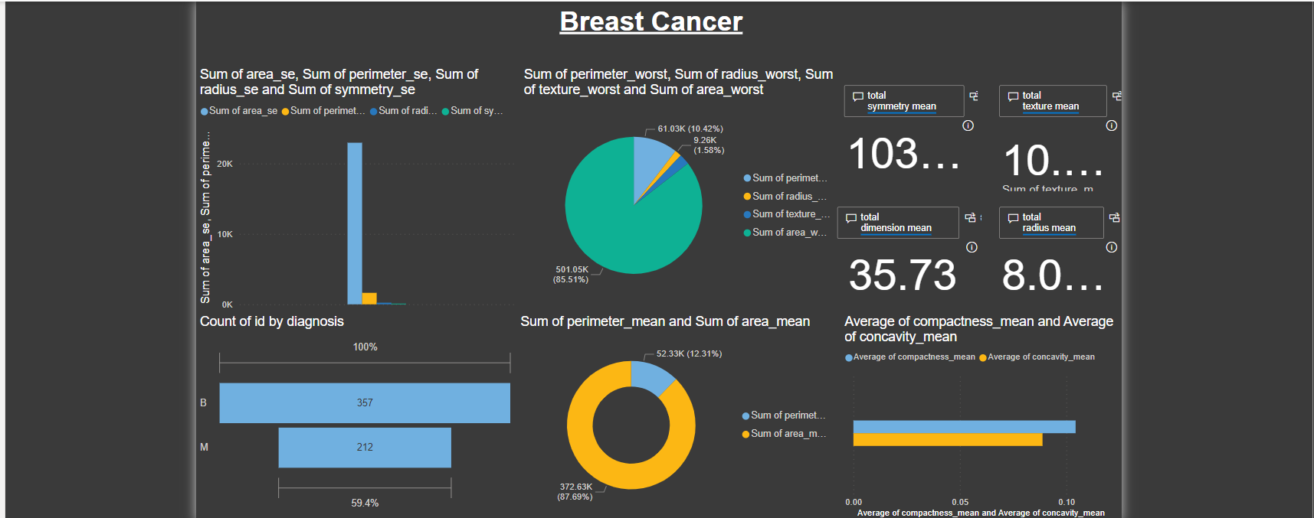
TOOL: Power BI

Slide 9
CONCLUSION
The breast cancer project employed diverse analytical approaches, including machine learning models like Logistic Regression, Decision Trees, Support Vector Machine and Cox Proportional Hazard. These methods aimed at diagnostic prediction, risk assessment, recurrence analysis, and treatment effectiveness evaluation and Survival Analysis. Through these techniques, the project not only predicted the likelihood of cancer but also estimated risk, survival rates, and treatment outcomes.

Slide 10
Thank You!!

