Slide 1
TaskBoard
DevOps Capstone
From FastAPI and PostgreSQL to CI/CD, Kubernetes, security scanning, and observability on Minikube.
Neeshant Ahire · Roll No: 10635 · Batch A

Slide 2
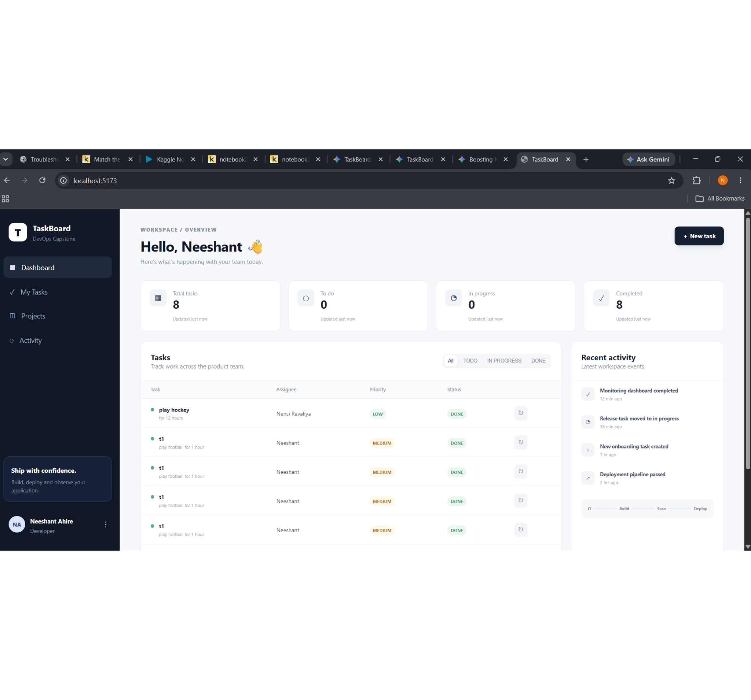
02
TaskBoard is a full delivery system, not just a task app
Enterprise-style task management platform demonstrating the complete DevOps lifecycle.
FastAPI backend with a responsive frontend
PostgreSQL persistence and tested API behavior
Docker images, GitHub Actions automation, and Trivy scanning
Helm-driven Kubernetes deployment on a local Minikube cluster
Prometheus and Grafana for operational visibility

Slide 3
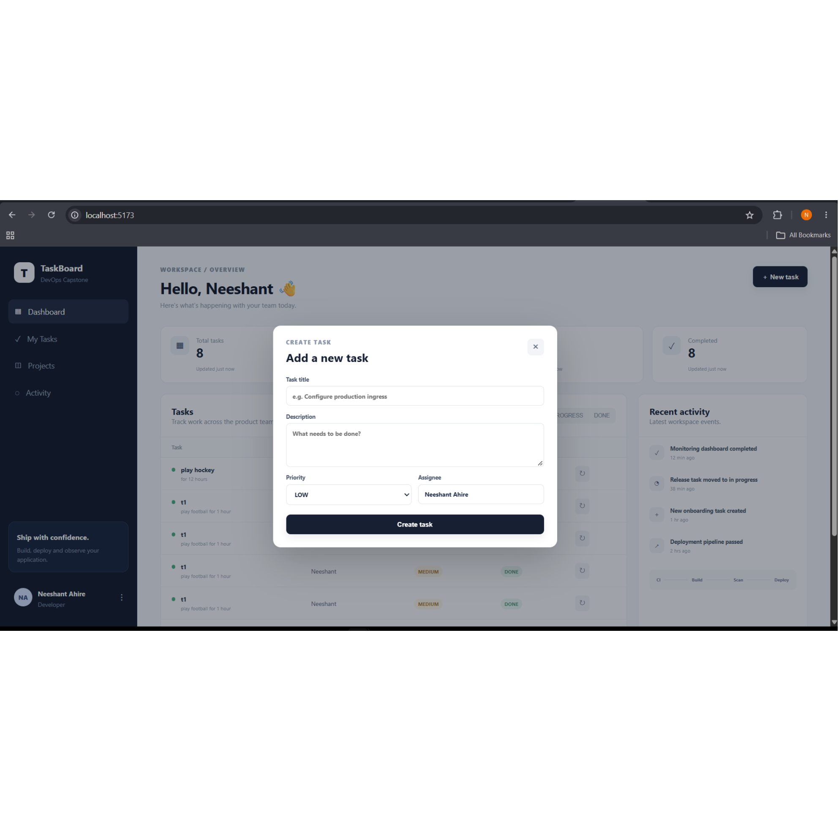
03
Architecture & local development connect the layers cleanly
FastAPI exposes task and health endpoints; the frontend runs through Vite; PostgreSQL stores task state; Docker Compose gives a repeatable local environment.
Backend: modular FastAPI endpoints with /health, /ready, /api/tasks, and /metrics
Frontend: responsive TaskBoard UI with task creation and status views
Database: PostgreSQL with a task schema designed for CRUD workflows
Containerization: separate backend and frontend images with production-ready Dockerfiles

Slide 4
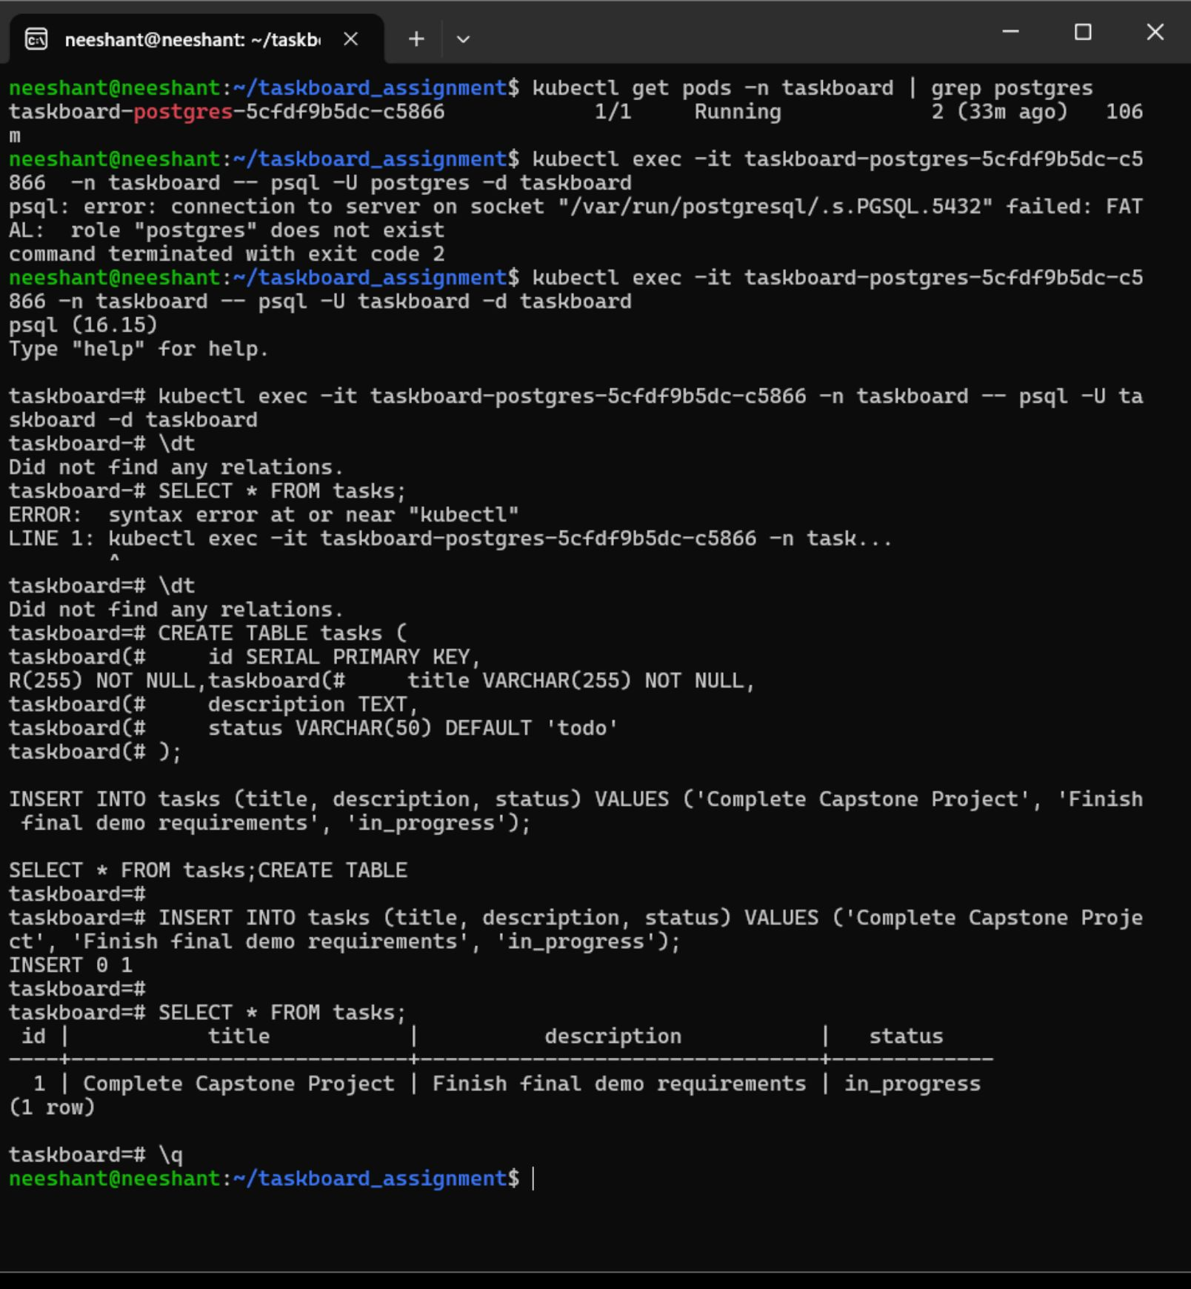
04
Database and tests establish a reliable baseline
Schema creation and automated tests validate the application before container images are promoted.
tasks table: id, title, description, and status
Sample record inserted for the final demo workflow
pytest suite completed with 11 passed and 1 warning in 0.65s
Coverage includes health, readiness, CRUD, status updates, not-found behavior, and stats

Slide 5
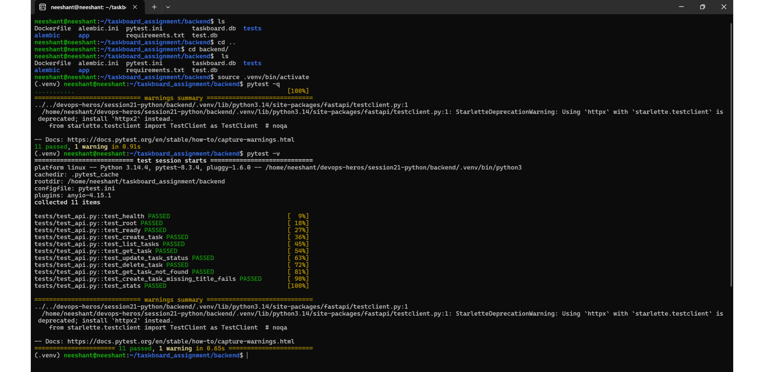
05
EVIDENCE · TESTS
Pytest run: 11 passed, 1 warning

Slide 6
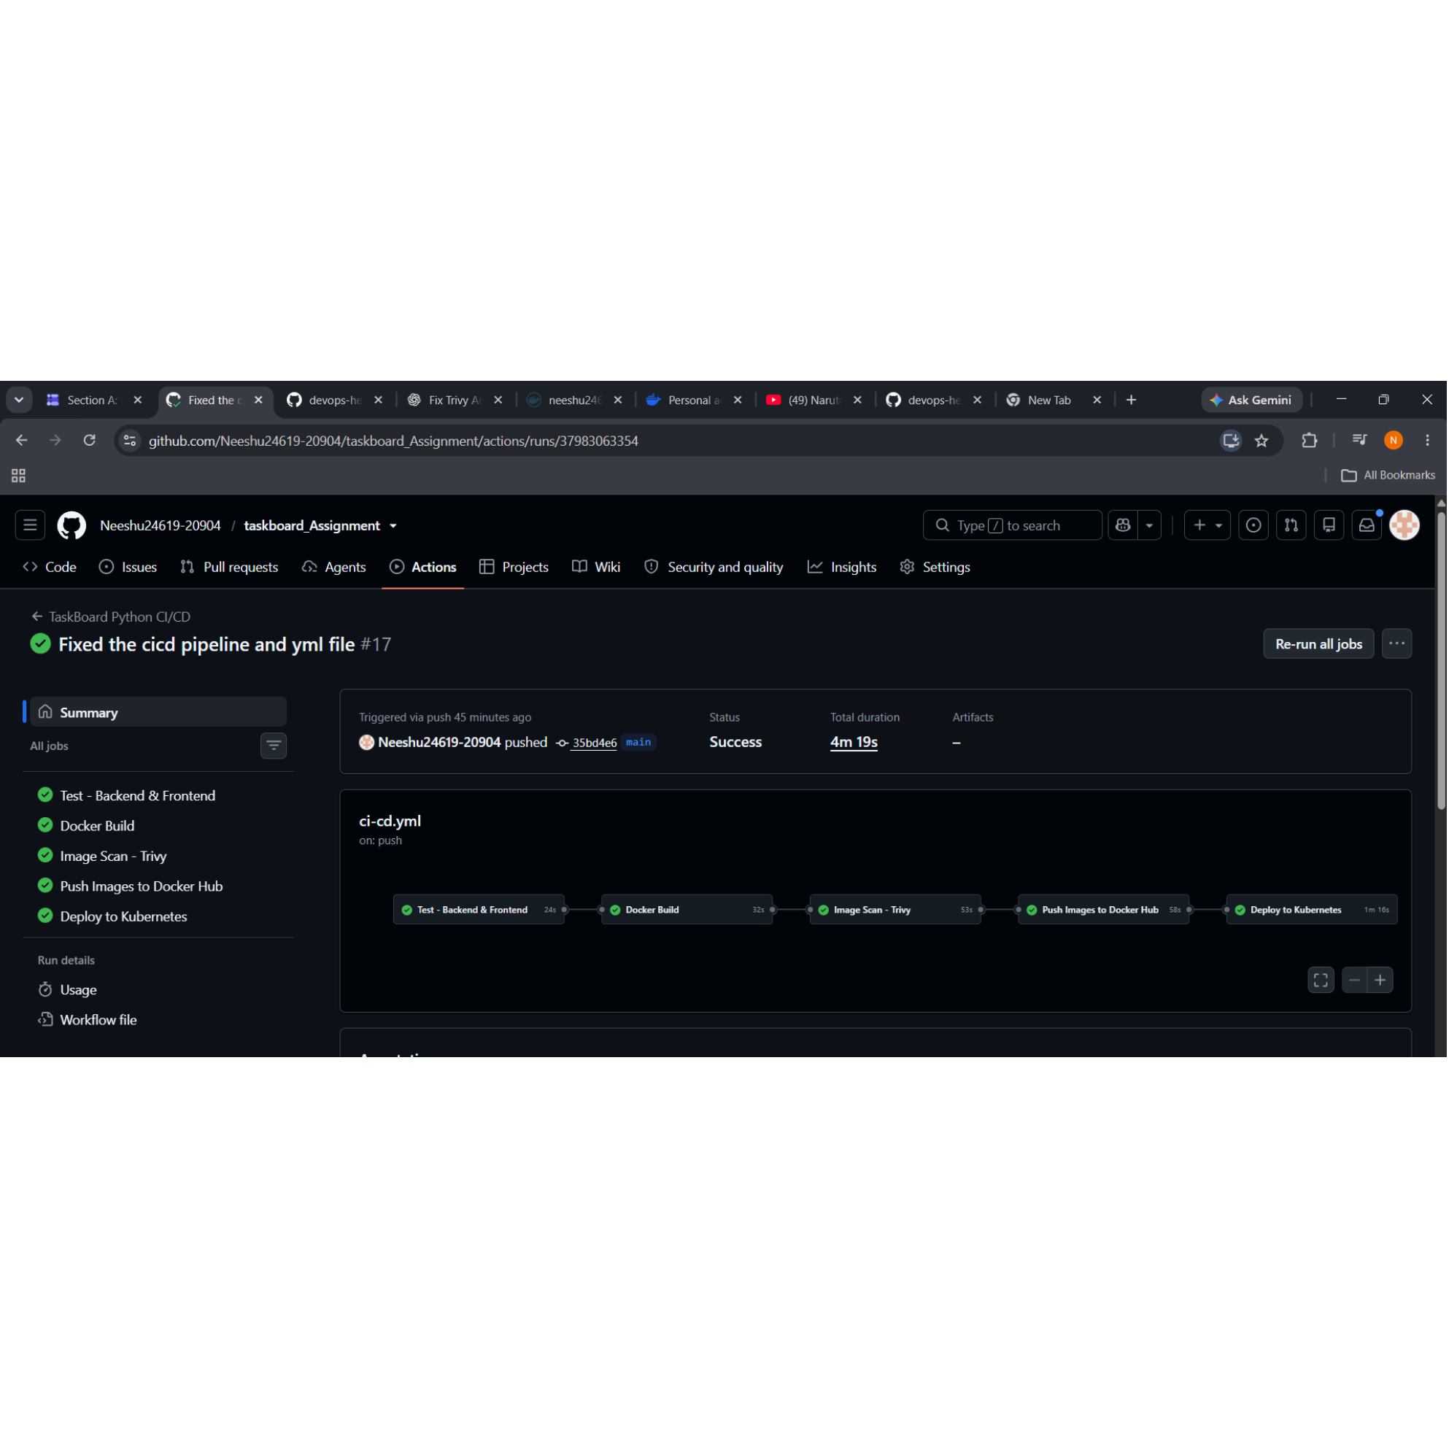
06
CI/CD turns every push into a delivery checkpoint
The GitHub Actions workflow chains validation, image creation, security scanning, registry publishing, and Kubernetes deployment.
01
02
Test backend and frontend
Build Docker images
03
04
Scan with Trivy
Push images to Docker Hub
05
Deploy to Kubernetes

Slide 7
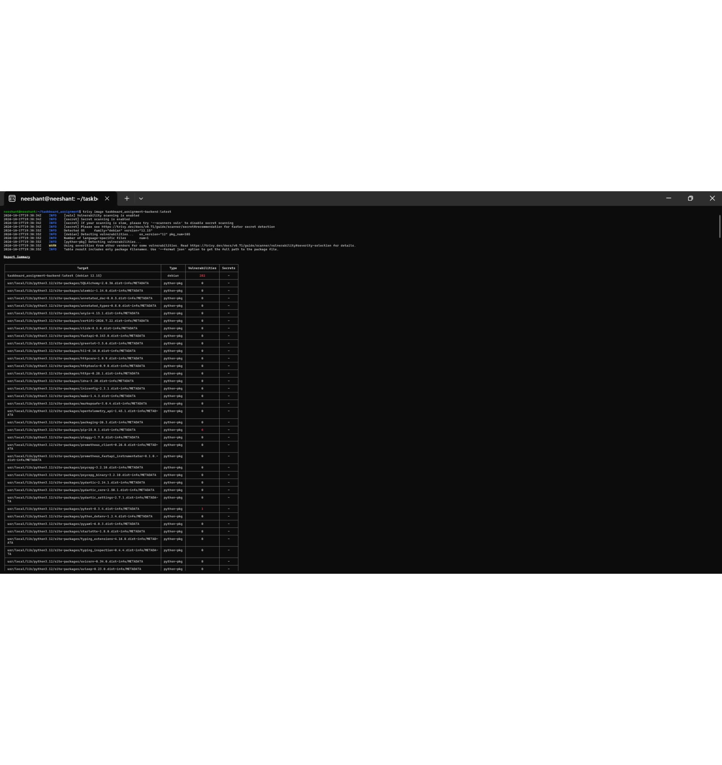
07
Security scanning makes image risk visible before release
Trivy scans the backend image for OS package vulnerabilities, language-package issues, and embedded secrets.
Scan command: trivy image taskboard_assignment-backend:latest
Reports surface severity, affected library, installed version, and fixed version
Findings become an actionable hardening backlog rather than a hidden production risk

Slide 8
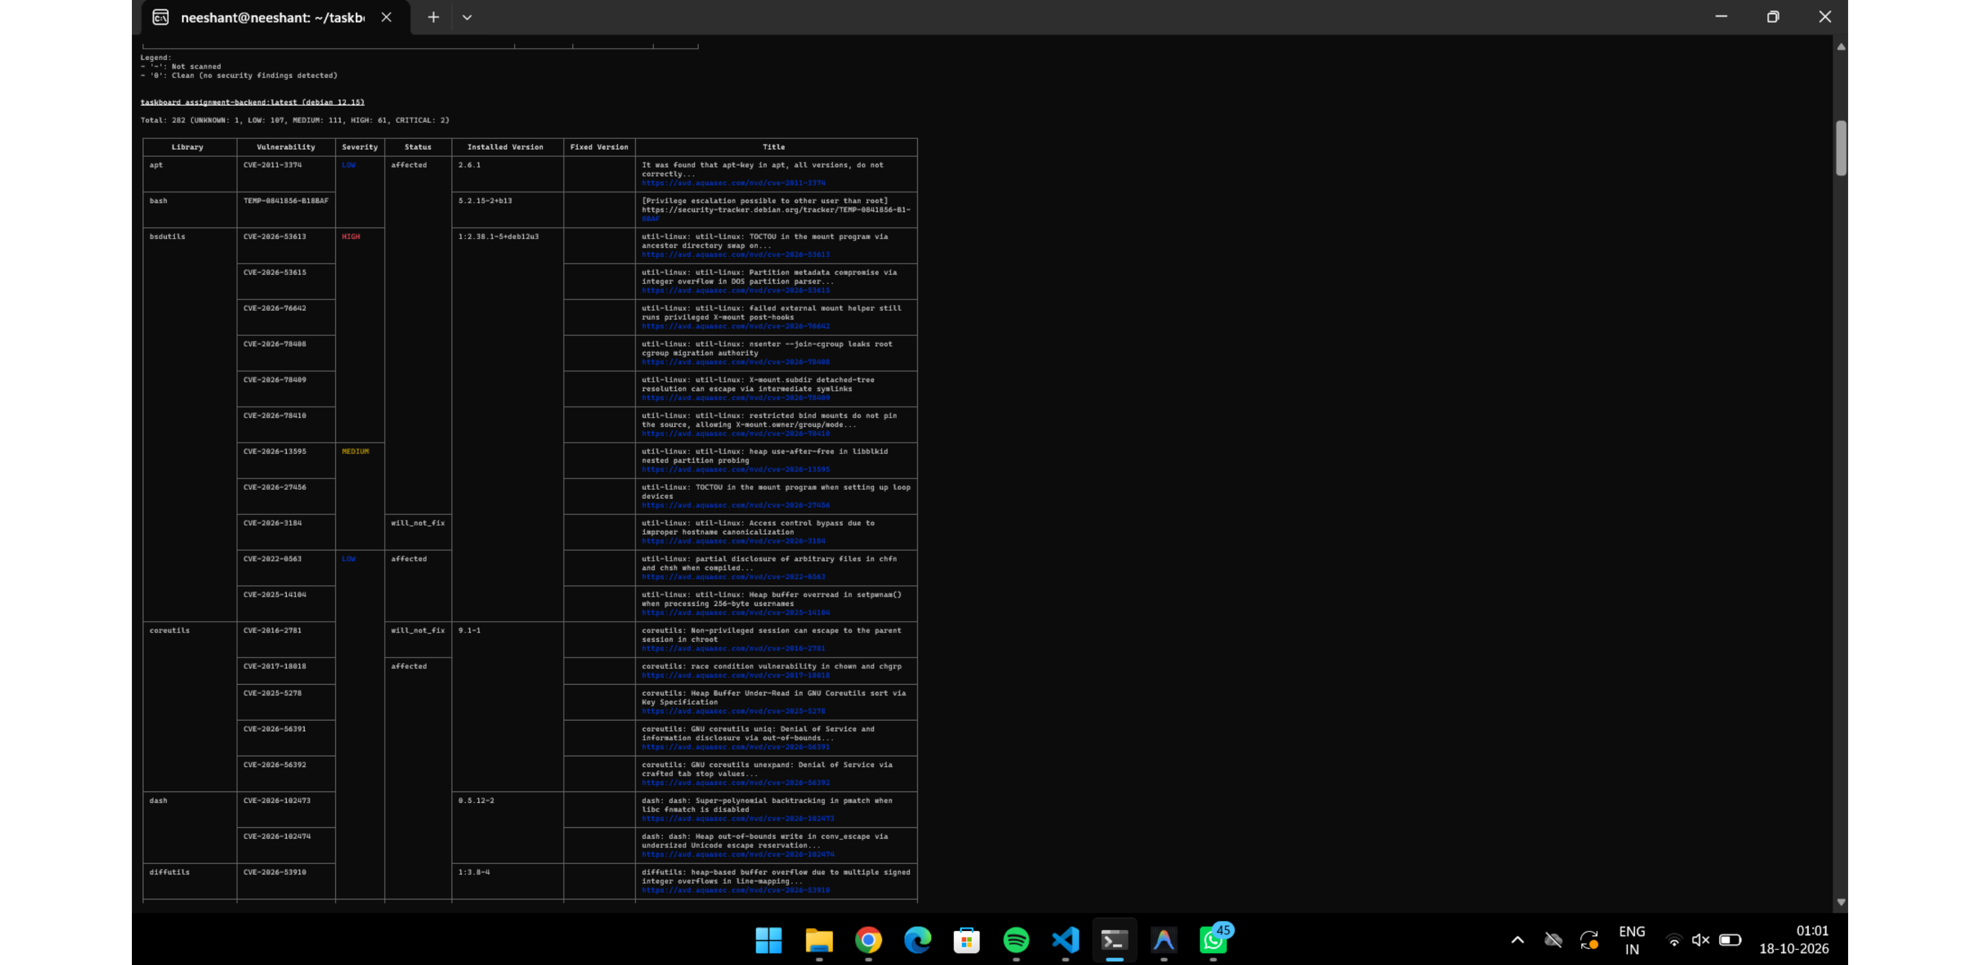
08
EVIDENCE · TRIVY
Trivy scan report 2

Slide 9
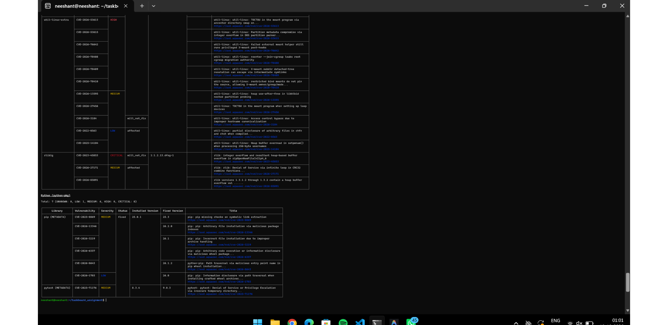
09
EVIDENCE · TRIVY
Trivy scan report 3

Slide 10
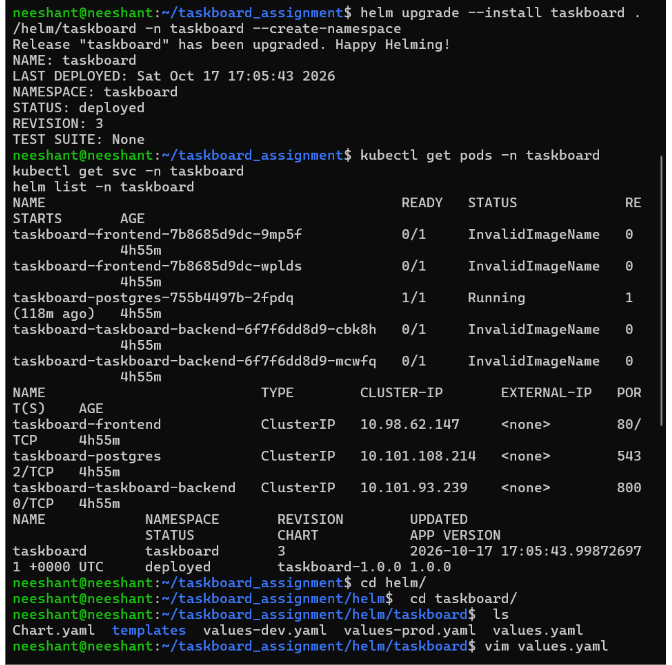
10
Helm packages the application for Kubernetes
The TaskBoard chart turns the application stack into repeatable, declarative deployment configuration.
helm upgrade --install taskboard ./helm/taskboard -n taskboard --create-namespace
PostgreSQL, backend, and frontend run together in the taskboard namespace
Helm revisions and rollout restarts support fast iteration during development
Monitoring is installed separately through kube-prometheus-stack in monitoring

Slide 11
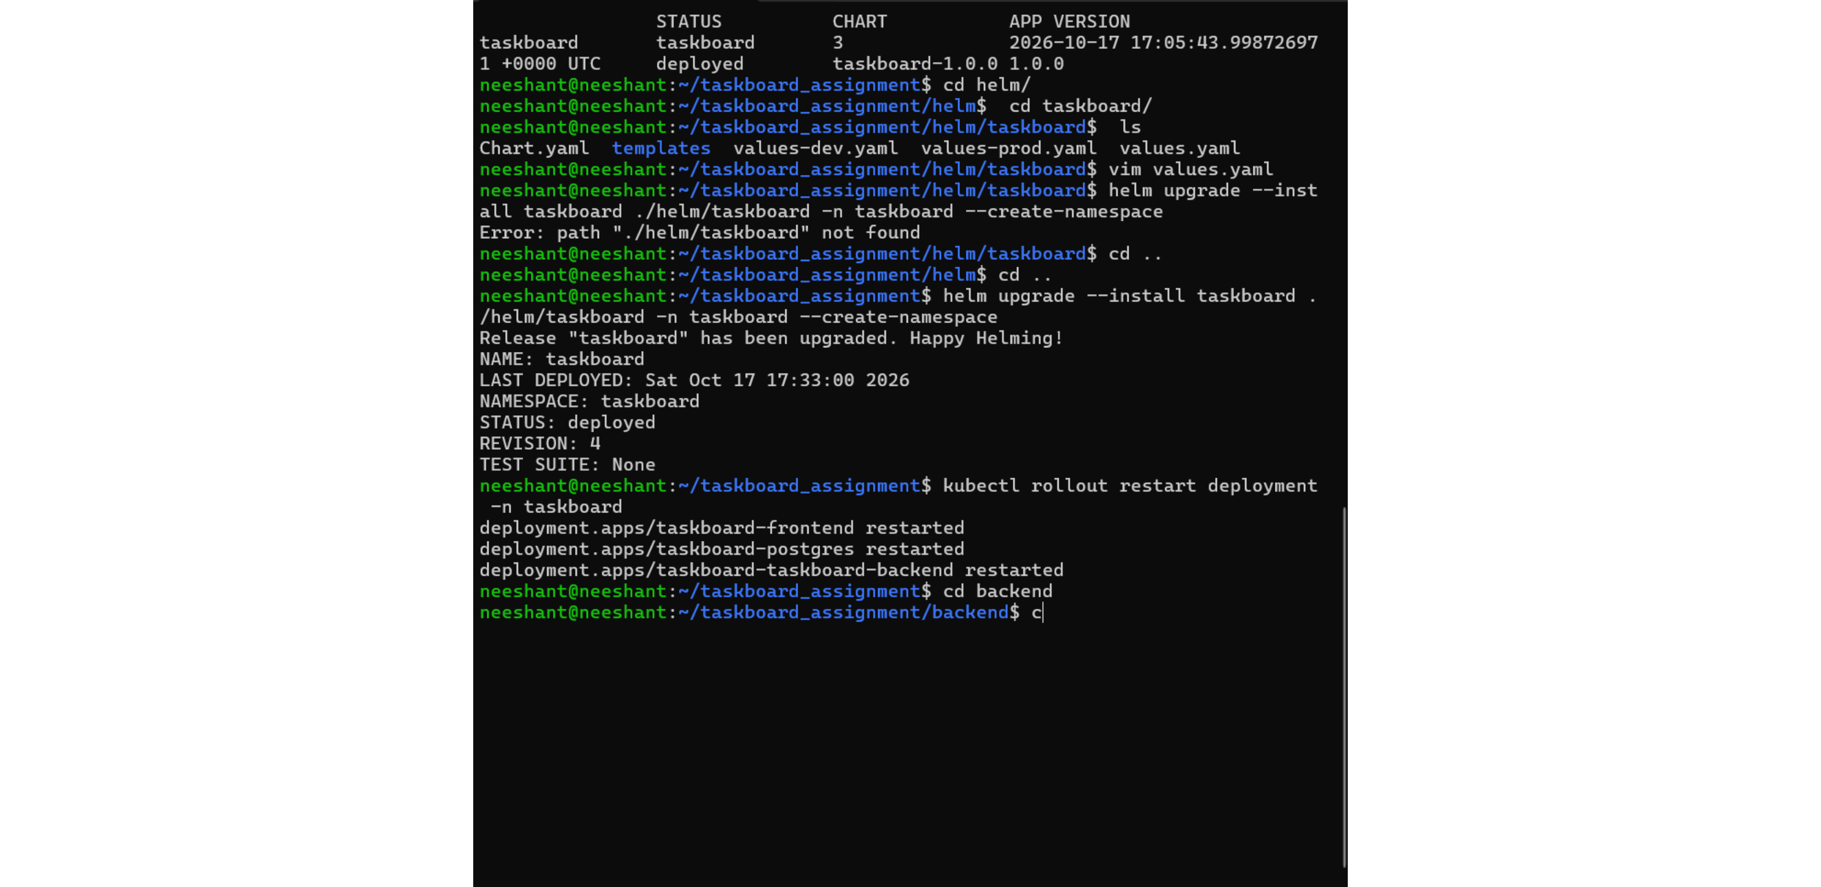
11
EVIDENCE · HELM
Helm upgrade, rollout and service checks

Slide 12
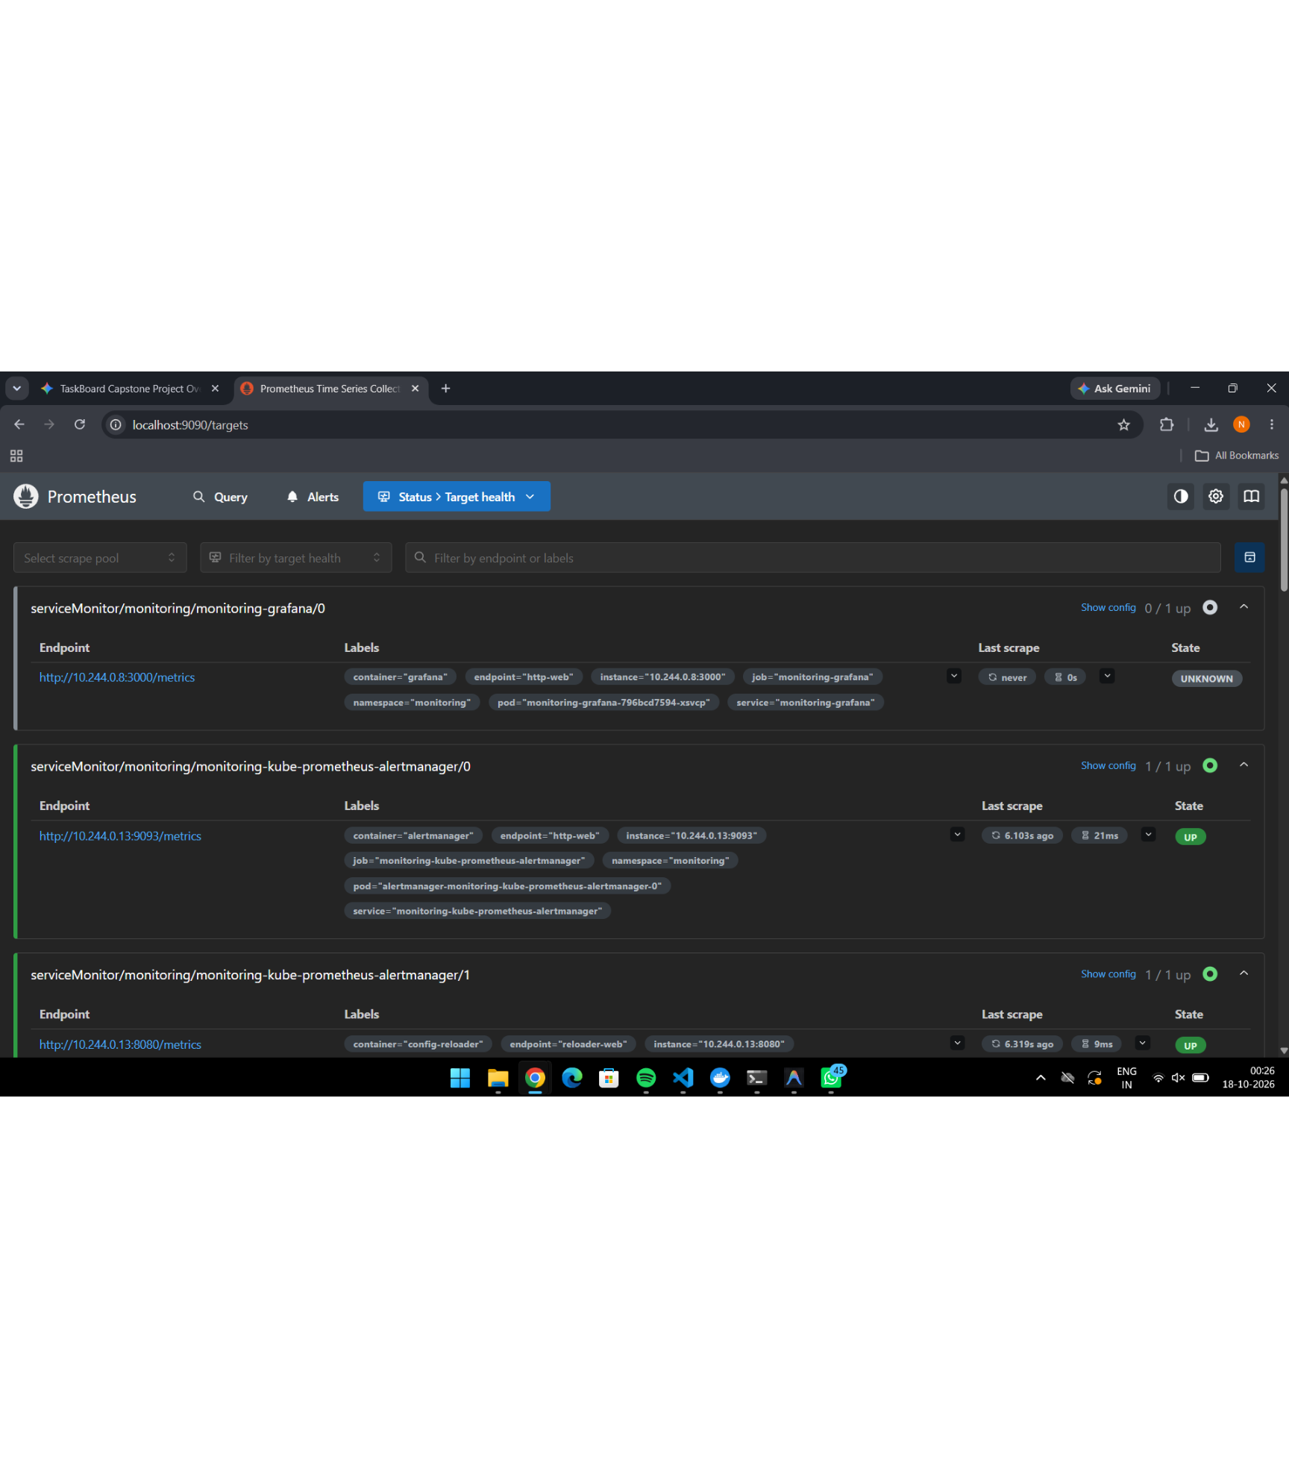
12
Observability closes the loop from deployment to insight
Prometheus scrapes targets and Grafana turns cluster telemetry into an operational view of CPU, memory, namespaces, and workloads.
kube-prometheus-stack deployed into the monitoring namespace
Minikube image loading resolved upstream pull constraints
Prometheus target health verified through port-forwarding
Grafana dashboards expose cluster and namespace-level resource behavior

Slide 13
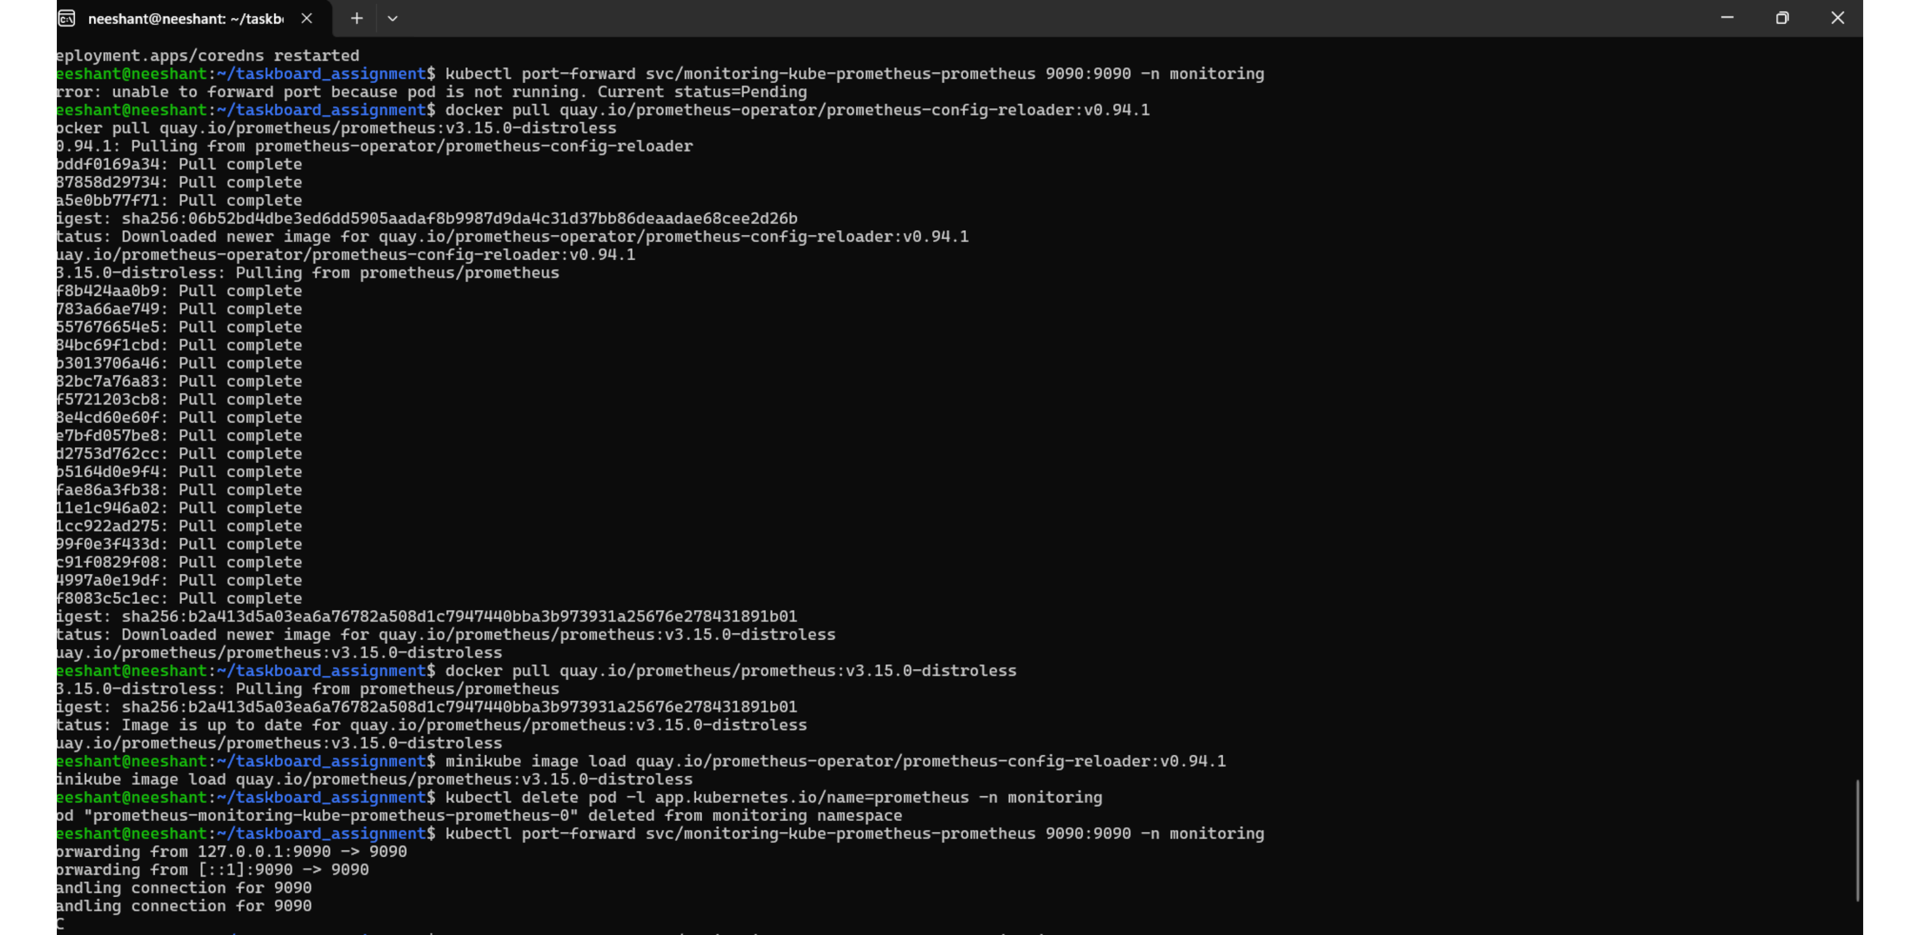
13
EVIDENCE · OBSERVABILITY
Prometheus port-forward and image setup

Slide 14
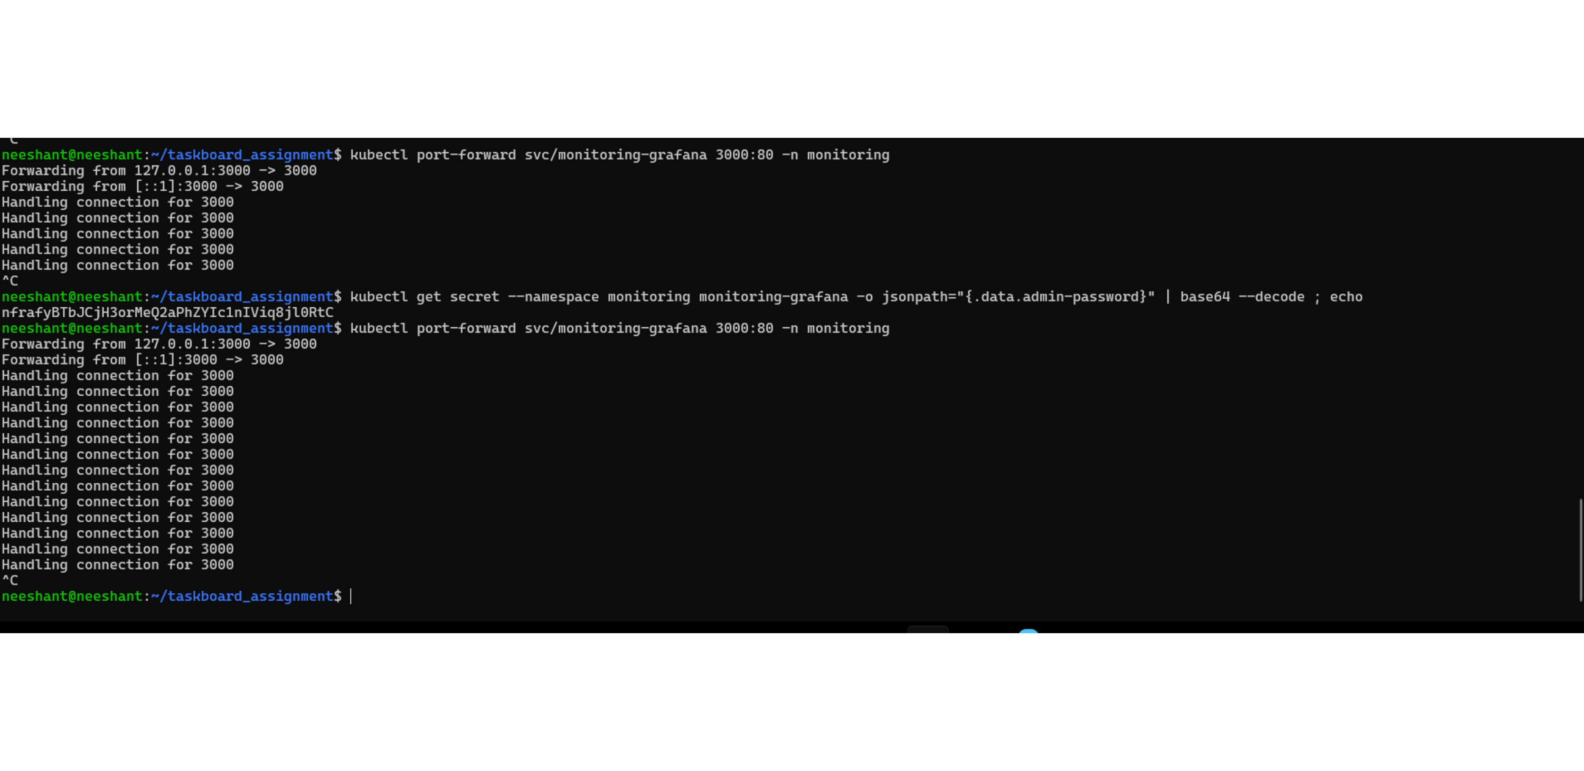
14
EVIDENCE · OBSERVABILITY
Grafana access via terminal

Slide 15
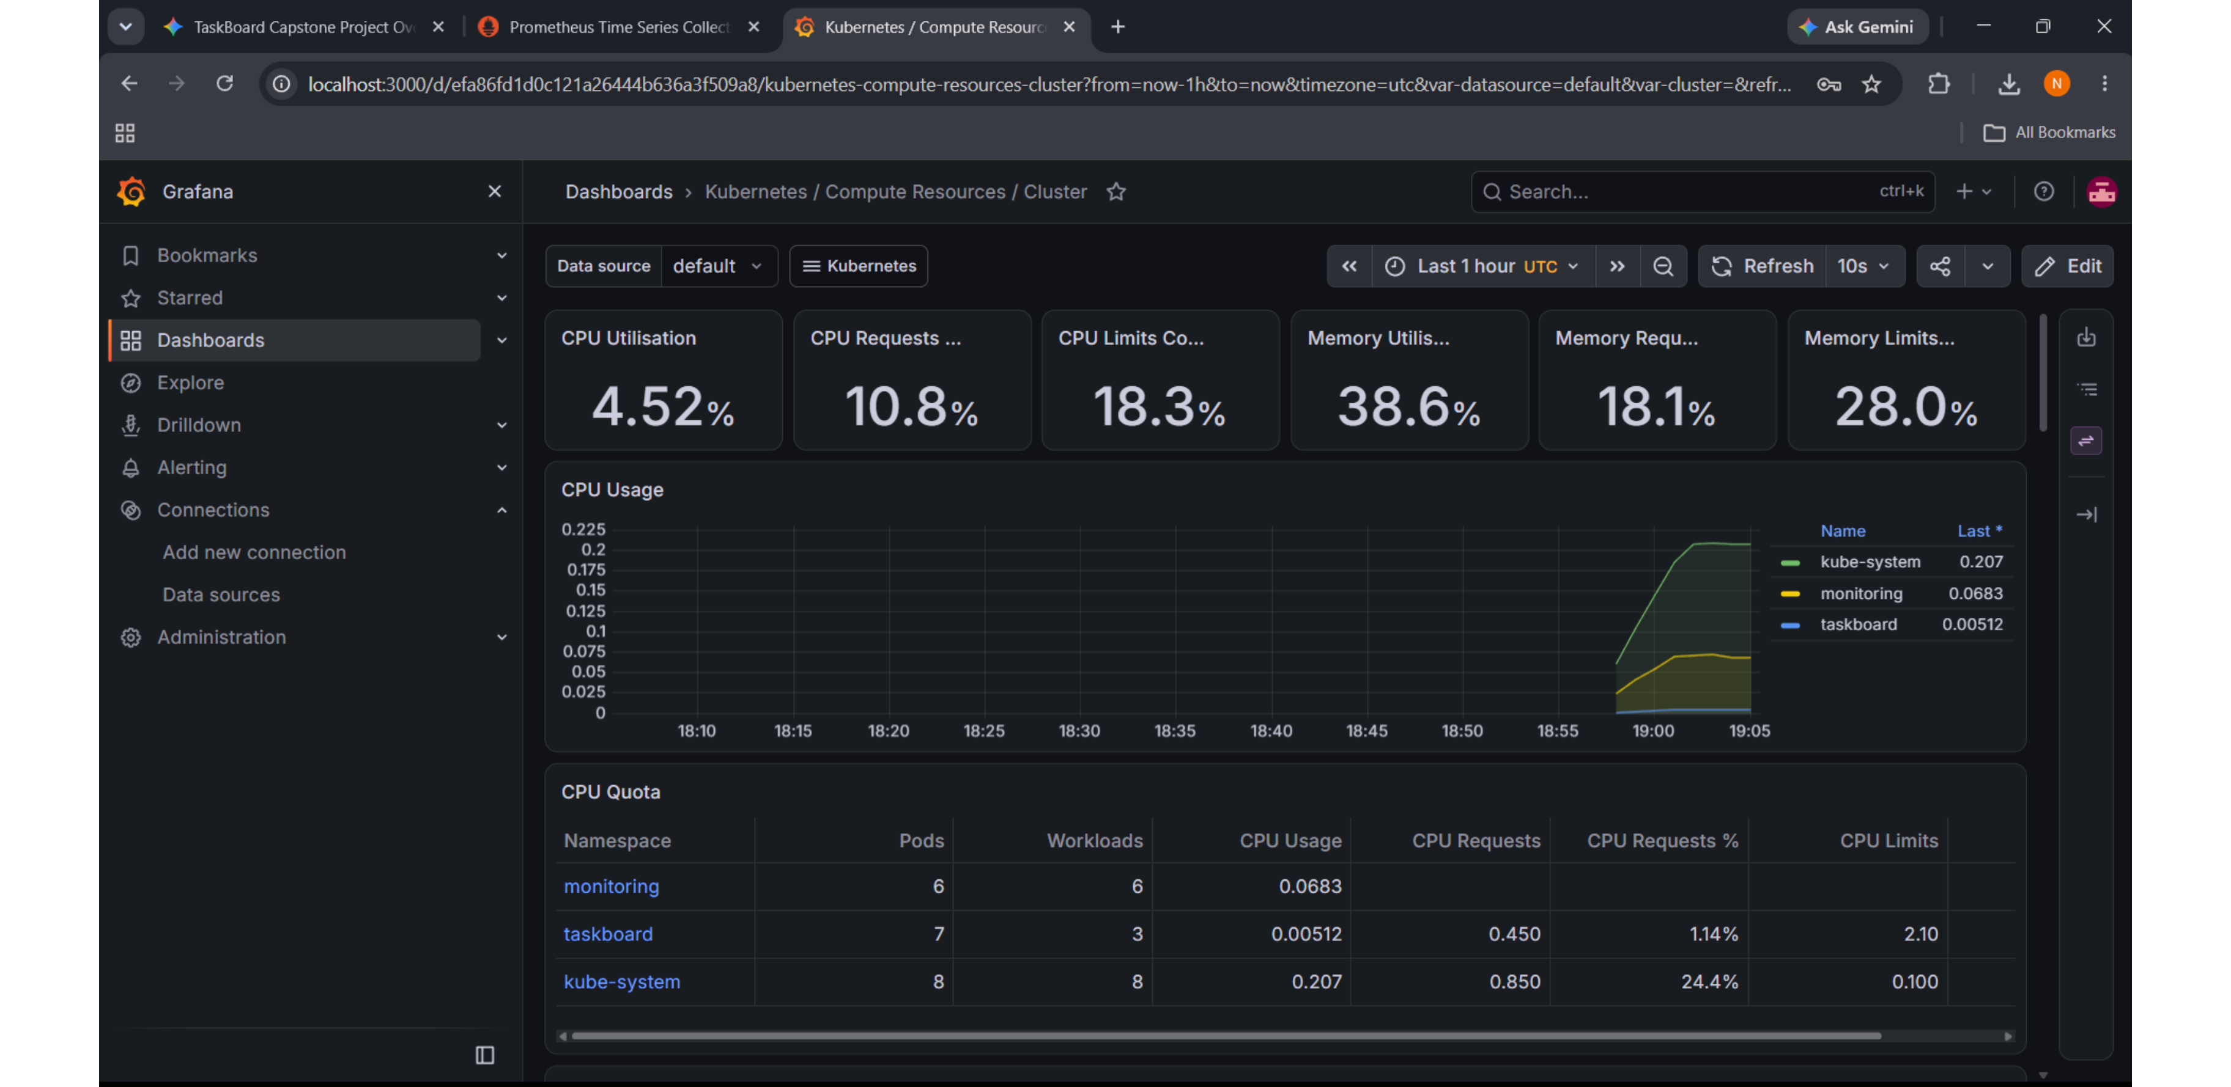
15
EVIDENCE · OBSERVABILITY
Grafana compute resources dashboard

Slide 16
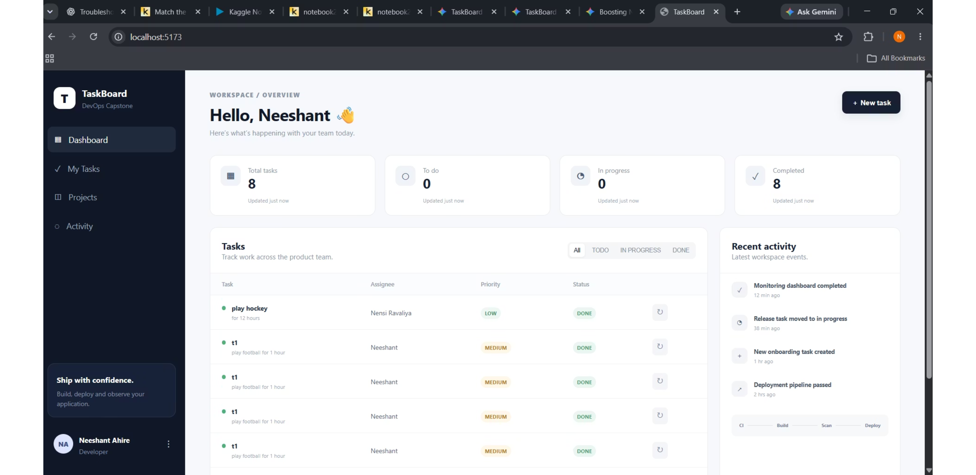
16
EVIDENCE · OBSERVABILITY
Ideal dashboard target

Slide 17
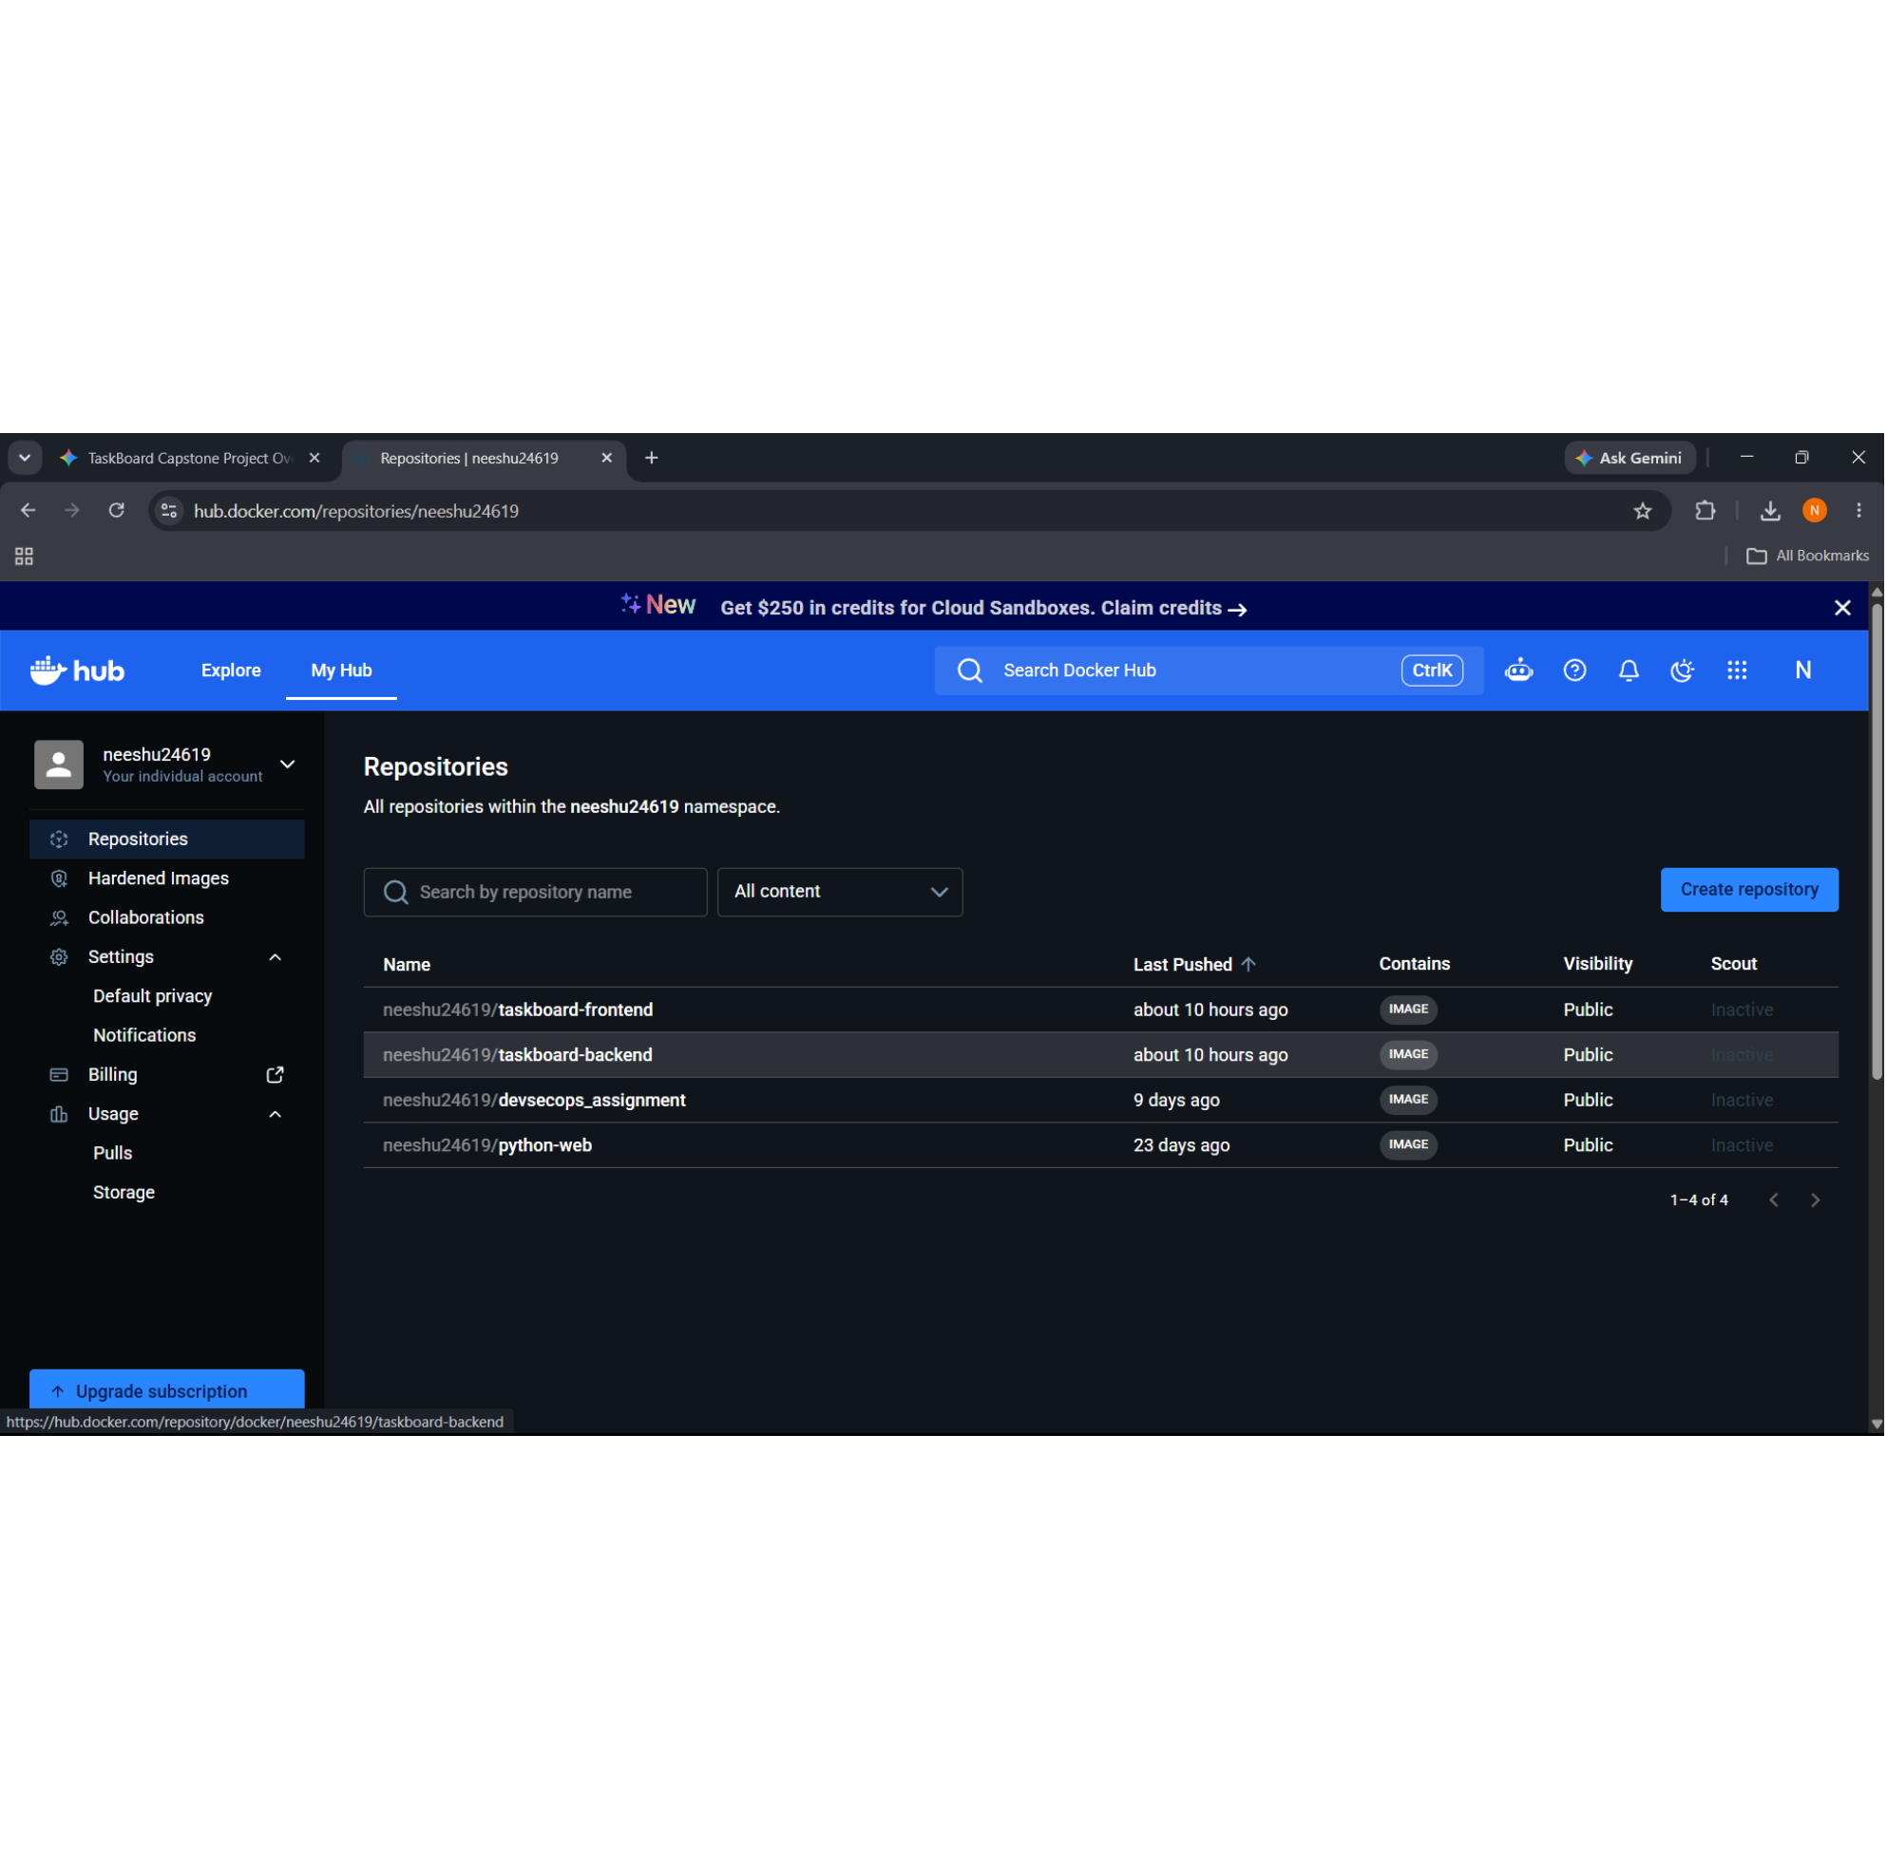
17
Registry, ingress, and troubleshooting make the system usable
Delivery is only complete when images are accessible, routes resolve, and failure modes are understood.
Docker Hub repositories and tags verified for backend and frontend images
Ingress and port-forwarding provide paths into internal services
Terminal diagnostics exposed image pull backoffs, invalid image names, and namespace issues
PostgreSQL access was corrected by using the taskboard database user

Slide 18
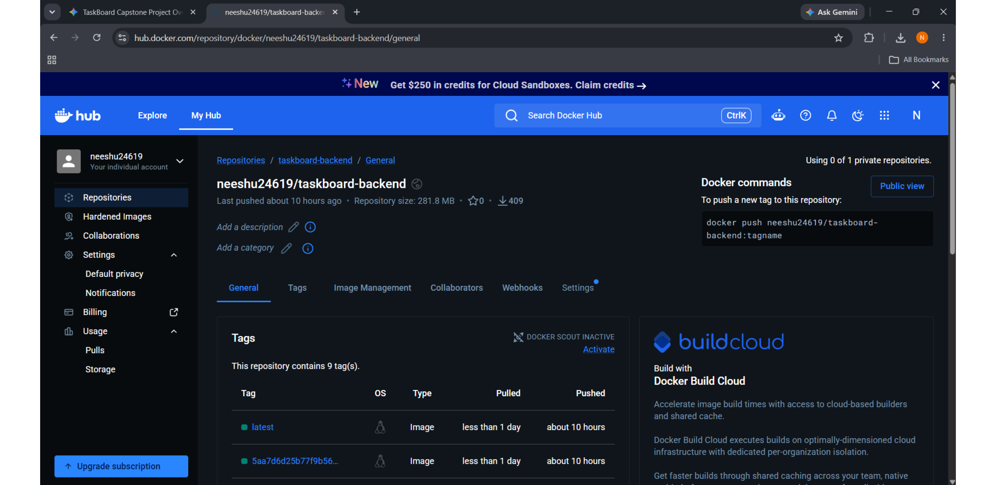
18
EVIDENCE · REGISTRY
Docker Hub registry: repository tags

Slide 19
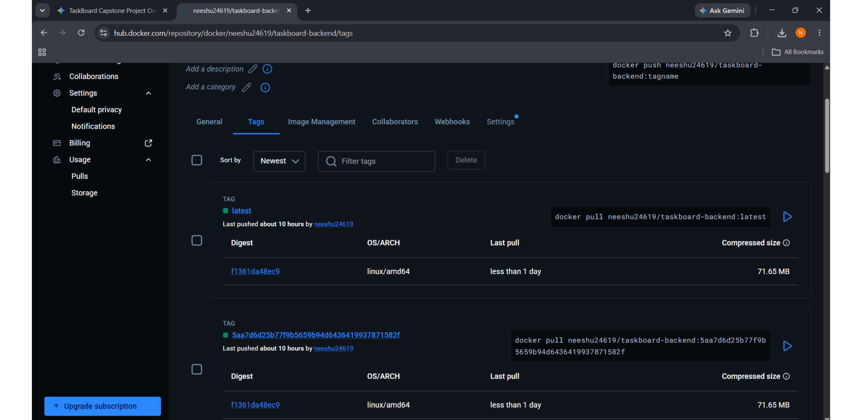
19
EVIDENCE · REGISTRY
Docker Hub registry: tag digests

Slide 20
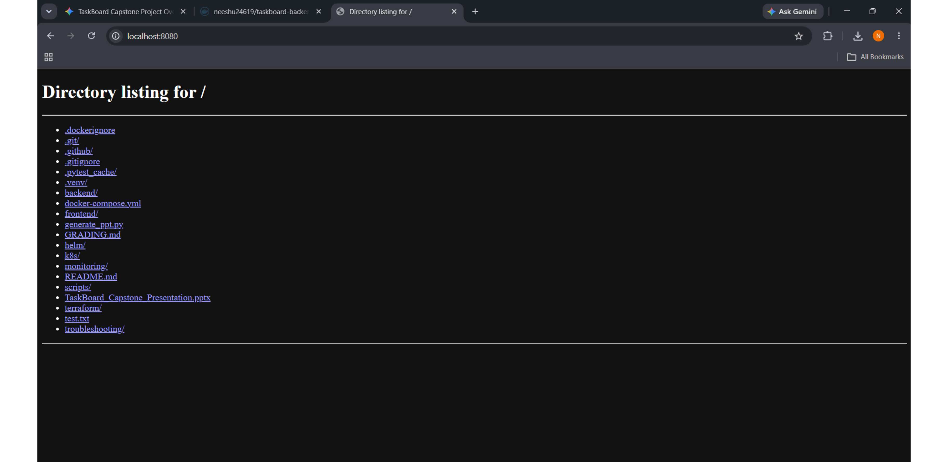
20
EVIDENCE · INGRESS
Ingress and port-forwarding paths

Slide 21
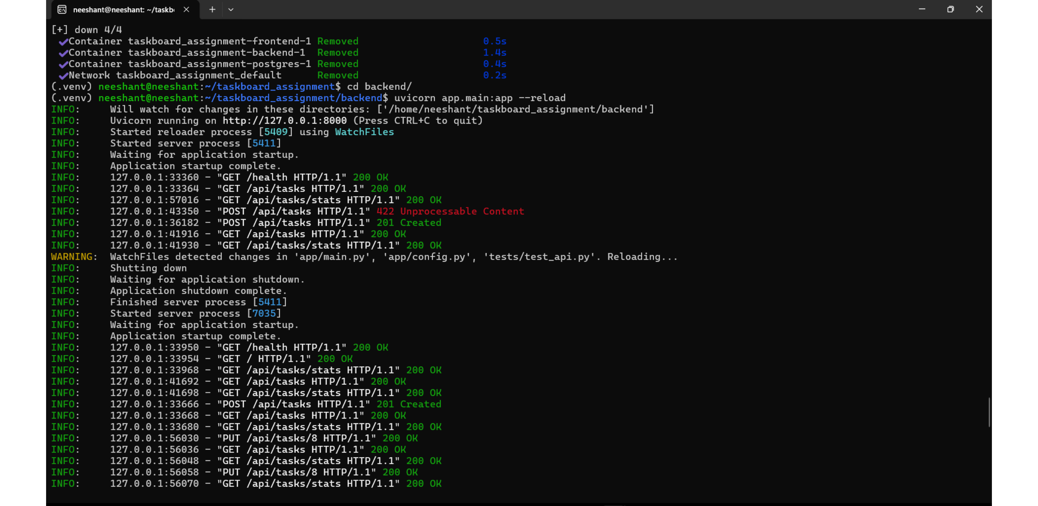
21
EVIDENCE · BACKEND
Backend terminal: live API requests

Slide 22
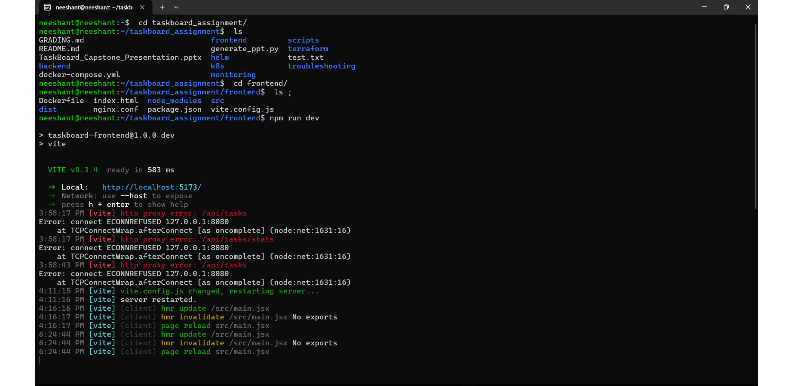
22
EVIDENCE · FRONTEND
Frontend terminal: Vite dev server

Slide 23
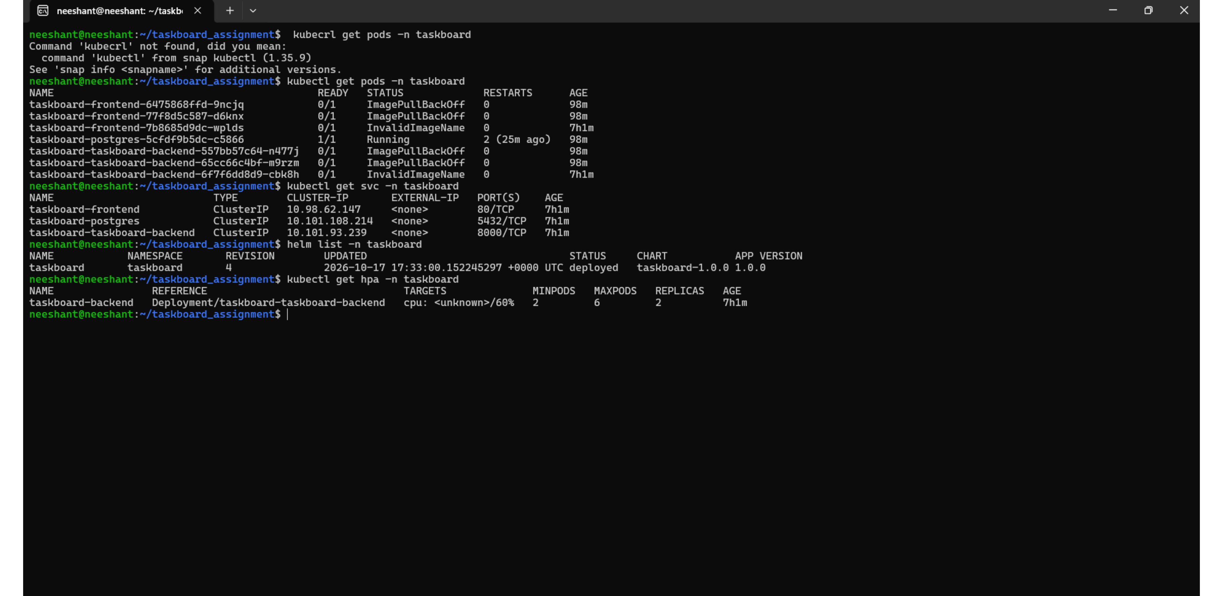
23
EVIDENCE · TROUBLESHOOTING
Terminal diagnostics and database fix

Slide 24
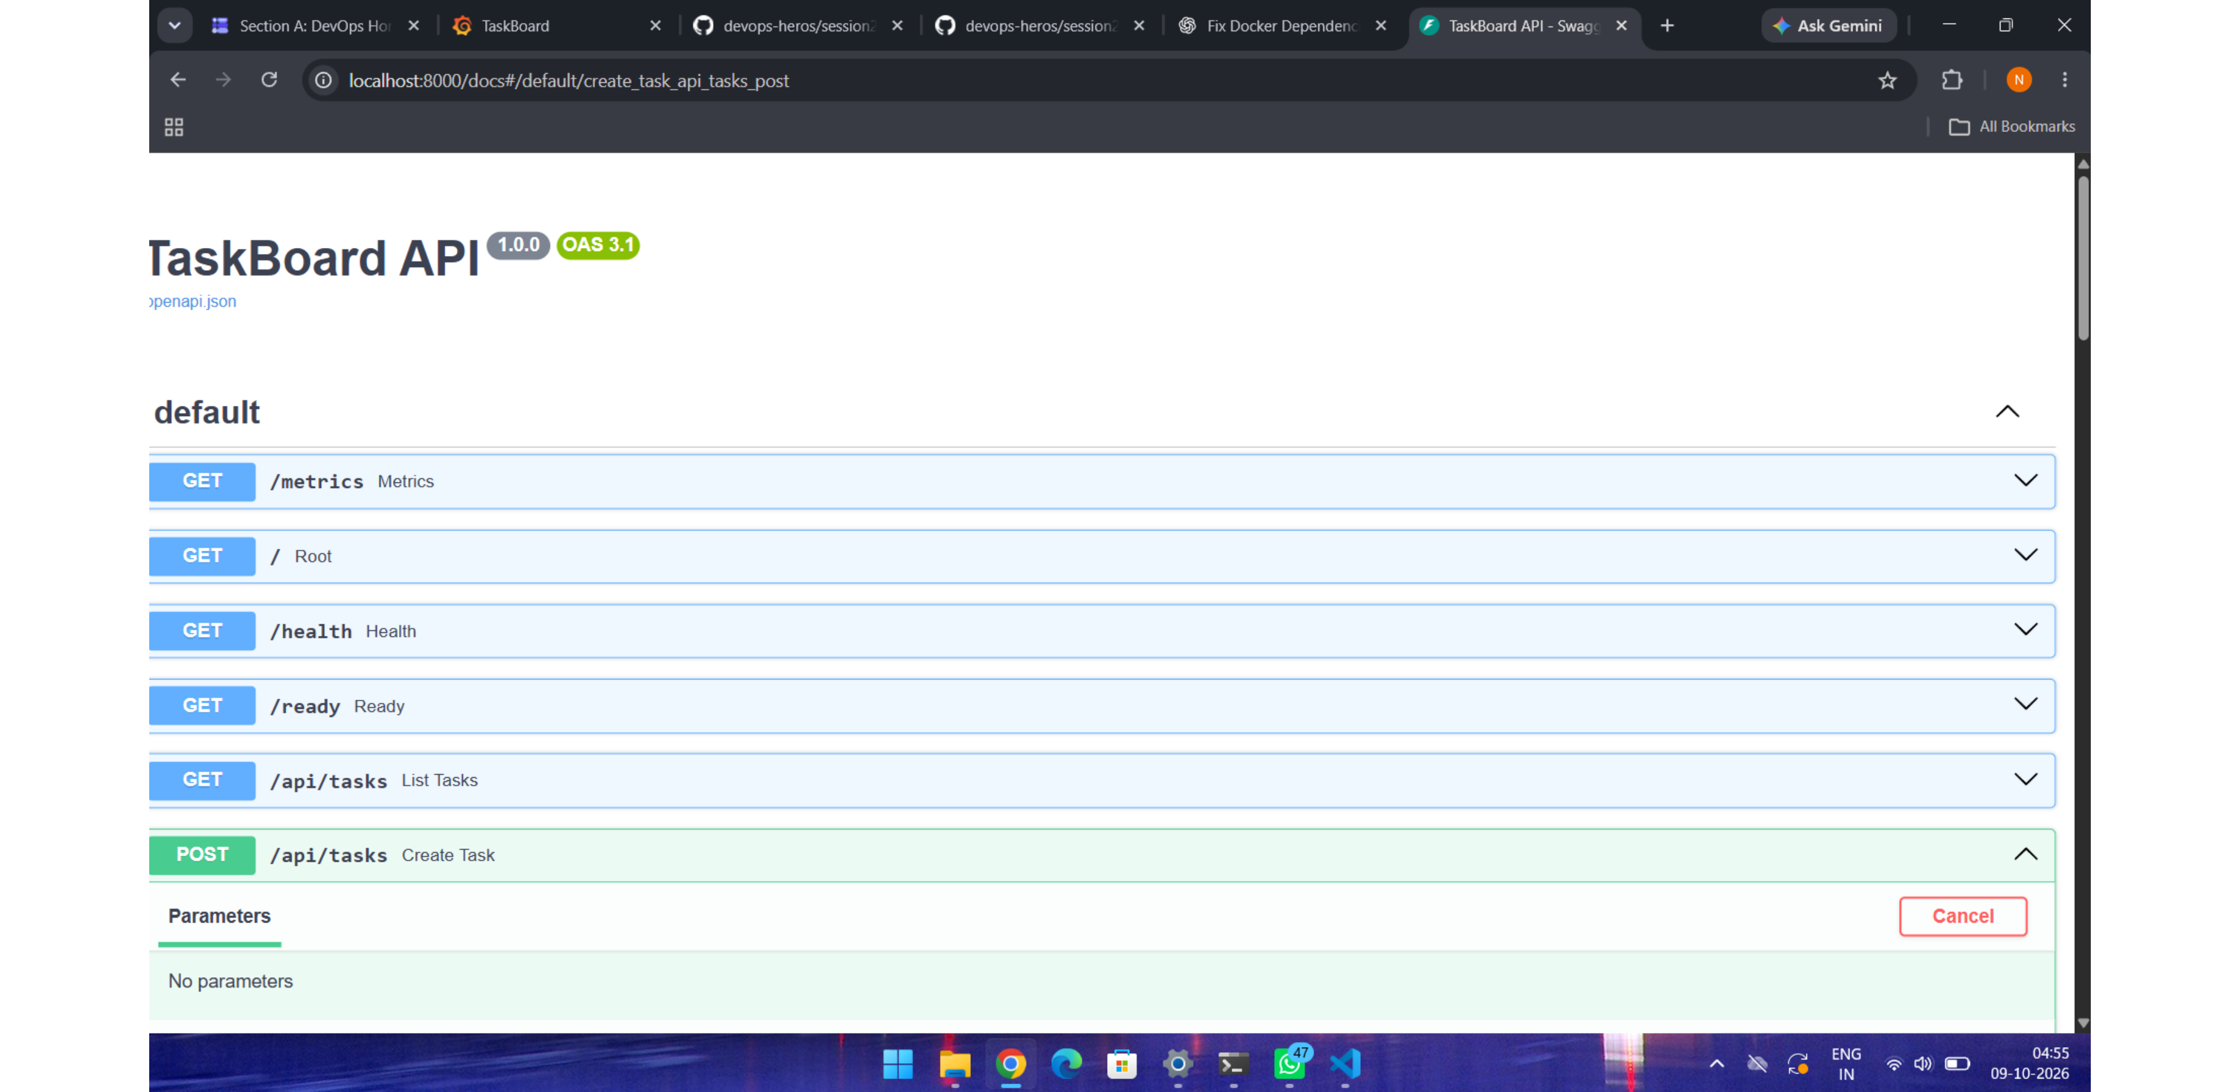
24
EVIDENCE · API
Swagger API docs

Slide 25
25
The delivery artifact is ready to carry forward
TaskBoard demonstrates a practical DevOps loop: build, test, scan, ship, deploy, observe, and improve.
1
Local presentation deliverable: TaskBoard_Capstone_Presentation.pptx
2
Project evidence is captured from the working application, terminals, dashboards, and registry
3
Next step: use the same pipeline to promote hardened images beyond Minikube

