Slide 1


MERN STACK PROJECT (NETFLIX-CLONE)
PRESENTED BY : NEESU PRASAD

Slide 2
User authentication: Users can create an account, log in, and log out of the application.
Browse movies and TV shows: Users can browse the available movies and TV shows on the platform.
Search: Users can search for specific movies or TV shows.
User profiles: Each user has their own profile where they can see their watch history and manage their account details.
API integration: The application uses The Movie Database (TMDb) API to get information about movies and TV shows.
FEATURES

Slide 3
TECHNOLOGIES USED
BACKEND
FRONTEND
NODEJS
EXPRESSJS
MONGODB
REACTJS

Slide 4
PACKAGES USED
BACKEND | FRONTEND
MONGOOSE CORS FIREBASE EXPRESS | STYLED-COMPONENTS REACT-ROUTER-DOM AXIOS REDUX-TOOLKIT

Slide 5

REACTJS
A popular JavaScript library used to build complex user interfaces and single-page applications, with a focus on component-based architecture and reusability.

Slide 6
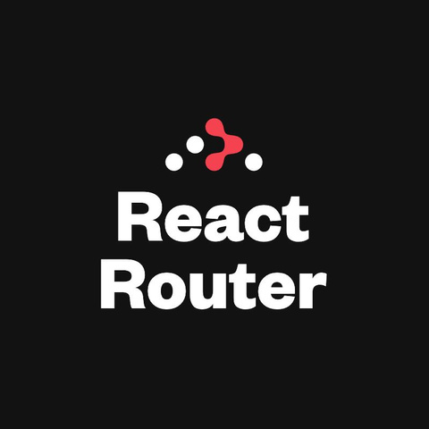
REACT-ROUTER-DOM
A popular routing library for React, providing a declarative API for defining and navigating between different pages and views in a single-page application.

Slide 7
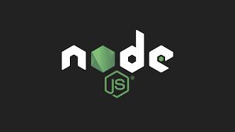
NODE.JS
A server-side JavaScript runtime environment that allows for scalable and efficient development of server-side applications, with access to a vast ecosystem of third-party modules and packages.

Slide 8

EXPRESSJS
A flexible and minimalistic web application framework for Node.js, providing a simple and intuitive API for building web applications, handling requests and responses, and implementing middleware functions.

Slide 9

MONGO DB
A scalable and flexible NoSQL document database that uses a JSON-like format for storing data, allowing for easy and efficient querying and indexing of data.

Slide 10
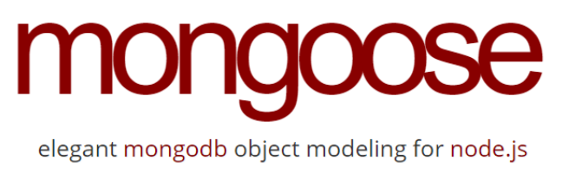
MONGOOSE
A MongoDB object modeling tool for Node.js, providing a simple and elegant API for defining schemas, models, and queries, and integrating with MongoDB databases.

Slide 11
TMDB API
An open and community-driven API for getting information about movies and TV shows, including metadata, ratings, reviews, and trailers, with a wide range of endpoints and parameters for flexible querying.

Slide 12

AXIOS
A promise-based HTTP client for the browser and Node.js, providing a simple and consistent API for making HTTP requests, handling responses, and handling errors, with support for interceptors and cancellation.

Slide 13

FIREBASE
A mobile and web application development platform, providing a range of services such as authentication, cloud functions, database, storage, and messaging, with a focus on simplicity and ease of use.

Slide 14
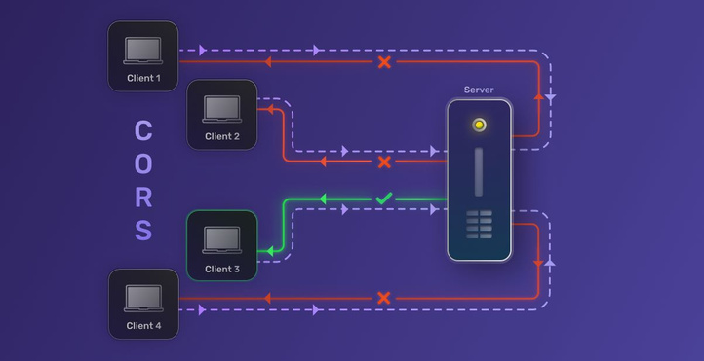
CORS
A security feature implemented in web browsers that allows web pages to make requests to a different domain than the one that served the page, by setting HTTP headers that indicate the allowed origins, methods, and headers for cross-domain requests.

Slide 15
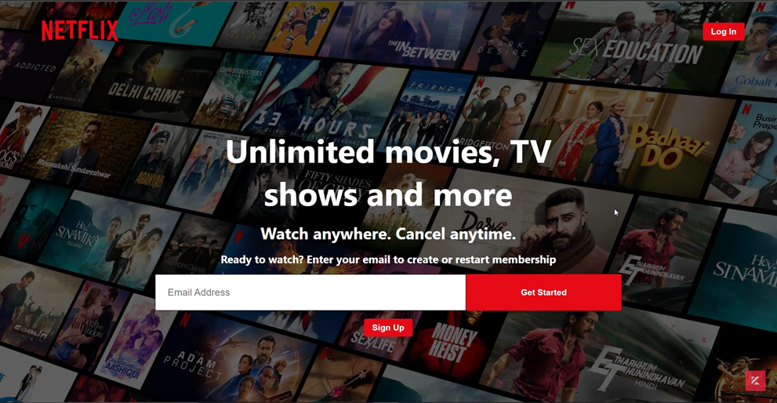
DEMO AND CODE EXPLANATION
STARTING FROM:

Slide 16
THANK YOU

