Slide 1



BlackFriday Deals Dataset Analysis

Slide 2
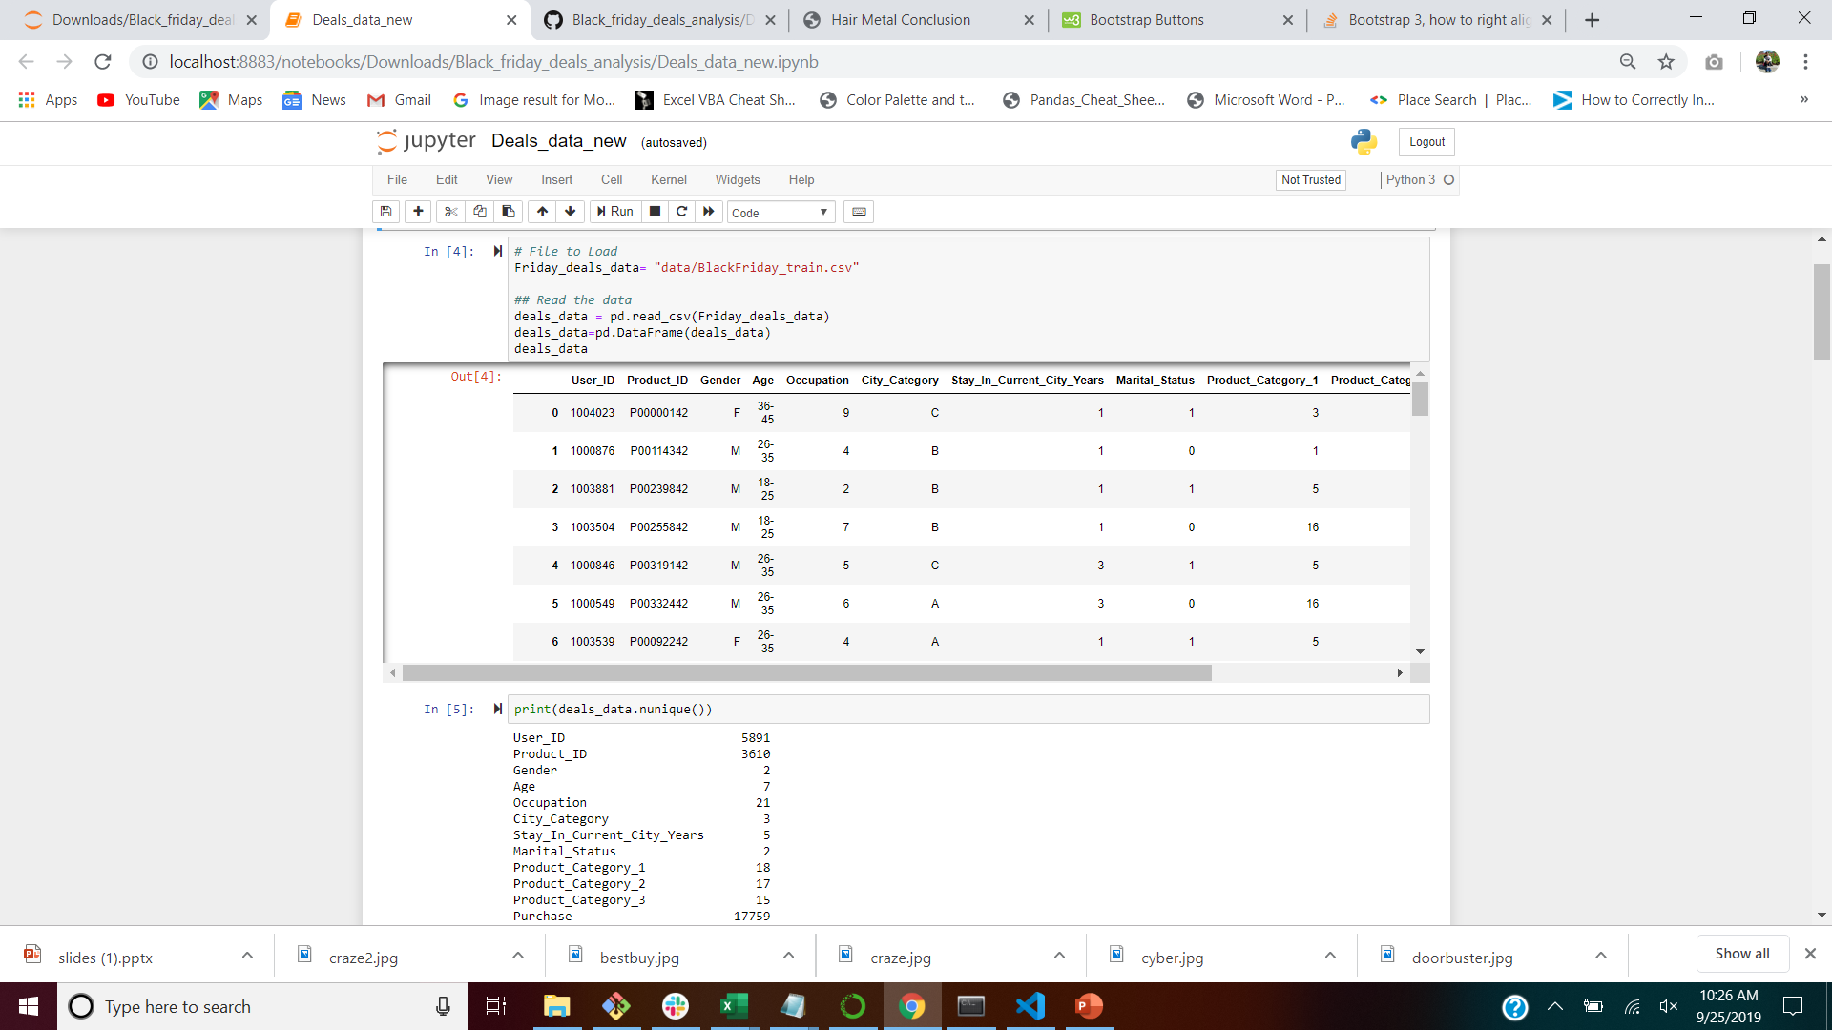
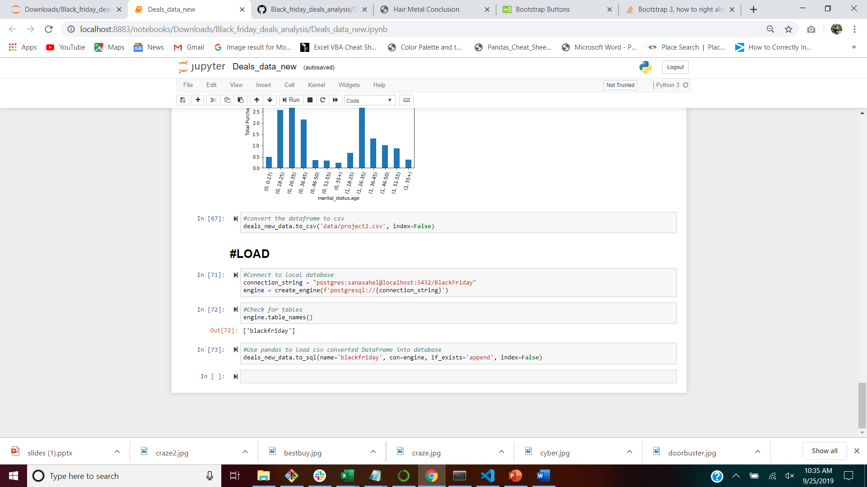
ETL Process
- Kaggle.com
CSV FILE with
483819 rows × 12 columns
- After dropping duplicates and NAN
147936 rows × 12 columns

Slide 4
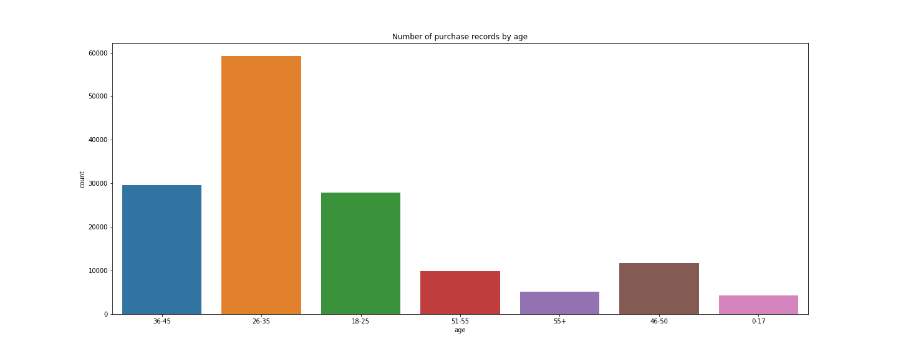
Age vs Purchase Plot

Slide 5
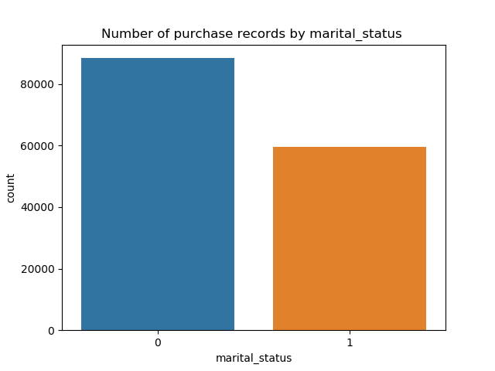
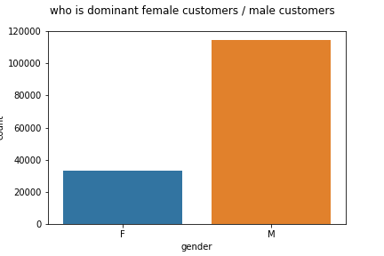
Gender and Marital Status Vs Purchase Plots

Slide 6
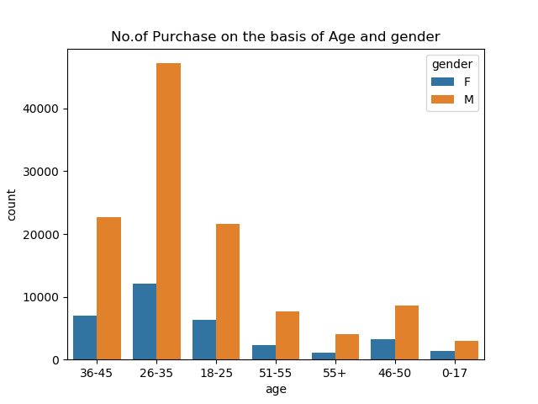

Slide 7
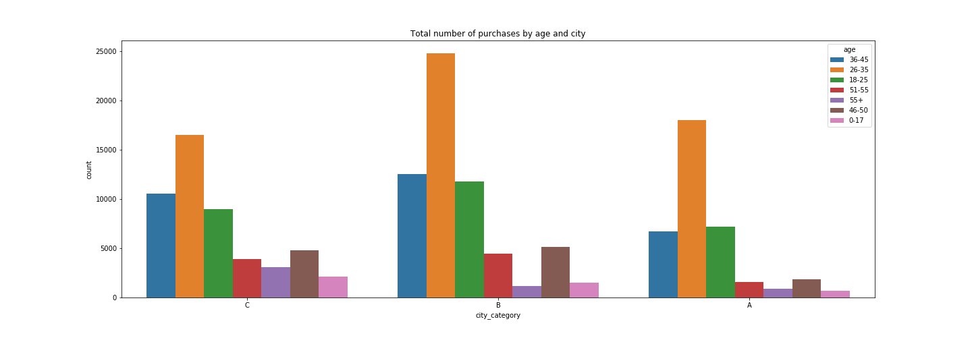
Total number of purchases by Age and City Plot

Slide 8
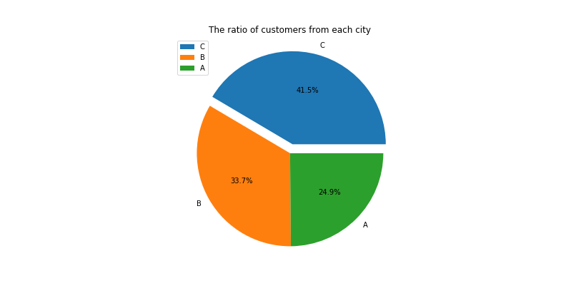

Slide 9
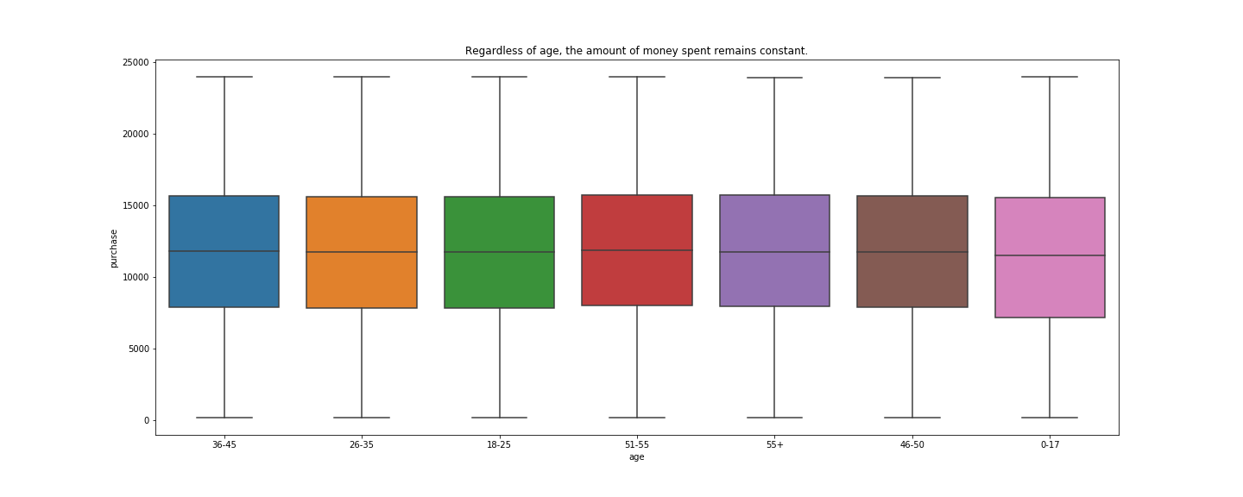

Slide 10
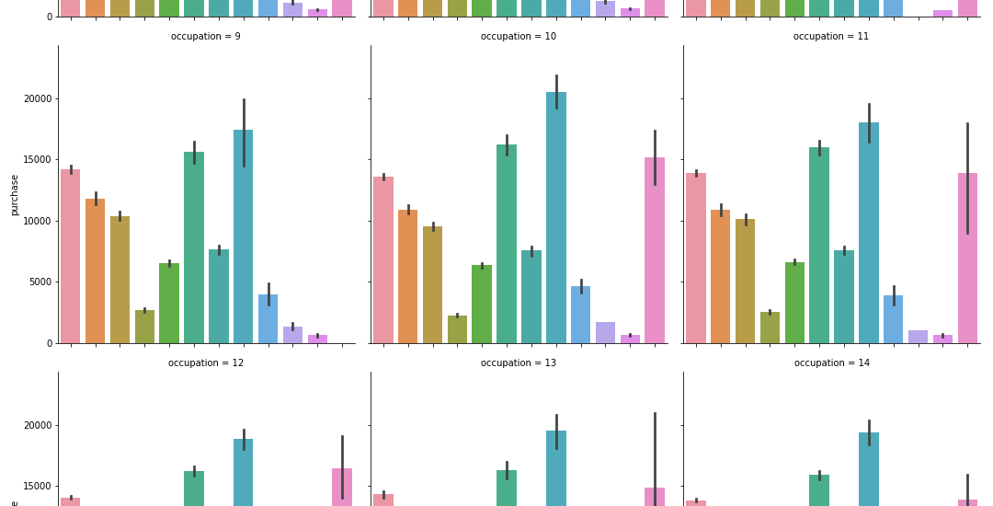

Slide 11
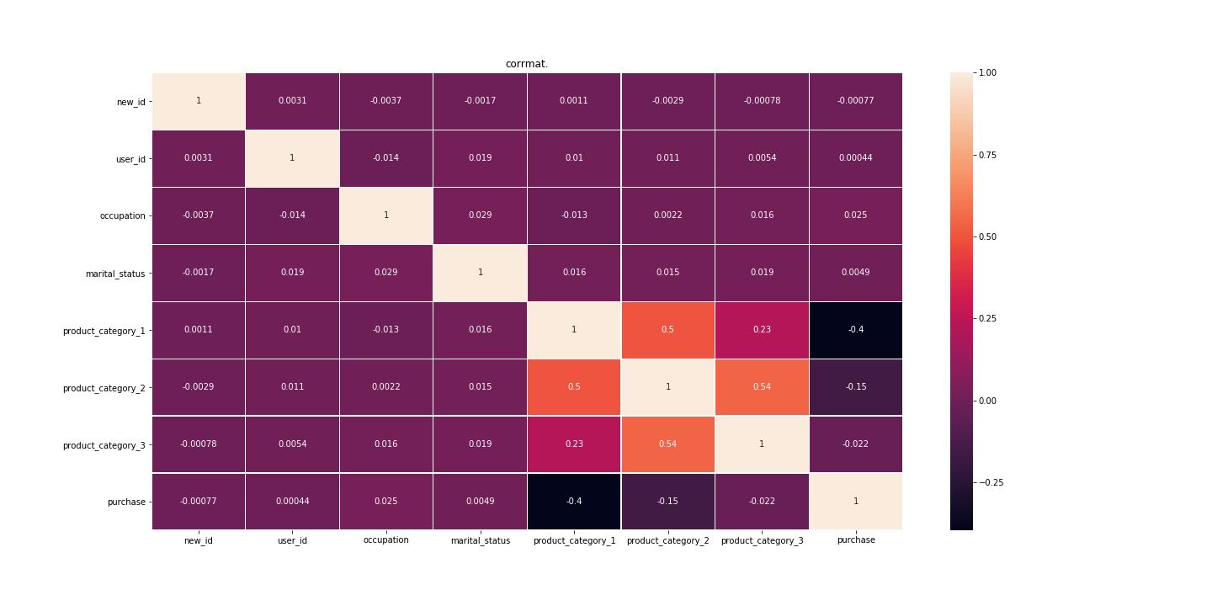

Slide 12
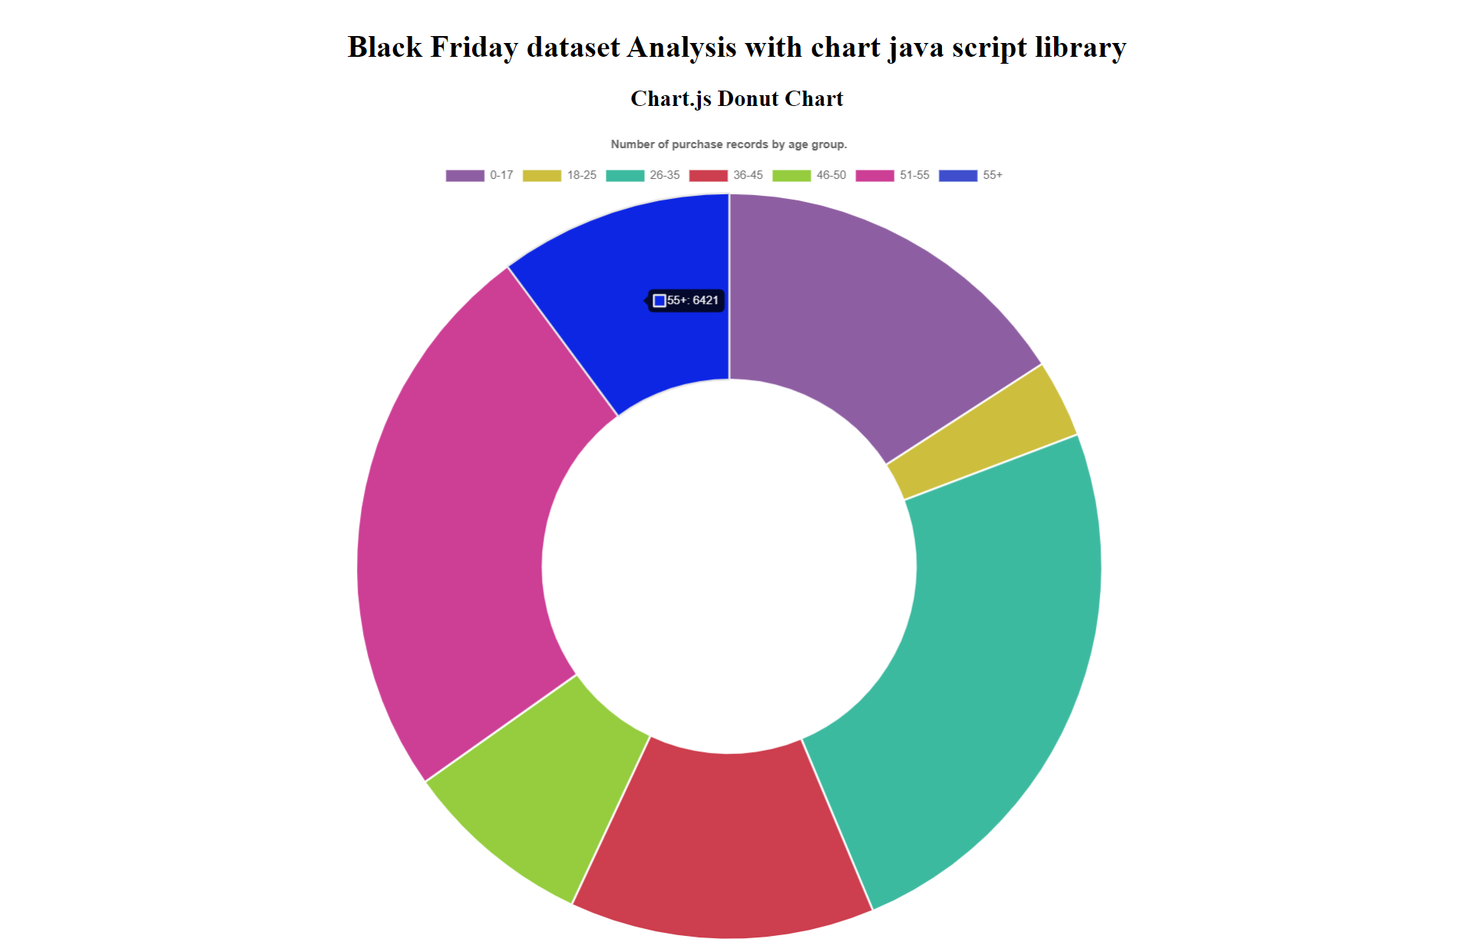

Slide 13
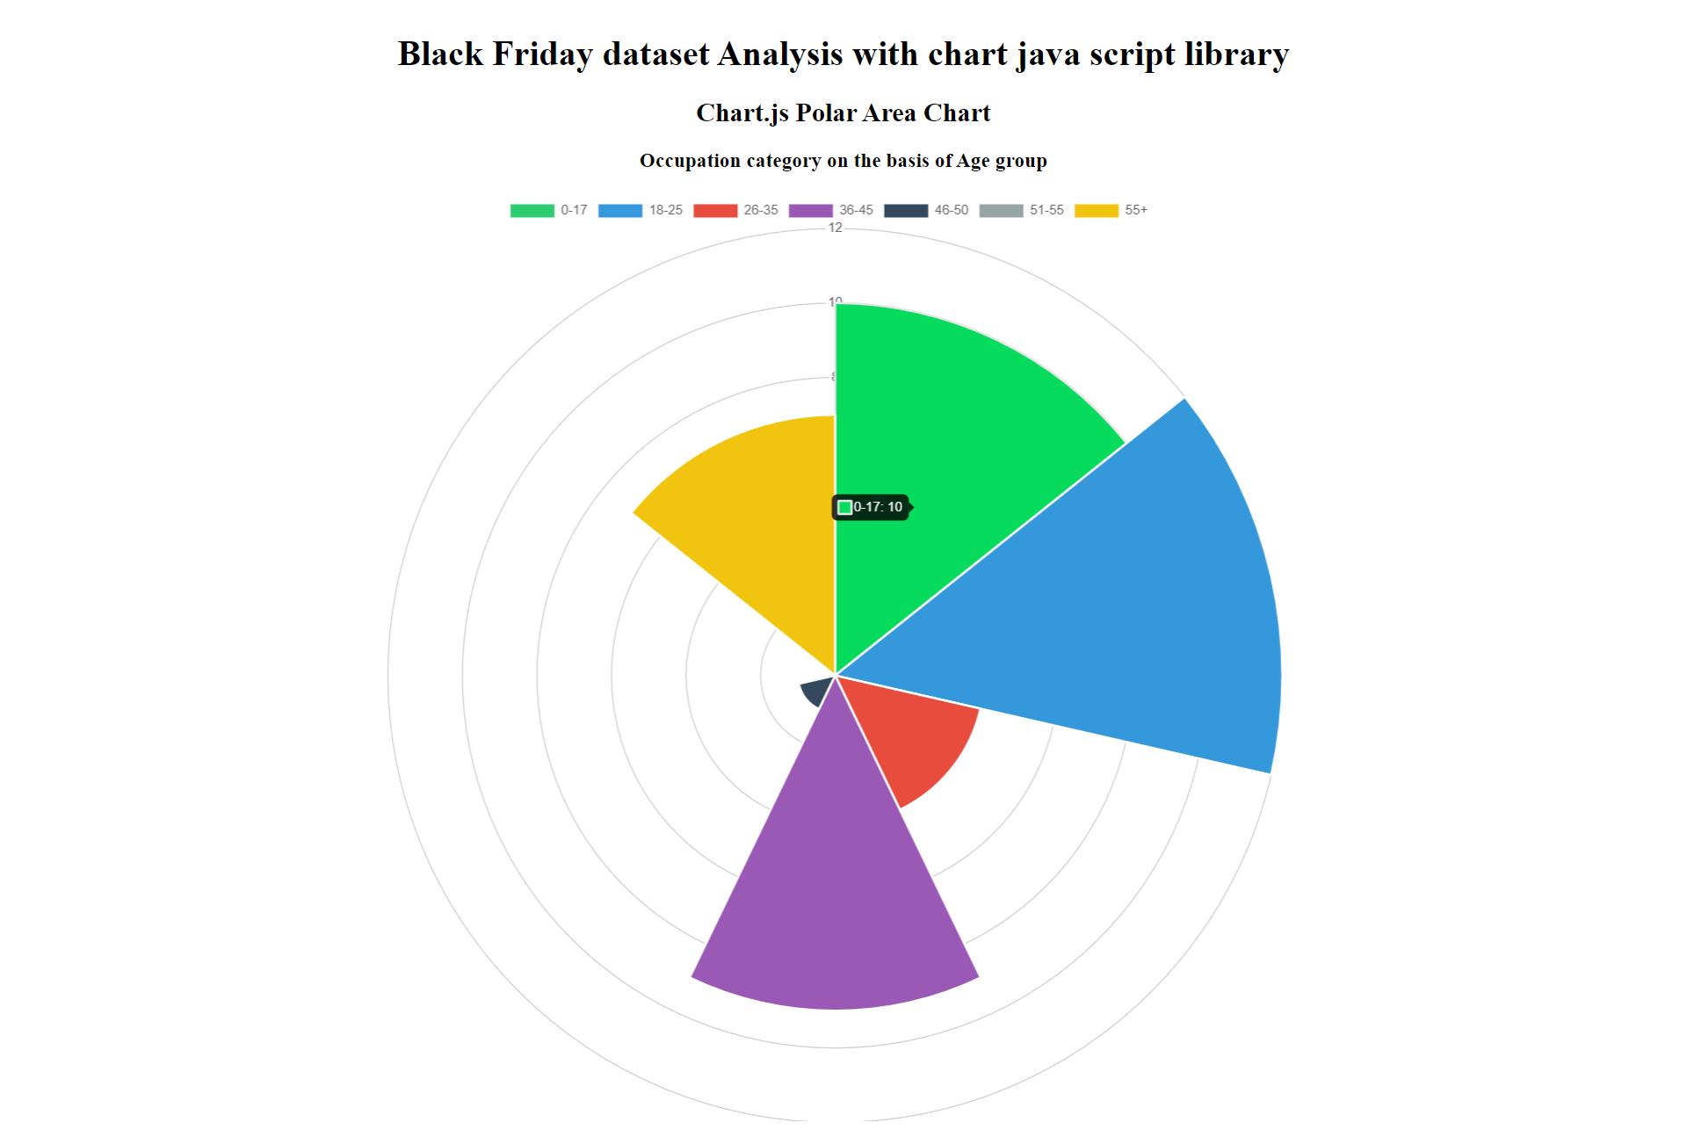

Slide 14
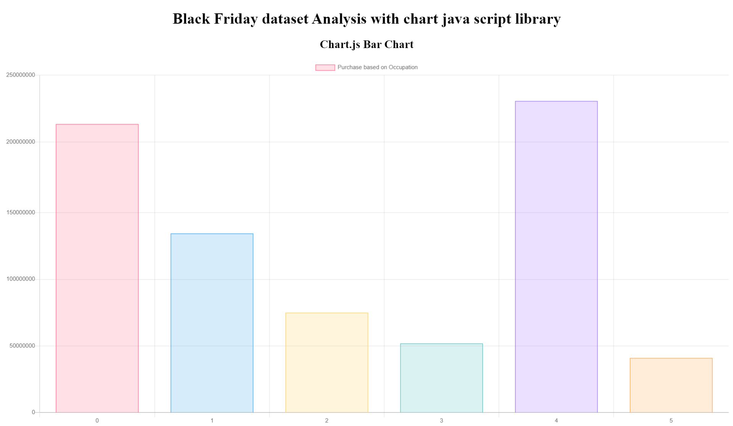

Slide 15
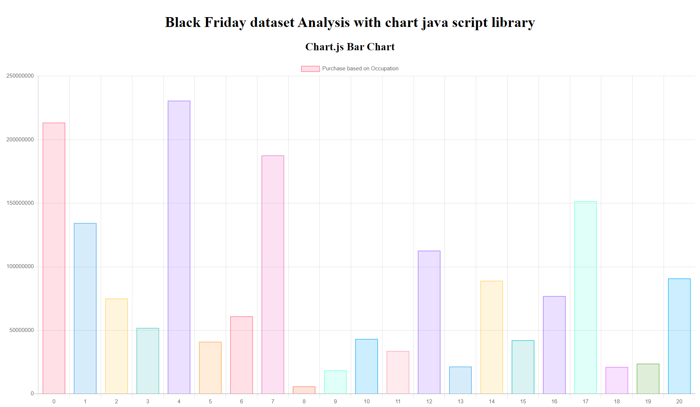

Slide 16
Analysis
We can see how age and marital status are quite related things, which is something very normal.
But we can also see some relation between the product categories. Relationship between category 1 and 2 is very strong. Category 3 is very good too
Relationship between category 2 and 3 is quite good as well, in fact more than the relationship between category 1 and 2.
We can say that these relationships tell us that depending on the category you buy, users will normally repeat the categories.
Corrmat will explain the correlation between two columns or category

Slide 17
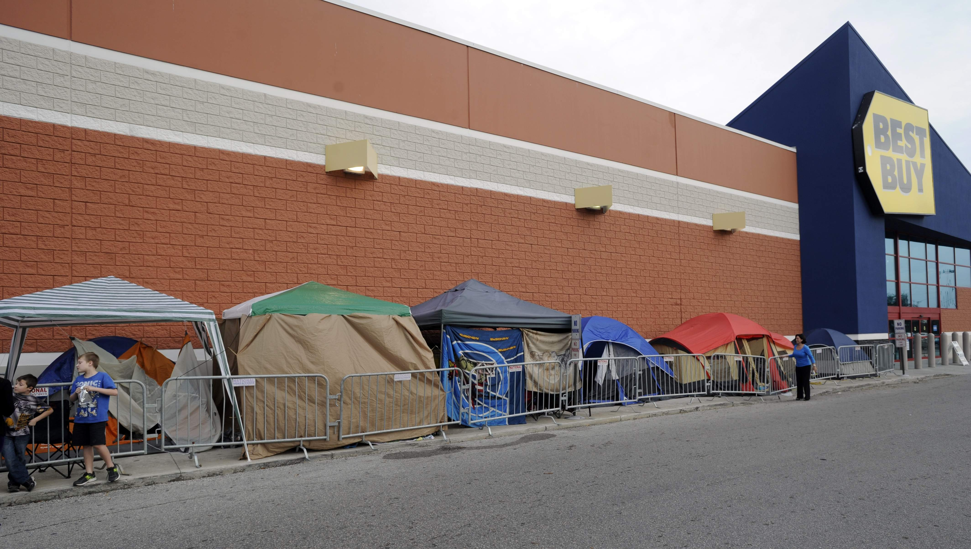
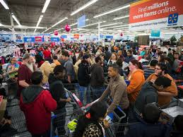
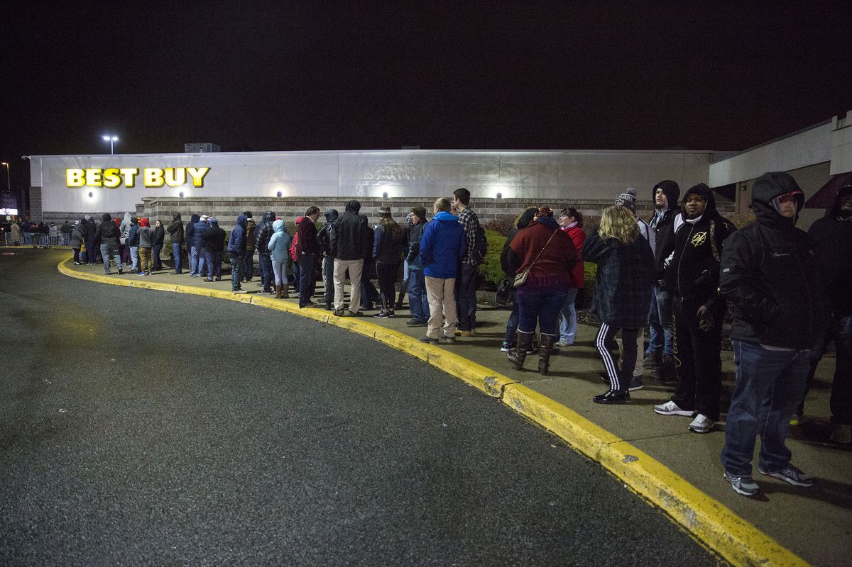
Happy Shopping Everyone!

Slide 18
Thank you
Presented by Neeta, Zareen and Jayshree
UT Bootcamp 2019

