Slide 1


Slide 2
Generics
The Java Generics programming is introduced in J2SE 5 to deal with type-safe objects.
The idea is to allow type (Integer, String, … etc and user defined types) to be a parameter to methods, classes and interfaces.
For example, classes like HashSet, ArrayList, HashMap, etc use generics very well.
It would be nice if we could write a single sort method that could sort the elements in an Integer array, a String array, or an array of any type that supports ordering.

Slide 3
Generics
It gives you a provision of telling the compiler the type of the collection.
So that it can be checked even before execution.
Once the compiler knows the element type of the collection, the compiler can check for type safety and can insert the correct casts on values being taken out of the collection.

Slide 4
Parameterized Classes and Generics
The class ArrayList is a parameterized class
It has a parameter, denoted by Base_Type, that can be replaced by any reference type to obtain a class for ArrayLists with the specified base type
Starting with version 5.0, Java allows class definitions with parameters for types
These classes that have type parameters are called parameterized class or generic definitions, or, simply, generics

Slide 5
Generics (Cont’d)
A class definition with a type parameter is stored in a file and compiled just like any other class.
Once a parameterized class is compiled, it can be used like any other class.
However, the class type plugged in for the type parameter must be specified before it can be used in a program.
Doing this is said to instantiate the generic class.
Sample<String> object = new Sample<String>();

Slide 6
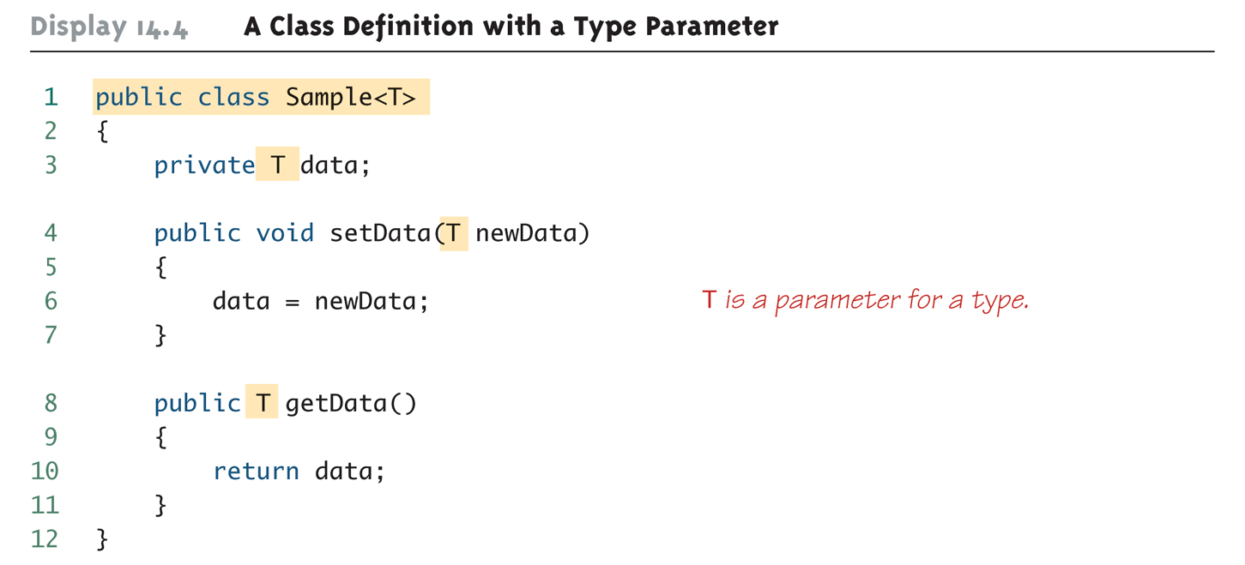
A Class Definition with a Type Parameter

Slide 7
A Class Definition with a Type Parameter (Cont’d)
A class that is defined with a parameter for a type is called a generic class or a parameterized class
The type parameter is included in angular brackets after the class name in the class definition heading.
Any non-keyword identifier can be used for the type parameter, but by convention, the parameter starts with an uppercase letter.
The type parameter can be used like other types used in the definition of a class.

Slide 8
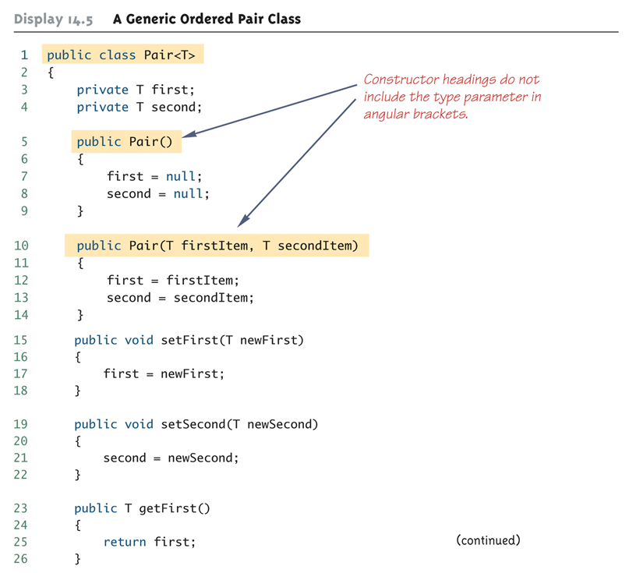
Generic Class Definition: An Example

Slide 9
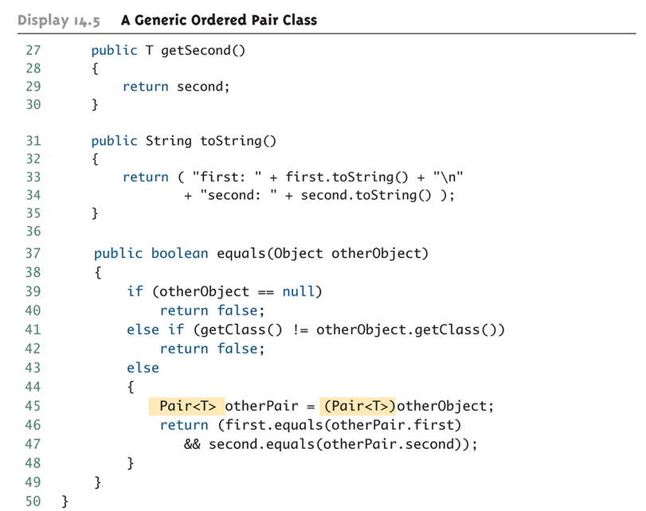
Generic Class Definition: An Example (Cont’d)

Slide 10
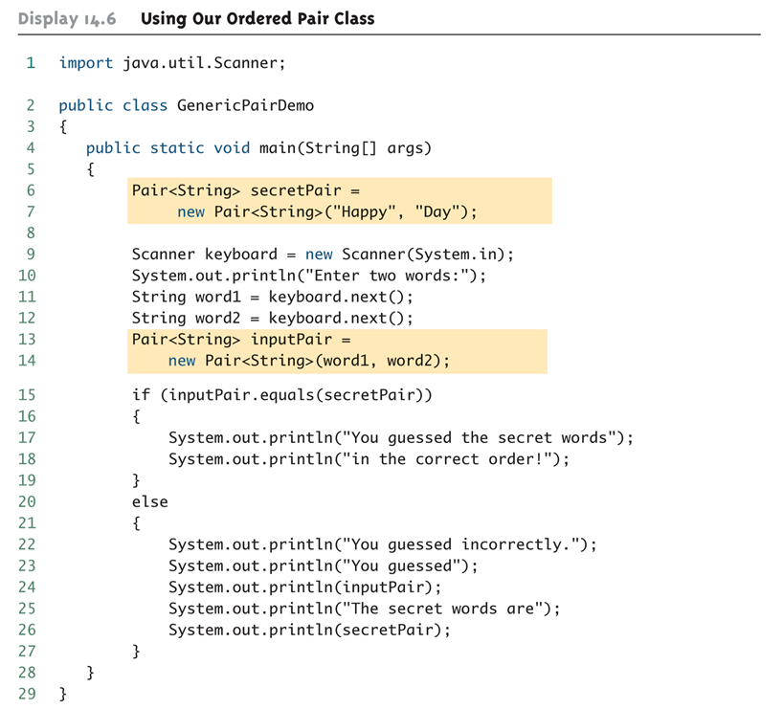
Generic Class Usage: An Example

Slide 11
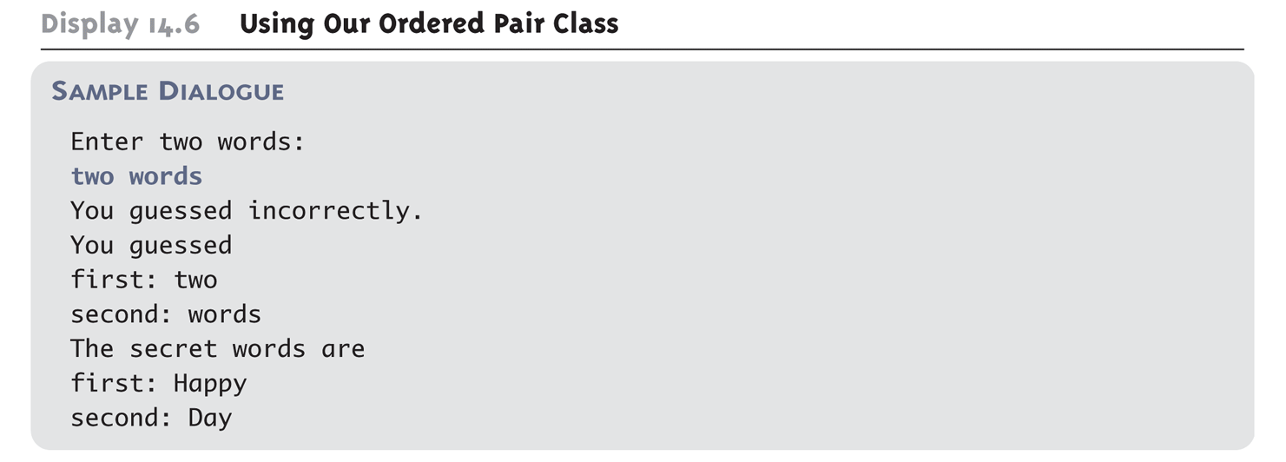
Generic Class Usage: An Example (Cont’d)
Program Output:

Slide 12
A Generic Constructor Name Has No Type Parameter!!!
Although the class name in a parameterized class definition has a type parameter attached, the type parameter is not used in the heading of the constructor definition:
public Pair<T>()
A constructor can use the type parameter as the type for a parameter of the constructor, but in this case, the angular brackets are not used:
public Pair(T first, T second)
However, when a generic class is instantiated, the angular brackets are used:
Pair<String> pair = new Pair<STring>("Happy", "Day");

Slide 13
A Primitive Type Cannot be Plugged in for a Type Parameter!!!
The type plugged in for a type parameter must always be a reference type:
It cannot be a primitive type such as int, double, or char
However, now that Java has automatic boxing, this is not a big restriction.
Note: Reference types can include arrays.

Slide 14
Limitations on Type Parameter Usage
Within the definition of a parameterized class definition, there are places where an ordinary class name would be allowed, but a type parameter is not allowed.
In particular, the type parameter cannot be used in simple expressions using new to create a new object
For instance, the type parameter cannot be used as a constructor name or like a constructor:
T object = new T();
T[] a = new T[10];

Slide 15
Limitations on Generic Class Instantiation
Arrays such as the following are illegal:
Pair<String>[] a =
new Pair<String>[10];
Although this is a reasonable thing to want to do, it is not allowed given the way that Java implements generic classes

Slide 16
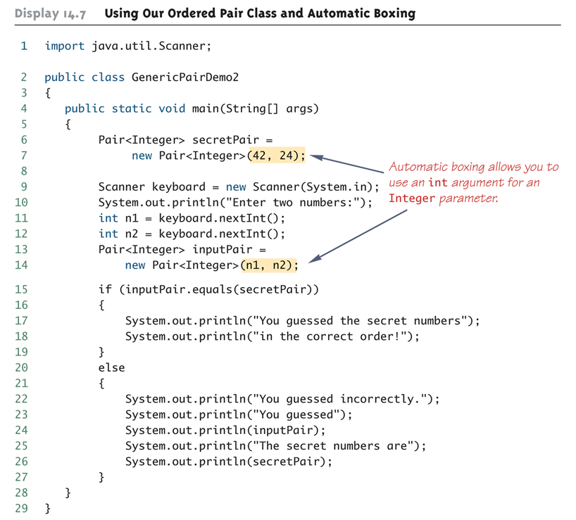
Using Generic Classes and Automatic Boxing

Slide 17
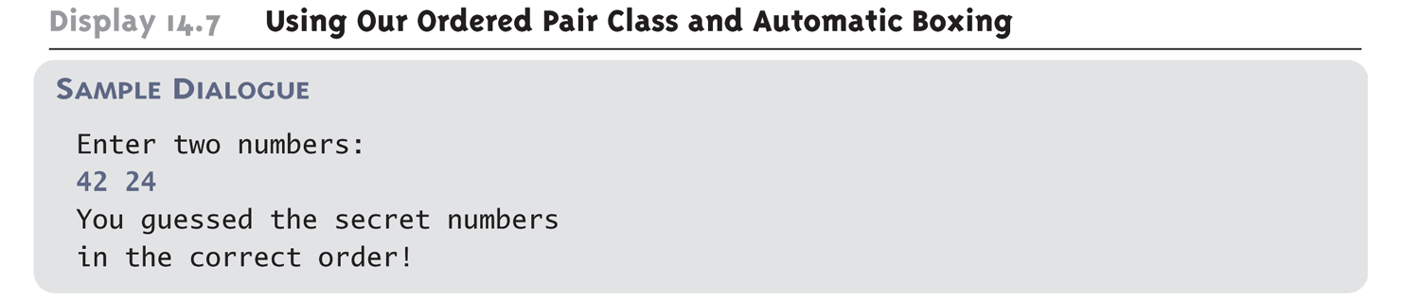
Using Generic Classes and Automatic Boxing (Cont’d)
Program Output:

Slide 18
Multiple Type Parameters
A generic class definition can have any number of type parameters.
Multiple type parameters are listed in angular brackets just as in the single type parameter case, but are separated by commas.

Slide 19
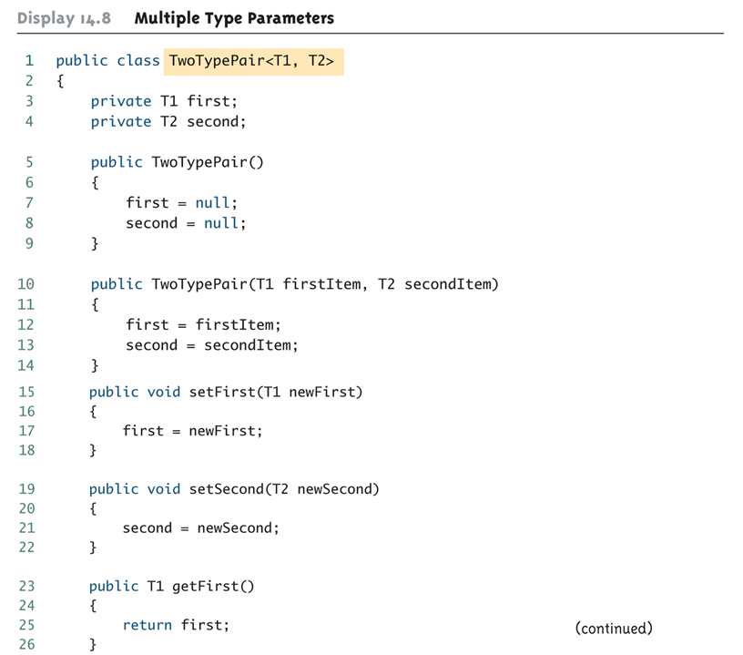
Multiple Type Parameters (Cont’d)

Slide 20
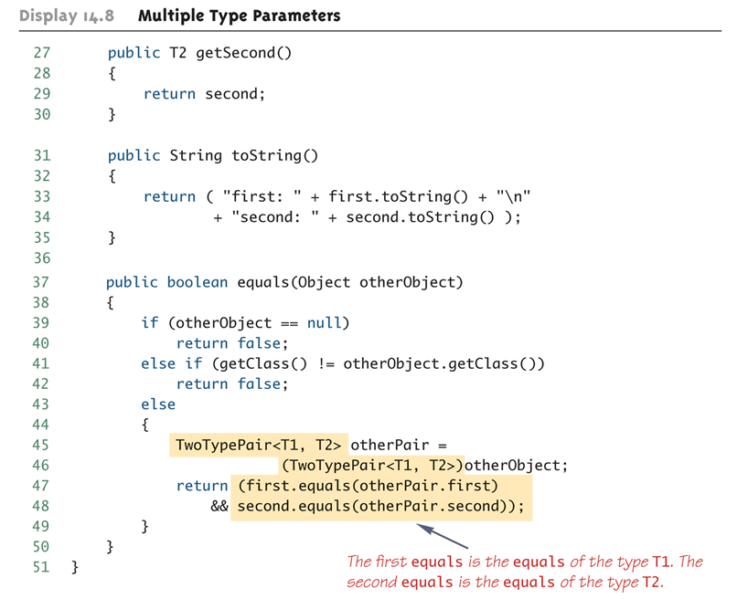
Multiple Type Parameters (Cont’d)

Slide 21
A Generic Classes and Exceptions
It is not permitted to create a generic class with Exception, Error, Throwable, or any descendent class of Throwable
A generic class cannot be created whose objects are throwable
public class GEx<T> extends Exception
The above example will generate a compiler error message

Slide 22
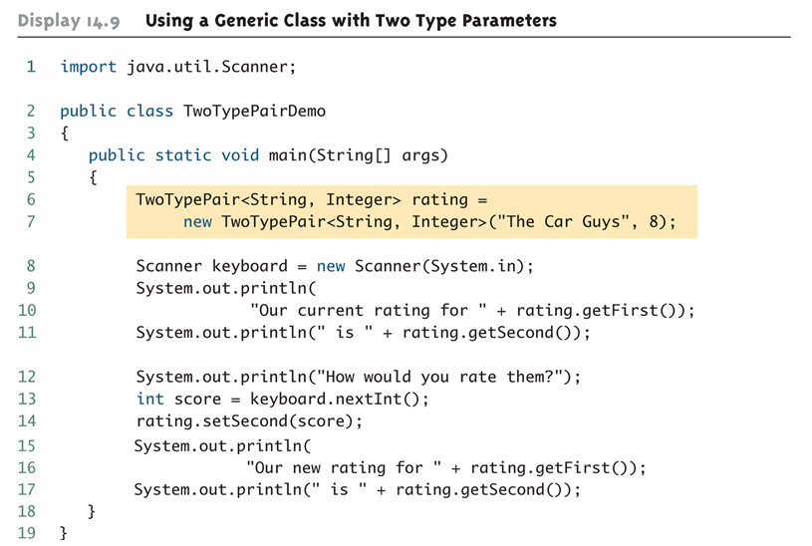
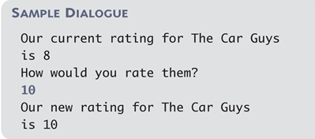
Using a Generic Class with Two Type Parameters
Program Output:

Slide 23
Bounds for Type Parameters
Sometimes it makes sense to restrict the possible types that can be plugged in for a type parameter T.
For instance, to ensure that only classes that implement the Comparable interface are plugged in for T, define a class as follows:
public class RClass<T extends Comparable>
"extends Comparable" serves as a bound on the type parameter T.
Any attempt to plug in a type for T which does not implement the Comparable interface will result in a compiler error message.

Slide 24
Bounds for Type Parameters (Cont’d)
A bound on a type may be a class name (rather than an interface name)
Then only descendent classes of the bounding class may be plugged in for the type parameters:
public class ExClass<T extends Class1>
A bounds expression may contain multiple interfaces and up to one class.
If there is more than one type parameter, the syntax is as follows:
public class Two<T1 extends Class1, T2 extends Class2 & Comparable>

Slide 25
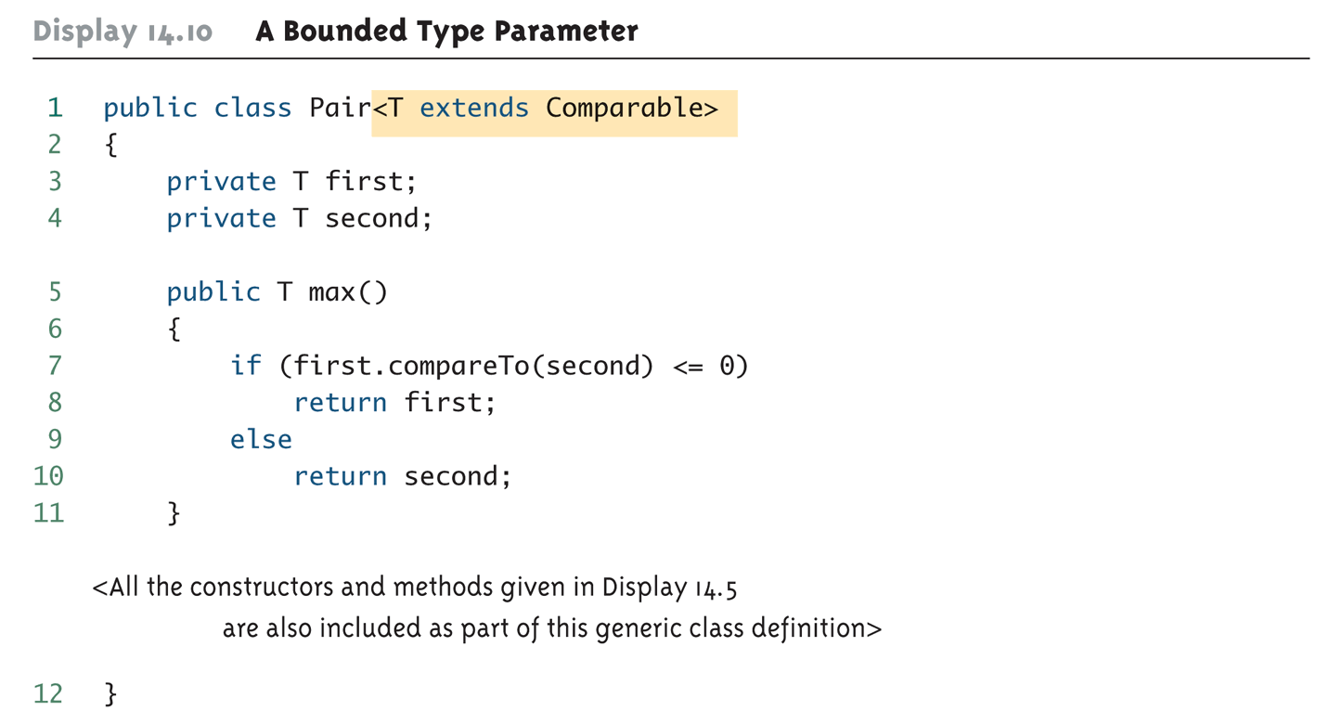
Bounds for Type Parameters (Cont’d)

Slide 26
Generic Interfaces
An interface can have one or more type parameters.
The details and notation are the same as they are for classes with type parameters.

Slide 27
Generic Methods
When a generic class is defined, the type parameter can be used in the definitions of the methods for that generic class.
In addition, a generic method can be defined that has its own type parameter that is not the type parameter of any class
A generic method can be a member of an ordinary class or a member of a generic class that has some other type parameter.
The type parameter of a generic method is local to that method, not to the class.

Slide 28
Generic Methods (Cont’d)
The type parameter must be placed (in angular brackets) after all the modifiers, and before the returned type:
public static <T> T genMethod(T[] a)
When one of these generic methods is invoked, the method name is prefaced with the type to be plugged in, enclosed in angular brackets
String s = NonG.<String>genMethod(c);

Slide 29
Inheritance with Generic Classes
A generic class can be defined as a derived class of an ordinary class or of another generic class
As in ordinary classes, an object of the subclass type would also be of the superclass type
Given two classes: A and B, and given G: a generic class, there is no relationship between G<A> and G<B>
This is true regardless of the relationship between class A and B, e.g., if class B is a subclass of class A

Slide 30
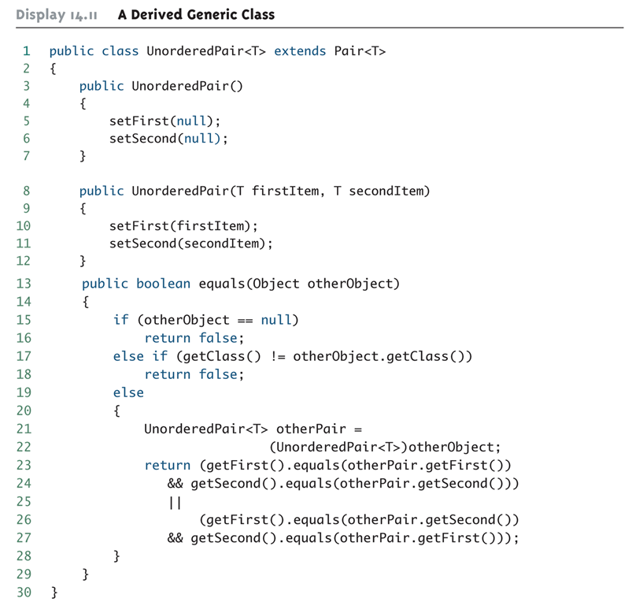
A Derived Generic Class: An Example

Slide 31
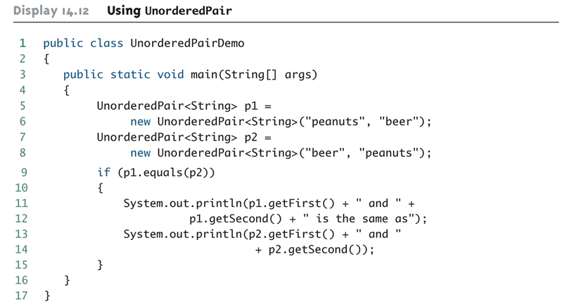

A Derived Generic Class: An Example (Cont’d)
Program Output:

Slide 32
Collection Classes 2-1
An object of the Collection class groups multiple elements into a single unit.
Collections are used to store, retrieve and manipulate data and to transmit data from one method to another.
Collection Framework is an unified architecture for representing and manipulating collections.

Slide 33
Collection Classes 2-2
Collection Framework is composed of three components.
Interface
Is abstract data types representing collections
Implementation
Algorithms
Are methods that perform computations on objects that implement the interface
Is actual execution of interfaces

Slide 34
Java collections framework (JCF)
It is a set of classes and interfaces that implement commonly reusable collection data structures.
Although referred to as a framework, it works in a manner of a library.
The JCF provides both interfaces that define various collections and classes that implement them.

Slide 35
Advantages of Collection Framework
Reduces programming effort by providing useful data structures and algorithms.
Increases program speed and quality since the implementation of each interface is interchangeable.
Allows interoperability among different APIs.
Extending or adapting a collection is easy.

Slide 36
The Collection Classes
Java provides a set of standard collection classes that implement Collection interfaces.
The Collection interface (java.util.Collection) and Map interface (java.util.Map) are two main root interfaces of Java collection classes.
The java.util package contains all the classes and interfaces for Collection framework.

Slide 37
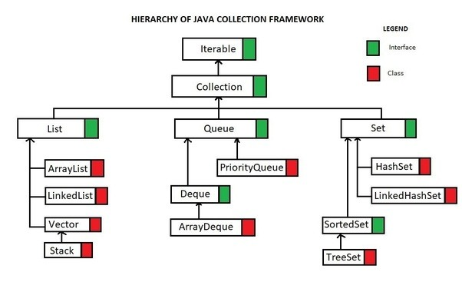
Hierarchy of Collection Framework

Slide 38
Methods of Collection interface
Method | Description
public boolean add(Object element) | is used to insert an element in this collection.
public boolean addAll(Collection c) | is used to insert the specified collection elements in the invoking collection.
public boolean remove(Object element) | is used to delete an element from this collection.
public boolean removeAll(Collection c) | is used to delete all the elements of specified collection from the invoking collection.
public boolean retainAll(Collection c) | is used to delete all the elements of invoking collection except the specified collection.
public int size() | return the total number of elements in the collection.
public void clear() | removes the total no of element from the collection.
public boolean contains(Object element) | is used to search an element.
public boolean containsAll(Collection c) | is used to search the specified collection in this collection.
public Iterator iterator() | returns an iterator.
public Object[] toArray() | converts collection into array.
public boolean isEmpty() | checks if collection is empty.
public boolean equals(Object element) | matches two collection.
public int hashCode() | returns the hashcode number for collection.

Slide 39
Iterator interface
Iterator interface provides the facility of iterating the elements in forward direction only.
Iterator is an interface available in Collection framework in java.util package.
It is a Java Cursor used to iterate a collection of objects.
It is used to traverse a collection object elements one by one.
It is available since Java 1.2 Collection Framework.
It is applicable for all Collection classes. So it is also known as Universal Java Cursor.
It supports both READ and REMOVE Operations.
Compare to Enumeration interface, Iterator method names are simple and easy to use.

Slide 40
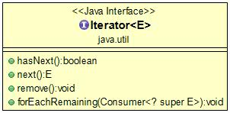
Iterator Methods
Method | Description
public boolean hasNext() | It returns true if iterator has more elements.
public Object next() | It returns the element and moves the cursor pointer to the next element.
public void remove() | It removes the last elements returned by the iterator. It is rarely used.
Notes:
default void forEachRemaining(Consumer action): Performs the given action for each remaining element until all elements have been processed or the action throws an exception.

Slide 41
Iterator Demo
Get an Iterator object from a Collection.
Each and every Collection class has the following iterator() method to iterate it’s elements.
Iterator<E> iterator()
Iterator<String> namesIterator = names.iterator();

Slide 42
Ways to iterate the elements of collection
for (int i = 0; i < listNames.size(); i++) {
String aName = listNames.get(i);
System.out.println(aName); }
The Classic For Loop
The Iterator Method
The Enhanced For Loop
The forEach Method with Lambda Expressions
Iterator<String> iterator = listNames.iterator();
while (iterator.hasNext()) {
String aName = iterator.next();
System.out.println(aName);}
for (String aName : listNames) {
System.out.println(aName);
}
listNames.forEach(name -> System.out.println(name));

Slide 43

ArrayList 2-1
An ArrayList object is a variable length array of object references.
It is used to create dynamic arrays.
Extends AbstractList and implements List interface.
ArrayLists are created with an initial size.
As elements are added, size increases and the array expands.
It gives better performance when accessing and iterating through objects.
1
25

Slide 44
ArrayList 2-2
PlayersList() {
playerArray = new ArrayList();
subListObj = new ArrayList();
}
void search() {
System.out.println();
System.out.println("************************************"
+ "***********************");
System.out.println("Search for an object and return "
+ "the first and last position");
System.out.println("*********************************"
+ "***************************");
System.out.println();
System.out.println("First occurance of the String"
+ " \"Serena\" is at position " + playerArray.indexOf("Serena"));
System.out.println("Last occurance of the String"
+ " \"Serena\" is at position " + playerArray.lastIndexOf("Serena"));
System.out.println();
}
void add() {
for (int ctr = 0; ctr < 5; ctr++) {
playerArray.add(new Integer(ctr));
}
playerArray.add("Martina");
playerArray.add("Serena");
playerArray.add("Venus");
playerArray.add("Serena");
System.out.println();
}
Initializing two ArrayList objects
Constructors of ArrayList class are:
Constructor | Description
ArrayList() | Creates an empty ArrayList
ArrayList(Collection c) | Creates an array list based on the elements of a given collection.
ArrayList(int size) | Creates an array list with given size. The size will grow automatically as elements are added to the array list.
An ArrayList can store objects of different type unlike an Array which can hold value of a particular datatype only
void extract() {
System.out.println("***************************"
+ "*********************");
System.out.println("Extract a sublist and "
+ "then print the new List ");
System.out.println("************************"
+ "*************************");
System.out.println();
subListObj = playerArray.subList(5, playerArray.size());
System.out.println("New Sub-List from index 5 to "
+ playerArray.size() + " is : " + subListObj);
System.out.println();
}
void display() {
System.out.println("**********************"
+ "****************");
System.out.println("Retrieve objects from the ArrayList");
System.out.println("*******************"
+ "*******************");
System.out.println();
for (int ctr = 0; ctr < playerArray.size(); ctr++) {
System.out.print(" " + playerArray.get(ctr));
}
Extracting a portion of the ArrayList and storing it in the second ArrayList by using the subList() method
Displaying the contents of the ArrayList
Searching the ArrayList for the first and last occurrence of an object using the indexOf() and lastIndexOf() method
Demonstration: Example 4

Slide 45
Vector class 3-1
Vector Class
It has array-like data structure and is dynamic
Can hold a certain number of elements
Capacity can be incremented

Slide 46
Vector class 3-2
Constructor | Description
Vector() | Creates an empty vector. Its size is 10 and capacity increment is 0.
Vector(int initialCap) | Creates an empty Vector with initial capacity specified by initialCap and capacity increment is 0.
Vector (int initialCap, int inc) | Creates an empty Vector with initial capacity specified by initialCap and capacity increment specified by inc.
Vector (Collection c) | Creates a new Vector consisting of elements of the given collection, in the order in which, they are returned by the collections iterator.

Slide 47
Difference between ArrayList and Vector
ArrayList | Vector
ArrayList is not synchronized. | Vector is synchronized
ArrayList increments 50% of current array size if number of element exceeds from its capacity. | Vector increments 100% means doubles the array size if total number of element exceeds than its capacity.
ArrayList is not a legacy class, it is introduced in JDK 1.2. | Vector is a legacy class.
ArrayList is fast because it is non-synchronized. | Vector is slow because it is synchronized i.e. in multithreading environment, it will hold the other threads in runnable or non-runnable state until current thread releases the lock of object.
ArrayList uses Iterator interface to traverse the elements. | Vector uses Enumeration interface to traverse the elements. But it can use Iterator also.

Slide 48
Vector class 3-3
Primitive data types cannot be added to a Vector.
PreciousStones() {
preciousVector = new Vector();
}
Creating an object of the Vector class
void add() {
preciousVector.addElement("Jade");
preciousVector.addElement("Topaz");
preciousVector.addElement("Turquoise");
preciousVector.addElement("Emerald");
}
Adding elements to the object of Vector class by using the addElement() method
void otherDetails() {
System.out.println("\nFirst Element = "
+ preciousVector.firstElement());
System.out.println("Default Capacity = "
+ preciousVector.capacity());
System.out.println("Last Element = "
+ preciousVector.lastElement());
}
void search() {
System.out.println("***************************");
System.out.println("Searching Contents :");
System.out.println("***************************");
String searchStone = "Diamond";
if (preciousVector.contains(searchStone)) {
System.out.println("Found " + searchStone
+ " at index " + preciousVector.indexOf(searchStone));
Inserting elements to the object of Vector class by using the insertElementAt() method
void insert() {
preciousVector.insertElementAt("Diamond" , 0);
preciousVector.insertElementAt("Opal" , 4);
}
Searching for a particular element using the indexOf() method
Usage of other methods like firstElement(), capacity(), lastElement()
Demonstration: Example 8

Slide 49
Stack Class
Java provides an inbuilt object type called Stack.
It is a collection that is based on the last in first out (LIFO) principle.
Stack only defines the default constructor, which creates an empty stack.
Stack is a subclass of Vector that implements a standard last-in, first-out stack.

Slide 50
Stack Methods
It extends Vector class with five methods that allow a vector to be treated as a stack.
Object push(Object element) : Pushes an element on the top of the stack.
Object pop() : Removes and returns the top element of the stack. An ‘EmptyStackException’ exception is thrown if we call pop() when the invoking stack is empty.
Object peek( ) : Returns the element on the top of the stack, but does not remove it.
boolean empty() : It returns true if nothing is on the top of the stack. Else, returns false.
int search(Object element) : It determines whether an object exists in the stack. If the element is found, it returns the position of the element from the top of the stack. Else, it returns -1.

Slide 51
Linked List
LinkedList is a generic class that extends the AbstractSequentialList and implements List, Queue, and Deque interfaces.
It basically is an implementation of a type of linked list data structure that facilitates the storage of elements.
The contents of this storage can grow and shrink at run time as per the requirement.
Quite visibly, it is not very different from the other List classes, such as ArrayList.
But, the point of difference is in how the list is maintained at the core.

Slide 52
Linked List
LinkedList class uses doubly linked list to store the elements.
It provides a linked-list data structure.
LinkedList class can contain duplicate elements.
LinkedList class maintains insertion order.
LinkedList class is non synchronized.
LinkedList class, manipulation is fast because no shifting needs to be occurred.
LinkedList class can be used as list, stack or queue.

Slide 53
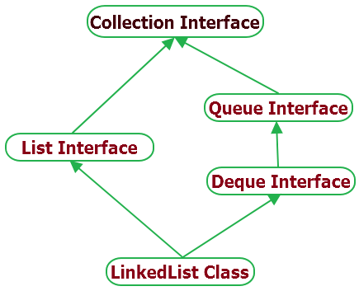
Linked List Hiearachy

Slide 54
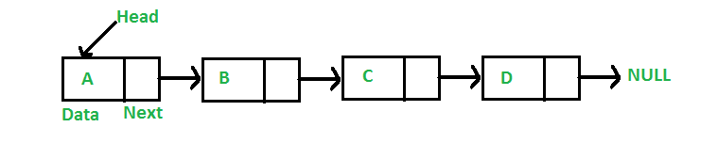
Linked Lists
Like arrays, Linked List is a linear data structure.
Unlike arrays, linked list elements are not stored at contiguous location; the elements are linked using pointers

Slide 55
Why Linked List
Arrays can be used to store linear data of similar types, but arrays have following limitations.
The size of the arrays is fixed: So we must know the upper limit on the number of elements in advance. Also, generally, the allocated memory is equal to the upper limit irrespective of the usage.
Inserting a new element in an array of elements is expensive, because room has to be created for the new elements and to create room existing elements have to shifted.

Slide 56
Pros & Cons
Pros:
1) Dynamic size
2) Ease of insertion/deletion
Cons:
1) Random access is not allowed. We have to access elements sequentially starting from the first node. So we cannot do binary search with linked lists.
2) Extra memory space for a pointer is required with each element of the list.

Slide 57
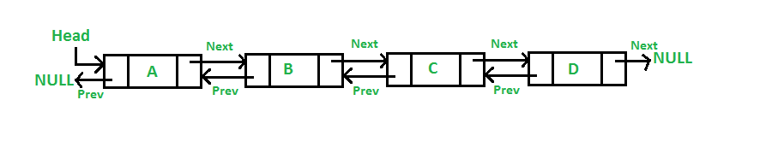
Doubly Linked List
A Doubly Linked List (DLL) contains an extra pointer, typically called previous pointer, together with next pointer and data which are there in singly linked list.

Slide 58
Advantages over singly linked list
A DLL can be traversed in both forward and backward direction.
The delete operation in DLL is more efficient if pointer to the node to be deleted is given.
In singly linked list, to delete a node, pointer to the previous node is needed. To get this previous node, sometimes the list is traversed. In DLL, we can get the previous node using previous pointer.

Slide 59
Insertion
A node can be added in four ways
At the front of the DLL
After a given node.
At the end of the DLL
Before a given node.

Slide 60
LinkedList class declaration
public class LinkedList<E> extends AbstractSequentialList<E> implements List<E>, Deque<E>, Cloneable, Serializable
Constructor | Description
LinkedList() | It is used to construct an empty list.
LinkedList(Collection c) | It is used to construct a list containing the elements of the specified collection, in the order they are returned by the collection's iterator.

Slide 61
Methods of LinkedList
Method | Description
void add(int index, Object element) | It is used to insert the specified element at the specified position index in a list.
void addFirst(Object o) | It is used to insert the given element at the beginning of a list.
void addLast(Object o) | It is used to append the given element to the end of a list.
int size() | It is used to return the number of elements in a list
boolean add(Object o) | It is used to append the specified element to the end of a list.
boolean contains(Object o) | It is used to return true if the list contains a specified element.
boolean remove(Object o) | It is used to remove the first occurence of the specified element in a list.
Object getFirst() | It is used to return the first element in a list.
Object getLast() | It is used to return the last element in a list.
int indexOf(Object o) | It is used to return the index in a list of the first occurrence of the specified element, or -1 if the list does not contain any element.
int lastIndexOf(Object o) | It is used to return the index in a list of the last occurrence of the specified element, or -1 if the list does not contain any element.

Slide 62
Linked List - Demo
import java.util.*;
public class TestCollection{
public static void main(String args[]){
LinkedList<String> al=new LinkedList<String>();
al.add(“Mike");
al.add(“John");
al.add(“Sandra");
al.add(“Jovel");
Iterator<String> itr=al.iterator();
while(itr.hasNext()){
System.out.println(itr.next());
} } }

Slide 63
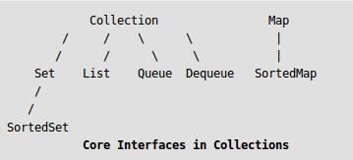
List Interface
Java.util.List is a child interface of Collection.
List is an ordered collection of objects in which duplicate values can be stored.
Since List preserves the insertion order it allows positional access and insertion of elements.
List Interface is implemented by ArrayList, LinkedList, Vector and Stack classes.

Slide 64
List Interface
Unlike sets, lists typically allow duplicate elements.
It contains methods to insert and delete elements in index basis.
Since List preserves the insertion order it allows positional access and insertion of elements.
Creating List Objects .
List a = new ArrayList();
List b = new LinkedList();
List c = new Vector();
List d = new Stack();

Slide 65
List – ordered Collection
In addition to the operations inherited from Collection, the List interface includes operations for the following:
Positional access — manipulates elements based on their numerical position in the list. This includes methods such as get, set, add, addAll, and remove.
Search — searches for a specified object in the list and returns its numerical position. Search methods include indexOf and lastIndexOf.
Iteration — extends Iterator semantics to take advantage of the list's sequential nature. The listIterator methods provide this behavior.
Range-view — The sublist method performs arbitrary range operations on the list.

Slide 66
List Interface declaration
public interface List<E> extends Collection<E>
Methods | Description
void add(int index,Object element) | It is used to insert element into the invoking list at the index passed in the index.
boolean addAll(int index,Collection c) | It is used to insert all elements of c into the invoking list at the index passed in the index.
object get(int index) | It is used to return the object stored at the specified index within the invoking collection.
object set(int index,Object element) | It is used to assign element to the location specified by index within the invoking list.
object remove(int index) | It is used to remove the element at position index from the invoking list and return the deleted element.
ListIterator listIterator() | It is used to return an iterator to the start of the invoking list.
ListIterator listIterator(int index) | It is used to return an iterator to the invoking list that begins at the specified index.

Slide 67
List Example
public class ListExample{
public static void main(String args[]){
ArrayList<String> al=new ArrayList<String>();
al.add(“Jean");
al.add(“Jenny");
al.add(“Jim");
al.add(1,“Jack");
System.out.println("Element at 2nd position: "+al.get(2));
for(String s:al) {
System.out.println(s); } } }

Slide 68
Java ListIterator Interface
An iterator for lists that allows the programmer to traverse the list.
It performs iteration in either direction, modify the list during iteration, and obtain the iterator's current position in the list.
It extends Iterator interface.
It is useful only for List implemented classes.

Slide 69
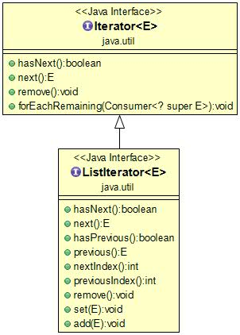
ListIterator
Unlike Iterator, It supports all four operations:
CRUD (CREATE, READ, UPDATE and DELETE).
Unlike Iterator, It supports both Forward Direction and Backward Direction iterations.
It is a Bi-directional Iterator.
It has no current element; its cursor position always lies between the element that would be returned by a call to previous() and the element that would be returned by a call to next().

Slide 70
ListIterator Interface declaration
public interface ListIterator<E> extends Iterator<E>
Methods | Description
boolean hasNext() | This method return true if the list iterator has more elements when traversing the list in the forward direction.
Object next() | This method return the next element in the list and advances the cursor position.
boolean hasPrevious() | This method return true if this list iterator has more elements when traversing the list in the reverse direction.
Object previous() | This method return the previous element in the list and moves the cursor position backwards.

Slide 71
Example of ListIterator Interface
public class TestCollection8{
public static void main(String args[]){
ArrayList<String> al=new ArrayList<String>();
al.add(“Jim");
al.add(“Jerry");
al.add(“John");
al.add(1,“Jive");
System.out.println("element at 2nd position: "+al.get(2));
ListIterator<String> itr=al.listIterator();
System.out.println("traversing elements in forward direction...");
while(itr.hasNext()){
System.out.println(itr.next());
}
System.out.println("traversing elements in backward direction...");
while(itr.hasPrevious()){
System.out.println(itr.previous()); } } }

Slide 72
ArrayList vs LinkedList
Insert and Remove operations give good performance in LinkedList compared to ArrayList.
If there is a requirement of frequent addition and deletion in application then LinkedList is a best choice.
Search (get method) operations are fast in Arraylist but not in LinkedList .
So If there are less add and remove operations and more search operations requirement, ArrayList would be your best bet.

Slide 73
The Set Interface
A Set is a Collection that cannot contain duplicate elements.
The Set interface contains only methods inherited from Collection and adds the restriction that duplicate elements are prohibited.
Set also adds a stronger contract on the behavior of the equals and hashCode operations, allowing Set instances to be compared meaningfully even if their implementation types differ.

Slide 74
List vs Set
List | Set
Is an Ordered grouping of elements. | Is an Unordered grouping of elements.
List is used to collection of elements with duplicates. | Set is used to collection of elements without duplicates.
New methods are defined inside List interface. | No new methods are defined inside Set interface, so we have to use Collection interface methods only with Set subclasses.
Use list for storing non-unique objects as per insertion order. | Use set for storing unique objects in random order

Slide 75
Hash Set Class
Java HashSet class is used to create a collection that uses a hash table for storage.
It inherits the AbstractSet class and implements Set interface.
Objects that you insert in HashSet are not guaranteed to be inserted in same order. Objects are inserted based on their hash code.
HashSet stores the elements by using a mechanism called hashing.
HashSet contains unique elements only.
Notes:
Hashing means using some function or algorithm to map object data to some representative integer value. This so-called hash code (or simply hash) can then be used as a way to narrow down our search when looking for the item in the map.

Slide 76
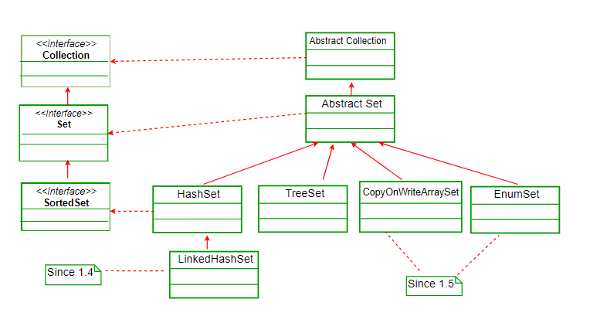
Hashset Hieararchy
The HashSet class extends AbstractSet class which implements Set interface.
The Set interface inherits Collection and Iterable interfaces in hierarchical order.

Slide 77
HashSet class declaration
public class HashSet<E> extends AbstractSet<E> implements Set<E>, Cloneable, Serializable
Constructor | Description
HashSet() | It is used to construct a default HashSet.
HashSet(Collection c) | It is used to initialize the hash set by using the elements of the collection c.
HashSet(int capacity) | It is used to initialize the capacity of the hash set to the given integer value capacity. The capacity grows automatically as elements are added to the HashSet.

Slide 78
Methods of Java HashSet class
Methods | Description
void clear() | It is used to remove all of the elements from this set.
boolean contains(Object o) | It is used to return true if this set contains the specified element.
boolean add(Object o) | It is used to adds the specified element to this set if it is not already present.
boolean isEmpty() | It is used to return true if this set contains no elements.
boolean remove(Object o) | It is used to remove the specified element from this set if it is present.
Object clone() | It is used to return a shallow copy of this HashSet instance: the elements themselves are not cloned.
Iterator iterator() | It is used to return an iterator over the elements in this set.
int size() | It is used to return the number of elements in this set.

Slide 79
HashSet Example
public class HashSetExample {
public static void main(String args[]) {
HashSet<String> hset = new HashSet<String>();
hset.add("Apple");
hset.add("Mango");
hset.add("Grapes");
hset.add("Orange");
hset.add("Fig");
//Addition of duplicate elements
hset.add("Apple");
hset.add("Mango");
//Addition of null values
hset.add(null);
hset.add(null);
//Displaying HashSet elements
System.out.println(hset);
}
}
[null, Mango, Grapes, Apple, Orange, Fig]

Slide 80
Treeset
TreeSet is similar to HashSet except that it sorts the elements in the ascending order while HashSet doesn’t maintain any order.
TreeSet allows null element but like HashSet it doesn’t allow.
TreeSet class implements the Set interface that uses a tree for storage.
TreeSet implements the SortedSet interface so duplicate values are not allowed.
TreeSet does not preserve the insertion order of elements but elements are sorted by keys.

Slide 81
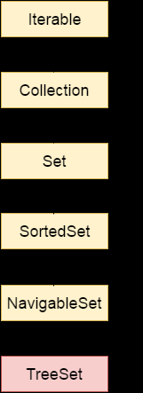
Treeset Hierarchy
Java TreeSet class implements NavigableSet interface.
The NavigableSet interface extends SortedSet, Set, Collection and Iterable interfaces in hierarchical order.

Slide 82
TreeSet class declaration
public class TreeSet<E> extends AbstractSet<E> implements NavigableSet<E>, Cloneable, Serializable
Constructor | Description
TreeSet() | It is used to construct an empty tree set that will be sorted in an ascending order according to the natural order of the tree set.
TreeSet(Collection c) | It is used to build a new tree set that contains the elements of the collection c.
TreeSet(Comparator comp) | It is used to construct an empty tree set that will be sorted according to given comparator.
TreeSet(SortedSet ss) | It is used to build a TreeSet that contains the elements of the given SortedSet.

Slide 83
Methods of Java TreeSet class
Method | Description
boolean addAll(Collection c) | It is used to add all of the elements in the specified collection to this set.
boolean contains(Object o) | It is used to return true if this set contains the specified element.
boolean isEmpty() | It is used to return true if this set contains no elements.
boolean remove(Object o) | It is used to remove the specified element from this set if it is present.
void add(Object o) | It is used to add the specified element to this set if it is not already present.
void clear() | It is used to remove all of the elements from this set.
Object clone() | It is used to return a shallow copy of this TreeSet instance.
Object first() | It is used to return the first (lowest) element currently in this sorted set.
Object last() | It is used to return the last (highest) element currently in this sorted set.
int size() | It is used to return the number of elements in this set.

Slide 84
Treeset Example
public class TreeSetExample {
public static void main(String args[]) {
TreeSet<String> tset = new TreeSet<String>();
tset.add("ABC");
tset.add("String");
tset.add("Test");
tset.add("Pen");
tset.add("Ink");
tset.add("Jack");
System.out.println(tset);
// TreeSet of Integer Type
TreeSet<Integer> tset2 = new TreeSet<Integer>();
// Adding elements to TreeSet<Integer>
tset2.add(88);
tset2.add(7);
tset2.add(101);
tset2.add(0);
tset2.add(3);
tset2.add(222);
System.out.println(tset2); } }
[ABC, Ink, Jack, Pen, String, Test]
[0, 3, 7, 88, 101, 222]
Output: You can see both the TreeSet have been sorted in ascending order implicitly.

Slide 85
HashSet vs TreeSet
HashSet gives better performance (faster) than TreeSet for the operations like add, remove, contains, size etc.
HashSet offers constant time cost while TreeSet offers log(n) time cost for such operations.
HashSet does not maintain any order of elements while TreeSet elements are sorted in ascending order by default.
If you want a sorted Set then it is better to add elements to HashSet and then convert it into TreeSet rather than creating a TreeSet and adding elements to it.
Both of these classes are non-synchronized that means they are not thread-safe and should be synchronized explicitly when there is a need of thread-safe operations.

Slide 86
Queue Interface
Java Queue interface orders the element in FIFO(First In First Out) manner.
In FIFO, first element is removed first and last element is removed at last.
A Queue is designed in such a way so that the elements added to it are placed at the end of Queue and removed from the beginning of Queue.
Java Queue is an interface available in java.util package and extends java.util.Collection interface.

Slide 87
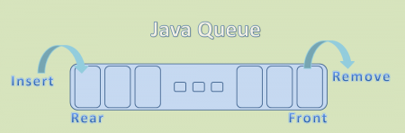
Queue Interface declaration
public interface Queue<E> extends Collection<E>

Slide 88
Methods of Java Queue Interface
Method | Description
boolean add(object) | It is used to insert the specified element into this queue and return true upon success.
boolean offer(object) | It is used to insert the specified element into this queue.
Object remove() | It is used to retrieves and removes the head of this queue.
Object poll() | It is used to retrieves and removes the head of this queue, or returns null if this queue is empty.
Object element() | It is used to retrieves, but does not remove, the head of this queue.
Object peek() | It is used to retrieves, but does not remove, the head of this queue, or returns null if this queue is empty.

Slide 89
Queue Interface
Since it is an interface, we need a concrete class during its declaration.
There are many ways to initialize a Queue object, most common being-
As a Priority Queue
As a LinkedList

Slide 90
PriorityQueue class
The PriorityQueue class provides the facility of using queue.
But it does not orders the elements in FIFO manner.
It inherits AbstractQueue class.
PriorityQueue class declaration
public class PriorityQueue<E> extends AbstractQueue<E> implements Serializable

Slide 91
Queue Demo
class TestCollection{
public static void main(String args[]){
PriorityQueue<String> queue=new PriorityQueue<String>();
queue.add(“John");
queue.add(“Jim");
queue.add(“Mary");
queue.add("Je");
queue.add("Raul");
System.out.println("head:"+queue.element());
System.out.println("head:"+queue.peek());
System.out.println("iterating the queue elements:");
Iterator itr=queue.iterator();
while(itr.hasNext()){
System.out.println(itr.next());
}
queue.remove();
queue.poll();
System.out.println("after removing two elements:");
Iterator<String> itr2=queue.iterator();
while(itr2.hasNext()){
System.out.println(itr2.next()); } } }

Slide 92
Map Interface
The java.util.Map interface represents a mapping between a key and a value.
The Map interface is not a subtype of the Collection interface.
Therefore it behaves a bit different from the rest of the collection types.

Slide 93
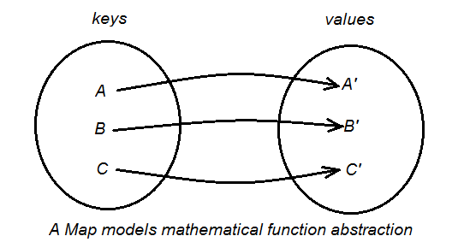
Map Interface
A Map cannot contain duplicate keys and each key can map to at most one value.
Some implementations allow null key and null value (HashMap and LinkedHashMap) but some do not (TreeMap).

Slide 94
Why and When Use Maps
Maps are perfectly for key-value association mapping such as dictionaries.
Use Maps when you want to retrieve and update elements by keys, or perform lookups by keys.
A map of error codes and their descriptions.
A map of zip codes and cities.
A map of managers and employees. Each manager (key) is associated with a list of employees (value) he manages.
A map of classes and students. Each class (key) is associated with a list of students (value).

Slide 95
Map Interfaces and Classes 4-1
Map Interfaces and Classes
Map is an object and stores data in the form of a relationship between keys and values
Keys should be unique but values can be duplicated
Some maps can store null object for keys and values

Slide 96
Map -Demo
Map<String, String> mapCountryCodes = new HashMap<>();
mapCountryCodes.put("1", "USA");
mapCountryCodes.put("44", "United Kingdom");
mapCountryCodes.put("33", "France");
mapCountryCodes.put("81", "Japan");
Set<String> setCodes = mapCountryCodes.keySet();
Iterator<String> iterator = setCodes.iterator();
while (iterator.hasNext()) {
String code = iterator.next();
String country = mapCountryCodes.get(code);
System.out.println(code + " => " + country);
}

Slide 97
Map Interfaces and Classes 4-2
It maps keys to values.
Each key can map to one value only.
It contains methods for basic operations, bulk operations and collection views.
SortedMap interface extends Map interface.
SortedMap interface maintains its entries in ascending order.

Slide 98
Commonly used Methods defined by Map
boolean containsKey(Object k): returns true if map contain k as key. Otherwise false.
Object get(Object k) : returns values associated with the key k.
Object put(Object k, Object v) : stores an entry in map.
Object putAll(Map m) : put all entries from m in this map.
Set keySet() : returns Set that contains the key in a map.
Set entrySet() : returns Set that contains the entries in a map.

Slide 99
Map.Entry Interface
Entry is the sub interface of Map.
So we will be accessed it by Map.Entry name.
It provides methods to get key and value.
Method | Description
Object getKey() | It is used to obtain key.
Object getValue() | It is used to obtain value.

Slide 100
Hash Map
A HashMap contains values based on the key.
It implements the Map interface and extends AbstractMap class.
It contains only unique elements.
It may have one null key and multiple null values.
It maintains no order.

Slide 101
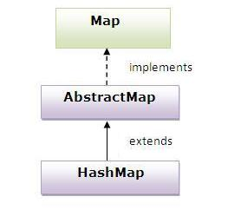
Hierarchy of HashMap class

Slide 102
HashMap 2-2
The constructors of this class are:
Constructor | Description
HashMap() | Creates an empty map with default capacity and load factor.
HashMap(int size) | Creates an empty map with the capacity specified in size and default load factor.
HashMap(int size, float load) | Creates an empty map with the capacity specified in size and load factor specified by load.
HashMap (Map map) | Creates a hash map with mappings as the specified map
It allows null values.

Slide 103
Demo Hash Map
import java.util.*;
class TestCollection13{
public static void main(String args[]){
HashMap<Integer,String> hm=new HashMap<Integer,String>();
hm.put(111,“John");
hm.put(222,“Jim");
hm.put(333,“Mike");
for(Map.Entry m:hm.entrySet()){
System.out.println(m.getKey()+" "+m.getValue());
}
}
}

Slide 104
Difference between HashMap and HashSet
HashMap | Hash Set
HashMap is an implementation of Map interface | HashSet is an implementation of Set Interface
HashMap Stores data in form of key-value pair | HashSet Store only objects
Put method is used to add element in map | Add method is used to add element is Set
In hash map hashcode value is calculated using key object | Here member object is used for calculating hashcode value which can be same for two objects so equal () method is used to check for equality if it returns false that means two objects are different.
HashMap is faster than HashSet because unique key is used to access object | HashSet is slower than Hashmap

Slide 105
Legacy classes and Interfaces
Earlier version of Java contained some classes and interfaces to store objects.
Legacy classes are synchronized as opposed to the classes in the collection framework.
java.util
Enumeration
Hashtable
Vector

Slide 106
Enumeration
Enumeration
Obtains the elements from a collection of objects
nextElement()
retrieves the next element as a general Object reference. Calling program should cast the object
hasMoreElements()
returns true if the instance contains more elements

Slide 107
Hashtable class 2-1
A Hashtable is an array of list.
Each list is known as a bucket.
The position of bucket is identified by calling the hashcode() method.
A Hashtable contains values based on the key.
It implements the Map interface and extends Dictionary class.
It contains only unique elements.
It may not have any null key or value.
It is synchronized.

Slide 108
Hashtable class 2-2
StudentHashTest() {
hashTableStudents = new Hashtable();
}
The hashCode() method is used to convert the key to its equivalent hash code.
The equals() method is used to compare two objects.
It expands in size as elements are added.
1
45
void display() {
String name = "Michael";
System.out.println("****************"
+ "***********************");
System.out.println("Retreiving a Single Student Information");
System.out.println("*****************"
+ "***********************");
System.out.println("\nStudent name is: " + name);
String result = (String) hashTableStudents.get(name);
System.out.println("\nGraduated in the Year: " + result);
System.out.println("\n********************");
System.out.println("Students Details");
System.out.println("********************\n");
Enumeration enumNames = hashTableStudents.keys();
while (enumNames.hasMoreElements()) {
name = (String) enumNames.nextElement();
System.out.println(name + " completed graduation in "
+ hashTableStudents.get(name) + "\n");
}
}
A Hashtable object is created
void add() {
hashTableStudents.put("Tony" , new String("2001"));
hashTableStudents.put("Cathy" , new String("2002"));
hashTableStudents.put("Michael" , new String("2002"));
hashTableStudents.put("Priscilla" , new String("2001"));
hashTableStudents.put("Mark" , new String("2001"));
}
Displaying a single element’s value
Values are added to Hashtable objects by using the put() method
Iterating through the entire Hashtable and displaying the value using Enumeration interface
Demonstration: Example 6

Slide 109
Difference between HashMap and Hashtable
HashMap | Hashtable
1) HashMap is non synchronized. It is not-thread safe and can't be shared between many threads without proper synchronization code. | Hashtable is synchronized. It is thread-safe and can be shared with many threads.
2) HashMap allows one null key and multiple null values. | Hashtable doesn't allow any null key or value.
3) HashMap is a new class introduced in JDK 1.2. | Hashtable is a legacy class.
4) HashMap is fast. | Hashtable is slow.
6) HashMap is traversed by Iterator. | Hashtable is traversed by Enumerator and Iterator.
8) HashMap inherits AbstractMap class. | Hashtable inherits Dictionary class.

Slide 110
LinkedHashMap Class
LinkedHashMap extends HashMap class.
It maintains a linked list of entries in map in order in which they are inserted.
LinkedHashMap is a Hash table and linked list implementation of the Map interface, with predictable iteration order.
This implementation differs from HashMap in that it maintains a doubly-linked list running through all of its entries.
This linked list defines the iteration ordering, which is normally the order in which keys were inserted into the map (insertion-order).

Slide 111
LinkedHashMap vs Hash & TreeMap
HashMap doesn’t maintain any order.
TreeMap sort the entries in ascending order of keys.
LinkedHashMap maintains the insertion order.
LinkedHashMap is like HashMap with additional feature that we can access elements in their insertion order.

Slide 112
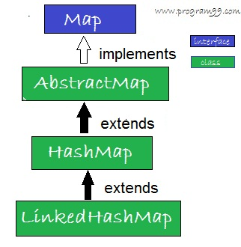
Hierachy of LinkedHashMap Class

Slide 113
Constructors
Constructor | Description
LinkedHashMap() | It is used to construct a default LinkedHashMap.
LinkedHashMap(int capacity) | It is used to initialize a LinkedHashMap with the given capacity.
LinkedHashMap(int capacity, float fillRatio) | It is used to initialize both the capacity and the fillRatio.
LinkedHashMap(Map m) | It is used to initialize the LinkedHashMap with the elements from the given Map class m.
Notes:
Here the fill ratio must be between 0.0 and 1.0, and it determines how full the hash set can be before it is resized upward. Specifically, when the number of elements is greater than the capacity of the hash set multiplied by its fill ratio, the hash set is expanded.s

Slide 114
Methods
Apart from the methods inherited from its parent classes, LinkedHashMap defines the following methods −
Method | Description
Object get(Object key) | It is used to return the value to which this map maps the specified key.
void clear() | It is used to remove all mappings from this map.
boolean containsKey(Object key) | It is used to return true if this map maps one or more keys to the specified value.

Slide 115
LinkedHashMap Demo
public class LinkedHashMapDemo {
public static void main(String args[]) {
// HashMap Declaration
LinkedHashMap<Integer, String> lhmap =
new LinkedHashMap<Integer, String>();
//Adding elements to LinkedHashMap
lhmap.put(22, "Abey");
lhmap.put(33, "Dawn");
lhmap.put(1, "Sherry");
lhmap.put(2, "Karon");
lhmap.put(100, "Jim");
// remove value
lhmap.remove(33);
// Generating a Set of entries
Set set = lhmap.entrySet();
// Displaying elements of LinkedHashMap
Iterator iterator = set.iterator();
while(iterator.hasNext()) {
Map.Entry me = (Map.Entry)iterator.next();
System.out.print("Key is: "+ me.getKey() +
"& Value is: "+me.getValue()+"\n");
} } }
Values are returned in the same order in which they got inserted.

Slide 116
TreeMap Class
Java TreeMap class implements the Map interface by using a tree.
It provides an efficient means of storing key/value pairs in sorted order.
A TreeMap contains values based on the key.
It implements the NavigableMap interface and extends AbstractMap class.
It contains only unique elements.
It cannot have null key but can have multiple null values.
It is same as HashMap instead maintains ascending order.

Slide 117
TreeMap class declaration
public class TreeMap<K,V> extends AbstractMap<K,V> implements NavigableMap<K,V>, Cloneable, Serializable
Constructor | Description
TreeMap() | It is used to construct an empty tree map that will be sorted using the natural order of its key.
TreeMap(Comparator comp) | It is used to construct an empty tree-based map that will be sorted using the comparator comp.
TreeMap(Map m) | It is used to initialize a tree map with the entries from m, which will be sorted using the natural order of the keys.
TreeMap(SortedMap sm) | It is used to initialize a tree map with the entries from the SortedMap sm, which will be sorted in the same order as sm.

Slide 118
Methods of Java TreeMap class
Method | Description
boolean containsKey(Object key) | It is used to return true if this map contains a mapping for the specified key.
boolean containsValue(Object value) | It is used to return true if this map maps one or more keys to the specified value.
Object firstKey() | It is used to return the first (lowest) key currently in this sorted map.
Object get(Object key) | It is used to return the value to which this map maps the specified key.
Object lastKey() | It is used to return the last (highest) key currently in this sorted map.
Object remove(Object key) | It is used to remove the mapping for this key from this TreeMap if present.
void putAll(Map map) | It is used to copy all of the mappings from the specified map to this map.
Set entrySet() | It is used to return a set view of the mappings contained in this map.
int size() | It is used to return the number of key-value mappings in this map.
Collection values() | It is used to return a collection view of the values contained in this map.

Slide 119
TreeMap Demo
public class Details {
public static void main(String args[]) {
TreeMap<Integer, String> tmap =
new TreeMap<Integer, String>();
/*Adding elements to TreeMap*/
tmap.put(1, "Data1");
tmap.put(23, "Data2");
tmap.put(70, "Data3");
tmap.put(4, "Data4");
tmap.put(2, "Data5");
/* Display content using Iterator*/
Set set = tmap.entrySet();
Iterator iterator = set.iterator();
while(iterator.hasNext()) {
Map.Entry mentry = (Map.Entry)iterator.next();
System.out.print("key is: "+ mentry.getKey() + " & Value is: ");
System.out.println(mentry.getValue());
} } }
Inserted data is in random order however when we displayed the TreeMap content we get the sorted result in the ascending order of keys.

Slide 120
HashMap Vs TreeMap
BASIS FOR COMPARISON | HASHMAP | TREEMAP
Basic | HashMap does not maintain insertion order. | TreeMap maintains insertion order.
DataStructure | HashMap uses Hash Table as an underlying data structure. | TreeMap uses Red-Black Tree as an underlying data structure.
Null Keys and Values | HashMap allows Null key once ad Null value any number of time. | TreeMap does not allow Null key but allows Null Values any number of time.
Extends and Implements | HashMap extends AbstractMap class and implements Map interface. | TreeMap extends AbstractMap class and implements SortedMap and NavigableMap interface.
Performance | HashMap operates faster. | TreeMap in comparison to HashMap operates slower.

Slide 121
Method of Collections class
java.util.Collections.sort()
method is present in java.util.Collections class.
It is used to sort the elements present in the specified list of Collection in ascending order.
static int binarySearch(List list1, Object obj1):
Searches the obj1 in the list list1. Returns the index number of the element obj1. Before applying this method, the elements must be sorted earlier with sort() method;

Slide 122
Method of Collections class
static void reverse(List list1):
Existing order of the elements in the list list1 are reversed. Again reversing gets the original order.
static void swap(List list1, int index1, int index2):
List list1 elements at index numbers index1 and index2 are swapped.
static void copy(List destination1, List source1):
Copies all the elements of List source1into the destination1 list. It is like arraycopy() method.

Slide 123
Comparable Interface
Java Comparable interface is used to order the objects of user-defined class.
A comparable object is capable of comparing itself with another object.
This interface is found in java.lang package and contains only one method named compareTo(Object).
It provide single sorting sequence only i.e. you can sort the elements on based on single data member only.
For example it may be rollno, name, age or anything else.

Slide 124

What is the Comparable Interface Used For?
It is used to Compare and Sort Objects.
Sorting Apples based on weight.
When we are sorting them, we need to repeatedly compare two apples weights until all the apples are in the correct order.
Comparable can’t sort the objects on its own, but the interface defines a method int compareTo(T).

Slide 125

How compareTo() Works
The compareTo() method works by returning an int value that is either positive, negative, or zero.
It compares the object by making the call to the object that is the argument.
A negative number means that the object making the call is “less” than the argument.
If we were comparing the apples by size, the above call would return a negative number, say -400, because the red apple is smaller than the green apple.
If the two apples were of equal weight, the call would return 0.
If the red apple was heavier, compareTo() would return a positive number, say 68.

Slide 126
Java Comparable Example
class Student implements Comparable<Student>
{
int rollno;
String name;
int age;
Student(int rollno,String name,int age){
this.rollno=rollno;
this.name=name;
this.age=age;
}
public int compareTo(Student st)
{
if(age==st.age)
return 0;
else if(age>st.age)
return 1;
else
return -1;
}
}

Slide 127
Java Comparable Example
public class TestSort3{
public static void main(String args[]){
ArrayList<Student> al=new ArrayList<Student>();
al.add(new Student(111,“John",29));
al.add(new Student(222,“Mike",21));
al.add(new Student(555,“Mary",26));
Collections.sort(al);
for(Student st:al){
System.out.println(st.rollno+" "+st.name+" "+st.age);
} } }

Slide 128
Comparator Interface
Java Comparator interface is used to order the objects of user-defined class.
A comparator object is capable of comparing two objects of two different classes.
This interface is found in java.util package and contains 2 methods compare(Object obj1,Object obj2) and equals(Object element).
It provides multiple sorting sequence i.e. you can sort the elements on the basis of any data member, for example rollno, name, age or anything else.

Slide 129
How to Use Comparator
Method of Collections class for sorting List elements is used to sort the elements of List by the given comparator.
ComparatorClass must implement Comparator interface.
public void sort(List list, ComparatorClass c)

Slide 130
Properties Class
The properties object contains key and value pair both as a string.
The java.util.Properties class is the subclass of Hashtable.
It can be used to get property value based on the property key.
The Properties class provides methods to get data from properties file and store data into properties file.
It can be used to get properties of system.

Slide 131
Example of Properties class to get all the system properties
import java.util.*;
import java.io.*;
public class Test {
public static void main(String[] args)throws Exception{
Properties p=System.getProperties();
Set set=p.entrySet();
Iterator itr=set.iterator();
while(itr.hasNext()){
Map.Entry entry=(Map.Entry)itr.next();
System.out.println(entry.getKey()+" = "+entry.getValue()); } } }

Slide 132
Methods of Properties class
Method | Description
public void load(Reader r) | loads data from the Reader object.
public void load(InputStream is) | loads data from the InputStream object
public String getProperty(String key) | returns value based on the key.
public void setProperty(String key,String value) | sets the property in the properties object.
public void store(Writer w, String comment) | writers the properties in the writer object.
public void store(OutputStream os, String comment) | writes the properties in the OutputStream object.
storeToXML(OutputStream os, String comment) | writers the properties in the writer object for generating xml document.
public void storeToXML(Writer w, String comment, String encoding) | writers the properties in the writer object for generating xml document with specified encoding.

Slide 133
Java.util.Date
Date class represents date and time.
Provides methods for manipulating date and time components.
One of the best applications of the Date class is in the creation of a real time clock.
It provides constructors and methods to deal with date and time in java.

Slide 134
Date class constructors
DateTimeDisplay() {
objDate = new Date();
}
Constructor | Description
Date() | Creates a Date using today’s date.
Date(long dt) | Creates a Date using the specified number of milliseconds since January 1, 1970.
void display() {
String strDate , strTime = "";
System.out.println("Today's date is : " + objDate);
long time = objDate.getTime();
System.out.println("Time in milliseconds since"
+ " Jan 1,1970 (GMT): " + time);
strDate = objDate.toString();
// Extract GMT time
strTime = strDate.substring(11 , (strDate.length() - 4));
// Extract the time in hours, minutes, seconds
strTime = "Time : " + strTime.substring(0 , 8);
System.out.println(strTime);
}
Date object is used to print the Date
Time is obtained from the Date object by using the getTime() method
Demonstration: Example 1

Slide 135
java.util.Date Methods
Method | Description
boolean after(Date date) | tests if current date is after the given date.
boolean before(Date date) | tests if current date is before the given date.
Object clone() | returns the clone object of current date.
int compareTo(Date date) | compares current date with given date.
boolean equals(Date date) | compares current date with given date for equality.
static Date from(Instant instant) | returns an instance of Date object from Instant date.
long getTime() | returns the time represented by this date object.
int hashCode() | returns the hash code value for this date object.
void setTime(long time) | changes the current date and time to given time.
Instant toInstant() | converts current date into Instant object.
String toString() | converts this date into Instant object.

Slide 136
Java Calendar Class
Java Calendar class is an abstract class.
It provides methods for converting date between a specific instant in time and a set of calendar fields such as MONTH, YEAR, HOUR, etc.

Slide 137

Calendar Class
CalendarComponents() {
objCalendar = Calendar.getInstance();
}
Based on a given Date object, the Calendar class can retrieve information in the form of integers such as YEAR and MONTH.
It is abstract and hence cannot be instantiated like the Date class.
GregorianCalendar: is a subclass of Calendar that implements the Gregorian form of a calendar.
An instance of Calendar class is obtained by using the getInstance() method
void display() {
// Display the Date and Time components
System.out.println("\nDate and Time components:");
System.out.println("Month : " + objCalendar.get(Calendar.MONTH));
System.out.println("Day : " + objCalendar.get(Calendar.DATE));
System.out.println("Year : " + objCalendar.get(Calendar.YEAR));
System.out.println("Hour : " + objCalendar.get(Calendar.HOUR));
System.out.println("Minute : " + objCalendar.get(Calendar.MINUTE));
System.out.println("Second : " + objCalendar.get(Calendar.SECOND));
// Add 30 minutes to current time,
// then display date and time
objCalendar.add(Calendar.MINUTE , 30);
Date objDate = objCalendar.getTime();
System.out.println("\nDate and Time after adding 30" + "minutes to current time:\n");
System.out.println(objDate);
}
Calendar class defines certain integer constants that are used to get or set the components of Calendar
Demonstration: Example 2

Slide 138
Methods of Java Calendar
Method | Description
abstract void add(int field, int amount) | It is used to add or subtract the specified amount of time to the given calendar field, based on the calendar's rules.
int get(int field) | It is used to return the value of the given calendar field.
static Calendar getInstance() | It is used to get a calendar using the default time zone and locale.
abstract int getMaximum(int field) | It is used to return the maximum value for the given calendar field of this Calendar instance.
abstract int getMinimum(int field) | It is used to return the minimum value for the given calendar field of this Calendar instance.
void set(int field, int value) | It is used to set the given calendar field to the given value.
void setTime(Date date) | It is used to set this Calendar's time with the given Date.
Date getTime() | It is used to return a Date object representing this Calendar's time value.

Slide 139
Java.util.Locale Class
The java.util.Locale class object represents a specific geographical, political, or cultural region. .Following are the important points about Locale −
An operation that requires a Locale to perform its task is called locale-sensitive and uses the Locale to form information for the user.
Locale is a mechanism for identifying objects, not a container for the objects themselves.

Slide 140
Constructors
Locale(String L) : Creates Locale form the given language code.
Locale(String L, String C) : Creates Locale form the given language, country code.
Locale(String L, String C, String V) : Creates Locale form the given language, country, variant code.

Slide 141
Locale- Methods
getDisplayCountry() :return the country to which locale belongs to.
getDefault() :return the current – default value for the locale as per the JVM instance.
getCountry() : return the country for the locale which could be empty or ISO 3166 2-letter code.
clone() : creates clone of the locale.
getAvailableLocales() : returns array of all the installed locales.
getDisplayLanguage() : returns the language with the locale.
getDisplayName() : displays name of the Locale

Slide 142
ResourceBundle class in Java
The ResourceBundle class is used to internationalize the messages.
It provides a mechanism to globalize the messages.
The hardcoded message is not considered good in terms of programming, because it differs from one country to another.
So we use the ResourceBundle class to globalize the messages.
The ResourceBundle class loads these informations from the properties file that contains the messages.

