Slide 1
Interfaces

Slide 2
Universal Super Class- Object Class
The Object Class is known as universal super class of Java.
This is so because Every class you create in Java automatically inherits the Object class.
The Object class is super class of all the classes in Java either directly or Indirectly.
You don't need to extend it manually.
All the properties of Object class are already in your class.
Object Class - Superclass of all classes.

Slide 3
Object Class
The definition of the Object class in java.lang package
Methods in this class which you can override in your class.
Methods | Functionality
hasCode() | this returns the hash code associated with the Object
toString() | returns any object in the form of string
getClass() | returns the class Name of the Object
equals() | check if two objects are equal or not.
finalize() | Called by the garbage collector on an object when garbage collection determines that there are no more references to the object

Slide 4
Advantages
The Object class is beneficial if you want to refer any object whose type you don't know.
The parent class reference variable can refer the child class object, know as upcasting.
The getObject() method that returns an object.
It can be of any type like Employee,Student etc,
We can use
Object class reference to refer that object.
Object obj=getObject()

Slide 5
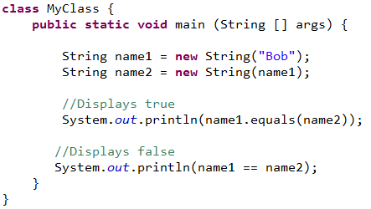
The Equals Method
Compares two string objects for value equality
Uses standard method call

Slide 6
Object Class Methods overriden in your class
public class ObjectClass {
public static void main(String[] args){
ObjectClass oc = new ObjectClass(); System.out.println(oc.hashCode()); System.out.println(oc.toString());
System.out.println(oc.getClass());
ObjectClass oc1 = new ObjectClass(); System.out.println(oc.equals(oc1)); System.out.println(oc1.hashCode()); System.out.println(oc1.toString());
ObjectClass oc2 = oc;
System.out.println(oc.equals(oc2)); } }
1680090029
ObjectClass@642423ad
class ObjectClass
false
1386102722
ObjectClass@529e3fc2
true

Slide 7
Inner Classes
In Java, just like methods, variables of a class too can have another class as its member.
Writing a class within another is allowed in Java.
The class written within is called the nested class, and the class that holds the inner class is called the outer class.
class Outer_Demo {
class Nested_Demo
{ }
}

Slide 8
Inner Classes
Inner classes are a security mechanism in Java.
We know a class cannot be associated with the access modifier private.
If we have the class as a member of other class, then the inner class can be made private.
This is also used to access the private members of a class.
Inner Class
Method-local Inner Class
Anonymous Inner Class

Slide 9
Inner Classes
class Outer_Demo {
int num;
// inner class
private class Inner_Demo {
public void print() {
System.out.println("This is an inner class"); } }
// Accessing inner class from the method within
void display_Inner() {
Inner_Demo inner = new Inner_Demo();
inner.print(); } }
public class My_class {
public static void main(String args[]) {
// Instantiating the outer class
Outer_Demo outer = new Outer_Demo();
// Accessing the display_Inner() method.
outer.display_Inner(); } }
Class within a class.
Unlike a class, an inner class can be private.
Once you declare an inner class private, it cannot be accessed from an object outside the class.

Slide 10
Singleton Class
In object-oriented programming, a singleton class is a class that can have only one object (an instance of the class) at a time.
The Singleton's purpose is to control object creation, limiting the number of objects to only one.
Since there is only one Singleton instance, any instance fields of a Singleton will occur only once per class, just like static fields.
Singletons often control access to resources, such as database connections or sockets.

Slide 11
Singleton Pattern
Singleton pattern is a design pattern which restricts a class to instantiate its multiple objects.
It is nothing but a way of defining a class.
Class is defined in such a way that only one instance of class is created in the complete execution of program or project.
It is used where only a single instance of class is required to control the action throughout the execution.
A singleton class shouldn’t have multiple instances in any case and at any cost.
Singleton classes are used for logging, driver objects, caching and thread pool, database connections.

Slide 12
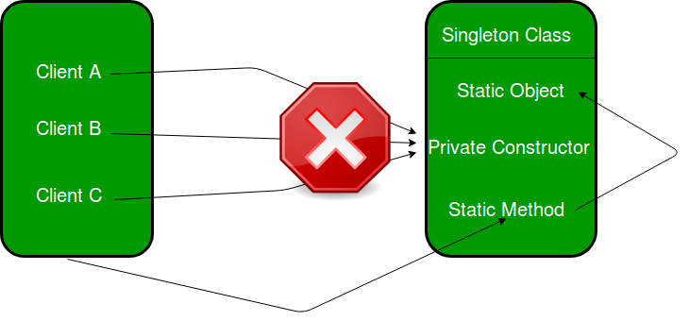
Singleton Pattern
If you have a license for only one connection for your database or your JDBC driver has trouble with multithreading.
The Singleton makes sure that only one connection is made or that only one thread can access the connection at a time.

Slide 13
Singleton Classes - Implementation
In this method, class is initialized whether it is to be used or not.
Main advantage of this method is its simplicity.
You initiate the class at the time of class loading.
Its drawback is that class is always initialized whether it is being used or not.
Early Initialisation
Lazy Initialisation
In this method, class in initialized only when it is required.
It can save you from instantiating the class when you don’t need it.
Generally lazy initialization is used when we create a singleton class

Slide 14
Singleton Classes
Singleton classes can have only one instance and that instance should be globally accessible.
Singleton classes provided by JVM
java.lang.Runtime
java.awt.Desktop
Singleton Design pattern is a type of creational design pattern.
Outer classes should be prevented to create instance of singleton class.

Slide 15
To design a singleton class:
Make constructor as private.
Write a static method that has return type object of this singleton class.
The concept of Lazy initialization is used to write this static method.

Slide 16
Normal class vs Singleton class
Difference in normal and singleton class in terms of instantiation is :
For normal class we use constructor, whereas for singleton class we use getInstance() method .
In general, to avoid confusion we may also use the class name as method name while defining this method

Slide 17
Implementing Singletons
public class Singleton {
private static Singleton singleton = new Singleton( );
/* A private Constructor prevents any other class from instantiating*/ private Singleton() { }
/* Static 'instance' method */
public static Singleton getInstance( ) {
return singleton; }
/* Other methods protected by singleton-ness */
protected static void demoMethod( ) {
System.out.println("demoMethod for singleton"); } }
It consists of a private constructor.
A field to hold its result, and a static accessor method with a name like getInstance().
The private field can be assigned from within a static initializer block or, more simply, using an initializer.
The getInstance( ) method (which must be public) then simply returns this instance
public class SingletonDemo {
public static void main(String[] args) {
Singleton tmp = Singleton.getInstance( );
tmp.demoMethod( ); } }

Slide 18
Classic Singleton design pattern
The ClassicSingleton class maintains a static reference to the lone singleton instance.
It returns that reference from the static getInstance() method.
It employs a technique known as lazy instantiation to create the singleton;
As a result, the singleton instance is not created until the getInstance() method is called for the first time.
This technique ensures that singleton instances are created only when needed.
public class ClassicSingleton {
private static ClassicSingleton instance = null;
private ClassicSingleton() {
// Exists only to defeat instantiation. }
public static ClassicSingleton getInstance() {
if(instance == null) {
instance = new ClassicSingleton(); }
return instance; } }

Slide 19
Instanceof Operator
The java instanceof operator is used to test whether the object is an instance of the specified type (class or subclass or interface).
The instanceof in java is also known as type comparison operator because it compares the instance with type.
It returns either true or false.
If we apply the instanceof operator with any variable that has null value, it returns false.

Slide 20
Instanceof operator
Instanceof operator is used to check the type of an object at runtime.
It means by which your program can obtain run-time type information about an object.
It is also important in case of casting object at runtime.
public class Test {
public static void main(String[] args) {
Test t= new Test();
System.out.println(t instanceof Test); } }

Slide 21
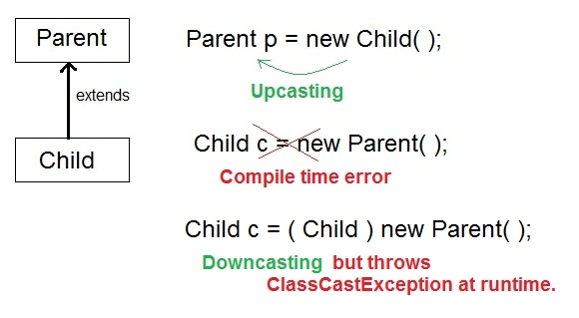
Downcasting with java instanceof operator
When Subclass type refers to the object of Parent class, it is known as downcasting.
If we perform it directly, compiler gives Compilation error.
If you perform it by typecasting, ClassCastException is thrown at runtime.
But if we use instanceof operator, downcasting is possible.

Slide 22
Example of downcasting with instanceof operator
class Parent{ }
public class Child extends Parent { public void check() {
System.out.println("Sucessfull Casting"); } public static void show(Parent p) {
if(p instanceof Child) {
Child b1=(Child)p;
b1.check(); } }
public static void main(String[] args) { Parent p=new Child();
Child.show(p); } }

Slide 23
Interfaces
Interface is a Java Element that contains
Contains Collection of methods with no code segments.
Can have only public members.
Can contain constant variables which are public, static and final by default.
Can extend other interface using extends keyword.
Cannot contain instances of itself.

Slide 24
Why Interfaces ?
Inheritance facilitates overriding of methods from Single Class.
Interface allows overriding of methods from multiple classes.
In Inheritance class may extend only one class.
For reusing functionality from multiple sources, Java provides Multiple Inheritance through Interfaces.
Interfaces reduces the code to greater extent.

Slide 25
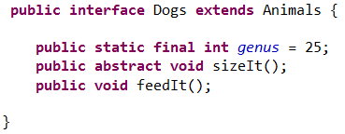
Syntax – Interface Declaration
Can extend another interface
Declared with the interface keyword
Can contain constants: public, static, and final
A collection of methods with no code statements
Can have only public members

Slide 26
Class v/s Interface
An interface is a collection of abstract methods.
A class implements an interface, thereby inheriting the abstract methods of the interface.
An interface is not a class.
Writing an interface is similar to writing a class, but they are two different concepts.
A class describes the attributes and behaviors of an object.
An interface contains behaviors that a class implements.
An interface is not extended by a class; it is implemented by a class.

Slide 27
Implementing Interfaces
Class implements an interface, you can think of the class as signing a contract, agreeing to perform the specific behaviors of the interface.
If a class does not perform all the behaviors of the interface, the class must declare itself as abstract.
A class uses the implements keyword to implement an interface.
The implements keyword appears in the class declaration following the extends portion of the declaration.

Slide 28
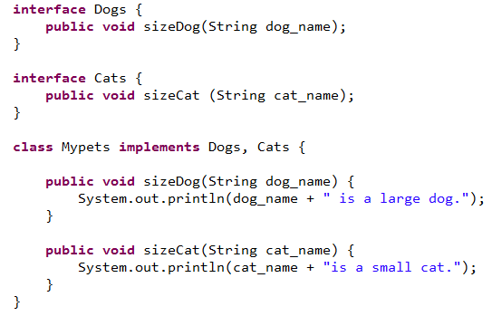
Interface Implementation Demo
Implemented using the implements keyword
Can implement more than one interface with commas
Must implement all methods
Retains the same signature as defined in the interface

Slide 29
Interface Implementation
interface Fruit {
public boolean hasAPeel();
//has a peel must be implemented in any class implementing Fruit
//methods in interfaces must be public } interface Vegetable {
public boolean isARoot();
//is a root must be implemented in any class implementing Vegetable
//methods in interfaces must be public }

Slide 30
Difference between Abstract class and interface
Abstract class and interface both are used to achieve Abstraction where we can declare the abstract methods.
Abstract class | Interface
1) Abstract class can have abstract and non-abstractmethods. | Interface can have only abstract methods.
2) Abstract class doesn't support multiple inheritance. | Interface supports multiple inheritance.
3) Abstract class can have final, non-final, static and non-static variables. | Interface has only static and final variables.
4) Abstract class can have static methods, main method and constructor. | Interface can't have static methods, main method or constructor.
5) Abstract class can provide the implementation of interface. | Interface can't provide the implementation of abstract class.

Slide 31
MultiThreading in Java

Slide 32
Multitasking Vs Multithreading
Multitasking is the ability to run one or more programs concurrently.
Operating system controls the way in which these programs run by scheduling them.
Time elapsed between switching of programs is minuscule.
Multithreading is the ability to execute different parts of a program, called threads, simultaneously.

Slide 33
Thread
Thread is the smallest unit of executable code that performs a particular task.
An application can be divided into multiple tasks and each task can be assigned to a thread.
Many threads executing simultaneously is termed as Multithreading.

Slide 34
Benefits of Multithreading
Multithreading requires less overhead than multitasking.
In multitasking, processes run in their own different address space.
Tasks involved in multithreading can share the same address space.
Inter-process calling involves more overhead than inter-thread communication.
Multithreading allows us to write efficient programs that make maximum use of the CPU.
Multithreading allows animation loops to sleep for a second between each frame without causing the whole system to pause.
You can perform many operations together so it saves time.
Threads are independent so it doesn't affect other threads if exception occur in a single thread.

Slide 35
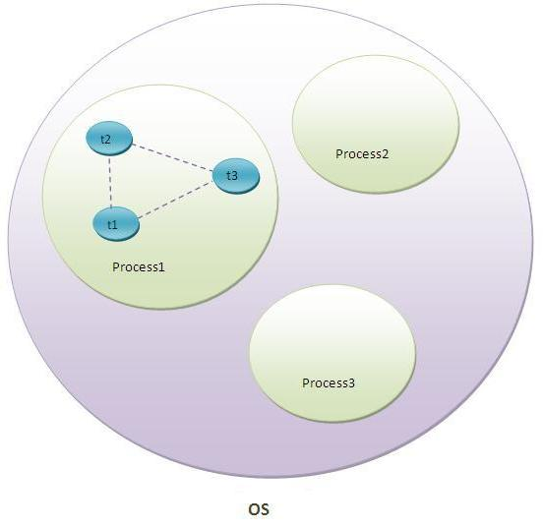
Thread Execution
Thread is executed inside the process.
There is context-switching between the threads.
There can be multiple processes inside the OS and one process can have multiple threads.

Slide 36


Applications of thread
Playing sound and displaying images simultaneously.
Displaying multiple images on the screen.
Displaying scrolling text patterns or images on the screen.
Java

Slide 37
The ‘main’ thread
When Java programs execute, there is always one thread running and that is the main thread.
It is this thread from which child threads are created.
Program is terminated when main thread stops execution.
Main thread can be controlled through Thread objects.
Reference of the main thread can be obtained by calling the currentThread() method of the Thread class.

Slide 38
Creating Threads 4-1
Thread objects can be created in two ways:
Declare a class that is a sub-class of the class Thread defined in java.lang package.
class mythread extends Thread
Declare a class that implements the Runnable interface.
class mythread implements Runnable
Thread class extends Object class and implements Runnable interface.

Slide 39
Creating Threads 4-2
After a new thread has been initiated, we use the start() method to start the thread, otherwise it is an empty Thread object with no system resources allocated.
Mythread t = new Mythread();
t.start();
When start() method is invoked, the system allocates resources required to run the thread and schedules the thread to run.
It then calls the thread’s run() method.

Slide 40
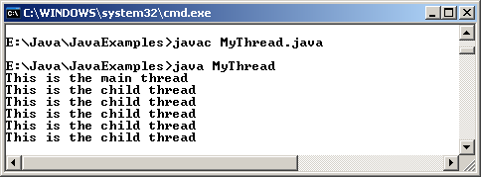
Creating Threads 4-3
Example 1 –
Creating a thread by extending the Thread class
class MyThread extends Thread
{
public static void main(String args[])
{
MyThread Objex = new MyThread();
Objex.create();
System.out.println("This is the main thread");
}
public void create()
{
Thread Objth = new Thread(this);
Objth.start();
}
Output
public void run()
{
while(true)
{
try
{
System.out.println("This is the child thread");
Thread.sleep(500);
}
catch(InterruptedException e)
{ }
}
}
}

Slide 41
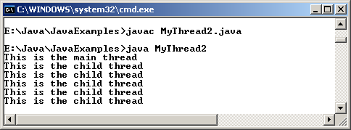
Creating Threads 4-4
*The Runnable interface should be implemented by any class whose instances are intended to be executed by a thread.
*Runnable interface have only one method named run().
Example2 –
Creating a thread by implementing the Runnable interface
class MyThread2 implements Runnable
{
public static void main(String args[])
{
MyThread2 Objx = new MyThread2();
Objx.create();
System.out.println("This is the main thread");
}
public void create()
{
Thread Objth = new Thread(this);
Objth.start();
}
Output
public void run()
{
while(true)
{
try
{
System.out.println("This is the child thread");
Thread.sleep(500);
}
catch(InterruptedException e)
{ }
}
}
}

Slide 42
Methods of Thread class
Method Signature | Description
String getName() | Retrieves the name of running thread in the current context in String format
void start() | This method will start a new thread of execution by calling run() method of Thread/runnable object.
void run() | This method is the entry point of the thread. Execution of thread starts from this method.
void sleep(int sleeptime) | This method suspend the thread for mentioned time duration in argument (sleeptime in ms)
void yield() | By invoking this method the current thread pause its execution temporarily and allow other threads to execute.
void join() | This method used to queue up a thread in execution. Once called on thread, current thread will wait till calling thread completes its execution
boolean isAlive() | This method will check if thread is alive or dead

Slide 43
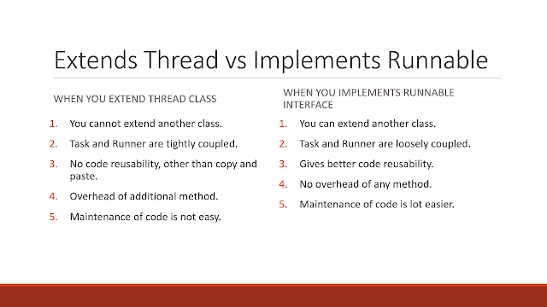

Slide 44


Thread States 3-1
Born: A newly created thread is in a born state.
Ready: After a thread is created, it is in its ready state waiting for start() method to be called.

Slide 45


Thread States 3-2
Running: Thread enters the running state when it starts executing.
Sleeping: Execution of a thread can be halted temporarily by using sleep() method. The thread becomes ready after sleep time expires.

Slide 46



Thread States 3-3
Waiting: Thread is in waiting state if wait() method has been invoked. Used when two or more threads run concurrently.
Blocked: The thread enters a blocked state when it waits for an event such as Input/Output operations.
Dead: The thread enters the dead state after the run() method has finished or the thread’s stop() method is called.

Slide 47
Different stages in the life of a Thread
New Thread
(BORN)
READY
SLEEPING
SUSPENDED
RUNNING
WAITING
BLOCKED
DEAD

Slide 48
Conditions that prevent Thread Execution
Thread execution is interrupted if:
Not of highest priority.
Put to sleep using sleep() method.
Is waiting because wait() method was called.
Explicitly yielded using yield() method.
Blocked for file I/O.

Slide 49
Managing Thread Priorities 2-1
Priorities for carrying out activities changes at times.
Similarly while programming, we may have to run a thread of higher importance without stopping or suspending the current running thread.
Thread priorities play an important role in such a situation.

Slide 50
Managing Thread Priorities 2-2
Thread priorities in Java are constants defined in the Thread class.
NORM_PRIORITY – value is
MAX_PRIORITY – value is
MIN_PRIORITY – value is
5
10
1
The default priority is NORM_PRIORITY
Two methods used to change priority:
final void setPriority(int newp): changes the thread’s current priority.
final int getPriority(): returns the thread’s priority.

Slide 51
Thread Priority Example
class ThreadDemo extends Thread
{ public void run()
{ System.out.println("Inside run method");
}
public static void main(String[]args)
{ Thread.currentThread().setPriority(6);
System.out.println("main thread priority : " +
Thread.currentThread().getPriority());
ThreadDemo t1 = new ThreadDemo();
// t1 thread is child of main thread
// so t1 thread will also have priority 6.
System.out.println("t1 thread priority : "
+ t1.getPriority()); } }

Slide 52
Daemon Thread
Daemon thread is a low priority thread that runs in background to perform tasks such as garbage collection.
Daemon thread in java can be useful to run some tasks in background.
It is a service provider thread that provides services to the user thread.
Its life depend on the mercy of user threads i.e. when all the user threads dies, JVM terminates this thread automatically.
There are many java daemon threads running automatically e.g. gc, finalizer etc.
Notes:
You can see all the detail by typing the jconsole in the command prompt. The jconsole tool provides information about the loaded classes, memory usage, running threads etc.

Slide 53
Properties of Daemon Thread
It provides services to user threads for background supporting tasks. It has no role in life than to serve user threads.
Its life depends on user threads.
JVM terminates itself when all user threads finish their execution
It is an utmost low priority thread

Slide 54
Methods – Daemon Threads
Methods | Description
Public void setDaemon(boolean status) | is used to mark the current thread as daemon thread or user thread.
public boolean isDaemon() | is used to check that current is daemon.
Note: If you want to make a user thread as Daemon, it must not be started otherwise it will throw IllegalThreadStateException.

Slide 55
Example – Daemon Thread
public class TestDaemonThread1 extends Thread{
public void run(){
if(Thread.currentThread().isDaemon()){//checking for daemon thread
System.out.println("daemon thread work"); }
else{ System.out.println("user thread work"); } }
public static void main(String[] args){
TestDaemonThread1 t1=new TestDaemonThread1();//creating thread
TestDaemonThread1 t2=new TestDaemonThread1();
TestDaemonThread1 t3=new TestDaemonThread1();
t1.setDaemon(true);//now t1 is daemon thread
t1.start();//starting threads
t2.start();
t3.start(); } }

Slide 56
Java Thread Pool
A thread pool reuses previously created threads to execute current tasks.
It offers a solution to the problem of thread cycle overhead and resource thrashing.
Since the thread is already existing when the request arrives, the delay introduced by thread creation is eliminated, making the application more responsive.
Java Thread pool represents a group of worker threads that are waiting for the job and reuse many times.

Slide 57
Executor interface & ThreadPoolExecutor Class
Java provides the Executor framework which is centered around the Executor interface.
Its sub-interface –ExecutorService and the class-ThreadPoolExecutor, which implements both of these interfaces.
By using the executor, one only has to implement the Runnable objects and send them to the executor to execute.
They allow you to take advantage of threading, but focus on the tasks that you want the thread to perform, instead of thread mechanics.
To use thread pools, we first create a object of ExecutorService and pass a set of tasks to it.
ThreadPoolExecutor class allows to set the core and maximum pool size.
The runnables that are run by a particular thread are executed sequentially.

Slide 58
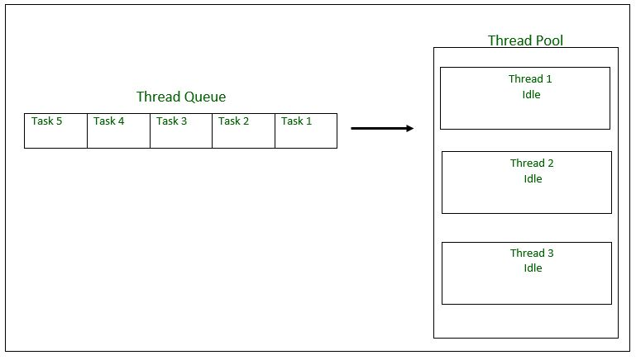
Thread Pool Initialization
Thread Pool Initialization with size = 3 threads.
Task Queue = 5 Runnable Objects

Slide 59
Advantage of Java Thread Pool
Better performance.
It saves time because there is no need to create new thread.
It is used in Servlet and JSP where container creates a thread pool to process the request.

Slide 60
Example of thread pool executor- FixedThreadPool.
1. Create a task(Runnable Object) to execute
2. Create Executor Pool using Executors
3. Pass tasks to Executor Pool
4. Shutdown the Executor Pool

Slide 61
Shutdown Hooks
Shutdown Hooks are a special construct that allow developers to plug in a piece of code to be executed when the JVM is shutting down.
This comes in handy in cases where we need to do special clean up operations in case the JVM is shutting down.
The shutdown hook can be used to perform cleanup resource or save the state when JVM shuts down normally or abruptly.
(ex. kill request from O/S), or due to a resource problem (out of memory).

Slide 62
When does the JVM shut down?
The JVM shuts down when:
User presses Ctrl+c on the command prompt
System.exit(int) method is invoked
User logoff
User shutdown etc.

Slide 63
Using a shutdown hook
Write a class which extends the java.lang.Thread class.
Provide the logic that we want to perform when the JVM is shutting down, inside the public void run() method.
The addShutdownHook() method of Runtime class is used to register the thread with the Virtual Machine.
Then we register an instance of this class as a shutdown hook to the JVM by calling Runtime r=Runtime.getRuntime() method.
The method that returns the instance of a class is known as factory method.
If you need to remove a previously registered shutdown hook, the Runtime class provides the removeShutdownHook(Thread) method as well.

Slide 64
Example of Shutdown Hook
class MyThread extends Thread{
public void run(){
System.out.println("shut down hook task completed.."); } }
public class TestShutdown1{
public static void main(String[] args)throws Exception {
Runtime r=Runtime.getRuntime();
r.addShutdownHook(new MyThread());
System.out.println("Now main sleeping... press ctrl+c to exit");
try{Thread.sleep(3000);}catch (Exception e) {} } }

Slide 65
Thread Synchronization 2-1
At times, two or more threads may try to access a resource at the same time.
For example, one thread might try to read data from a file while the other tries to change the data in the same file.
In such a case, data may become inconsistent.
To ensure that a shared resource is used by only one thread at any point of time, we use synchronization.
Thread safety is the process to make our program safe in MultiThreaded Environment.
Synchronization is the most widely used tool for Thread Safety

Slide 66
Thread Synchronization 2-2
Synchronization is based on the concept of monitor.
A monitor is an object that is used as a mutually exclusive lock.
Only one thread can enter a monitor.
When one thread enters the monitor, it means that the thread has acquired a lock and all other threads must wait till that thread exits the monitor.
For a thread to enter the monitor of an object, the programmer must invoke a method created using the synchronized keyword.
Owner of the method has to exit from the method to give up control.

Slide 67
Synchronizing Code
No explicit class called Monitor in Java. Each object has its own implicit monitor that is entered when any of the object’s implicit methods are called.
If a thread is executing within the synchronized method of an object, any other thread or synchronized method that tries to call that object would have to wait.
The owner (thread) of the monitor has to exit the monitor to give up control of the monitor to the next thread waiting in the queue.

Slide 68
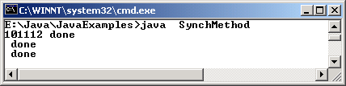
Race condition
If synchronized keyword is omitted, all the threads can simultaneously invoke the same method, on the same object.
This condition is known as race condition.
Race conditions in a program are possible when:
Two or more threads share data.
They are reading and writing the shared data simultaneously.
Output
Without
Synchronization

Slide 69
Synchronized Block
It is not always possible to achieve synchronization by creating synchronized methods within classes.
We can put all calls to the methods defined by this class inside a synchronized block.
A synchronized block ensures that a method can be invoked only after the current thread has successfully entered object’s monitor.
The example shown earlier can be modified with the synchronized keyword used in the method run() of the class ‘One’.

Slide 70
Using ‘wait-notify’ mechanism 3-1
Java provides a well-designed inter-thread communication mechanism using the wait(), notify() and notifyAll() methods.
The methods are implemented as final methods in the class Object.
wait(), notify() and notifyAll() can be called only from within a synchronized method.

Slide 71
Using ‘wait-notify’ mechanism 3-2
wait() method tells the calling thread to exit and enter the sleep state till some other thread enters the monitor and calls the notify() method.
notify()method wakes up the first thread that called wait().
notifyAll() wakes up or notifies all the threads that called wait().
Once all the threads are out of sleep mode, the thread that has the highest priority will run first.

Slide 72
Using ‘wait-notify’ mechanism 3-3
notify()
First thread
notify() wakes up or notifies the first thread.
notifyAll()
Thread 2
notifyAll() wakes up or notifies all the threads that called wait( ) on the same object.
Thread 3
Thread 1

Slide 73
wait()
Points to remember while using the wait() method:
The calling thread gives up the CPU.
The calling thread gives up the lock.
The calling thread goes into the waiting pool of the monitor.

Slide 74
notify()
Main points to remember about notify():
One thread moves out of the waiting pool of the monitor and into the ready state.
The thread that was notified must reacquire the monitor’s lock before it can proceed since it was in sleep state and no longer has control of the monitor.

Slide 75
DeadLock
synchronized keyword is used to make the class or method thread-safe.
It means only one thread can have lock of synchronized method and use it.
Other threads have to wait till the lock releases and anyone of them acquire that lock.
In multi-threaded environment two or more threads execute simultaneously.
But sometimes it also causes a problem which is called Deadlock.

Slide 76
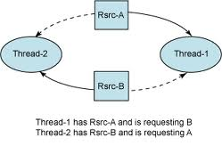
Deadlock in java
Deadlock in java is a part of multithreading.
Deadlock can occur in a situation when a thread is waiting for an object lock, that is acquired by another thread and second thread is waiting for an object lock that is acquired by first thread.
Since, both threads are waiting for each other to release the lock, the condition is called deadlock.

Slide 77
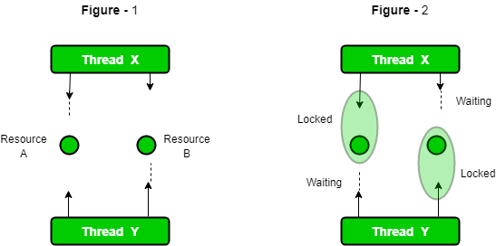
DeadLock Condition

Slide 78
Summary 2-1
Multithreading allows programmers to write efficient programs that make the maximum use of the CPU.
Java provides built-in support for multithreading in the form of classes and interfaces.
When Java programs are executed, there is already one thread that is running and it is the main thread. This main thread is important for two reasons:
It is the thread from which child threads will be created.
Program is terminated when the main thread stops execution.
Thread objects can be created in two ways:
Declare the class to be a sub-class of the Thread class where we need to override the run() method of the Thread class.
Declare a class that implements the Runnable interface. Then define the run() method.
Each thread in a Java program is assigned a priority, and the Java Virtual Machine never changes the priority of a thread.
The default priority of a thread that is created is 5.

Slide 79
Summary 2-2
Two of the constructors in the Thread class are:
public Thread(String threadname)
public Thread( )
Data may get corrupted when two or more threads access the same variable or object at the same time.
Synchronization is a process that ensures that the resource will be used by only one thread at a time.
Synchronization does not provide any benefit for single threaded programs. In addition, their performance is three to four times slower than their non-synchronized counterparts.
The method wait() tells the calling thread to give up the monitor and enter the sleep state till some other thread enters the same monitor and calls the method notify().
The method notify() wakes up or notifies the first thread that called wait() on the same object.

