Slide 1

Java.sql package

Slide 2
Introduction
Discuss Java Database Connectivity (JDBC)
Describe the java.sql package in brief
Discuss types of JDBC drivers
Explain the anatomy of a JDBC program
Describe the PreparedStatement interface
Use ResultSet Interface
Notes:
How presentation will benefit audience: Adult learners are more interested in a subject if they know how or why it is important to them.
Presenter’s level of expertise in the subject: Briefly state your credentials in this area, or explain why participants should listen to you.

Slide 3
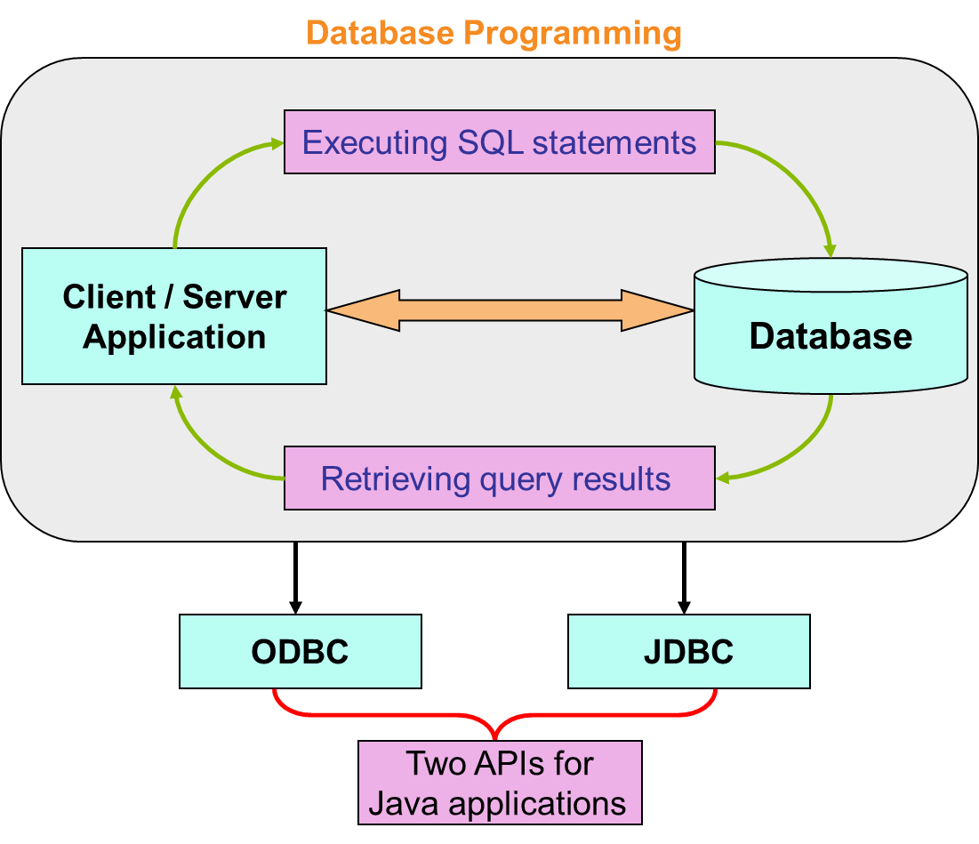
Database

Slide 4
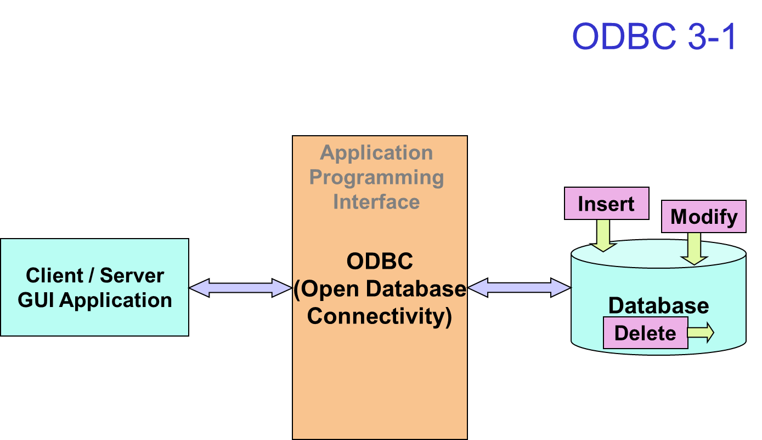

Slide 5
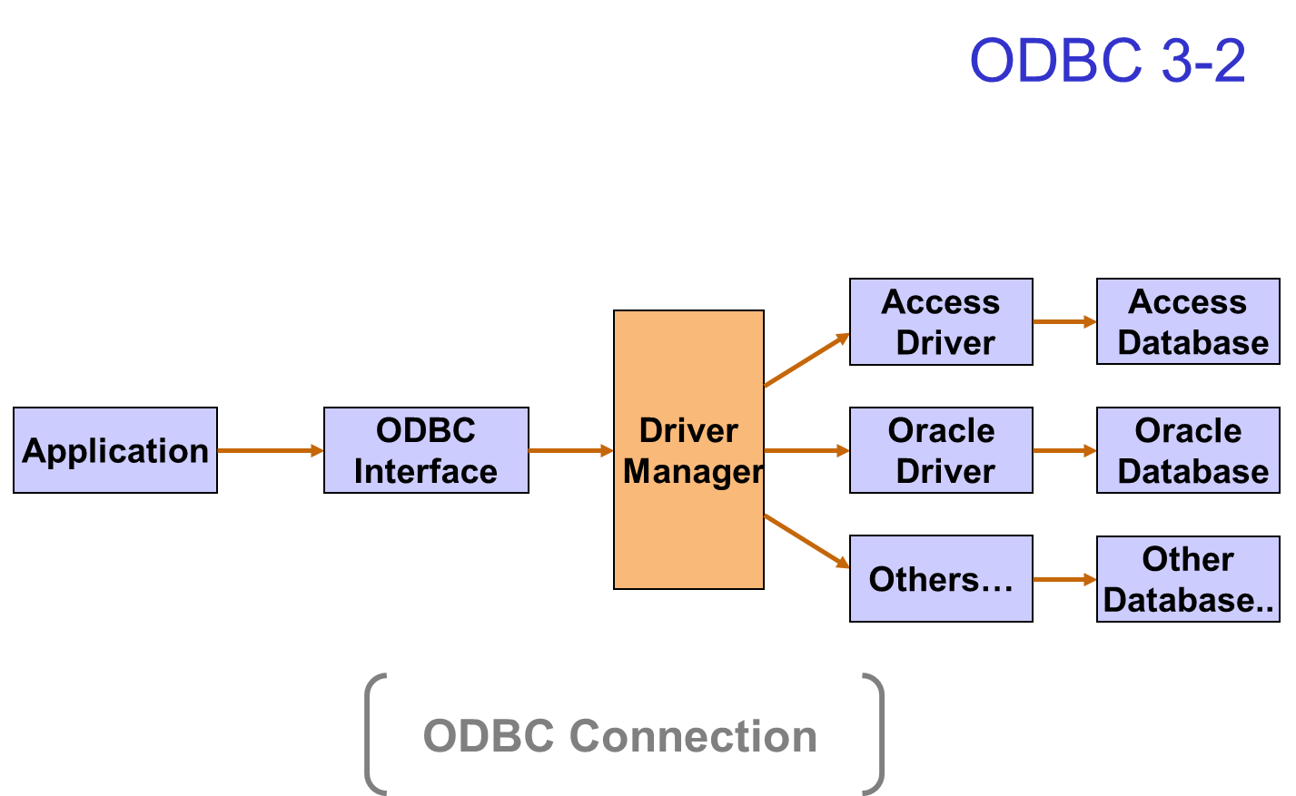

Slide 6
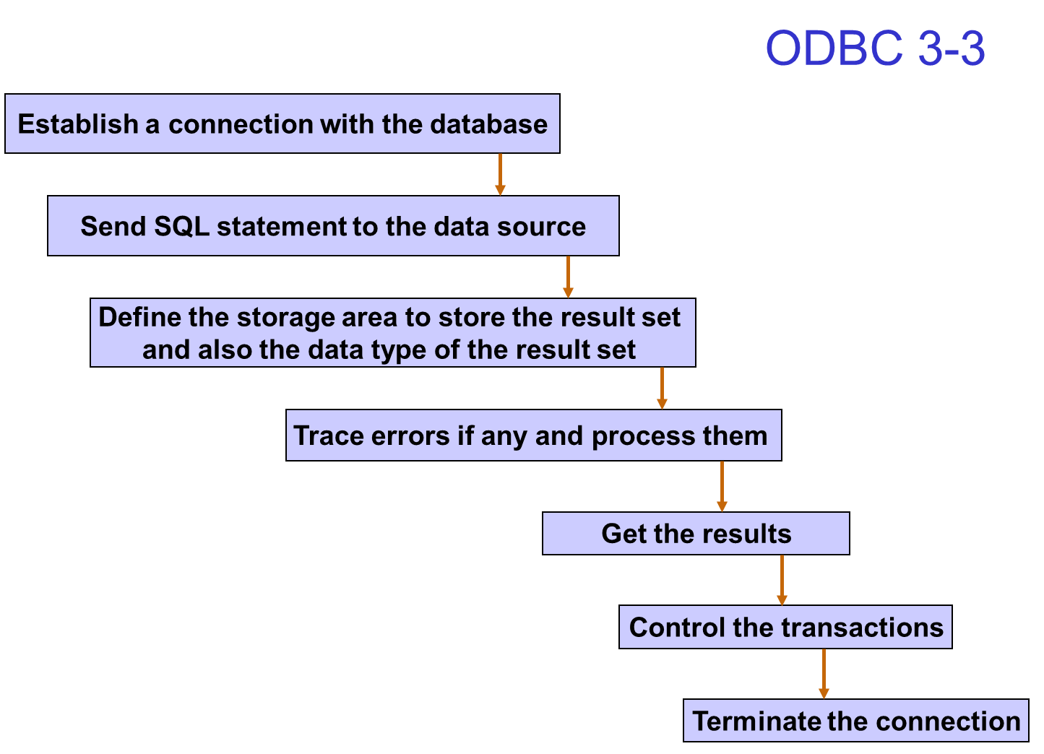

Slide 7
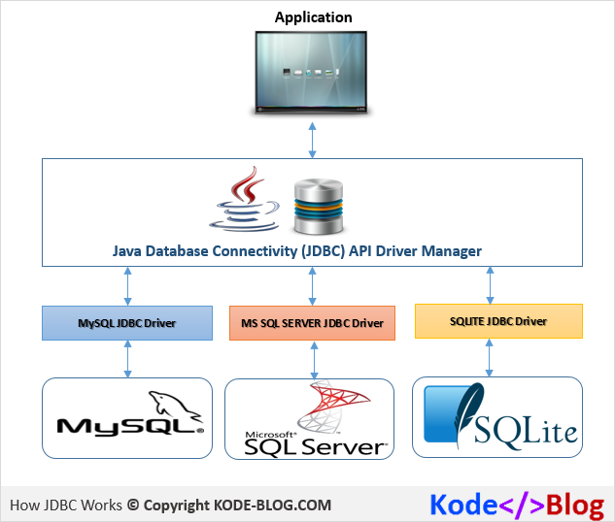
JDBC
JDBC is a Java-based data access technology (Java Standard Edition platform) from Oracle Corporation.
This technology is an API for the Java programming language that defines how a client may access a database.
It provides methods for querying and updating data in a database.

Slide 8
JDBC History
Before JDBC, ODBC API was used to connect and execute query to the database.
But ODBC API uses ODBC driver that is written in C language which is platform dependent and unsecured.
That is why Sun Micro System has defined its own API (JDBC API) that uses JDBC driver written in Java language.
Sun Microsystems released JDBC as part of JDK 1.1 on February 19, 1997.
The JDBC classes are contained in the Java package java.sql and javax.sql
The latest version, JDBC 4.2, and is included in Java SE 8.

Slide 9
API
The Java API is the set of classes included with the Java Development Environment.
These classes are written using the Java language and run on the JVM.
The Java API includes everything from collection classes to GUI classes.
JDBC is also an API.

Slide 10
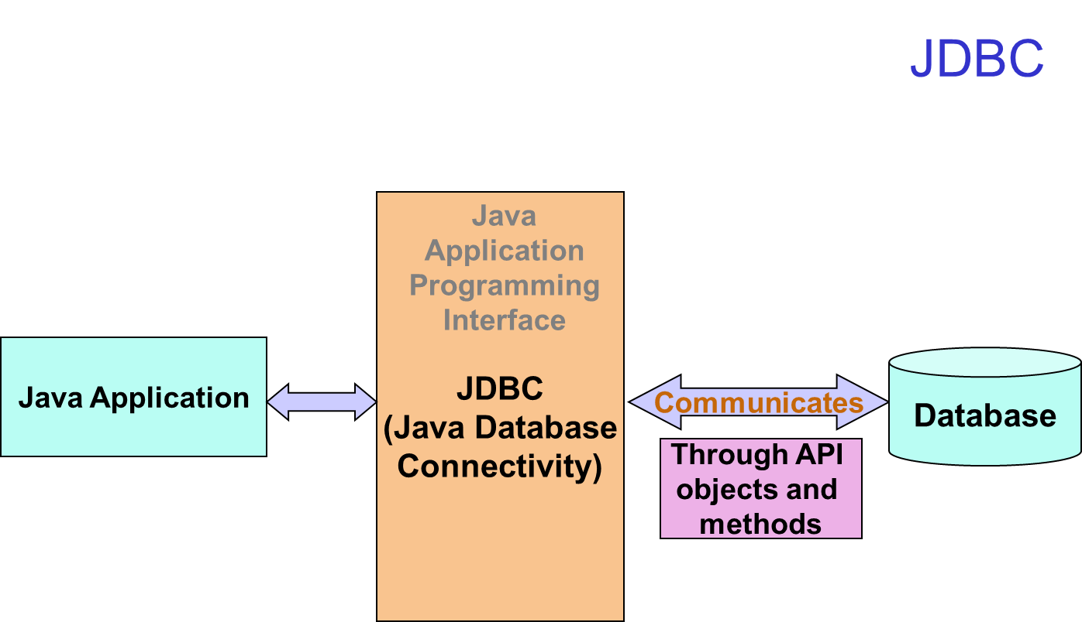

Slide 11
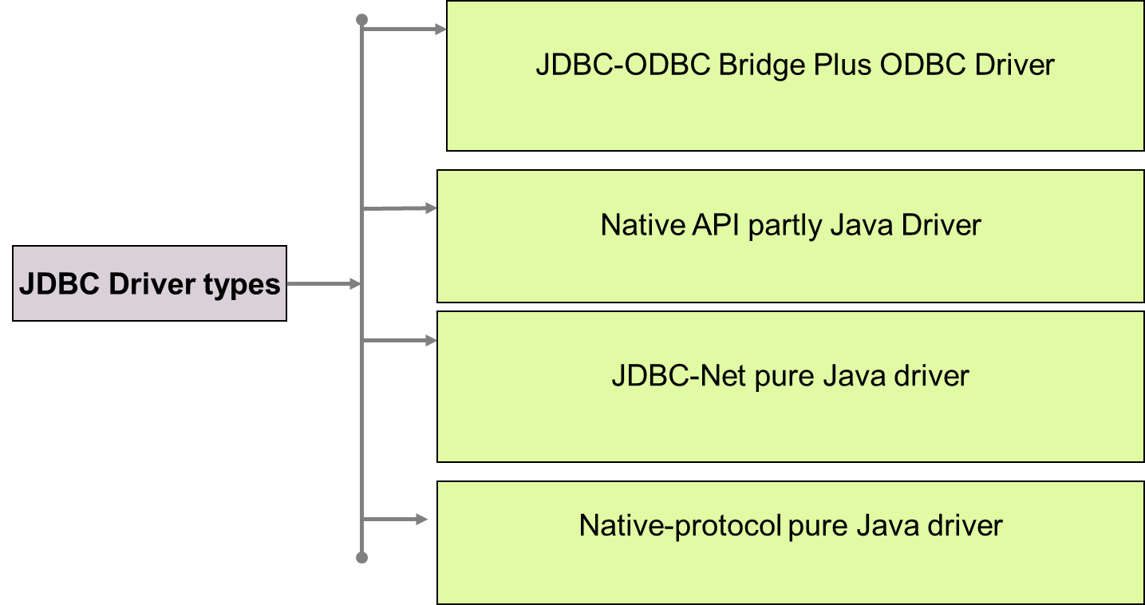
JDBC Driver
JDBC Driver is a software component that enables java application to interact with the database.
There are 4 types of JDBC drivers:
– Type 1: JDBC-ODBC bridge driver
– Type 2: Native-API driver (partially java driver)
– Type 3: Network Protocol driver (fully java driver)
– Type 4: Thin driver (fully java driver)

Slide 12
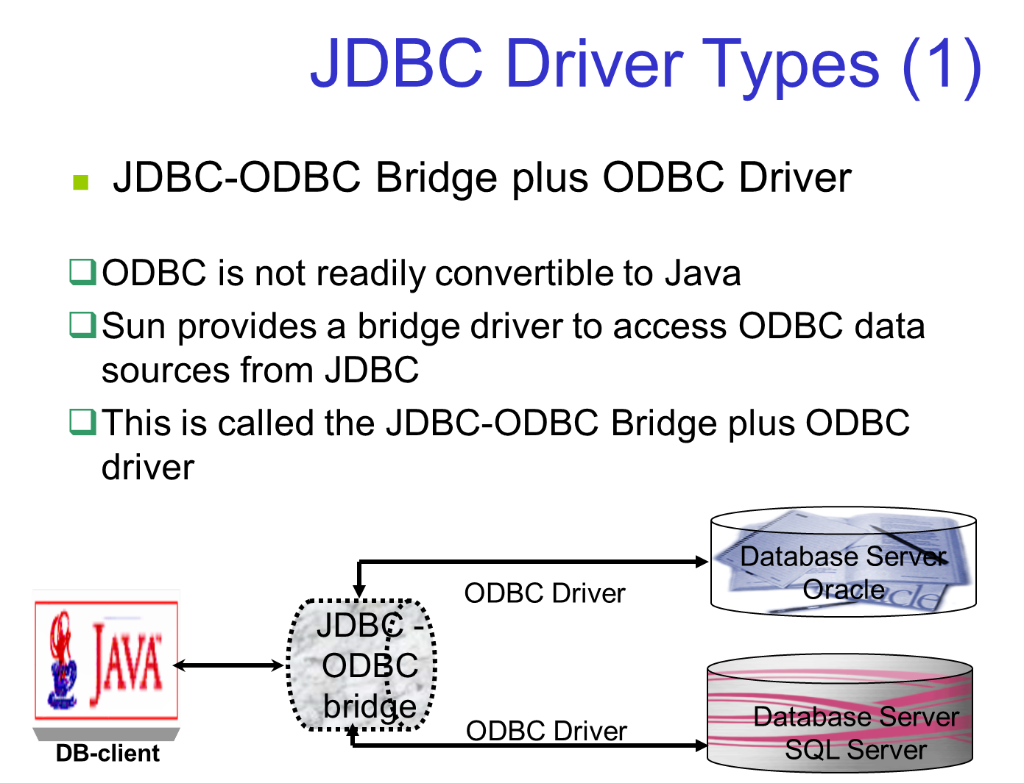

Slide 13
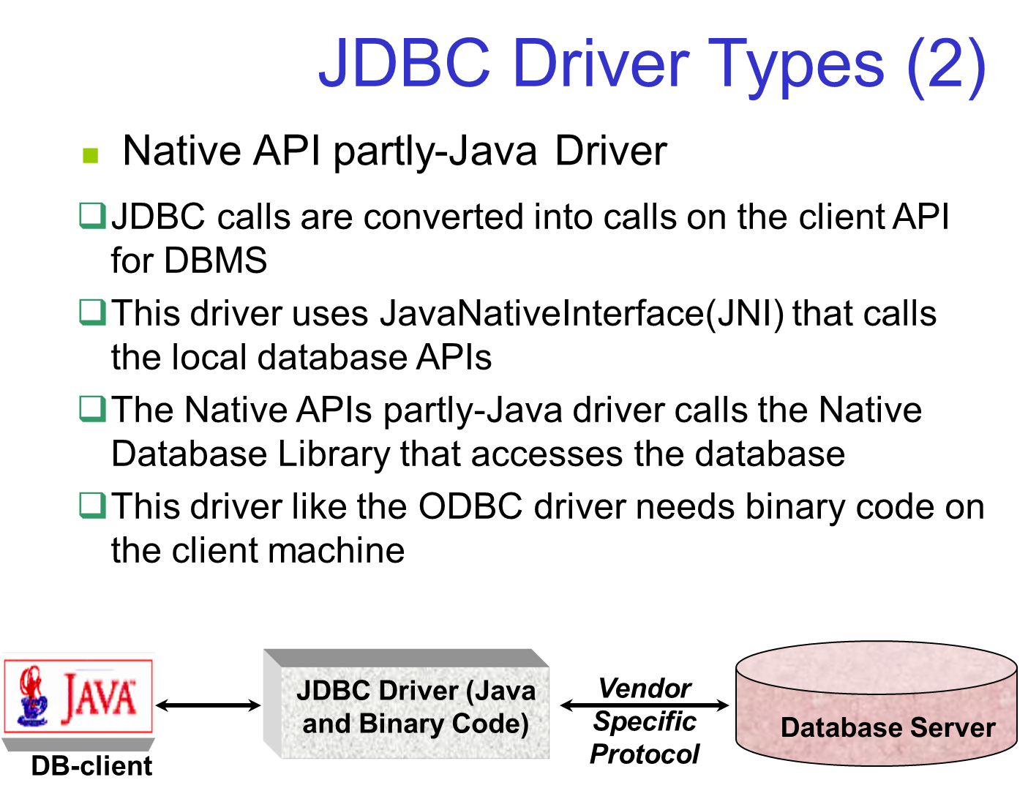

Slide 14
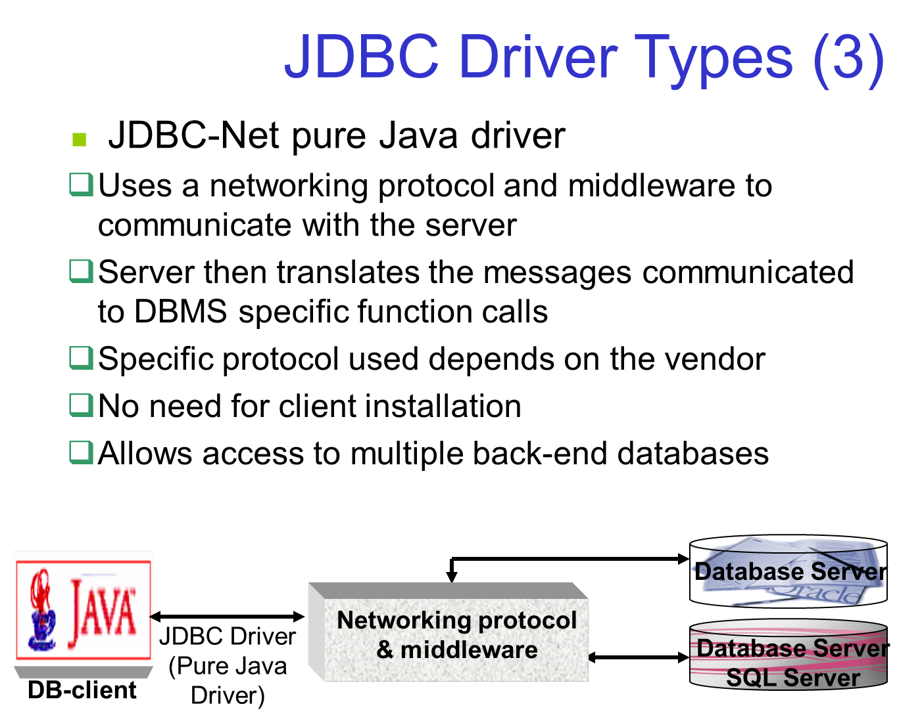

Slide 15
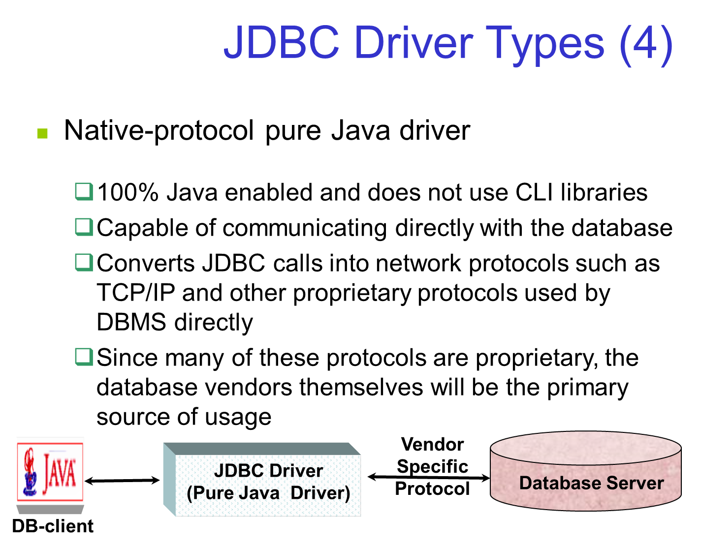

Slide 16
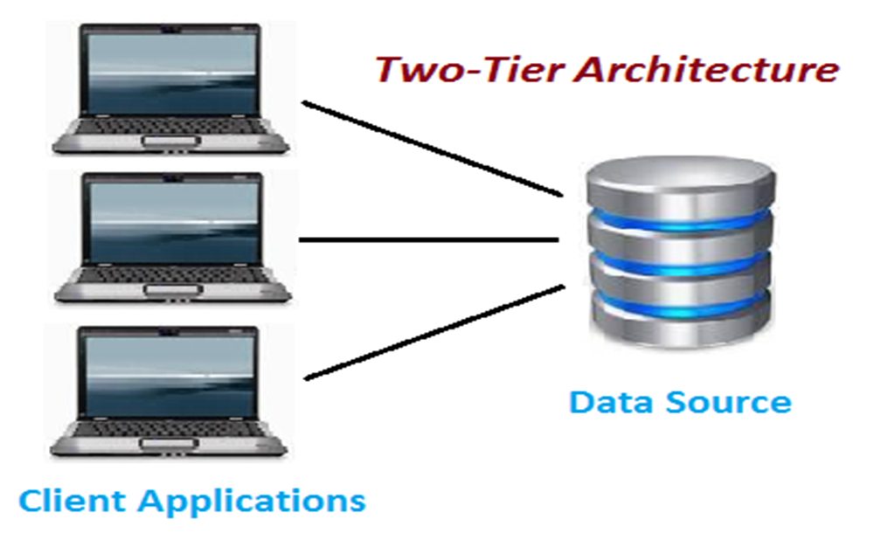
Two-Tier Architecture
The two-tier is based on Client Server architecture.
The two-tier architecture is like client server application.
The direct communication takes place between client and server.
There is no intermediate between client and server.
Tight coupling allows 2 tiered application run faster.

Slide 17
Two-Tier Architecture
Pros:
Easy to maintain and modification is bit easy
Communication is faster
Cons:
In two tier architecture application performance will be degrade upon increasing the users.
Cost-ineffective

Slide 18
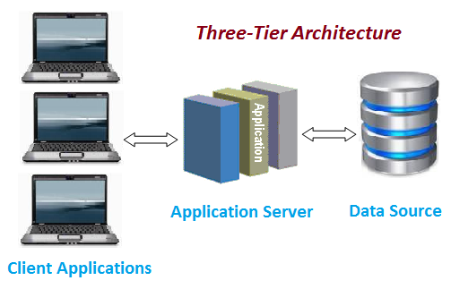
Three-Tier Architecture
Three-tier architecture typically comprise a presentation tier, a business or data access tier, and a data tier.
Three layers in the three tier architecture are as follows:
1) Client layer
2) Business layer
3) Data layer

Slide 19
3- Tier Architecture
1) Client layer:
It is also called as Presentation layer which contains UI part of our application. This layer is used for the design purpose where data is presented to the user or input is taken from the user. For example designing registration form which contains text box, label, button etc.
2) Business layer:
In this layer all business logic written like validation of data, calculations, data insertion etc. This acts as a interface between Client layer and Data Access Layer. This layer is also called the intermediary layer helps to make communication faster between client and data layer.
3) Data layer:
In this layer actual database is comes in the picture. Data Access Layer contains methods to connect with database and to perform insert, update, delete, get data from database based on our input data.

Slide 20
3- Tier Pros & Cons
Pros
High performance, lightweight persistent objects
Scalability – Each tier can scale horizontally
Performance – Because the Presentation tier can cache requests, network utilization is minimized, and the load is reduced on the Application and Data tiers.
High degree of flexibility in deployment platform and configuration
Better Re-use
Improve Data Integrity
Improved Security – Client is not direct access to database.
Easy to maintain and modification is bit easy, won’t affect other modules
In three tier architecture application performance is good.
Cons
Increase Complexity/Effort

Slide 21
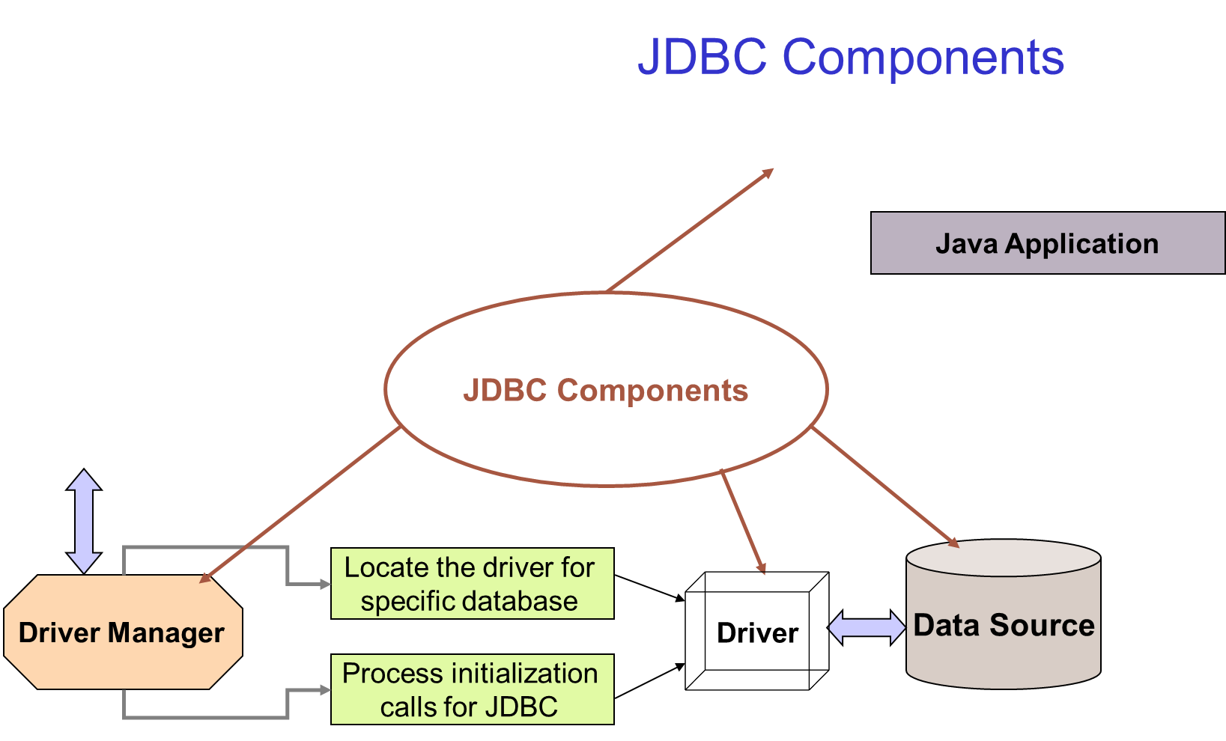
import java.sql.*;
import java.util.*;
class Jdbctest2 {
public static void main(String args[]) {
try {
Class.forName("sun.jdbc.odbc.JdbcOdbcDriver");
} catch(ClassNotFoundException ce) {
System.out.println(ce);
}
try {
String url = "jdbc:odbc:test";
Connection con = DriverManager.getConnection(url);
Statement s = con.createStatement();
ResultSet rs = s.executeQuery("select hiredate,sum(salary)
from friends group by hiredate");
while(rs.next()) {
System.out.print(rs.getDate(1) +"\t" );
System.out.print(rs.getInt(2) +"\t" );
System.out.println(" ");
}
} catch(SQLException ce) {
System.out.println(ce);
}}
}
Java Application

Slide 22
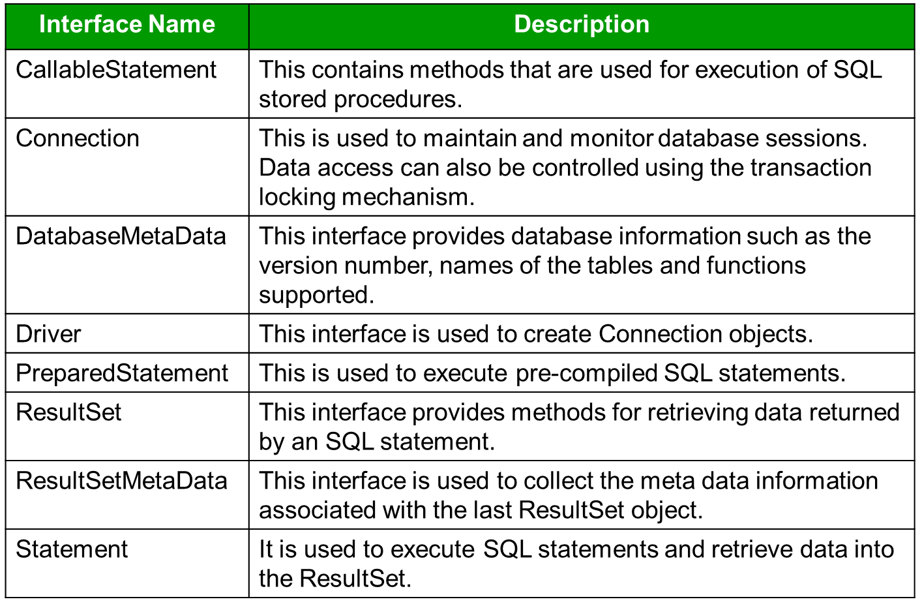
java.sql package 3-1

Slide 23
java.sql package 3-2
Class Name | Description
Date | This class contains methods for performing conversion of SQL date formats to Java Date formats.
DriverManager | This class is used to handle loading and unloading of drivers and establish connection with the database.
DriverPropertyInfo | The methods in this class are used to retrieve or insert driver properties.
Time | This class provides formatting and parsing operations for Time values.
TimeStamp | This provides precision to Java Date object by adding a Nanosecond field.
Types | This class has no methods. This class defines the constants used to identify the SQL types.

Slide 24
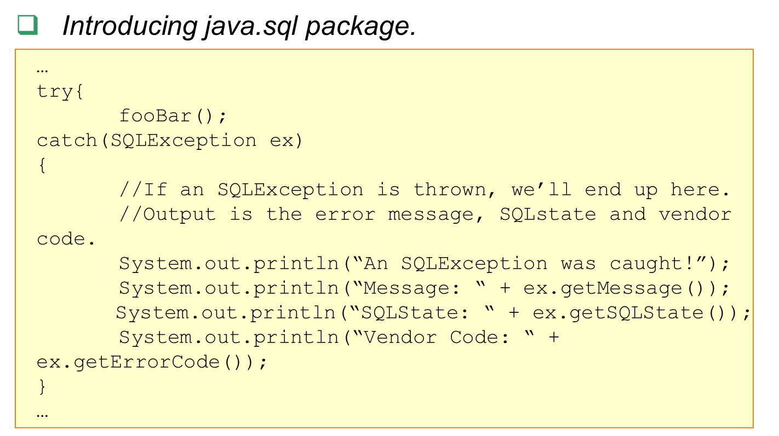
java.sql package 3-3

Slide 25
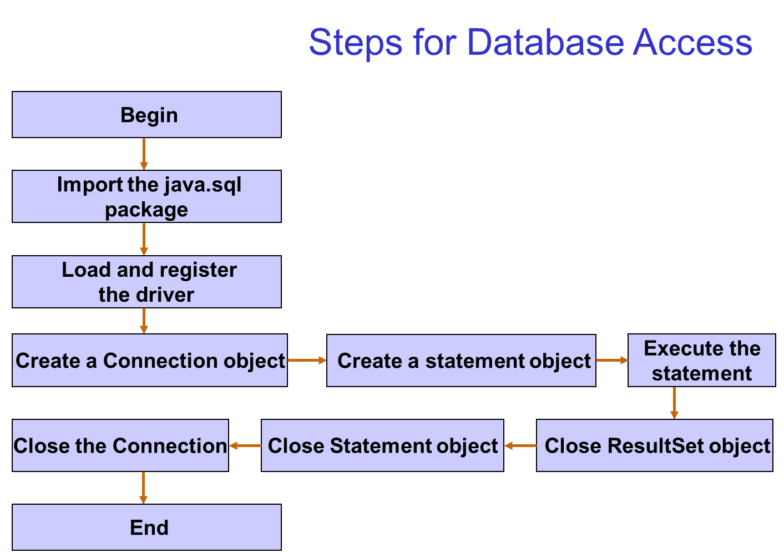

Slide 26
Registering the Driver
The forName() method of Class class is used to register the driver class.
Class.forName("com.mysql.jdbc.Driver");
Class.forName("oracle.jdbc.driver.OracleDriver)

Slide 27
Creating Connection Object
The getConnection() method of DriverManager class is used to establish connection with the database.
Connection con=DriverManager.getConnection( "jdbc:mysql://localhost:3306","root","password");
Connection con=DriverManager.getConnection(
"jdbc:oracle:thin:@localhost:1521:orcl","system","oracle");

Slide 28
Creating Statement Object
The createStatement() method of Connection interface is used to create statement.
The object of statement is responsible to execute queries with the database.
Statement stmt=con.createStatement();

Slide 29
Execute Query
The executeQuery() method of Statement interface is used to execute queries to the database.
This method returns the object of ResultSet that can be used to get all the records of a table.
ResultSet rs=stmt.executeQuery("select * from emp");
while(rs.next()) {
System.out.println(rs.getInt(1)+" "+rs.getString(2)); }

Slide 30
Closing Connection
By closing connection object statement and ResultSet will be closed automatically.
The close() method of Connection interface is used to close the connection.
con.close();

Slide 31
Connecting to the MySQL Database
Driver class: com.mysql.jdbc.Driver.
Connection URL: jdbc:mysql://localhost:3306/db_name
Username: The default username for the mysql database is root.
Password: Given by the user at the time of installing the mysql database
Example:
Connection con=DriverManager.getConnection( "jdbc:mysql://localhost:3306/dbname","root","root")
"jdbc:oracle:thin:@localhost:1521:orcl","system","oracle"

Slide 32
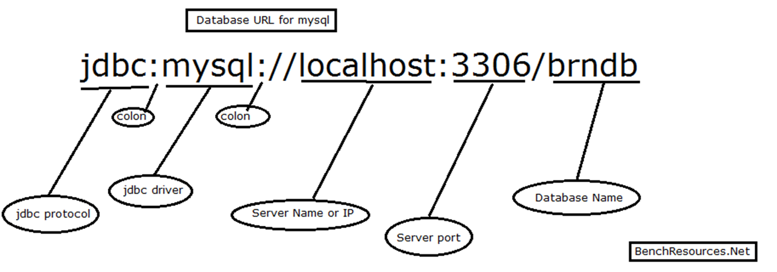
Database URL for MYSQL
"jdbc:oracle:thin:@localhost:1521:orcl","system","oracle"
Oracle Service

Slide 33
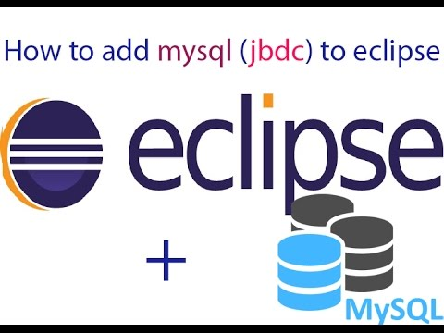
Loading the .jar
Download the MySQL connector.jar from mysql.com
Paste the mysqlconnector.jar in the lib folder of source directory.
Set the classpath
Add jar file to the build path in the
Eclipse IDE
Ojdbc14.jar for Oracle

Slide 34
DriverManager class
The DriverManager class acts as an interface between user and drivers.
It keeps track of the drivers that are available and handles establishing a connection between a database and the appropriate driver.
Connection con = null;
con=DriverManager.getConnection( "jdbc:mysql://localhost:3306/dbname","root","password");
DriverManager.registerDriver().
"jdbc:oracle:thin:@localhost:1521:orcl","system","oracle"

Slide 35
Connection Interface
A Connection is the session between Java application and database.
The Connection interface is a factory of Statement and PreparedStatement.
Object of Connection can be used to get the object of Statement and PreparedStatement.

Slide 36
Methods of Connection interface
public Statement createStatement(): creates a statement object that can be used to execute SQL queries.
public void commit(): saves the changes made since the previous commit/rollback permanent.
public void close(): closes the connection and Releases a JDBC resources immediately.

Slide 37
Statement Interface
The Statement interface provides methods to execute queries with the database.
The statement interface is a factory of ResultSet.
It provides factory method to get the object of ResultSet.

Slide 38
Methods of Statement interface
public ResultSet executeQuery(String sql): is used to execute SELECT query. It returns the object of ResultSet.
public int executeUpdate(String sql): is used to execute specified query, it may be create, drop, insert, update, delete etc.
public boolean execute(String sql): is used to execute queries that may return multiple results.

Slide 39
Statement Interface Example
Statement stmt=con.createStatement();
int result=stmt.executeUpdate("delete from table where id=xy");
System.out.println(result+" records affected");
con.close();

Slide 40
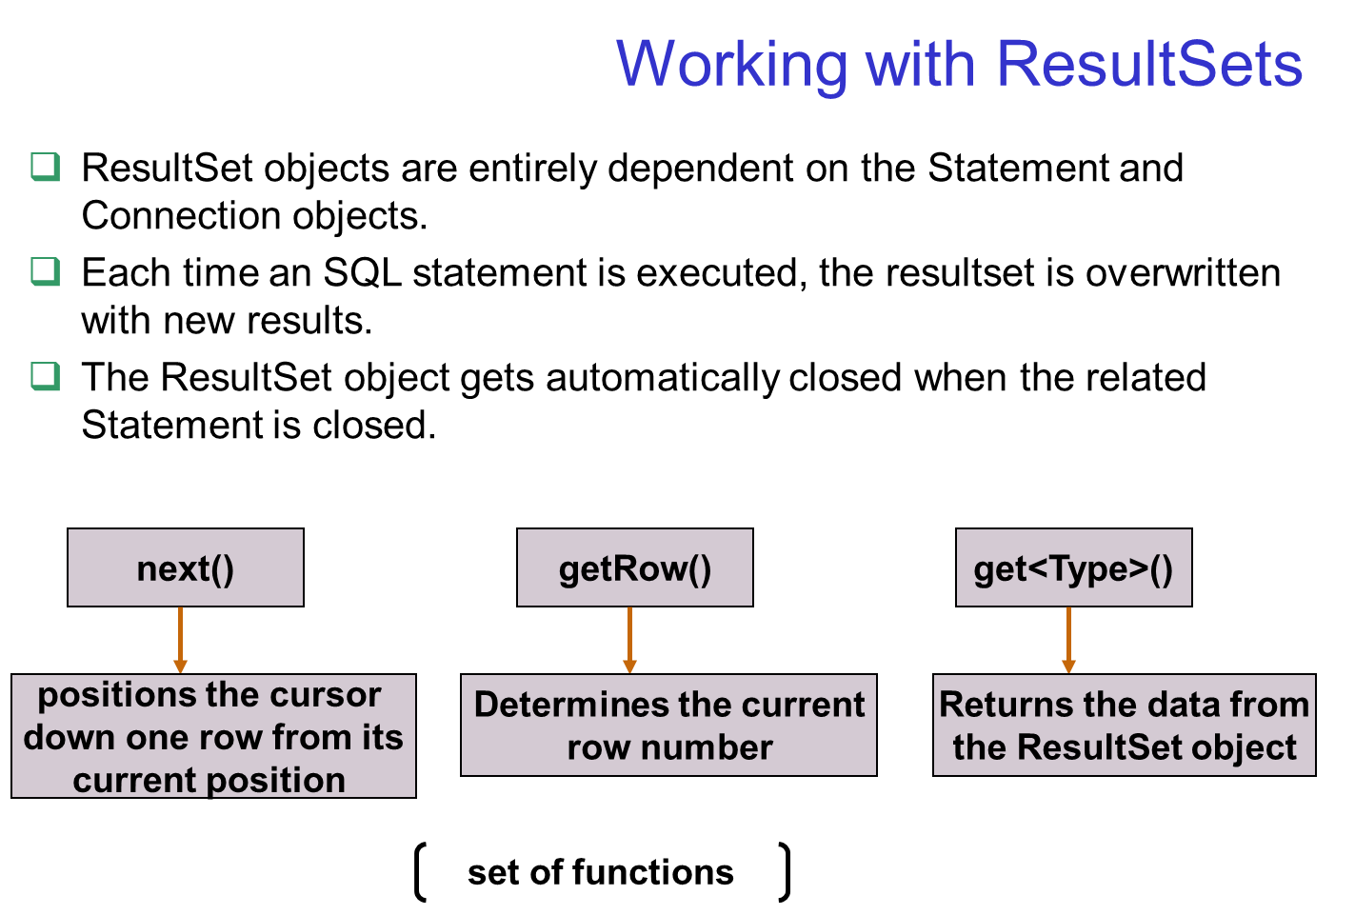

Slide 41
ResultSet interface
The object of ResultSet maintains a cursor pointing to a particular row of data.
Initially, cursor points to before the first row.

Slide 42
Methods of ResultSet interface
public boolean next(): is used to move the cursor to the one row next from the current position.
public boolean previous():is used to move the cursor to the one row previous from the current position.
public boolean first(): is used to move the cursor to the first row in result set object.
public boolean last():is used to move the cursor to the last row in result set object.

Slide 43
Methods of ResultSet interface
public int getInt(int columnIndex): is used to return the data of specified column index of the current row as int.
public int getInt(String columnName):is used to return the data of specified column name of the current row as int.
public String getString(int columnIndex): is used to return the data of specified column index of the current row as String.
public String getString(String columnName): is used to return the data of specified column name of the current row as String.

Slide 44
ResultSet Interface Example
ResultSet rs=stmt.executeQuery("select * from table");
//getting the record of 3rd row
rs.absolute(3);
System.out.println(rs.getString(1)+" "+rs.getString(2)+" "+rs.getString(3));
con.close();

Slide 45
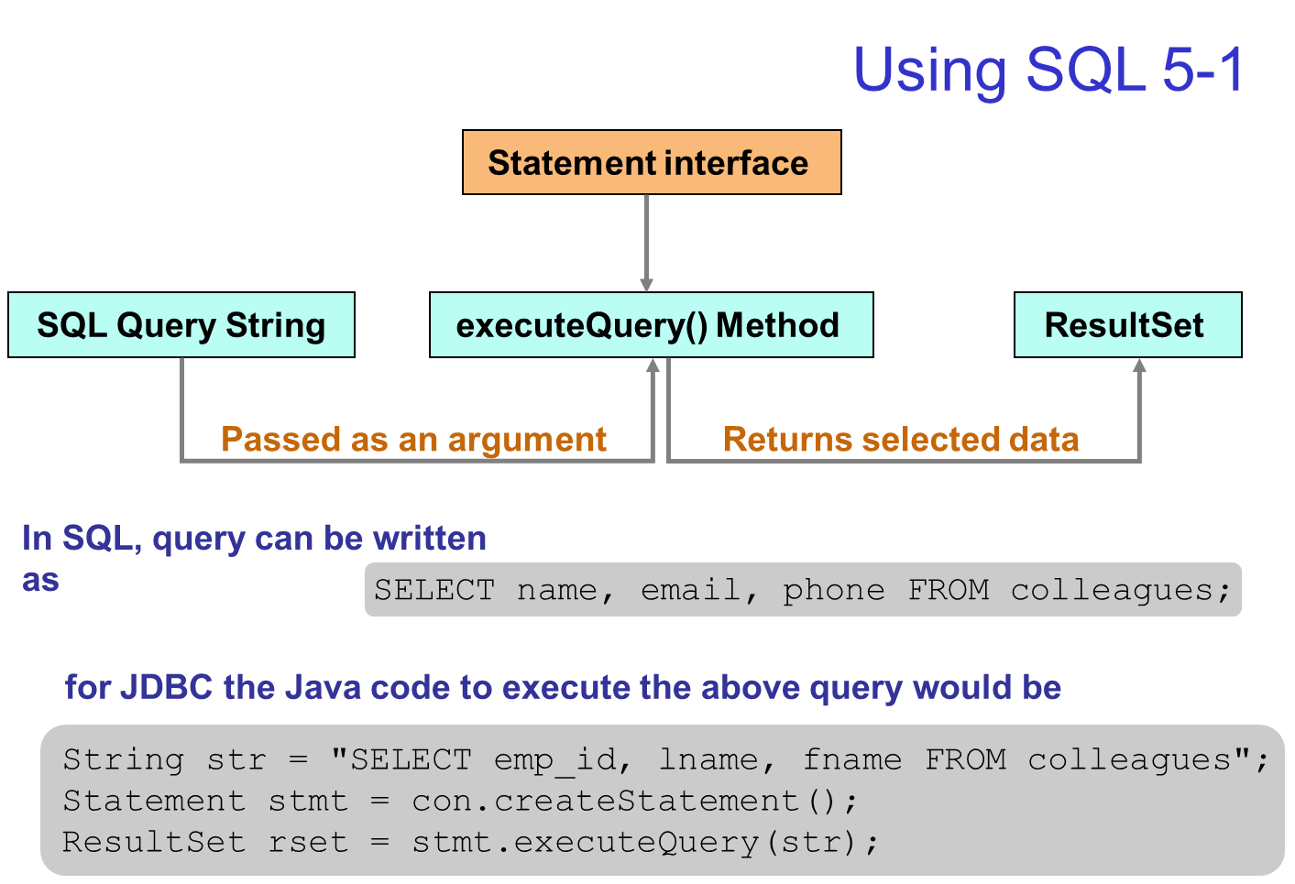

Slide 46
Setting Up MySQL JDBC Development Environment
Download and install JDK.
Download and install NetBeans / Eclipse IDE.
Download MySQL Connector/J /ojdbc14.jar and configure it to build path in Eclipse.

Slide 47
Connecting & Querying Data From MySQL Using JDBC
import java.sql.Connection;
import java.sql.DriverManager;
import java.sql.SQLException;
class MysqlCon{
public static void main(String args[]){
try{
Class.forName(“com.mysql.jdbc.Driver");
Connection con=DriverManager.getConnection( "jdbc:mysql://localhost:3306/dbname","root","redhat")
Statement stmt=con.createStatement();
ResultSet rs=stmt.executeQuery("select * from employees");
while(rs.next())
System.out.println(rs.getInt(1)+" "+rs.getString(2)+" "+rs.getString(3));
con.close();
}catch(Exception e){ System.out.println(e);}
}
}

Slide 48
Scrollable Resultset in JDBC
In Jdbc ResultSet Interface are classified into two type;.
Non-Scrollable ResultSet in JDBC
Scrollable ResultSet
By default a ResultSet Interface is Non-Scrollable.
In non-scrollable ResultSet we can move only in forward direction, but not in Backward Direction,
If you want to move in backward direction use Scrollable Interface.

Slide 49
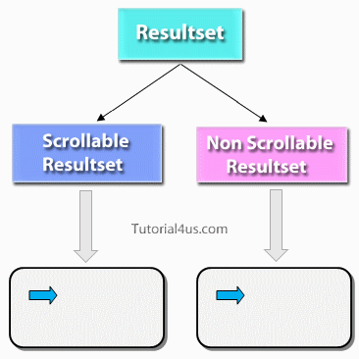
Types of Resultset

Slide 50
Difference between Scrollable ResultSet and Non-Scrollable ResultSet
Non-Scrollable ResultSet | Scrollable ResultSet
Cursor move only in forward direction | Cursor can move both forward and backward direction
Slow performance, If we want to move nth record then we need to n+1 iteration | Fast performance, directly move on any record.
Non-Scrollable ResultSet cursor can not move randomly | Scrollable ResultSet cursor can move randomly

Slide 51
Create Scrollable ResultSet
To create a Scrollable ResultSet, create Statement object with two parameters.
Syntax :
Statement stmt=con.CreateStatement(param1, param2);
// parm1 type and param2 mode

Slide 52
Scrollable ResultSet – Type
These type and mode are predefined in ResultSet Interface of Jdbc like below which is static final.
Type | Description
ResultSet.TYPE_FORWARD_ONLY | The cursor can only move forward in the result set.
ResultSet.TYPE_SCROLL_INSENSITIVE | The cursor can scroll forward and backward, and the result set is not sensitive to changes made by others to the database that occur after the result set was created.
ResultSet.TYPE_SCROLL_SENSITIVE. | The cursor can scroll forward and backward, and the result set is sensitive to changes made by others to the database that occur after the result set was created.
Statement stmt=con.CreateStatement(ResutlSet.TYPE_SCROLL_INSENSITIVE, ResultSet.CONCUR_READ_ONLY);

Slide 53
Scrollable ResultSet – Mode & Methods
Concurrency | Description
ResultSet.CONCUR_READ_ONLY | Creates a read-only result set. This is the default
ResultSet.CONCUR_UPDATABLE | Creates an updateable result set.
Below all methods are used for move the cursor in Scrollable ResultSet.
afterLast: Used to move the cursor after last row.
BeforeFirst: Used to move the cursor before first row.
previous: Used to move the cursor backward.
first: Used to move the cursor first at row.
last: Used to move the cursor at last row.
absolute: Moves the cursor to the specified row.
relative: Moves the cursor the given number of rows forward or backward.

Slide 54
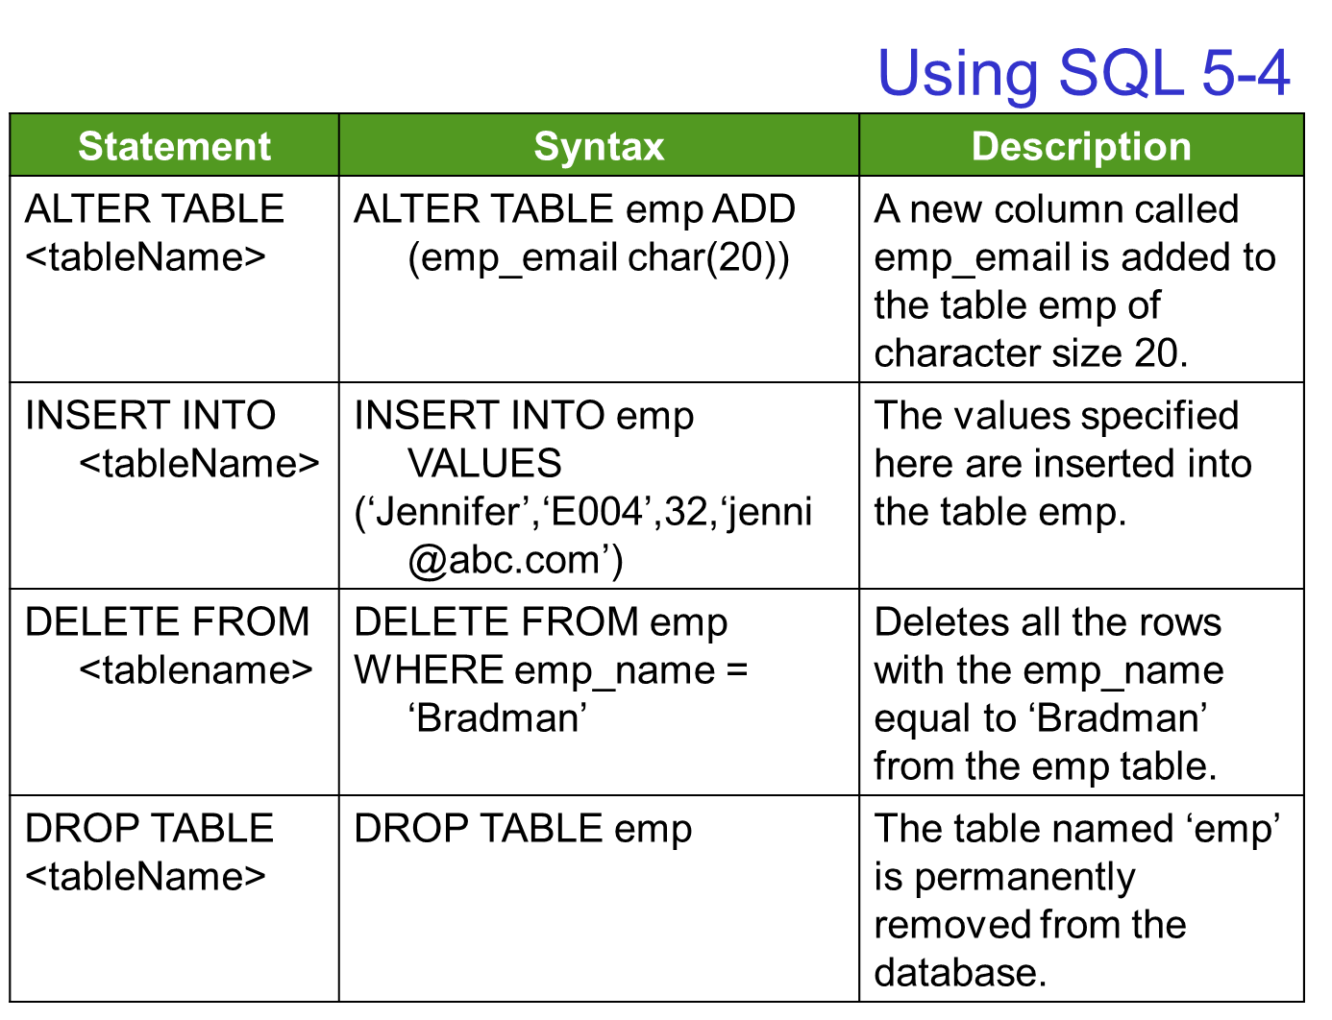

Slide 55
Using SQL Insert
It demonstrates the usage of INSERT statement in SQL.
/** This is a main method. */
public static void main(final String [] args) {
try {
Class.forName("sun.jdbc.odbc.JdbcOdbcDriver");
} catch (ClassNotFoundException ce) {
System.out.println(ce);
}
try {
String url = "jdbc:odbc:test";
String str = "INSERT INTO friends(name,address,salary)" + "VALUES('Jessica','Alaska',25690)";
Connection con = DriverManager.getConnection(url);
Statement s = con.createStatement();
int rowcount = s.executeUpdate(str);
String str1 = "select name, avg(salary) from friends"
+ " group by name";
import java.sql.SQLException;
import java.sql.Connection;
import java.sql.DriverManager;
import java.sql.Statement;
import java.sql.ResultSet;
/** This class demonstrates the usage of INSERT statement.
*/
class Jdbctest3 {
/** Constructor. */
protected Jdbctest3() {
}
ResultSet rs = s.executeQuery(str1);
while (rs.next()) {
System.out.print(rs.getString(1) + "\t");
System.out.print(rs.getInt(2) + "\t");
System.out.println(" ");
}
} catch (SQLException ce) {
System.out.println(ce);
}
}
}
Demonstration: Example 3

Slide 56
/** This is a main method. */
public static void main(final String [] args) {
try {
Class.forName("sun.jdbc.odbc.JdbcOdbcDriver");
} catch (ClassNotFoundException ce) {
System.out.println(ce);
}
try {
String url = "jdbc:odbc:test";
String str = "INSERT INTO friends(name,address,salary)" + "VALUES('Jessica','Alaska',25690)";
Connection con = DriverManager.getConnection(url);
Statement s = con.createStatement();
int rowcount = s.executeUpdate(str);
String str1 = "select name, avg(salary) from friends"
+ " group by name";

Slide 57
Using SQL 5-5
It demonstrates the usage of commands in SQL.
public static void main(final String [] args) {
Connection con;
Statement stmt;
String url;
String sql;
try {
Class.forName("sun.jdbc.odbc.JdbcOdbcDriver");
} catch (ClassNotFoundException ce) {
System.out.println(ce);
}
try {
url = "jdbc:odbc:test";
con = DriverManager.getConnection(url);
sql = "Delete from friends where rtrim(name)like\'Kim\';";
System.out.println(" ");
stmt = con.createStatement();
stmt.executeUpdate(sql);
System.out.println("Record for Kim is deleted“);
con.close();
import java.sql.SQLException;
import java.sql.Connection;
import java.sql.DriverManager;
import java.sql.Statement;
/** This class demonstrates the usage of commands in SQL.
*/
class Jdbc2 {
/** Constructor. */
protected Jdbc2() {
}
con = DriverManager.getConnection(url);
sql = "Update friends set address=\'Adelaide\' where " + "rtrim(name) like \'Mike\'; ";
System.out.println(" ");
stmt = con.createStatement();
stmt.executeUpdate(sql);
con.close();
System.out.println("Record for Mike updated");
} catch (SQLException ce) {
System.out.println(ce);
}
}
}
Demonstration: Example 4

Slide 58
PreparedStatement Interface
The PreparedStatement interface is a sub interface of Statement.
If the sql command is same then actually no need to compiling it for each time before it is executed.
So the performance of an application will be Increased.
In this case PreparedStatement is used.
It accepts values to query at runtime.
It is used to execute parameterized query.
Example of parameterized query: –
String sql="insert into emp values(?,?,?)";

Slide 59
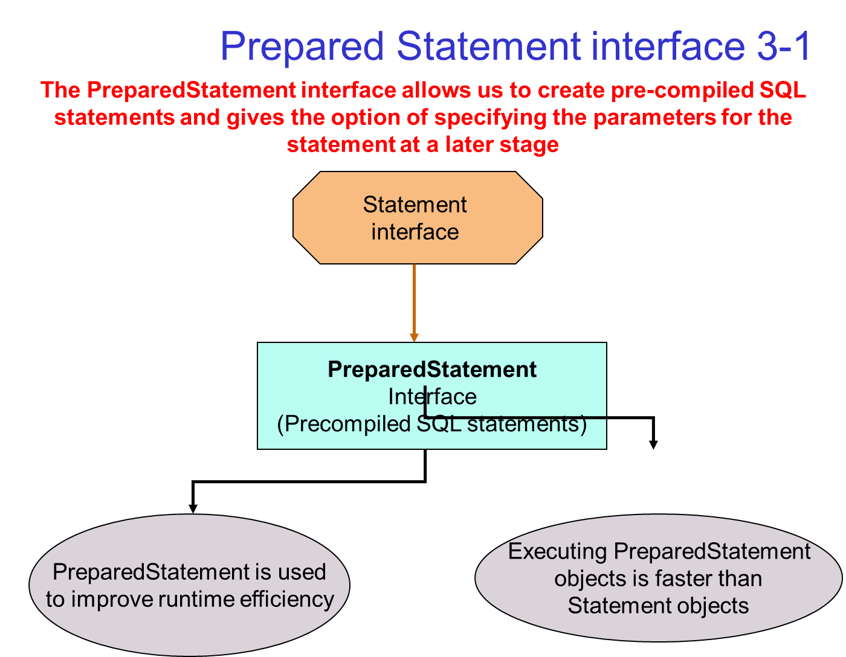

Slide 60
PreparedStatement

Slide 61
Difference between PreparedStatement and Statement
Statement | PreparedStatement
Statement interface is slow because it compile the program for each execution | PreparedStatement interface is faster, because its compile the command for once.
We can not use ? symbol in sql command so setting dynamic value into the command is complex | We can use ? symbol in sql command, so setting dynamic value is simple.
We can not use statement for writing or reading binary data (picture) | We can use PreparedStatement for reading or writing binary data.

Slide 62
Why use '?' symbol in PreparedStatement
To pre-compile a command only syntax of the command is required.
So we can use '?' symbol for value in the command.
'?' symbol is called parameter or replacement operator or place-resolution operator.

Slide 63
Methods of PreparedStatement
public void setInt(int paramIndex, int value): sets the integer value to the given parameter index.
public void setString(int paramIndex, String value): sets the String value to the given parameter index.
public void setFloat(int paramIndex, float value): sets the float value to the given parameter index.

Slide 64
Methods of PreparedStatement
public void setDouble(int paramIndex, double value): sets the double value to the given parameter index.
public int executeUpdate(): executes the query. It is used for create, drop, insert, update, delete etc.
public ResultSet executeQuery(): executes the select query. It returns an instance of ResultSet.

Slide 65
PreparedStatement Interface Example
PreparedStatement stmt=con.prepareStatement("insert into Emp values(?,?)");
stmt.setInt(1,101);
//1 specifies the first parameter in the query
stmt.setString(2,"Ratan");
int i=stmt.executeUpdate();
System.out.println(i+" records inserted");
Note that you can use any statement such as SELECT, INSERT, DELETE, etc with PreparedStatement interface.

Slide 66
Callablestatement in Jdbc
To call the procedures and functions of a database, CallableStatement interface is used.
CallableStatement is a derived Interface of preparedStatement.
It has one additional feature over PreparedStatement that is calling procedures and function of a database.
Because of CallableStatement is inherited from PreparedStatement all the features of PreparedStatement are also available with CallableStatement.

Slide 67
Callable Statement

Slide 68
Stored Procedures & Functions
We can have business logic on the database by the use of stored procedures and functions.
It will make the performance better because these are precompiled.
Example:
Suppose you need the get the age of the employee based on the date of birth, you may create a function that receives date as the input and returns age of the employee as the output.

Slide 69
Stored Procedures vs Functions
Stored Procedure | Function
is used to perform business logic. | is used to perform calculation.
must not have the return type. | must have the return type.
may return 0 or more values. | may return only one values.
We can call functions from the procedure. | Procedure cannot be called from function.
Procedure supports input and output parameters. | Function supports only input parameter.
Exception handling using try/catch block can be used in stored procedures. | Exception handling using try/catch can't be used in user defined functions.

Slide 70
Create object of CallableStatement
The prepareCall() method of Connection interface returns the instance of CallableStatement.
To create a reference of CallableStatement we have two syntaxes one with command and the other is with calling procedure or function.

Slide 71
Syntax of prepareCall() method

Slide 72
The general syntax of calling a stored procedure
{?= call procedure_name(param1,param2,...)}
Wrap the stored procedure call within braces ({}).
If the stored procedure returns a value, you need to add the question mark and equal (?=) before the call keyword.
If a stored procedure does not return any values, you just omit the ?= sign.
In case the stored procedure accepts any parameters, you list them within the opening and closing parentheses after the stored procedure’s name

Slide 73
Examples of using the syntax for calling stored procedures in different contexts
Syntax | Stores Procedures
{ call procedure_name() } | Accept no parameters and return no value
{ call procedure_name(?,?) } | Accept two parameters and return no value
{?= call procedure_name() } | Accept no parameter and return value
{?= call procedure_name(?) } | Accept one parameter and return value

Slide 74
JDBC MySQL stored procedure example -1
Open a connection to MySQL server by creating a new Connection object.
Then, prepare a stored procedure call and create a CallableStatement object by calling prepareCall() method of the Connection object.
String query = "{CALL get_candidate_skill(?)}";
CallableStatement stmt = conn.prepareCall(query)
Next, pass all the parameters to the stored procedure. In this case, the get_candidate_skill stored procedure accepts only one IN parameter.
stmt.setInt(1, candidateId);

Slide 75
JDBC MySQL stored procedure example -2
After that, execute the stored procedure by calling the executeQuery() method of the CallableStatement object.
It returns a result set in this case.
ResultSet rs = stmt.executeQuery();
Finally, traverse the ResultSet to display the results.

Slide 76
Callable Statement Example
String query = "{ call get_candidate_skill(?) }";
ResultSet rs;
try {
CallableStatement stmt = conn.prepareCall(query)) {
stmt.setInt(1, candidateId);
rs = stmt.executeQuery();
while (rs.next()) {
System.out.println(String.format("%s - %s",
rs.getString("first_name") + " "
+ rs.getString("last_name"),
rs.getString("skill")));
}

Slide 77
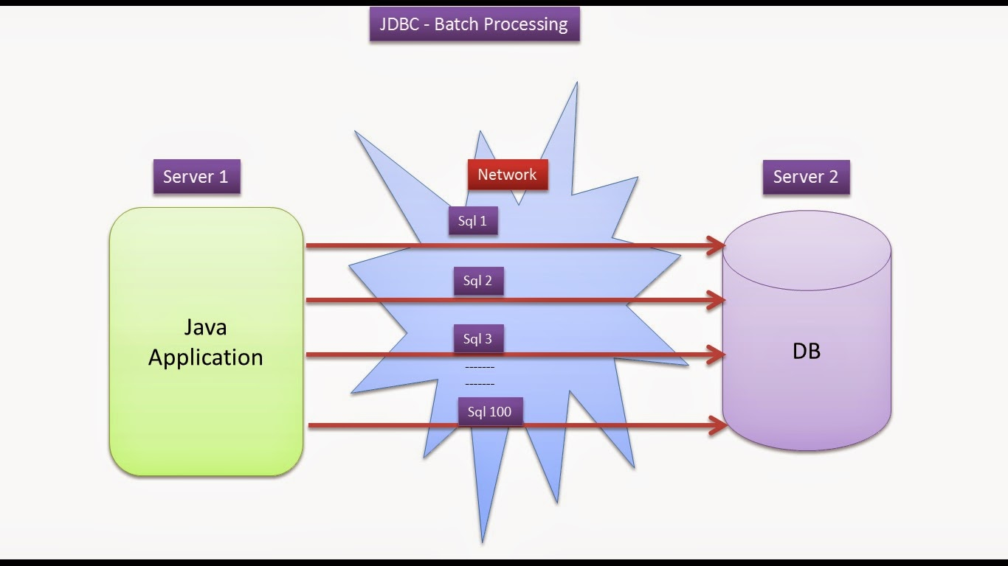
Batch Processing in Jdbc
Instead of executing a single query, we can execute a batch (group) of queries using batch processing. It makes the performance fast.
The java.sql.Statement and java.sql.PreparedStatement interfaces provide methods for batch processing.

Slide 78
Why need of Batch Processing ?
In a Jdbc program if multiple sql operations are there, then each operation is individually transferred to the database.
This approach will increase the number of round trips between java program (application) and database.
If the number of round trips is increased between an application and database, then it will reduce the performance of an application.
To overcome these problems we use Batch Processing.
Advantage:
Increase the performance of an application.

Slide 79
Methods of Batch Processing
These methods are given by Statement Interface.
Method | Description
void addBatch(String query) | It adds query into batch.
int[] executeBatch() | It executes the batch of queries.
In Batch Processing only non-select operations are allowed select operation is not allowed.
If any operation failed in batch processing then java.sql.BatchUpdate Exception will be thrown.
When we want to cancel all the operation of the batch when one operation failed then apply batch processing with transaction management.

Slide 80
Batch Processing - Example
//create batch
stmt.addBatch("insert into student values(901,'PQR',788)");
stmt.addBatch("update emp_info set esal=8888 where eno=1012");
stmt.addBatch("delete from customer where custid=111");
//disabl auto-commit mode
con.setAutoCommit(false);
try {
int i[]=stmt.executeBatch();
con.commit();
System.out.println("batch is successfully executed"); }
catch (Exception e)
{
Try {
con.rollback();
System.out.println("batch is failed") }

Slide 81
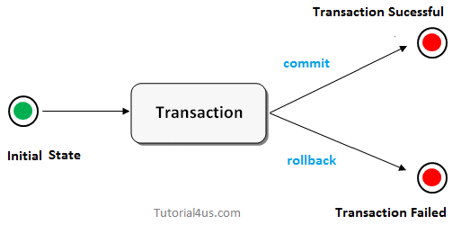
Transaction Management in JDBC
A transaction is a group of operation used to performed one task.
If all operations in the group are success then the task is finished and the transaction is successfully completed.
If any one operation in the group is failed then the task is failed and the transaction is failed.

Slide 82
Transaction - Example
Suppose a movie ticket booking at online is a transaction. This task contains four operation.
Verify the seats
Reserve the seats
Payment
Issue tickets
If all the above four operations are done successfully then a transaction is finished successfully.
In the middle, if any one operation is failed then all operation are canceled and finally a transaction is failed.

Slide 83
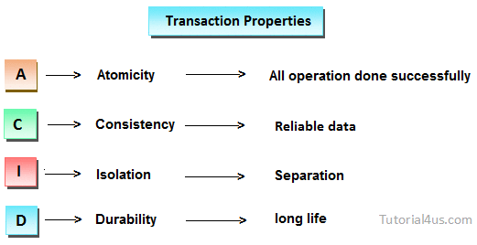
Properties of Transaction managements
Every transaction follows some transaction properties these are called ACID properties.

Slide 84
ACID
Atomicity: Atomicity of a transaction is nothing but in a transaction either all operations can be done or all operation can be undone, but some operations are done and some operation are undone should not occur.
Consistency: Consistency means, after a transaction completed with successful, the data in the datastore should be a reliable data this reliable data is also called as consistent data.
Isolation: Isolation means, if two transaction are going on same data then one transaction will not disturb another transaction.
Durability: Durability means, after a transaction is completed the data in the data store will be permanent until another transaction is going to be performed on that data.

Slide 85
Types of Transaction
Local Transaction
A local transaction means, all operation in a transaction are executed against one database. For example; If transfer money from first account to second account belongs to same bank then transaction is local transaction.
Global Transaction
A global transaction means, all operations in a transaction are executed against multiple database.
For Example; If transfer money from first account to second account belongs to different banks then the transaction is a global transaction.
Jdbc technology perform only local transactions.
For global transaction in java we need either EJB or spring framework.

Slide 86
Things required for transaction in Jdbc
Step 1: Disable auto commit mode of Jdbc
Step 2: Put all operation of a transaction in try block.
Step 3: If all operation are done successfully then commit in try block, otherwise rollback in catch block.
By default in Jdbc autocommit mode is enabled but we need to disable it.
To disable call setAutoCommit() method of connection Interface.
con.setAutoCommit(false);
To commit a transaction, call commit() and to rollback a transaction, call rollback() method of connection Interface respectively.
con.commit();
con.rollback();

Slide 87
Transaction Example
Statement stmt=con.createStatement();
con.setAutoCommit(false);
Try {
int i1=stmt.executeUpdate("insert into student values(110,‘Ravi',685)");
int i2=stmt.executeUpdate("update customer set custadd=‘Bangalore‘ where custid=111");
int i3=stmt.executeUpdate("delete from student where sid=101");
con.commit();
System.out.println("Transaction is success"); }//end of try
catch (Exception e) {
Try {
con.rollback();
System.out.println("Trasaction is failed"); }

Slide 88
Resultsetmetadata Interface in JDBC
The metadata means data about data, in case of database we get metadata of a table like total number of column, column name, column type etc.
While executing a select operation on a database if the table structure is already known for the programmer, then a programmer of JDBC can read the data from ResutlSet object directly. If the table structure is unknown then a JDBC programmer has to take the help of ResultSetMetadata.
A ResultSetMetaData reference stores the metadata of the data selected into a ResutlSet object.

Slide 89
Object & Methods of ResultSetMetaData
ResultSetMetaData rsmd=rs.getMetaData();
method | Discription
getColumnCount() | To find the number of columns in a ResultSet
getColumnName() | To find the column name of a column index.
getColumnTypeName() | To find data type of a column.
getColumnDisplaySize() | To find size of a column.

Slide 90
Example of ResultSetMetaData
Statement stmt=con.createStatement();
ResultSet rs=stmt.executeQuery("select * from student");
ResultSetMetaData rsmd=rs.getMetaData();
//find the no of columns
int count=rsmd.getColumnCount();
for(int i=1;i <=count;i++)
{
System.out.println("column no :"+i);
System.out.println("column name :"+rsmd.getColumnName(i));
System.out.println("column type :"+rsmd.getColumnTypeName(i));
System.out.println("column size :"+rsmd.getColumnDisplaySize(i));
System.out.println("-----------");
}

Slide 91
DatabaseMetaData in JDBC
This metadata interface is used for reading metadata about a database.
Metadata about database is nothing but reading database server, version, driver name and its version, maximum number of columns allowed in a table etc.
To obtain a object of DatabaseMetaData, we need to call getMetaData() method of Connection object.
DatabaseMetaData dbms=con.getMetaData();

Slide 92
Methods of DatabaseMetaData
Method | Description
getDatabaseProductName() | To read database server name.
getDatabaseProductVersion() | To read database server version.
getDriverName() | To read driver software name.
getColumnInTable() | To find maximum number of columns allowed in the table..

Slide 93
Example of DatabaseMetaData
Statement stmt=con.createStatement();
DatabaseMetaData dbmd=con.getMetaData();
System.out.println("database server name:"+dbmd.getDatabaseProductName());
System.out.println("database server version:"+dbmd.getDatabaseProductVersion());
System.out.println("driver server version:"+dbmd.getDriverVersion());
System.out.println("driver server name:"+dbmd.getDriverName());
System.out.println("max columns:"+dbmd.getMaxColumnsInTable());
stmt.close();
con.close();

Slide 94
END

