Slide 1
Session 14
java.io Package

Slide 2
Review
An object of Date class represents current date and time.
An object of the Calendar class can retrieve information in the form of integers such as YEAR, MONTH and so on.
Random numbers can be generated by using an object of the Random class.
An object of Collection class groups multiple elements into a single unit.
A Collection Framework is a unified architecture for representing and manipulating collections.
Legacy classes and interfaces formed the collection framework in the earlier versions of Java.
A Map is an object that stores data in the form of relationships between keys and values.

Slide 3
Objectives
Discuss I/O
Explain the concept of streams
Explain the standard input/output streams
Explain the classes InputStream and OutputStream
Describe the Byte array I/O
Discuss Filtered and Buffered I/O operations
Discuss the class RandomAccessFile
Describe Reader and Writer classes

Slide 4
File I/O 3-1
File class
Specifies the properties of the File
Works with file system
Does not specify how to retrieve or store information in the File
Common File and directory operations are performed using the access methods

Slide 5
File I/O 3-2
File class
File access methods help in creating, deleting and renaming files as well as checking the read/write access permission.
Directory access methods also help in creating, deleting, renaming and listing of directories.

Slide 6
File I/O 3-3
Constructor | Description
File(String dirpath) | Creates a File object with pathname of the file specified in dirpath
File(String dirpath, String filename) | Creates a File object with pathname of the file specified in dirpath and filename specified in filename
File(File fileObj, String filename) | Creates a File object with another File object specified in fileObj and filename specified in filename
File(URL urlObj) | Creates a File object by converting the given file:URL into an abstract pathname
void details() {
File filename = new File("/Text");
System.out.println("Name of the File: " + filename.getName());
System.out.println("Path of the File: " + filename.getPath());
System.out.println("File Last Modified: " + filename.lastModified());
System.out.println("Parent Directory: " + filename.getParent());
System.out.println("Size of the File: " + filename.length() + " Bytes");
}
}
The path, name, when the file was last modified and its length in bytes is displayed
Demonstration: Example 1

Slide 7
InputStream Hierarchy
InputStream
FileInput Stream
FilterInput Stream
ByteArrayInput Stream
PipedInput Stream
SequenceInput Stream
StringInput Stream
DataInput Stream
BufferInput Stream
LinedNumberInput Stream
Pushback
Input Stream

Slide 8
OutputStream Hierarchy
OutputStream
FileOutput Stream
PipedOutput Stream
FilterOutput Stream
ByteArrayOutput Stream
DataOutput Stream
BufferedOutput Stream
Print Stream

Slide 9
What is I/O
Communication between the Computer and Outside World.

Slide 10

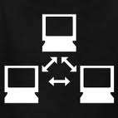
What’s in the Outside World?
Human users
Hardware devices
Monitors, keyboards, disk drives …
Other computers and programs

Slide 11
What are the Different Types of I/O?
Console I/O
Keyboard I/O
File I/O
Network I/O
…and possibly more

Slide 12

How Does Java Support I/O?
The Java I/O API
– The java.io package
– Since JDK 1.0
– Extensible

Slide 13

Stream

Slide 14
Streams
Java performs I/O through Streams.
A Stream is linked to a physical layer by java I/O system to make input and output operation in java.
In general, a stream means continuous flow of data.
Streams are clean way to deal with input/output without having every part of your code understand the physical.

Slide 15
Streams
A channel for sending information in first-in, first-out manner.
InputStream
F
E
D
C
B
A
OutputStream
Stream of data flowing to a destination
Stream of data flowing from a source

Slide 16

Two Kinds of Steams
InPutStream − The InputStream is used to read data from a source.
OutPutStream − The OutputStream is used for writing data to a destination.

Slide 17
Streams…
In java, 3 streams are created for us automatically. All these streams are attached with console.
System.out: standard output stream
System.in: standard input stream
System.err: standard error stream

Slide 18
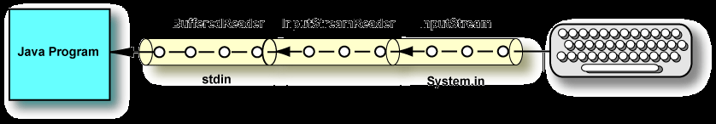
Processing Streams
A processing stream operates on the data supplied by another stream.
It acts as a buffer for the data coming from another stream.
A buffer is a block of main memory used as a work area.
For example, disks usually deliver data in blocks of 512 bytes, no matter how few bytes a program has asked for.
Blocks of data are buffered and delivered from the buffer to the program in the amount the program asked for.

Slide 19
Types of Streams
Java defines two types of streams.
Byte Stream :
It provides a convenient means for handling input and output of byte.
Character Stream :
It provides a convenient means for handling input and output of characters.
Character stream uses Unicode and therefore can be internationalized.

Slide 20
ByteStream
Basic unit for this type of stream is a byte.
Java byte streams are used to perform input and output of 8-bit bytes.
Extends InputStream and OutputStream class.
There are classes to convert byte streams into character streams.

Slide 21
Character Streams
Basic unit for this type of stream is Unicode character.
Preferred way of handling strings and text.
Extend from Reader and Writer classes in the java.io package.
It creates a BufferedReader and BufferedWriter by passing normal Reader / Writer subclass into the constructors.

Slide 22
When to use Character Stream over Byte Stream?
In Java, characters are stored using Unicode conventions.
Character stream is useful when we want to process text files.
These text files can be processed character by character.
A character size is typically 16 bits.

Slide 23
When to use Byte Stream over Character Stream?
Byte oriented reads byte by byte.
A byte stream is suitable for processing raw data like binary files.

Slide 24
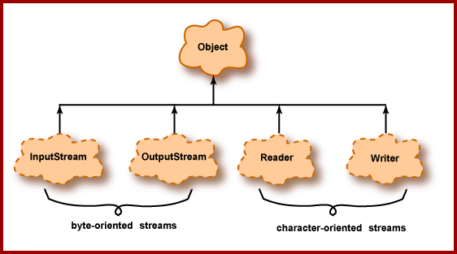
I/O Class Hierarchy
The diagram shows the top of the hierarchy for the java.io package.
The dotted clouds are abstract classes.
They act as base classes for specialized streams

Slide 25
Character Streams
Handle character oriented input / output operation.
Reader and Writer class are at the top of the class hierarchy.
They are abstract classes.
Support reading and writing of Unicode character streams.

Slide 26
The Character Stream Classes
Character streams are defined by using two class hierarchies topped by these two abstract classesReader and Writer.
Reader is used for input, and Writer is used for output.
Concrete classes derived from Reader and Writer operate on Unicode character streams.
From Reader and Writer are derived several concrete subclasses that handle various I/O situations.
In general, the character-based classes parallel the byte-based classes.

Slide 27
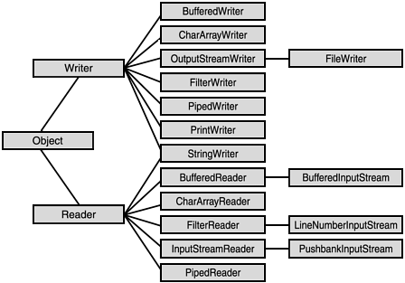
Hierarchy of Character Streams

Slide 28
Reader & Writer Classes
Class | Description
FileReader | Character-oriented counterpart to FileInputStream.
FileWriter | Character-oriented counterpart to FileOutputStream.
InputStreamReader | Converts InputStream objects to Readers.
OutputStreamWriter | Converts OutputStream objects to Writers.
BufferedReader | Reader that uses a buffer for efficiency.
CharArrayReader | Reads an array of characters as a Reader object.
StringReader | Reads a String as a Reader object.
PipedReader | Used for communicating between threads.
BufferedWriter | Writer that uses a buffer for efficiency.
CharArrayWriter | Outputs to a char[].
StringWriter | Writes to a StringBuffer as a Writer object.
PipedWriter | Other half of thread communications.
PrintWriter | Character equivalent to PrintStream.

Slide 29
Reader Methods
Method | Description
abstract void close() | Closes the stream
void mark(int readAheadLimit) | Marks the present position in the stream
boolean markSupported() | Tells whether this stream supports the mark() operation
int read() | Reads a single character
int read(char[] cbuf) | Reads characters into an array
abstract int read(char[] cbuf, int off, int len) | Reads characters into a portion of an array
boolean ready() | Tells whether this stream is ready to be read
void reset() | Resets the stream
long skip(long n) | Skips characters

Slide 30
Writer Methods
Method | Description
abstract void close() | Closes the stream, flushing it first
abstract void flush() | Flushes the stream
void write(char[] cbuf) | Writes an array of characters
abstract void write(char[] cbuf, int off, int len) | Writes a portion of an array of characters
void write(int c) | Writes a single character
void write(String str) | Writes a string
void write(String str, int off, int len) | Writes a portion of a string

Slide 31
Reader Class
Reader Class
Subclasses override the methods defined in this class to increase efficiency
Subclasses implement read(char[], int, int) and close() methods
Abstract class for reading character streams

Slide 32
Writer Class
Writer Class
Subclasses override the methods defined in this class to increase efficiency
Subclasses implement write(char[],int,int), flush() and close() methods
Abstract class for writing character streams

Slide 33
File Writer
Java FileWriter and FileReader classes are used to write and read data from text files (they are Character Stream classes).
This class inherits from the OutputStream class.
The constructors of this class assume that the default character encoding and the default byte-buffer size are acceptable.
To specify these values yourself, construct an OutputStreamWriter on a FileOutputStream.
FileWriter is meant for writing streams of characters. For writing streams of raw bytes, consider using a FileOutputStream.
FilterWriter(Writer out) It creates InputStream class Object

Slide 34
FileReader
FileReader is useful to read data in the form of characters from a ‘text’ file.
This class inherit from the InputStreamReader Class.
The constructors of this class assume that the default character encoding and the default byte-buffer size are appropriate.
To specify these values yourself, construct an InputStreamReader on a FileInputStream.
FileReader is meant for reading streams of characters.

Slide 35
Buffered Writer
Bufferreader class writes text to character-output stream, buffering characters.
Thus, providing efficient writing of single array, character and strings.
A buffer size needs to be specified, if not it takes Default value.
An output is immediately set to the underlying character or byte stream by the Writer.

Slide 36
Constructors- Buffered Writer
BufferedWriter(Writer out)
Creates a buffered character-output stream that uses a default-sized output buffer.
BufferedWriter(Writer out, int size)
Creates a new buffered character-output stream that uses an output buffer of the given size.

Slide 37
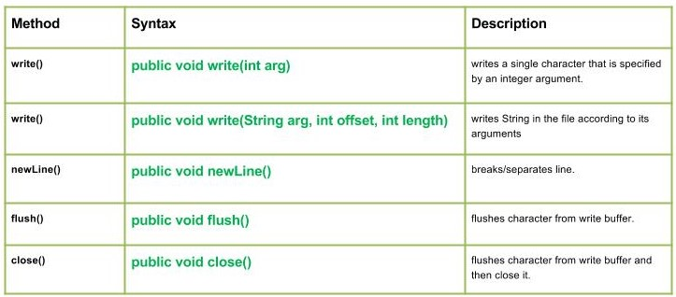
BufferedWriter class methods

Slide 38
Buffered Reader
Reads text from a character-input stream, buffering characters so as to provide for the efficient reading of characters, arrays, and lines.
The buffer size may be specified, or the default size may be used. The default is large enough for most purposes.
In general, each read request made of a Reader causes a corresponding read request to be made of the underlying character or byte stream.
It is therefore advisable to wrap a BufferedReader around any Reader whose read() operations may be costly, such as FileReaders and InputStreamReaders.

Slide 39
Constructors- Buffered Reader
BufferedReader(Reader in)
Creates a buffering character-input stream that uses a default-sized input buffer.
BufferedReader(Reader in, int sz)
Creates a buffering character-input stream that uses an input buffer of the specified size.

Slide 40
BufferReader Methods()
Modifier and Type | Method and Description
void | close() – Closes the stream and releases any system resources associated with it.
Stream<String> | lines() – Returns a Stream, the elements of which are lines read from this BufferedReader.
void | mark(int readAheadLimit) – Marks the present position in the stream.
boolean | markSupported() – Tells whether this stream supports the mark() operation, which it does.
int | read() – Reads a single character.
int | read(char[] cbuf, int off, int len) – Reads characters into a portion of an array.
String | readLine() – Reads a line of text.
boolean | ready() – Tells whether this stream is ready to be read.
void | reset() – Resets the stream to the most recent mark.
long | skip(long n) – Skips characters.

Slide 41
PushBack Reader
It is a character-stream reader class.
It allows characters to be pushed back into the Stream.
This is a Wrapper Class.
It is intended to be used when you parse data from a Reader.
Sometimes you need to read ahead a few characters to see what is coming, before you can determine how to interpret the current character.
It actually allows you to push back the read characters into the Reader.
These characters will then be read again the next time you call read().

Slide 42
PushBackReader Methods
Method | Description
int read() | It is used to read a single character.
Void.mark(int readAheadLimit) | It is used to mark the present position in a stream.
boolean ready() | It is used to tell whether the stream is ready to be read.
boolean markSupported() | It is used to tell whether the stream supports mark() operation.
long skip(long n) | It is used to skip the character.
void unread (int c) | It is used to pushes back the character by copying it to the pushback buffer.
void unread (char[] cbuf) | It is used to pushes back an array of character by copying it to the pushback buffer.
void reset() | It is used to reset the stream.
void close() | It is used to close the stream.

Slide 43
PrintWriter Class
Formatted representations of objects are printed to text output stream.
All the print methods of the PrintStream class are implemented by this class.
It supports printing of primitive data types, character array, strings and objects.
print() and println() methods are used to provide formatted output.

Slide 44
CharArrayReader
This class needs character array as an input source.
Constructor | Description
CharArrayReader(char [] arr) | Creates a CharArrayReader from the specified array of chars
CharArrayReader(char [] arr, int start, int num) | Creates a CharArrayReader from the specified array of chars starting from index start and is num characters long

Slide 45
CharArrayWriter
This class implements a character buffer that can be used as a Writer.
Data can be retrieved using toCharArray() and toString() methods.
Constructor | Description
CharArrayWriter() | Creates a CharArrayWriter with a default buffer size
CharArrayWriter(int num) | Creates a CharArrayWriter with a buffer having its size specified by num

Slide 46
ByteStream
Basic unit for this type of stream is a byte.
Java byte streams are used to perform input and output of 8-bit bytes.
Extends InputStream and OutputStream class.
There are classes to convert byte streams into character streams.

Slide 47
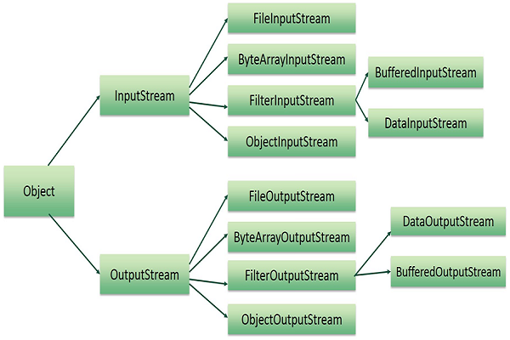
ByteStream Hierarchy

Slide 48
InputStream
InputStream is an abstract class from which all byte-oriented input streams are derived.
Its descendant classes are used for general-purpose input (non-character input).
These streams deliver data to a program in groups of 8-bit bytes.
The bytes can be grouped into the size necessary for the type of data.
Eg: if a disk file contains 32-bit int data, data can be delivered to the program in 4-byte groups in the same format as Java primitive type int.

Slide 49
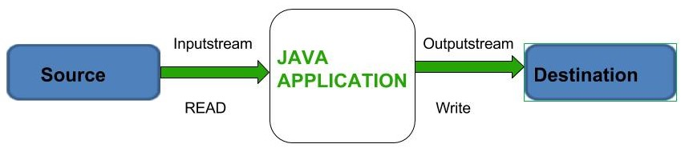
InputStream
Defines methods for reading bytes or array of bytes, marking locations in the stream, skipping bytes of input, finding out number of bytes available for reading and many more.
Opened automatically when created.
We will be mostly concerned with DataInputStream and FileInputStream.

Slide 50
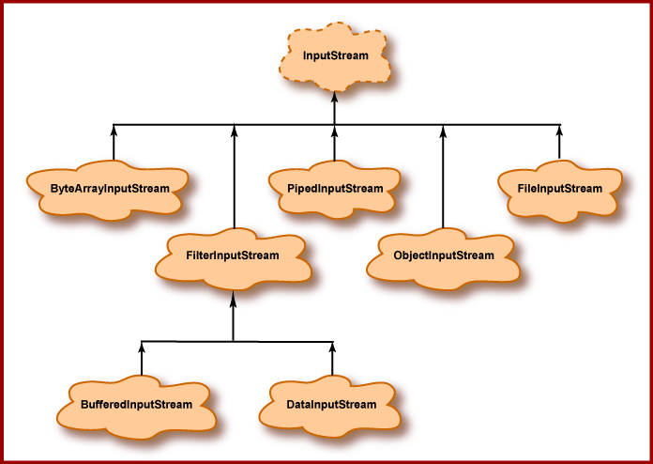
Input stream Hierarchy

Slide 51
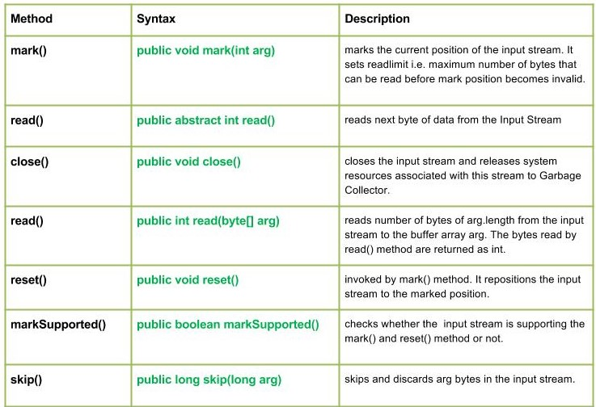
Input Stream Methods

Slide 52
FileInputStream
Reads input from a file in the form of a stream.
All methods of InputStream class are overridden except mark() and reset().
void show(final String file) throws IOException {
int size;
InputStream fileobject = new FileInputStream(file);
System.out.println("Bytes available to read: "
+ (size = fileobject.available()));
char[] text = new char[200];
for (int count = 0; count < size; count++) {
text[count] = ((char) fileobject.read());
System.out.print(text[count]);
}
System.out.println("");
fileobject.close();
}
Creates a FileInputStream object
Constructor | Description
FileInputStream(String filename) | Creates an input stream that reads bytes from a file in the form of a stream. filename is the full pathname of the file
FileInputStream(File name) | Creates an input stream that can be used to read bytes from a file where name is a File object
Finds out the size of the file by using the available() method
Reads each character one at a time using the read() method and stores it in a character array and displays it
Demonstration: Example 2

Slide 53
ByteArrayInputStream
Creates an InputStream using an array of bytes.
Internal pointer keeps track of the next byte to be read.
Overrides methods of the base class.
void prints() {
String text = "Jack and Jill went up the hill";
byte[] data = text.getBytes();
ByteArrayInputStream bais = new ByteArrayInputStream(data, 0, 4);
int word;
while ((word = bais.read()) != -1) {
System.out.print((char) word);
}
System.out.println();
bais.reset(); //using reset ( ) method and again reading
word = 0;
while ((word = bais.read()) != -1) {
System.out.print((char) word);
}
}
Converts the string into a bytearray by using the getBytes() method
Constructor | Description
ByteArrayInputStream(byte[] b) | Creates a byte array input stream with b as the input source
ByteArrayInputStream(byte[] b, int start, int num) | Creates a byte array input stream, b, that begins with the character at the index specified by start and is num bytes long
Creates a ByteArrayInputStream starting from 0 position of the byte array and is 4 bytes long
Reads each byte and prints it after casting it into character type
Uses reset() method to move the pointer to the beginning of the file and reads it again from the begining
Demonstration: Example 3

Slide 54
OutputStream
It is an abstract class.
Defines methods for writing bytes or array of bytes to the stream.
An OutputStream is automatically opened when it is created.

Slide 55
FileOutputStream
It is used to write output to a file stream.
Constructor | Description
FileOutputStream(String filename) | Creates an output stream that writes bytes to a file specified by filename
FileOutputStream(File name) | Creates an output stream that can be used to write bytes to a file specified by name, which is a File object
FileOutputStream(String filename, boolean flag) | Creates an output stream that writes bytes to a file specified by filename and if the flag is having a true value then the file is opened in append mode
FileOutputStream(File name, boolean flag) | Creates an output stream that can be used to write bytes to a file specified by name, which is a File object. If flag is true, file is opened in append mode.
void update() {
byte[] words = new byte[80];
try {
System.out.println("Enter a line to be saved into a file");
int bytes = System.in.read(words);
FileOutputStream fos = new FileOutputStream("Text");
fos.write(words, 0, bytes);
System.out.println("Updated!");
} catch (IOException obj) {
System.out.println("Error creating file!");
}
}
Returns the number of bytes read
Uses the write() method to write the data into the file
Throws an IOException if a read only file is opened
Demonstration: Example 4

Slide 56
DataOutputStream & Input Stream
A data output stream lets an application write primitive Java data types to an output stream in a portable way.
A data input stream enable an application read primitive Java data types from an underlying input stream in a machine-independent way(instead of raw bytes).

Slide 57
DataOutputStream Methods()
Method | Description
int size() | It is used to return the number of bytes written to the data output stream.
void write(int b) | It is used to write the specified byte to the underlying output stream.
void write(byte[] b, int off, int len) | It is used to write len bytes of data to the output stream.
void writeBoolean(boolean v) | It is used to write Boolean to the output stream as a 1-byte value.
void writeChar(int v) | It is used to write char to the output stream as a 2-byte value.
void writeChars(String s) | It is used to write string to the output stream as a sequence of characters.
void writeByte(int v) | It is used to write a byte to the output stream as a 1-byte value.
void writeBytes(String s) | It is used to write string to the output stream as a sequence of bytes.
void writeInt(int v) | It is used to write an int to the output stream
void writeShort(int v) | It is used to write a short to the output stream.
void writeShort(int v) | It is used to write a short to the output stream.
void writeLong(long v) | It is used to write a long to the output stream.
void writeUTF(String str) | It is used to write a string to the output stream using UTF-8 encoding in portable manner.
void flush() | It is used to flushes the data output stream.

Slide 58
DataInputStream Methods()
Method | Description
int read(byte[] b) | It is used to read the number of bytes from the input stream.
int read(byte[] b, int off, int len) | It is used to read len bytes of data from the input stream.
int readInt() | It is used to read input bytes and return an int value.
byte readByte() | It is used to read and return the one input byte.
char readChar() | It is used to read two input bytes and returns a char value.
double readDouble() | It is used to read eight input bytes and returns a double value.
boolean readBoolean() | It is used to read one input byte and return true if byte is non zero, false if byte is zero.
int skipBytes(int x) | It is used to skip over x bytes of data from the input stream.
String readUTF() | It is used to read a string that has been encoded using the UTF-8 format.
void readFully(byte[] b) | It is used to read bytes from the input stream and store them into the buffer array.
void readFully(byte[] b, int off, int len) | It is used to read len bytes from the input stream.

Slide 59
ByteArrayOutputStream
ByteArrayOutputStream
Creates an output stream in which data is written to a byte array
ByteArrayOutputStream(int size)
Creates a new byte array output stream, with a buffer capacity specified in bytes
ByteArrayOutputStream()
Creates a new byte array output stream

Slide 60
Buffered I/O classes
Buffer means a temporary storage area.
The time taken to retrieve data is less when data is temporarily stored in a buffer.
These classes do not create a new stream but provide buffering functionality for existing stream.
Filters operate on buffers, which are located between the program and the destination of the buffered stream.

Slide 61
BufferedInputStream
Constructor | Description
BufferedInputStream(InputStream in) | Creates a buffered input stream for the specified input stream instance using a default buffer size
BufferedInputStream(InputStream in, int size) | Creates a buffered input stream of given size for the specified input stream instance
void print() throws IOException {
String text = "Jack & Jill, went up the hill";
System.out.println("Original String: " + text);
System.out.println("After replacing '&' with 'and': ");
byte[] buffer = text.getBytes();
ByteArrayInputStream arrayin = new ByteArrayInputStream(buffer);
BufferedInputStream bufferin = new BufferedInputStream(arrayin);
int character;
Creates a BufferedInputStream object
Demonstration: Example 6

Slide 62
BufferedOutputStream
Provides output buffering.
The flush() method ensures that the data is written to an actual physical output device.
Constructor | Description
BufferedOutputStream(OutputStream os) | Creates a buffered output stream for the specified output stream instance using a default buffer size
BufferedInputStream(OutputStream os, int size) | Creates a buffered output stream of given size for the specified output stream instance

Slide 63
PrintStream
It is a class that adds functionality with ability to print representations of various data values conveniently.
Unlike other output streams, a PrintStream never throws an IOException
The PrintStream class automatically flushes the data so there is no need to call flush() method.
All characters printed by a PrintStream are converted into bytes using the platform’s default character encoding.
The PrintWriter class should be used in situations that require writing characters rather than bytes.

Slide 64
PrintStream- Constructors()
PrintStream(File file): Creates a new print stream, without automatic line flushing, with the specified file.
PrintStream(File file, String csn) : Creates a new print stream, without automatic line flushing, with the specified file and charset.
PrintStream(OutputStream out) : Creates a new print stream.
PrintStream(OutputStream out, boolean autoFlush) : Creates a new print stream.
PrintStream(OutputStream out, boolean autoFlush, String encoding) : Creates a new print stream.
PrintStream(String fileName) : Creates a new print stream, without automatic line flushing, with the specified file name.
PrintStream(String fileName, String csn) :Creates a new print stream, without automatic line flushing, with the specified file name and charset.

Slide 65
PrintStream Methods()
Method | Description
void print(boolean b) | It prints the specified boolean value.
void print(char c) | It prints the specified char value.
void print(char[] c) | It prints the specified character array values.
void print(int i) | It prints the specified int value.
void print(long l) | It prints the specified long value.
void print(float f) | It prints the specified float value.
void print(double d) | It prints the specified double value.
void print(String s) | It prints the specified string value.
void print(Object obj) | It prints the specified object value.
void println(boolean b) | It prints the specified boolean value and terminates the line.
void println(char c) | It prints the specified char value and terminates the line.
void println(char[] c) | It prints the specified character array values and terminates the line.
void println(int i) | It prints the specified int value and terminates the line.
void println(long l) | It prints the specified long value and terminates the line.
void println(float f) | It prints the specified float value and terminates the line.
void println(double d) | It prints the specified double value and terminates the line.
void println(String s) | It prints the specified string value and terminates the line.
void println(Object obj) | It prints the specified object value and terminates the line.
void println() | It terminates the line only.
void printf(Object format, Object... args) | It writes the formatted string to the current stream.
void printf(Locale l, Object format, Object... args) | It writes the formatted string to the current stream.
void format(Object format, Object... args) | It writes the formatted string to the current stream using specified format.
void format(Locale l, Object format, Object... args) | It writes the formatted string to the current stream using specified format.

Slide 66
Object Serialization & Deserialization

Slide 67
So you want to save your data…
Common problem:
You’ve built a large, complex object
Spam/Normal statistics tables
Game state
Database of student records
Etc…
Want to store on disk and retrieve later
Or: want to send over network to another Java process
In general: want your objects to be persistent -- outlive the current Java process

Slide 68
Object Serialization
To read an entire object from or write an entire object to a file, Java provides object serialization.
A serialized object is represented as a sequence of bytes that includes the object’s data and its type information.
After a serialized object has been written into a file, it can be read from the file and deserialized to recreate the object in memory.

Slide 69
Serialization & Deserialization
It is a mechanism where an object can be represented as a sequence of bytes that includes the object's data as well as information about the object's type and the types of data stored in the object.
The serialized object can be written into a file.
It can be read from the file and deserialized that is, the type information and bytes that represent the object and its data can be used to recreate the object in memory.
The entire process is JVM independent, meaning an object can be serialized on one platform and deserialized on an entirely different platform.

Slide 70
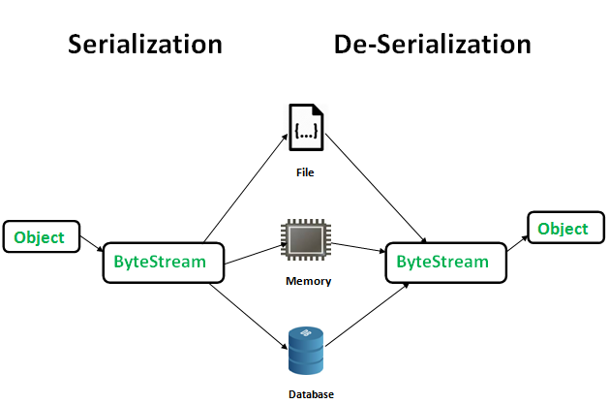
Serialization and Deserialization
Serialization is a mechanism of converting the state of an object into a byte stream.
Deserialization is the reverse process where the byte stream is used to recreate the actual Java object in memory.
This mechanism is used to persist the object.

Slide 71
Serialization - Advantages
Write to Disk
Store in Memory
Sent byte stream to other platform over network
Save byte stream in DB(As BLOB)

Slide 72
Serialization - Class
Classes ObjectOutputStream are high-level streams that contain the methods for serializing an object
public final void writeObject(Object x) throws IOException
.
The above method serializes an Object and sends it to the output stream.

Slide 73
Deserialization - Class
Classes ObjectInputStream are high-level streams that contain the methods for deserializing an object
public final Object readObject() throws IOException, ClassNotFoundException
This method retrieves the next Object out of the stream and deserializes it.
The return value is Object, so you will need to cast it to its appropriate data type.

Slide 74
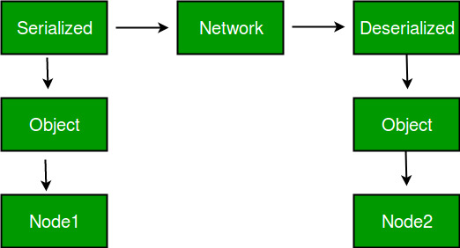
Advantages of Serialization
To save/persist state of an object.
To travel an object across a network.

Slide 75
Serialization -Terms
The class must implement the java.io.Serializable interface.
All of the fields in the class must be serializable.
If a field is not serializable, it must be marked transient.
If you define any data member as transient, it will not be serialized.
transient int age;

Slide 76
Transient Variable
The transient keyword in java is used on class attributes/variables to indicate that serialization process of such class should ignore such variables while creating a persistent byte stream for any instance of that class.
A transient variable is a variable that can not be serialized. According to Java Language Specification.
Variables may be marked transient to indicate that they are not part of the persistent state of an object.
class Employee implements Serializable
{
private String firstName;
private String lastName;
private transient long crediCardNumber;
}

Slide 77
java.io.Serializable interface
import java.io.Serializable;
public class Student implements Serializable{
int id;
String name;
public Student(int id, String name) {
this.id = id;
this.name = name;
}
}

Slide 78
ObjectOutputStream class
The ObjectOutputStream class is used to write primitive data types and Java objects to an OutputStream.
Only objects that support the java.io.Serializable interface can be written to streams.
Constructors
public ObjectOutputStream(OutputStream out) throws IOException {}

Slide 79
Methods
Method | Description
public final void writeObject(Object obj) throws IOException {} | writes the specified object to the ObjectOutputStream.
public void flush() throws IOException {} | flushes the current output stream.
public void close() throws IOException {} | closes the current output stream.

Slide 80
Example of Java Serialization
import java.io.*;
class Persist{
public static void main(String args[])throws Exception{
Student s1 =new Student(101,“Raj");
FileOutputStream fout=new FileOutputStream("f.txt");
ObjectOutputStream out=new ObjectOutputStream(fout);
out.writeObject(s1);
out.flush();
System.out.println("success");
}
}

Slide 81
ObjectInputStream class
An ObjectInputStream deserializes objects and primitive data written using an ObjectOutputStream.
Constructor
creates an ObjectInputStream that reads from the specified InputStream.

Slide 82
Methods
Method | Description
public final Object readObject() throws IOException, ClassNotFoundException{} | reads an object from the input stream.
public void close() throws IOException {} | closes ObjectInputStream.

Slide 83
Deserialisation Example
import java.io.*;
class Depersist{
public static void main(String args[])throws Exception{
ObjectInputStream in=new ObjectInputStream(new FileInputStream("f.txt"));
Student s=(Student)in.readObject();
System.out.println(s.id+" "+s.name);
in.close();
}
}

Slide 84
Summary
A File class is used to access the File system.
InputStream and OutputStream are abstract classes that define how data is received or written to streams.
ByteArrayInputStream creates an input stream from the memory buffer while ByteArrayOutputStream creates an output stream on a byte array.
A buffer is a temporary storage area for data. Java uses buffered input / output to temporarily cache data read from or written to a stream.
The RandomAccessFile class provides the capability to perform I/O to specific locations within a file.
Character streams provide a way to handle character oriented input/output operations.
Reader and Writer classes are abstract classes that support reading and writing of Unicode character streams.

