Slide 1
Problem Statement No.13 Fitness Buddy
CAPSTONE PROJECT
Presented By:
Name: Neetish B Patil
College Name: REVA University
Dept: Electronics And Communication Engineering

Slide 2
OUTLINE
Problem Statement
Proposed System/Solution
System Development Approach
Algorithm & Deployment
Result
Conclusion
Future Scope
References

Slide 3
Problem Statement
Fitness is crucial for a healthy lifestyle, but many individuals struggle to stay consistent due to lack of motivation, personalized guidance, and flexible support. Existing fitness platforms are often costly, rigid, or overwhelming. There is a need for an intelligent, easy-to-use virtual agent that can provide customized workouts, motivational support, and healthy meal suggestions—tailored to the user’s mood, fitness level, and goals, without requiring complex infrastructure.

Slide 4
Proposed Solution
The proposed system aims to address the challenge of helping individuals stay consistent with fitness and wellness through a context-aware, intelligent virtual agent. By leveraging IBM Agent AIand serverless logic tools, the Fitness Buddy system dynamically interacts with users to provide home workouts, motivational prompts, and healthy meal ideas.
Data Collection:
User inputs like mood, fitness goal, and workout preferences are collected through natural conversation with the agent.
These values are dynamically stored in context variables and passed to predefined tools through the Add Tool interface (not custom scripts or external APIs).
Data Preprocessing:
No advanced preprocessing is done — inputs are handled using Granity’s built-in context tracking and parameter passing features.
Variables like goal, level, or mood are used directly by tools to generate personalized responses.
Deployment:
The project is deployed entirely within IBM watsonx Agent Lab (Lite).
Tools are added through the “Add Tool” interface using code blocks (e.g., JSON or Python) directly inside the GranityUI.
No external frontend or backend (like GitHub Pages or Watson Assistant) is used — interactions are tested within the console itself.
Evaluation:
The agent was tested through example user inputs like: “I feel lazy today” → returns light workout suggestions. “Motivate me” → tool responds with inspirational messages. “Suggest a meal” → tool provides simple healthy recipes.
Responses were evaluated for clarity, personalization, and friendliness.
Result: Fitness Buddy successfully: Suggested workouts based on user input and fitness level.
Provided motivational tips and simple meal plans.
Worked reliably within IBM Cloud Lite, without requiring external APIs or backend hosting.

Slide 5
System Approach
The “System Approach” section outlines the strategy and technology used to build the Fitness Buddy AI agent, which helps users stay consistent with fitness through motivational support, habit building, and healthy meal suggestions.
System requirements
IBM Cloud Lite account (free tier)
Access to watsonx Agent Lab
Internet browser (for development and testing in the Agent Lab console)
Basic understanding of LangGraph-based agent logic (ReAct framework)
Library required to build the model
No external Python or JS libraries are required
All logic and reasoning handled inside IBM Granity using built-in tools
Tools are added using the “Add Tool” feature in Agent Lab
Tools are simple functions that return structured text (e.g., workout, meal, or motivation response)

Slide 6
Algorithm & Deployment
Watson Assistant uses dialog flows, intents, and slot-filling to deliver personalized motivational tips, daily habit reminders, and simple meal suggestions. JavaScript listens for specific chatbot responses to play corresponding music tracks (Workout, Relaxing, or Motivational) in real-time.
Algorithm Selection:
The Fitness Buddy agent uses goal-driven reasoning logic based on the LangGraph + ReAct framework within IBM watsonx Agent Lab. It does not rely on traditional ML or NLP models like Watson Assistant. Instead, the agent selects tools and actions based on the current context variables.
Data Input:
Inputs User inputs are collected during live interactions inside Agent Lab:
Goal: "weight loss", "flexibility", "muscle gain“, Meal/Workout Requests: "Suggest lunch", "Give me a workout"
Training Process:
The agent uses condition-based logic and flow control: Tools like recommend workout, suggest meal, and motivate user are triggered based on variable values.
For example: If mood = tired and goal = flexibility recommend workout returns yoga/stretching routine
Prediction Process:
The project is deployed entirely inside the watsonx Agent Lab (Granity) UI using IBM Cloud Lite.
Tools are created using the “Add Tool” option (no external APIs, no backend).
The agent runs in the Agent Lab console, allowing real-time testing and refinement.

Slide 7
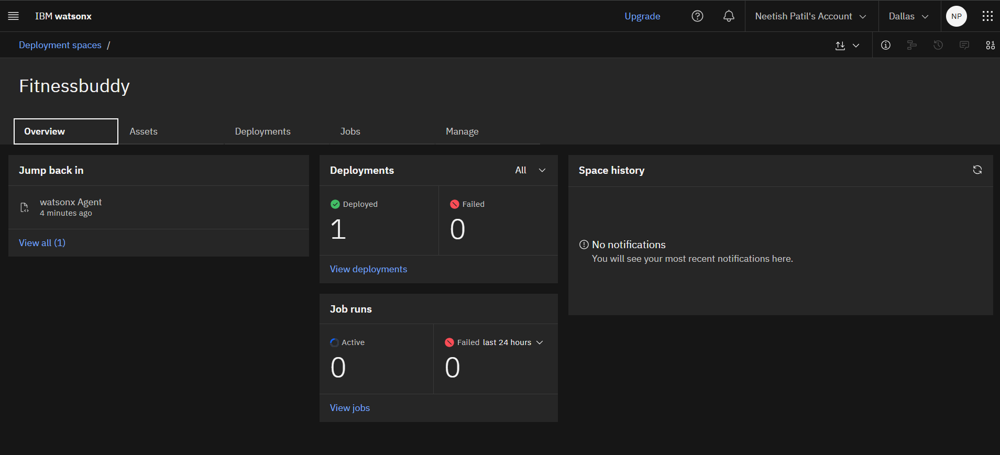
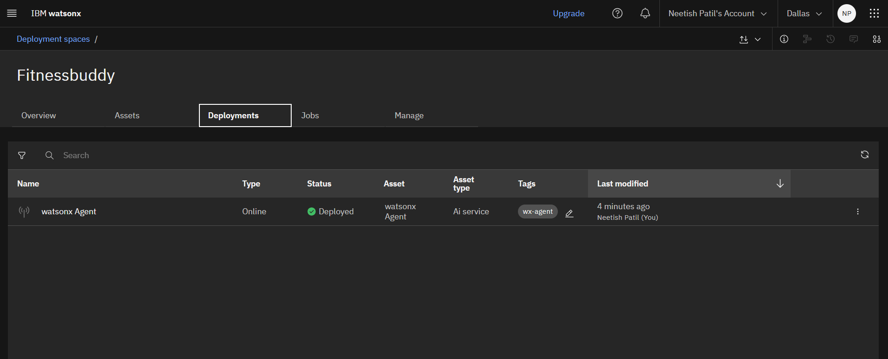
Deployment

Slide 8
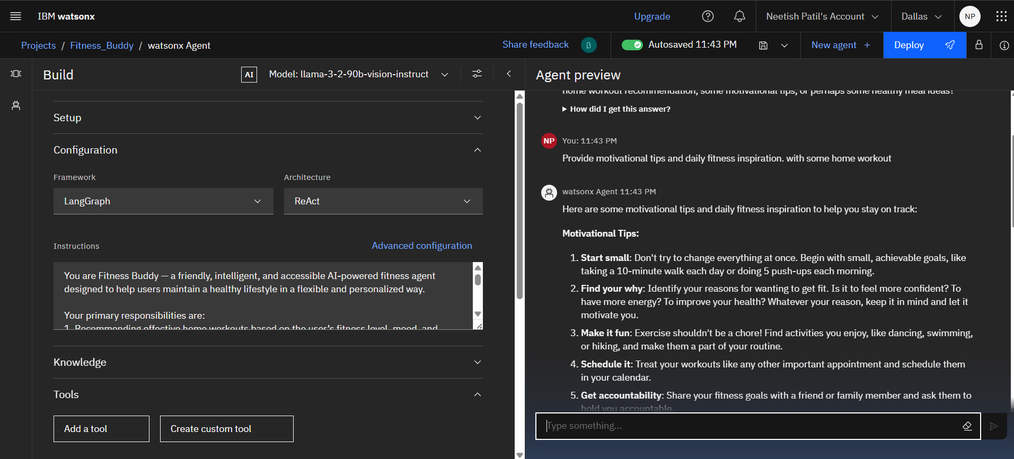
Result
The agent successfully delivered personalized workout suggestions, motivational tips, and simple meal ideas based on user inputs like mood and fitness goals using built-in tools in IBM watsonx Agent Lab.
All features functioned smoothly within the IBM Cloud Lite environment without requiring any external backend, proving the system’s effectiveness and simplicity.

Slide 9
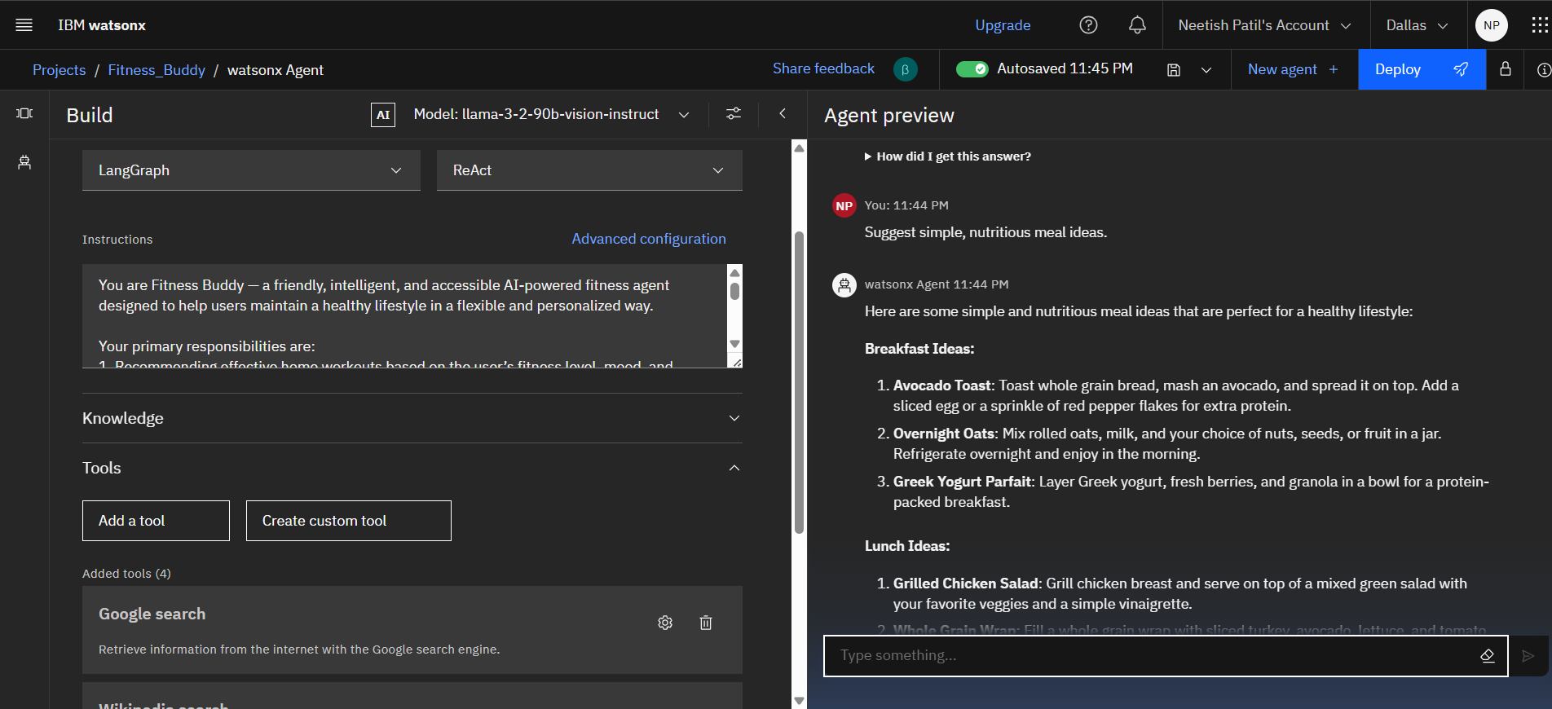
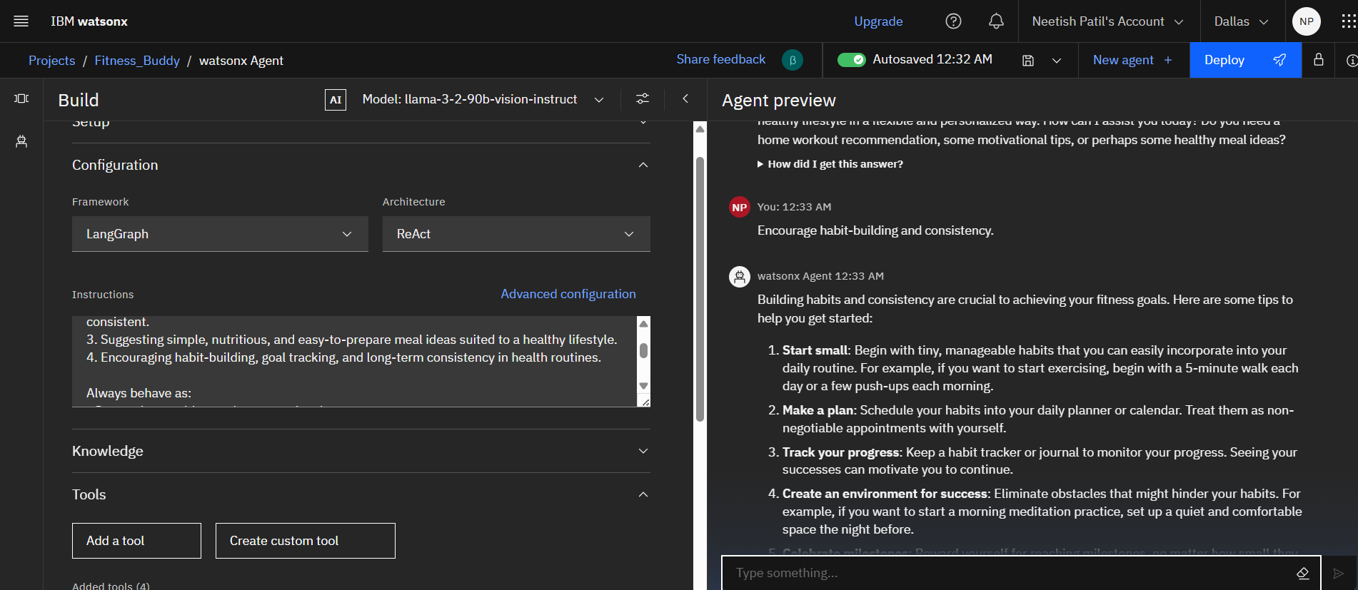
Result

Slide 10
Conclusion
The Fitness Buddy project demonstrates how an AI agent can effectively support users in maintaining a healthy lifestyle through personalized and context-aware suggestions.
Built entirely using IBM watsonx Agent Lab on the Lite plan, the system required no external backend or advanced machine learning models.
The agent provides dynamic workout routines, motivational prompts, and healthy meal suggestions based on user mood and fitness goals.
The project highlights the potential of agentic AI to deliver real-time, flexible, and goal-driven support without predefined dialog scripting.
This solution is scalable and can be enhanced further with progress tracking, user history, and integration with fitness APIs in the future.

Slide 11
Future scope
Progress Tracking: Integrate habit tracking features to monitor user workouts, meals, and consistency over time.
User Profile Memory: Enhance the agent with long-term memory to remember user preferences and goals across sessions.
Voice Interaction: Extend the interface with speech-to-text and text-to-speech for voice-enabled fitness assistance.
API Integration: Connect with external fitness platforms (like Google Fit or Apple Health) to fetch real-time activity data.
Multilingual Support: Enable the agent to interact in regional languages using IBM Watson Language Translator for wider accessibility.

Slide 12
References
IBM Cloud Documentation
IBM watsonx Agent Lab– Official documentation and console
IBM Cloud Functions
World Health Organization – Healthy Diet Guidelines
Fitness Blender – Home Workout and Nutrition Ideas
WHO Guidelines on Physical Activity and Diet.

Slide 13
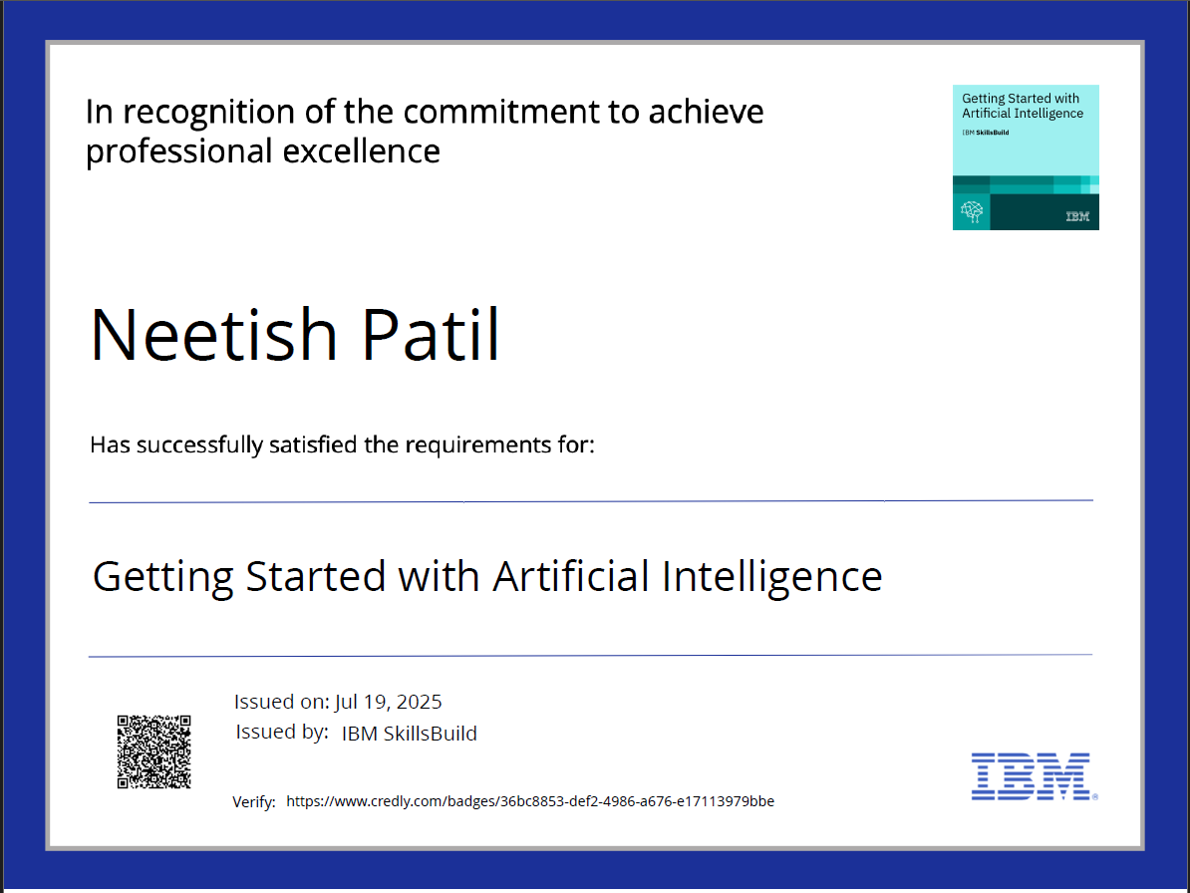
IBM Certifications

Slide 14
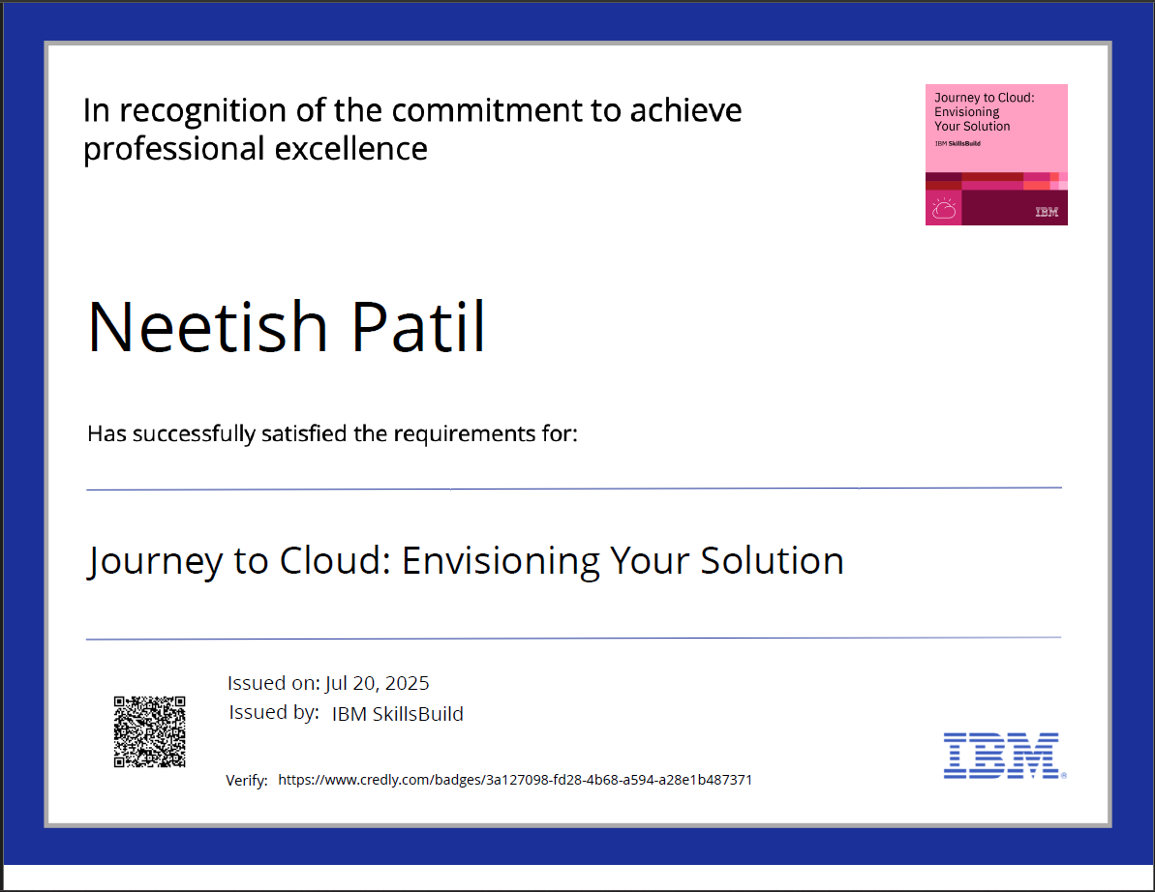
IBM Certifications

Slide 15
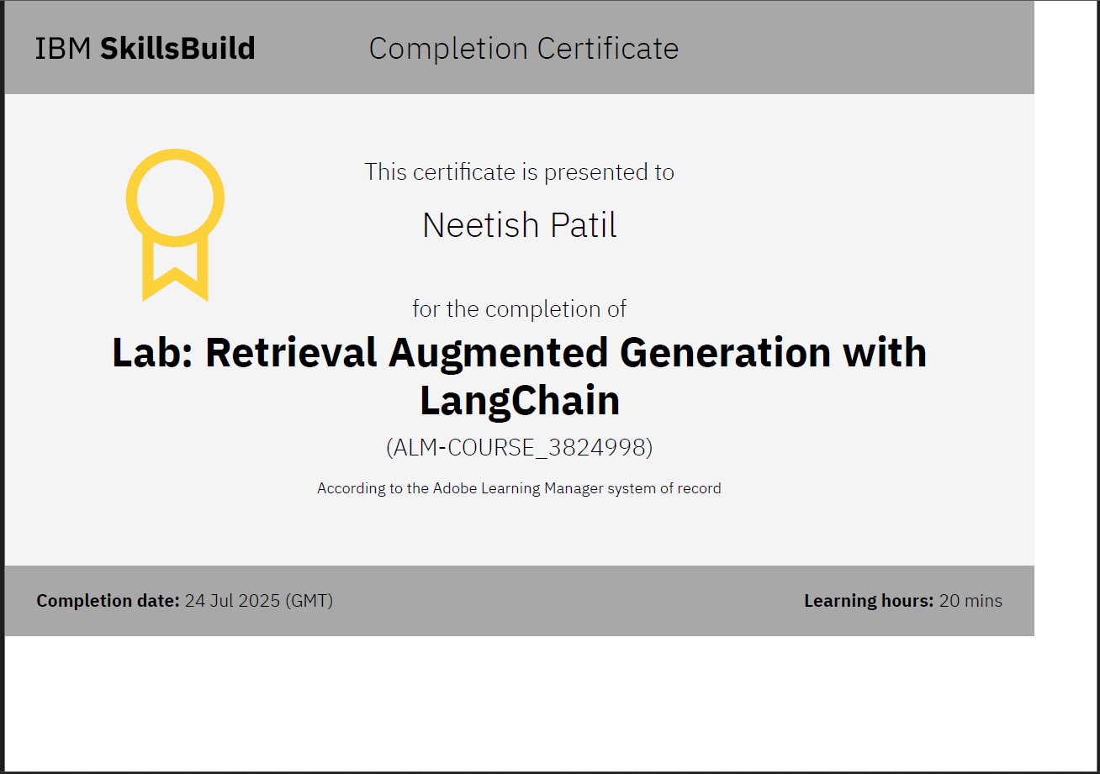
IBM Certifications

Slide 16
THANK YOU

