Slide 1
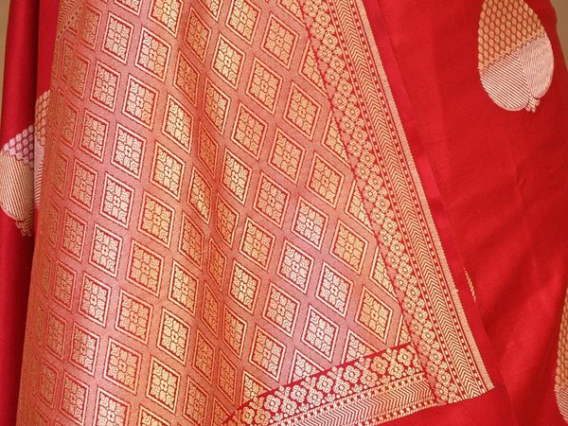


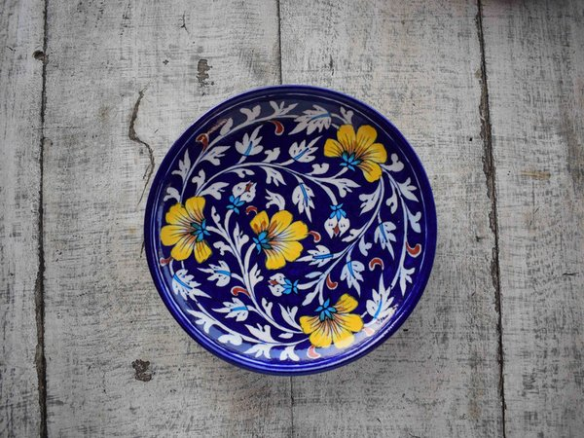

ArtisanHub
Artisan Marketplace & Business Management Platform
From WhatsApp chaos to one connected workspace for India's artisans
Web & Mobile Applications • Rural Innovation • Social Impact • Generative AI

Slide 2
01
Problem
ArtisanHub
Artisans across India run their business on WhatsApp, Instagram DMs and paper notebooks.
Operational pain
• Lost orders: custom requests, deadlines and payments scattered across chats
• No inventory visibility: overselling or idle stock
• Weak customer relationships: no history, no follow-up, no repeat business
Growth pain
• Low discoverability: word of mouth only; buyers can't find authentic handmade work
• No business insight: which products, seasons or customers actually earn?
• Result: low sales, unrecognised craft, no growth

Slide 3
02
Solution – one platform, two sides
ArtisanHub
Artisan back-office
• Digital storefront with story & process
• Products & inventory, low-stock alerts
• Order pipeline: Received → In Progress → Shipped → Delivered
• Custom-order quotations with reference images
• Per-order chat with customers
• Sales dashboard: revenue, top products, repeat buyers
• AI: photo → Hindi + English listing
Customer marketplace
• Discover by craft, material, region, price
• Verified artisan profiles – know who made it
• Order & track live
• Design it your way: upload a reference, get a quote, approve
• Chat directly with the maker
• Hindi / English descriptions
One order automatically updates chat, stock and analytics — no double entry.

Slide 4
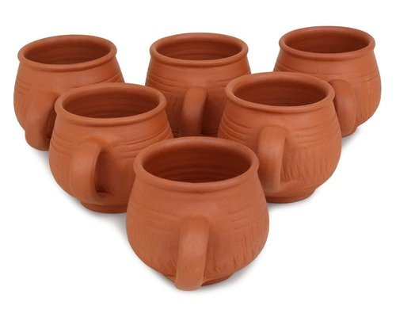
03
Hero feature – Design it your way
ArtisanHub
Discover
Request custom
Upload reference
Receive quote
Approve
Production
Delivery
• Customer describes size, colour, material, deadline and attaches a photo or sketch
• Artisan sees brief + reference, replies with price, timeline and notes — or declines
• Customer approves before any work starts; both chat inside the order
• Progress tracked step by step to delivery; revenue lands in the dashboard automatically
• Why it matters no marketplace today structures bespoke work — it all happens in WhatsApp and gets lost

Slide 5
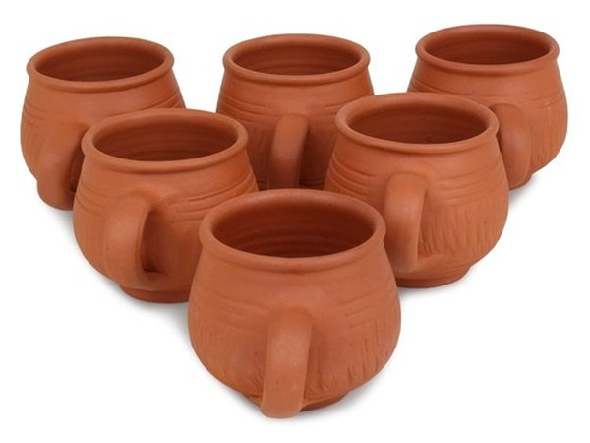
04
Generative AI – photo to listing in 5 seconds
ArtisanHub
Gemini output (real run)
• Name: Handcrafted Terracotta Clay Pot
• Category / Material: Pottery · Natural Clay
• English: Traditional terracotta pot handcrafted by skilled artisans using natural clay…
• हिंदी: यह पारंपरिक टेराकोटा बर्तन प्राकृतिक मिट्टी का उपयोग करके कुशल कारीगरों द्वारा हस्तनिर्मित है…
• Tags: terracotta, clay pot, handmade, pottery, home decor
• Suggested price: ₹450
Removes the biggest barrier for low-digital-literacy artisans: writing a listing. One photo → complete bilingual catalogue entry, editable before saving.

Slide 6
05
Technical implementation
ArtisanHub
Stack
• Frontend: React 18 + Vite + Tailwind CSS + React Router
• Backend / DB: Supabase – PostgreSQL, 5 tables, Row Level Security, signup trigger, atomic stock RPC
• Auth: Supabase Auth, role-based (artisan / customer)
• Storage: Supabase Storage – product, reference & profile images
• Realtime: Postgres change streams – quotes & messages appear live across devices
• AI: Gemini API with model fallback + retry
• Analytics: Recharts
• Deploy: Vercel + Supabase – zero cost
Architecture
• React SPA (Vercel)
• ↓ supabase-js
• Auth → profiles (role)
• PostgreSQL: artisans · products · orders · messages
• Storage: images bucket
• Realtime: postgres_changes → UI refresh
• ↓ fetch
• Gemini API: image → JSON listing
• Demo mode: same UI on localStorage when no keys

Slide 7
06
Impact, feasibility & scale
ArtisanHub
Economic
• Wider reach + repeat customers
• Fewer lost orders
• Better prices for custom work
Operational
• Bookkeeping automated
• Artisans create, not administrate
Social & Cultural
• Crafts visible beyond locality
• Skills become viable livelihoods
• Hindi-first, low-end phones
Scalable
• Any handmade sector
• Clusters, SHGs, ODOP, PM Vishwakarma
• Managed free-tier infra, no servers
• Phase 2: Razorpay payments · WhatsApp notifications · reviews · logistics · more regional languages · PWA offline
• Business model: free listing · small subscription for analytics & custom tools · low commission on sales

Slide 8
07
Live demo
ArtisanHub
3-minute flow
• Priya (customer) searches 'madhubani', opens artisan story
• Custom Order → picks Rahul → uploads sketch → sends
• Rahul (artisan) sees quote request → sends ₹ + days
• Priya approves — appears live, no refresh
• Rahul: In Progress → Shipped; chat inside order
• Rahul adds product: photo → AI listing (EN + HI) → save
• Dashboard: revenue, low stock, top products update
• Toggle हिंदी
What's in the box
• Working prototype on live Supabase backend
• 8 artisans · 6 states · 17 products · seeded orders
• rahul@artisan.com / priya@customer.com · demo123
• Source: /src · Schema: /supabase · Docs: /docs
Not another Etsy — the operating system for artisans who currently run everything on WhatsApp.

