Slide 1

Social Media vs Micro-Earnings
DATA211 - Final Project
Neetu Shrestha Pradhan

Slide 2
Research Questions
The Productivity Correlation: To what extent does daily social media consumption (measured in minutes) negatively correlate with daily micro-earning productivity?
Temporal Variance: Does the relationship between social media usage and earnings significantly differ between weekdays and weekends?
Comparative Severity: Is the negative impact of social media on earnings more severe on weekdays compared to weekends?
Statistical Overview: What is the overall statistical relationship between daily social media usage (minutes) and daily micro-earnings ($)

Slide 3
Data Variables
Date
Day Type (Weekday/Weekend)
Minutes (Social Media Time)
Earning ($ per day)

Slide 4

Methods Used
t-test (weekday vs weekend)
Pearson correlation
Linear regression
Descriptive statistics & graphs
This Photo by Unknown Author is licensed under CC BY-NC-ND

Slide 5
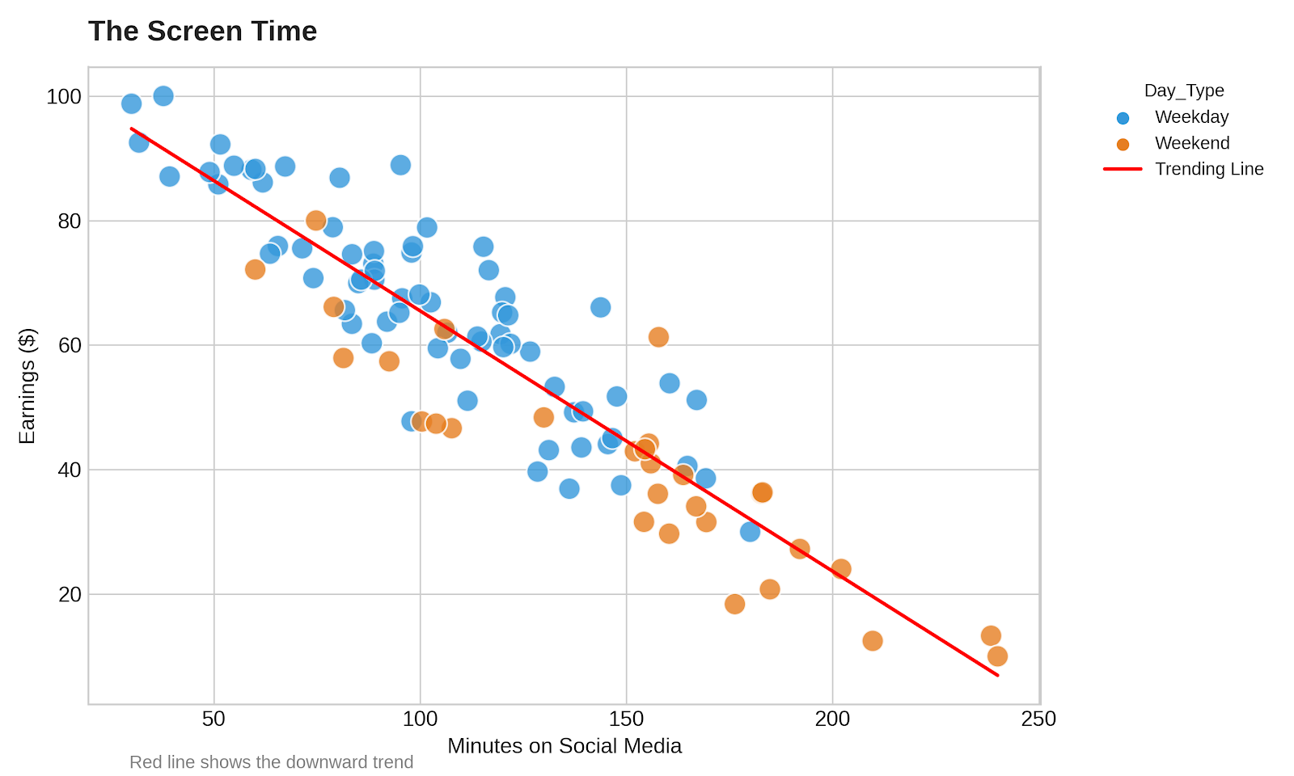
t-test Result
Weekday mean = 145.10 min
Weekend mean = 165.56 min
t = -0.7847, p = 0.4462
Result: Fail to reject H0

Slide 6
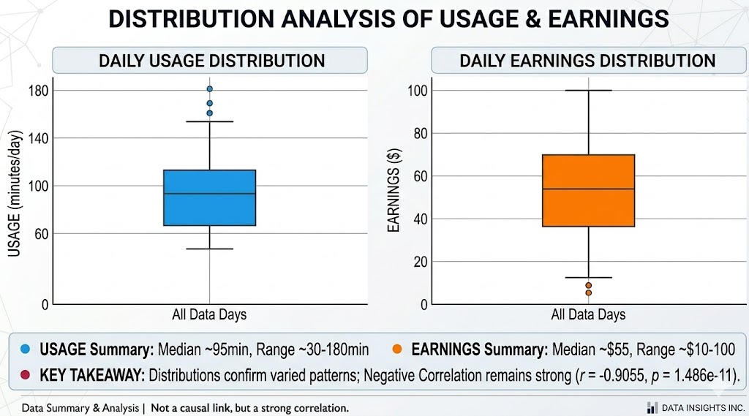
CORRELATION TEST
r = -0.9055
p = 1.486e-11
Strong negative relationship
More usage → lower earnings

Slide 7
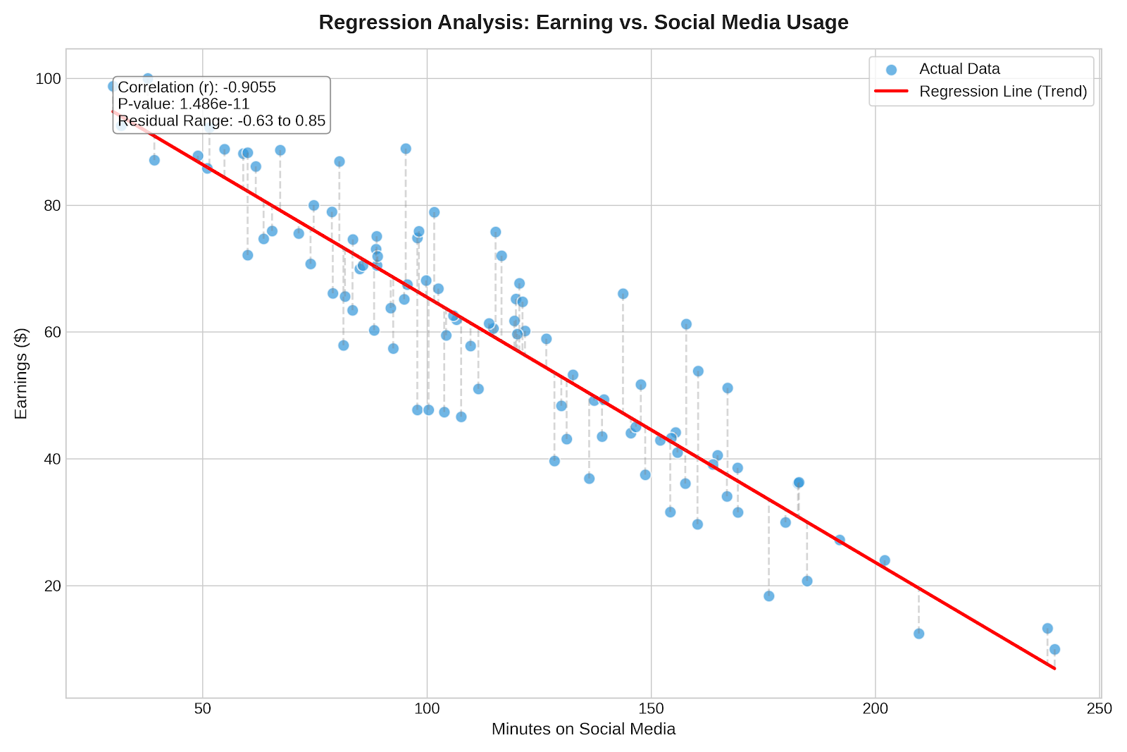
Regression Result
Earning = 4.9909 - 0.01598(SM_Minutes)
p = 1.49e-11
R² = 0.8199
Strong predictive model

Slide 8

Key Insight
No difference in usage by day type
But strong effect on earnings
Screen time reduces productivity.

Slide 9
Conclusion
Social media has a strong negative impact on earnings.
Focus should be on quality over quantity of usages.

