Slide 1

The C Programming Language

Slide 2
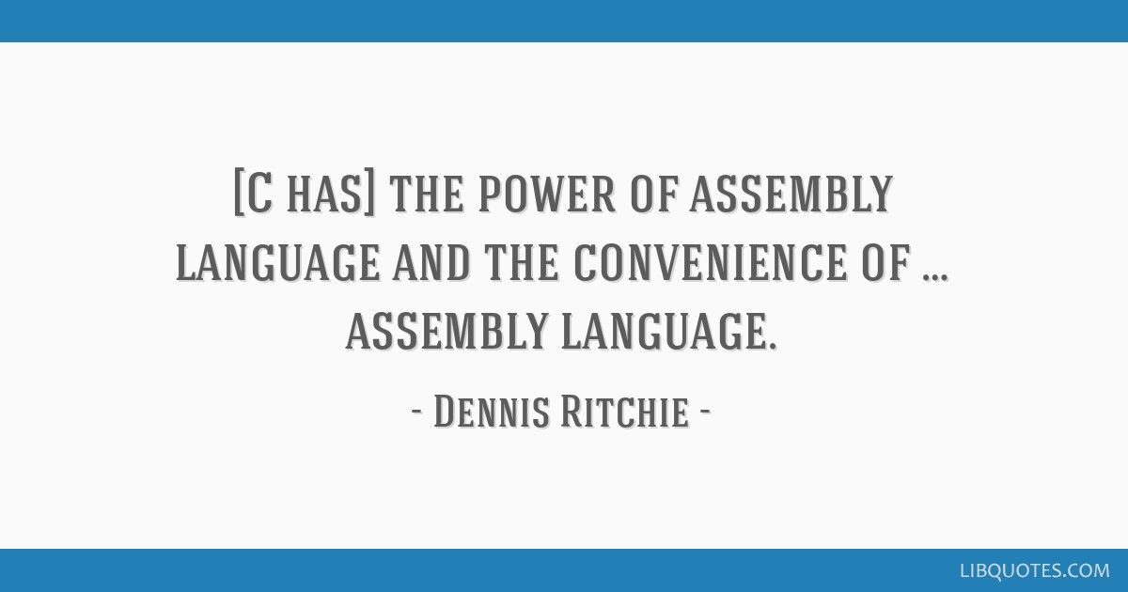
Contents
The structure of C Program
Compile and executing C program

Slide 3
C Language
C is a general-purpose programming language created by Dennis Ritchie at the AT & T Bell Laboratories in 1972
C is strongly associated with UNIX, as it was developed to write the UNIX operating system

Slide 4
C Language
Widely used today that easily extends to newer system architectures
Better efficiency / performance
Offers low-level access

Slide 5
C Chronology
1972 – C invented
1978 – The C Programming Language published; first specification of language
1989 – C89 standard (known as ANSI C or Standard C)
1990 – ANSI C adopted by ISO, known as C90
1999 – C99 standard
mostly backward-compatible
not completely implemented in many compilers
2007 – work on new C standard C1X announced

Slide 6
More on C
More recent derivatives: C++, Objective C, C#
Influenced: Java, Perl, Python (quite different)
C lacks:
Exceptions
range-checking
garbage collection
object-oriented programming
Polymorphism
…
Low-level language faster code (usually)

Slide 7
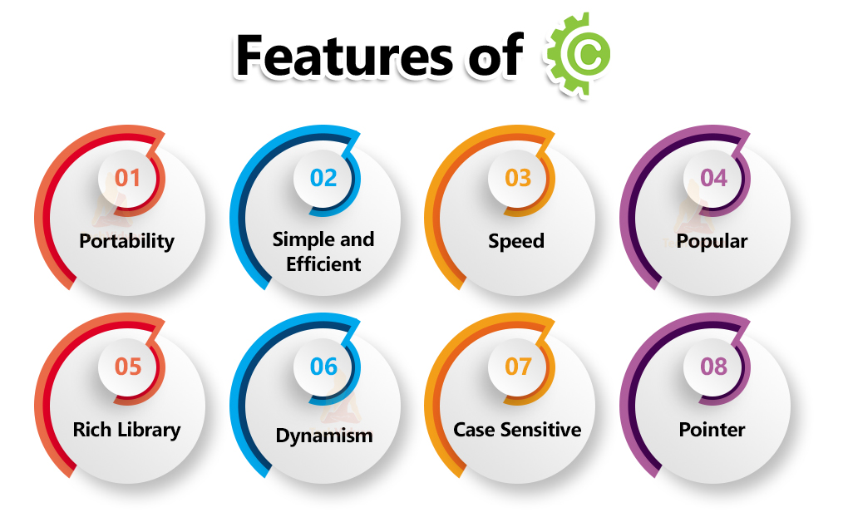
C Language

Slide 8
Before Writing a Program
Requires
A text editor, like Notepad, to write C code
A compiler, like GCC, to translate the C code into a language that the computer will understand
An IDE (Integrated Development Environment) is used to edit AND compile the code.
Popular IDE's include Code::Blocks, Eclipse, and Visual Studio. These are all free, and they can be used to both edit and debug C code.

Slide 9
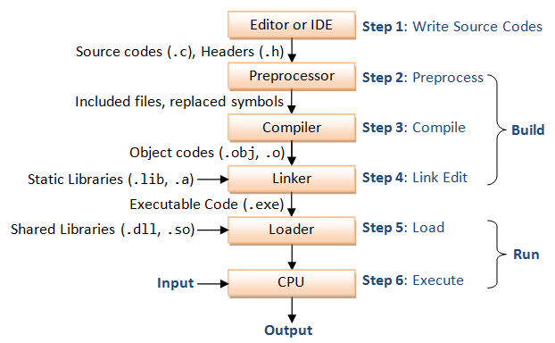

Slide 10
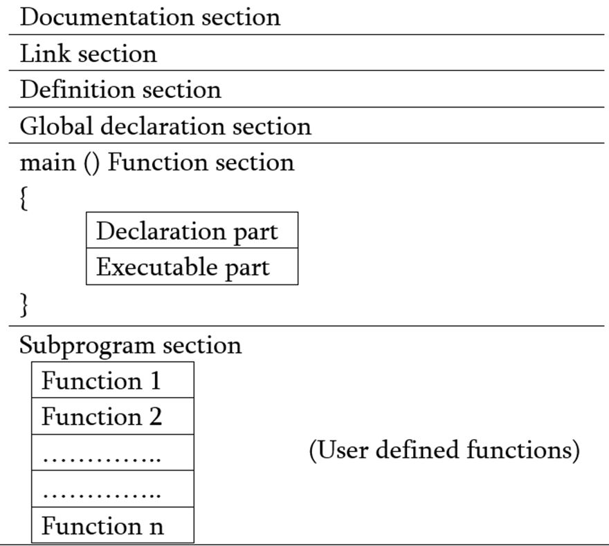
Structure of C Program

Slide 11
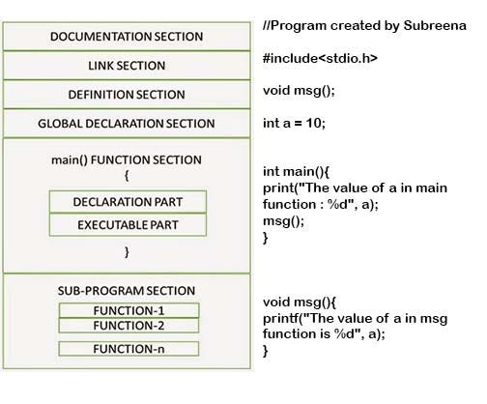

Slide 12
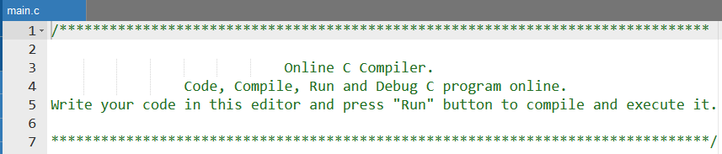
Documentation Section
The documentation section consists of a set of comment lines giving the name of the program, the author and other details, which the programmer would like to use later
/*description, name of the program, programmer name, date, time etc. */

Slide 13
Link Section – Preprocessor Directives
It consist of preprocessor directives which link the compiler to the standard library functions.
We include different predefined standard library functions in our C programs that are available in standard header files.
# include<stdio.h>
# include<math.h>

Slide 14
Header Files
Include Syntax
Include Operation
Search Path
Once-Only Headers
Alternatives to Wrapper #ifndef
Computed Includes
Wrapper Headers
System Headers
https://gcc.gnu.org/onlinedocs/cpp/Header-Files.html

Slide 15
Include
Files are included using the preprocessing directive ‘#include’
#include <file> - It searches for a file named file in a standard list of system directories.
#include “file” - This variant is used for header files of your own program. It searches for a file named “file” first in the directory containing the current file, then in the quote directories and then the same directories used for <file>

Slide 16
Example
if you have a header file header.h
And a file as program.c
Compiler sees it as
char *test (void);
int x;
#include "header.h"
Int main (void)
{
puts (test ());
}
int x;
char *test (void);
Int main (void)
{
puts (test ());
}

Slide 17
Definition Section – Preprocessor Directives
For defining symbolic constants
# define PI 3.1415
# define DATE 31

Slide 18
Definition - Macros
// C program to illustrate macros
#include <stdio.h>
// Macro definition
#define AREA(l, b) (l * b)
// Driver Code
int main()
{
int l1 = 10, l2 = 5, area; // Given lengths l1 and l2
area = AREA(l1, l2); // Find the area using macros
printf("Area of rectangle" is: %d", area);
return 0;
}

Slide 19
Global Declarations
This section contains global variables, function declaration, and static variables. Variables and functions which are declared in this scope can be used anywhere in the program
int num = 18;

Slide 20
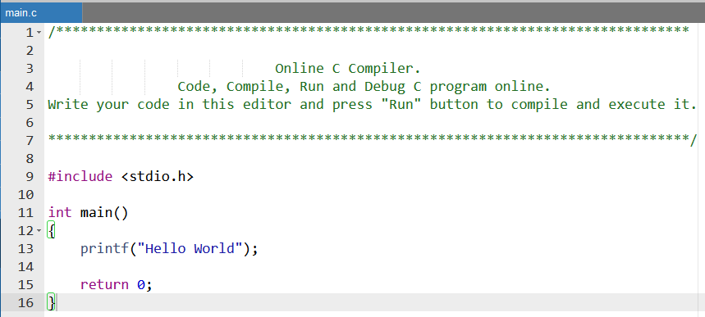

Slide 21
The main Function
The main function is the entry point of a C program. It’s where the execution of the program begins.
#include <stdio.h>
int main() {
printf(“Let me see \n"); // Print a message to the console
return 0; // Indicate that the program ended successfully
}

Slide 22
The main Function
Declaration Part
Executable Part

Slide 23
