Slide 1


Big Data Computing Project 2021
Prof. Gabriele Tolomei
Nefeli Tavoulari
E-mail: tavoulari.1977701@studenti.uniroma1.it
Georgios Nikolaou
E-mail: nikolaou.1977703@studenti.uniroma1.it

Slide 2
Twitter Bot Classification
A Big Data task, tackled with PySpark

Slide 3
The Problem
The use of automated accounts (bots) has become one of the most severe issues of Social Media.
Studies suggest that as many as 48 million Twitter accounts are actually bots.
Commonly used for commercial purposes such as advertisement, recent events like the US elections have shown further potentially malicious uses.

Slide 4
How to Spot a Bot
Absence of personalised content such as a profile photo, or geolocation of tweets
Non verified status of the account
Similarity between tweets
Amount of retweets and mentions of other users
Big number of followers or friends
Tweets similar to other bot accounts’ content
Recent creation date

Slide 5
Dataset
Starting off, we used the Twitter Bot Accounts dataset from Kaggle.
Later on, we added datasets used by Botometer, which the team provides for academic use.
All datasets share the same structure: account id and account type, either human or bot

Slide 6
Information Retrieval using Tweepy
Using Tweepy, a python library made for accessing the Twitter API, we collected user data for each id.
We performed some formatting and cleaning of the data, removing suspended accounts and accounts using languages other than English, also removing emojis, URLs etc. from the valid accounts’ content.
We computed some basic metrics on the spot, such as the ratio of retweets to original tweets, and the average cosine similarity of the user’s tweets.

Slide 7
The Final Dataset
For each account we collected the following features:
Numerical: Followers, Friends, Listed Count, Status Count, Retweets, Mentions, Days since the account’s Creation, URLs Count
Categorical: Geo Enabled, Verified, Extended Profile, Default Profile Picture
Textual: Description, Tweets
We ended up with around […] accounts

Slide 8
Methodology
We used PySpark and run our program on Databricks Community Edition.
Due to the different types of data in the dataset (Numerical/Categorical and Textual), we decided to create 3 types of models, one for Numerical/Categorical data, one for Textual data, and one for an aggregation of both.
In all cases, we experimented with Logistic Regression, Decision Tree, Random Forest, Factorization Machines, after we had performed some formatting on the dataset.
Finally, we evaluated the results using AUC and UPR.

Slide 10
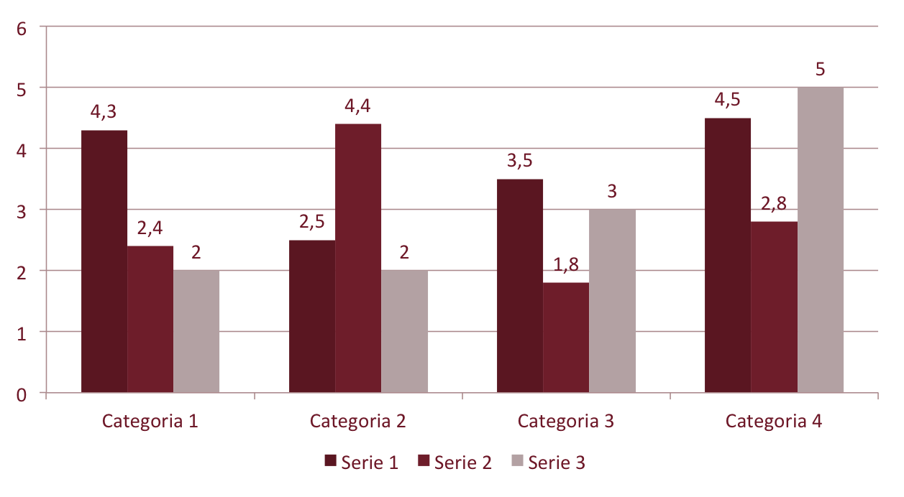

Slide 11
Scuola di Specializzazione in Malattie dell’Apparato Cardiovascolare
Direttore Prof. Massimo Volpe
Facoltà di Medicina e Psicologia, Università di Roma Sapienza
Anno Accademico 2013-2014
Dr.ssa/Dr. Nome e Cognome
Grazie per la Vostra Attenzione!
Progetto Formazione Avanzata in Cardiologia nel Web 2014
Scuola di Specializzazione in Malattie dell’Apparato Cardiovascolare
Direttore: Prof. Massimo Volpe
E-mail: massimo.volpe@uniroma1.it
Coordinatore: Dr. Giuliano Tocci
E-mail: giuliano.tocci@uniroma1.it

