Slide 1


Big Data Computing Project 2021
Prof. Gabriele Tolomei
Nefeli Tavoulari
E-mail: tavoulari.1977701@studenti.uniroma1.it
Georgios Nikolaou
E-mail: nikolaou.1977703@studenti.uniroma1.it

Slide 2
Twitter Bot Classification
A Big Data task, tackled with PySpark

Slide 3
The Problem
The use of automated accounts (bots) has become one of the most severe issues of Social Media.
Studies suggest that as many as 48 million Twitter accounts are actually bots.
Commonly used for commercial purposes such as advertisement, recent events like the US elections have shown further potentially malicious uses.

Slide 4
How to Spot a Bot
Absence of personalised content such as a profile photo, or geolocation of tweets
Non verified status of the account
Similarity between tweets
Amount of retweets and mentions of other users
Big number of followers or friends
Tweets similar to other bot accounts’ content
Recent creation date

Slide 5
Dataset
Starting off, we used the Twitter Bot Accounts dataset from Kaggle.
In order to better balance our dataset, we added datasets used by Botometer, which the team provides for academic use.
All datasets share the same structure: account id and account type, either human or bot

Slide 6
Information Retrieval using Tweepy
Using Tweepy, a python library made for accessing the Twitter API, we collected user data for each id.
We performed some formatting and cleaning of the data, removing suspended accounts and accounts using languages other than English, as well as removing emojis, URLs etc. from the valid accounts’ content.
We computed some basic metrics on the spot, such as the ratio of retweets to original tweets, and the average cosine similarity of the user’s tweets.

Slide 7
The Final Dataset
For each account we collected the following features:
Numerical: Followers, Friends, Listed Count, Status Count, Retweets, Mentions, Days since the account’s Creation, number of URLs, average Cosine Similarity of the account’s tweets
Categorical: Geo Enabled, Verified, Extended Profile, Default Profile Picture
Textual: Description, Tweets
We ended up with around 26 thousand accounts

Slide 8
Methodology
We used PySpark and run our program on Databricks Community Edition.
Due to the different types of data in the dataset (Numerical/Categorical and Textual), we decided to create 3 types of models, one for Numerical/Categorical data, one for Textual data, and one for an aggregation of both.
In all cases, we experimented with Logistic Regression, Decision Tree, Random Forest, Factorization Machines, having previously performed some formatting on the dataset.
Finally, we evaluated the results using AUC and UPR.

Slide 9
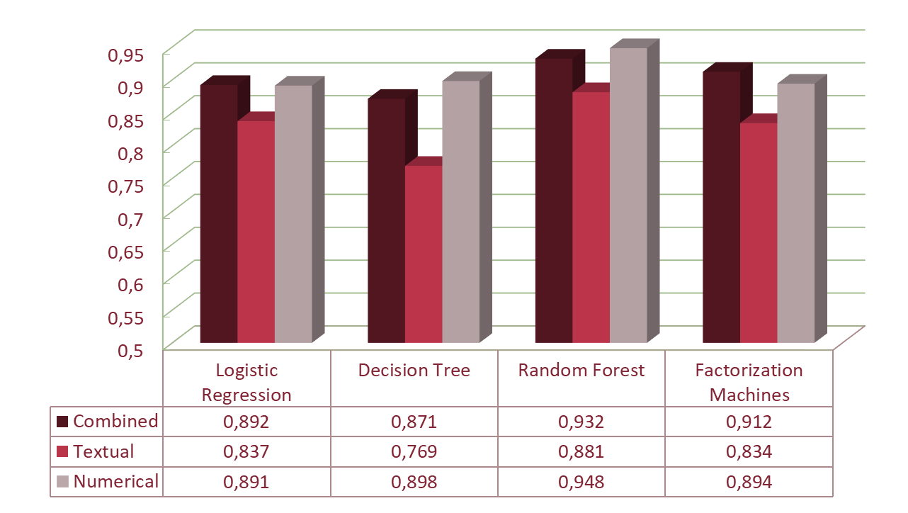
Area Under ROC Curve

Slide 10
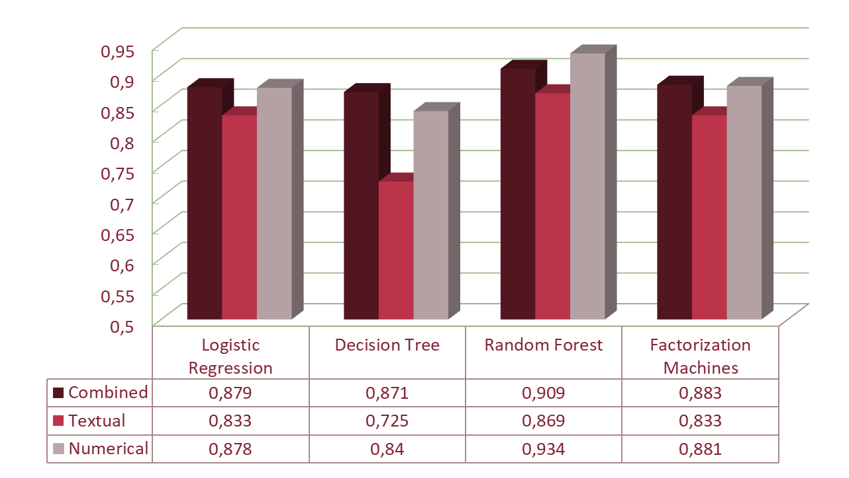
Area Under Precision-Recall Curve

Slide 11
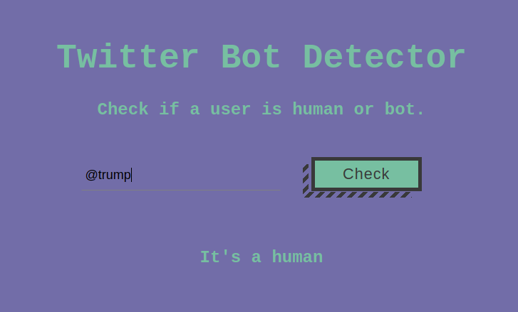
Frontend
We implemented a simple Flask web-app using our most successful model, Numerical Random Forest. The user can submit a Twitter screen name and have it evaluated as either a bot or a human.

Slide 12
Challenges
Collecting and preprocessing the data
Performing feature engineering
Checking correlation between features and target
Finding the best classifiers for the task
Experimenting with different models

Slide 13
Summary
We achieved a pretty satisfactory result with the Numerical Random Forest, with AUC 0.948 and UPR 0.934.
Some ways to improve this result would be an increase in dataset size, amelioration in pre-processing, examination of communities of the accounts, utilization of user feedback in the web-app to evaluate the results and fine-tune performance, more extensive use of cross-validation

Slide 14
Big Data Computing Project 2021
Prof. Gabriele Tolomei
Thank you for your attention!
Nefeli Tavoulari
E-mail: tavoulari.1977701@studenti.uniroma1.it
Georgios Nikolaou
E-mail: nikolaou.1977703@studenti.uniroma1.it

