Slide 1

HuisClos
Use generative AI on client files without breaching professional secrecy.
Local pseudonymisation of French and English legal documents, human review, outbound check and restoration of the AI answer.
Advanced AI Algorithms | Group assignment | Feature freeze, 28 October 2026
All names and identifiers in this deck are fictitious.
Notes:
HuisClos lets a lawyer use a general AI tool on a client file without sending the identities in it. Everything shown today uses invented names and identifiers.

Slide 2
Client files are secret; AI tools are external
Lawyers and legal staff want a language model to summarise a file, draft a letter or compare two contracts.
Pasting the file as it is sends names, addresses, bank details and case numbers to a third party.
Professional secrecy covers every document of the case file (Law no. 71-1130, art. 66-5); revealing it is an offence (Penal Code, art. 226-13).
GDPR art. 4(5) defines pseudonymisation; recital 26: pseudonymised data remain personal data.
Raw file to an AI tool
M. Octave Brunel, salarié de Ferlac SARL, a écrit depuis octave.brunel@example.com.
Every identifier leaves the firm.
With HuisClos
M. [PERSONNE_1], salarié de [SOCIETE_A], a écrit depuis [EMAIL_1].
Only checked tokens leave; the key stays local.
HuisClos | all data shown are fictitious
2 / 14
Notes:
The need: summarise, draft, compare. The risk: the raw file goes to a third party. French professional secrecy covers the whole case file, and revealing it is an offence. Under the GDPR, pseudonymised data remain personal data, so we never claim anonymisation.

Slide 3
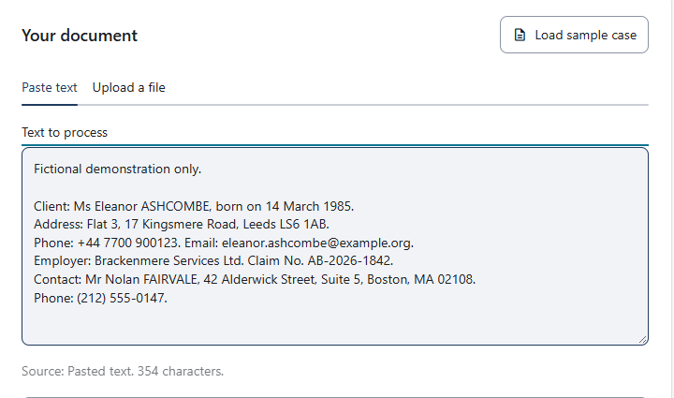
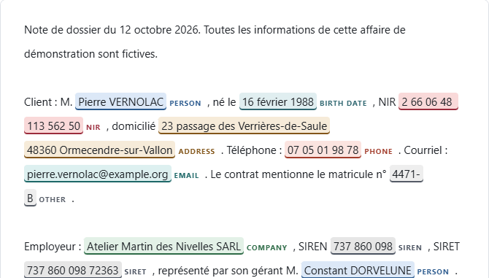
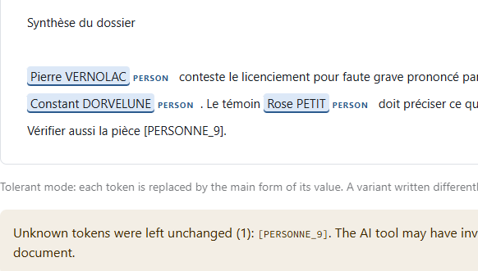
Three visible steps: Import, Review, Restore
1
Import
2
Review
3
Restore
Paste text or open a .txt, .docx or text-based PDF. Detection runs on the computer.
Keep, reject, retype or add each value. Nothing is accepted by default.
Paste the AI answer: tokens become real values; unknown tokens are listed.
Between Review and Restore: tokens, then an outbound check of the exact message. The mapping table never leaves the computer.
HuisClos | all data shown are fictitious
3 / 14
Notes:
The interface shows three steps. Import reads the text and proposes detections locally. Review is where the lawyer decides. Restore puts the real values back into the AI answer.

Slide 4
One fictitious sentence, end to end
Original
M. Octave Brunel PERSON, salarié de Ferlac SARL COMPANY, a écrit depuis octave.brunel@example.com EMAIL.
Sent to the AI tool
M. [PERSONNE_1], salarié de [SOCIETE_A], a écrit depuis [EMAIL_1].
AI answer (illustrative)
[PERSONNE_1] should reply to [SOCIETE_A] within eight days.
Restored locally
Octave Brunel should reply to Ferlac SARL within eight days.
HuisClos | all data shown are fictitious
4 / 14
Notes:
The title M. stays visible by convention, so the model keeps grammatical gender. The answer shown is illustrative: it was written for this slide, not produced by a model.

Slide 5
The pipeline: rules, models and a human
Import
paste, .txt, .docx, text-based PDF
Detection
keys, patterns, heuristics, spaCy, optional local model
Cleaning
exclusions, merge, company bounds, propagation
Human review
keep, reject, retype, add
Restore
real values back, unknown tokens listed
External AI tool
third party: receives the checked message only
Outbound check
document and instruction re-read
Tokens
grouping: [PERSONNE_1], [SOCIETE_A]
The mapping table stays on the computer: Restore reads it, the AI tool never does
Mapping table
session memory, never sent
HuisClos | all data shown are fictitious
5 / 14
Notes:
Detection combines checksums, patterns, heuristics and the spaCy model of the document language; Enhanced adds CamemBERT for French or GLiNER for English, locally. Cleaning removes excluded words, resolves overlaps and finds every other mention. The human reviews before any token is assigned.

Slide 6
Hybrid detection, with explainable scores
G7 challenge recall, by configuration
Confidence scale (excerpt of D-07)
Valid control key (IBAN, NIR, SIREN, SIRET), manual addition
0.69
patterns only
1.00
Email address
0.95
Labelled case number, birth date, internal identifier
0.90
0.46
spaCy only
spaCy named entity
0.85
Title followed by a name
0.80
Name pattern, complete address
0.70
0.84
hybrid with propagation
Wrong key on a well-formed IBAN or NIR (likely typo)
0.40
Kept if score reaches the threshold 0.30, chosen by F2 on dev.
Source: results/summary.md, challenge split, threshold 0.30
HuisClos | all data shown are fictitious
6 / 14
Notes:
Scores follow a fixed scale (decision D-07). The threshold 0.30 maximises F2 on the development set, the lowest value at a tie. On the G7 challenge, neither patterns nor the language model alone come close to their combination.

Slide 7
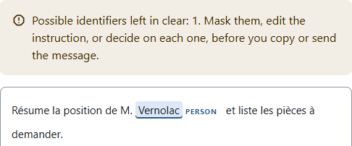
The human decides; the outbound check verifies
Colour and text label on every highlighted value; colour is never the only signal.
Keep, reject, retype or add: no proposal is accepted by default.
Low-confidence card lists scores under 0.75 to read first.
Outbound check re-reads the document and the instruction as one exact message.
Any edit revokes the check and the confirmation; the send function recomputes it.
An alert masks nothing: the lawyer masks or explicitly keeps the value.
Fictitious sample case: Review (top), Final check alert (bottom)
HuisClos | all data shown are fictitious
7 / 14
Notes:
Every highlighted value carries a colour and a written type. The lawyer validates each one. Before anything is copied or sent, the exact message, document plus instruction, is re-read. An alert never masks anything by itself; any edit revokes the earlier confirmation.

Slide 8
What leaves the computer
Local installation
Public demo
Reading, detection, review, tokens, check and restoration
Streamlit on localhost only, usage statistics off
No network call while a document is processed
checked message only
External AI tool
third party chosen by the lawyer
copy and paste, or the optional Mistral connector after confirmation
Separate cloud deployment
Same Standard code on the host's server
Fictitious data only
Enhanced profiles refused
answer with tokens
Mapping table
token to real value, in session memory; never sent, never committed
Installing packages or preparing optional models uses the network, outside the application.
HuisClos | all data shown are fictitious
8 / 14
Notes:
Real files belong in the local installation. The public demo runs the same Standard code on the host's server and must only receive fictitious data. The AI tool receives the checked message and nothing else; the mapping table is never sent.

Slide 9
How we measured
Set | Docs | Role
French dev | 20 | tuning, threshold choice
English dev | 8 | English tuning
Historical test | 6 | held out, four measures
Challenge | 8 | blind after S14 freeze, now known
C3 French and English | 8 + 8 | blind after A4, measured once (G8)
Full coverage: every character of a value masked
Leaked characters: sensitive characters left visible
Over-masking: masked characters outside any annotation
F2: recall weighs twice as much as precision
Eleven types evaluated; CUSTOM and LOCATION reported apart.
No human is simulated: figures describe the tool before review.
Paired bootstrap: 2,000 document draws, seed 45
HuisClos | all data shown are fictitious
9 / 14
Notes:
All corpora are fictitious. Dev was used for tuning and is saturated. The historical test was measured four times across gates. The challenge was written blind after a rule freeze and is now known. C3 was written blind after the A4 freeze and measured once by G8.

Slide 10
French challenge, G8R2: Enhanced protects more
Leakage reduction
Coverage gain
Before review
paired 95% CI [-0.062; -0.006]: excludes zero
paired 95% CI [0; 0.167]: touches zero, not significant
33 (Standard) and 20 (Enhanced) entities at least partly exposed
Partial precision 0.8039 (Standard) and 0.8018 (Enhanced). Not a new blind validation. Source: results/gate8-resume/report.md, D-G8R2-1.
HuisClos | all data shown are fictitious
10 / 14
Notes:
Single registered resume on code 930c414, eight fictitious French documents already known since G7. Enhanced meets the four criteria fixed before the measure. The leakage reduction is significant on this set; the coverage gain is not, because its paired interval touches zero.

Slide 11
English: experimental, with reservations
C3 blind set, code e3d13bd | Precision | Fully covered | Leaked | Status
French Standard | 0.8922 | 95/105 | 139/2042 | Default
French Enhanced | 0.8824 | 96/105 | 130/2042 | Local French option
English Standard | 0.8349 | 78/100 | 235/2285 | Experimental, strong reservations
English Enhanced | 0.7000 | 88/100 | 115/2285 | Not recommended
Precision loss of English Enhanced: 0.1349, above the 0.02 margin fixed before the measure. Standard is the fallback; every detection still needs review. Source: D-G8-1, results/gate8/report.md.
HuisClos | all data shown are fictitious
11 / 14
Notes:
These C3 figures are historical: measured once by G8 on code e3d13bd, not on the current code. English Enhanced loses 13.5 precision points against a two-point margin, so it is not recommended. There is no complete bilingual validation.

Slide 12
Engineering beyond the course
1
Overlapping windows
2
Unicode projection
3
Tolerant restoration
CamemBERT 510 tokens, 64 overlap; GLiNER prompt checked against 512
invisible characters normalised in a view, spans projected back
altered tokens restored, ordinary words left untouched
4
Case memory
5
Two-segment check
6
Paired bootstrap
a previous mapping table keeps tokens stable across a case
document and instruction checked as one exact string
profiles compared on the same document draws
HuisClos | all data shown are fictitious
12 / 14
Notes:
Several mechanisms go beyond the course material: overlapping windows for the neural models, a projected analysis view for Unicode, tolerant restoration, case memory, the two-segment check with revoked consent, and paired bootstrap comparisons.

Slide 13
Limits we state openly
Omissions
Context
File quality
values are missed, especially in English and unusual formats
a rare job, a small town and a date can identify a person
no OCR; mixed PDFs and some Word structures import partially
Synthetic corpora
The mapping table
Token continuity
small, fictitious, few authors: real files may score lower
whoever holds it can re-identify the text
a name also in a file name can get a new token later (D-FIX3-2)
HuisClos | all data shown are fictitious
13 / 14
Notes:
No detector finds everything; context can re-identify a person; there is no OCR; the corpora are small and fictitious; whoever holds the mapping table can re-identify the text; and a person can receive a new token in a later document of the same case.

Slide 14
What is validated, and what is not
Validated on fictitious data
Still needed
French measured scope: Standard default, Enhanced as a local French option
Technical French and English flow on offline fixtures
Local processing, exact outgoing message, revoked consent
Sourced legal review: bar guidance, European guidelines, case law
Timed study with real users on realistic, non-sensitive files
A new blind English set before any English claim; OCR
Pseudonymisation is not anonymisation. Review every detection.
Demo, fictitious data only: huisclos.streamlit.app | Code: github.com/Negan-san/huisclos
Notes:
The measured French scope is validated on small fictitious corpora. English is experimental. A sourced legal review, a timed study with real users and a new English blind set are still needed. Pseudonymisation is not anonymisation.

