Slide 1
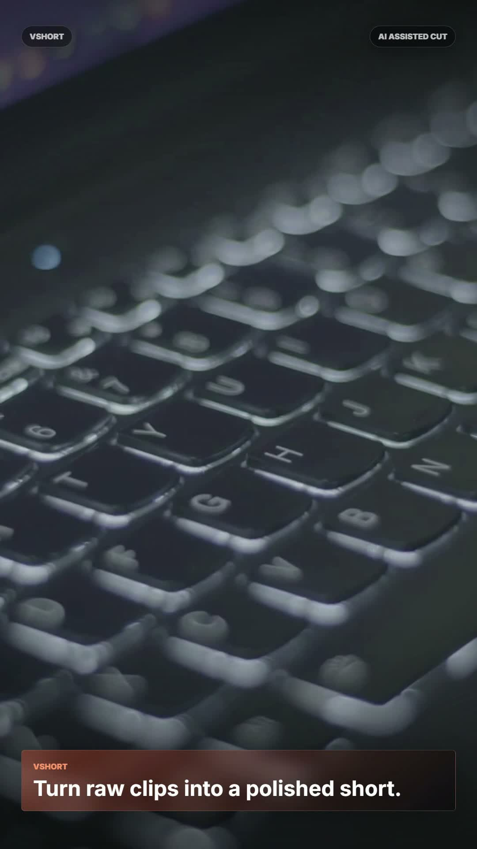
DEMO BUILD
VSHORT now edits talking-head videos automatically.
Drop in a clip. The backend removes long pauses, normalizes the source, adds BGM and motion packaging, then renders a vertical short through HyperFrames.
Auto pause cut
BGM mixing
HyperFrames render
1080 x 1920 export
Verified output: H.264 video, AAC stereo audio, 30fps vertical MP4.
VSHORT / HyperFrames Auto Editing
01

Slide 2
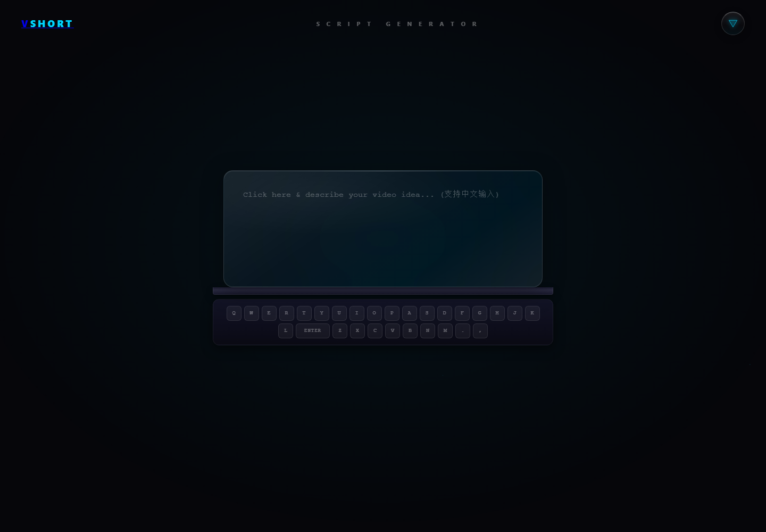
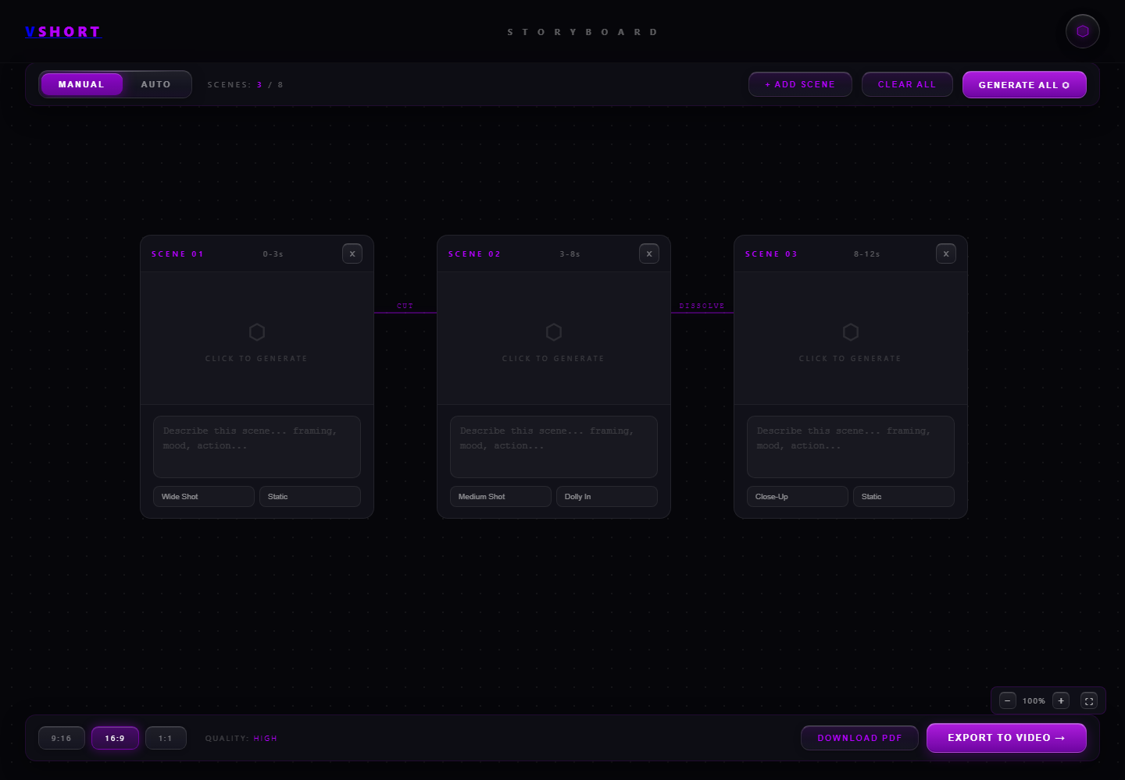
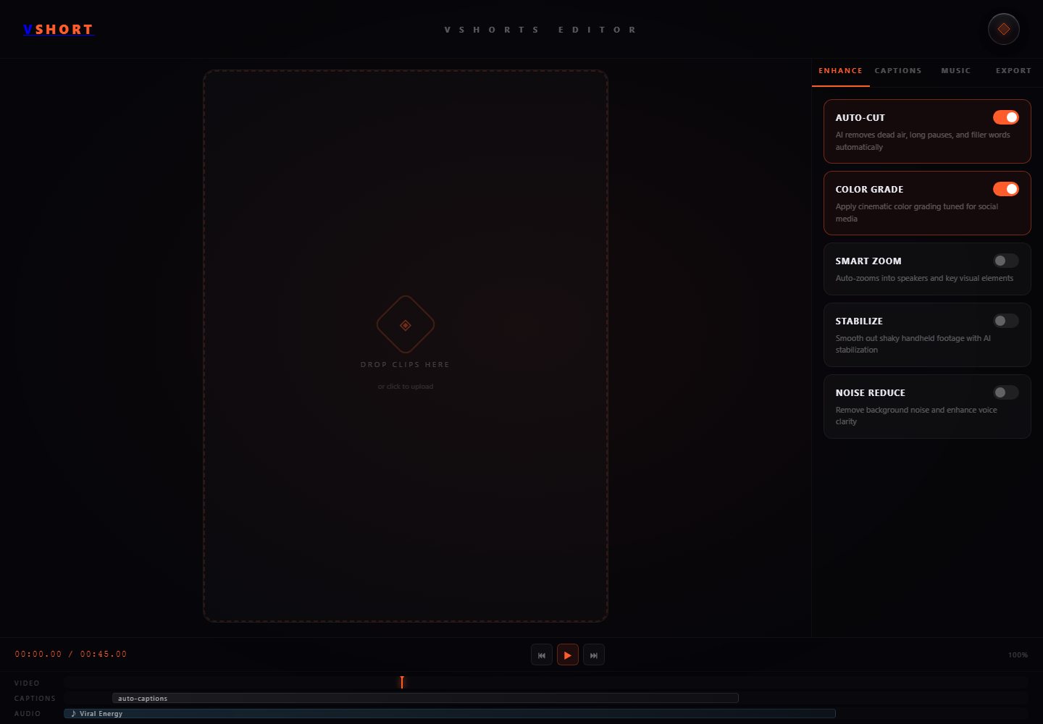
PRODUCT SURFACE
The original Vshort frontend stays intact.
Script, storyboard, and video editor remain separate work areas instead of being merged into one generic flow.
01 / Script Generator
02 / Storyboard Builder
03 / Video Editor
VSHORT / HyperFrames Auto Editing
02

Slide 3
AUTOMATION LOGIC
A clean backend pipeline does the manual editing work.
The user does not mark cuts. Audio silence becomes edit points; HyperFrames becomes the visual and audio packaging layer.
01
02
03
04
05
06
Upload
Stitch
Detect pauses
Cut
Normalize
Render
One or more talking-head clips enter the project.
FFmpeg prepares one source timeline.
silencedetect finds long low-volume gaps.
Quiet gaps are removed with natural padding.
MOV / ProRes / PCM become browser-ready H.264 / AAC.
HyperFrames adds BGM, overlays, motion and exports MP4.
Default talking-head setting: cut pauses >= 0.45s, keep 0.11s padding, then mix BGM at render time.
VSHORT / HyperFrames Auto Editing
03

Slide 4
IMPLEMENTATION
The active export path no longer calls CutClaw.
CutClaw remains legacy code in the repo, but the live job path now routes through FFmpeg pause cutting and HyperFrames rendering.
silenceCutter.js
FFmpeg silence detection and pause removal
SMOKE TEST RESULT
Composition generation, BGM, lint and render
DONE
hyperframesRenderer.js
videoProcessor.js
Job orchestration and progress stages
Nymard MOV -> auto pause stage -> normalized HyperFrames source -> 1080x1920 final MP4.
auth.js
Supabase auth with env-based publishable key
Validation: node --check, /api/health 200, HyperFrames lint, HyperFrames inspect.
VSHORT / HyperFrames Auto Editing
04

Slide 5
DEMO OUTPUT
The final render is a platform-ready vertical short.
The same path is triggered from the editor export button; this run used the Nymard MOV test asset.
Format
MP4
Video
H.264
Audio
AAC stereo
Canvas
1080 x 1920
Frame rate
30fps
HyperFrames lint + inspect: pass
VSHORT / HyperFrames Auto Editing
05

Slide 6
DELIVERY CHECKLIST
Ready to push as the HyperFrames auto-editing version.
The commit captures the backend transition, README updates, screenshots and the demo deck.
Preserved frontend
No redesign of scripts, storyboard or editor pages.
NEXT
Automated edits
Long pauses are cut without manual trim points.
Add transcript-based captions, user-facing pause-cut controls, and queue workers for longer uploads.
HyperFrames render
HTML composition, BGM, overlays and final MP4 render.
Deployability
Node 22+, dependency-pinned HyperFrames, cross-platform npx.
Presentation
Demo screenshots and verification story packaged in PPTX.
VSHORT / HyperFrames Auto Editing
06

