Slide 1
Prediction of
IMDB Score of Movies
The Data Incubator interview
Negar Monfared
Feb 2021

Slide 2
Prediction of IMDB Score of Movies
x1,
x2,
.
.
xn
Find most effective variables
Reducing variables
Optimizing process
Saving cost and energy
Reaching better market
Predict
Value
IMDB score of movies
Merchandise
Services
Productions
Health/Social Studies
Producer
Retails
Finances
Medical Devices
Mental Health
Vehicles
Energy
Automotive
Medicals
Distributer
Electronics
Transportation
Entertainment
Crimes

Slide 3
Prediction of IMDB Score of movies
Prediction of IMDB Score of Movies
Extraction of data of more than 5000 movies from different websites:
  https://www.the-numbers.com/movie/budgets/all
    Movie title, release date, production budget, domestic gross and worldwide gross
  Link of each movie from: https://www.the-numbers.com/movie
    MPAA, duration, genre, keywords, language, country and company
  More details from: https://www.imdb.com
    IMDB score, director, crews, color, aspect ratio, number of votes and critics
Data cleaning and selecting meaningful data
  Nulls, dtypes, duplications, unity, outliers, one-hot-encoding
Data analysis
  Distribution and deviation of different features
  Correlations between different features
Prediction methods (ML)
  Regression (Linear and Non-Linear)
  Random Forest
  Neural Network
Metrics

Slide 4
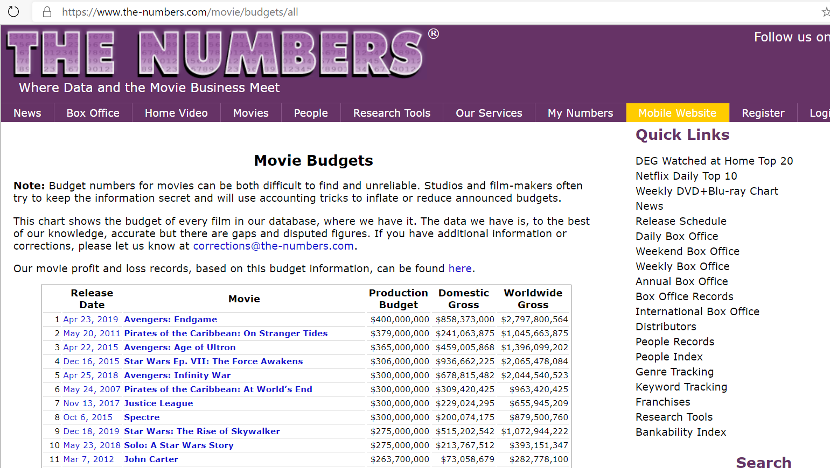
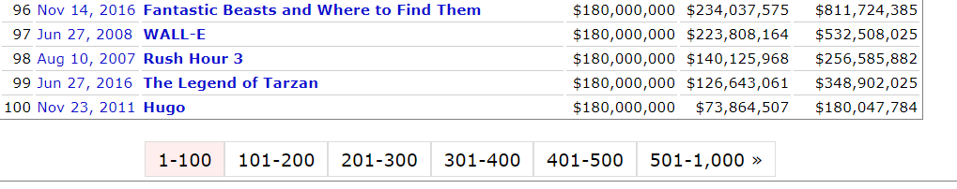
Data Extraction
Selecting correct table
Extract movie links from titles
Generate address of other pages

Slide 5
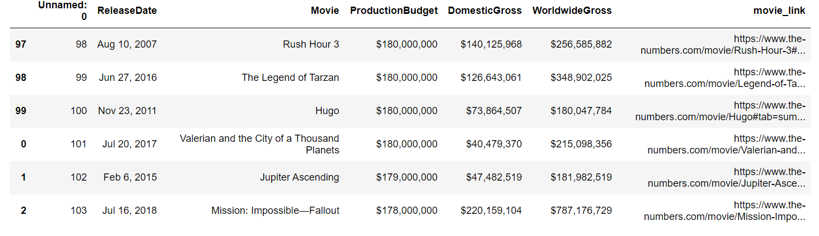
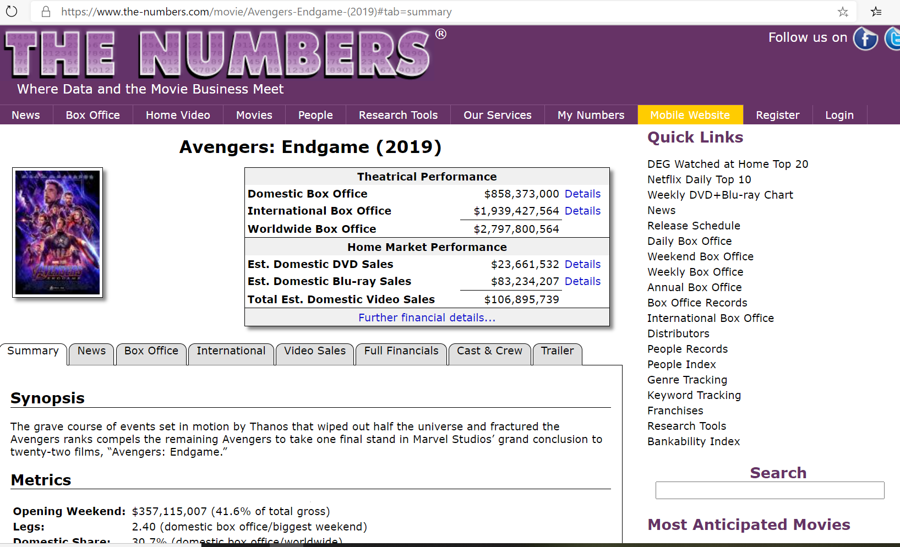
Data Extraction
Repeated movie name
Fix Indices
Deal with problematic characters
Go to the link of each movie
Select the correct table
Transpose and define columns
Add columns to DataFrame
Handle lack of data
Go to each movie’s IMDB page and extract more data

Slide 6
Data Cleaning
  Repeated movies
  Problematic characters
  Nulls for each feature
    Budget, gross
    Color
    Language, country, company
  Data types
  Redundancy
    Genre, MPAA rating
  Unity
  One-Hot-Encoding
  Normalizing
  Distributions, STDs and Outlier

Slide 7
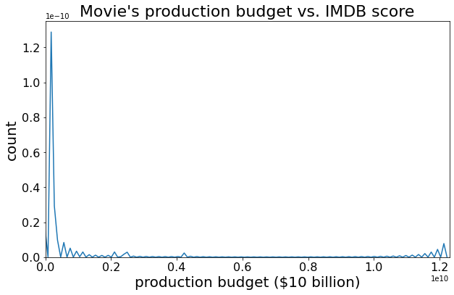
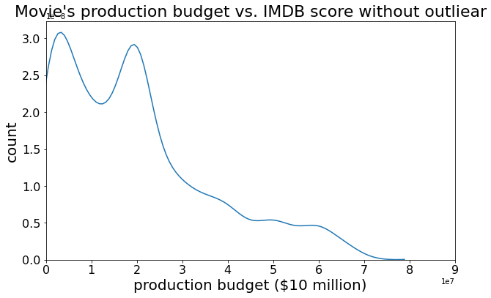
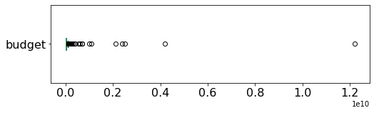
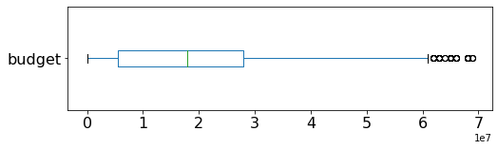
Distributions and Outliers
Budget Distribution:

Slide 8
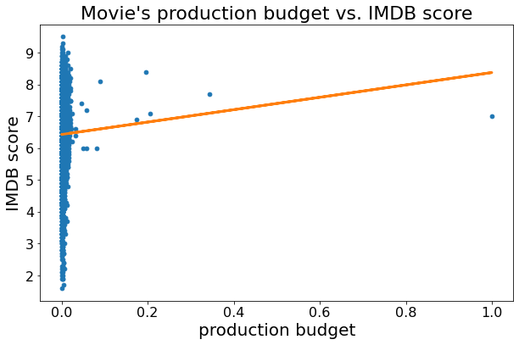
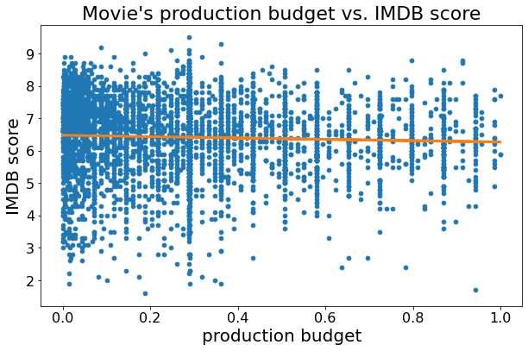
Data Analysis
Budget vs IMDB score:
R^2: .002
Pearson Corr.: -.044
MSE: 1.306

Slide 9
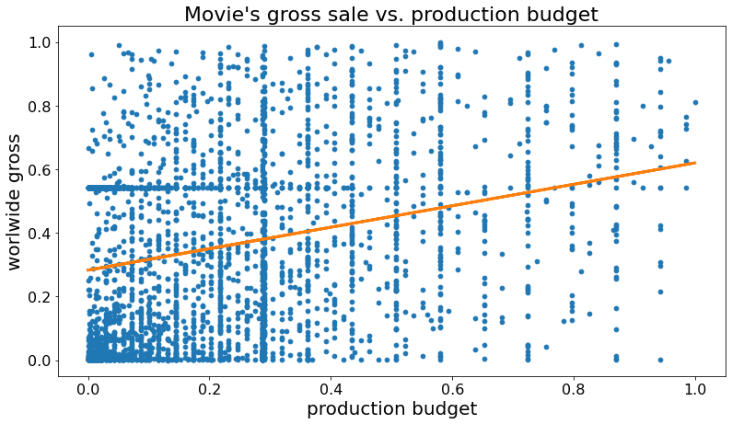
Data Analysis
Budget vs Gross:
R^2: .067
Pearson Corr.: .259
MSE: 37.295

Slide 10
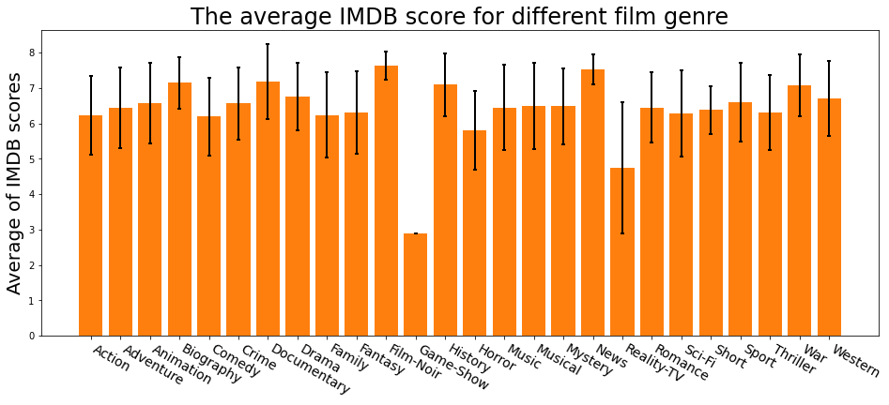
Data Analysis
Genres vs IMDB score:

Slide 11
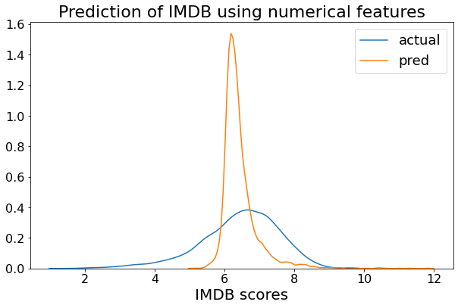
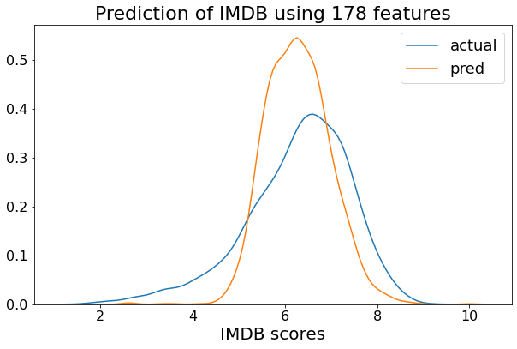
Prediction
Linear Regression:
Numerical features:7 Numerical + categorical features: 178
R^2: .215
Pearson Corr.: .464
MSE: .997
R^2: .349
Pearson Corr.: .591
MSE: .827

Slide 12
Data Analysis
Linear Regression:
  Year
  Director
  Actors
Non-Linear Regression
Random Forest
Neural Network

