Slide 1
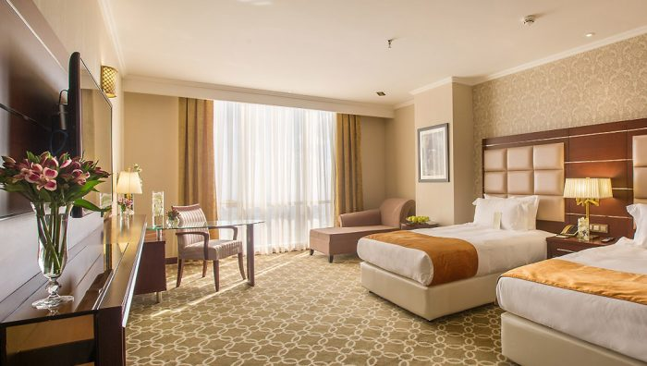
Hotels in Iran
Negar Mokhtari

Slide 2
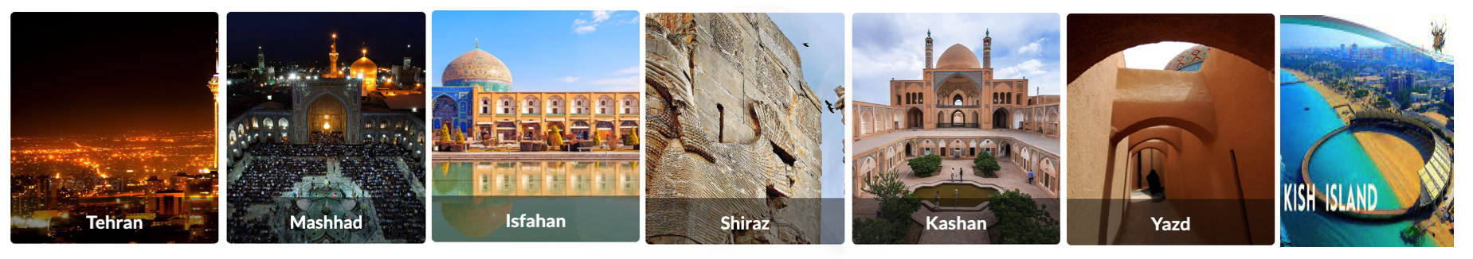
Data Sources:
websites to scrape for hotel info: https://iran.1stquest.com/hotel
Cities that are most tourist destinations.
Tehran | Mashhad | Isfahan | Shiraz | Kashan | Yazd | Kish-island | Qeshm-island
Capital | Religious | Cultural heritage and architecture | Cultural heritage and architectur | Ancient | Ancient | Beach Water sports | Natural and geological wonders

Slide 3
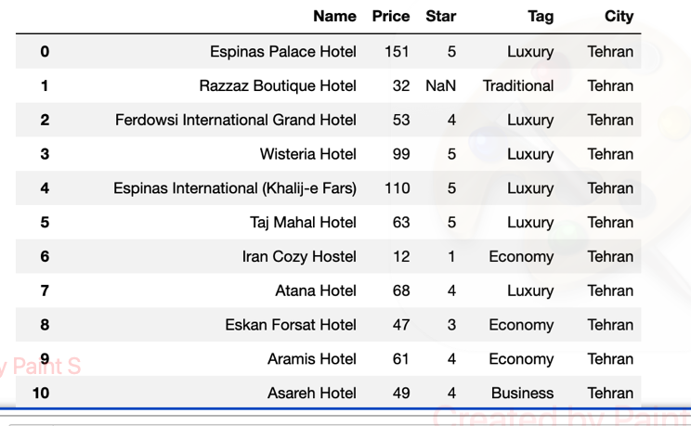
Data Set:

Slide 4



Hypothesis
Hypothesis 1- Price impact:
Most expensive hotels are located in specific cities.
Hypothesis 2- Location impact:
Hotels in certain locations might have highter rating compared to others due to factors like proximity to tourist attractions or amenities.
Hypothesis 3- Price vs. Rating by location:
Analyzing price ranges within different locations could reveal trends, such as budget hotels in one area having similar ratings to mid-range hotels in another.

Slide 5
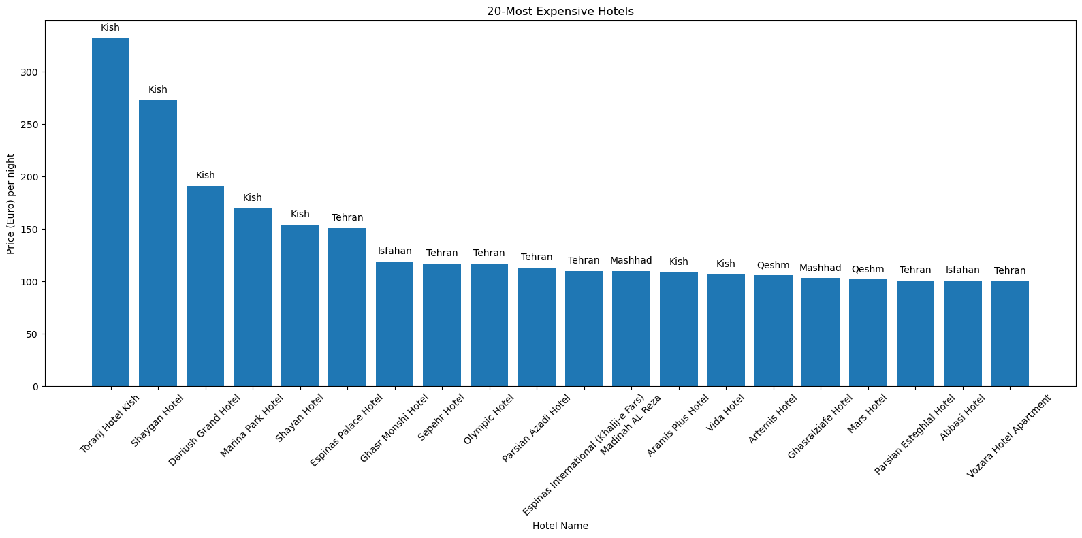
Findings Hypothesis 1- Price impact:
3 pt

Slide 6
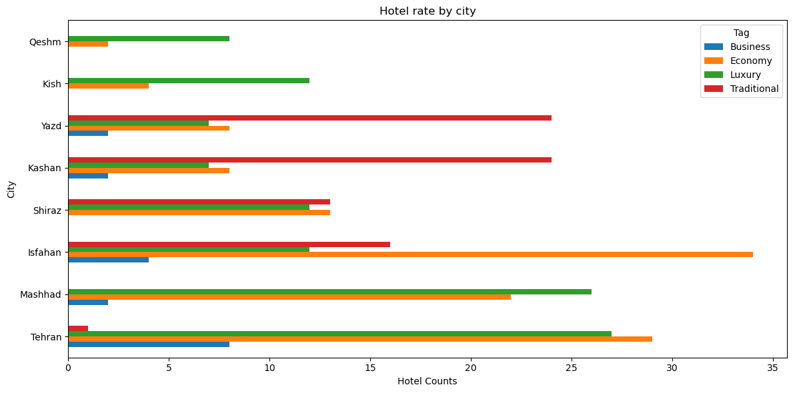
Findings: Hypothesis 2- Location impact

Slide 7
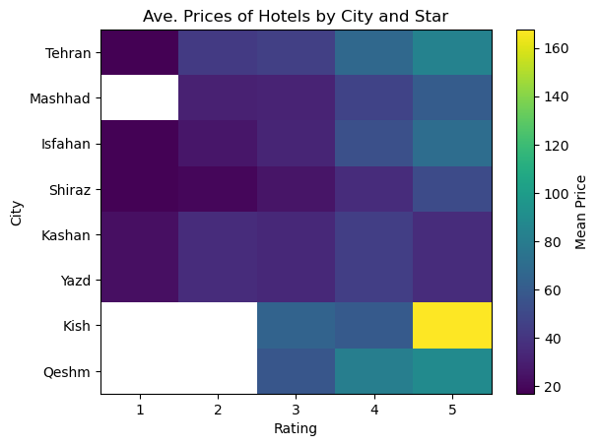
Findings: Hypothesis 3- Price vs. Rating by location
Findings:
Qeshm, Kish and Mashhad don’t have 1 star hotels
Kish and Qeshm don’t have 2 star hotels.
Kish has 5 star hotels with hight price.
Kashan and yazd which are traditional cities 4 star hotels have more price than 5 star.

Slide 8
Conclusions and future actions:
Hypothesis 1- Price impact:
Most expensive hotels are located in specific cities.
Findings:
Most expensive hotels are located in Kish island which is famous for beaches and water sports and then in Tehran which is the capital city
Future Considerations: Investigate if the result is the same during other seasons.

Slide 9
Conclusions and future actions:
Hypothesis 2- Location impact:
Hotels in certain locations might have highter rating compared to others due to factors of tourist attractions or amenities.
Findings:
Kish and Qeshm island : luxury hotels and then economy
Yazd and Kashan: Traditional hotels
Shiraz: Traditional, luxury and economy
Isfahan: Economy, traditinal, luxary and business
Mashhad: Luxary and economy
Tehran: economy, luxury and then business
Future Considerations: Relationship between location of the hotel and tourist attractions impact the price and rate of the hotels

Slide 10
Conclusions and future actions:
Hypothesis 3- Price vs. Rating by location:
Analyzing price ranges within different locations could reveal trends, such as budget hotels in one area having similar ratings to mid-range hotels in another.
Findings:
Relationship between hotel rate and price differ significantly in different cities.
The ralationship between hotel rating and price varies across cities, with instances in traditional cities such as kashand and yazd 4 stars hotels are more expensive than 5 stars, may be because of demand to stay in traditional hotels.

Slide 11
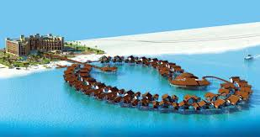
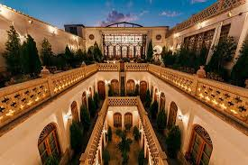
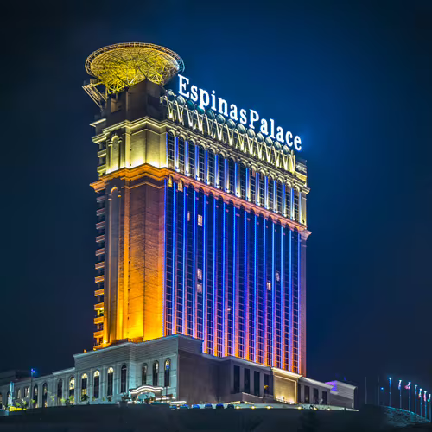
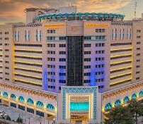
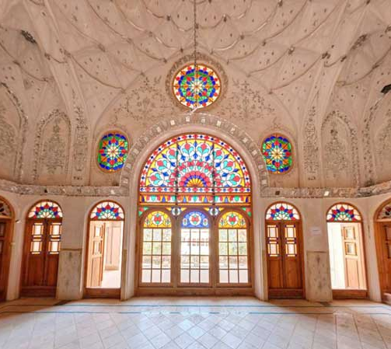
Thanks for your kind attention
Toranj hotel
Kish island
Ghasr Monshi
Isfahan
Espinas Palace
Tehran
Madinat Reza
Mashhad
Ameriha boutique hotel
Yazd

