Slide 1

Negar Mokhtari
Mid Project:
Eda & Machine learning
for
Data Science Job Salaries

Slide 2

introduction:
Data Scientist job market trends over the past four years (2020-2024). In this project, we delve into a comprehensive dataset sourced from Kaggle, which provides a detailed overview of various aspects of the Data Scientist job market. Our goal is to uncover significant trends, insights, and patterns that have emerged in this rapidly evolving field.
Dataset Details
Job Title:
Experience Level
Employment Type
Remote Ratio
Company Size
Company Location
Employee Residence
Salary

Slide 3

EDA (exploratory data analysis)
How is the job market for data scientist during the last years.
Jobs in terms of Experience, type of employment, remote ratio, and company size.
What is the salary range in this market?
What are the most common job titles in the data science market?
Which countries pay the highest salary in average?
Which counties have the highest demand of data scientists?
What is the avrage job salary in different job titles?
Does Experience level influence Salary?
Which Experiene level is more demanded by companies?
Which Job titles are the most paid ?
Does Company size and remote_ratio affect salary?

Slide 4

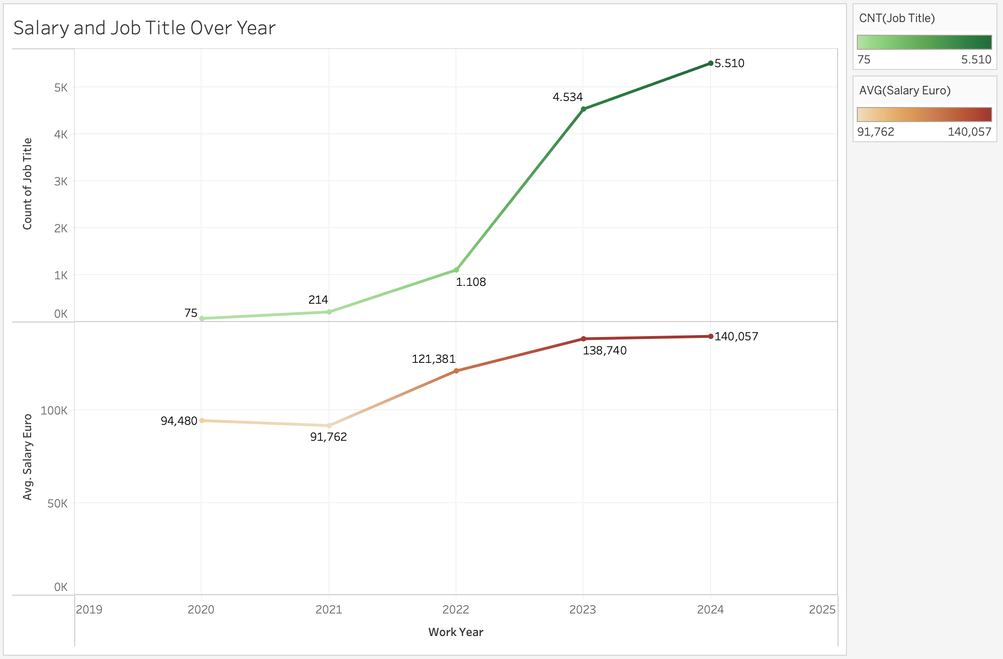
Data science jobs over years(2020-2024)
Number of job Titles and Ave. Salary

Slide 5


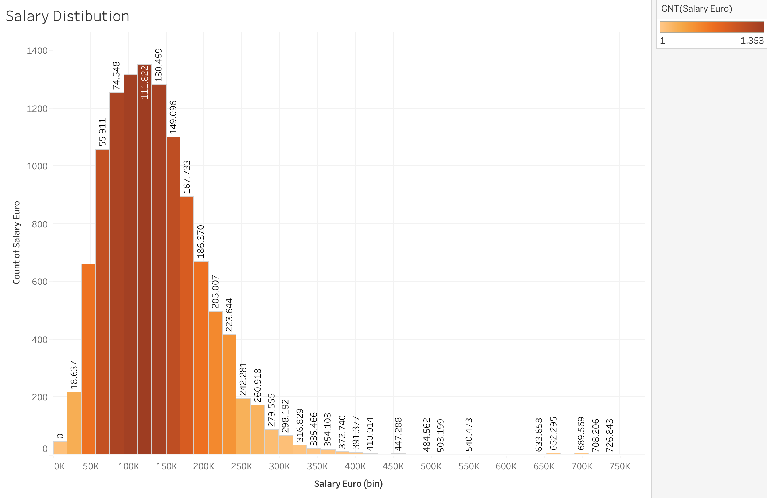
Distribution of salary range
 | salary
count | 11,441
mean | 136,524
std | 67,556
min | 13,860
25% | 87,872
50% | 128,436
75% | 173,712
max | 739,200

Slide 6

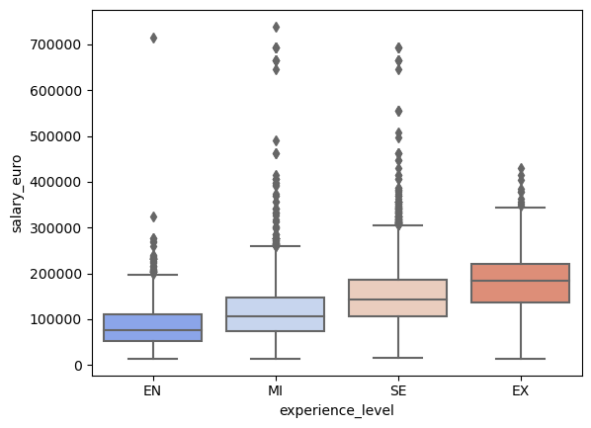
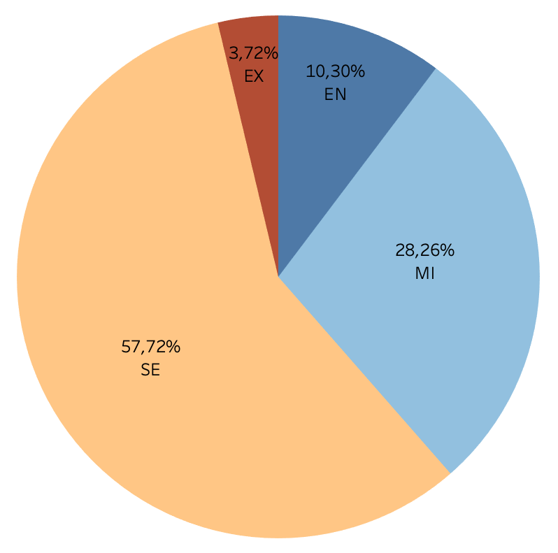
Experience level & salay

Slide 7
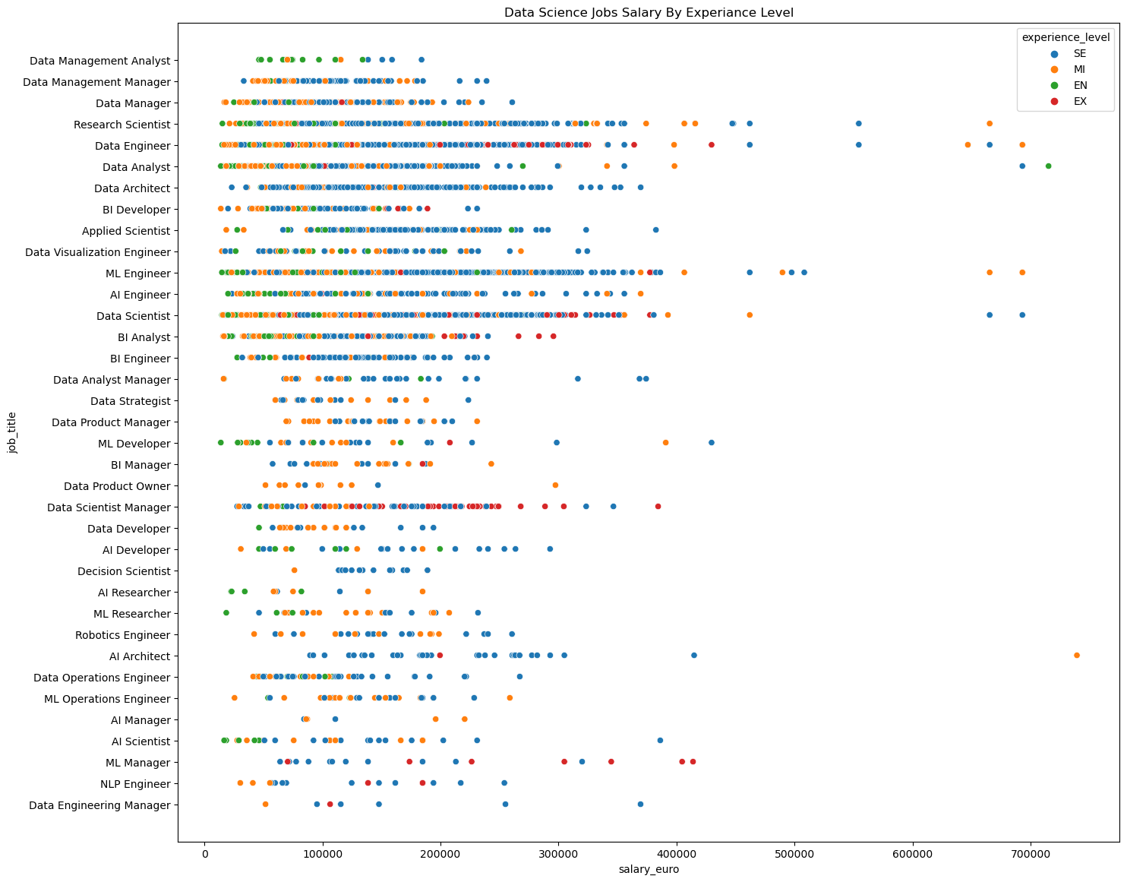
Salary by job title and experience level

Slide 8
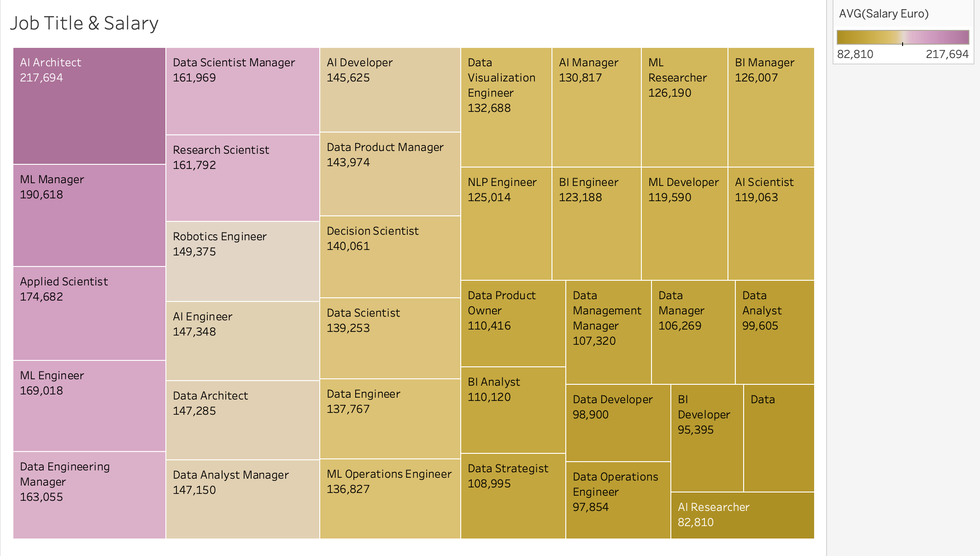
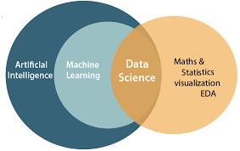
Distribution of job titles by average salary

Slide 9
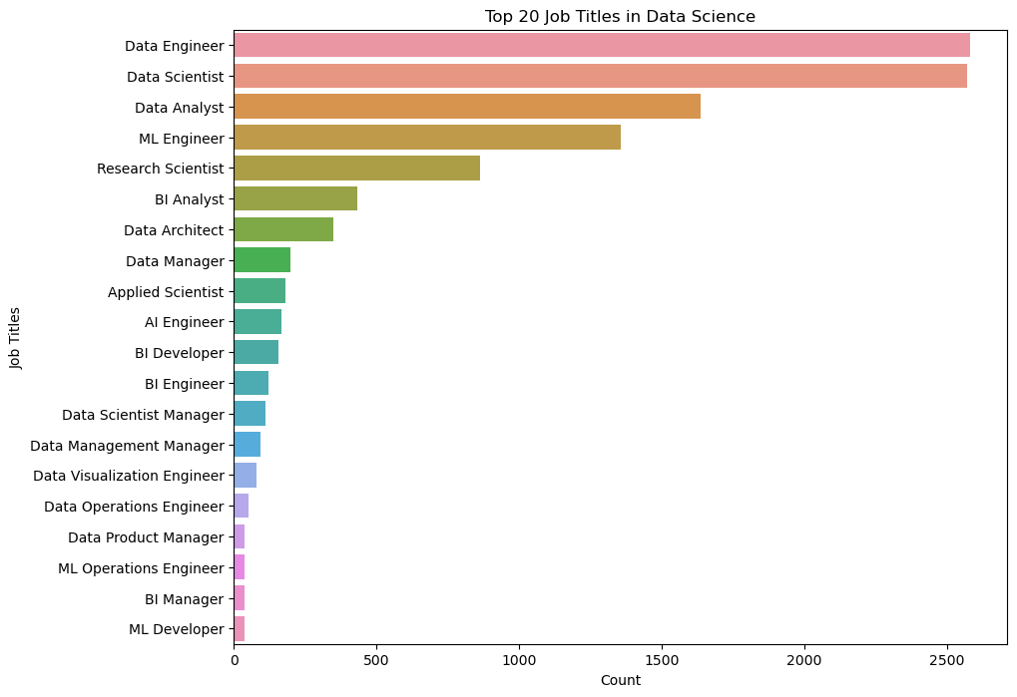
Most demanded job titles – top 20

Slide 10

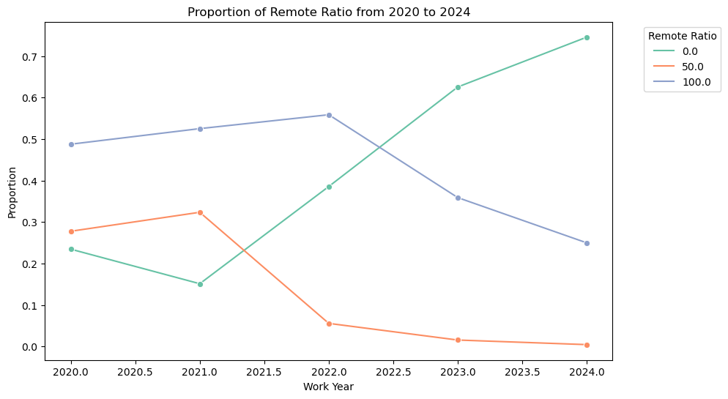
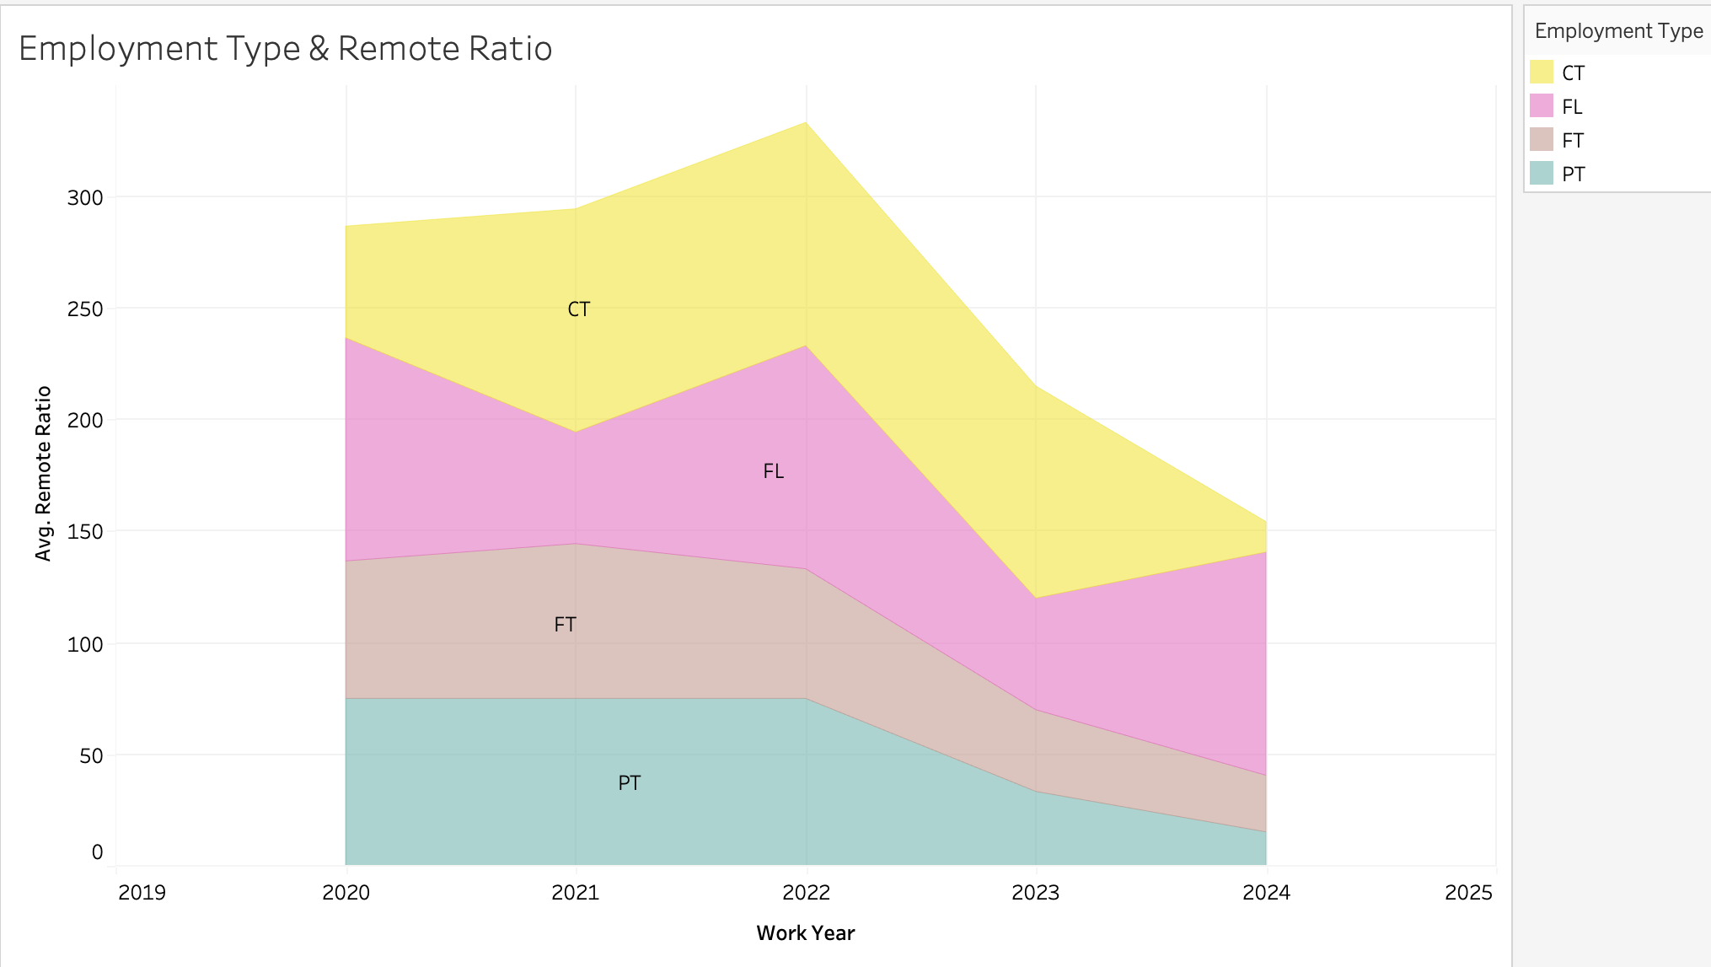
Remote Rato over years (2020-2024)

Slide 11
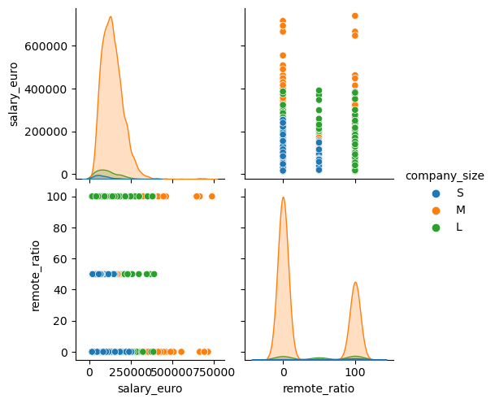
salary and remote ratio by company size

Slide 12
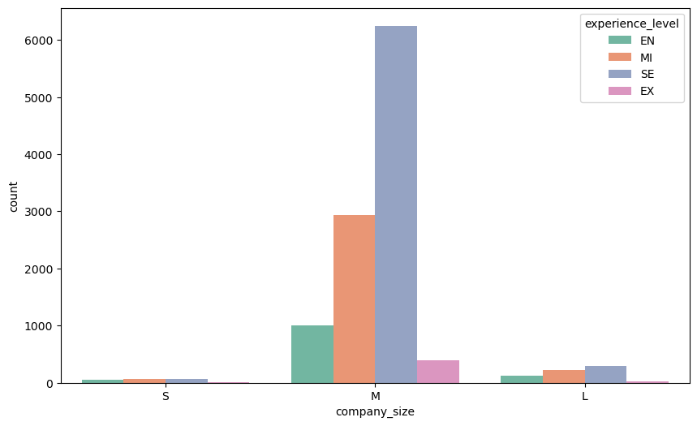
Distribution of company size and experience level
Crosstab_result:
Company Size | Experience level
 | EN | MI | SE | EX
Large | 128 | 225 | 290 | 22
Medium | 999 | 2,937 | 6,250 | 396
Small | 51 | 71 | 64 | 8
Chi2: 167.7140
P-value: 1.3733
Cramer’s V: 0.0856126
Rejection of the null hypothesis.
There is association between the Company size & Exp level
Cramer’s V: Correlation is not strong

Slide 13
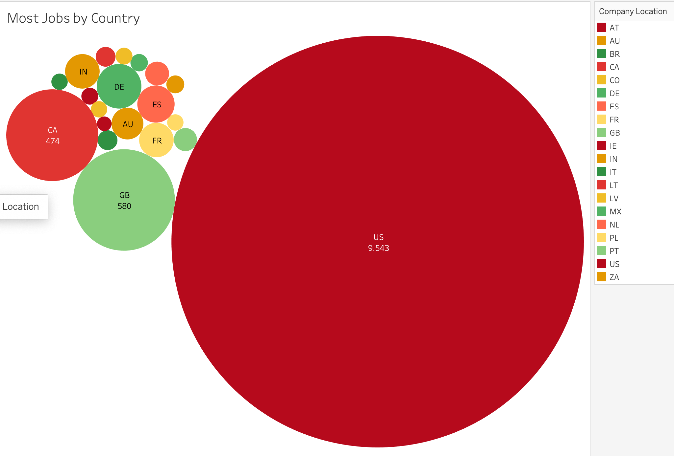
Job demand by country

Slide 14
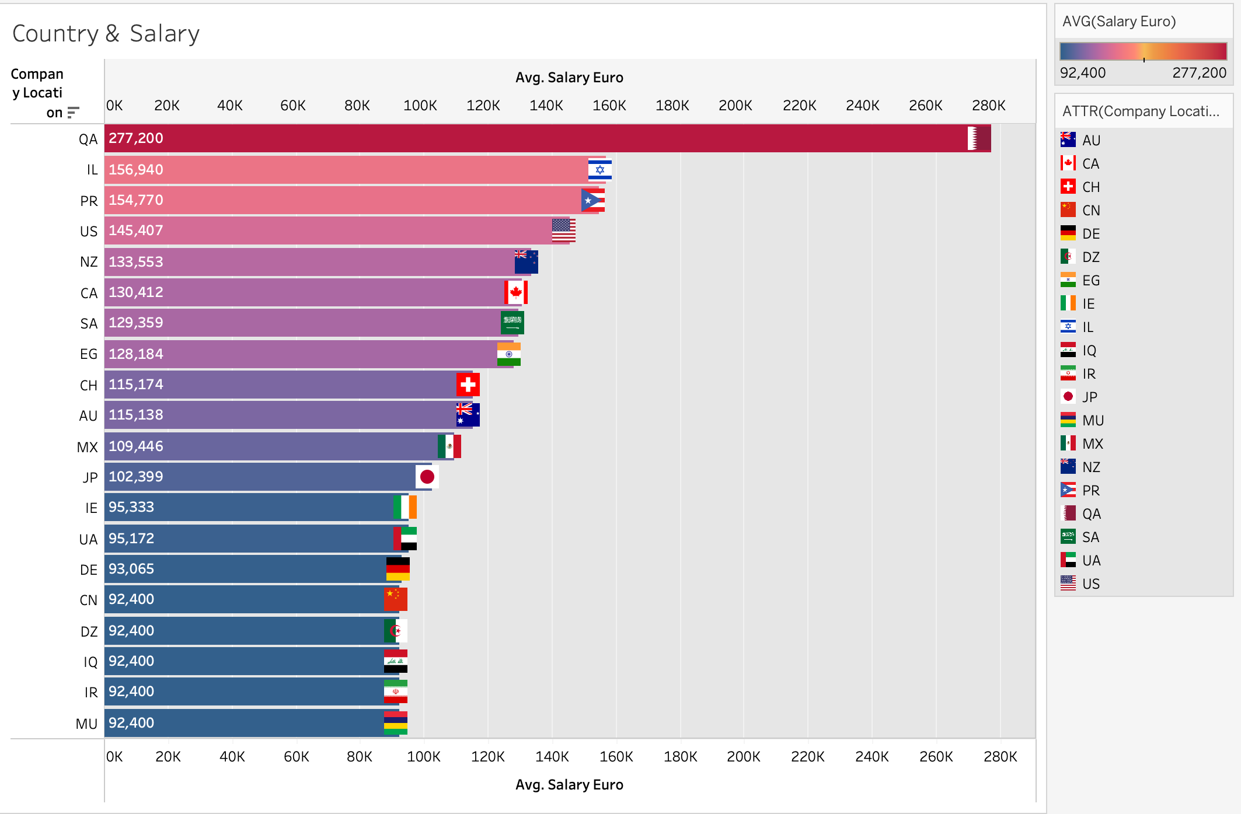
Top 10 countries with highest average salary

Slide 15
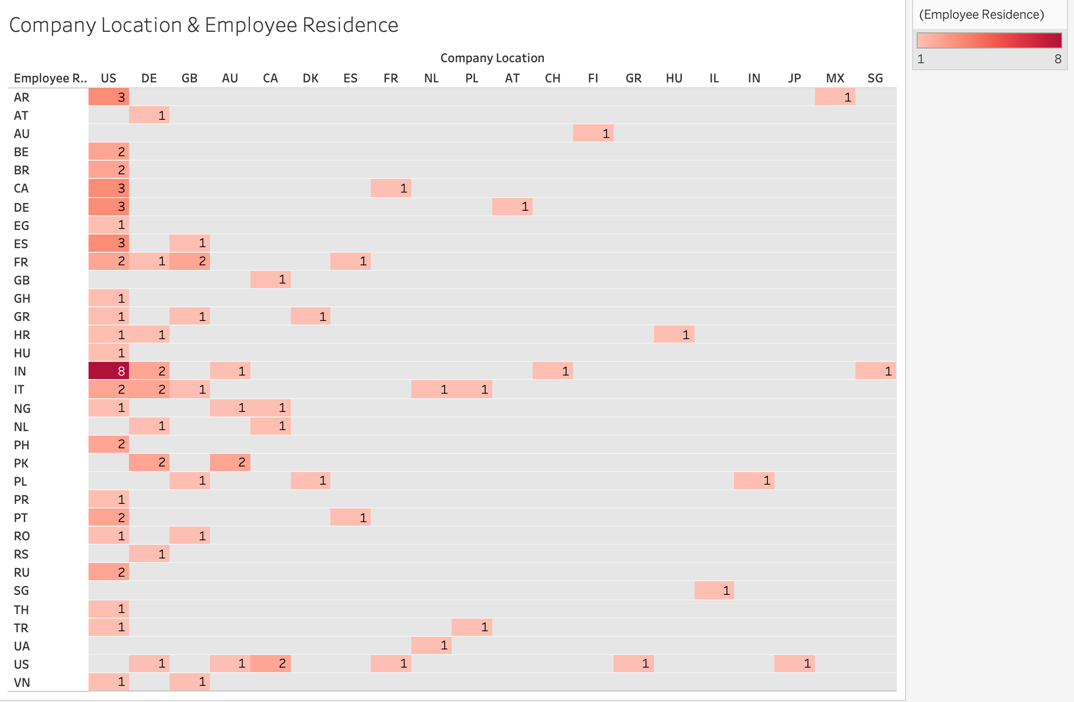
Company location and employee residence

Slide 16
ML - predict job salary
Model | Linear Regression | Ridge | Lasso | Decision Tree | KNN | XGBoost | Random Forest
R² | 0.272344 | 0.273326 | 0.272621 | 0.227753 | 0.176093 | 0.263263 | 0.254621
RMSE | 58795.47 | 58755.80 | 58784.30 | 60570.21 | 62563.34 | 59161.21 | 59507.18
MSE | 3.456908e+09 | 3.452245e+09 | 3.455594e+09 | 3.691525e+09 | 3.914172e+09 | 3.500050e+09 | 3.541105e+09
MAE | 4.201784e+04 | 4.198715e+04 | 4.200992e+04 | 4.349805e+04 | 4.481529e+04 | 4.230563e+04 | 42712.721015

Slide 17
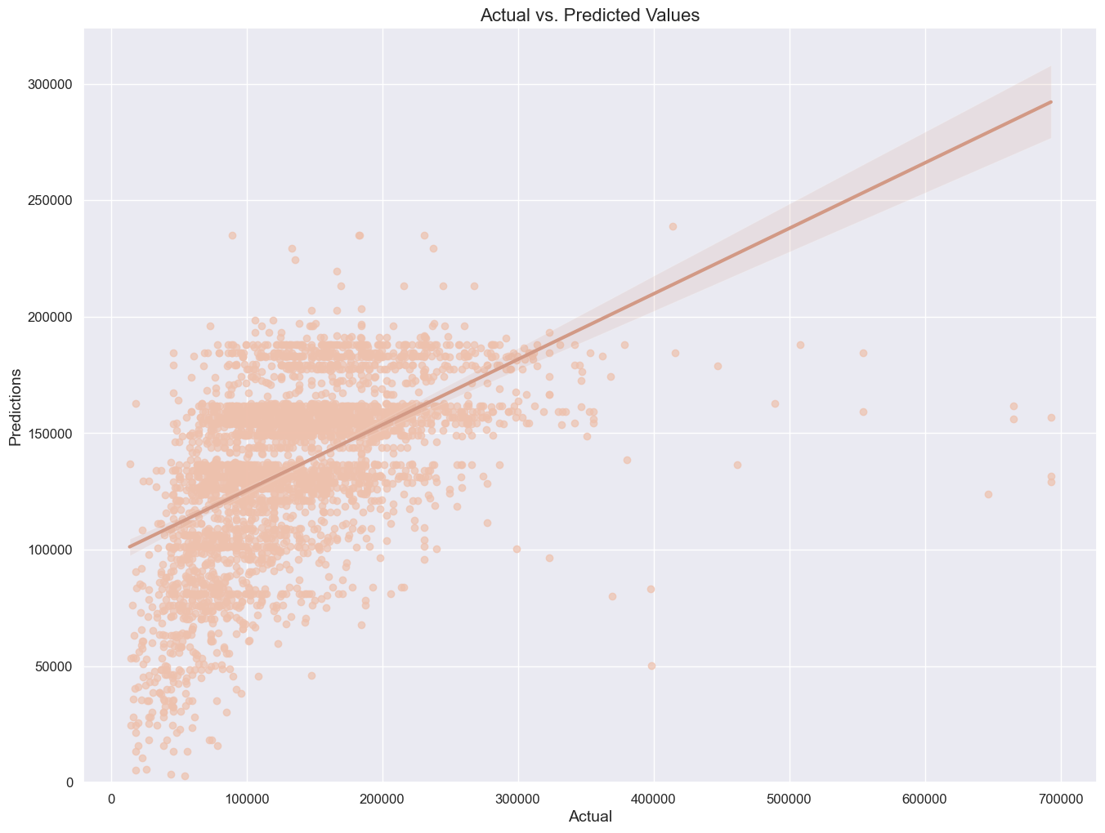
Actual vs prediction by Ridge model

Slide 18
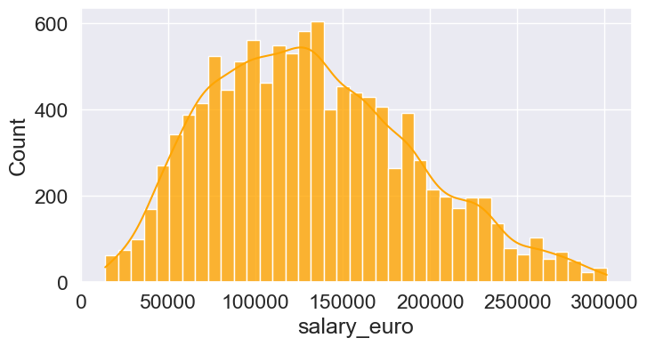
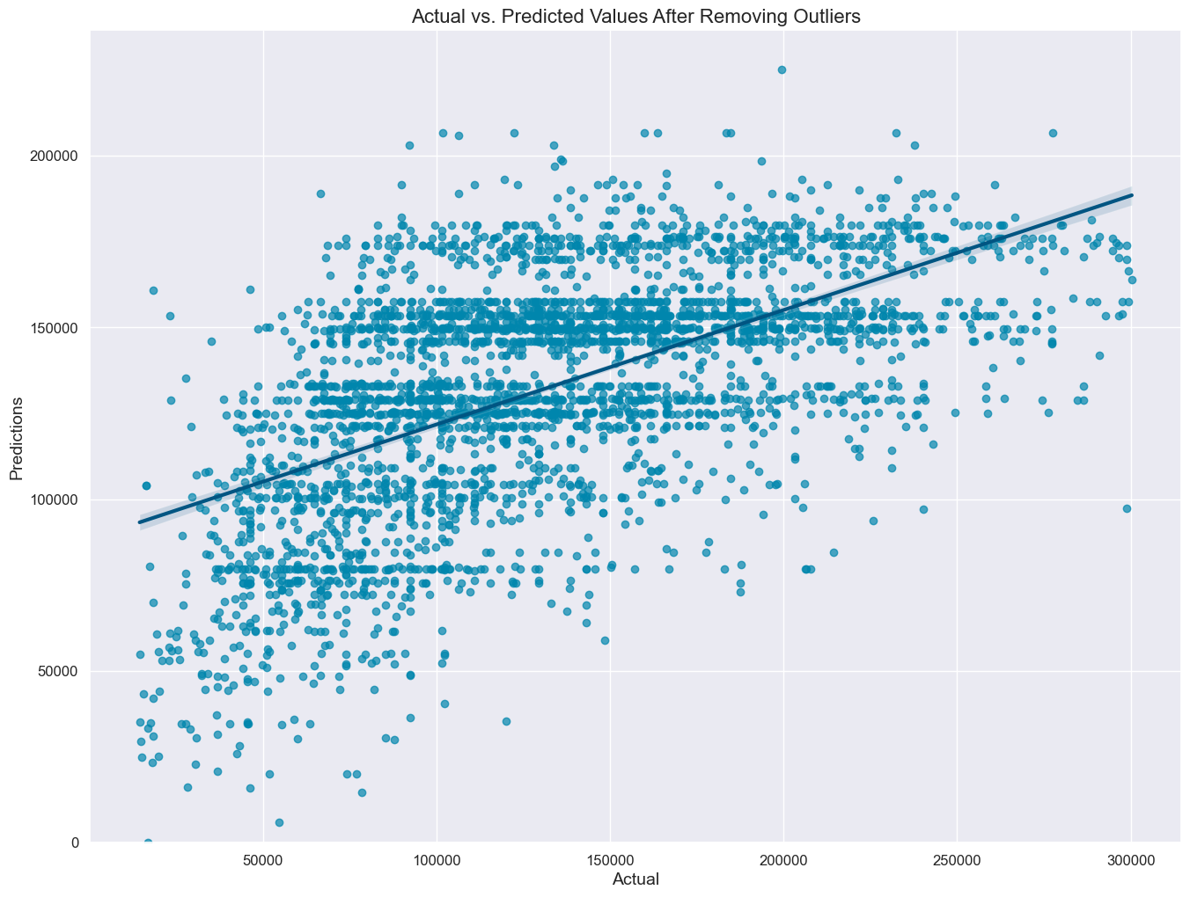
Actual vs prediction by ridge model
Salary
distribution
without
outliers
Model
Validation
R2 | 0.3269
RMSE | 47551.78
MSE | 2261171995
MAE | 38022

Slide 19

THANKS FOR YOUR ATTENTION

