Slide 1
Memetic Algorithm
By : Negar Mirgati

Slide 2
About Memetic Algorithms
Memetic algorithms combine genetic algorithms with local search. Memetic algorithms are inspired by memes (Dawkins, 1976), pieces of mental ideas, like stories, ideas, and gossip, which reproduce (propagate) themselves through a population of meme carriers. Corresponding to the selfish gene idea (Dawkins, 1976) in this mechanism each meme uses the host(the individual) to propagate itself further through the population, and in this way competes with different memes for the limited resources (there is always limited memory and time for knowing and telling all ideas and stories).

Slide 3
Comparisons between memetic algorithms and other algorithms
Memetic algorithms have already been compared to GAs on a number of combinatorial optimization problems such as the traveling salesman problem (TSP) (Radcliffe and Surry, 1994) and experimental results indicated that the memetic algorithms found much better solutions than standard genetic algorithms. Memetic algorithms have also been compared to the Ant Colony System (Dorigo et al., 1996), (Dorigo and Gambardella, 1997) and to Tabu Search (Glover and Laguna, 1997) and results indicated that memetic algorithms outperformed both of them on the Quadratic Assignment Problem (Merz and Freisleben, 1999). Thus, memetic algorithms provide us with a powerful method for solving complex problems.

Slide 4
Memetic Algorithm Pseudocode
Make a population of random individuals
For each individual perform local hill climbing
For each individual do :
parentA = selectParent(Population)
parentB = selectParent(Population)
child = ParentA.crossOver(ParentB)
child.mutate()
child.hillClimb()
4) If termination criterion not met goto 3

Slide 5
Modules Used in The Implementation
DNA ( represents each individual)
Population( represents the generations)
customeDatabase(has the information about nodes and datacenters)
Global(the global variables such as perfect score, number of requests, number of individuals in each generation, … can be set in this module)
Request( represents the list of requests which must be placed on nodes)
main

Slide 6
Database Node Table
Datacenter ID | Total Cpu | Remained Cpu | Total Mem | Remained Mem
1 | 560 | 320 | 1654 | 870
… | … | … | … | …

Slide 7
Solving Resource Allocation Using Memetic Algorithm
Genes : An array of selected nodes for the requests Fitness : Number of requests which can be placed on their selected node Goal : Maximizing fitness or maximizing the number of requests which are placed on nodes

Slide 8
First-Visit Hill-Climbing
We use local hillclimbing on each newly created individual. This local hillclimber is a first-visit method; the first change which improves the individual is used. So in this problem, we use arrays of nodes for the individuals in our experiments and use the simplest neighborhood function as possible which contains only individuals generated by a mutation of a single node. The local hillclimber starts with a random node of an individual and examines whether changing this bit improves the fitness of the individual. Then it goes to the next bit, etc. After it tried out all bits of the individual, it checks whether it has made at least one improvement, and if so it continues to try to change bits and otherwise it stops.

Slide 9
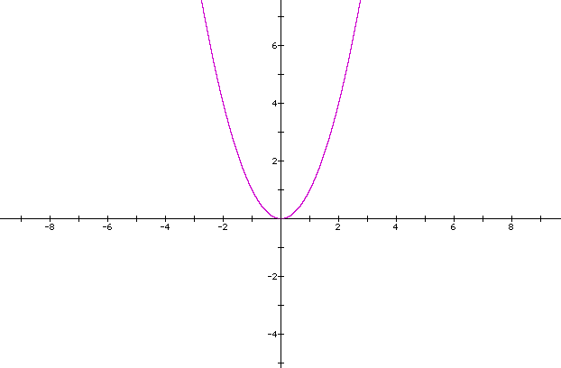
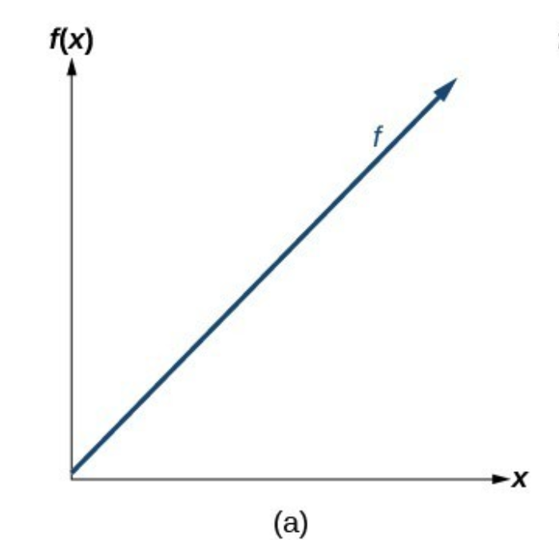
Improving Fitness Function
To improve Fitness function, we can use nonlinear functions( like f(x) = x^4 ) to select the better individuals for the next generation between the ones which have fitness values that have a little difference.

Slide 10
The algorithm’s source code can be found at : https://github.com/NegarMirgati/server-placement-memetic
A number of test cases can be found at logs folder in the repository. In these test cases, memetic found better solutions than first fit, best fit and worst fit algorithms.

Slide 11
Resources
Marco Wiering, Intelligent Systems Group "Memory Based Memetic Algorithms"

